Slide 1
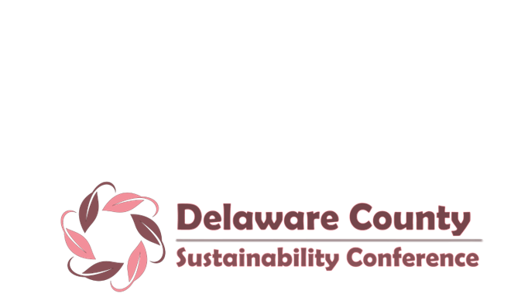
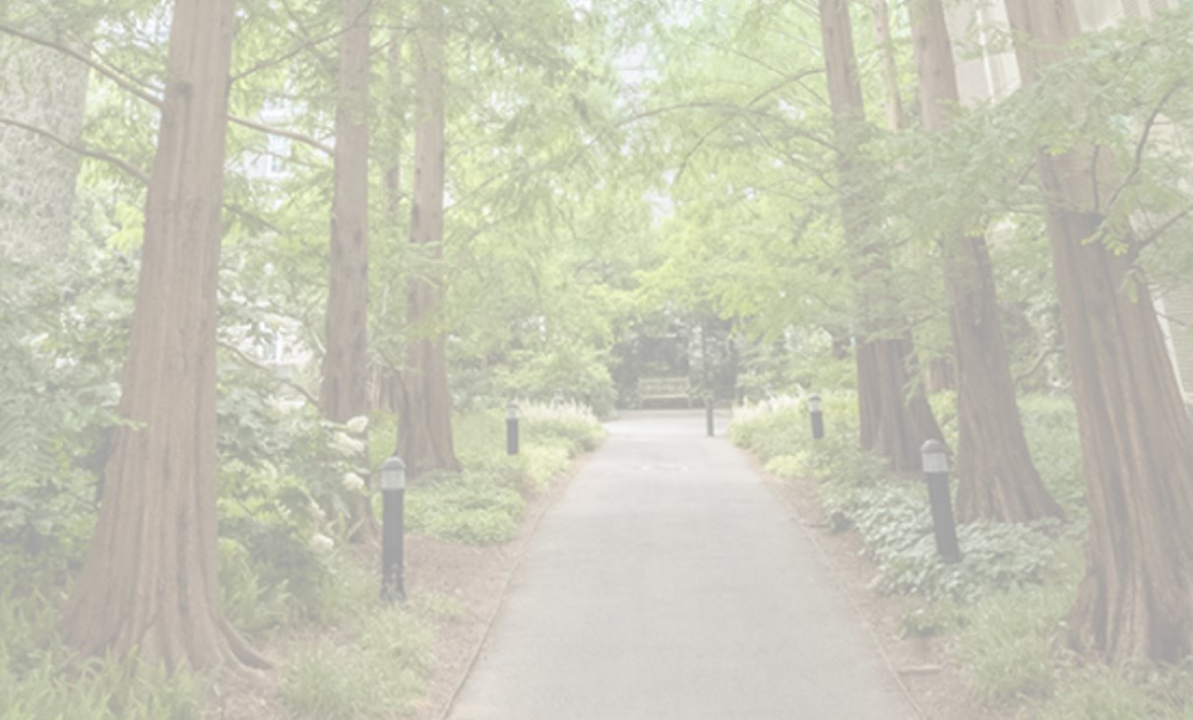
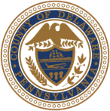
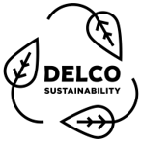

Welcome to
The Case for Zero Waste
Rethinking Our System from Policy to Practice

Slide 2

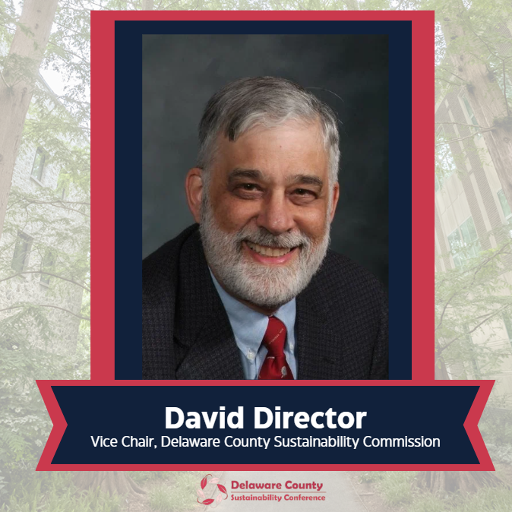

Slide 3
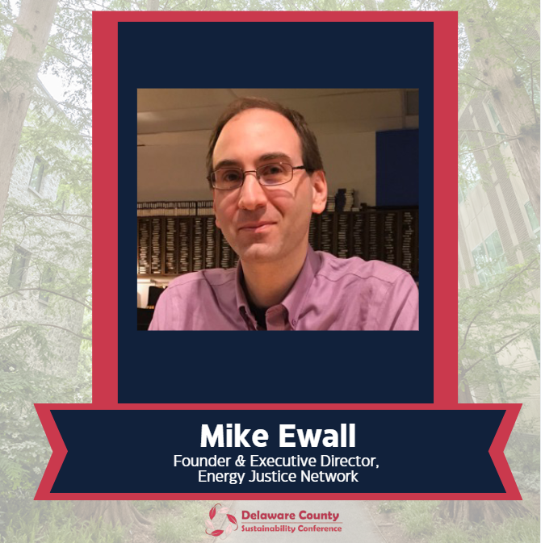

Slide 4
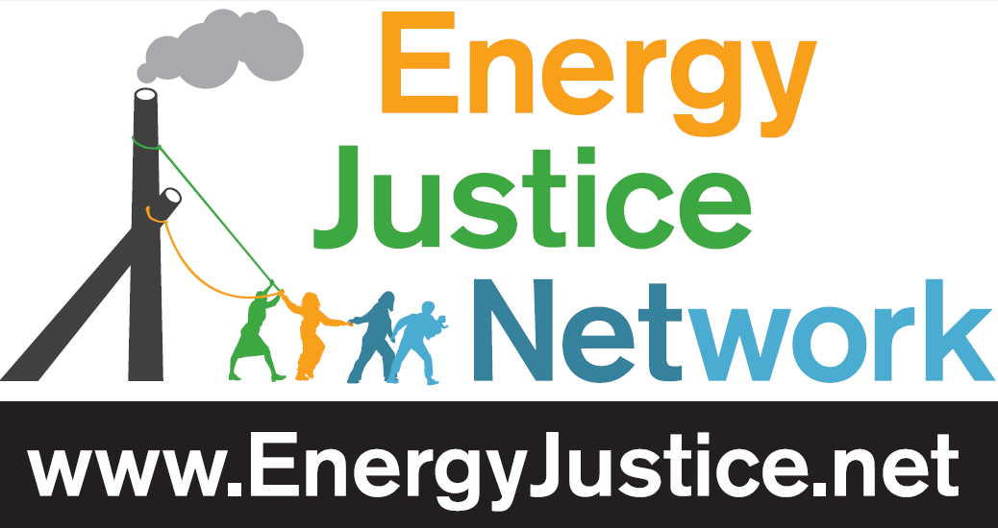

Delco Environmental Justice www.DelcoEJ.org

Slide 5
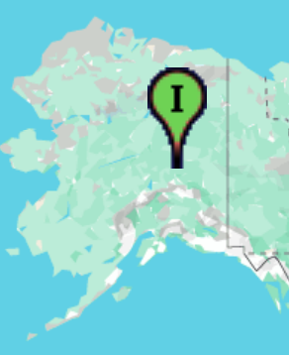
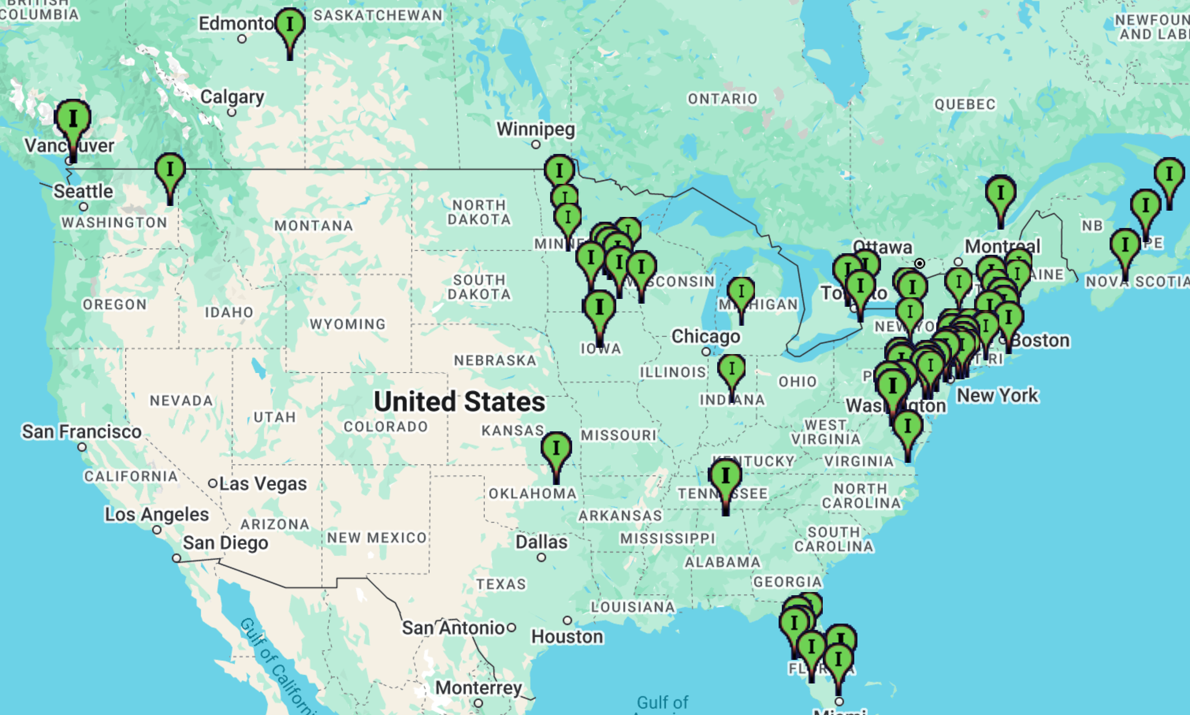
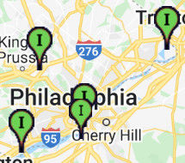
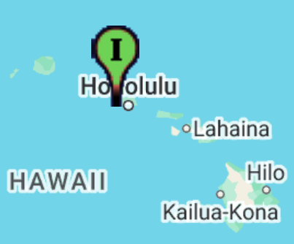
Philly Area’s Burn Problem
www.ejmap.org

Slide 6
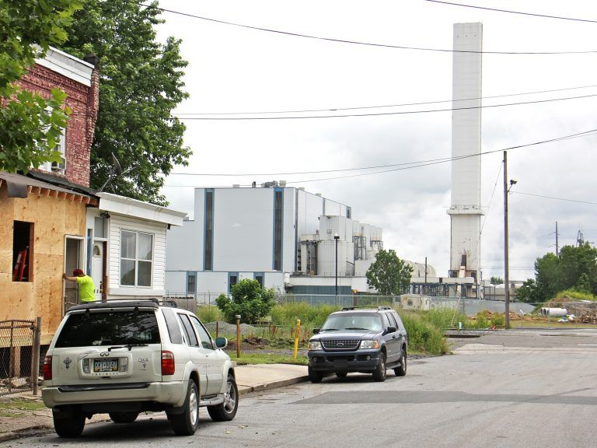

Slide 7
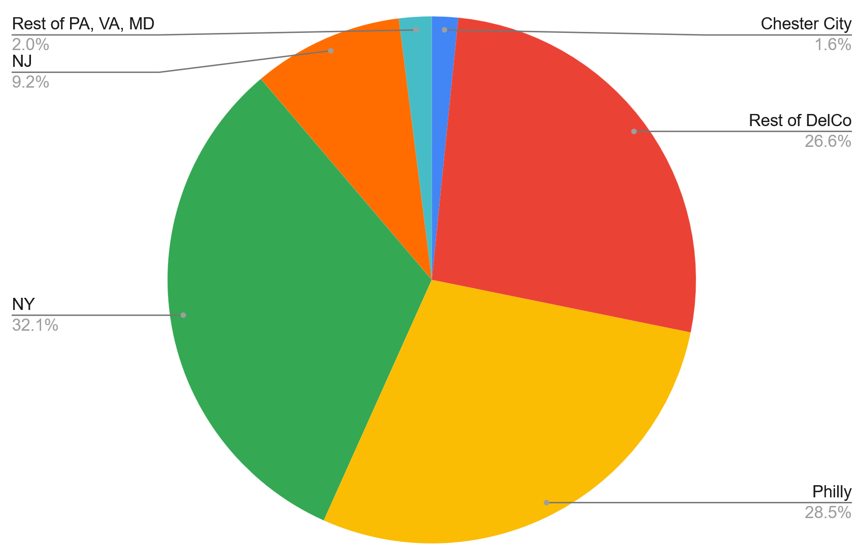
Waste Burned at Reworld Incinerator in Chester (2025)
Source: PA Dept of Environmental Protection http://cedatareporting.pa.gov/reports/powerbi/Public/DEP/WM/PBI/Solid_Waste_Disposal_Information

Slide 8
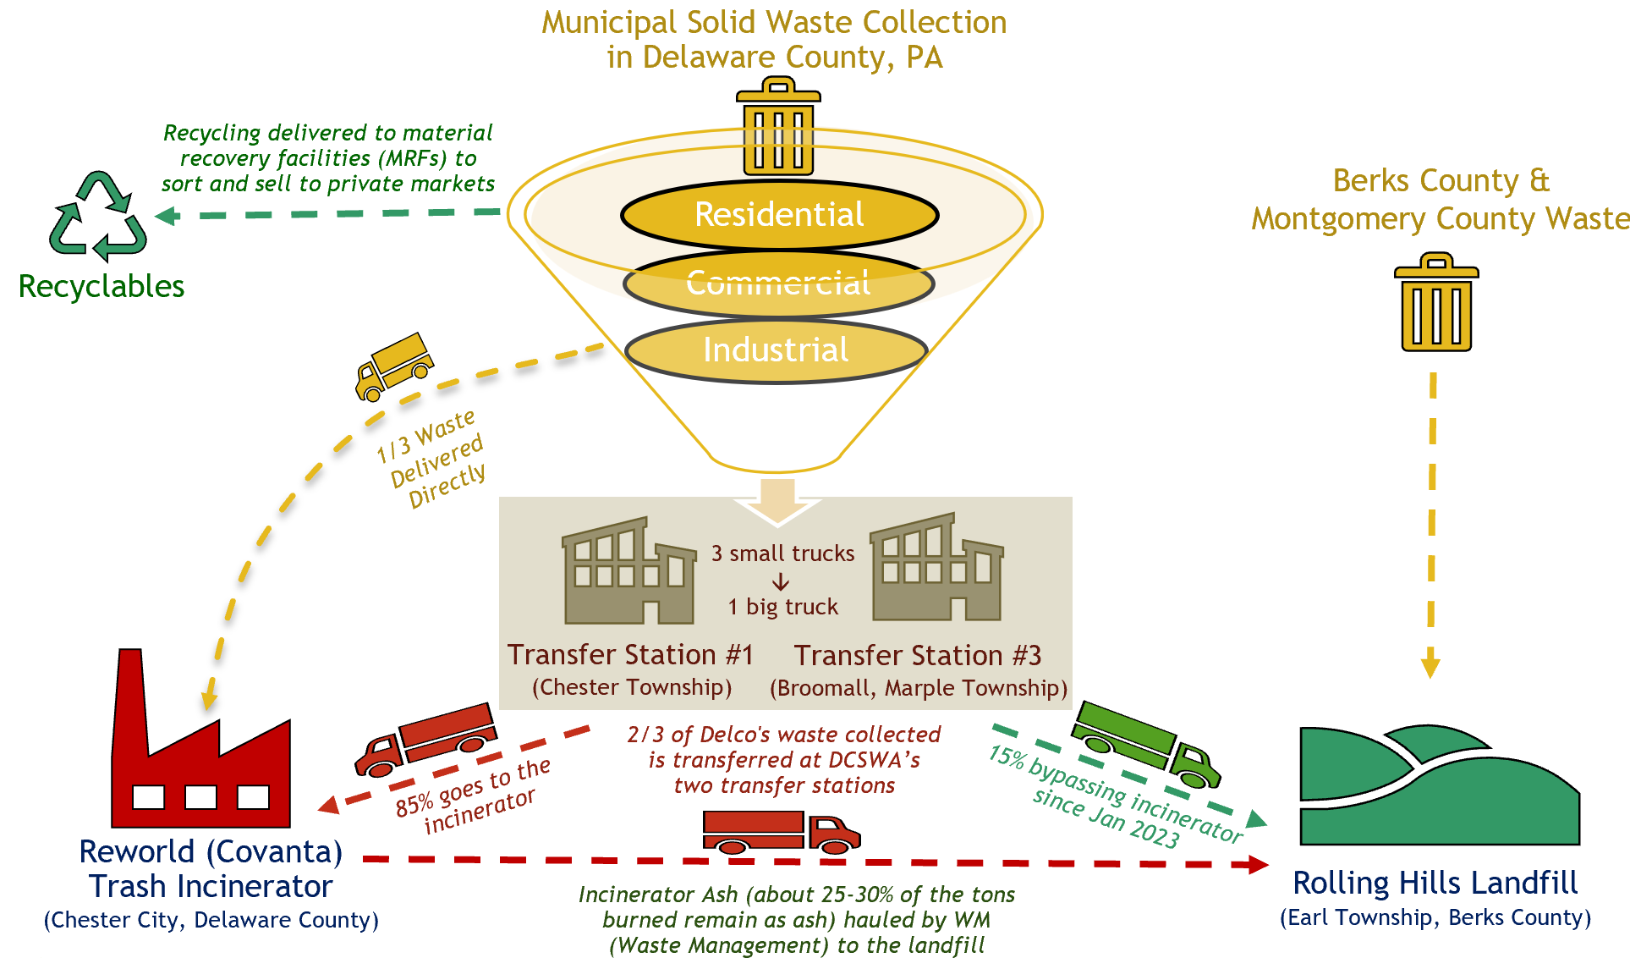

Slide 9
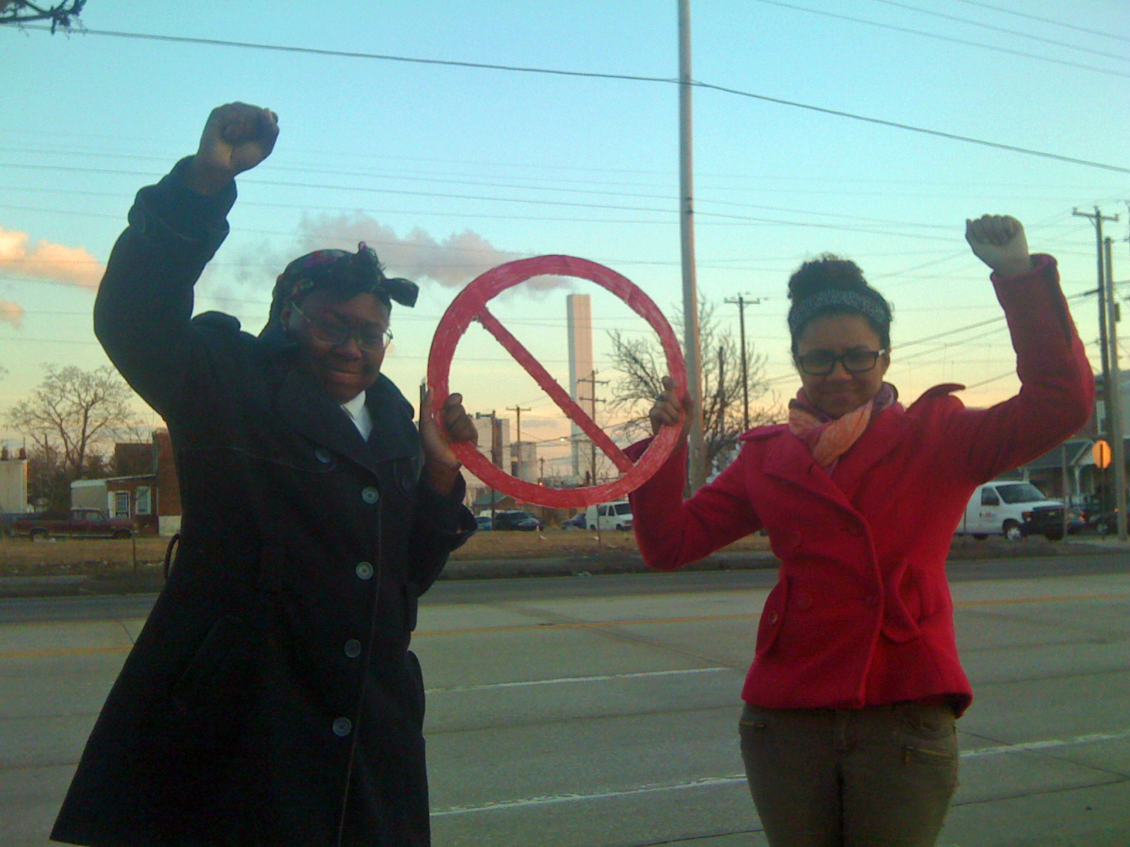
Trash Incineration & Environmental Racism

Slide 10
Reworld Delaware Valley’s Air Emissions
Pollutant (in pounds except CO2e) | 2024 Emissions* | Rank in DelCo | Health Effects
Global Warming Pollution (in metric tons of CO₂ equivalents) | 831,283 | 4 | Extreme weather, disease, crop damage, species extinction
Nitrogen Oxides | 2,224,700 | 1 | Asthma attacks, chronic respiratory disease & stroke
Carbon Monoxide | 786,200 | 1 | Headaches, dizziness; increases lifetime risk of heart disease
Sulfur Oxides | 221,660 | 1 | triggers asthma attacks; chronic respiratory and heart diseases; stroke
Particulate Matter | 88,600 | 3 | heart attacks, stroke, irregular heartbeat, aggravated asthma, decreased lung function, difficulty breathing
Volatile Organic Compounds | 21,620 | 12 | eye, nose and throat irritation, headaches, loss of coordination and nausea, liver, kidney and central nervous system damage, cancer
Hydrochloric Acid | 20,320 | 1 | irritates eyes, skin, and nose, damages lungs
Fine Particulate Matter (PM2.5) | 9,860 | 6 | same as above, but worse, gets deep into lungs and into blood stream
Mercury | 63 | 1 | damage to nervous, digestive, & immune systems, lowers IQ
Lead | 27 | 2 | damages nervous system and kidneys, lowers IQ, increases likelihood of antisocial behavior
Nickel | 20 | 2 | allergy, cardiovascular and kidney diseases, lung fibrosis, lung and nasal cancer
Cadmium | 5 | 2 | kidney disease; lung cancer
Arsenic | 4 | 2 | lung, skin, bladder, and liver cancers; irritation of skin and mucous membranes; affects brain and nervous system
Chromium (VI) | 4 | 2 | lung cancer, shortness of breath, coughing, and wheezing
All is 2024 data except cadmium, arsenic, and chromium (VI), which is 2016-2019 average for lack of newer data. Source: PA Department of Environmental Protection Air Emissions Report: http://cedatareporting.pa.gov/reports/powerbi/Public/DEP/AQ/PBI/Air_Emissions_Report
Notes:
Cd, As, and Cr-VI are 2016-2019 avg due to lack of newer data

Slide 11
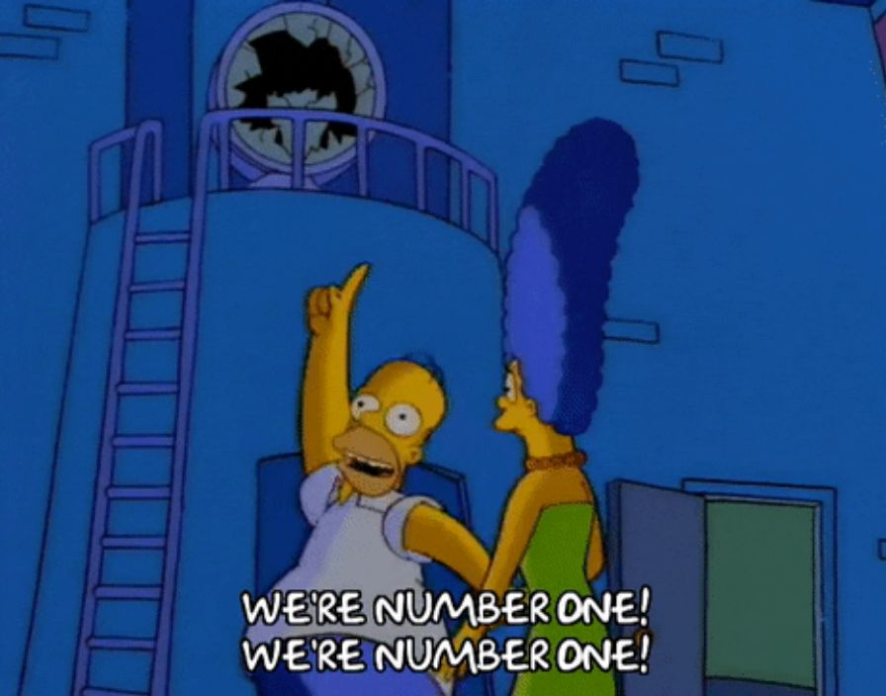
Covanta (now “Reworld”) is a Top Air Polluter
Their trash incinerator in Chester is the:
#1 industrial air polluter in Chester City, in Delaware County, and in the entire 7-county region surrounding Philadelphia. All five trash incinerators in this region are among the region’s top seven industrial air polluters.
Source: PA Department of Environmental Protection Agency Air Emissions Reports: http://cedatareporting.pa.gov/reports/powerbi/Public/DEP/AQ/PBI/Air_Emissions_Report

Slide 12
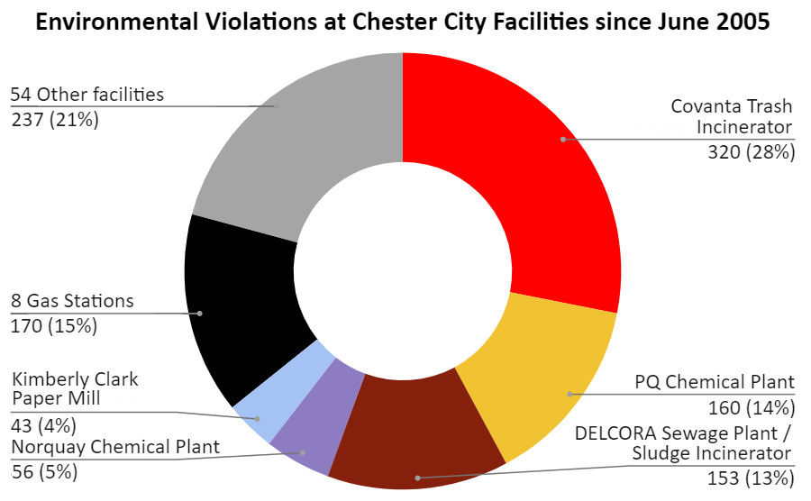

Slide 13
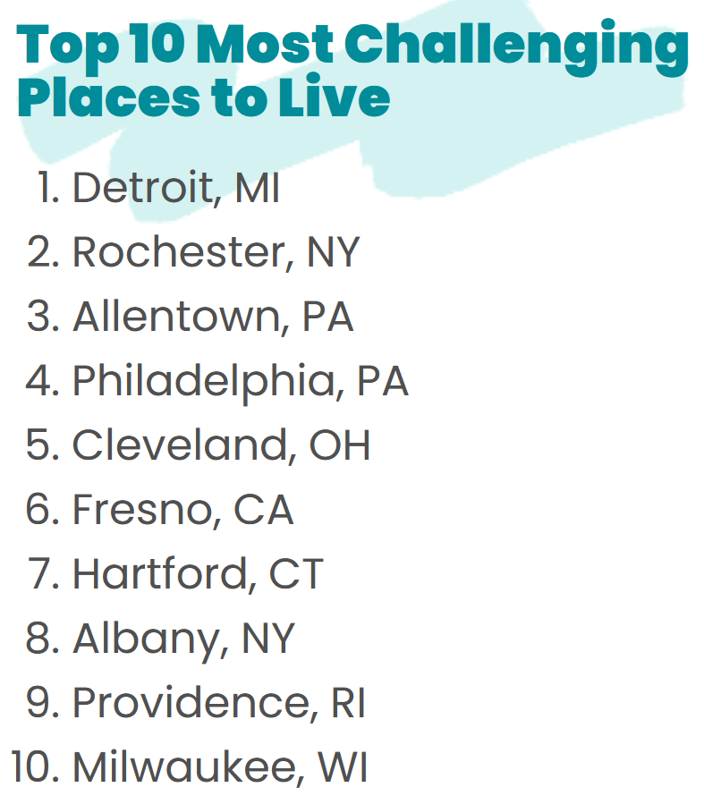

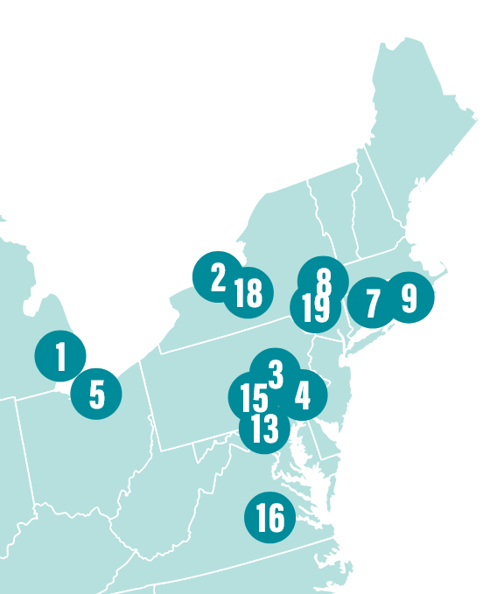

Philadelphia Metro Area ranked… #4 in 2018
#4 in 2019
#7 in 2021
#9 in 2022
#8 in 2023
#5 in 2024
#4 in 2025
www.aafa.org/asthma-capitals/
Notes:
Also get an “F” for ground-level ozone from American Lung Association: https://www.lung.org/research/sota/city-rankings/states/pennsylvania

Slide 14
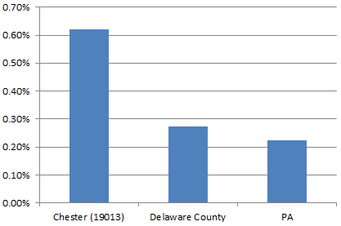

Childhood asthma hospitalization 3x PA rate
Data for those under 18 years of age, for 2010
Source: Analysis based on 2010 Census data and asthma data from The Asthma Program, PA Department of Health. Data provided by Pennsylvania Health Care Cost Containment Council (PHC4).

Slide 15

Health effects
People living near incinerators have an increased risk of…
All types of cancer, including:
Stomach
Colorectal
Liver
Renal
Lung & pleural
Gallbladder
Bladder
Non-Hodgkin lymphoma
Leukemia
Soft-tissue sarcoma
Respiratory diseases & symptoms
Cardiovascular diseases
Urinary diseases
Covanta: “incinerators have been studied comprehensively for health risk” Fact: Not much in the U.S. and not comprehensively at all.
Source: www.energyjustice.net/incineration/healthstudies.pdf

Slide 16
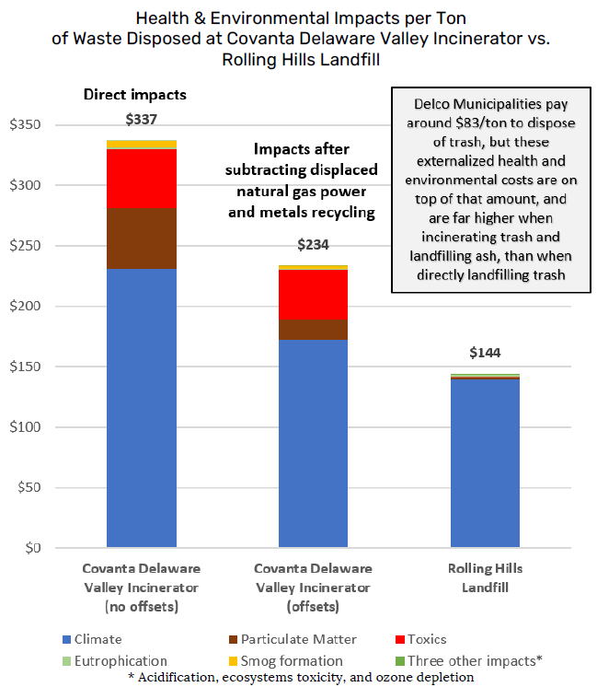
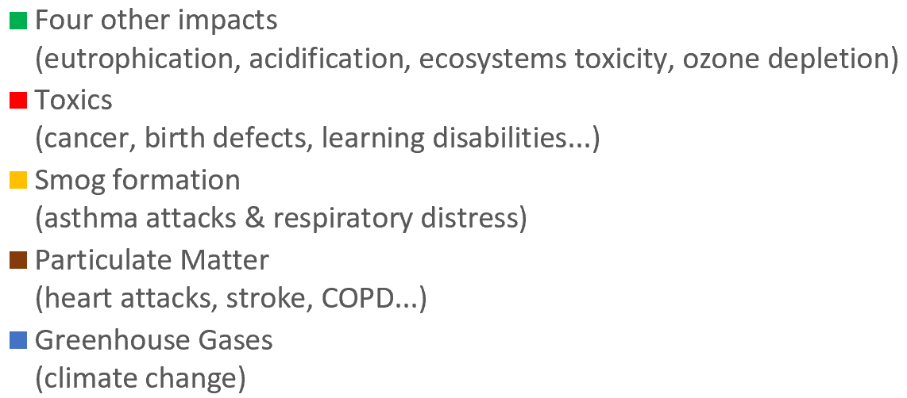
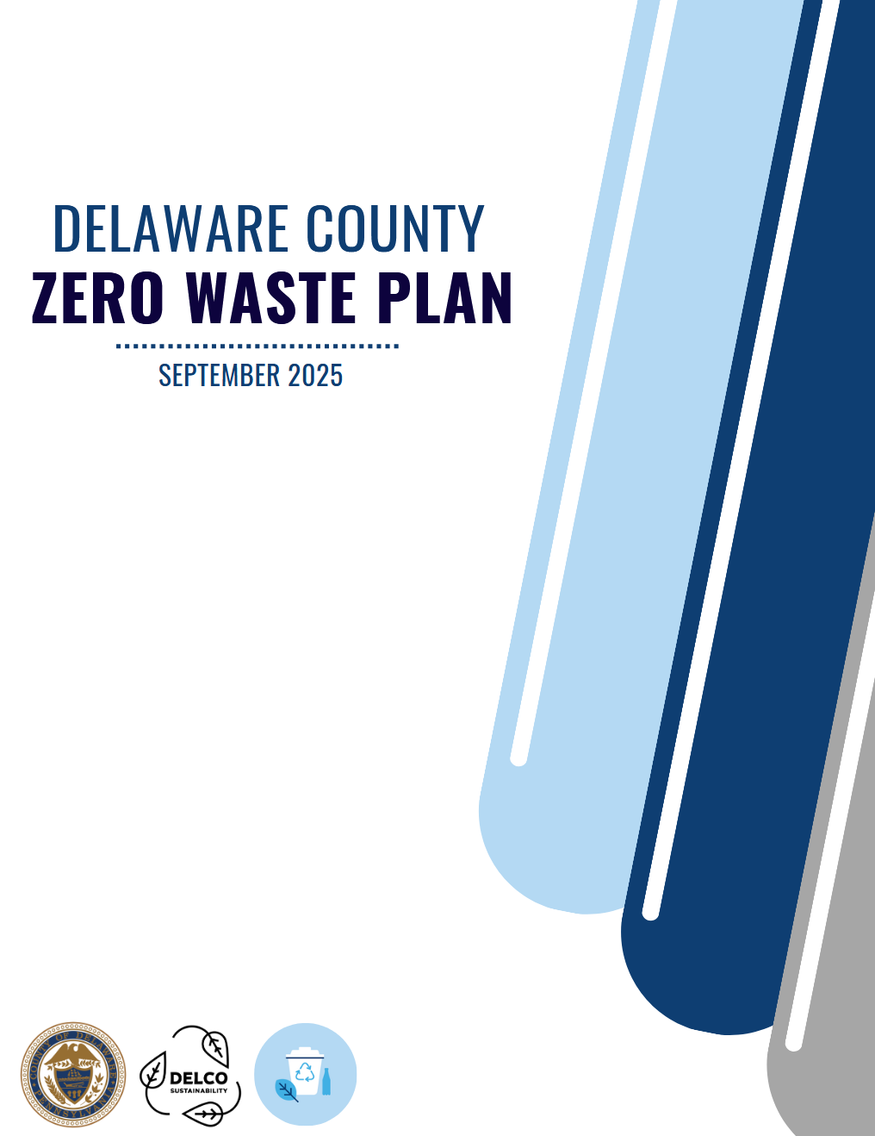
Incineration vs. Landfilling
Delaware County municipalities pay around $95/ton in 2026 to disposal of trash, but these externalized health and environmental costs (in 2021 dollars) are on top of that amount, paid in medical bills and consequences of climate change.
Incinerating trash and landfilling ash is 2.3 times as harmful as directly landfilling trash.

Slide 17
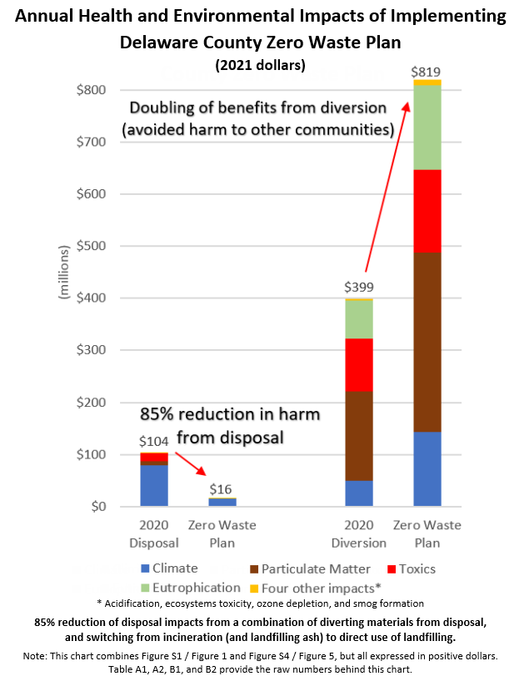
While the last chart looked at externalized health and environmental costs per ton, this looks at the entire impact of Delaware County’s waste system (all tons in a year), showing $104 million dollars of health and environmental costs per year.
Adopting the Zero Waste Plan (ending incineration and reducing waste) cuts those harms by 85%, while the benefits (avoided harms) that already happen from current recycling efforts (about $400 million a year) would be doubled.
Examples of these avoided harms are not needing to log or mine new raw materials because we’re now consuming less, reusing/repairing, recycling and composting.

Slide 18
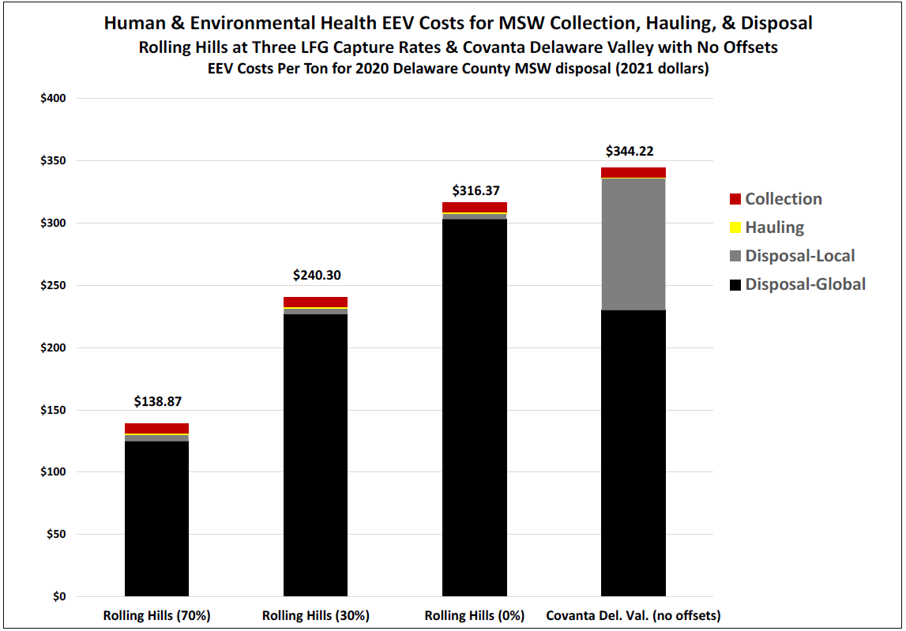
Transportation Impacts Insignificant Yellow lines show difference between hauling from two transfer stations 3 and 13 miles from the incinerator (last bar) vs. trucking all trash to landfill 60 miles away (first 3 bars)
Collection trucks from
homes to transfer stations (TS)
Hauling from TS to disposal site
Other health/enviro impacts
Climate impacts
NOTE: The last bar is the incinerator. The first three bars represent Rolling Hills Landfill with 70%, 30% and no landfill gas capture. A 75% gas capture rate is typically assumed at landfills with gas collection systems.

Slide 19
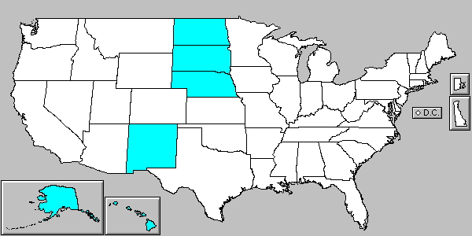
Where would Philly’s waste go if we don’t burn it?
Pennsylvania has a problem with TOO MUCH landfill space, making the state a magnet for dumping.
Pennsylvania has been the nation’s #1 importer of trash since it was first studied in the early 1990s, accepting trash from 44 states, DC, Puerto Rico, the Virgin Islands, Bermuda, and Canada.
Pennsylvania has 43 landfills and six trash incinerators.
States that have NOT dumped on PA:
Sources: PA Department of Environmental Protection, Municipal Waste Landfills and Resource Recovery Facilities: https://www.dep.pa.gov/Business/Land/Waste/SolidWaste/MunicipalWaste/MunicipalWastePermitting/Pages/MW-Landfills-and-Resource-Recovery-Facilities.aspx; Solid waste disposal information database: http://cedatareporting.pa.gov/reports/powerbi/Public/DEP/WM/PBI/Solid_Waste_Disposal_Information Congressional Research Service reports on interstate shipment of municipal waste are available at http://www.actionpa.org/waste/

Slide 20
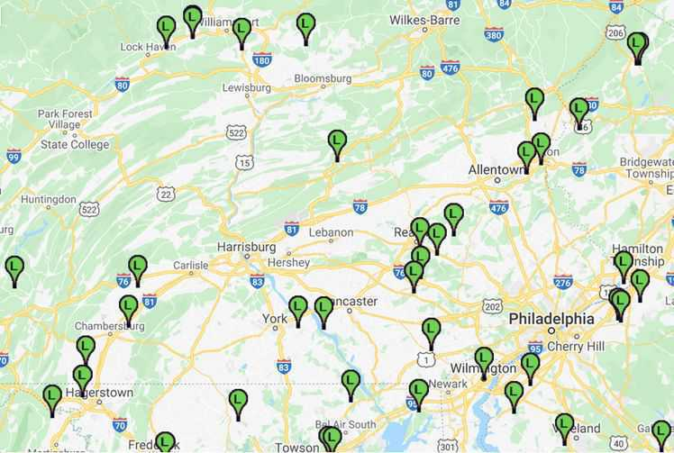
Landfills in our Region
Sources: Energy Justice Communities Map: : http://www.energyjustice.net/map/jtiny=4782
PA Department of Environmental Protection, Municipal Waste Landfills and Resource Recovery Facilities: https://www.dep.pa.gov/Business/Land/Waste/SolidWaste/MunicipalWaste/MunicipalWastePermitting/Pages/MW-Landfills-and-Resource-Recovery-Facilities.aspx

Slide 21
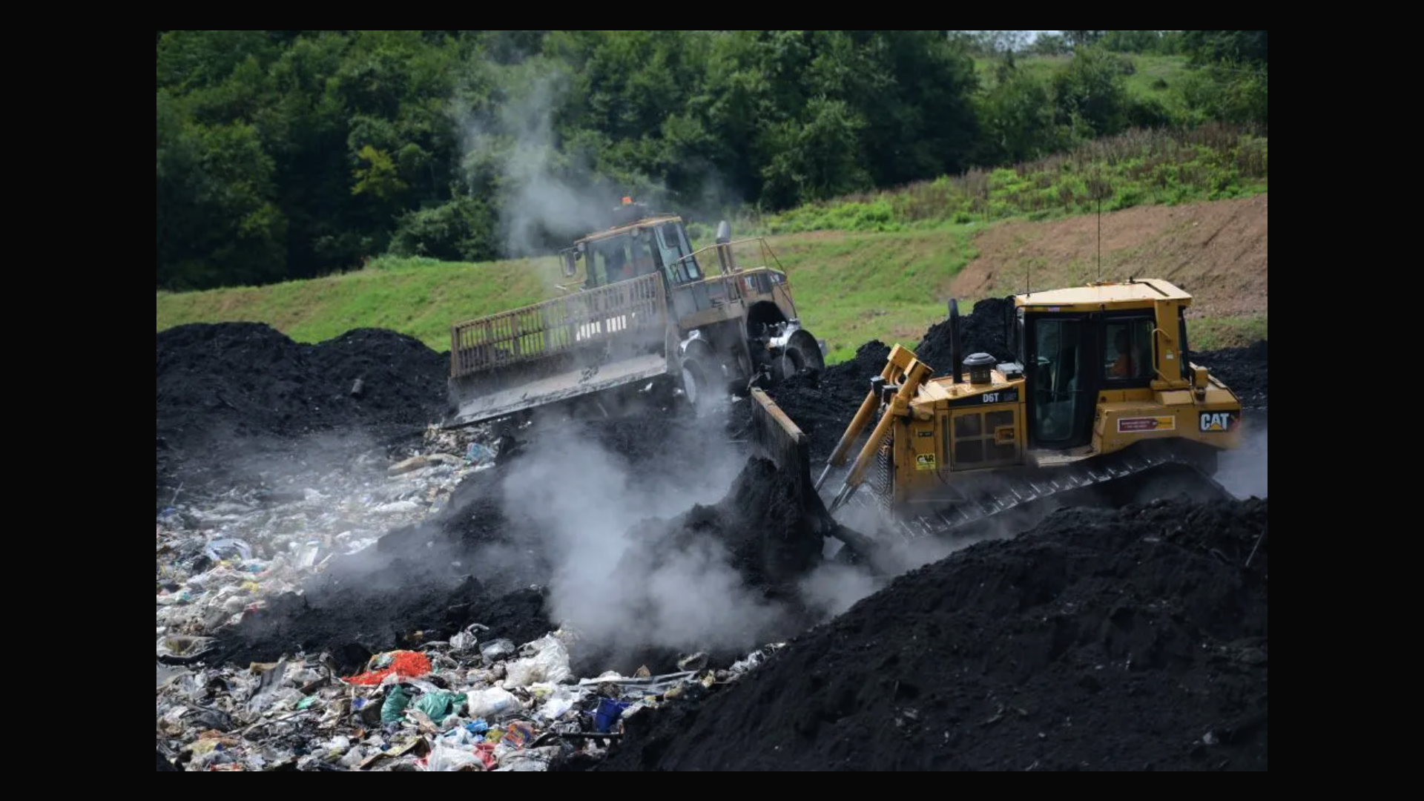
Delaware County’s Landfill
Covanta’s toxic ash being dumped at the Delaware County Solid Waste Authority’s Rolling Hills Landfill in Berks County:

Slide 22
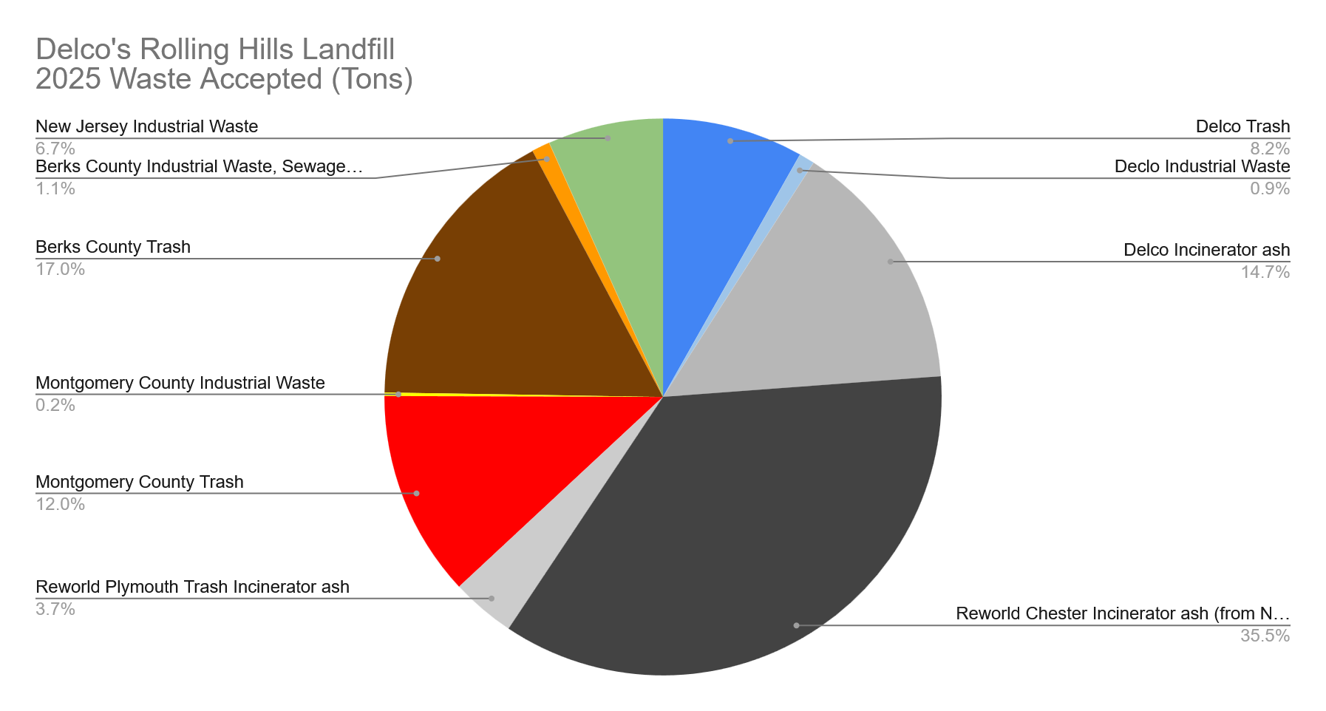

Delco’s Rolling Hills Landfill: 76% sold to other counties and states

Slide 23
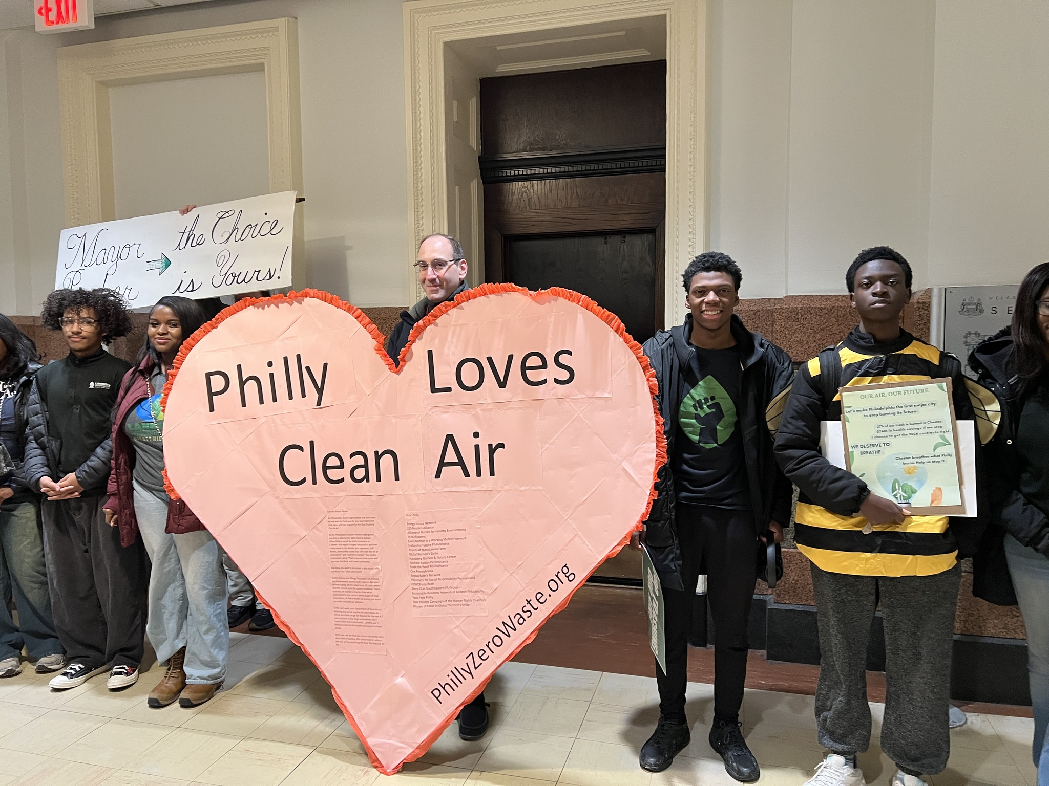

Slide 24
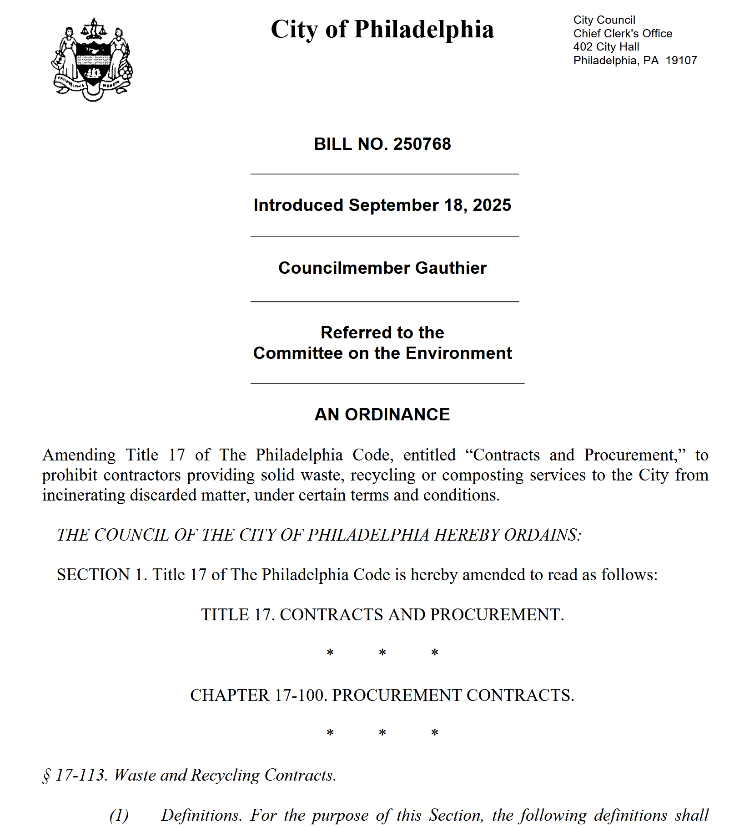
Stop Trashing Our Air Act

Slide 25

Why is Delco Still Burning its Trash?
Delaware County Solid Waste Authority (DCSWA) started diverting up to 15% in 2023, but cannot go to 100% yet because…
Its two decrepit trash transfer stations need to be rebuilt to handle the full amount of trash.
This has been a slow process
They don’t have funding for it and may only rebuild one for now
Earl Township (Berks County) has a legal agreement that doesn’t allow trash from Delco; only ash. Until this can be renegotiated, Delco can only get away with a minimal amount (up to 15%).

Slide 26
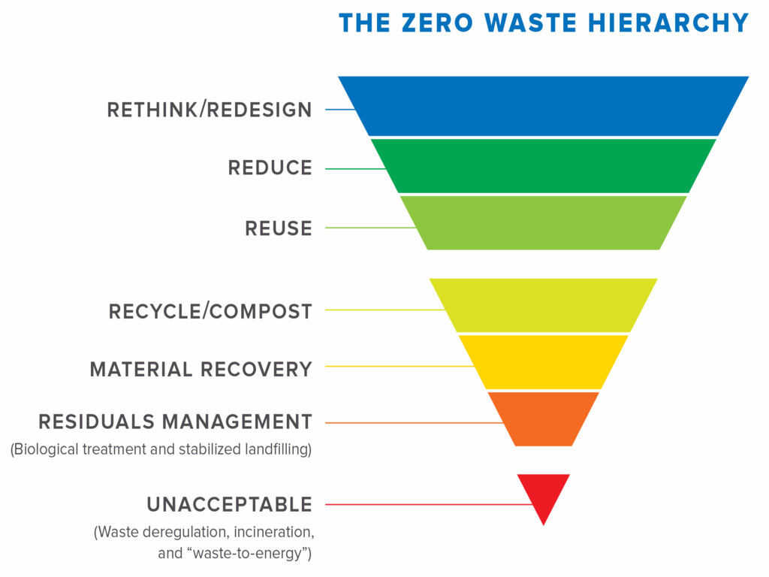
www.zwia.org/zwh
Notes:
www.zwia.org/zwh

Slide 27
Recommendations:
End incineration
Pay as you throw (pay per bag)
Recycling & composting infrastructure
Universal curbside composting and recycling collection
Deconstruction, not demolition; building material reuse centers
Ban single use plastics/packaging
Outreach & education
Edible food donation
Reuse & repair, including curbside reuse collection
Reduce trash collection frequency
Refillable stations & zero packaging stores
Center for hard-to-recycle materials

Slide 28
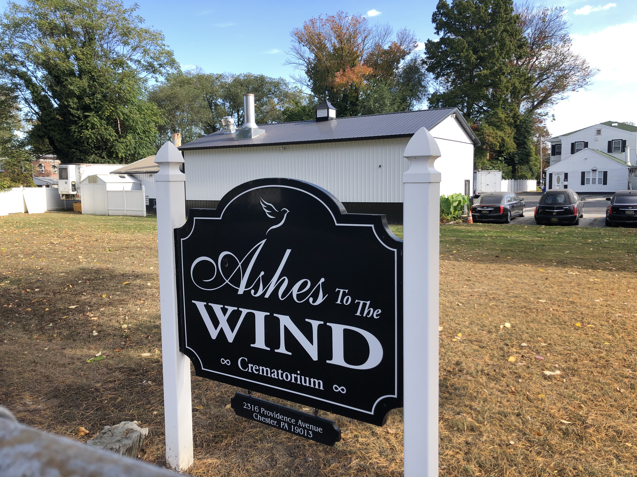

Slide 29
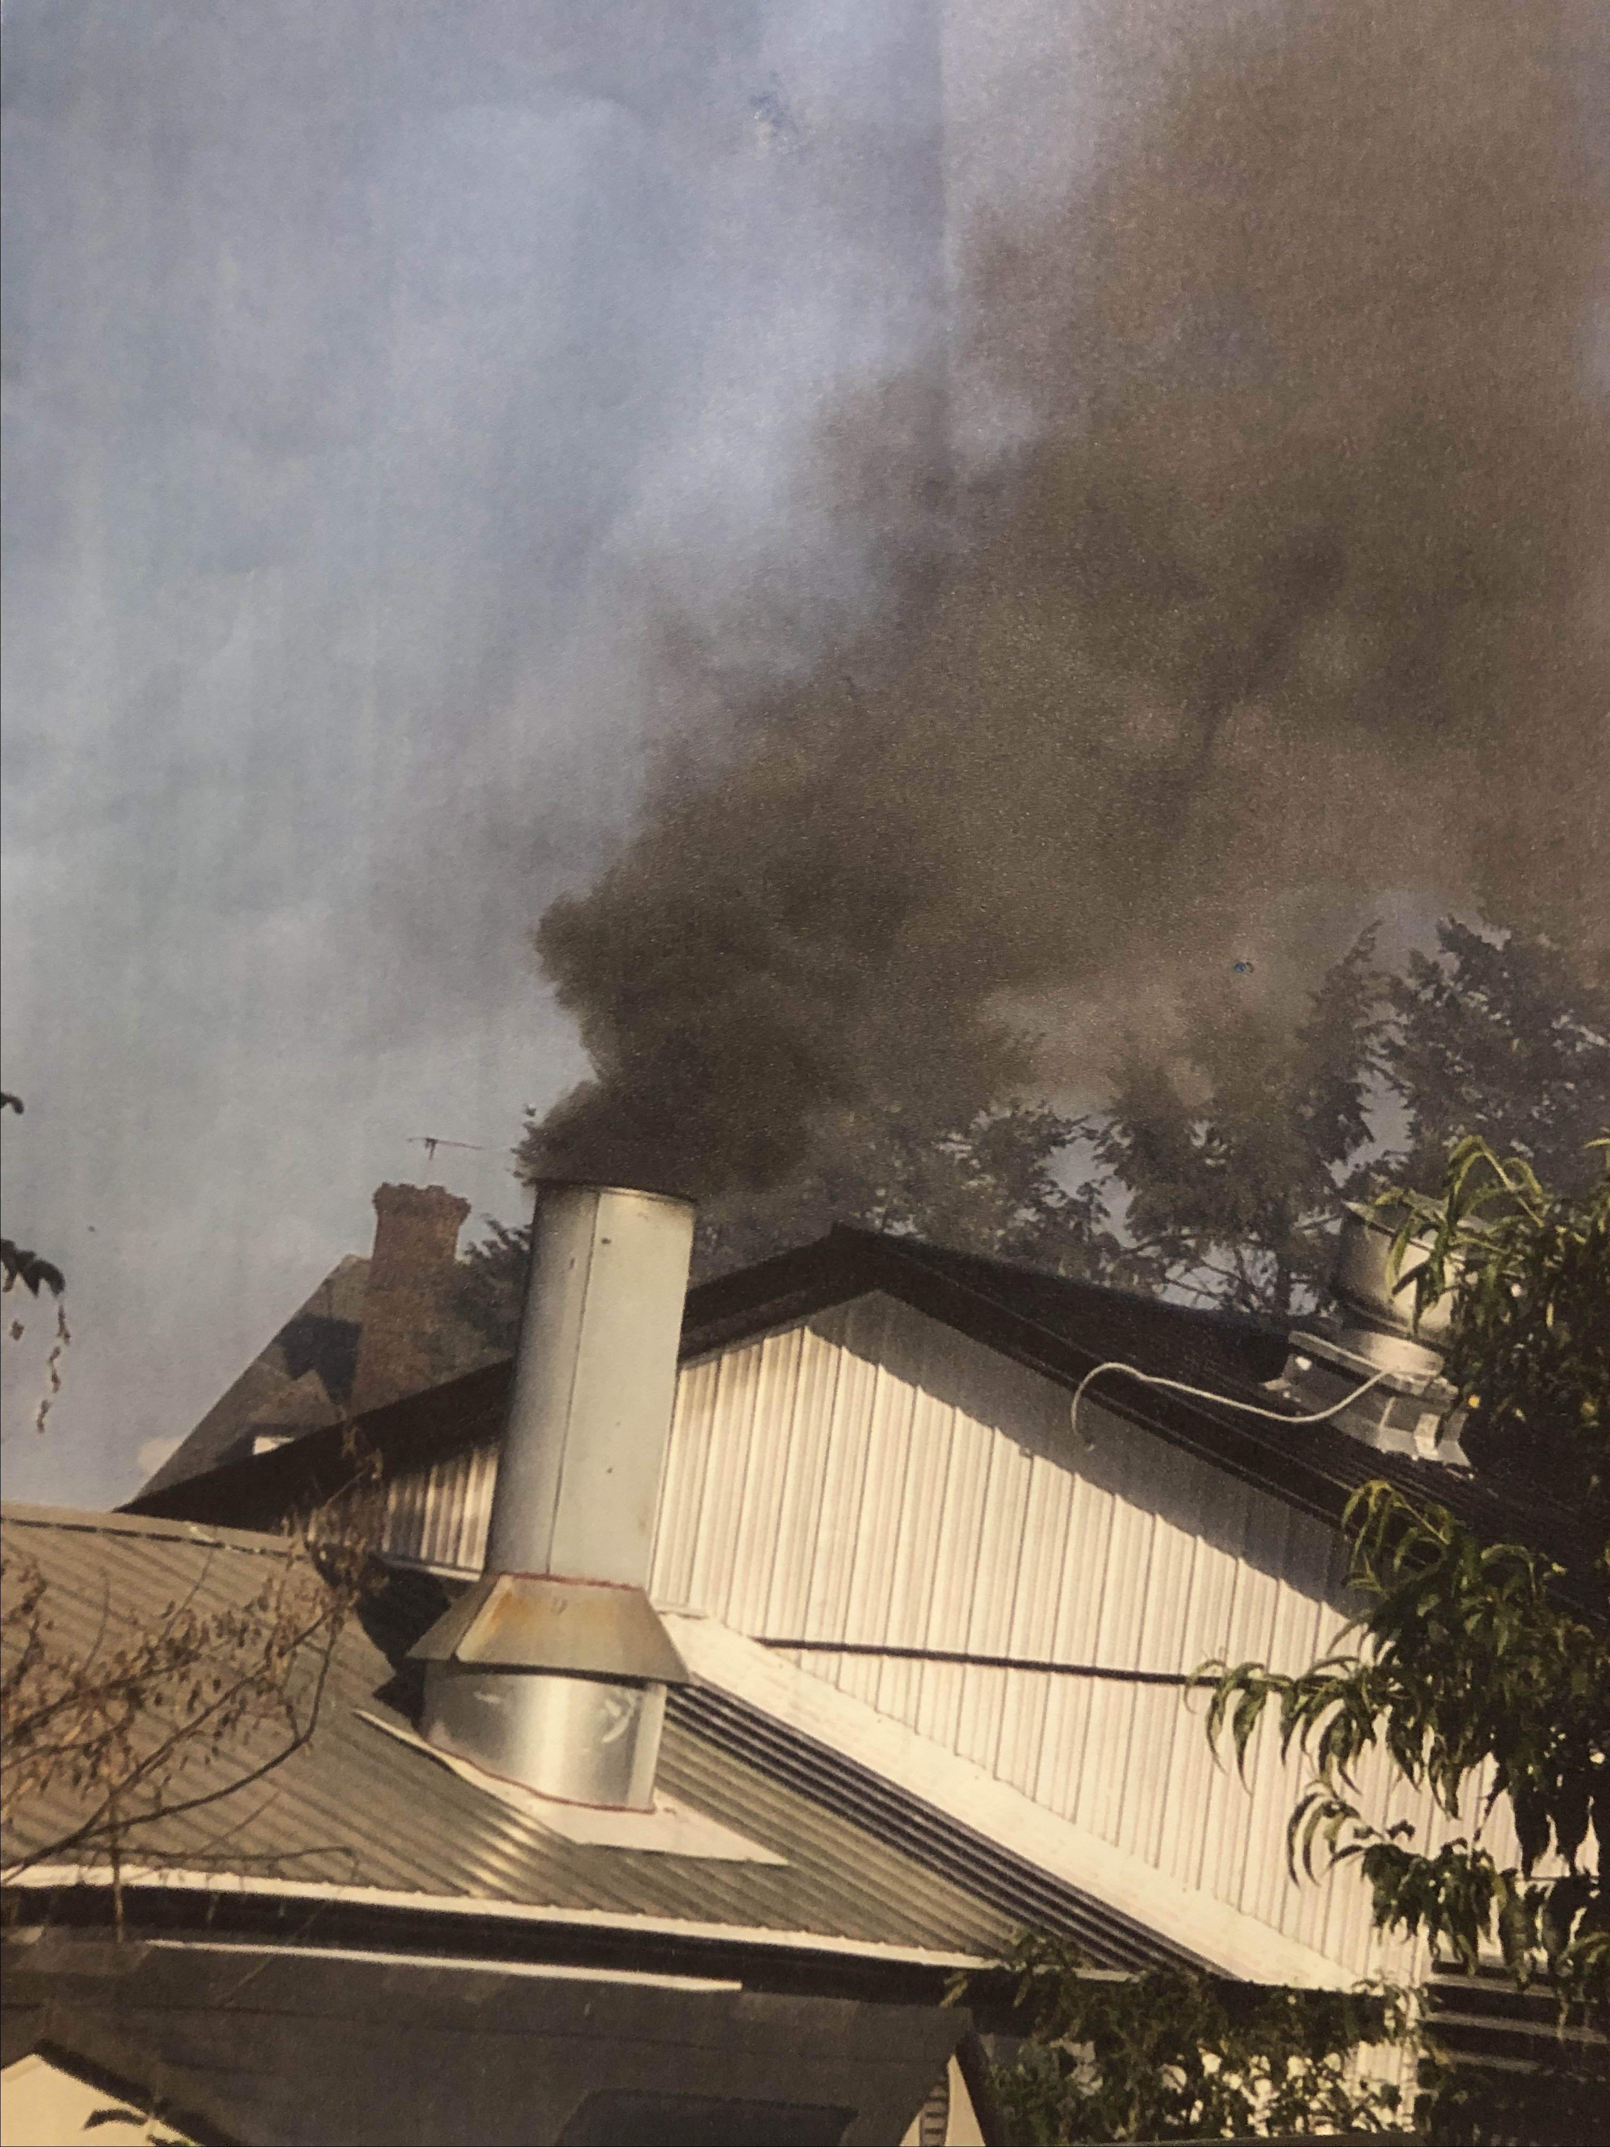

Slide 30
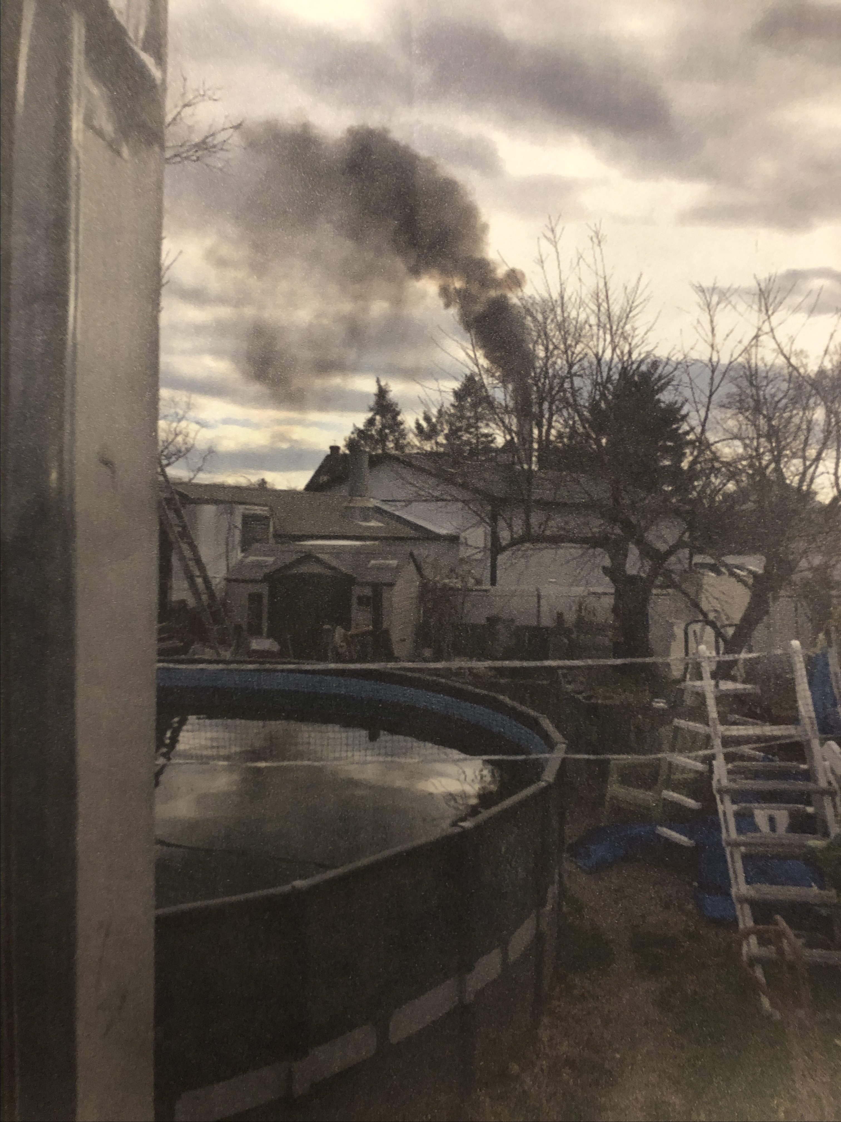

Slide 31
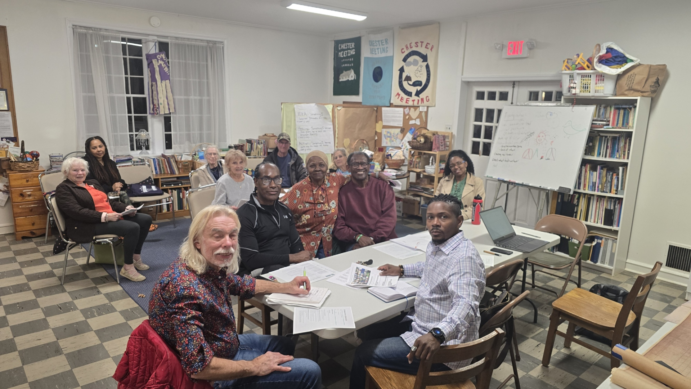
Cremation Negation!

Slide 32
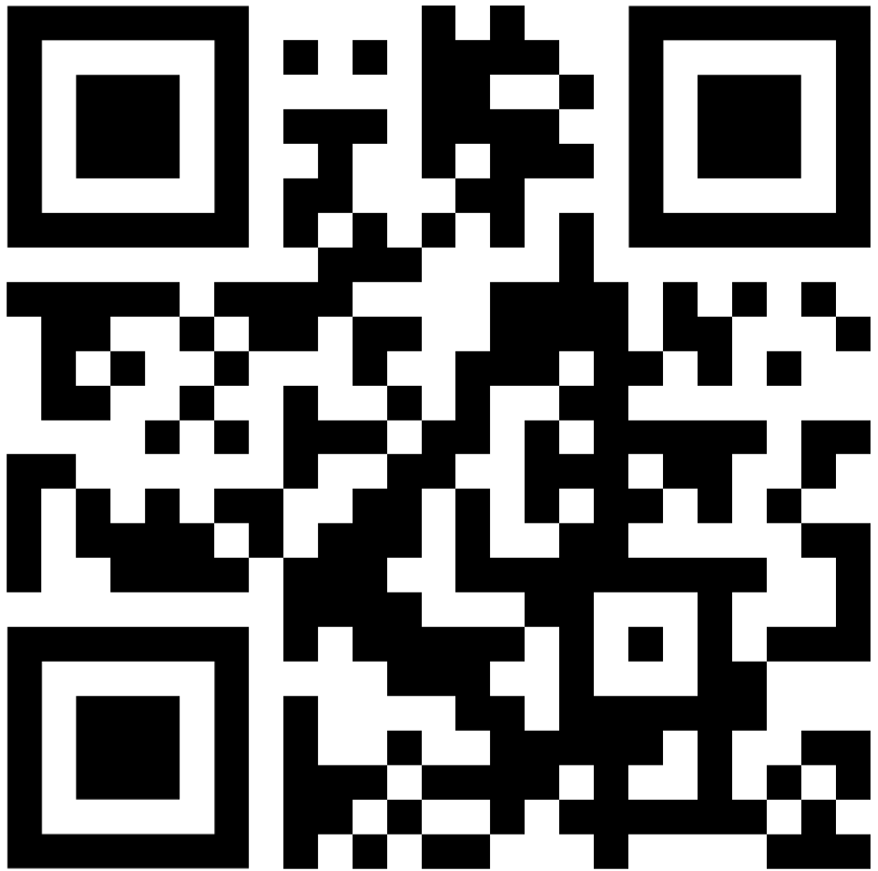
Take Action!
Tell County Council…
End incineration
Preserve our landfill space
Fund the Zero Waste Plan
delcoej.org/zwp

Slide 33

Delco Environmental Justice www.DelcoEJ.org www.PhillyZeroWaste.org
Mike Ewall, Esq. Executive Director 215-436-9511

Slide 34
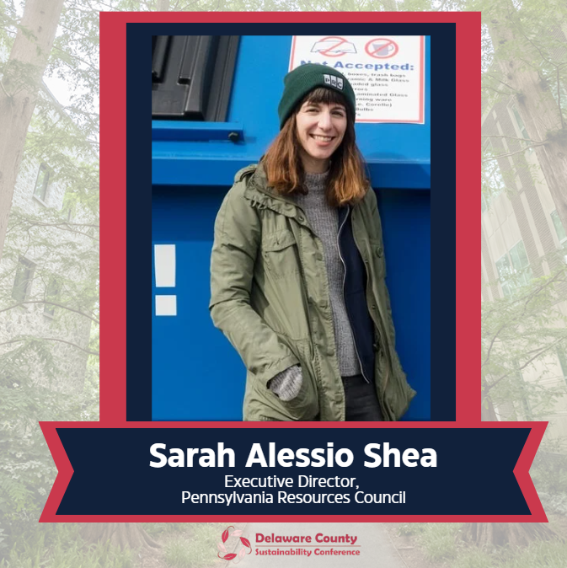

Slide 35
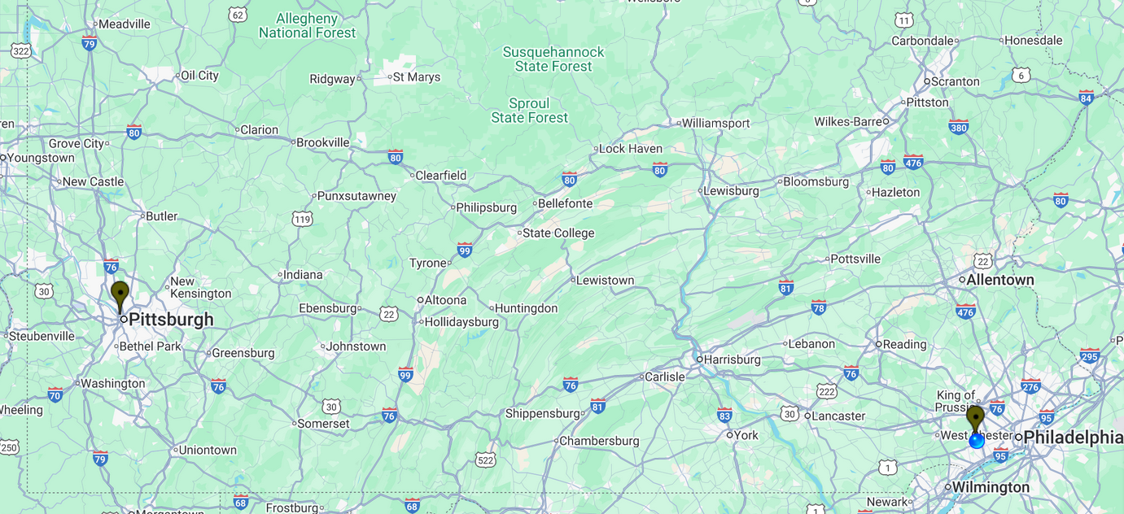

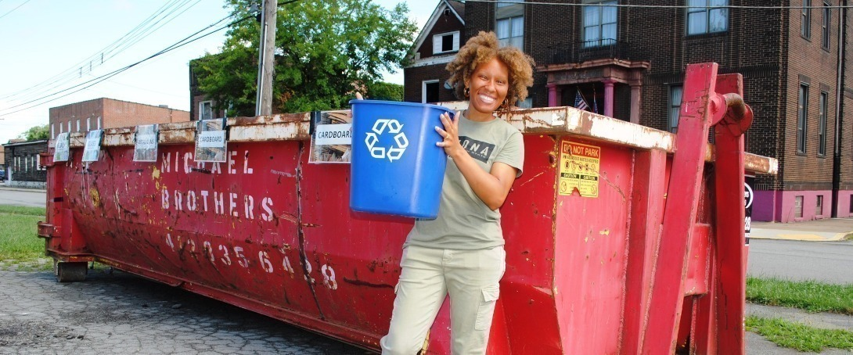
PRC WEST
828 W. North Ave
Pittsburgh PA 15233
PRC EAST
1521 N. Providence Rd.
(Rose Tree Park)
Media, PA 19063
Mission: We steward resources to prevent waste and conserve the environment

Slide 36
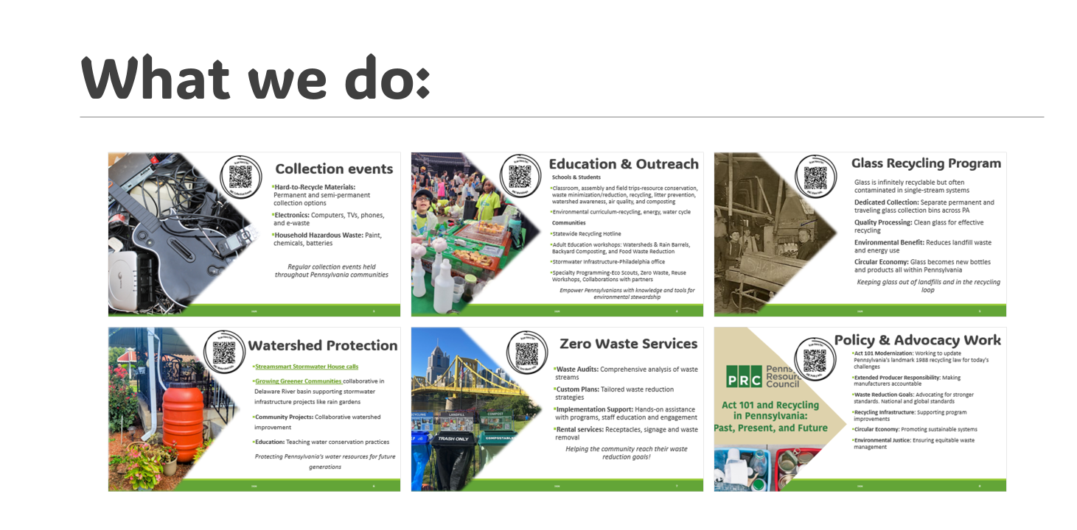

Slide 37
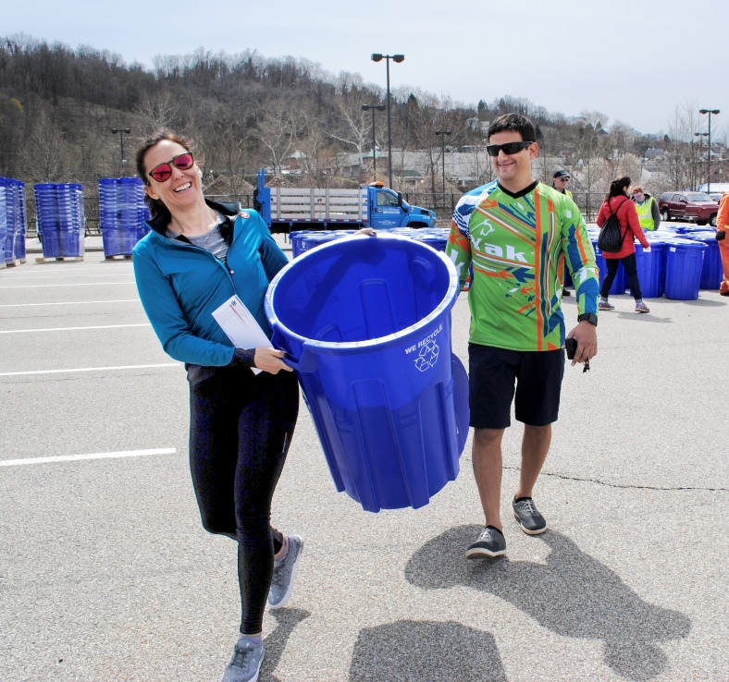
Can we reach Zero Waste?
4.9 lbs. of waste per person/ per day in the U.S. (2018 data)¹
335,000,000 population of the United States (2018)²
Many people doing a little is better than a few people doing a lot
USEPA. National Overview: Facts and Figures on Materials, Wastes and Recycling. 2018 https://www.epa.gov/facts-and-figures-about-materials-waste-and-recycling/national-overview-facts-and-figures-materials
United Nations Department of Economic and Social Affairs. World Population Prospects 2024. (U.S. Population data from 2018) https://population.un.org/wpp/
Notes:
The conservation of all resources by means of responsible production, consumption, reuse, and recovery of products, packaging, and materials without burning and with no discharges to land, water, or air that threaten the environment or human health.[zwia.org]
Zero waste is recognized as achieving 90% or greater
diversion from landfills and incinerators

Slide 38
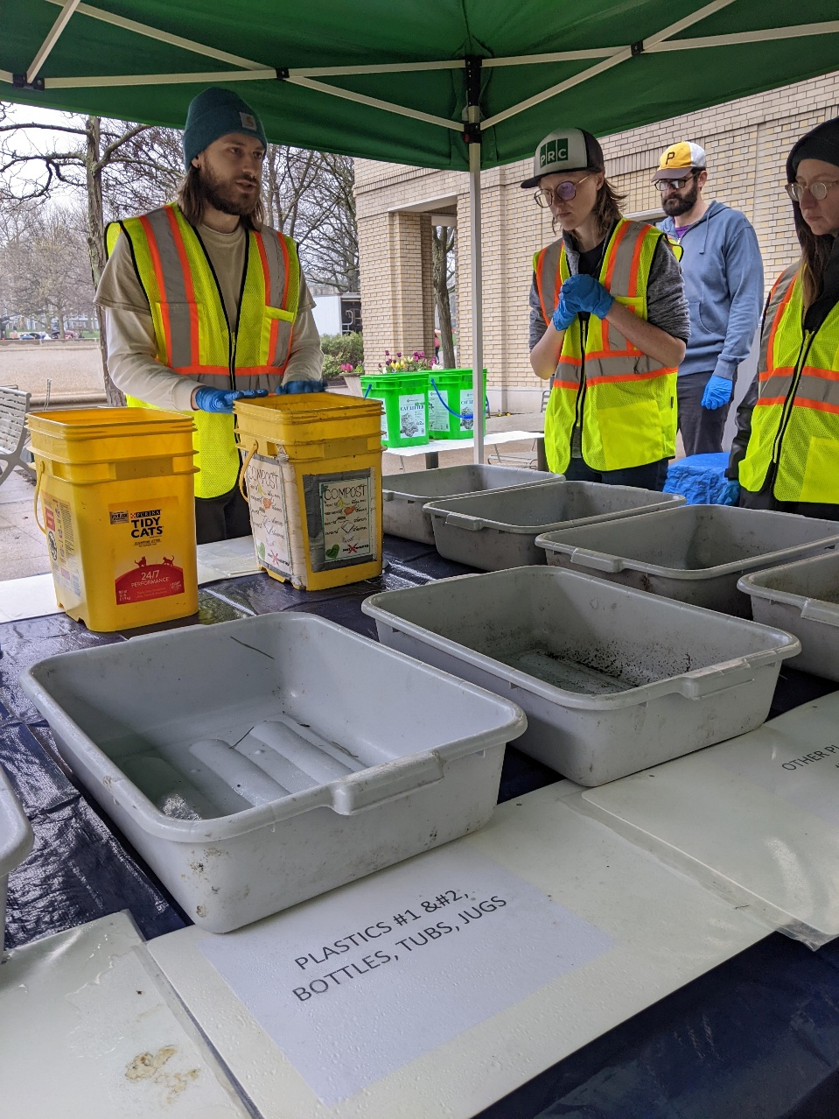
Where To Start?
First, let’s discover what is being generated
=> Do A Waste Audit

Slide 39
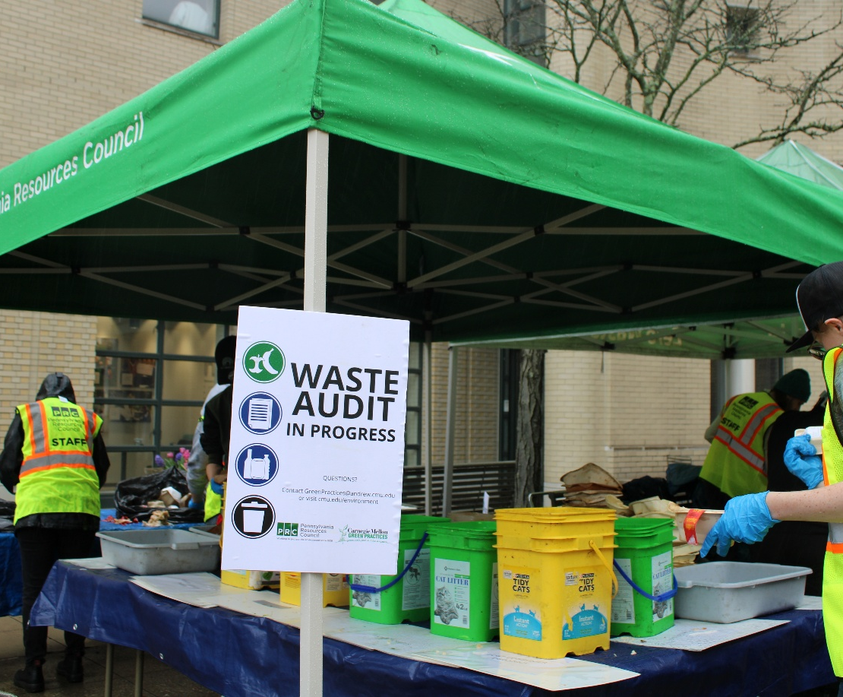
WHY A WASTE AUDIT?
Evaluate existing waste-related services and programs
Identify opportunities for waste avoidance, reduction, and diversion
Document programming to measure change over time
Right-size system components to achieve economic efficiencies
Maximize the performance of waste diversion efforts

Slide 40
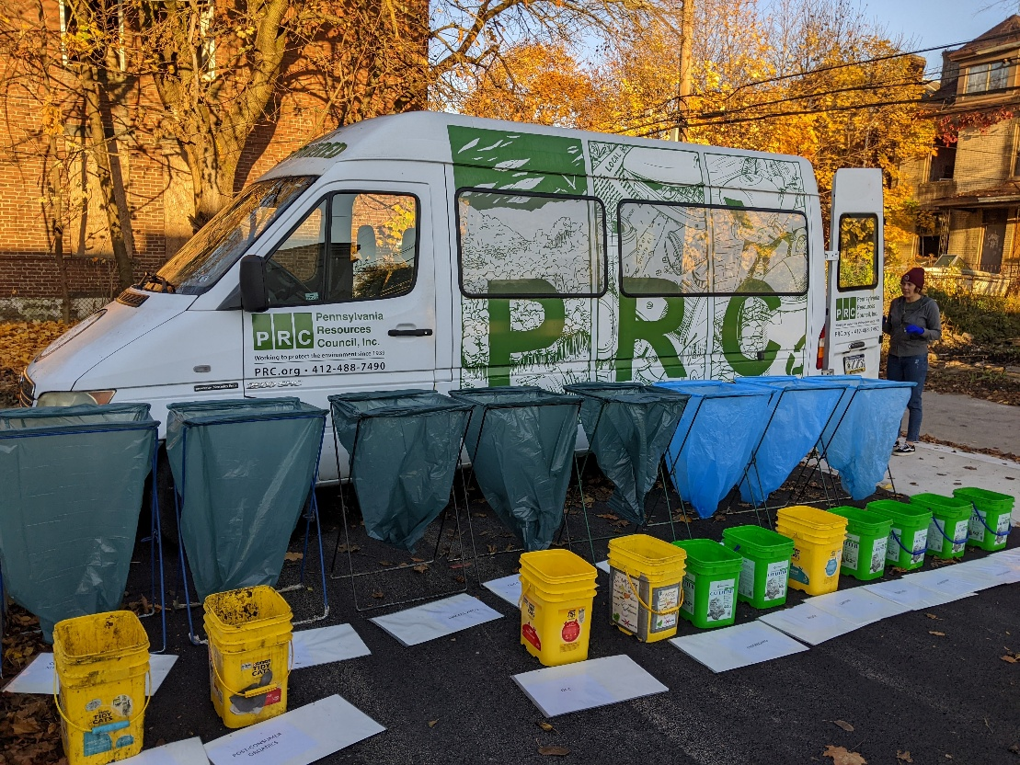
Audit Background & Intention
What is your venue? The entire building? One floor? Cafeteria?
What is your intention?
Determine material categories – how detailed
Choose the number of days of materials to sort
Plan location of sort
Review details with facilities
Sort
Characterize
Record

Slide 41
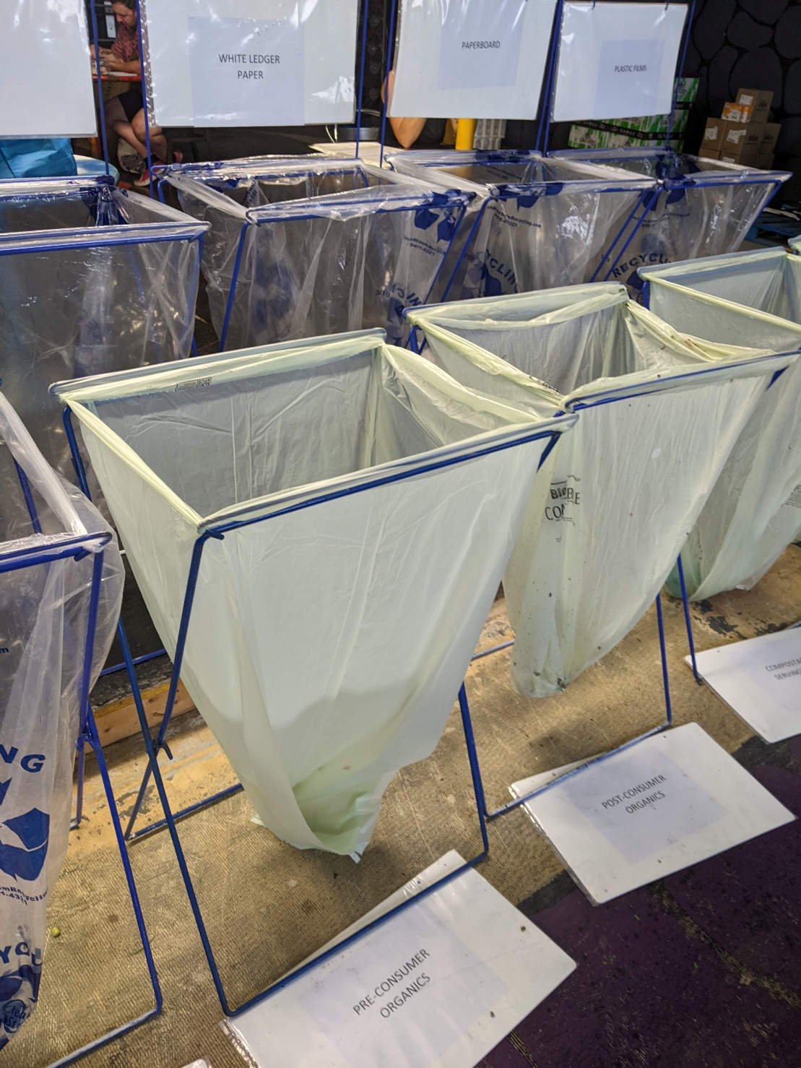
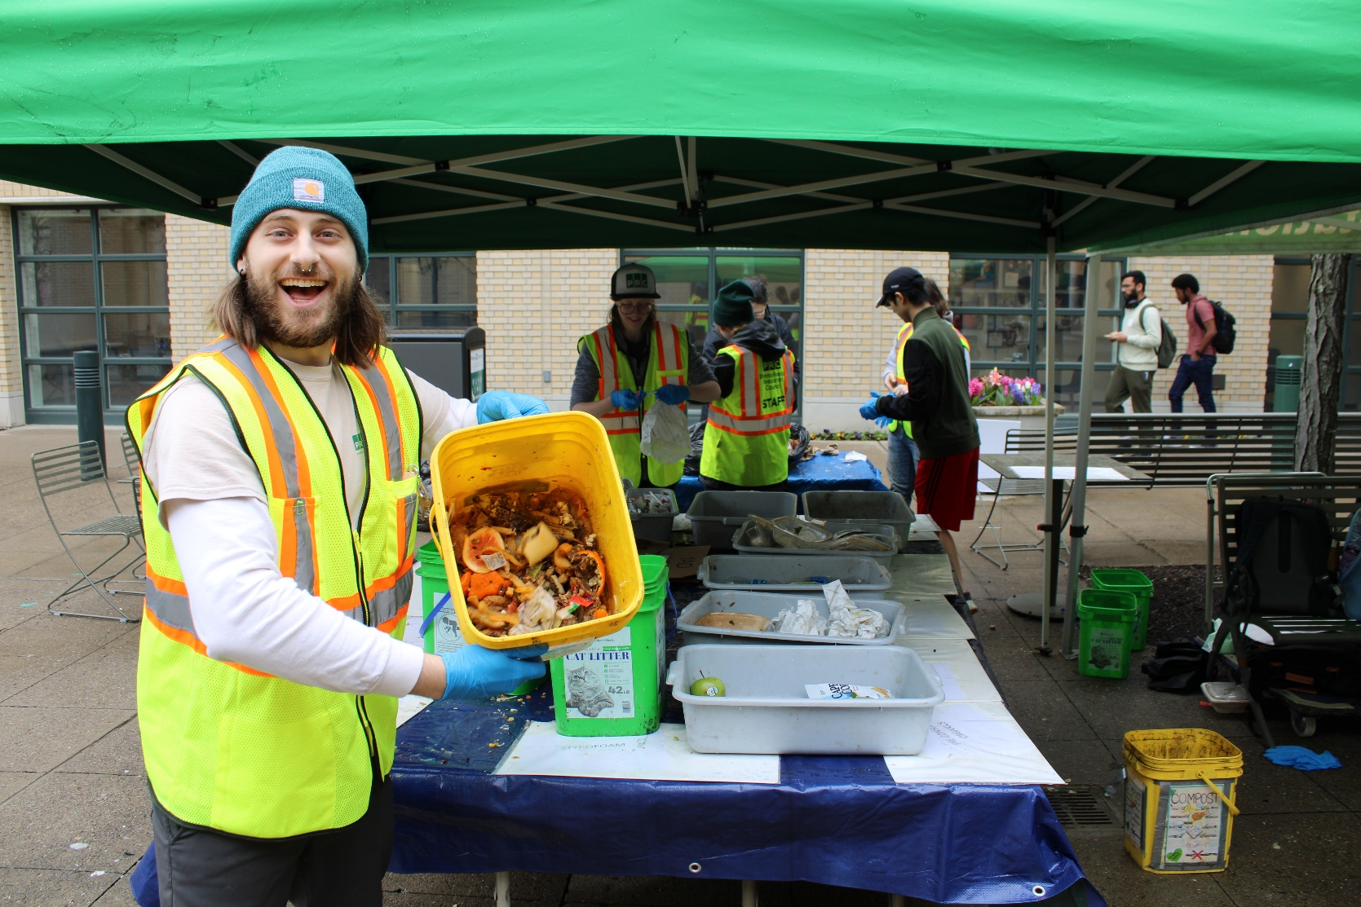
Get Auditing!

Slide 42
Pittsburgh Rec Center
Typical/expected waste stream
Office, Kitchen & Dining, Gym & Classroom
Waste handled by staff, picked up by DPW
Only landfill pick-up
Potential diversion rate: 77%
Food Recovery, Source Reduction
Composting
Recycling
Contamination rate in recycling bins: 32%
Signage needed

Slide 43
Pittsburgh Rec Center (Homewood)
Typical and Atypical Waste
Office, Kitchen & Dining, Activity Rooms
Waste handled by staff, picked up by DPW
Only landfill pick-up
Potential diversion rate: 87%
Food Recovery, Source Reduction
Composting & Recycling
Partnership with PCCR or other end-use for reusable items (craft supplies, games, puzzles)
Signage needed

Slide 44
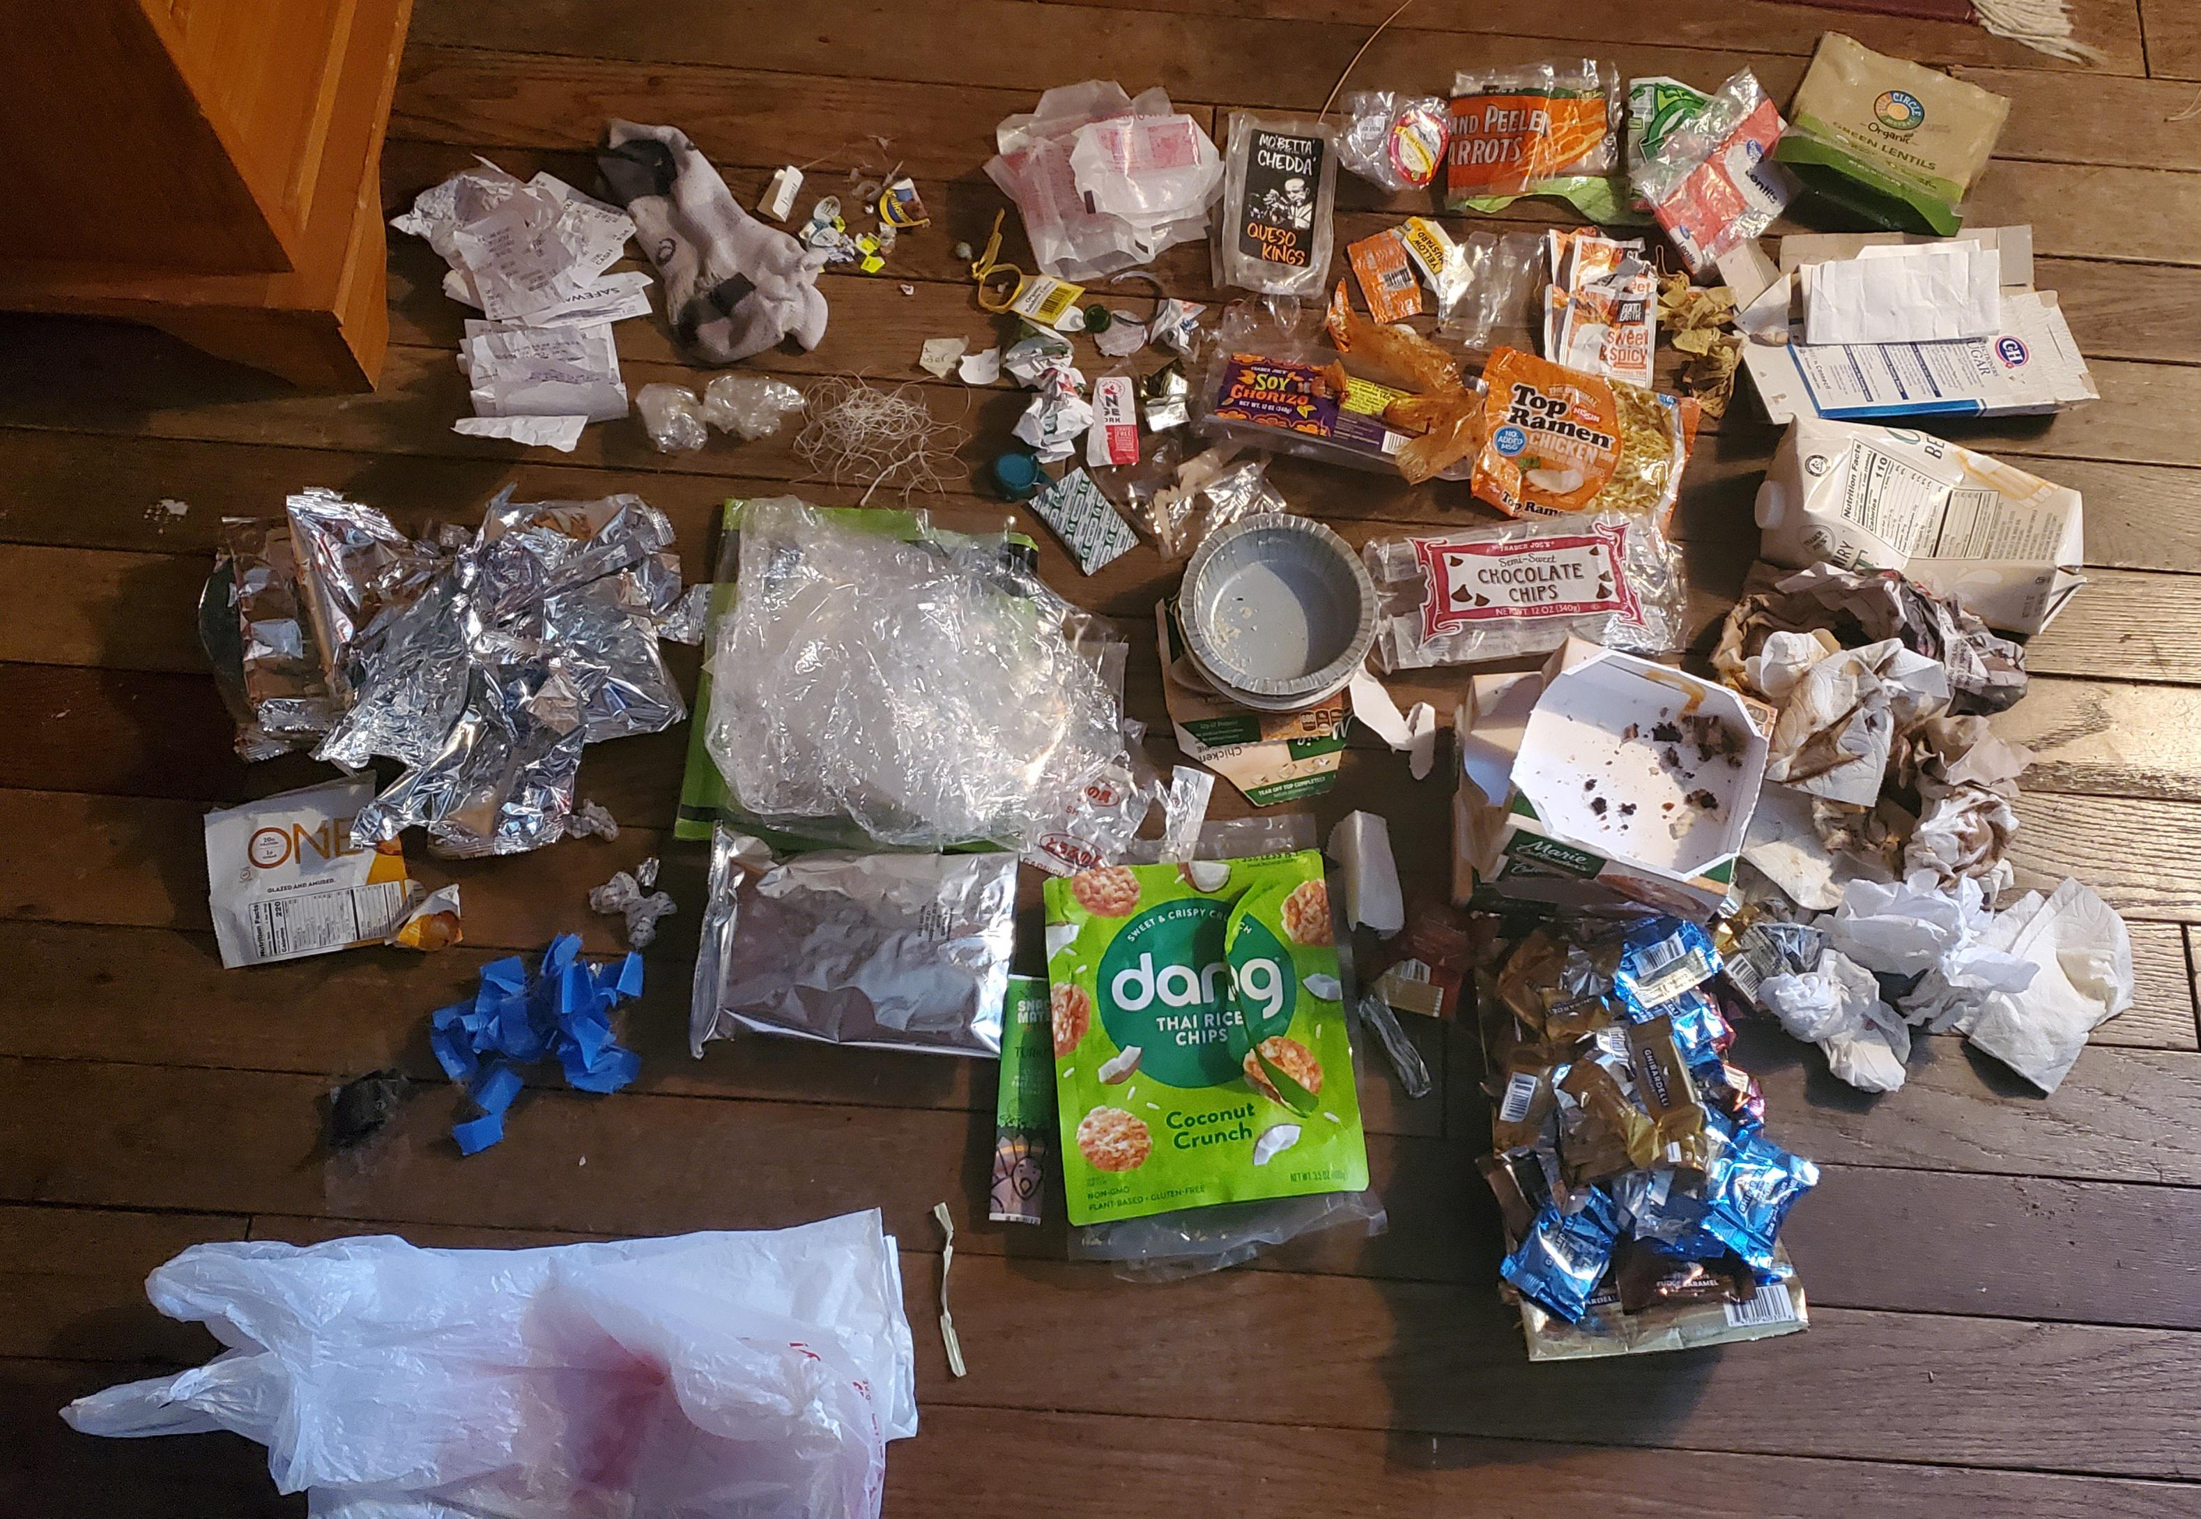

What about at Home?
Lay out three tarps label them 1. “landfill”, 2. “recycling” or 3. “compost”
Empty your trash, recycling and/or composting bins onto the corresponding labeled tarp
Remove any contamination from each tarp (i.e., move all trash that was in your recycling bin to the recycling tarp; all recycling in your compost to the recycling tarp and so on)
Arrange materials from each tarp (“landfill”, “recycling” and “compost”) into specific sub-categories (i.e., All straws in one pile, all paper napkins in another) – use the data collection form on the next page to document the materials you sorted.
Once all your materials are sorted, make commitments on how you can: Rethink, Reduce, Return, Reuse (or donate), Recycle, & Compost
Find more info at TRUE HOME WASTE AUDIT

Slide 45

RETHINK/REDESIGN
Determine what items you don’t need or could be replaced with alternatives
Refuse plastic bags
Refuse straws
Bring a take-away kit and refuse take-out containers
Thrift
Be conscious of packaging-the less the better

Slide 46
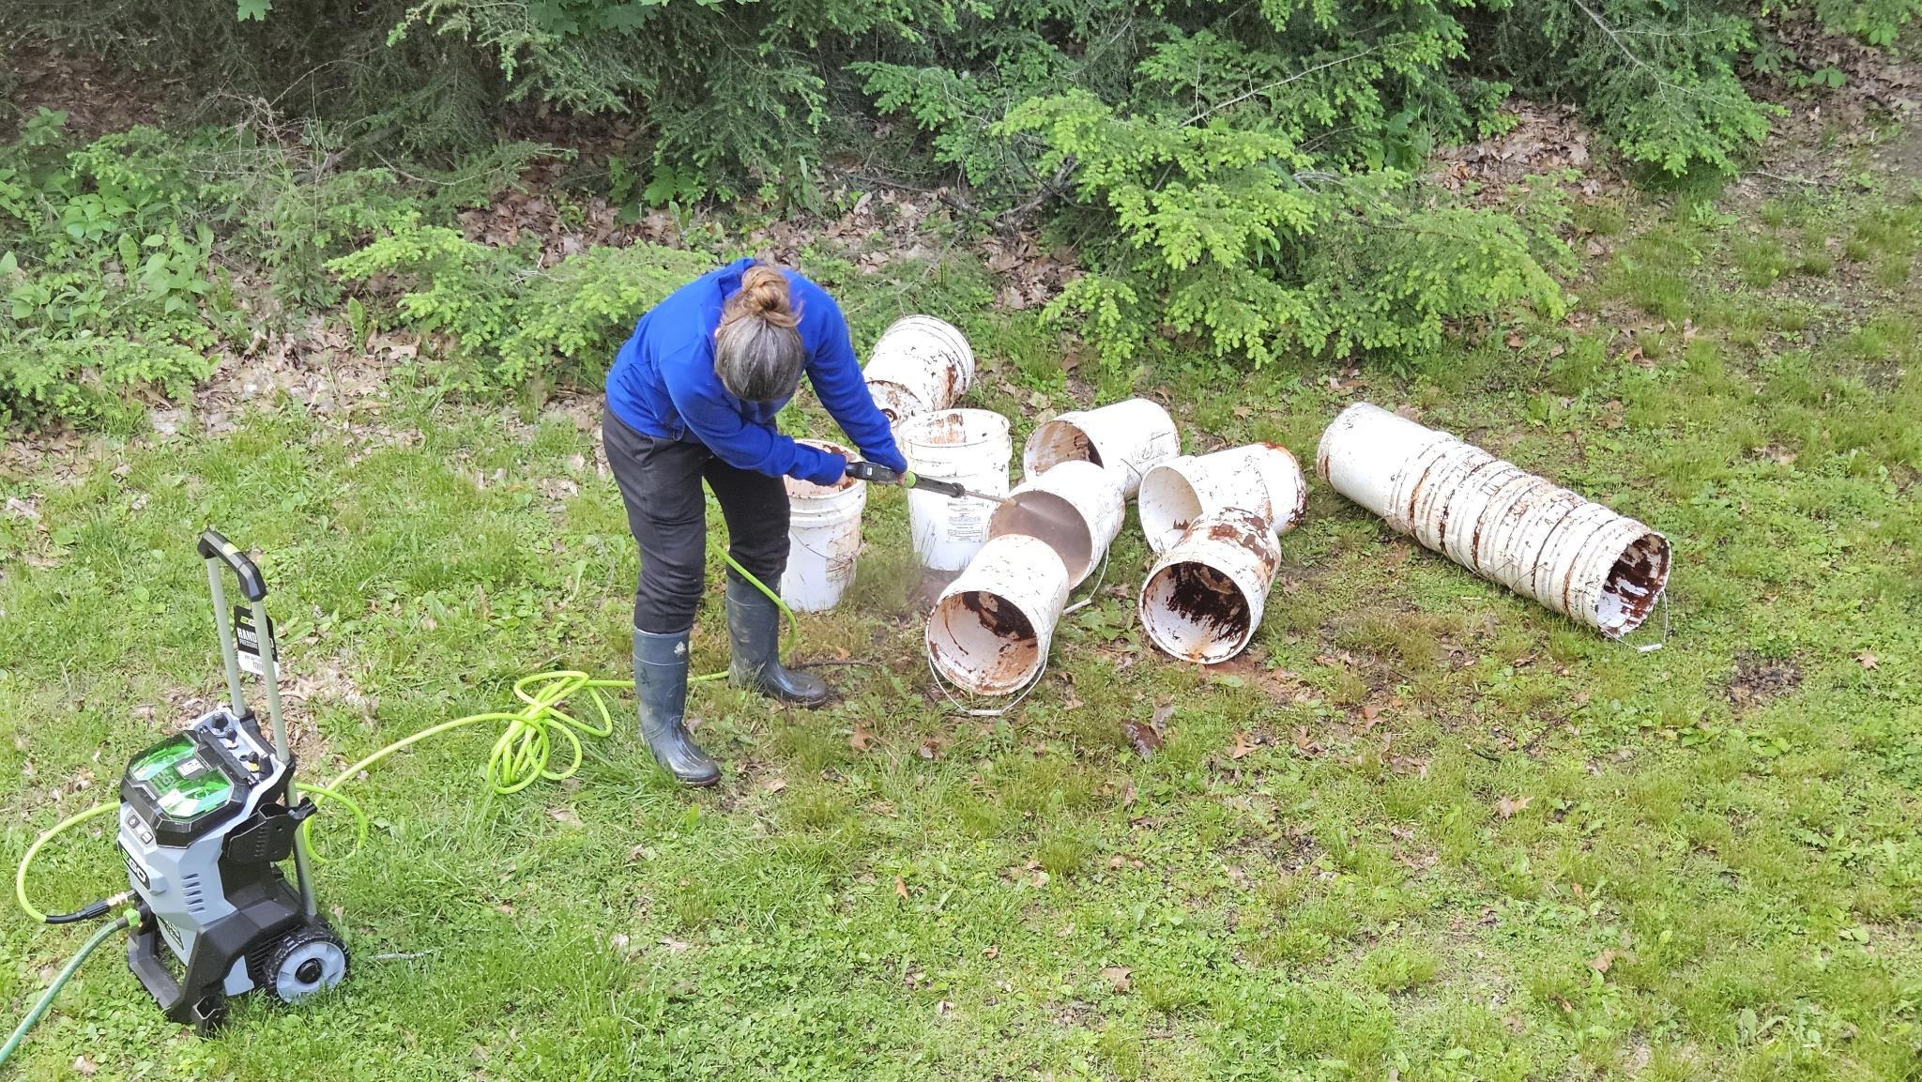
REDUCE
Meal plan-prep to buy less
Use alternatives that use less resources:
Laundry sheets instead of plastic tubs of detergent
DIY cleaning supplies
Public transportation options
Reduce Junk Mail
Clean up buckets instead of buying new ones

Slide 47
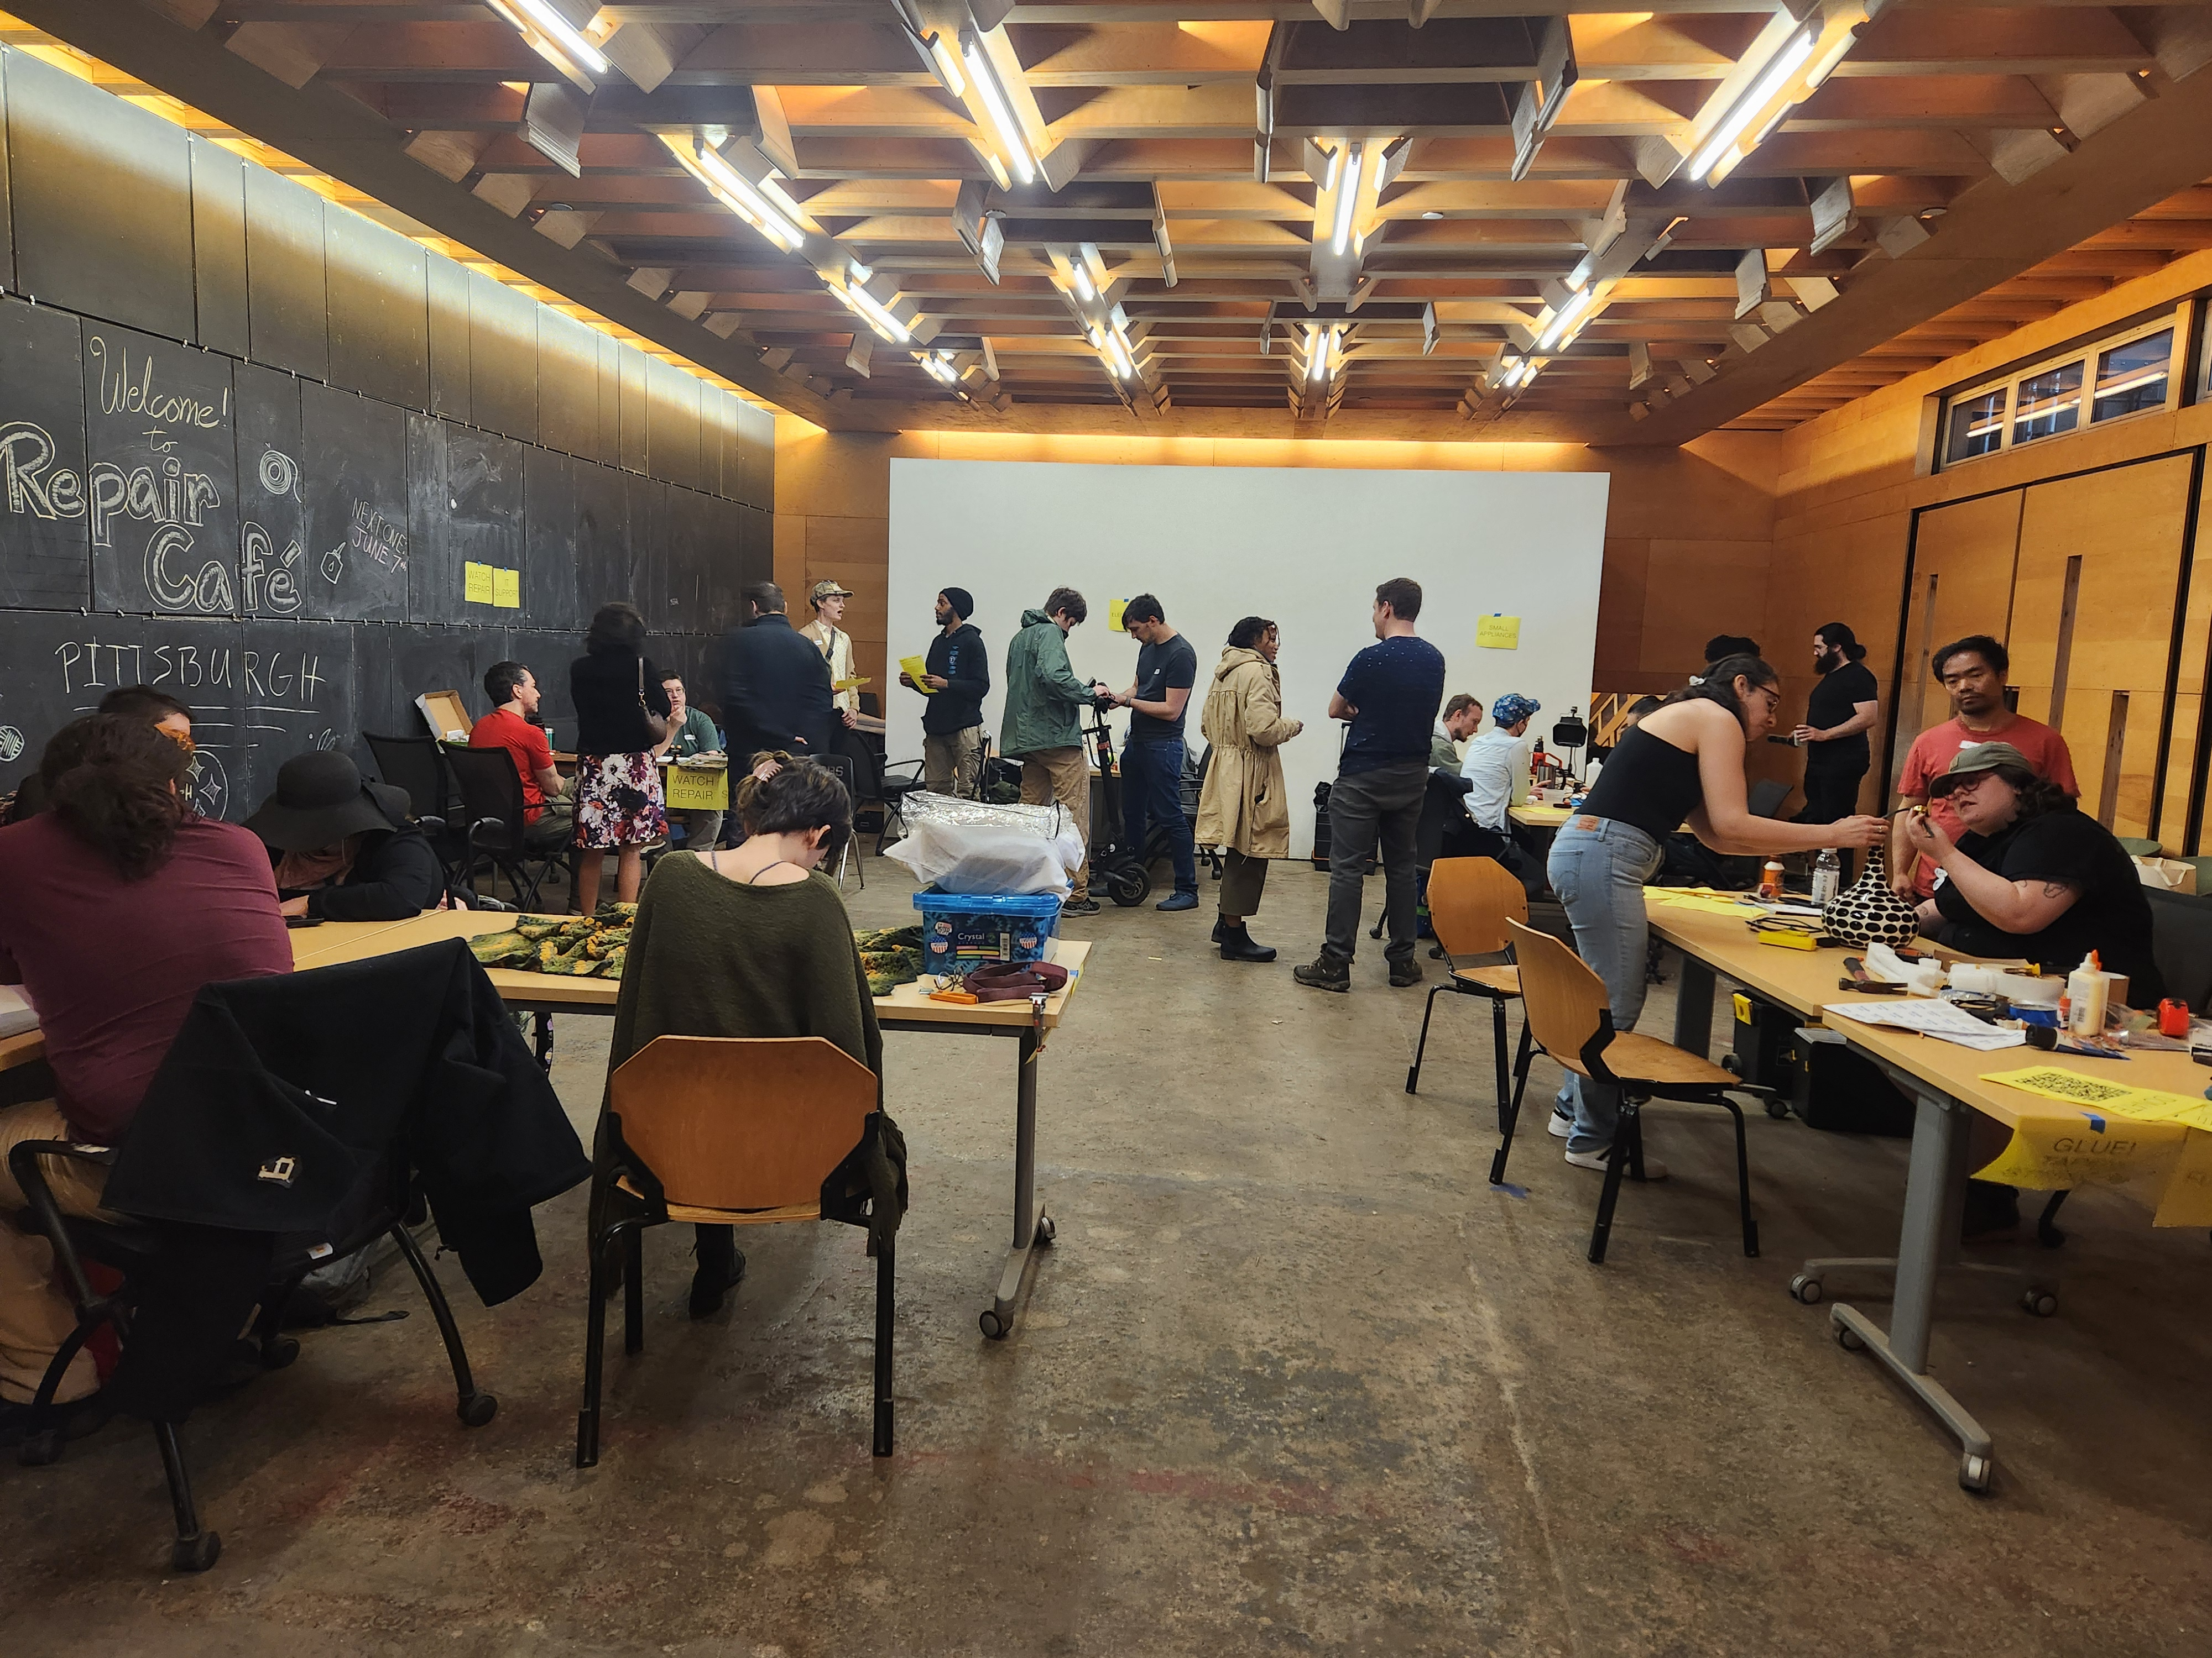
REUSE/REPAIR
Thrift with durability in mind
“Buy Nothing” app
Ifixit.com
Clothing mending
Repair cafes

Slide 48

RECYCLE/COMPOST
Learn the rules and options in your area
Sorting and cleaning
PA DEP Hotline and DCSWA recycle drop-off finder

Slide 49


Sarah Alessio Shea
Executive Director
saraha@prc.org
www.prc.org
Notes:
PRC also holds collection events throughout the year, primarily in SW and SE PA. You can find more information about our Hazardous Household Waste, E-Waste, and Hard to Recycle collections under the Workshops & Collection Events menu on the website.

Slide 50


Slide 51




&
Creative Glass Recirculation
and Community Based Impact

Slide 52

THE PROBLEM
glass goes to waste
Cross contamination in single stream makes glass lose its value
More than 50,000 tons of glass a year from Philadelphia goes to landfill
This causes avoidable environmental and economic waste
Notes:
Slide 3: The Problem: Glass is Going to Waste
• Header: The Broken Cycle: 90,000 Tons Landfilled Annually in Philadelphia
• Glass is atomically one of the most permanent materials and can be easily remelted, making it the simplest closed-loop material.
• However, in single-stream recycling, post-consumer glass is too contaminated to be useful.
• Approximately 90,000 tons of glass are sent to landfills annually in Philadelphia alone.
• Key Message: This represents a significant environmental and economic opportunity lost.
• Visual: Remark Glass & Bottle Underground logos

Slide 53

OUR SOLUTION
create value from glass
Remark Glass and Bottle underground work together to maximize value and minimize waste
Diverting glass and scaling through market development
Build a balanced loop that creates value from every glass particle
Notes:
Slide 4: Our Solution: Creating Value from Waste
• Header: Our Method: Maximize Value, Minimize Waste
• Our proven method creates as much value as possible from glass by:
◦ Downcycling into sand aggregate (e.g., for EPA-funded stormwater infrastructure gardens).
◦ Recycling by manufacturers.
◦ Reusing as packaging for local makers' goods.
◦ Upcycling into unique glassware through the Remark Glass studio.
• BU has diverted over 210 tons of glass from landfills since 2020.
• We provide employment for 12-17 justice-impacted individuals and over 20 internships for opportunity youth.
• Key Message: We are building a scalable model for creative waste diversion and recovery with branded products and data tracking.

Slide 54


Where We Started: The Story of the Bottle
Barware, lighting, and keepsakes transforming special bottles from your occasion into glassware for your home

Slide 55

Eco-friendly and Timeless Gifting
Barware, lighting, and keepsakes transforming special bottles from your occasion into glassware for your home

Slide 56



Barware and Decor from the Remark Glass Studio
Barware, lighting, and keepsakes transforming special bottles from your occasion into glassware for your home

Slide 57




CLIENT
Partnership Sample
Maker’s Mark sponsored the collection of its bottles from local bars and we turned them into rocks glasses for employee gifts and events.

Slide 58





Our method creates as much value as possible
DOWNCYCLED into sand for soil aggregate (EPA-funded initiative)
SINCE 2020
>250
tons of glass diverted from landfill
RECYCLED by manufacturers
RECYCLED WITH BU
3K
People engaged in glass diversion
REUSED as packaging for local makers’ goods
Local businesses & community members donate bottles to our non-profit
>50
Internship opportunities
UPCYCLED into glassware through Remark Glass studio
>1K
volunteers & glass donors
Notes:
From their website:
The circular economy is a resilient growth model suited to changes in available resources (scarcity of resources, new energy sources, reduction of greenhouse gas emissions etc.) and to societal changes (urbanization, demographics, etc.). This model exists closest to the markets, at the regional level. Successfully transitioning to the circular economy will make it possible to continue offering solutions and services over the long-term which take into account environmental, labor and societal expectations and which balance well-being, sustainability and performance for stakeholders.
Our strategy to develop the circular economy has the following focus areas:
- evolve products and solutions to reduce the intensity in virgin raw materials and to promote increased integration of recycled or renewable materials, extend their lifespan and facilitate their recycling or reuse in order to reduce the resource intensity of the solutions;
develop manufacturing processes;
- work with stakeholders to change society and to develop new business models and value chains.
We commit through collective initiatives, such as the Factor 10 program of the WBCSD, to develop the debate.

Slide 59

RG and BU revolutionize glass and empower communities
Processing and recirculation to ideal end markets (manufacturers, refill stores, Remark Glass)
Glass production with high recycled cullet content
Network of BU drop off points feeding into primary facility(ies)
Retail & consumption by community member network
Notes:
From their website:
The circular economy is a resilient growth model suited to changes in available resources (scarcity of resources, new energy sources, reduction of greenhouse gas emissions etc.) and to societal changes (urbanization, demographics, etc.). This model exists closest to the markets, at the regional level. Successfully transitioning to the circular economy will make it possible to continue offering solutions and services over the long-term which take into account environmental, labor and societal expectations and which balance well-being, sustainability and performance for stakeholders.
Our strategy to develop the circular economy has the following focus areas:
- evolve products and solutions to reduce the intensity in virgin raw materials and to promote increased integration of recycled or renewable materials, extend their lifespan and facilitate their recycling or reuse in order to reduce the resource intensity of the solutions;
develop manufacturing processes;
- work with stakeholders to change society and to develop new business models and value chains.
We commit through collective initiatives, such as the Factor 10 program of the WBCSD, to develop the debate.

Slide 60


Collect, Sort and Clean whole bottles
COLLECTIONS
DROP OFFS
RECYCLED WITH BU
Local businesses & community members donate bottles to our non-profit
Notes:
From their website:
The circular economy is a resilient growth model suited to changes in available resources (scarcity of resources, new energy sources, reduction of greenhouse gas emissions etc.) and to societal changes (urbanization, demographics, etc.). This model exists closest to the markets, at the regional level. Successfully transitioning to the circular economy will make it possible to continue offering solutions and services over the long-term which take into account environmental, labor and societal expectations and which balance well-being, sustainability and performance for stakeholders.
Our strategy to develop the circular economy has the following focus areas:
- evolve products and solutions to reduce the intensity in virgin raw materials and to promote increased integration of recycled or renewable materials, extend their lifespan and facilitate their recycling or reuse in order to reduce the resource intensity of the solutions;
develop manufacturing processes;
- work with stakeholders to change society and to develop new business models and value chains.
We commit through collective initiatives, such as the Factor 10 program of the WBCSD, to develop the debate.

Slide 61




REUSE
BOTTLE UNDERGROUND recirculates glass locally
Cleaned bottles and jars are repackaged with locally-made goods
Notes:
BU reuse and downcycle
Impact graphic from dashboard- glass intake chart

Slide 62



RECYCLE
BU sends clear to a larger producer for remelting
Bottles are sorted and sent out whole in bulk
Notes:
Remelt-
https://www.luminarc.com/collections/storage/pure-jar-2/

Slide 63


DOWNCYCLE
BU grinds glass into sand
Bottles and jars become a sand alternative
Credit: Chris Baker Evens Photography
Notes:
Non-profit
Downcycling Process

Slide 64




DOWNCYCLE
Philly Collaboration
Glass-sand, biochar, and food-waste compost
Notes:
Philadelphia collaboration: Bennett Compost, Bottle Underground
Materials in Gritty Blend
Compost: Bennett Our locally sourced compost, primarily from Philadelphia’s food scraps, enriches soil by improving drainage, aeration, and beneficial microorganisms, leading to healthier plants. For use on outdoor plants only.
Future of the work: Sand and Soil online, Tu Bloom has colored sand at the show
https://www.bennettcompost.com/products

Slide 65




To Your Home & Garden
Notes:
Slide 7: Direction 1: RG - Elevating Our Brand & Reach
• Goal: Expand keepsake revenue and grow the RG brand in lighting, sculpture, and design.
• Description:
◦ Increase marketing and packaging efforts for keepsakes.
◦ Invest in proposals and events to secure business-to-business (B2B) projects and collaborations.
◦ Continue to handcraft unique barware, tableware, and lighting.
• Investment Required: $25,000
◦ $10,000 for marketing and packaging for keepsake reach.
◦ $10,000 for proposals (giveaways, materials, etc.) and $5,000 for events to elevate the brand.
• Initial Annual Revenue: Up to $200,000 from keepsake sales.
• Revenue Potential: Increase keepsake revenue by 300% (from $200,000 annually) and grow custom work revenue to $300,000/year.

Slide 66





OUR IMPACT
What began as a small community-based pilot has grown into a scalable model.
Key metrics
Trademarked logos & trade secret processes protected by NDAs
Current and target partnerships
>$2M
in revenue in last 5 years
50
Work opportunities for community members with barriers
TM
>250
tons of glass diverted since 2020
TM

Slide 67


CHALLENGES
Site Expansion
Consumer Education
Industry Partnerships
Municipal Support
Product Procurement
Notes:
Slide 10: Direction 4: BU - Forging Industrial Partnerships
• Goal: Create a coalition to redirect glass waste to industry, securing off-take agreements and potential equipment sponsorships.
• Description:
◦ Ardagh: Propose co-hosting community drop-off events to raise awareness and receive support for transportation/processing, with Ardagh accepting clear cullet.
◦ Johns Manville (JM): Develop a partnership to supply pulverized glass sand (<12 mesh size) for their fiberglass plant, potentially exchanging load-out equipment for glass supply. JM uses 5,000 tons/year at their Berlin plant.
◦ ARC: Continue ongoing glass recirculation and invoicing for sorted clear bottles.
◦ Giordanos: Ongoing glass recirculation and residuals processing.
• Investment Required: $10,000
◦ Equipment sponsorship for a quarterly stream of 20-ton truckloads to Johns Manville (to be worked off through glass supply). Note: Ardagh is a request for sponsorship/operational support, not an investment ask from us.
• Initial Annual Revenue: ~$15,000 from Manville and ARC ($10,000 from Manville; $5,000 from ARC). Giordanos is non-revenue generating.
• Revenue Potential:
◦ Manville: Generate fair market value ($400-1600/truckload), scaling as capacity increases from 300 to 2000 tons/year (accounting for 30% of BU output).
◦ ARC: Scale as productivity increases to account for 30% of total BU glass output

Slide 68

GROW TOGETHER
Impact investing
Philanthropy
Sponsorships
Project collaboration
Volunteering
Amplify

Slide 69






THANK YOU
www.remarkglass.com
@remarkglass
Danielle@remarkglass.com
www.bottleunderground.org
@bottleunderground
info@bottleunderground.org

Slide 70
Questions?

Slide 71


Slide 72




To Reduce Waste, Lanyards and Nametags are Reused Each Year - At the End of Today’s Program, Please Drop Nametags in Designated Bins Near Each Exit
End of Conference Survey

