Slide 1
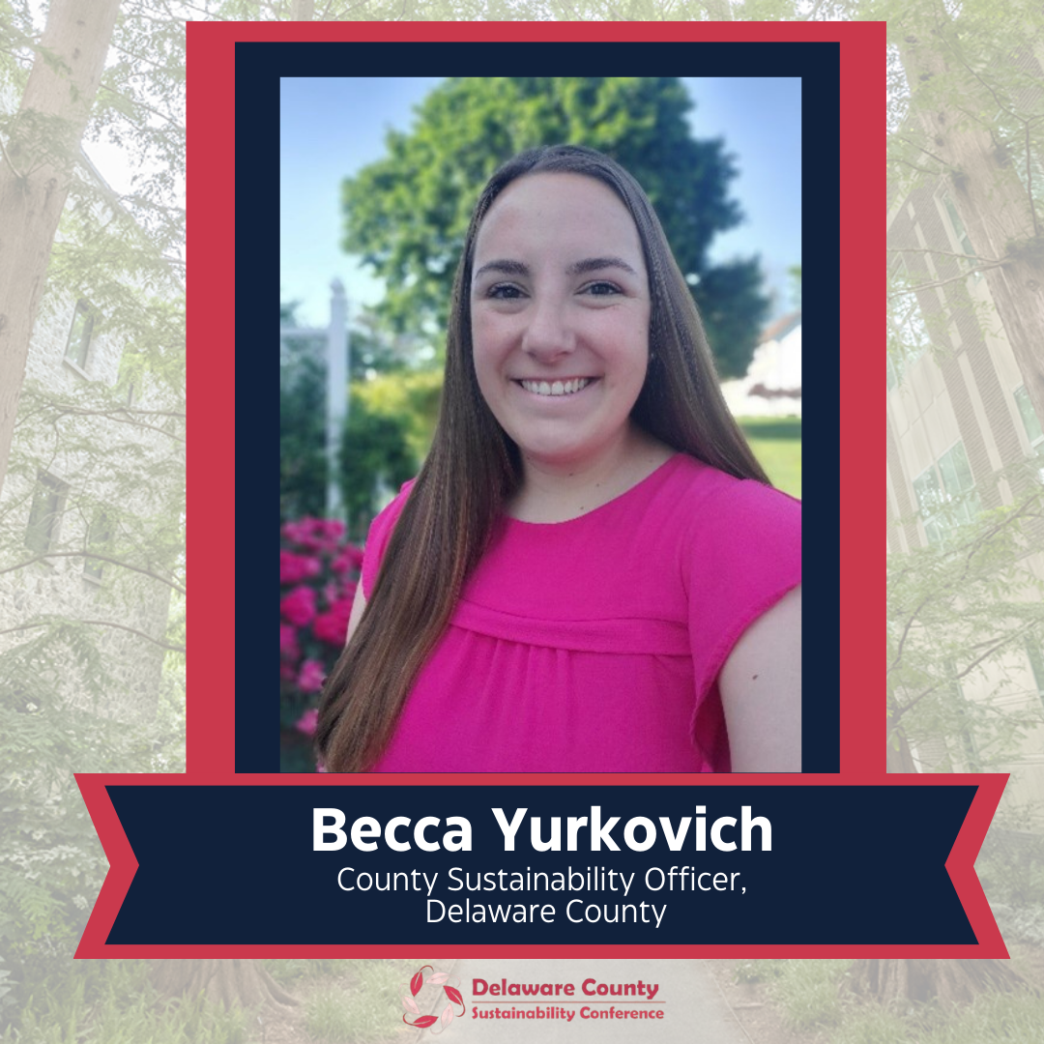

Slide 2
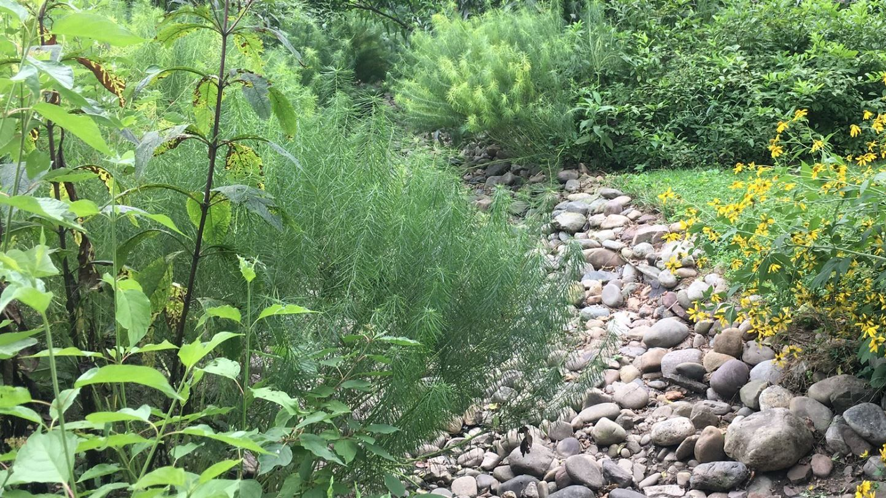
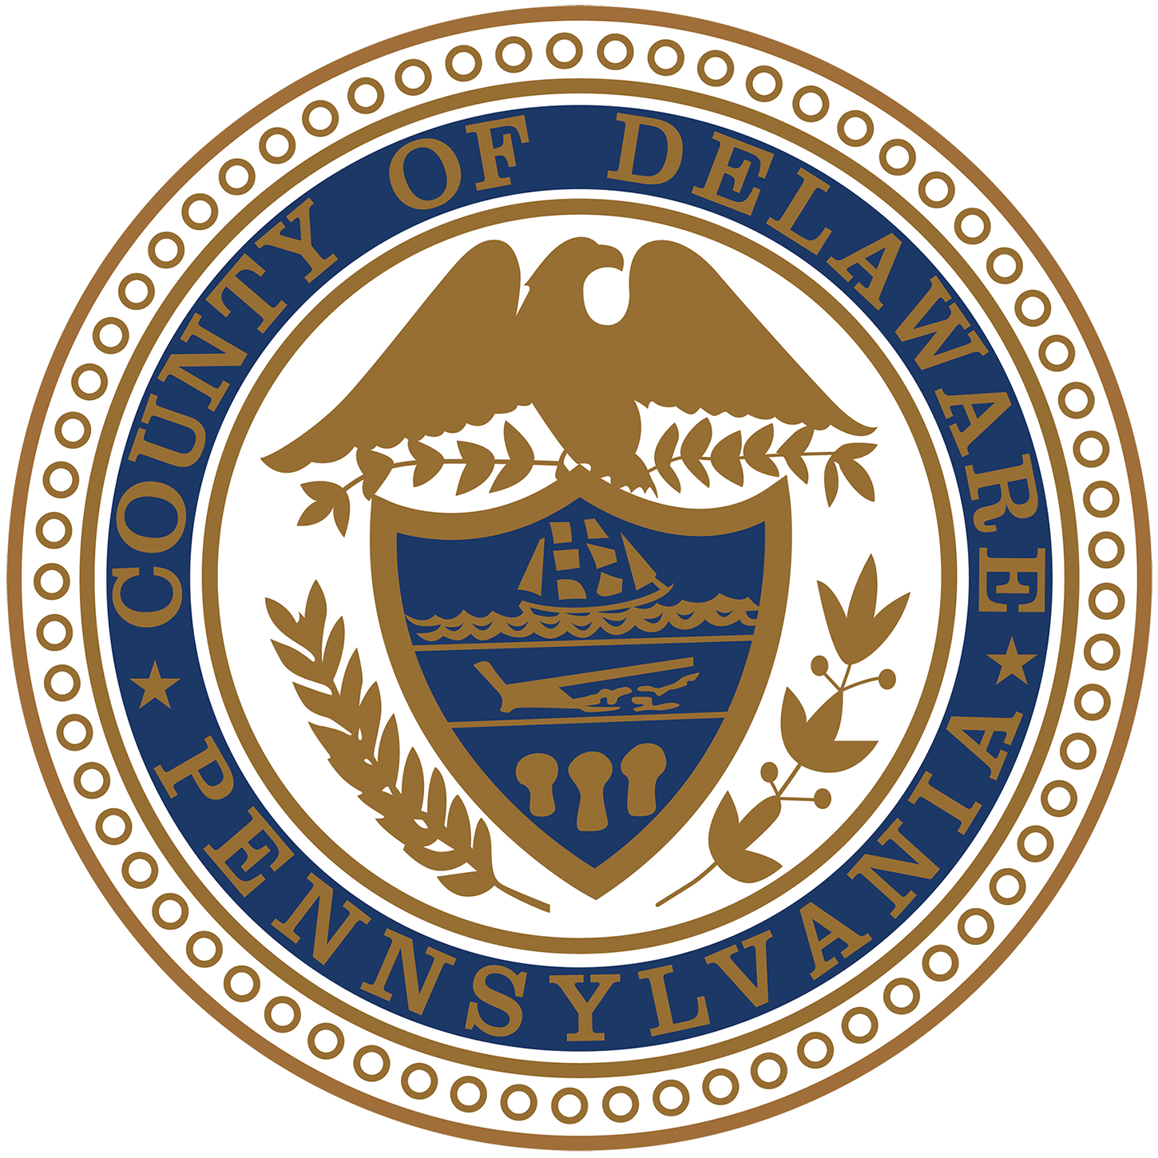
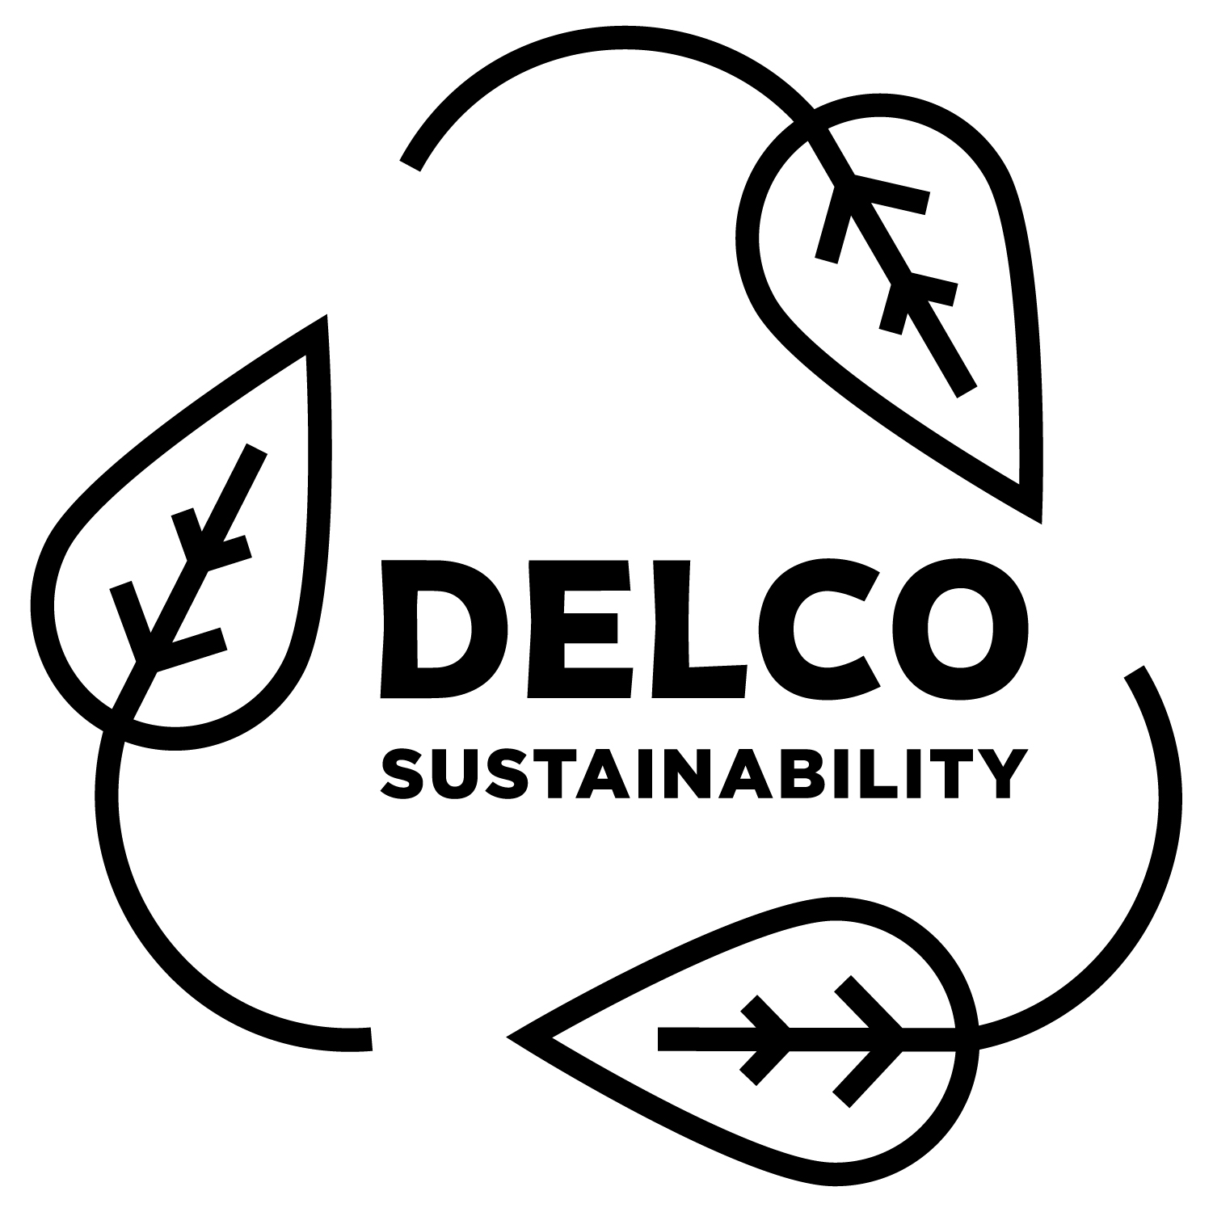
DELAWARE COUNTY OFFICE OF SUSTAINABILITY 2026 UPDATE

Slide 3
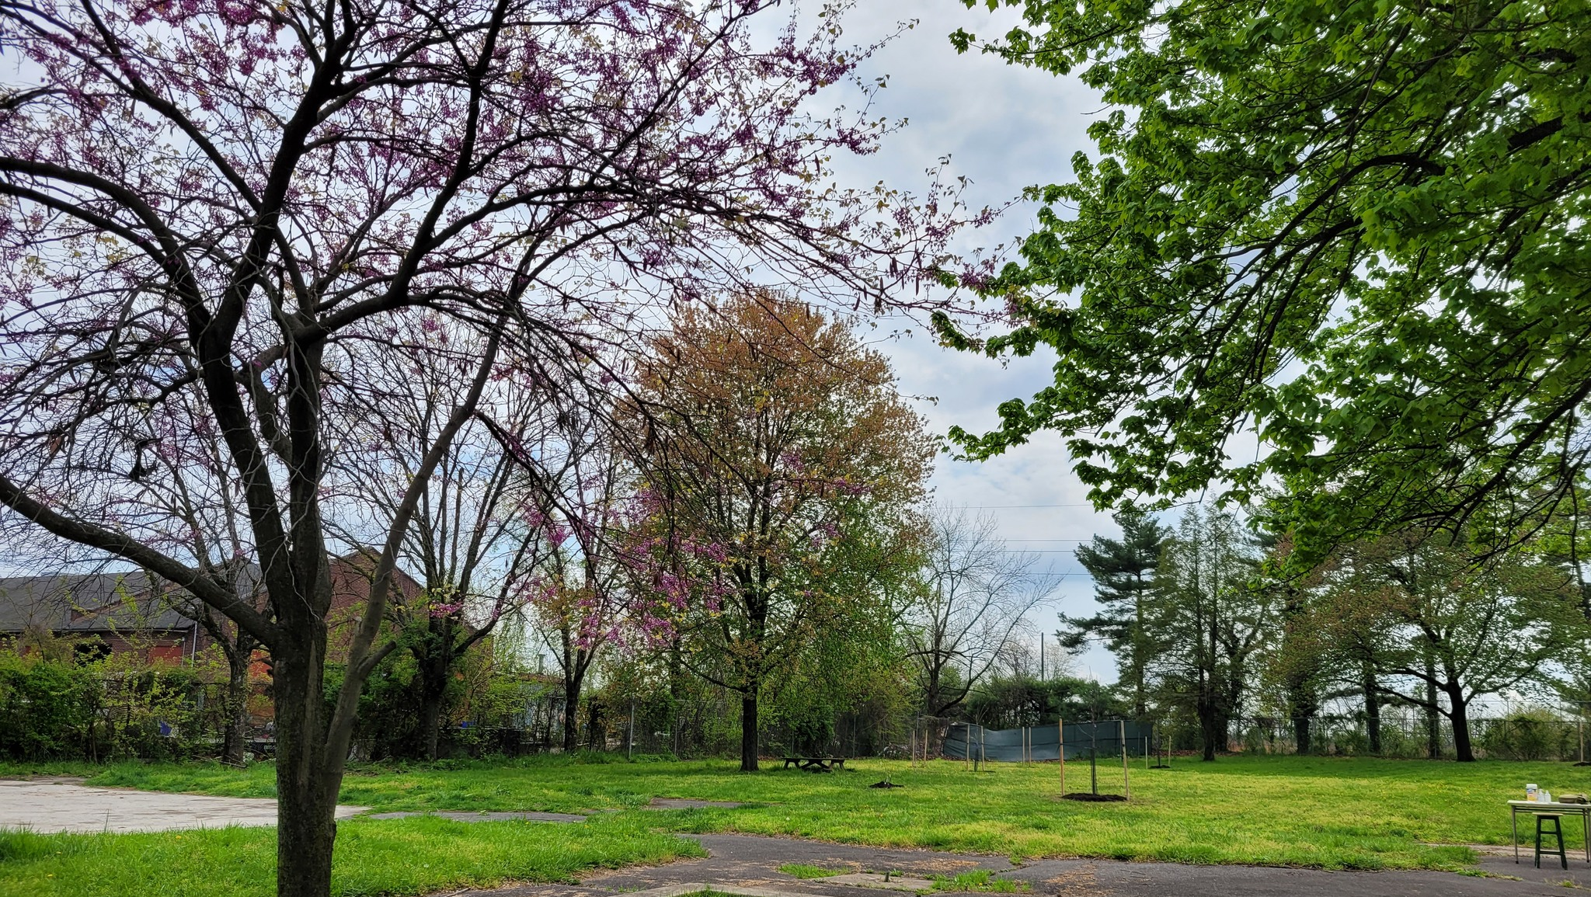

Agenda
Introduction to DCOS
Office of Sustainability Updates
Highlights since June 2025
In the Works - 2026
Economic Sustainability

Slide 4
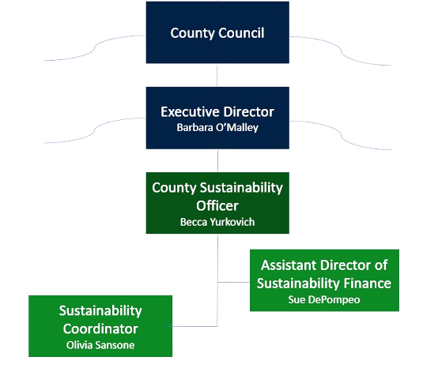
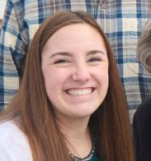
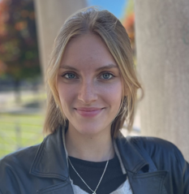
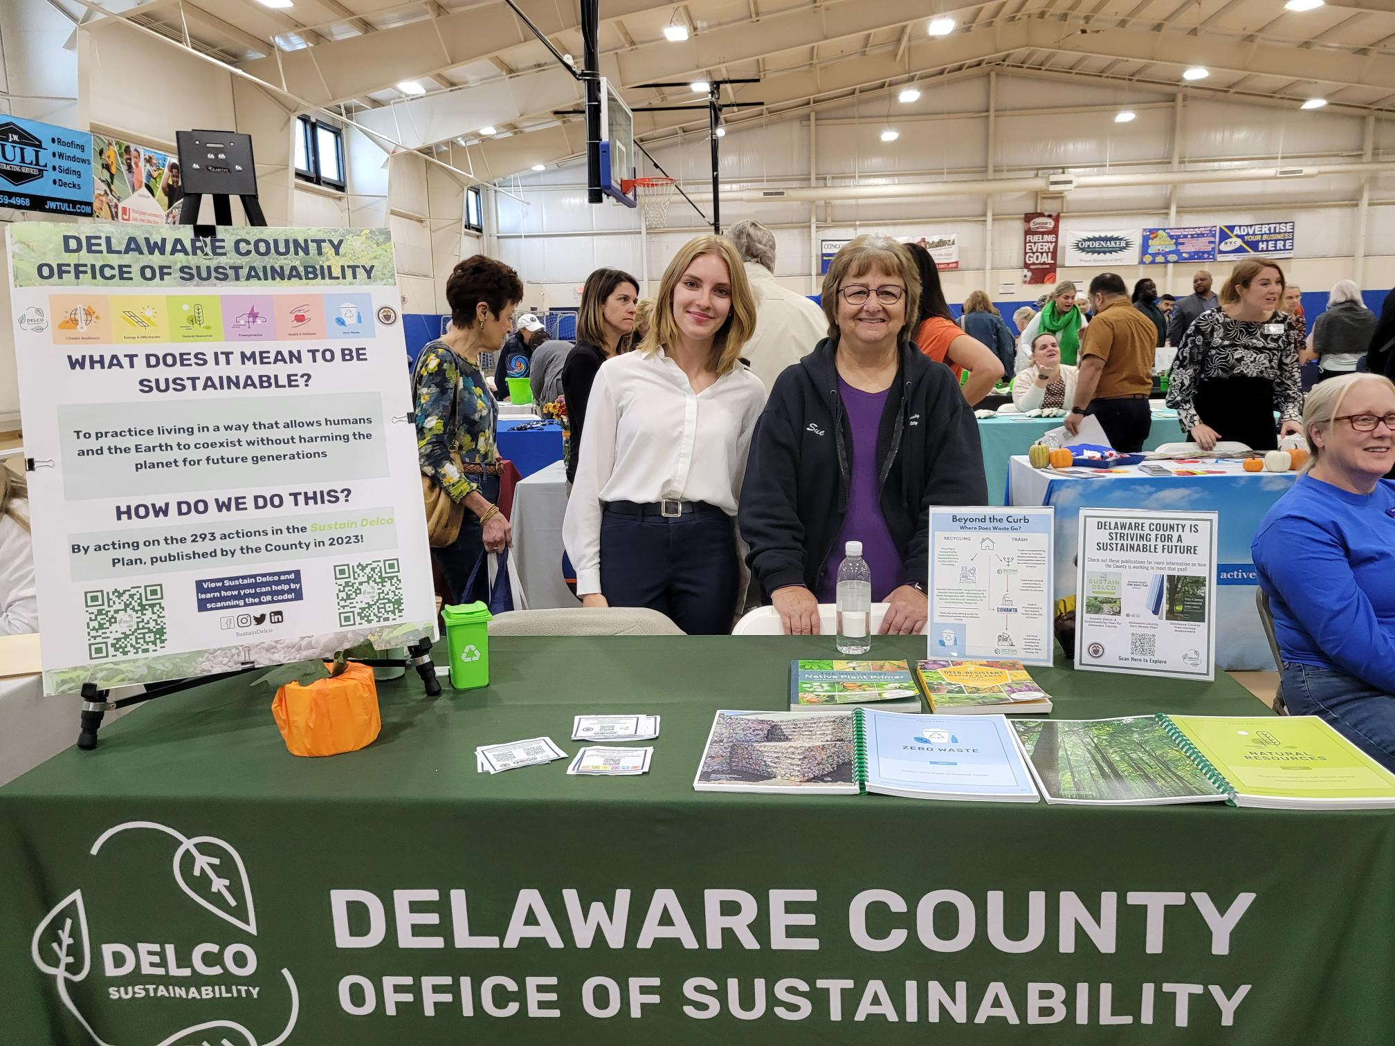
Office of Sustainability Structure
Our mission is making the Delaware County community and its government operations more sustainable and resilient to the effects of climate change.
Notes:
DCOS is charged with:
Examining government operations,
Engaging with the community, and
Working with the Sustainability Commission to implement the County’s first Sustainability and Climate Action Plan, "Sustain Delco: A Sustainability Plan for Delaware County.“
Sustainability – “To create and maintain the conditions under which humans and nature can exist in productive harmony to support present and future generations in a changing climate”

Slide 5
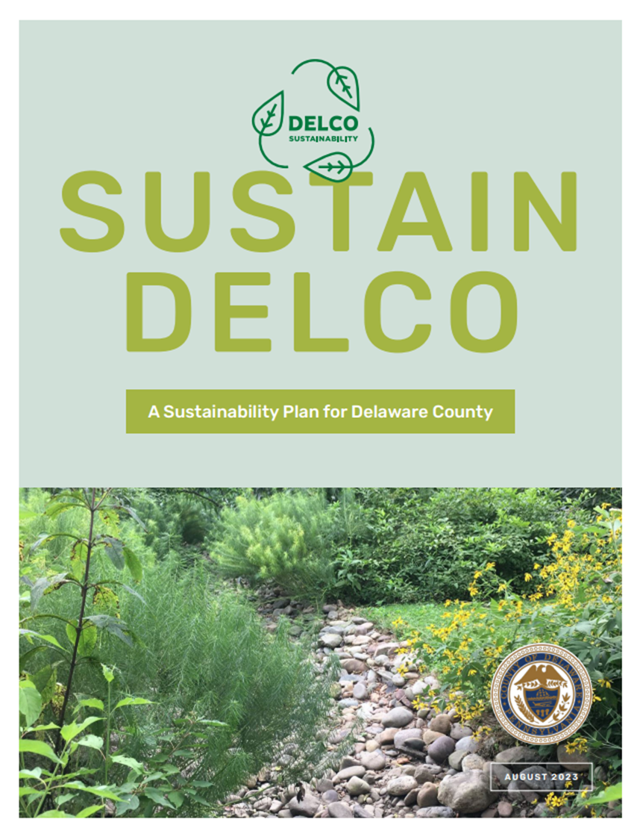
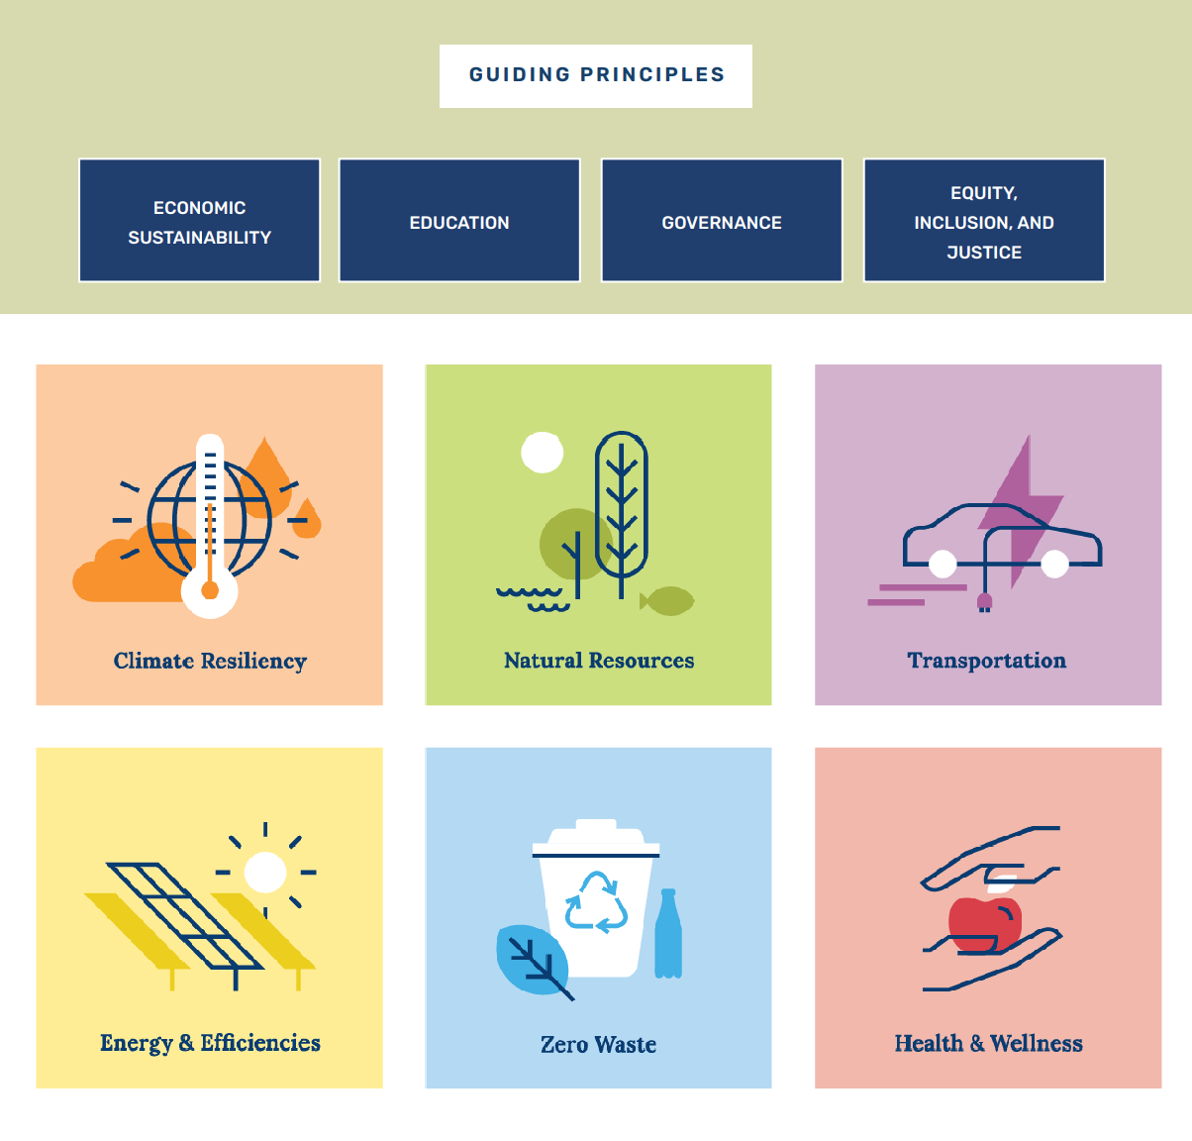

Slide 6
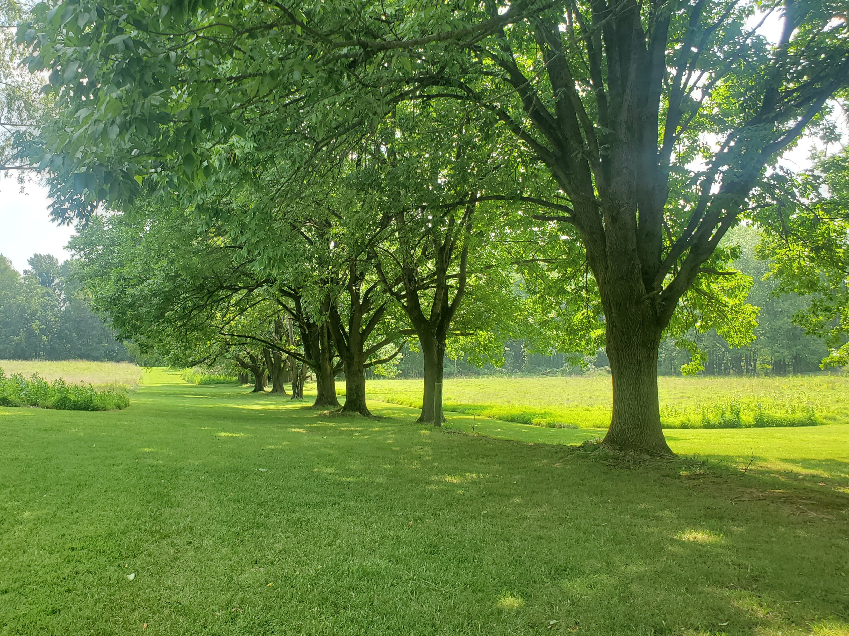
Highlights
from 2025

Slide 7
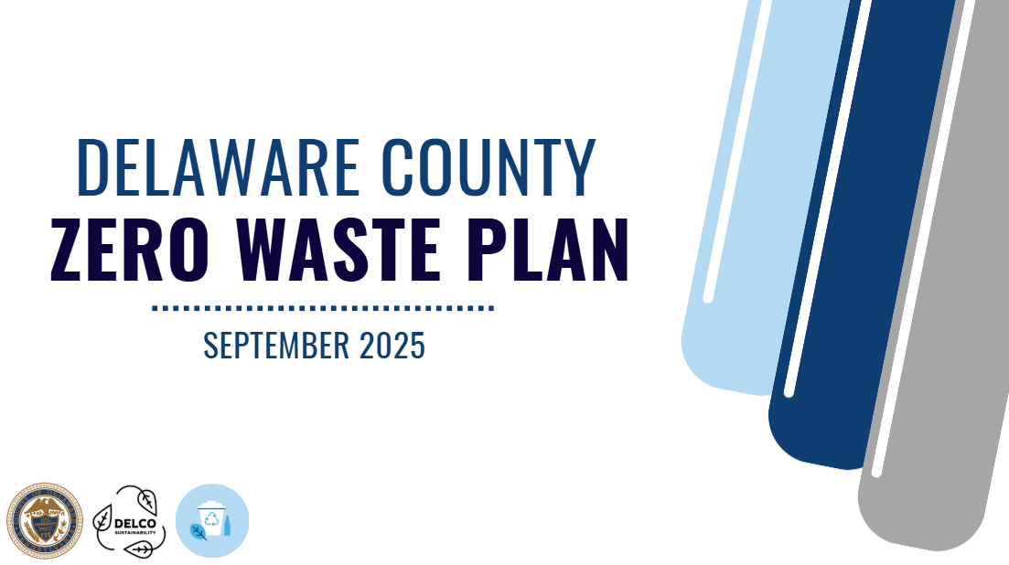
2025

Slide 8
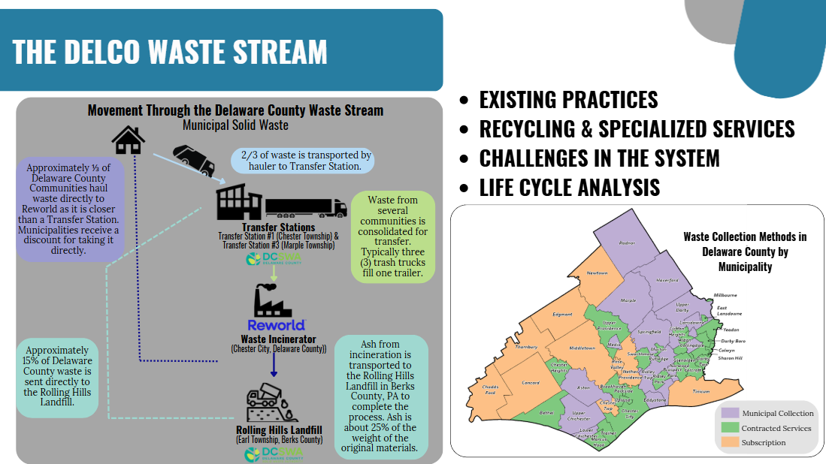
2025

Slide 9
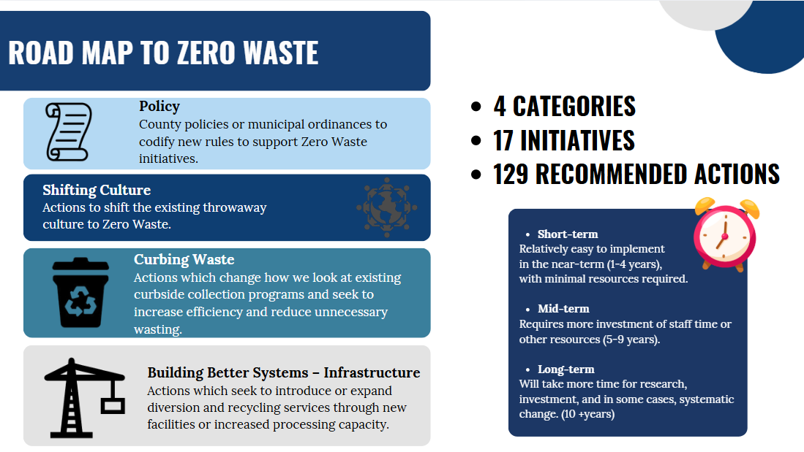
2025

Slide 10
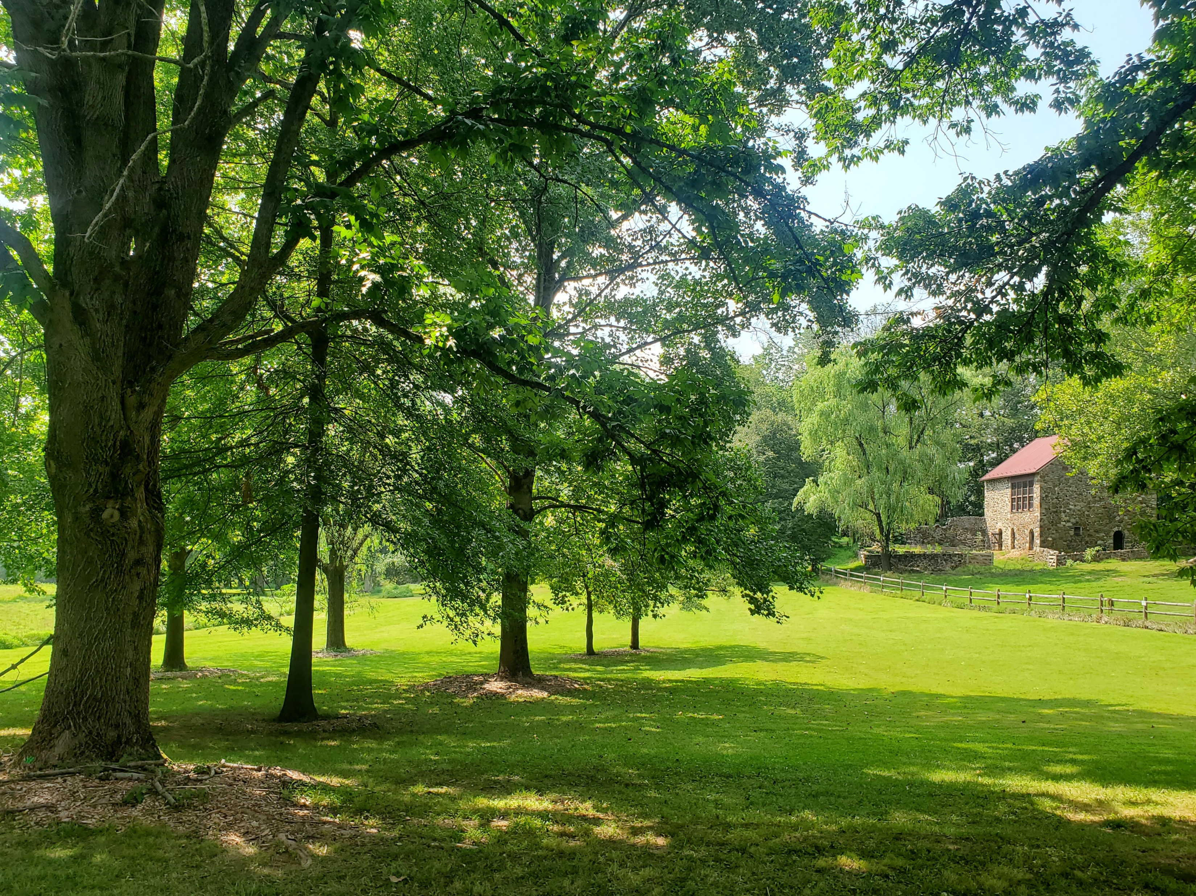
Tree Canopy Assessment
2010-2022
_____
Delaware County, Pennsylvania

Slide 11
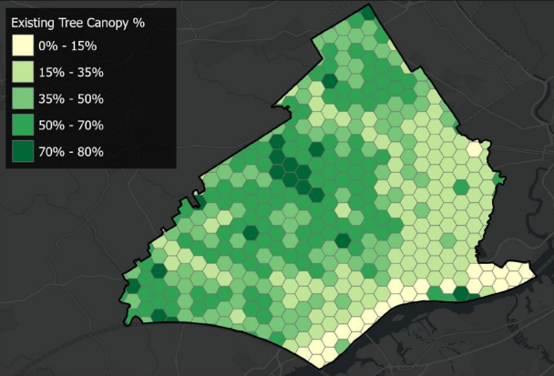
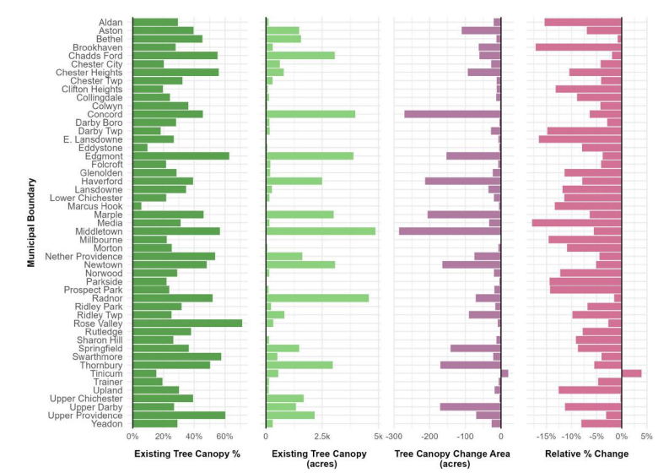
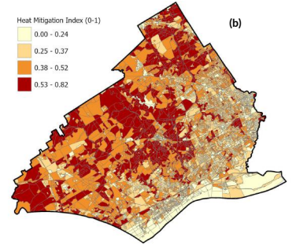
2025
Notes:
Landcover analysis
High-level geospatial analysis to better understand
Losses
Gaines
Overall Canopy Change
Timeframe: From 2010 – 2022
Scale: Municipality, Census Tract, and Census Block Group

Slide 12
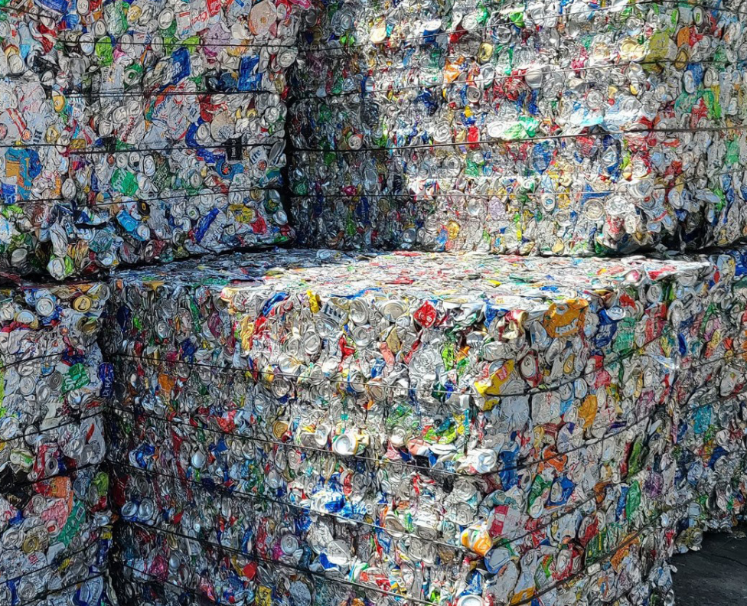

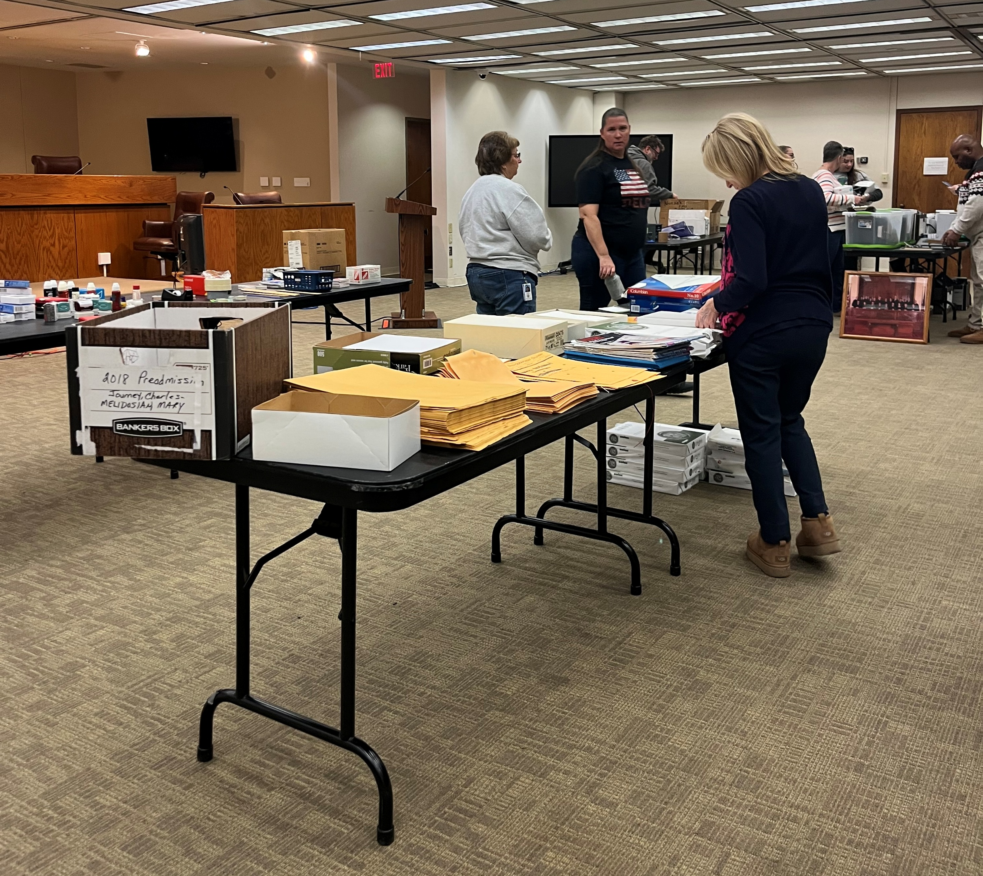
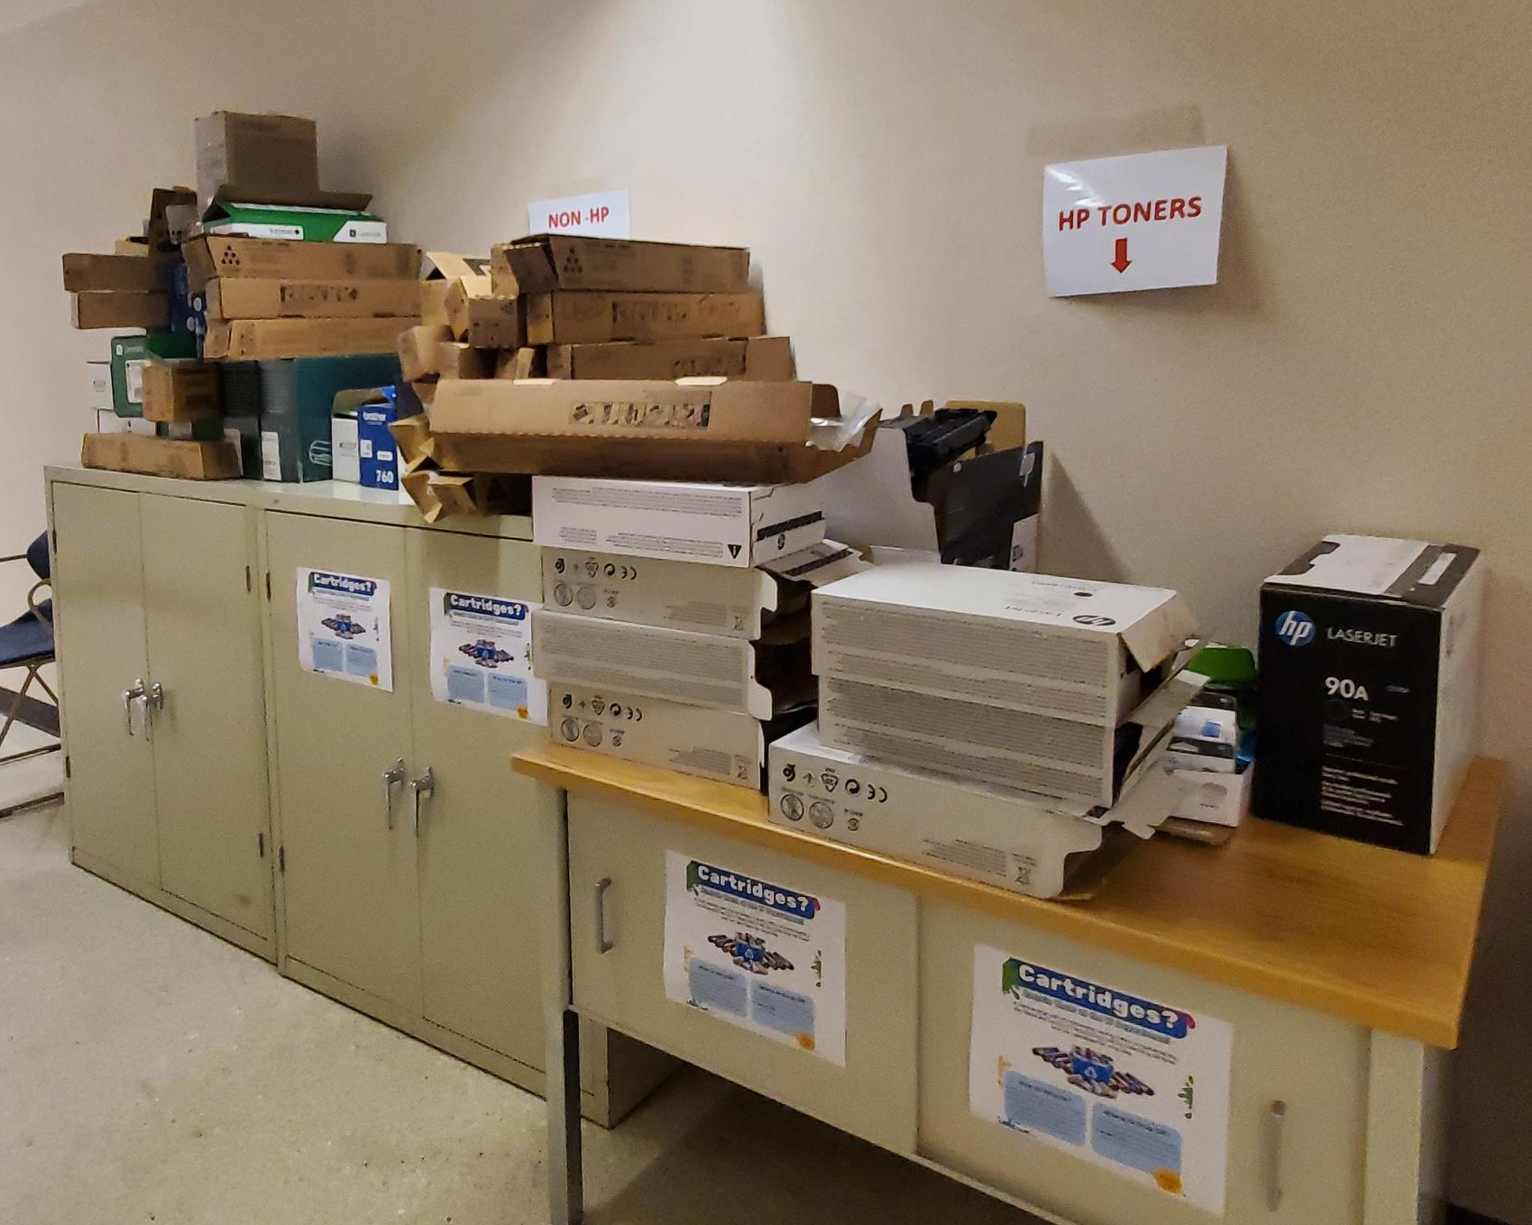
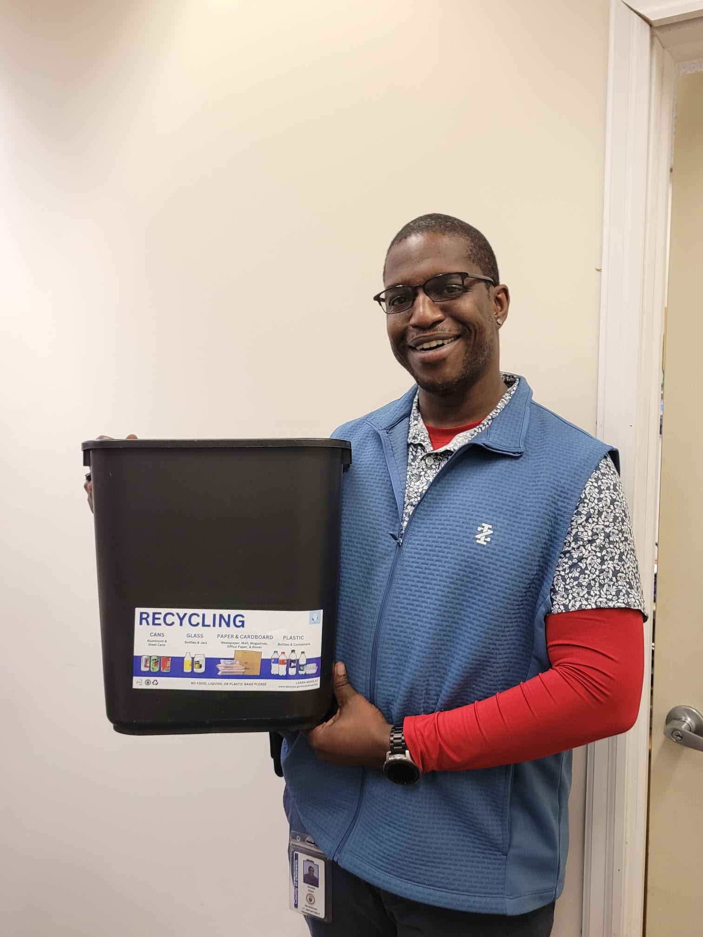
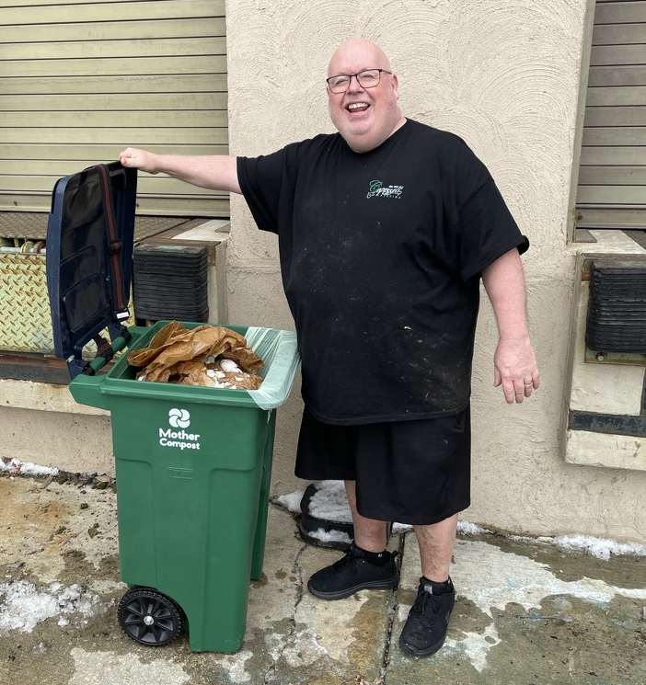
Year-End Zero Waste Totals
940+
Deskside Bins Converted to Recycling through Recycling Standardization Project
14,000
Pounds of Organics Composted by Capozzoli’s
2,000+
Items swapped between County Employees at Spring/Fall Events
&
5 Boxes of Supplies Donated to Teachers’ Teammates
500+
Ink and Toner Cartridges Recycled through HP and Staples
2025

Slide 13
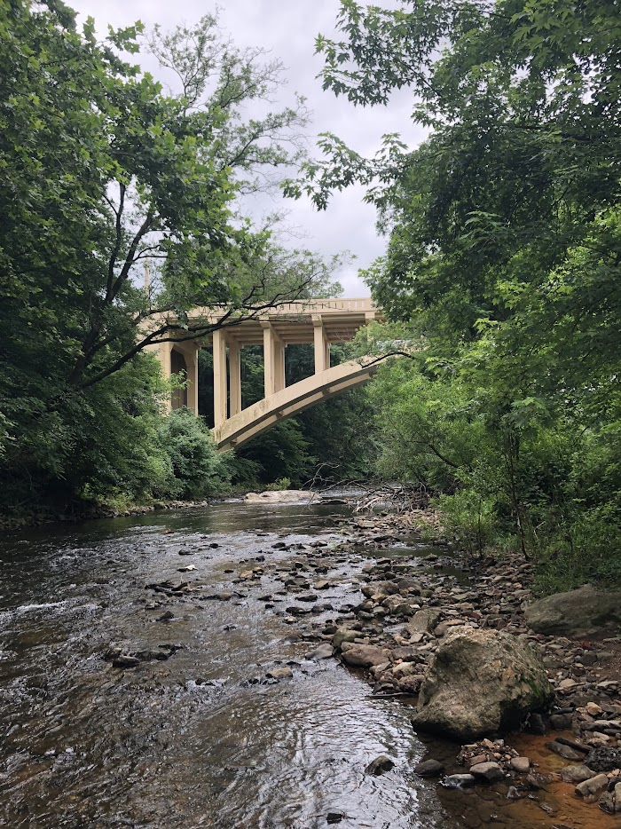
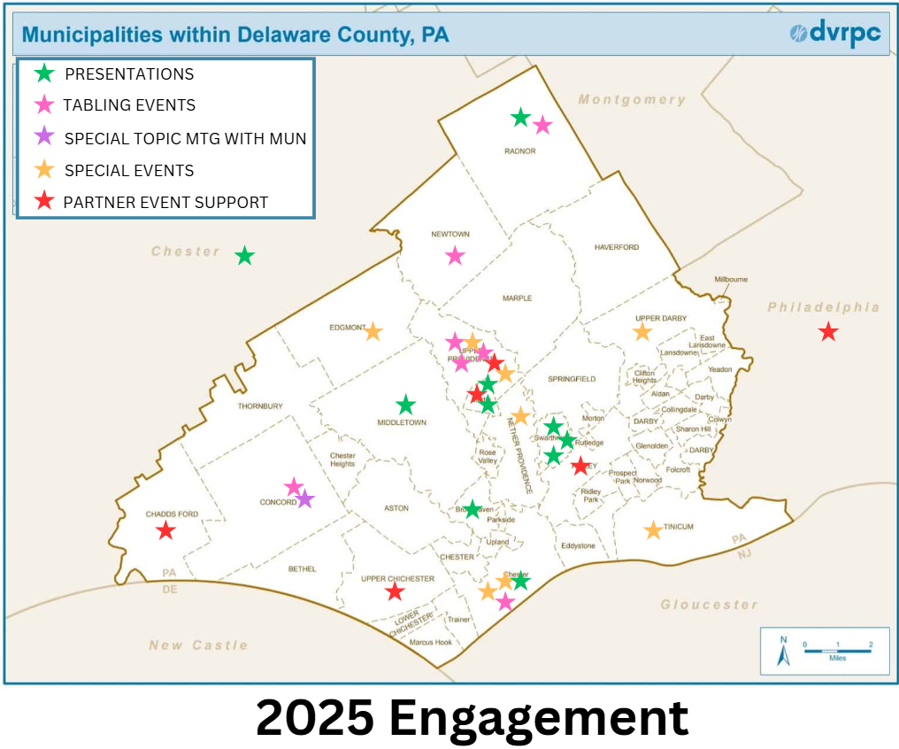
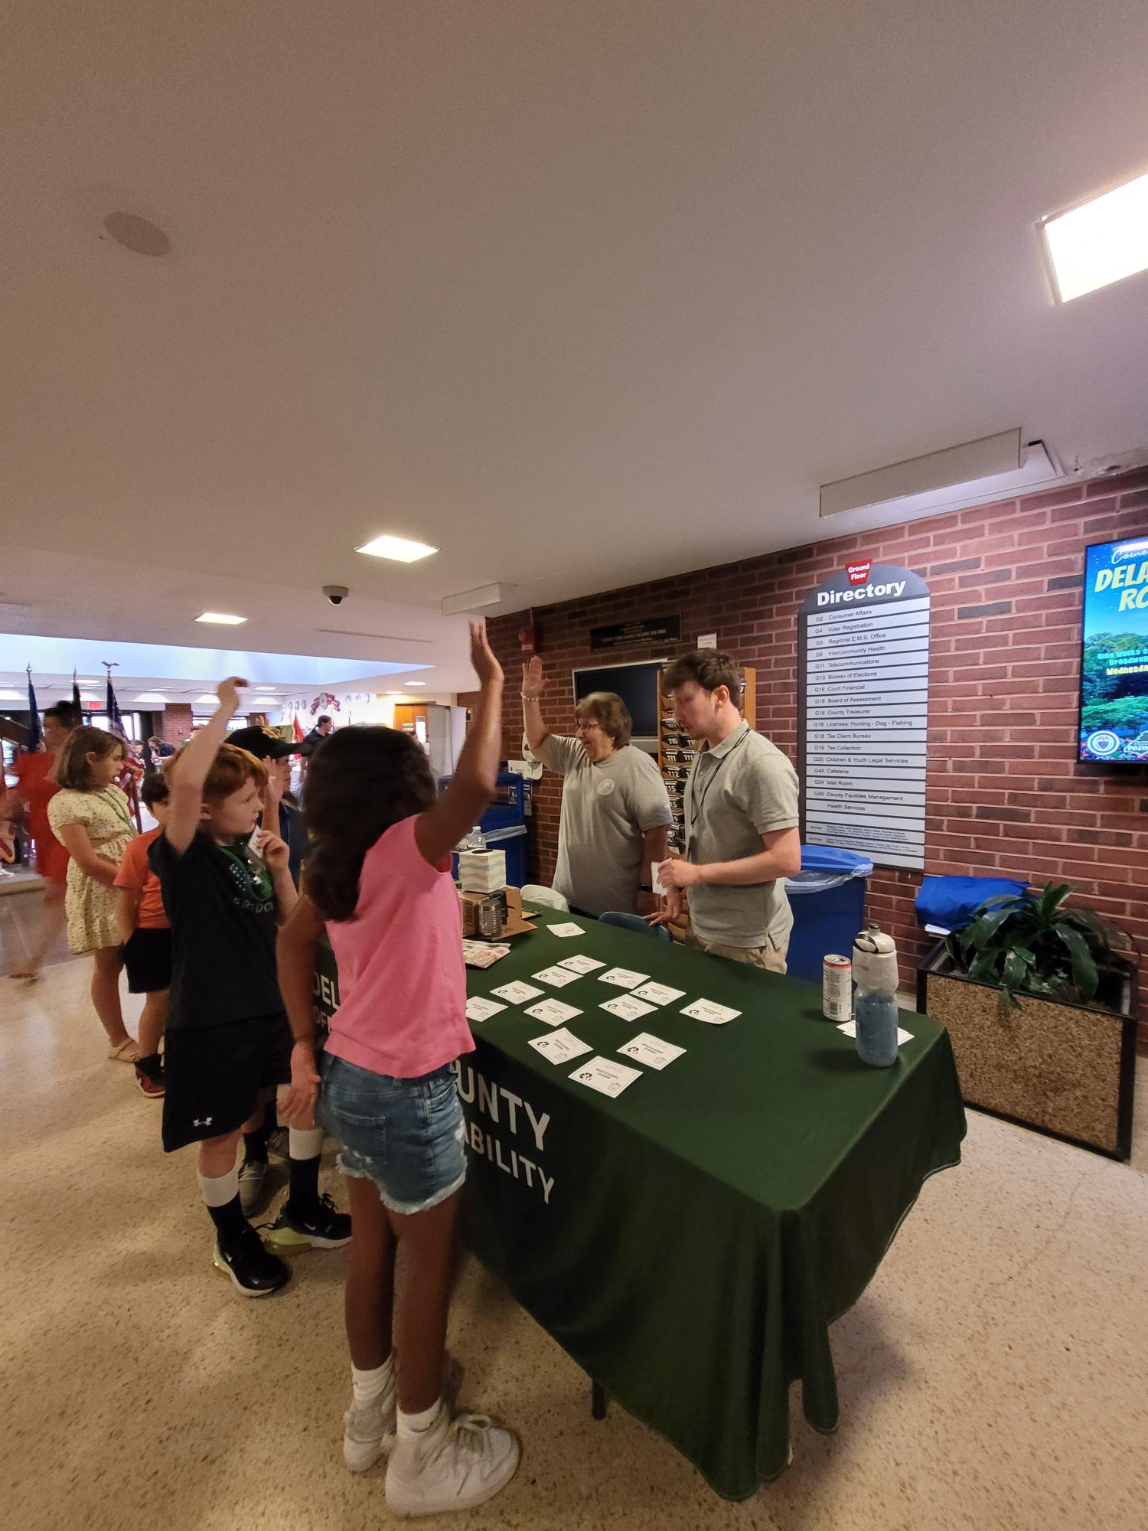
Education & Outreach
31+ Presentations and events supporting the community
Events in 17 Delco Municipalities
2025
Notes:
EACs, Rotary Clubs, Religious Organizations, Universities, and Community Groups
Recycling Events, Conference Activities, Clean Ups, and Plantings
Public Meetings and Testimony, Workshops, Annual Planning Meetings, and More

Slide 14
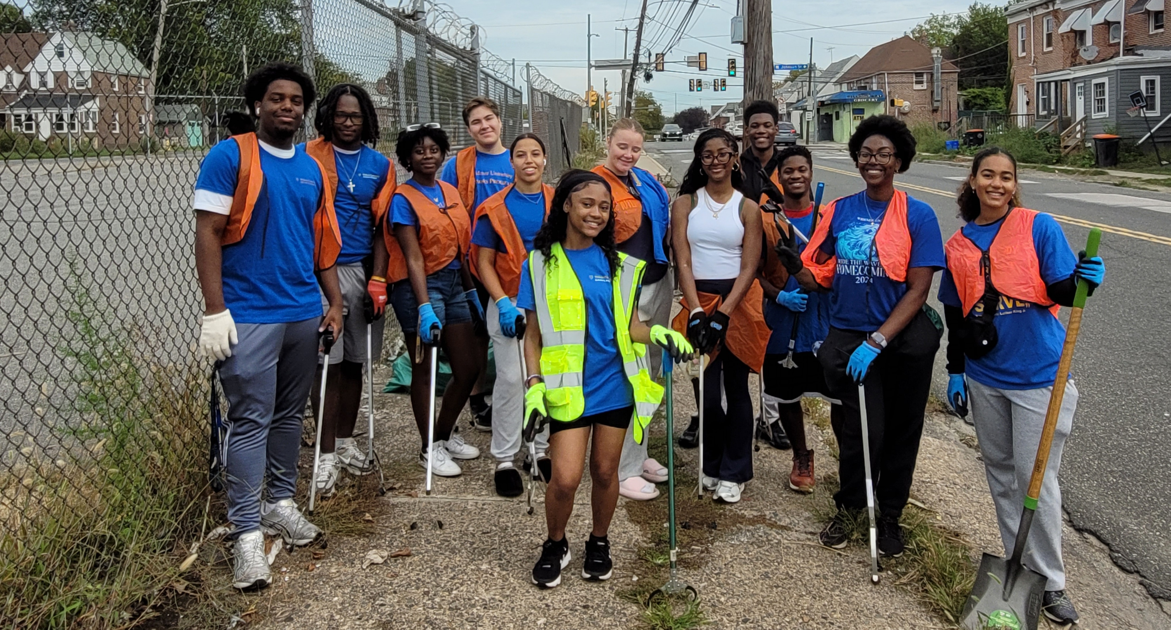
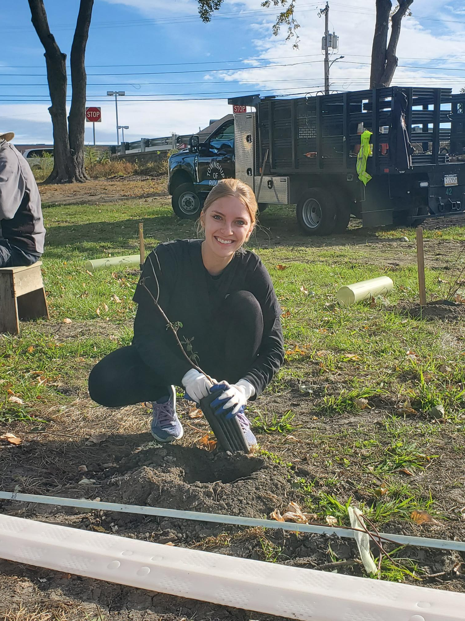
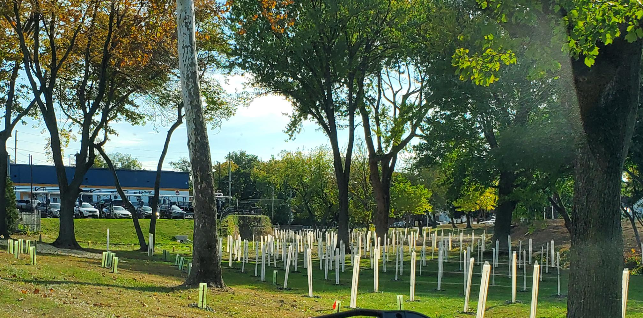
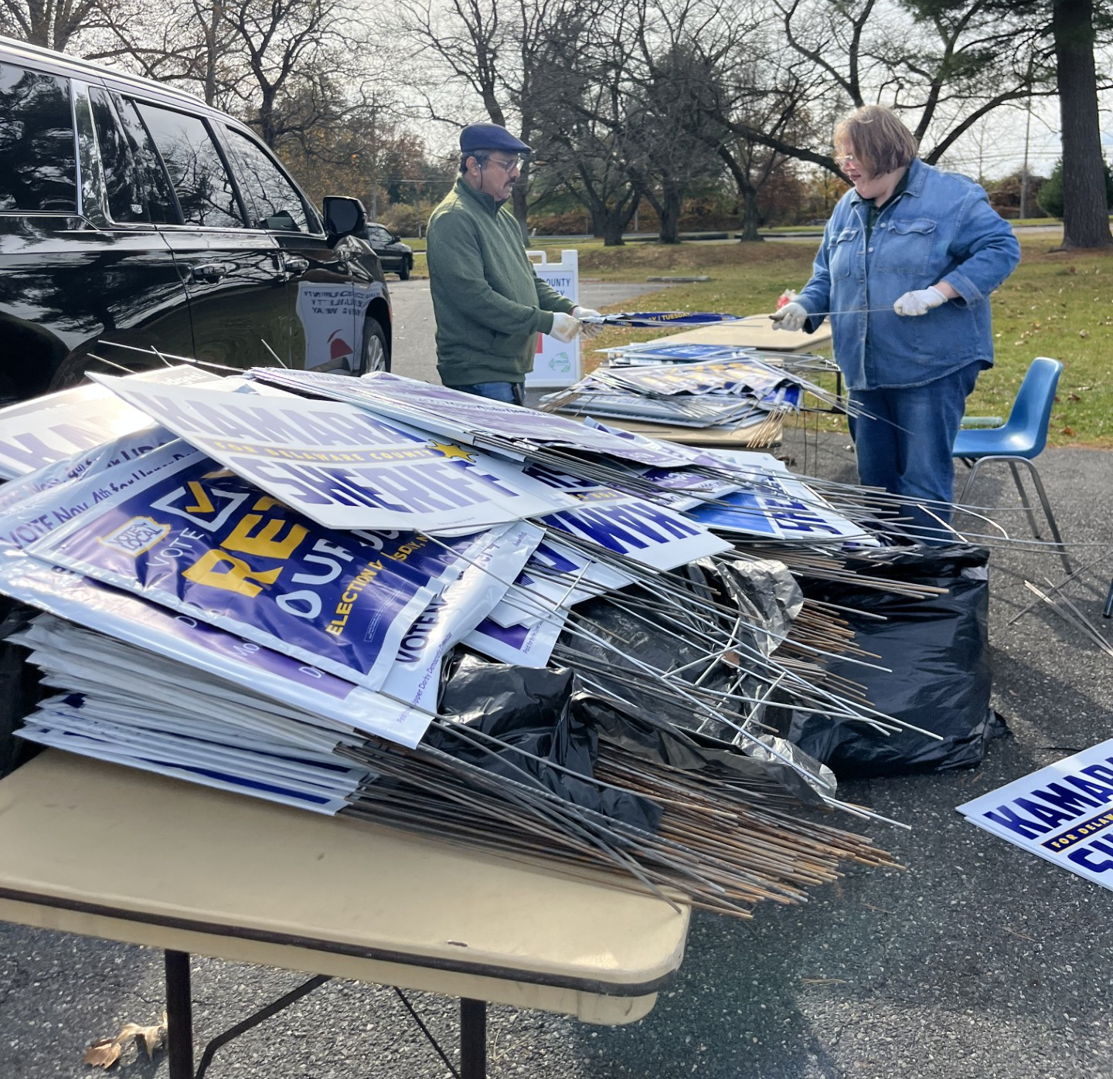
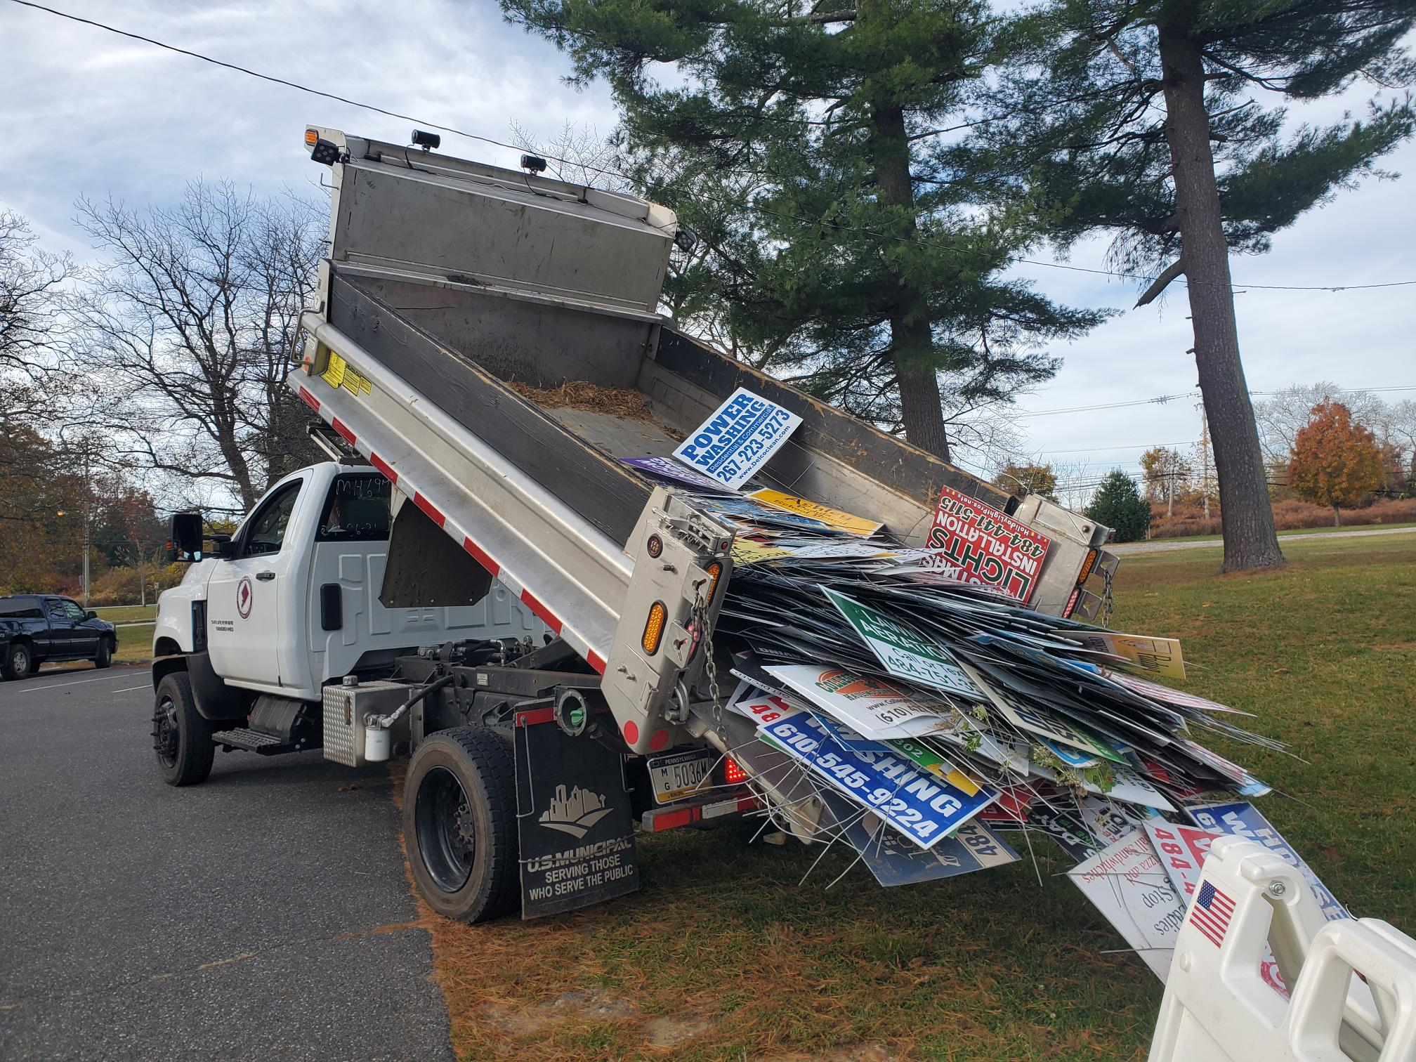

Community Beautification
Keep Delco Beautiful Partners with Chester City Wide Clean Up & Delco 10- Miler
500+ Trees and Shrubs planted in Ridley at Conservation District Tree Planting
5,100 Lbs of Campaign Signs Recycled
2025
Notes:
New partnership with Bureau of Elections for Campaign Sign Recycling

Slide 15
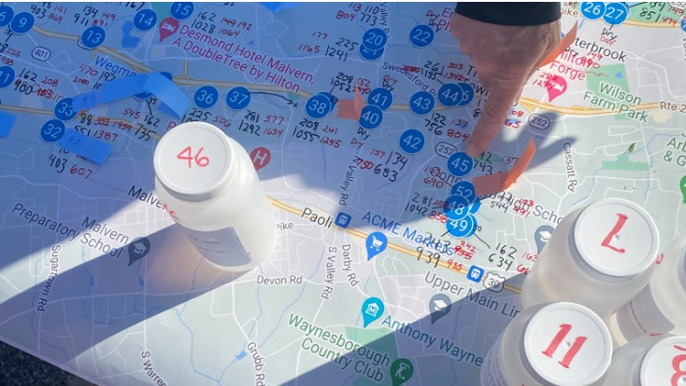
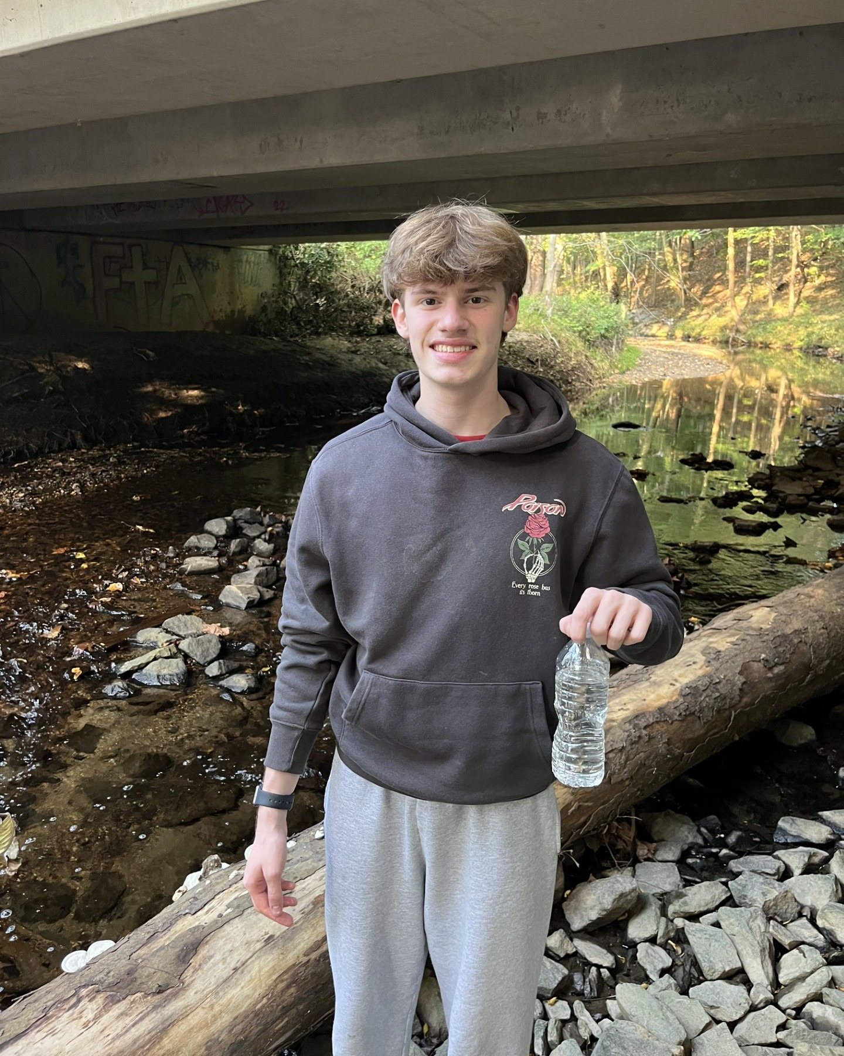
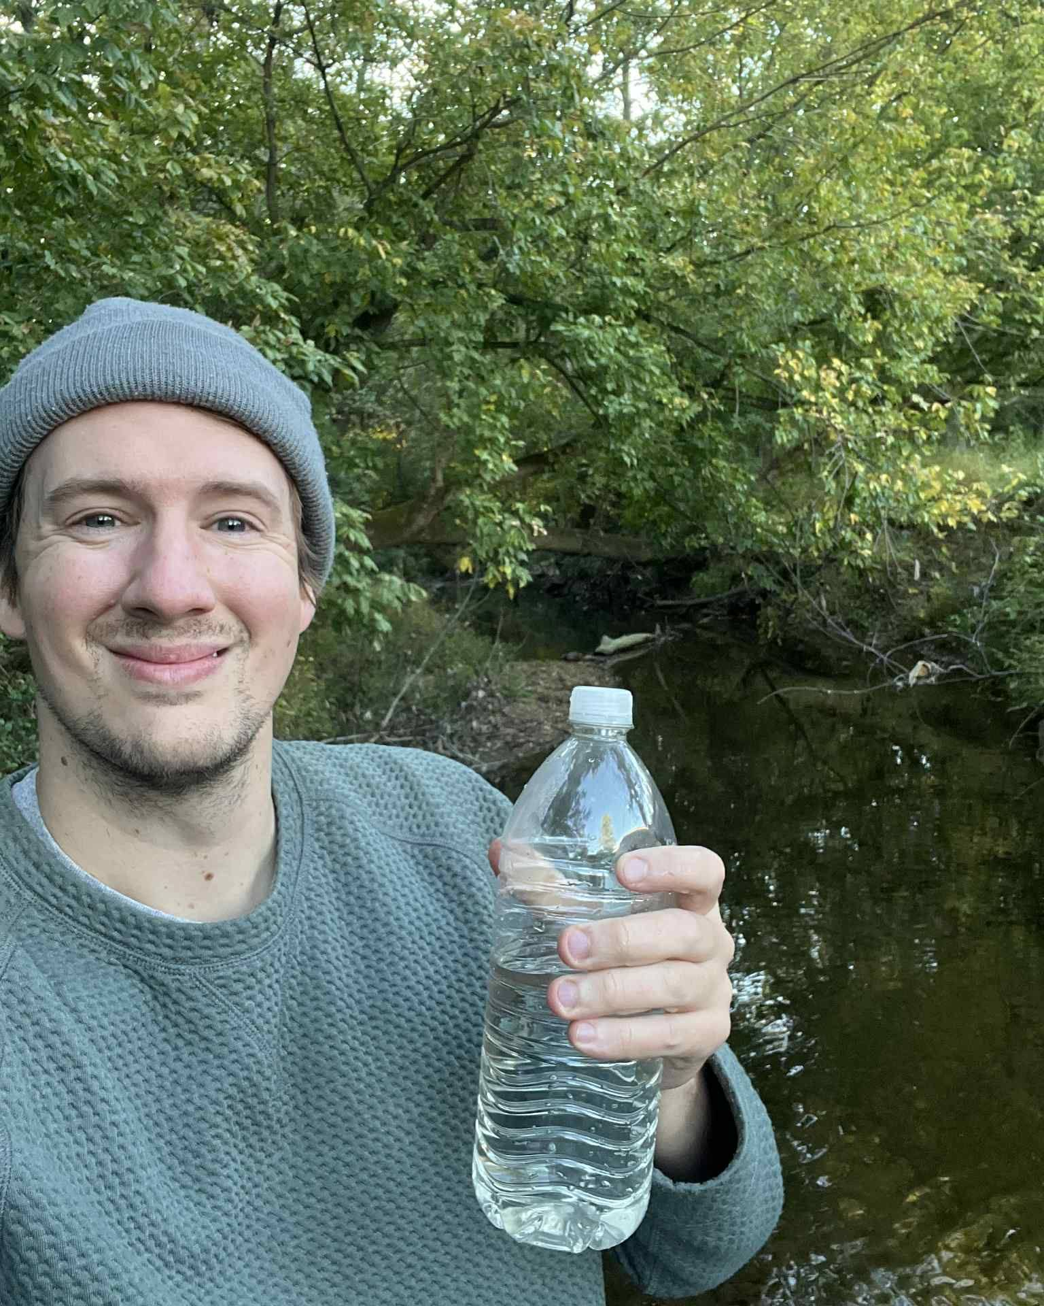
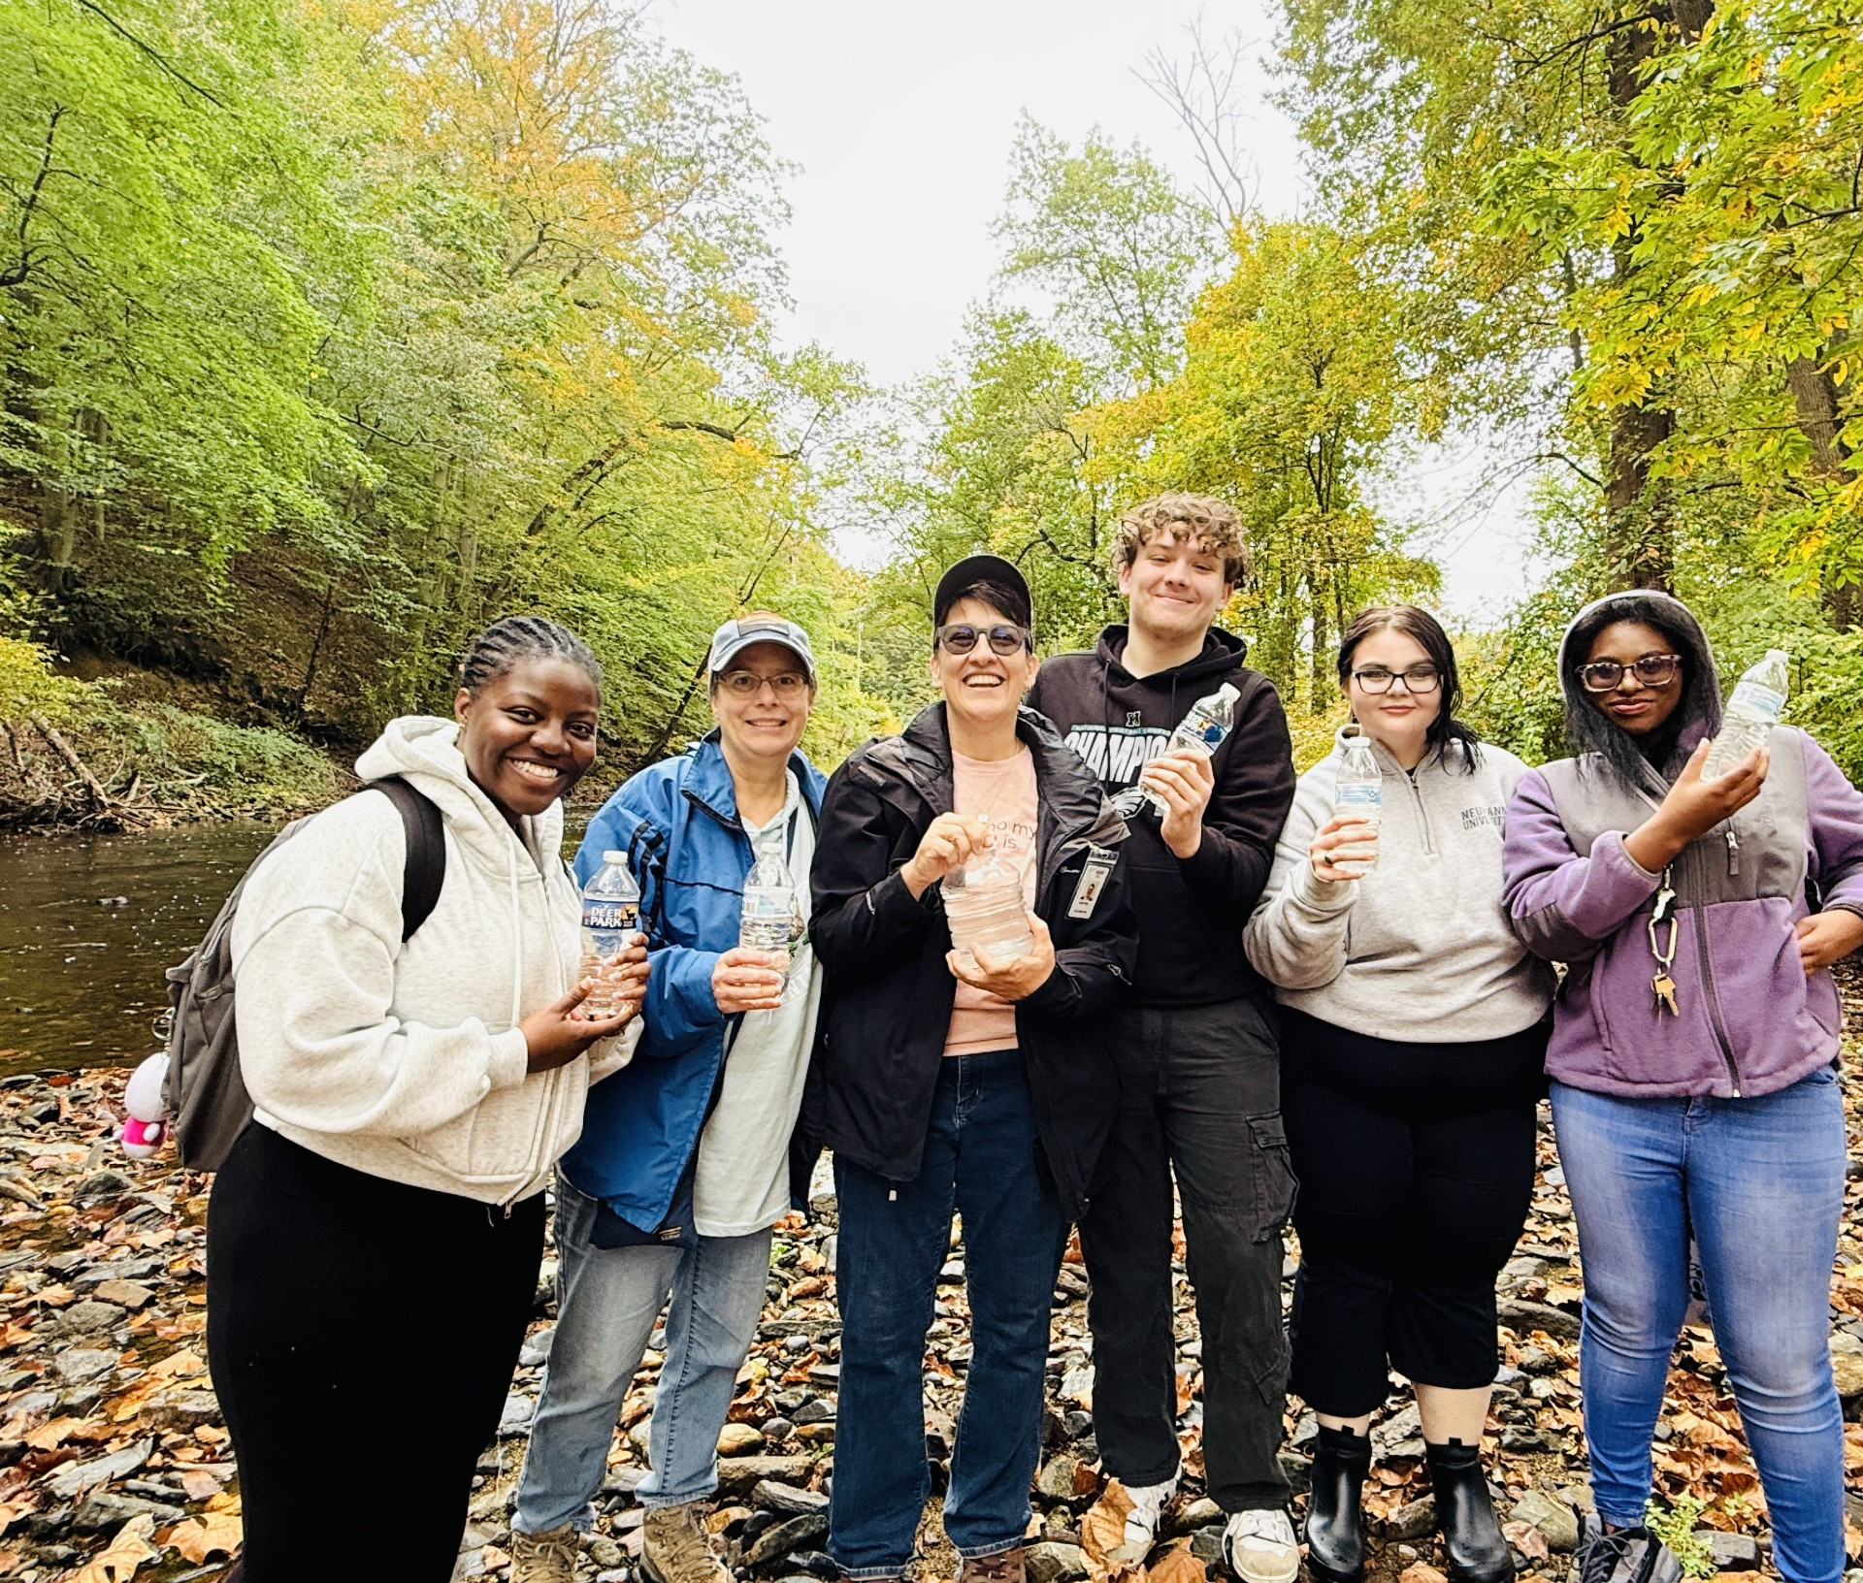
New to 2025 - Salt Snapshots
Fall Salt Snapshot – Creek Sampling Effort to better understand the long-term impacts of winter salt usage led by Stroud Water Research Center
175 sites+ tested in Delaware County
Partnered with 17+ local organizations
Partnership on-going for 2026 Winter Salt Snapshot and beyond
2025
Notes:
In 2024 - Less than 40 sites in Delco
Colleges/Universities
Arboretums
Land Trusts
EACs
Penn State Extension Programs

Slide 16
Welcome 2026!

Slide 17
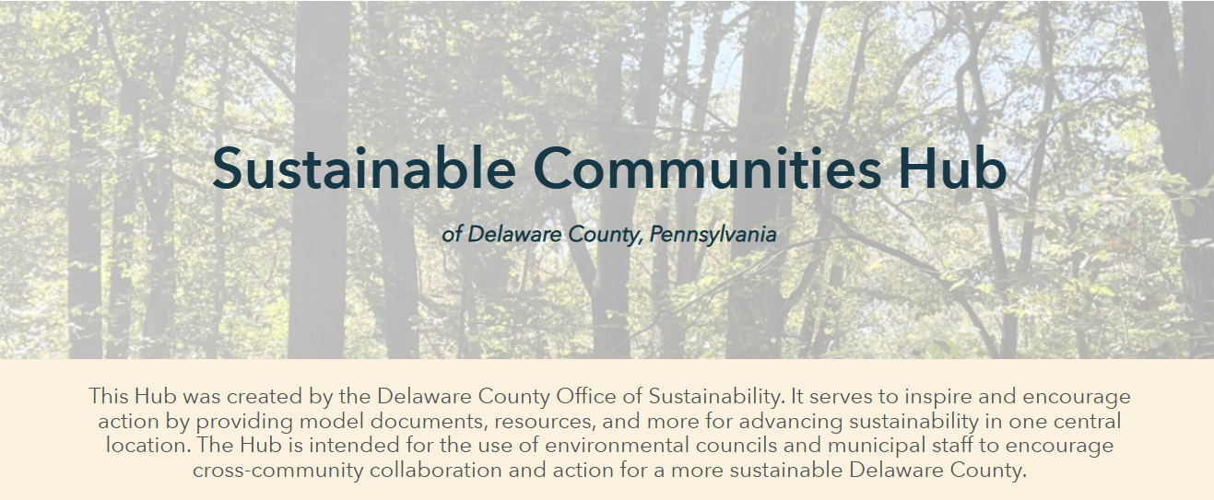

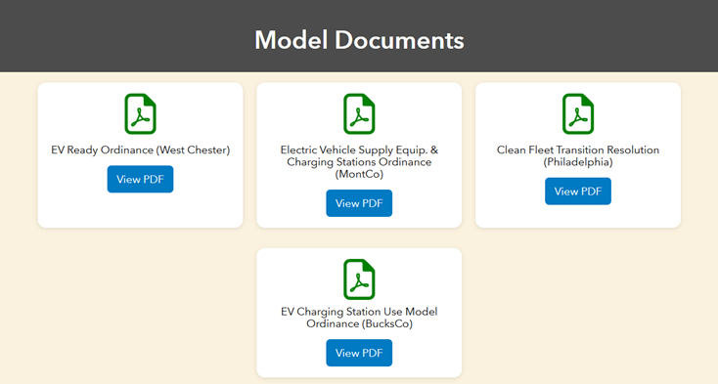

Sustainable Communities Hub
www.delcopa.gov/sustainability
Online Repository of Resources for Municipal Implementation
Organized to align with Sustain Delco Focus Areas
Over 100+ Model Documents, Educational Resources, and Tools
Low, Mid, and High recommended actions for each section
2026

Slide 18
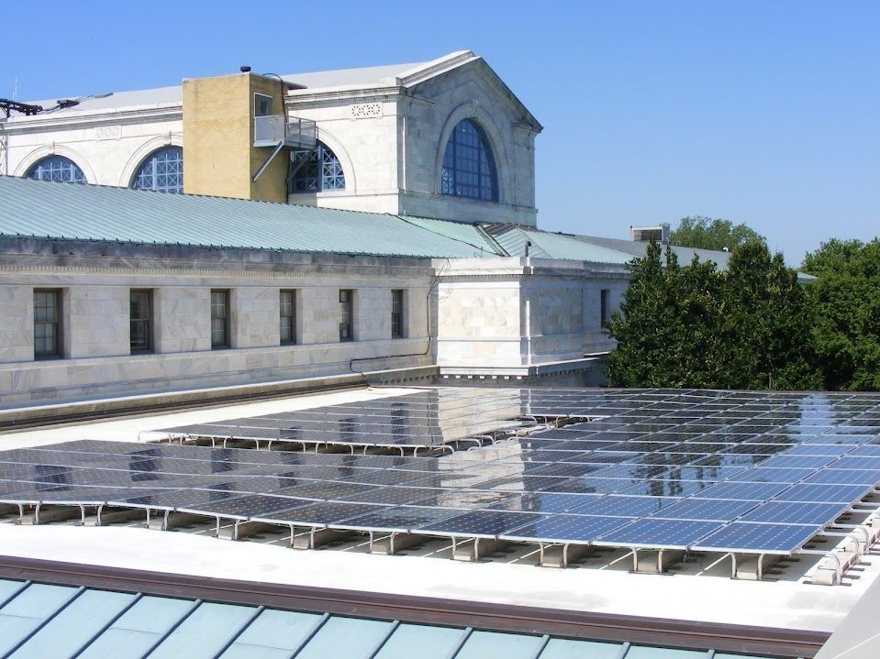
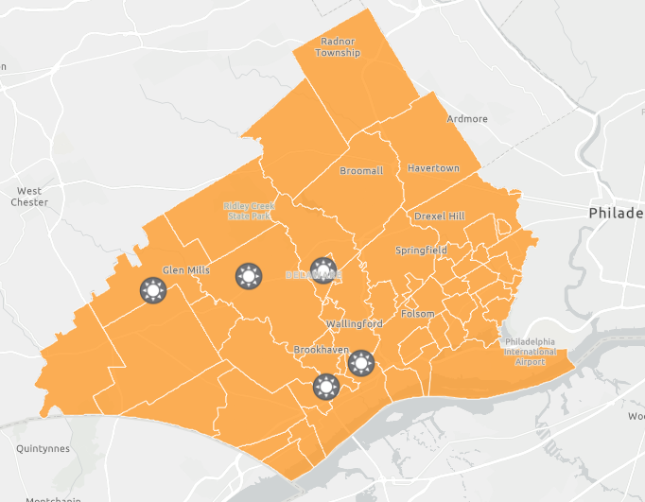
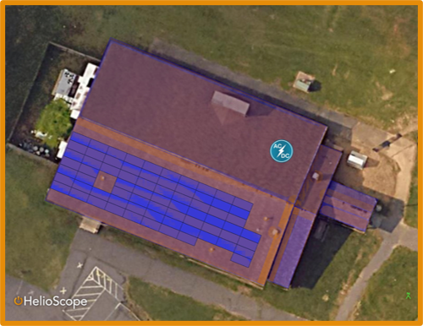
Sustainability in County Buildings
Evaluating Solar Opportunities on County Properties
Grant-Funded LED Replacement and Submetering in Government Center
Finalizing Recycling Standardization Report – State of Waste/Recycling in County Buildings
Benchmarking Electricity Bills
2026
Notes:
before Federal Tax Incentives Expire – Direct Pay and Power Purchasing Agreements
Government Center Recycling Revamp with Facilities
Building Trust in the System – Touring Republic with County Leadership
Partnering with Facilities Department for Implementation
Tri-Lingual Custodial Training – English, Vietnamese, French (Creole)
Upgraded Equipment and Cheat Sheet for Each Cart
All Staff Lunch and Learn (Resources on Intranet)
Cost Effective Implementation (Decals vs New Bins)
Toner Recycling with IT
Refunds and Rewards through vendors
Earth Day Supply Swap
Items from 5 Departments
Swapped 1,500+ Items – Folders, Clips, Paperclips, Desk Organizers
22 Offices Participated
SEPSPA Renewable Energy Purchasing with Neighboring Counties
Adoption of Joint Renewable Energy Strategy
First Block Purchases in New Structure
Off-Hours Lighting Reductions with Facilities
Adjusting Lighting Programs to Reflect Times in Buildings
EV Charging Study through PA Shared Energy Manager Program with Public Works
Free Engineering Services through Wilson Engineering
Composting in Capozzoli’s Courthouse Café – 7.4 TONS in 2024
Solar Panel Recycling
Staff Questions and Assurances

Slide 19

Education and Outreach
5 Community Presentations
Springfield Lion’s Club – 2/24
Delaware County Consortium of Governments – 2/24
Darby Creek Valley Association – 2/21
Chester Residents Concerned for Quality Living – 3/7
Delaware County Sustainability Conference - 3/13
Earth Day Celebration – Saturday, April 18th - 11 AM – 2 PM – Rose Tree Park
2026

Slide 20


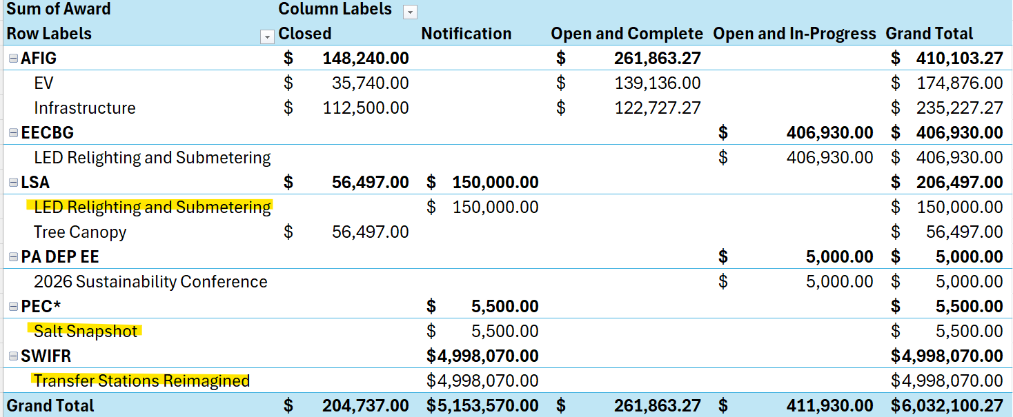
Economic Sustainability
*7 Open Grants in 2025
*3 New Awards in 2026

Slide 21
How to Get Involved!
Join Us For Community Events!
Earth Day Celebration – Saturday, April 18th in Rose Tree Park
Campaign Sign Recycling – May 29th & 30th in Rose Tree Park
Explore County Resources and Bring Back to Your Organizations or Communities for Implementation!
Sustainable Communities Hub
Sustain Delco Plan
Zero Waste Plan
Tree Canopy Study
Take the Positive Momentum from today and go make a change!
2026

Slide 22
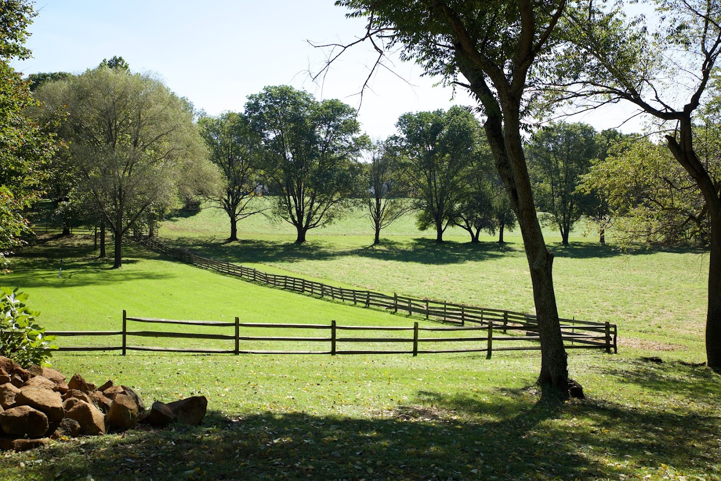
Rebecca Yurkovich
County Sustainability Officer
Delaware County Office of Sustainability
Media, PA 19063
yurkovichr@co.delaware.pa.us
Cell: (484) 846-2075
www.delcopa.gov/sustainability

