Slide 1


Slide 2

Data Centers at the local level
Anneke L.W. van Rossum
Advocacy & advancement coordinator – Delaware riverkeeper network
215-369-1188 ext 106
Anneke@delawareriverkeeper.org

Slide 3



Demand for land
In 2024 avg data center site covered approx. 224 acres or 0.35 sq miles (1)
  A 144% increase since 2022
Rezoning land
Contorting existing zoning rules
(1) https://www.techtarget.com/searchdatacenter/feature/The-increasing-concern-of-data-center-land-acquisition

Slide 4
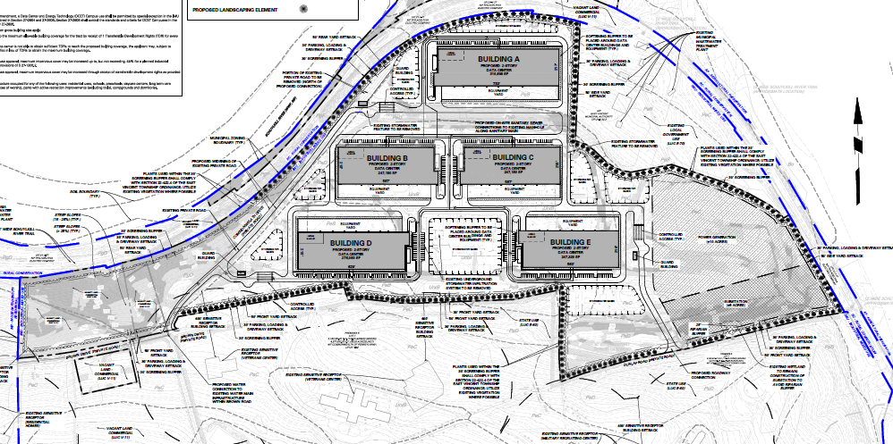
What does a data center look like

Slide 5

Water
Water for data centers is primarily used for cooling.
  PA seen as water rich
May use municipal sources, wells, or claim closed loop systems.
  Closed loop systems are not as simple as sold to be.
Other state residents have had the water to their homes impacted
Water impacted by the fossil fuels powering data centers as well
We have entered, as a world, water bankruptcy

Slide 6

Air and Noise
Data Centers claim between 55-96 dcb depending.
Constant exposure to even low levels of noise can have impacts on not just one’s enjoyment of life and property, but disrupt their sleep, increase stress, and raise the risk of cardiovascular disease.
30 dcb is enough to disturb sleep
Natural gas and diesel generators
  VOCs
  Carbon Monoxide
  Nitrogen Oxides
Due to the hazardous air pollutants, data centers in the U.S. may contribute to almost 1,300 deaths annually by 2030. Additionally, the growing demand for AI could contribute to approximately 600,000 asthma symptom cases.

Slide 7

What Can You do?
Get connected with your community
Stay up to date on Board of Supervisors, Planning Commission, Zoning Commission meetings
Show up and comment
Become a member or connect into nonprofits
bit.ly/DataCentersDRN

Slide 8
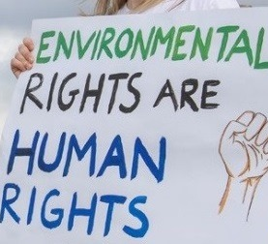
YOU HAVE a constitutional right
Article I Section 27 of the Pennsylvania constitution:
The people have a right to clean air, pure water, and to the preservation of the natural, scenic, historic and esthetic values of the environment. Pennsylvania's public natural resources are the common property of all the people, including generations yet to come. As trustee of these resources, the Commonwealth shall conserve and maintain them for the benefit of all the people.

Slide 9
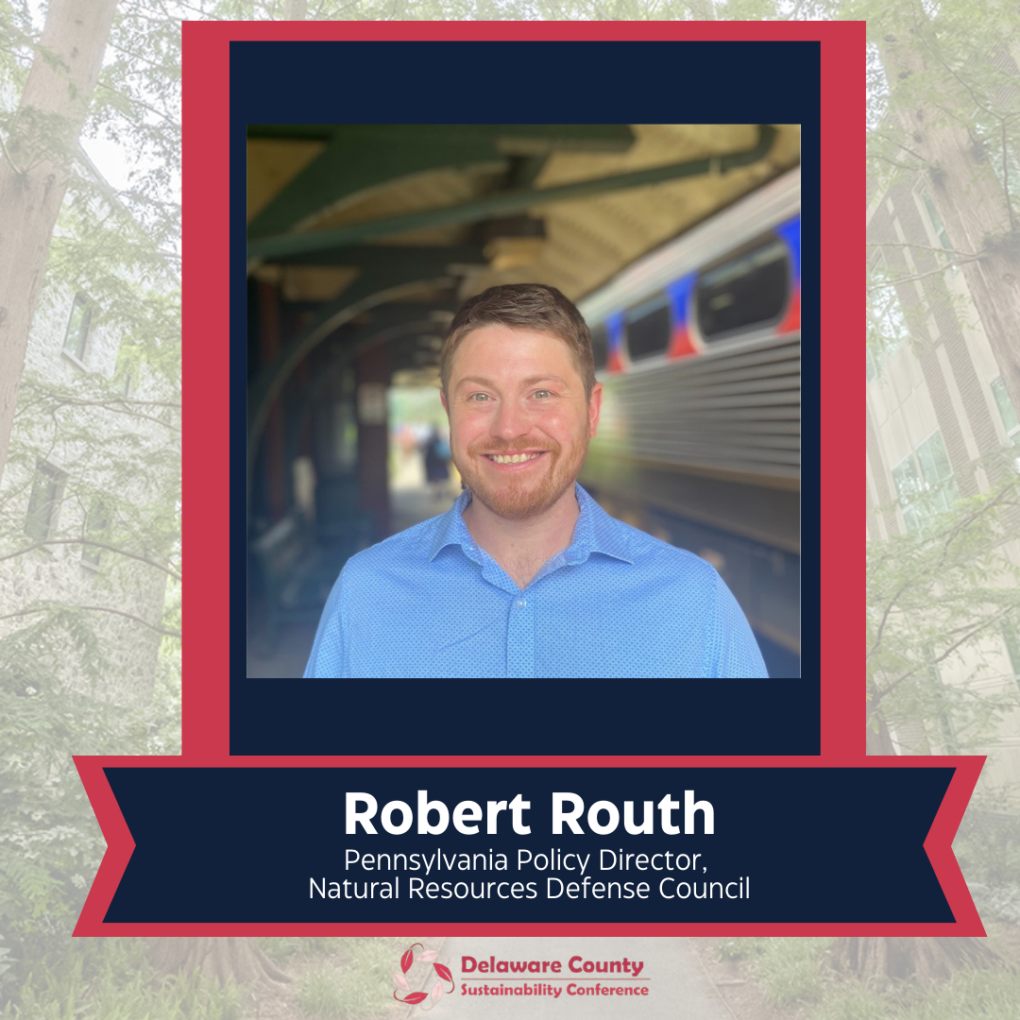

Slide 10
Data Centers: Climate and Environmental Considerations
PA Delaware County Sustainability Conference March 13, 2026

Slide 11

1
Context
Historical load growth vs. current projections of data center demand
Growth is coming faster, larger, and more concentrated than expected, overwhelming key data center markets

Slide 12
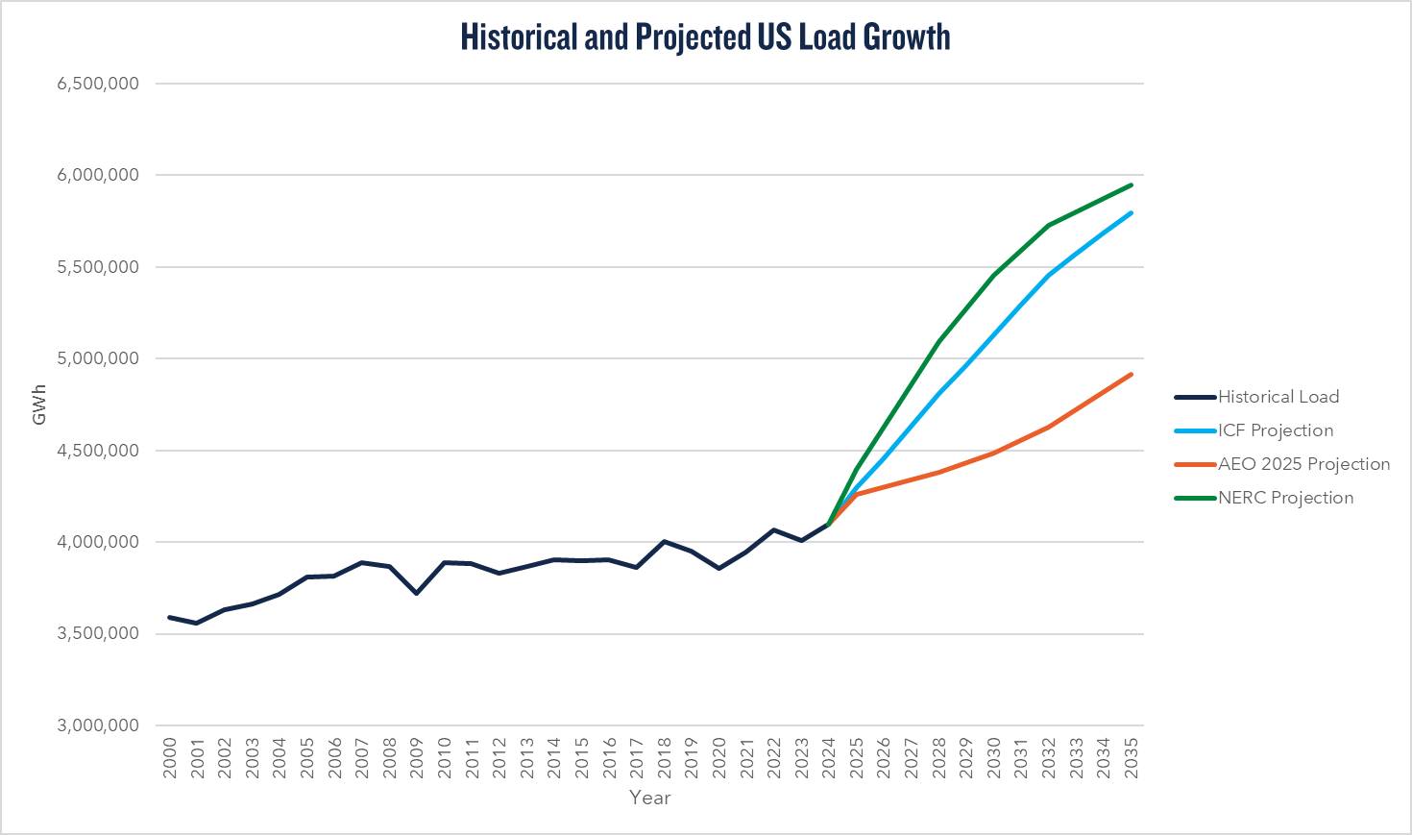
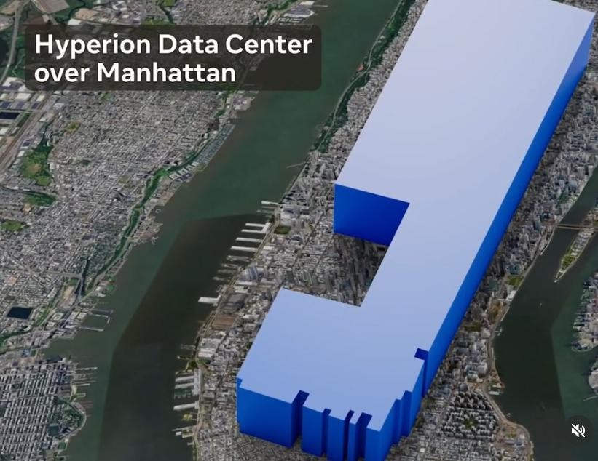
Load Growth: National Context
Source: NRDC (data from EIA, ICF, AEO, NERC)

Slide 13
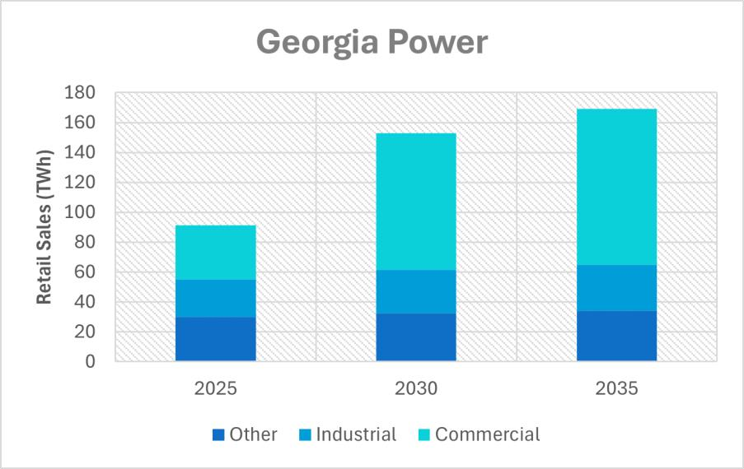
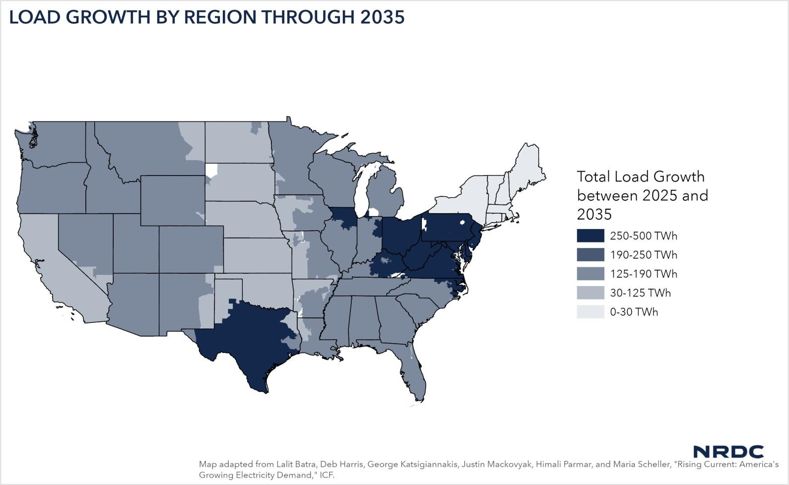
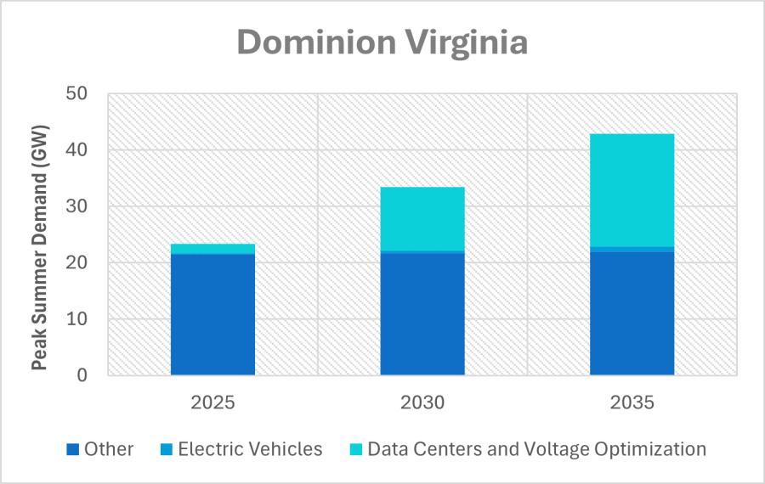
Growth is Highly Concentrated

Slide 14

State-Level Data Center Growth
7,000
6,000
5,000
4,000
3,000
2,000
,000
0
0, 86
Sunner Peak (MW)
7,573
57
378
656
80
2025
2030
Year
PPL PECO
2035
Leased Data Center
Hyperscaler
Crypto
S&P Global Capital IQ Data Center Database
2025 PJM Long Term Forecast

Slide 15
What's at Risk?
2
The worst case
Data centers will pose unchecked risks to grid reliability
Electricity costs for everyone will rise for decades
Fossil fuels are given a new life, locking in emissions and blowing a hole in state climate targets

Slide 16
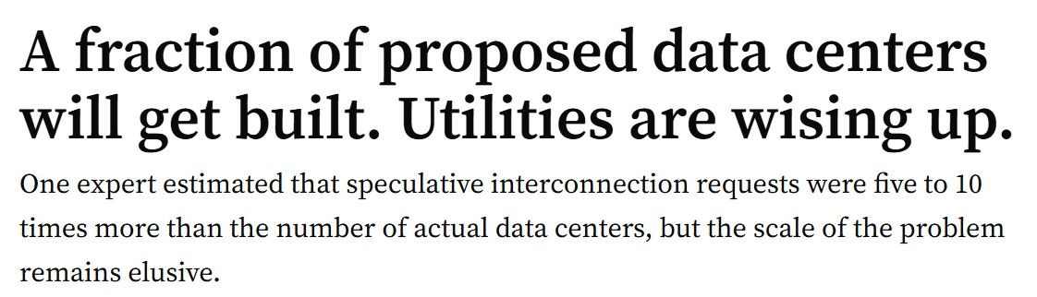
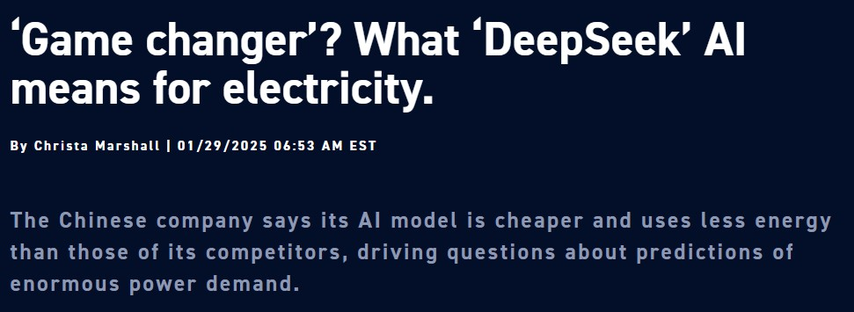
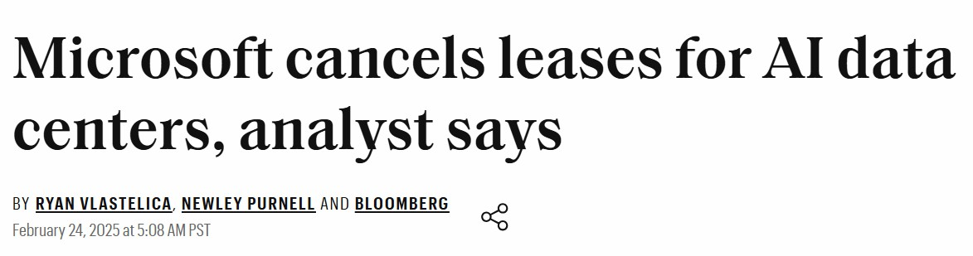
Affordability at Risk
Uncertainty in near-and long-term demand forecasts coupled with the highly risky nature of data center developments threatens affordability.
PA customers could see higher bills due to:
Stranded costs from overbuilt
infrastructure
Cost shifts in the absence of fair ratemaking (large load tariffs)
•
Volatile energy and capacity markets

Slide 17
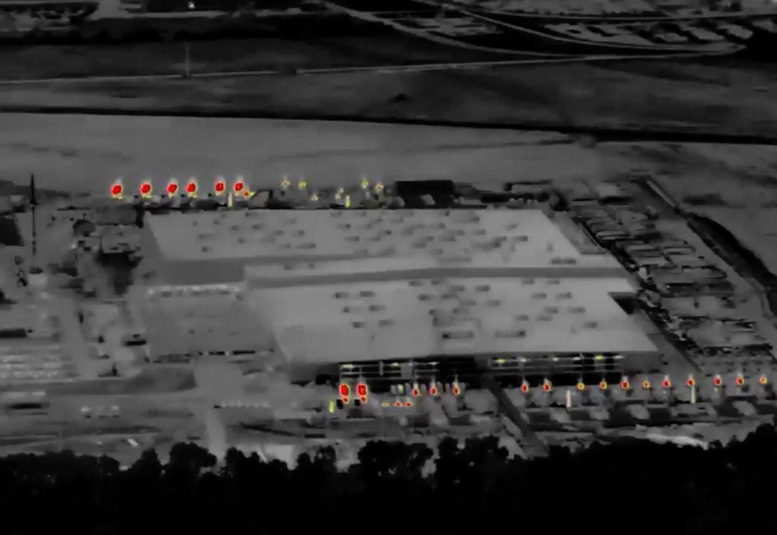
Climate Targets at Risk
Concerning national trends in the face of surging demand:
Increased reliance on existing fossil fuels
Buildout of new gas
Delayed retirements of coal and gas plants
Existing carbon free energy cannibalized by data centers
Data centers in PJM could cause an additional 1,014 million tons of CO2 from 2025-2040 and raise residential bills by 10% (Synapse, Sierra Club)
Musk Data Center Powered by 35
Unpermitted Gas Turbines, CNN

Slide 18

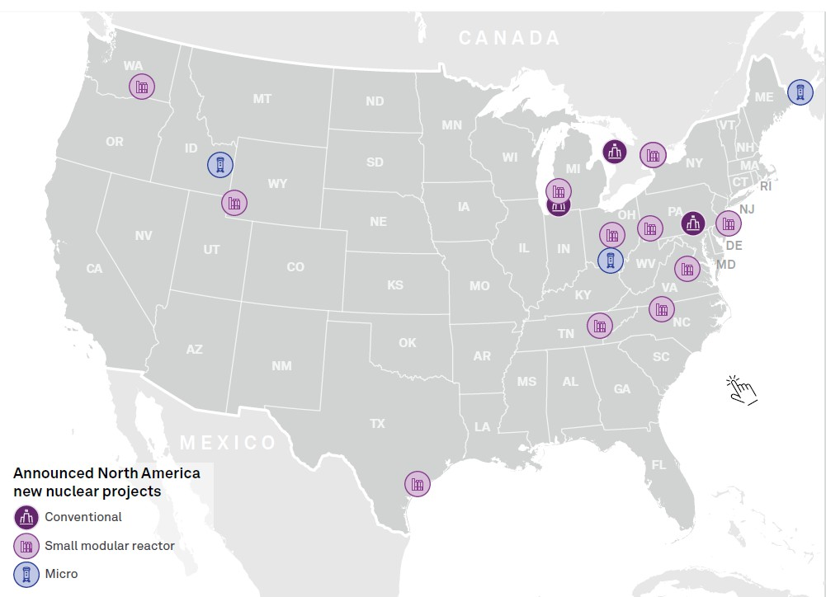
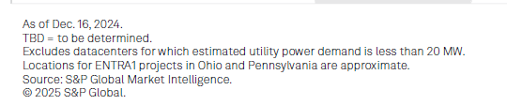
Announced Nuclear Projects
Conventional Nuclear in PA
Amazon’s Colossus campus collocated
with Talen’s Susquehanna plant
Microsoft set to restart the Three Mile Island Unit 1 Reactor potentially by 2027
Advanced Nuclear
Google & 500 MW Kairos advanced
nuclear reactor fleet by 2035
Amazon plans to bring 600 MW of SMRs through X-energy in WA and VA, and is partnered with Talen to explore SMR development in PA

Slide 19
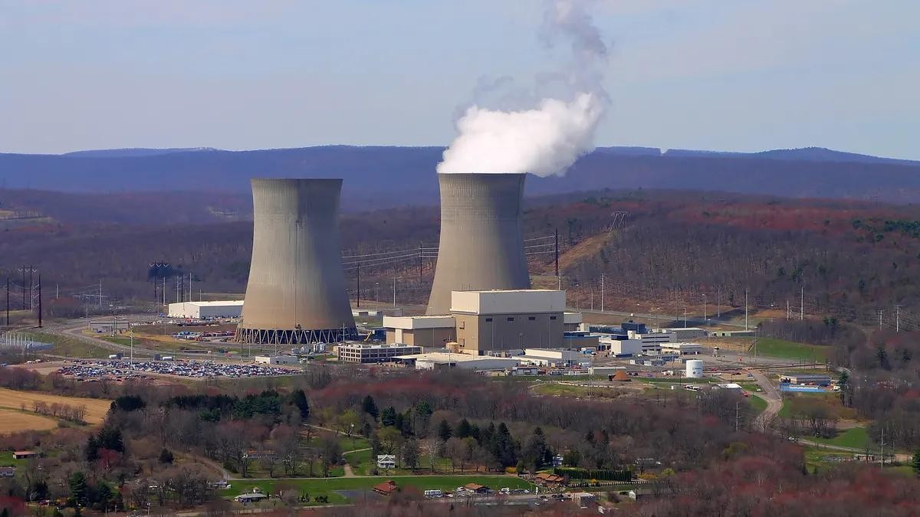
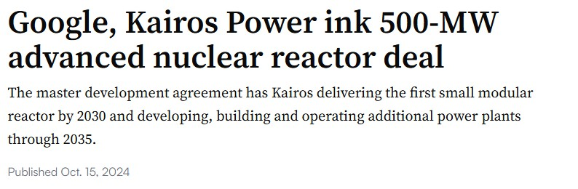
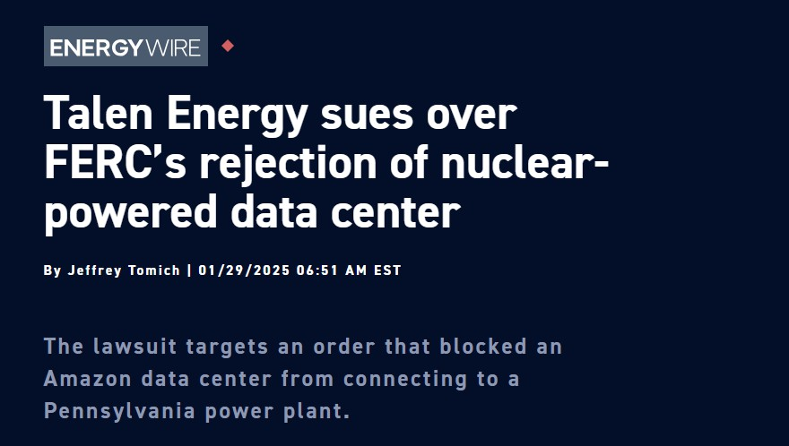
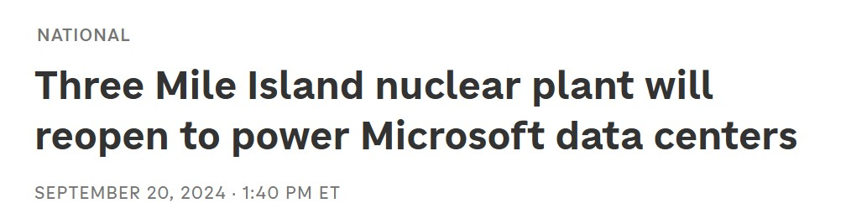

Slide 20
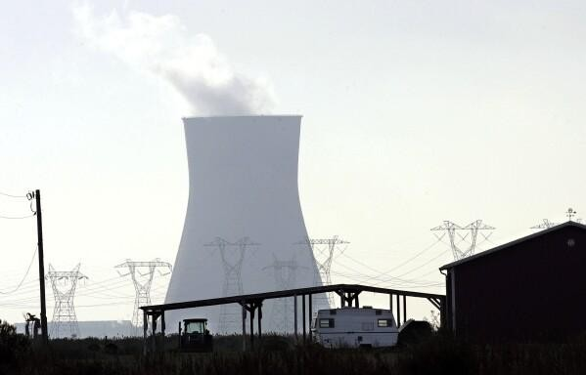
Existing Nuclear + Data Centers
93 GW in PJM, MISO, NYISO, ISO-NE
If even half go BTM, could result in over 155 million tons CO2 annually
Importance of additionality
PSEG nuclear plant in New Jersey

Slide 21
States Should Race to the Top, Not the Bottom
3
Strong consumer protections built into large load tariffs
Clean energy, efficiency, and flexibility requirements

Slide 22
Steering Data Centers in the Right Direction
36 states have data center tax incentives, including PA.
The bar is on the floor for eligibility, requiring at least $100 million of
investments and 45 new jobs.
It takes 1-2 years to build a data center, but 5-8 years to connect one to the grid. Solutions which address this barrier are the same solutions which make the grid more connected, increase clean energy capacity, and drive down costs.
Better investments
GETs
Renewables + storage
Transmission
Improved planning
Speculative loads
Scenario based/
probabilistic modeling
Customer obligations
Technical requirements
Demand response
BYONCE

Slide 23
Consumer Protections
The collective baseline of load growth management should be data centers paying their fair share. The solution is to align real load with utility investments.
Elements of a Capacity Commitment Framework
Eligibility
Terms
Duration
Other
High initial fee
Collateral
Size threshold (25-50 MW)
Minimum bills
Exit fees
12+ year term
Ramp period
Resizing clauses
Economic dev. payments
Reporting
Flexibility
Data centers should also contribute funds to low-income assistance, weatherization, and/or energy efficiency programs.

Slide 24
Ongoing Policy Opportunities
PA General Assembly
HB 1834 (Matzie) – “Data Center
Act”
  House Energy Committee vote on Feb. 2, 2026
PJM
Critical Issue Fast Path (CIFP) –
Large Load Additions
  Reliability Backstop Auction (RBA)
  Expedited Interconnection Track (EIT)
PA PUC
Large load model tariff
  Comment period closed Dec. 22, 2025
FERC
Advanced Notice of Proposed Rulemaking (ANOPR) – Interconnection of Large Loads
  Final action expected by April 30, 2026

Slide 25

Robert M. Routh, Esq.
Pennsylvania Policy Director Climate & Energy
NRDC
rrouth@nrdc.org

