Slide 1
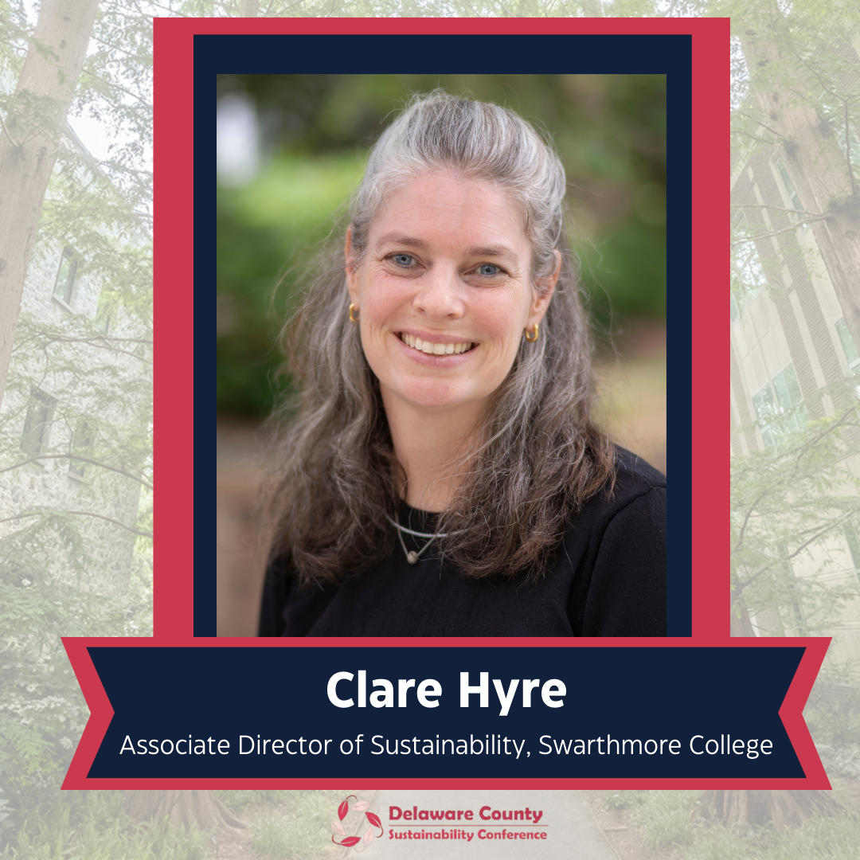

Slide 2
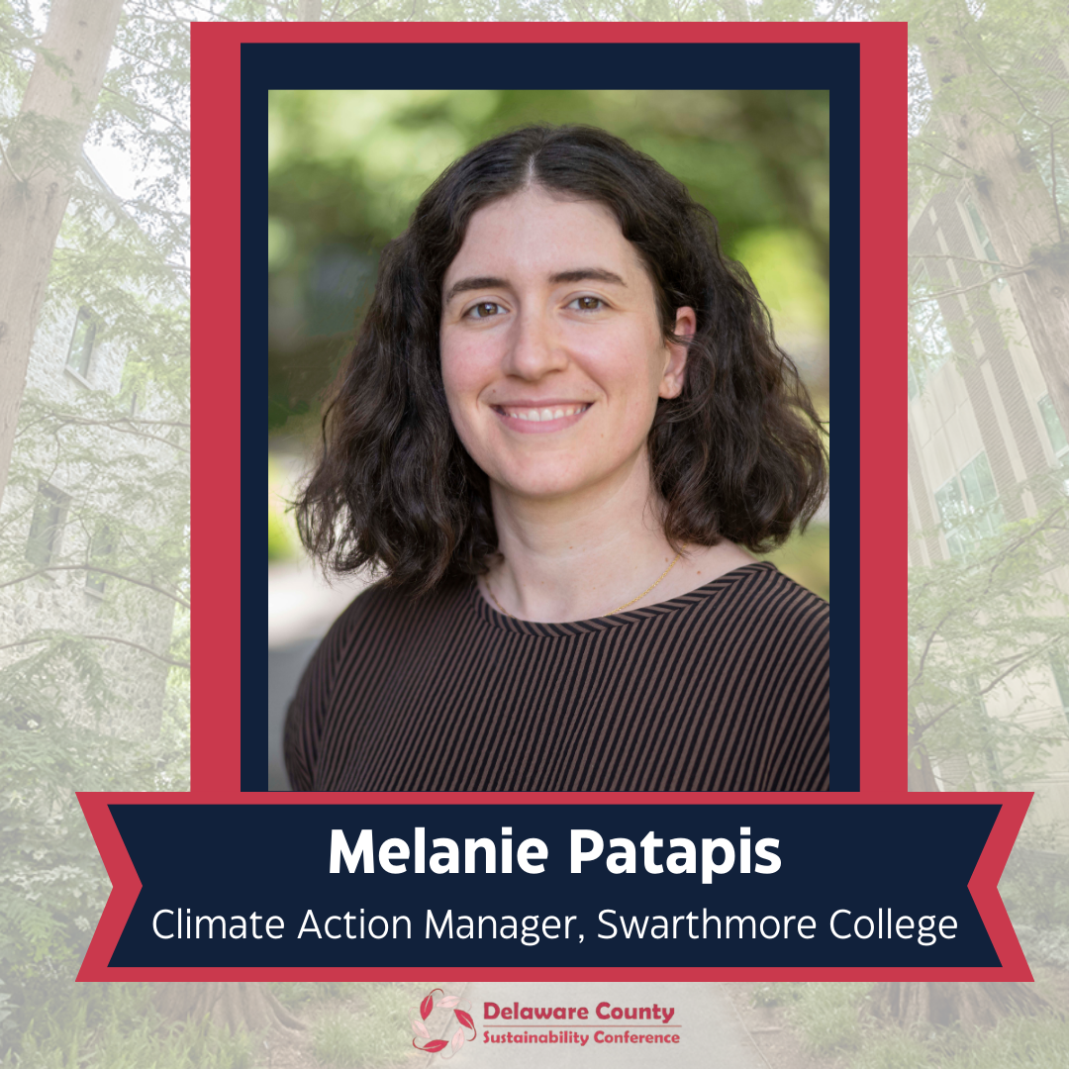

Slide 3


SUSTAINABILITY AT SWARTHMORE COLLEGE
5th Annual Delaware County Sustainability Conference
Swarthmore College
March 13th, 2026
Clare Hyre, Associate Director of Sustainability
Melanie Patapis, Climate Action Manager
Notes:
Melanie

Slide 4
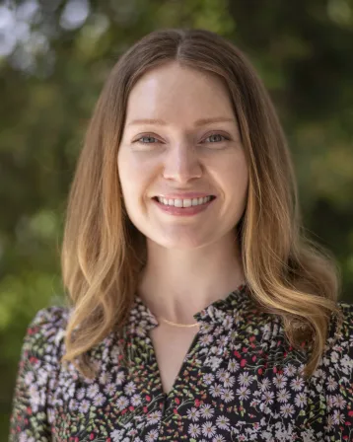
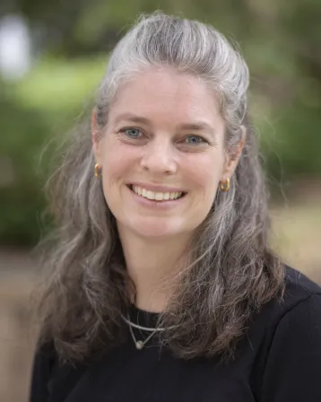
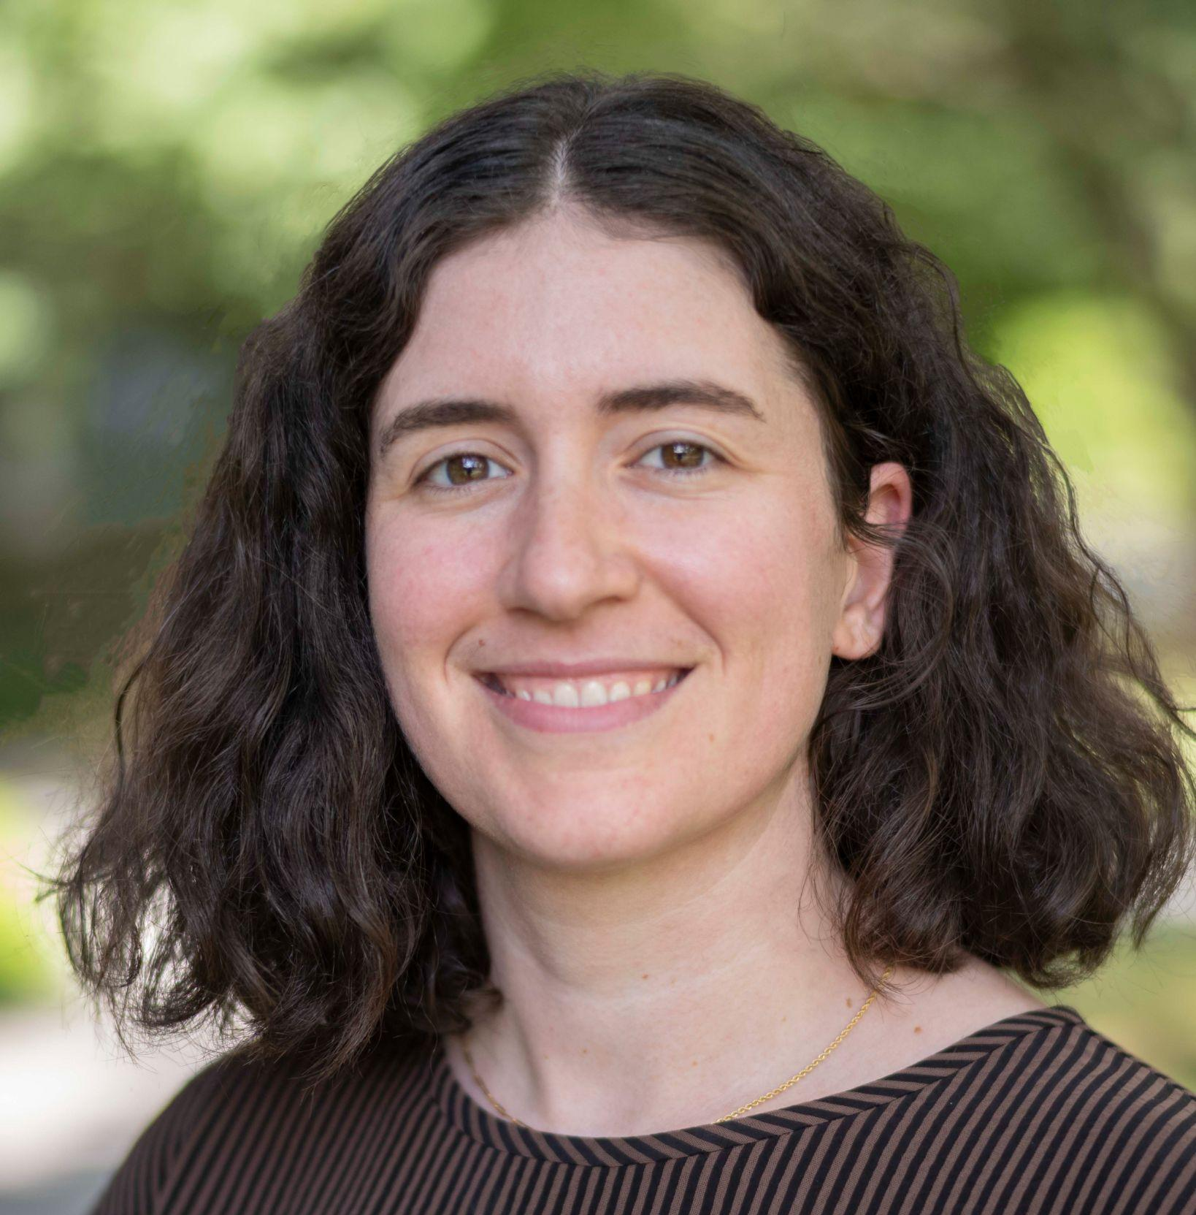
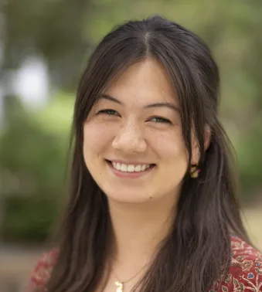
OFFICE OF SUSTAINABILITY SUSTAINABILITY STAFF
Elizabeth Drake
Assistant Vice President, Sustainability & Strategic Initiatives
Clare Hyre
Associate Director of Sustainability
Melanie Patapis Climate Action Manager
Juna Saito ‘25
Sustainability Fellow
Notes:
Clare

Slide 5
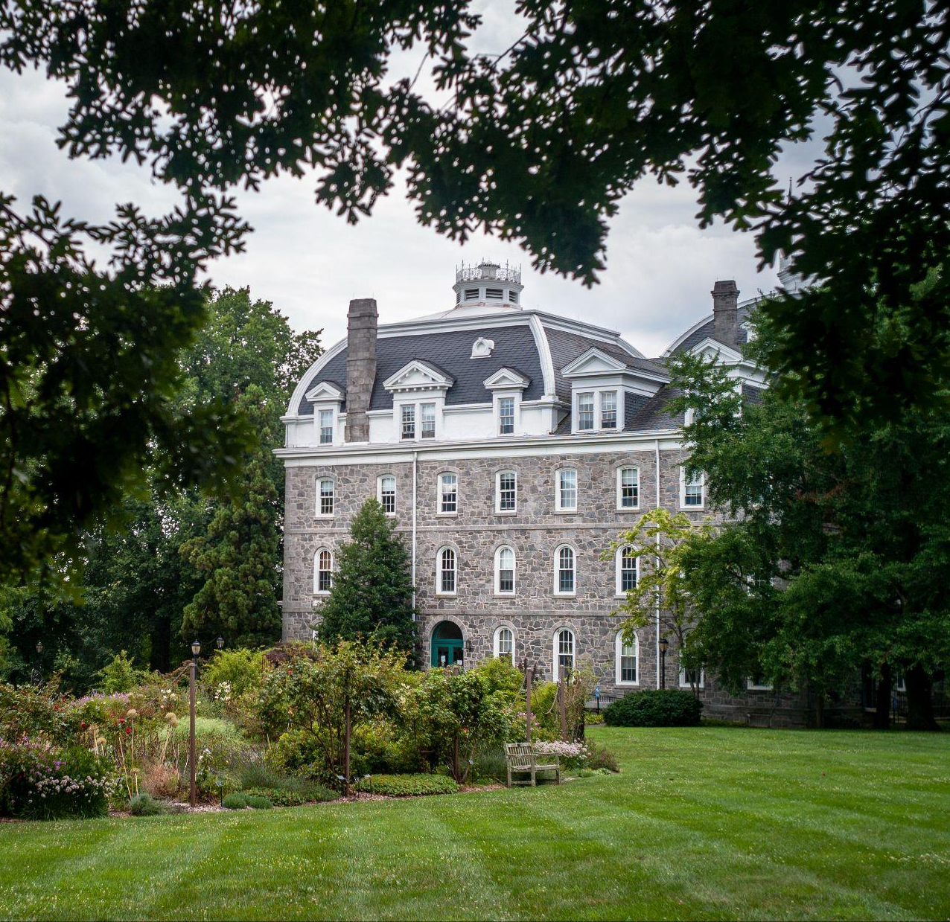
TODAY’S SESSION
To Zero by Thirty-Five
Green building
Zero waste
Food Systems
Education and outreach
Student opportunities
Notes:
Clare

Slide 6
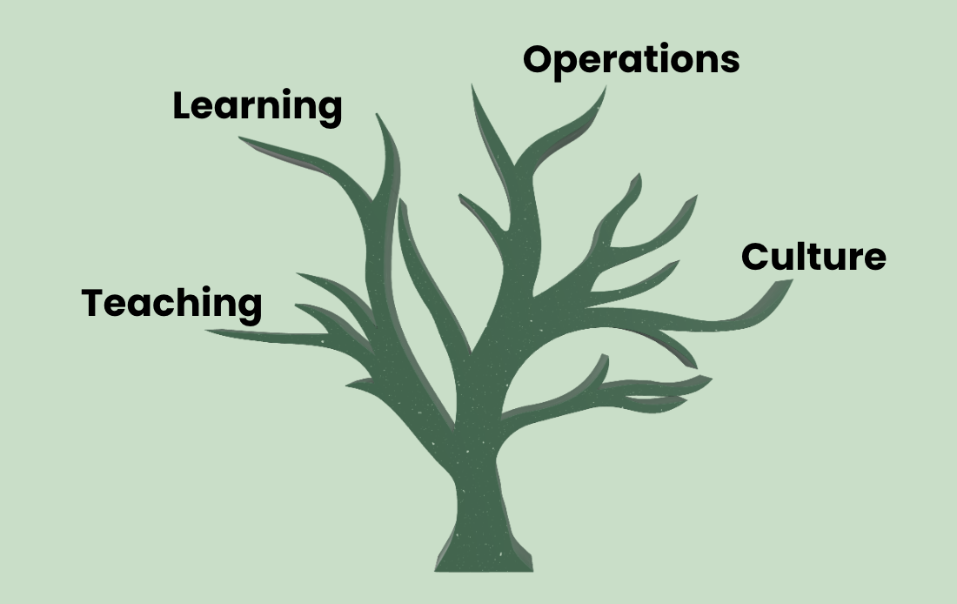
SUSTAINABILITY AT SWARTHMORE
The Office of Sustainability’s mission is to support and inspire the College community to integrate sustainability into all aspects of campus life: teaching, learning, operations, and culture.
Notes:
Clare

Slide 7
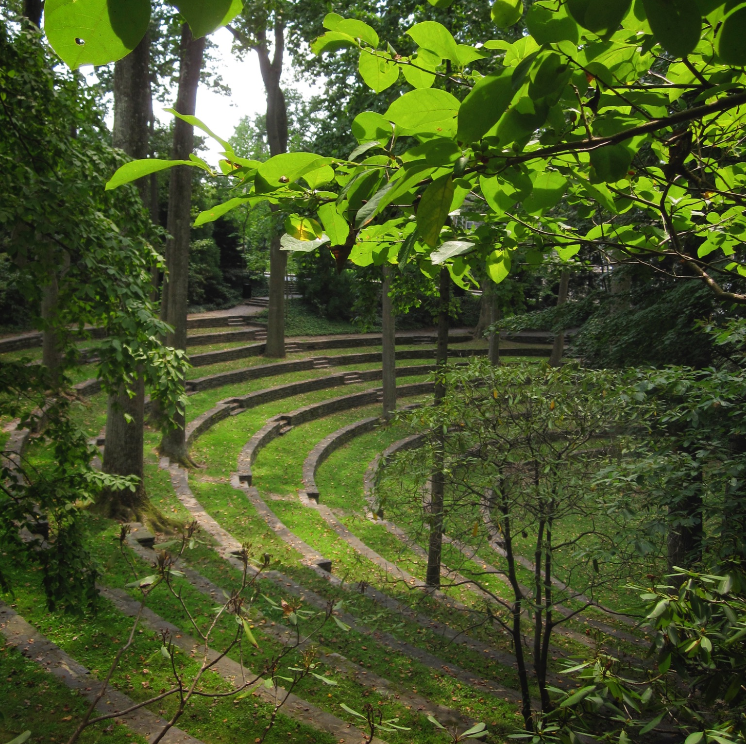
ROLE OF HIGHER ED IN CLIMATE ACTION
As an educational institution, Swarthmore is:
Seeking the latest information and research on climate solutions
Implementing innovative policies and initiatives
Providing a model for students, peers and community
Taking responsibility for institutional impact
Notes:
Clare

Slide 8
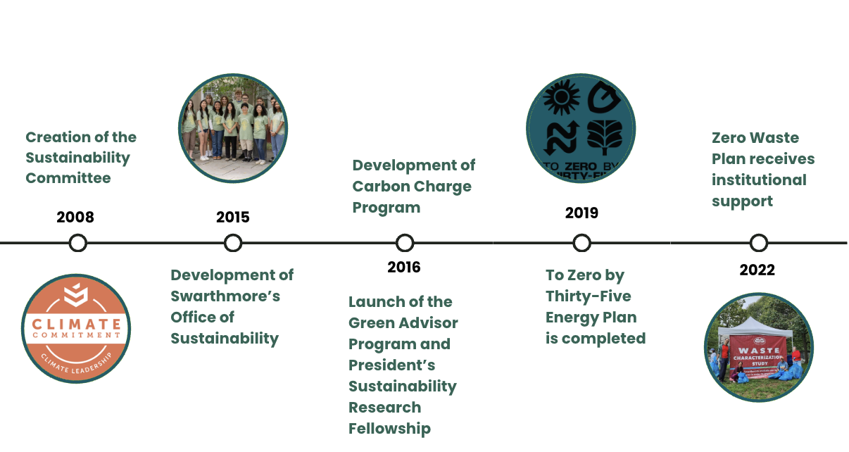
HISTORY OF SUSTAINABILITY AT SWARTHMORE
Notes:
Clare

Slide 9
TO ZERO BY THIRTY-FIVE
Notes:
Melanie

Slide 10
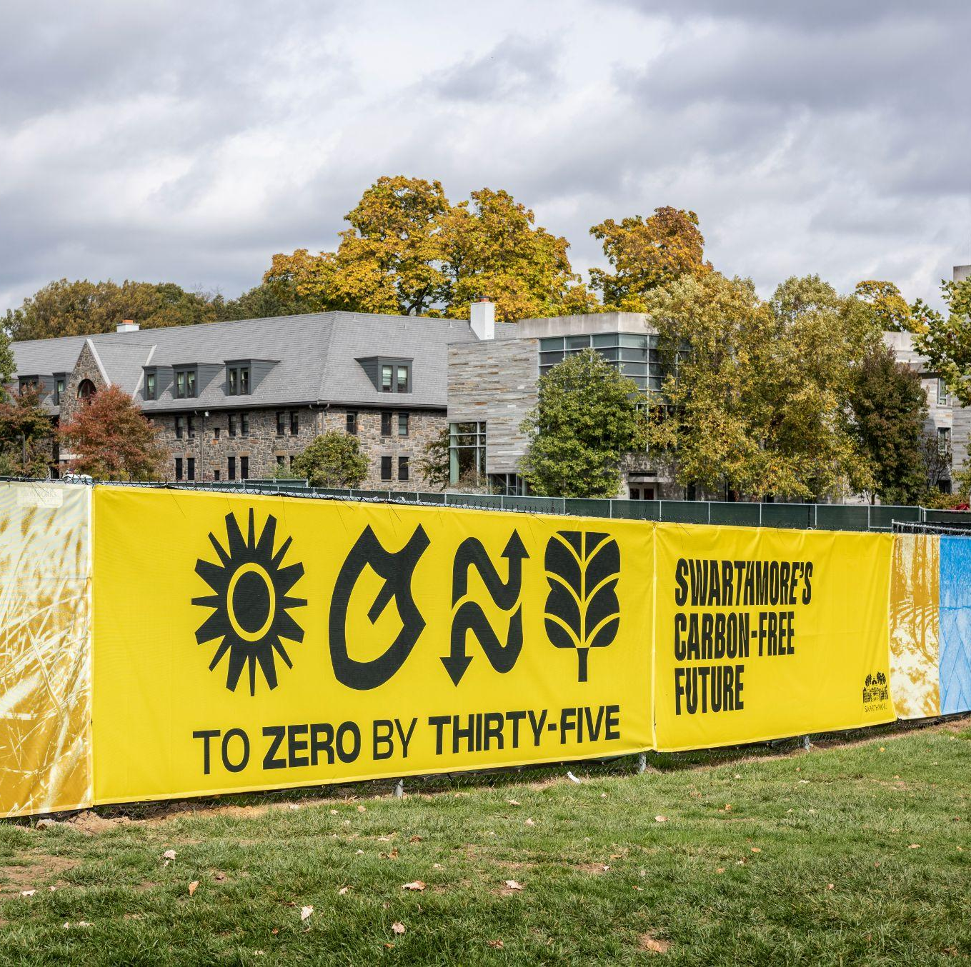
TO ZERO BY THIRTY-FIVE
2035 carbon neutrality commitment
20X35 is our comprehensive plan to completely decarbonize our energy system
Three main aspects:
Combustion-free heating & cooling through geoexchange
Transition to 100% renewable energy
Energy efficiency & resilience
Notes:
Melanie

Slide 11

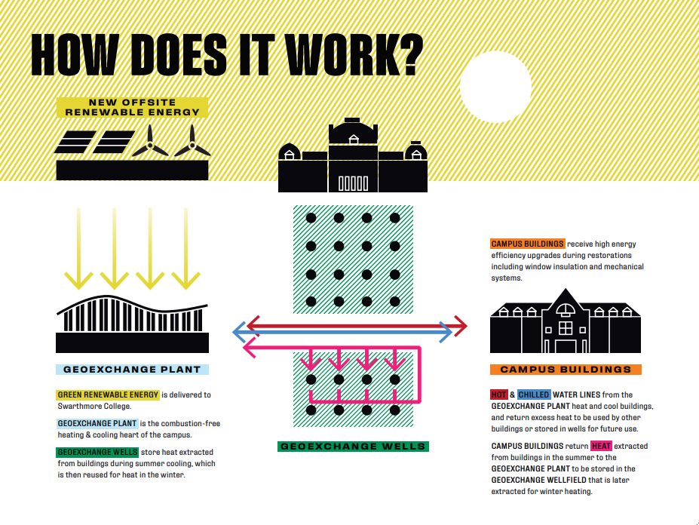

Notes:
Melanie
Geoexchange is the process of removing heat from campus buildings during summer, storing it in the earth, and then extracting it in the winter to heat campus buildings.

Slide 12
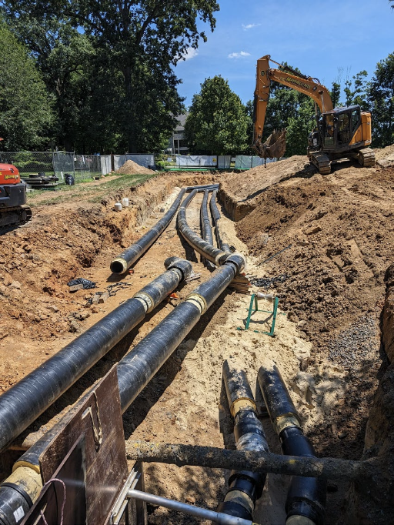
OTHER ELEMENTS OF 20X35
Buildings connected to geoexchange system (Alice Paul, David Kemp, Dining & Community Commons, Kohlberg, Lang Music, Martin, Mertz, Parrish (partial), Pearson, Singer
Distribution to four quadrants of campus
Backup generation for energy resilience and reliability
Notes:
Melanie

Slide 13
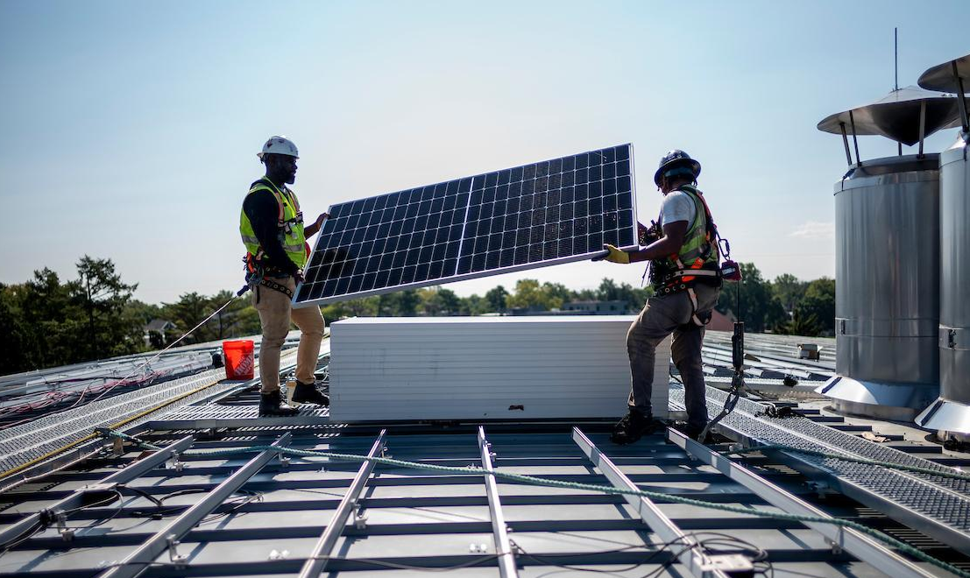
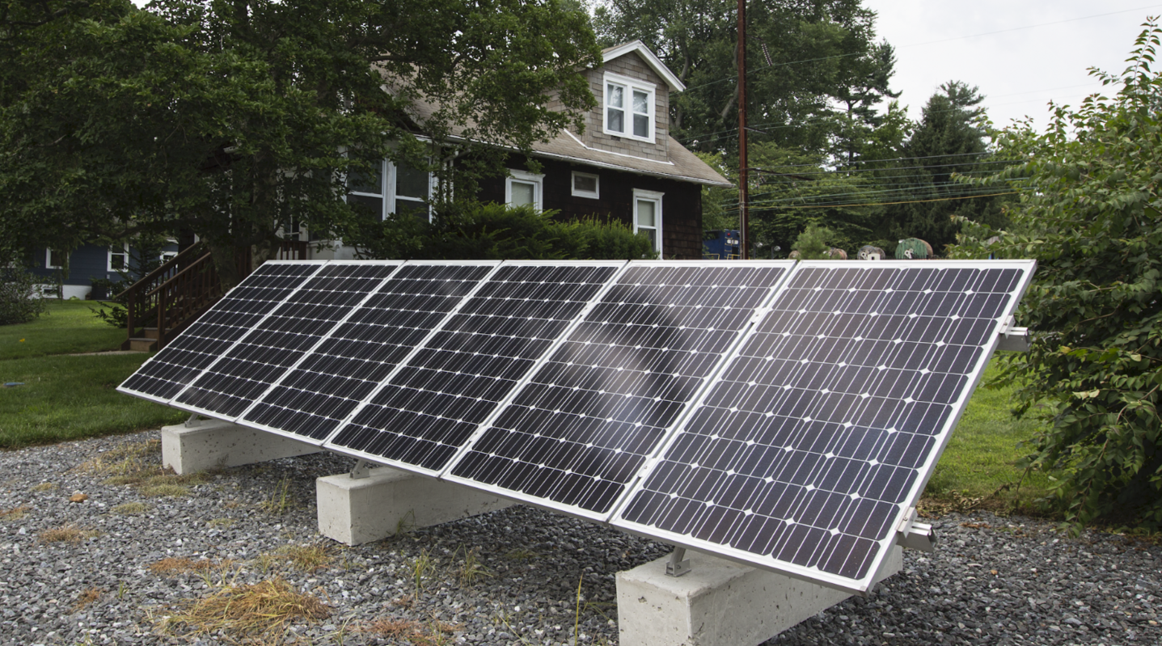
RENEWABLE ENERGY
Geoexchange allows us to electrify our campus heating and cooling, which support the College’s ongoing efforts to transition to 100% renewable energy.
We’re partnering with 8 other colleges and universities to buy renewable electricity from a new solar farm in Kentucky.
Notes:
Melanie

Slide 14
GREEN BUILDING

Slide 15
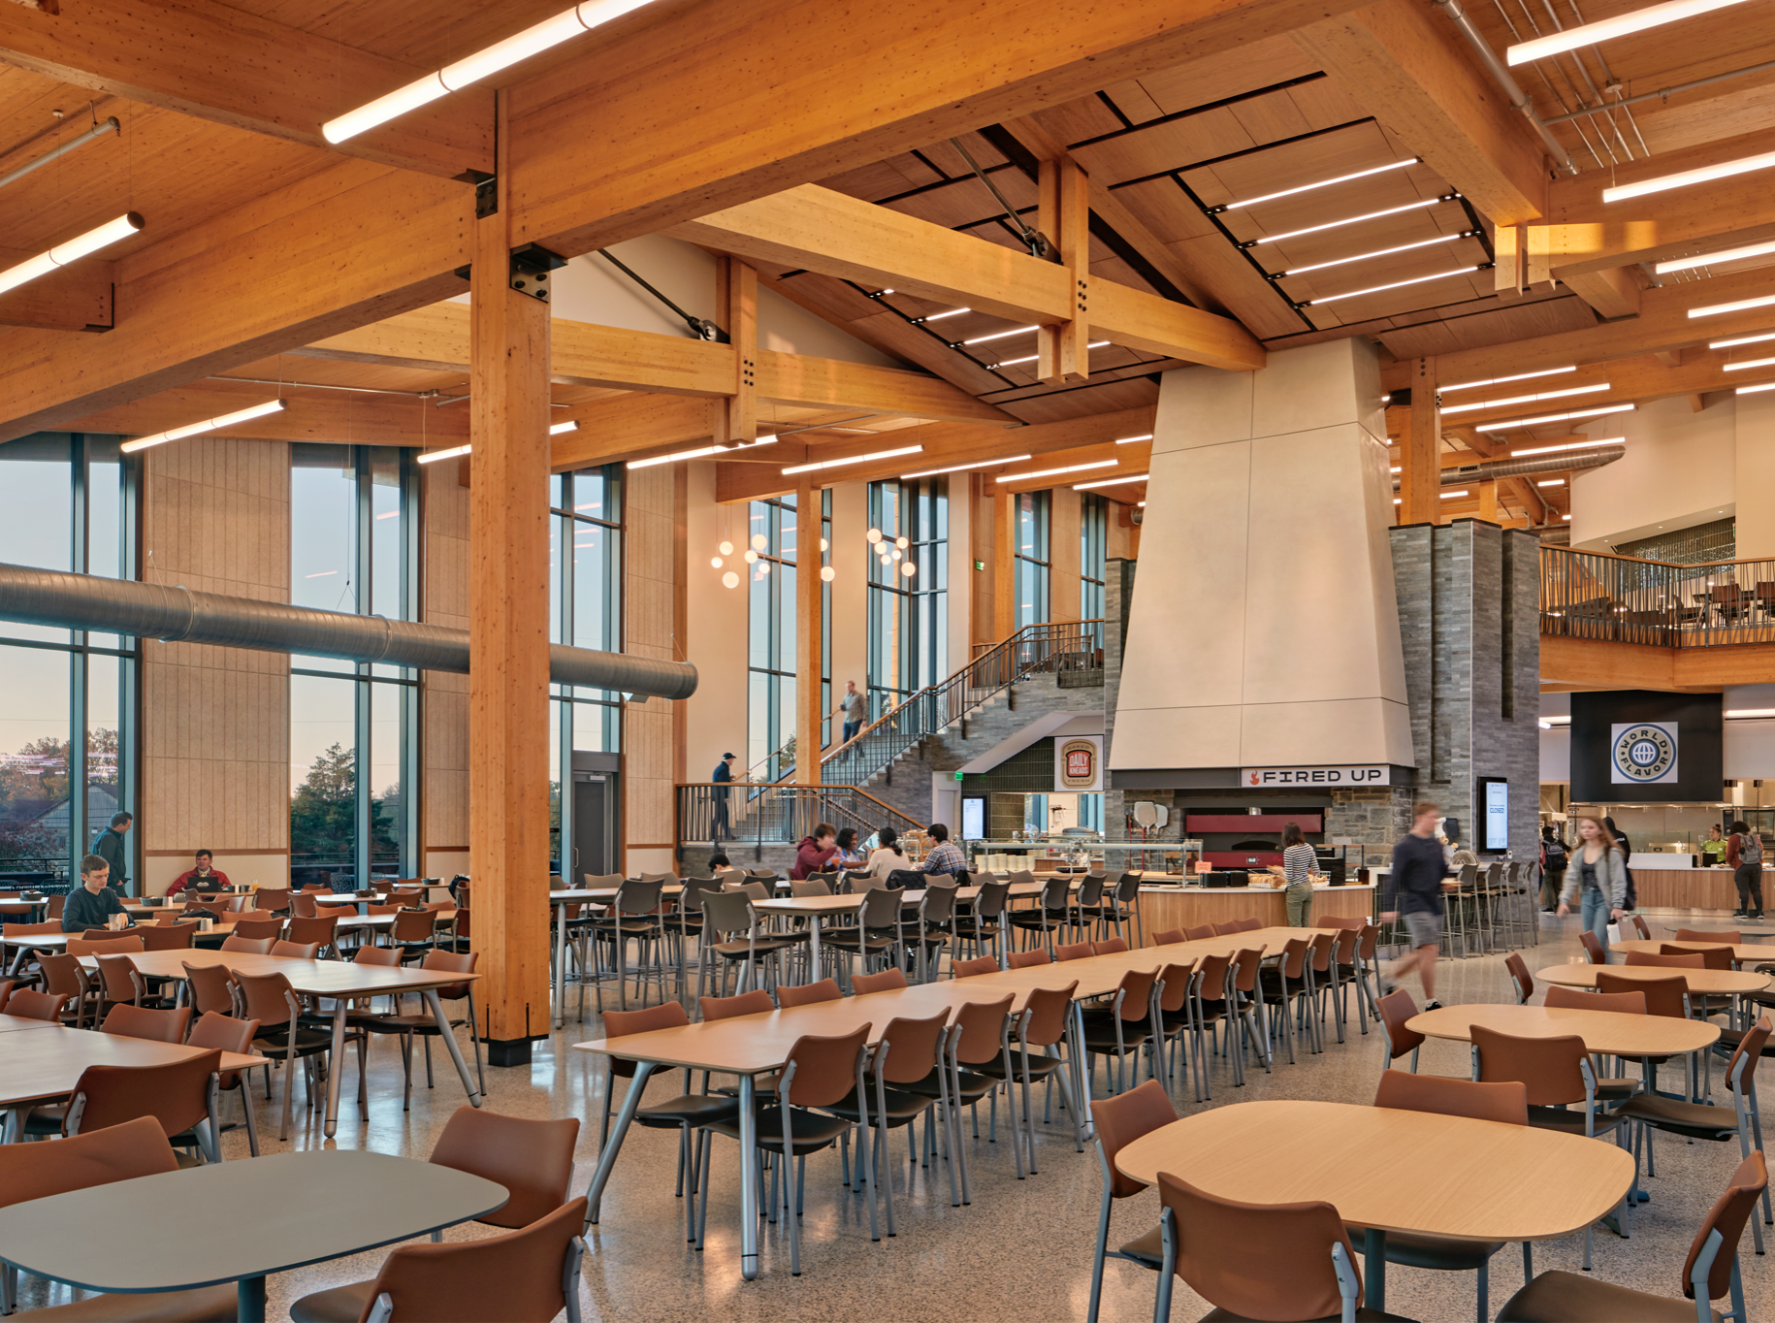
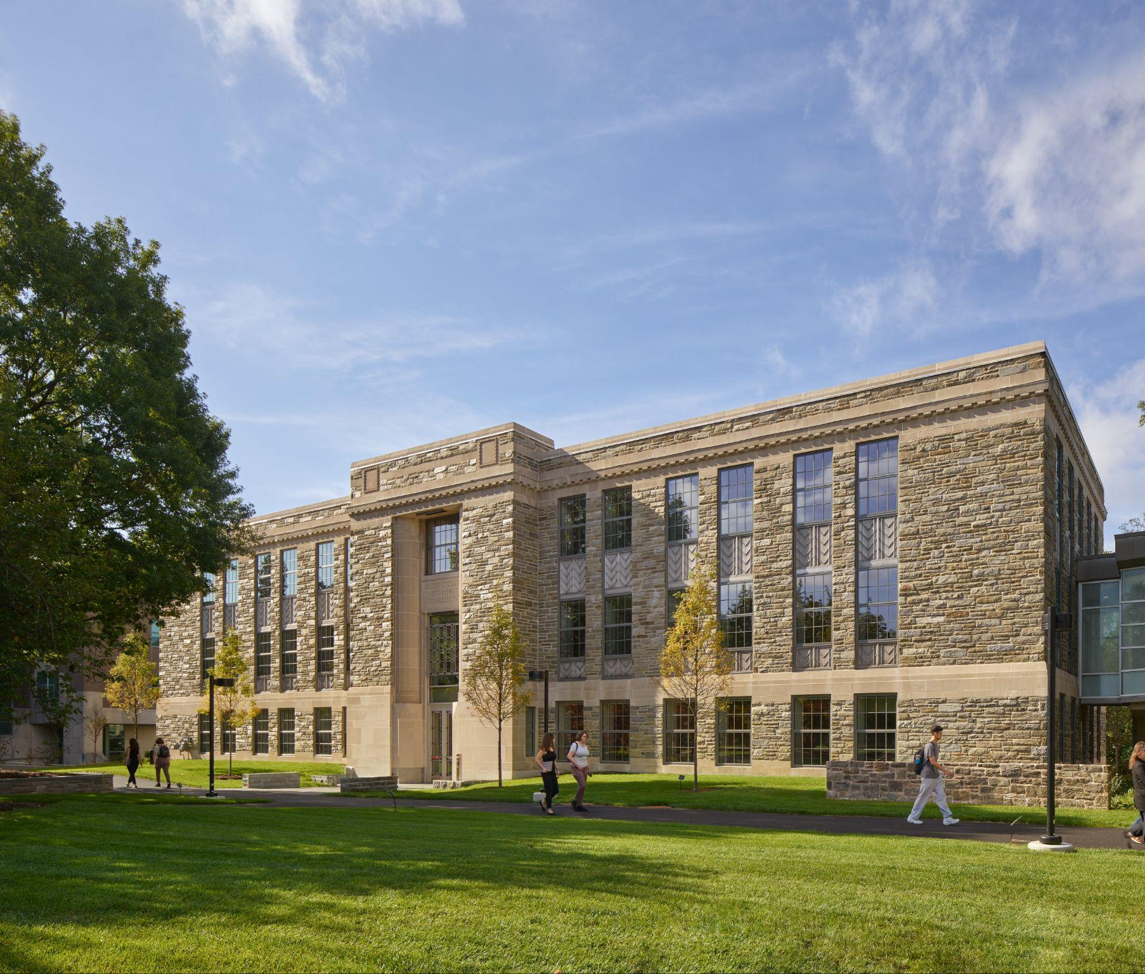
DINING CENTER & COMMUNITY COMMONS
MARTIN HALL
Notes:
Melanie
DCC
All electric
700+ solar panels that produce 28% of building electrical use
Biophilic design
Mass timber structure
Maximize use of sustainable materials & minimize use of Red List materials
No trays
All pre and post-consumer food waste is pulped and composted
MARTIN
Preserved historic facade and other materials
Pursuing Living Building Challenge Core certification
High energy efficiency
Rooftop solar
Connection to nature and the Crum
Accessibility features

Slide 16
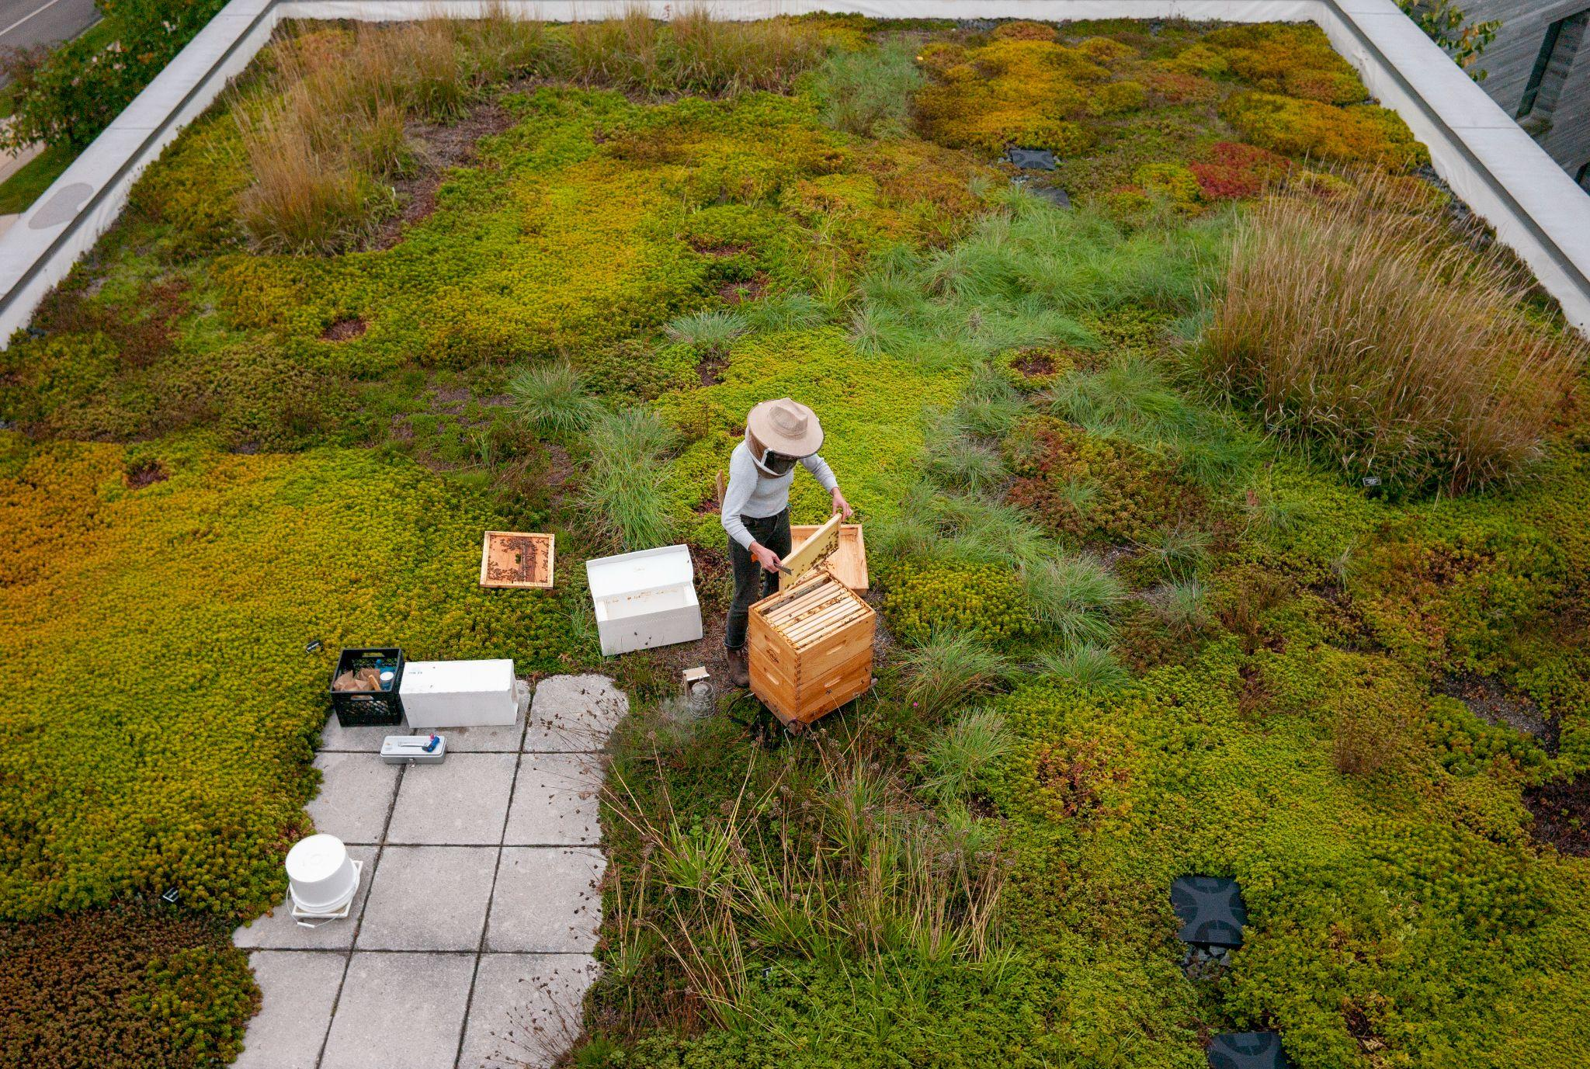
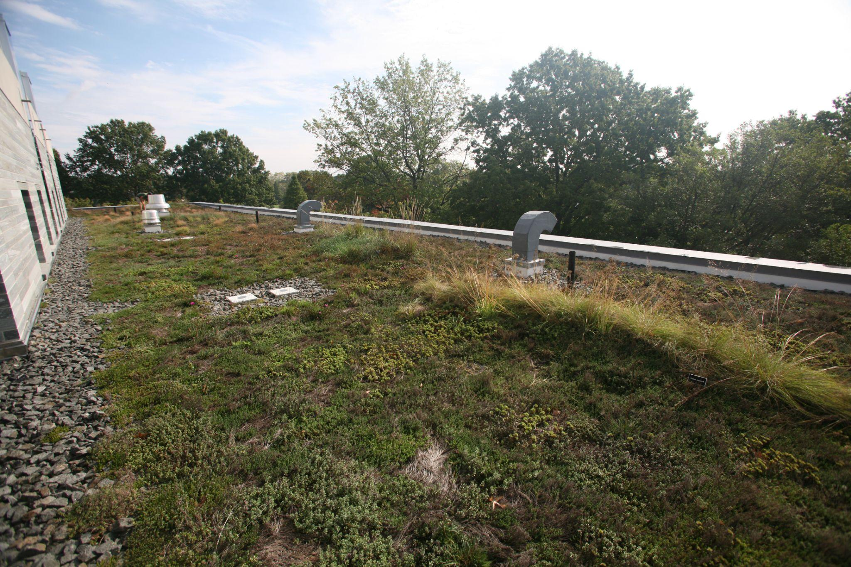
GREEN ROOFS
Notes:
Melanie

Slide 17
ZERO WASTE
Notes:
Clare

Slide 18
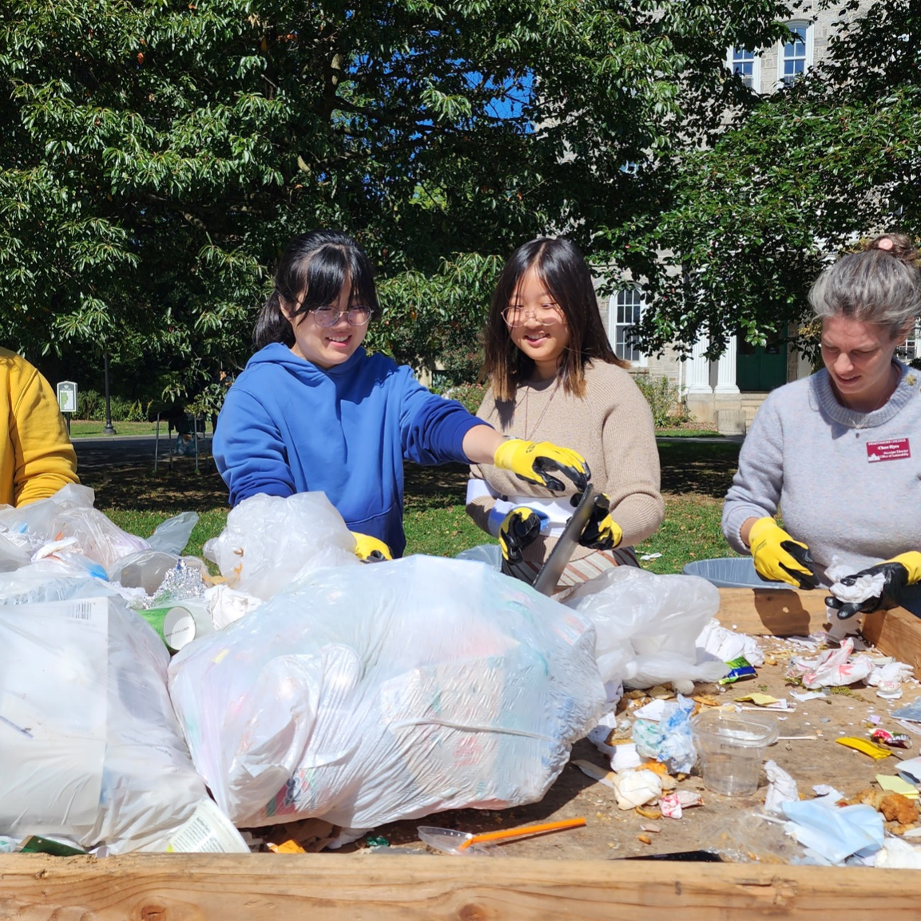
ZERO WASTE COMMITMENT
Swarthmore College is committed to achieving zero waste by 2035.
This includes embedding a zero waste mindset into campus culture, achieving a 25% per capita reduction of waste, and achieving 90% waste diversion.
Notes:
Clare

Slide 19
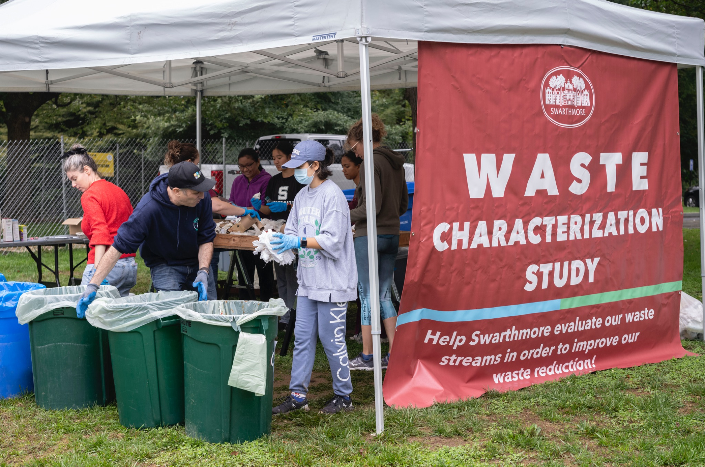
ZERO WASTE INITIATIVES
Campus-wide composting and recycling
Worthmore Free Store and move-out collection process
Reusable utensils and takeout containers
Education and behavior change initiatives
46% of waste diverted away from incineration in 2024-2025
Notes:
Clare

Slide 20
FOOD SYSTEMS
Notes:
Clare

Slide 21
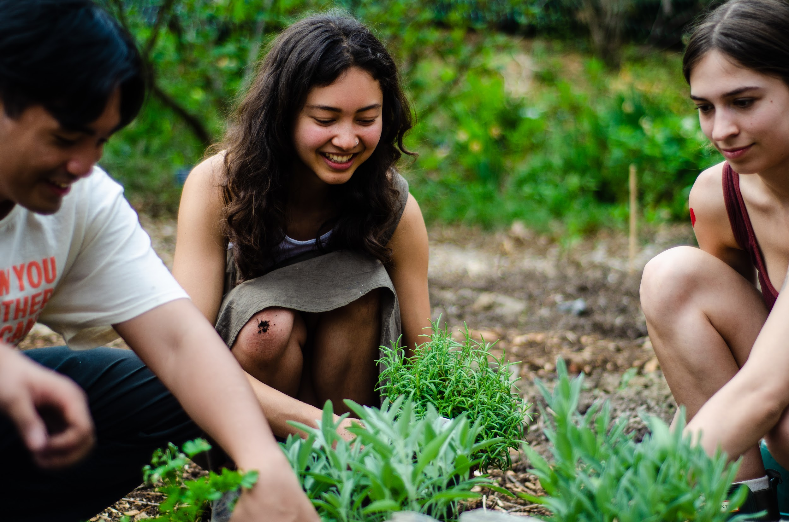
FOOD SYSTEMS
Our Food Course
Garden Collective
Good Food Garden
Food Recovery Fridge
PSRF projects
Programing through the Dining Center
Notes:
Clare

Slide 22
STUDENT OPPORTUNITIES

Slide 23
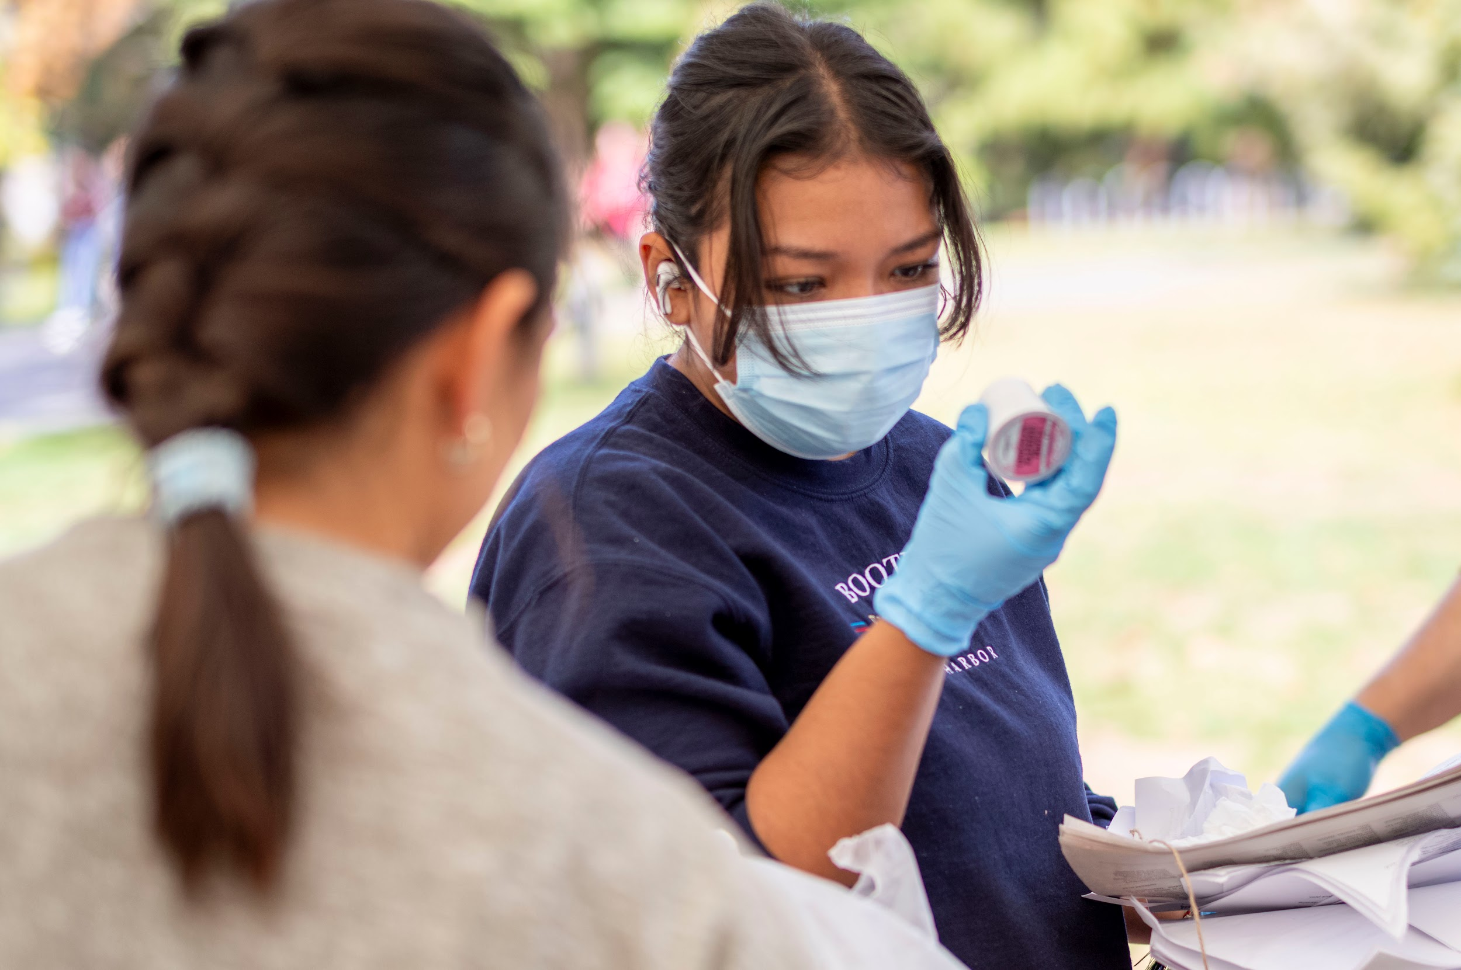
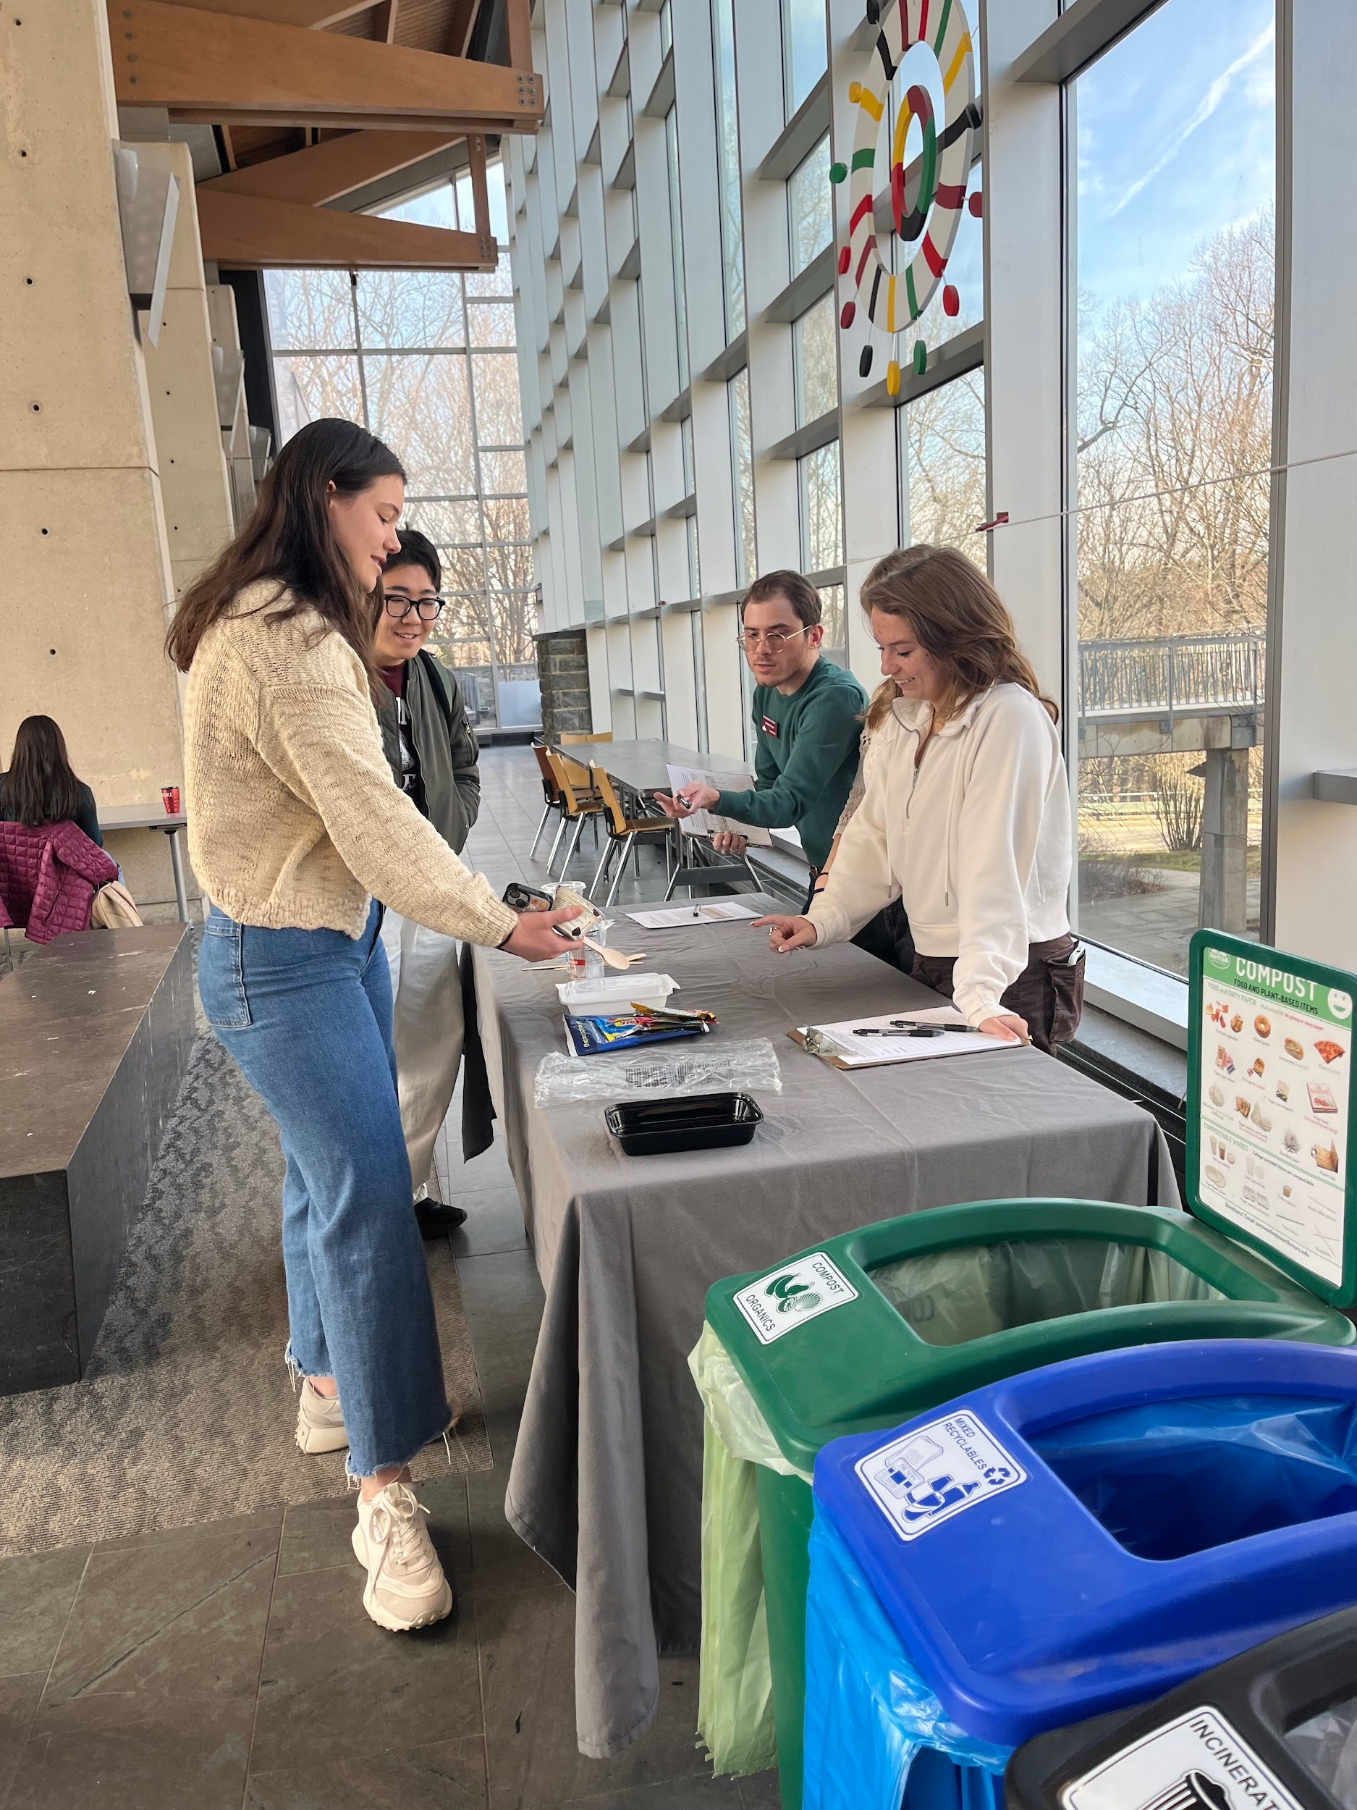
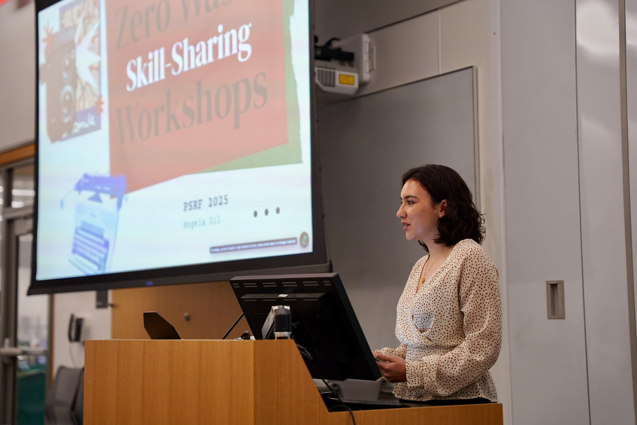
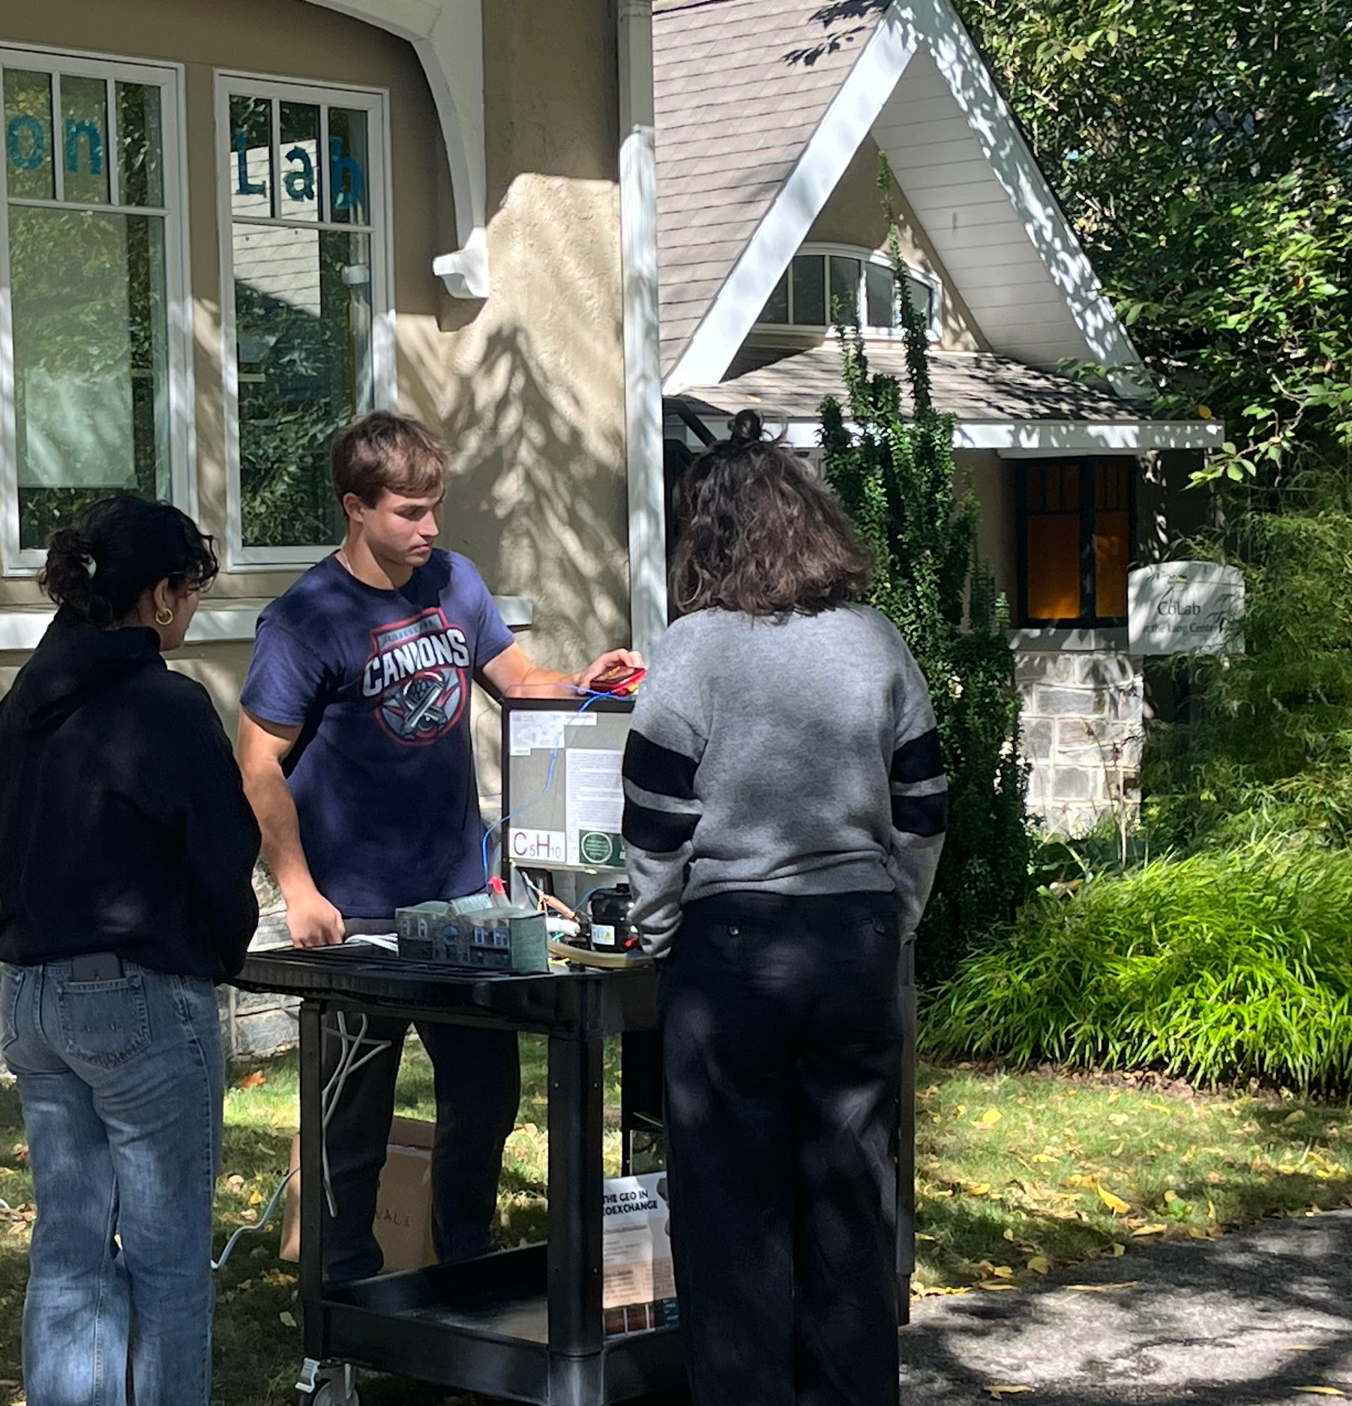
DEVELOPING SUSTAINABILITY LEADERS
Our campus sustainability initiatives establish Swarthmore College as a leader in sustainability in higher education, modeling what a zero waste and decarbonized campus looks like and providing a backdrop for our students to become the next generation of sustainability leaders.
Notes:
Melanie

Slide 24
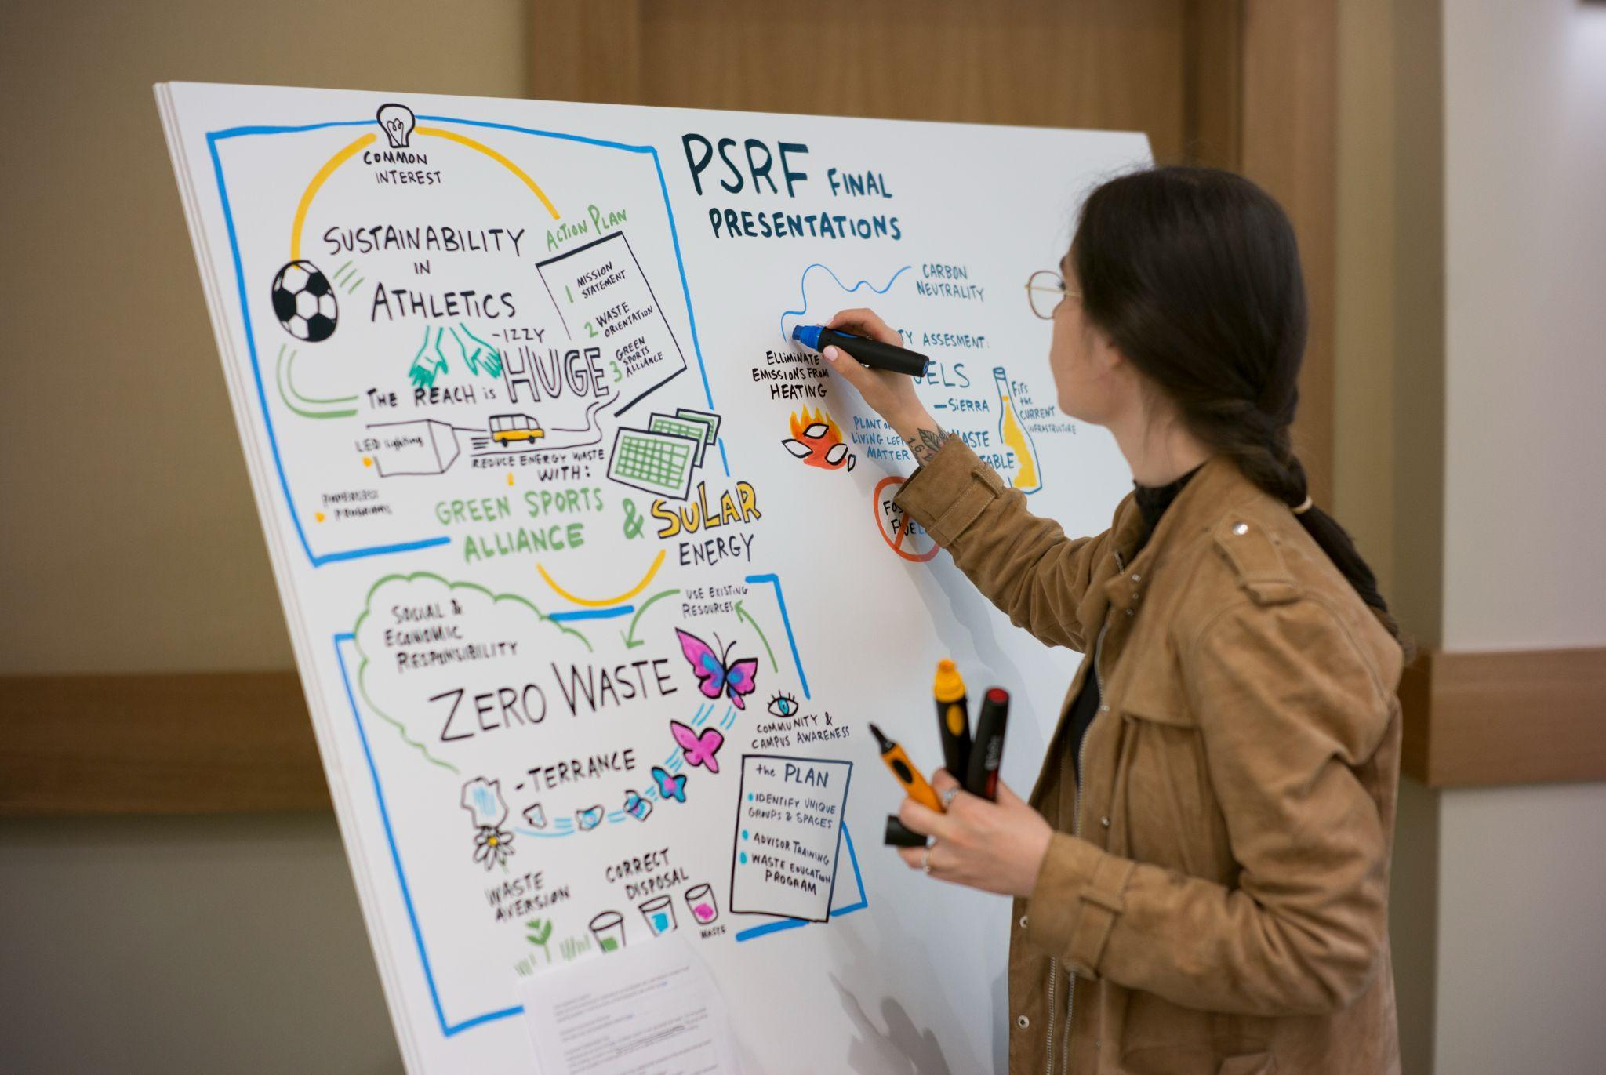
STUDENT OPPORTUNITIES
President’s Sustainability Research Fellowship
Green Advisors
Internships (Academic & Summer)
Food Recovery Fridge Liaisons
Environmental Studies Program
Environmental Justice and Community Resilience Program
Notes:
Clare

Slide 25
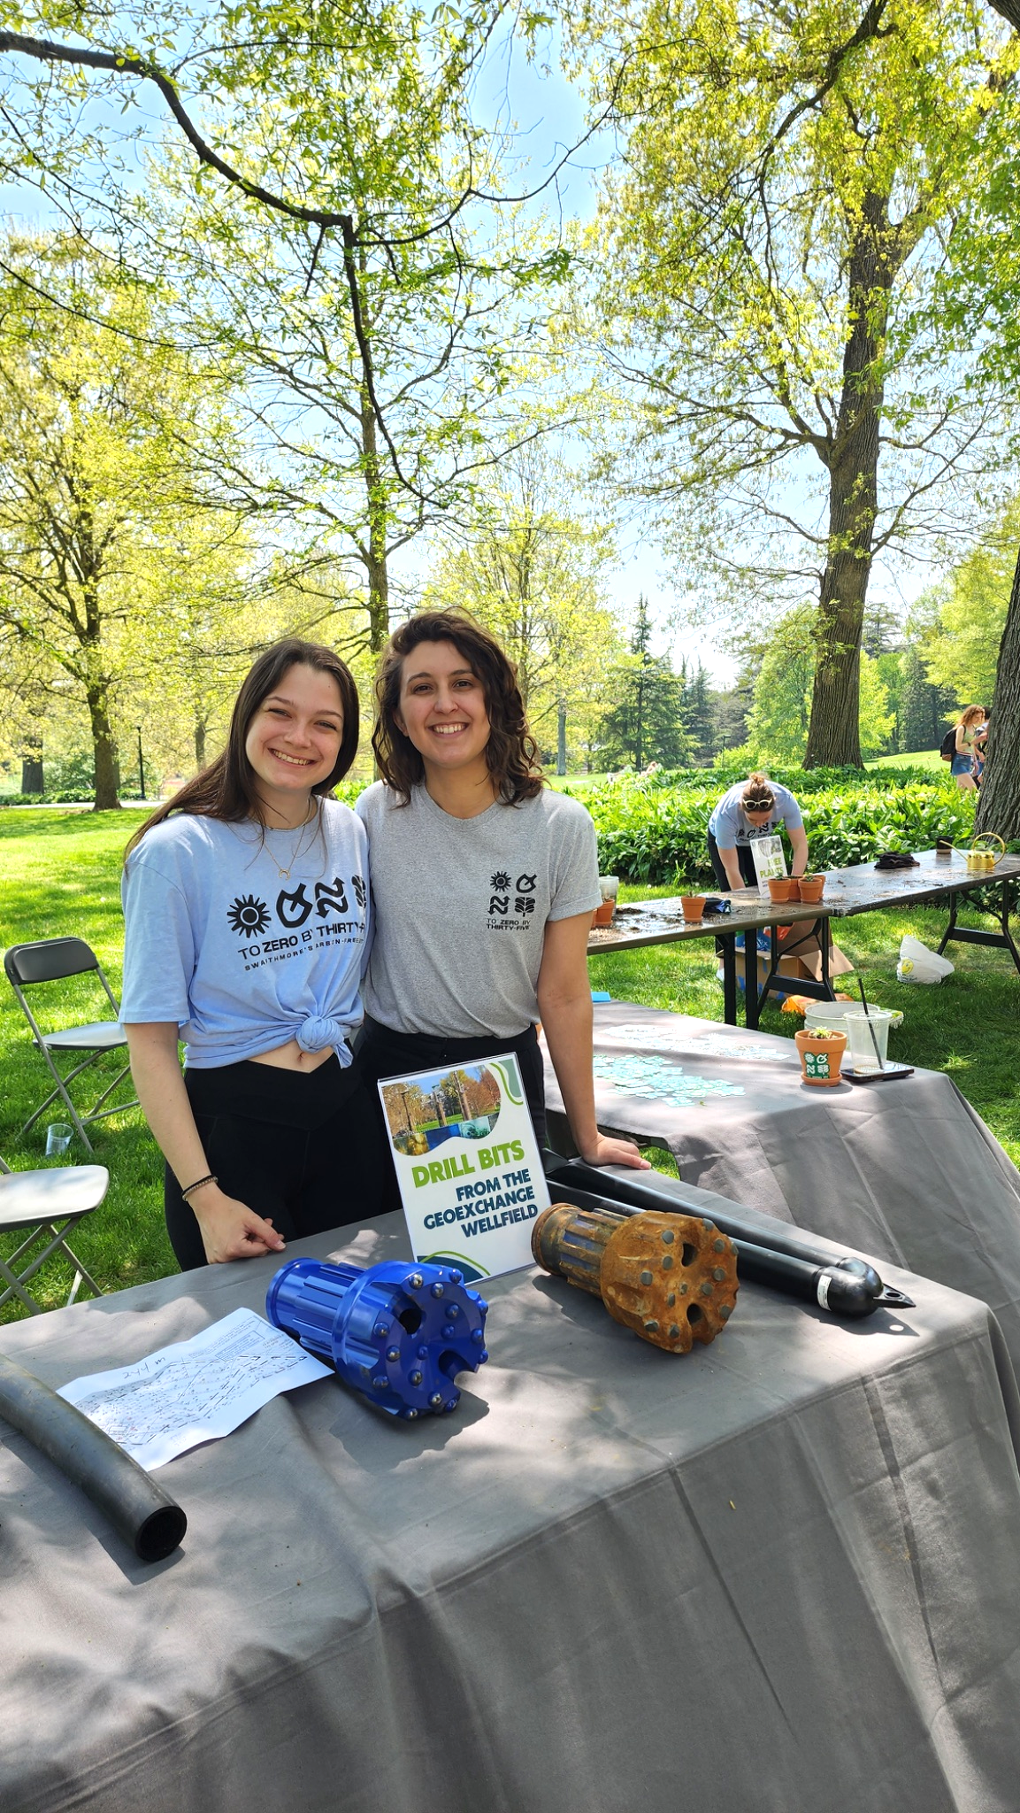
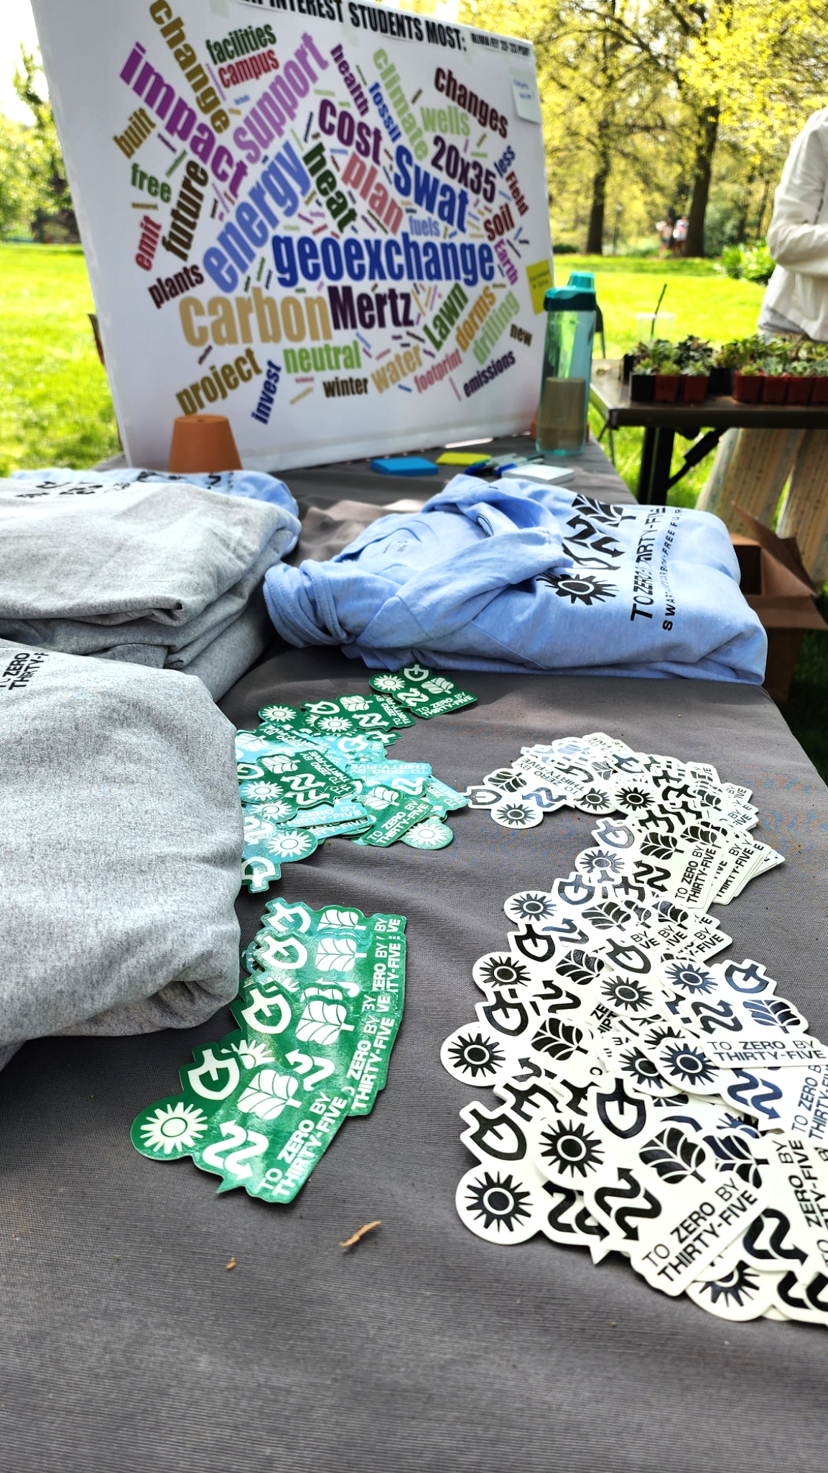
CAMPUS ENGAGEMENT & EDUCATION
Integration into classroom content
Events and educational opportunities for campus
Faculty/Staff project mentors for both PSRF and GA programs
Campus wide engagement
20X35 Pop-ups
Campus wide Zero Waste Challenge
Amplify Grant and funding opportunities
Notes:
Melanie

Slide 26
PLUS MUCH MORE!
swarthmore.edu/sustainability
sustainability@swarthmore.edu
Notes:
Hannah

