Slide 1
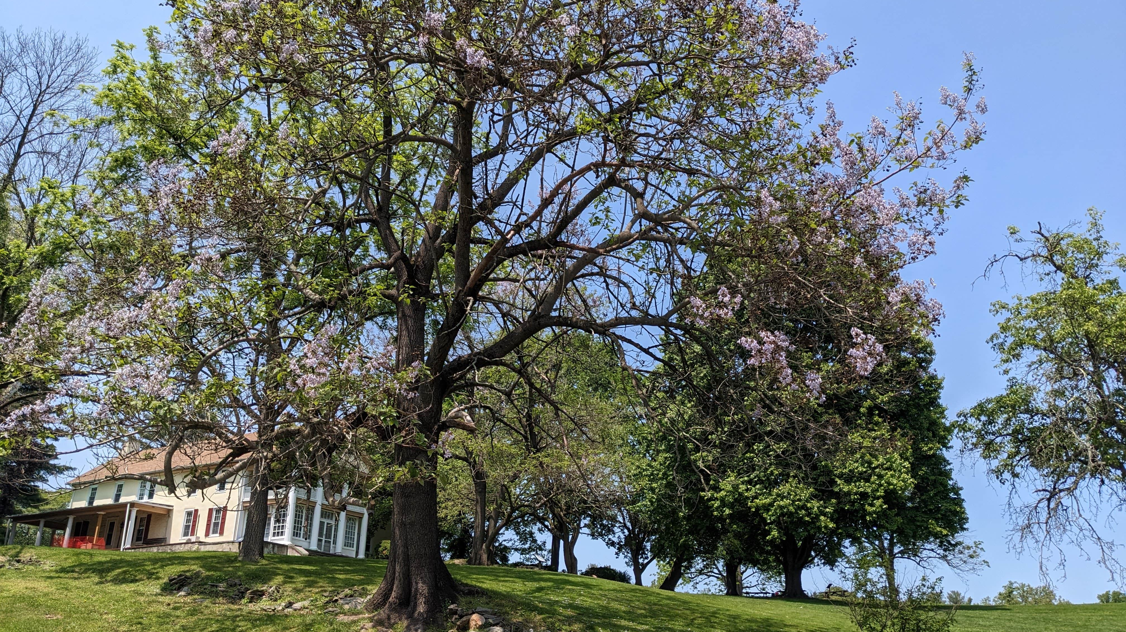

Delaware County
Parks & Recreation
Rose Tree Park
Media, Pa

Slide 2
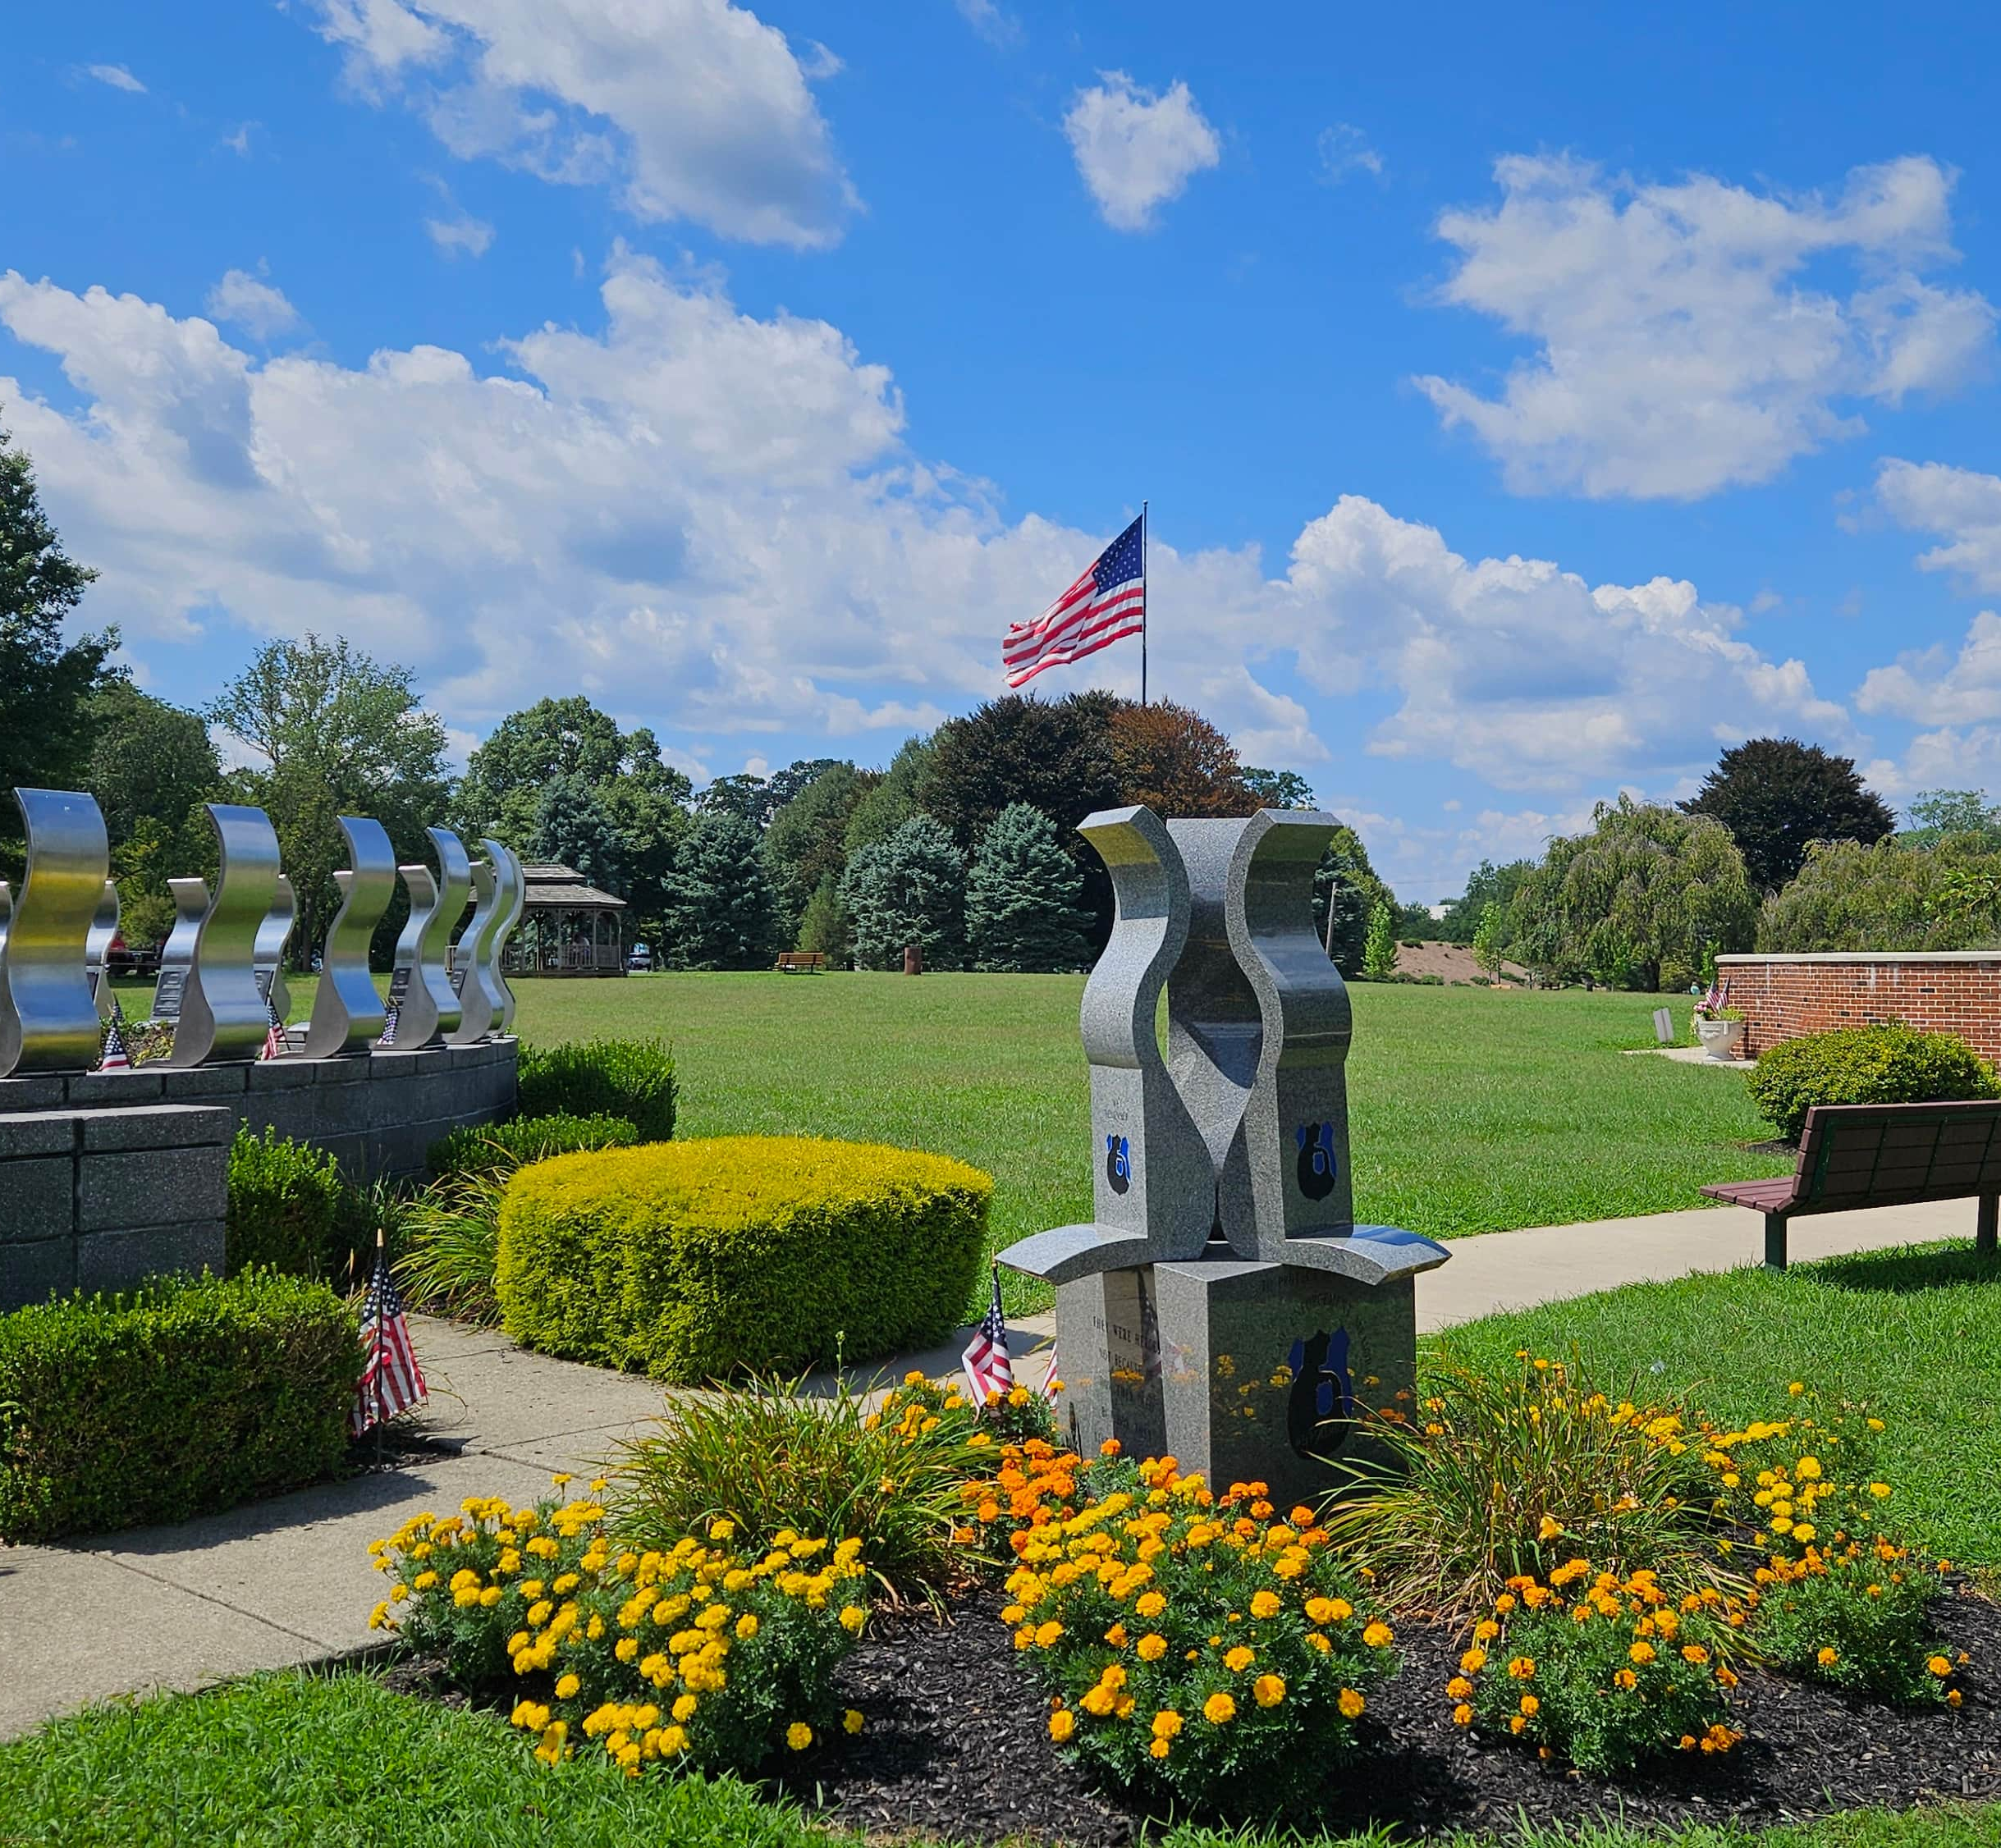

Rose Tree county Park
  118 Acres in Upper Providence Township
  Fairgrounds
  Outdoor amphitheater and concert stage
  Wooded trail
  Meadow (in development)
  3 Memorials (Delco. Law Enforcement Foundation, Philip Jaisohn Foundation)
  3 Historic buildings housing County offices
  Leedom House: Parks & Recreation Dept.
  Hunt Club: Conservation District, PRC
  Rose Tree Tavern: VisitDelco

Slide 3
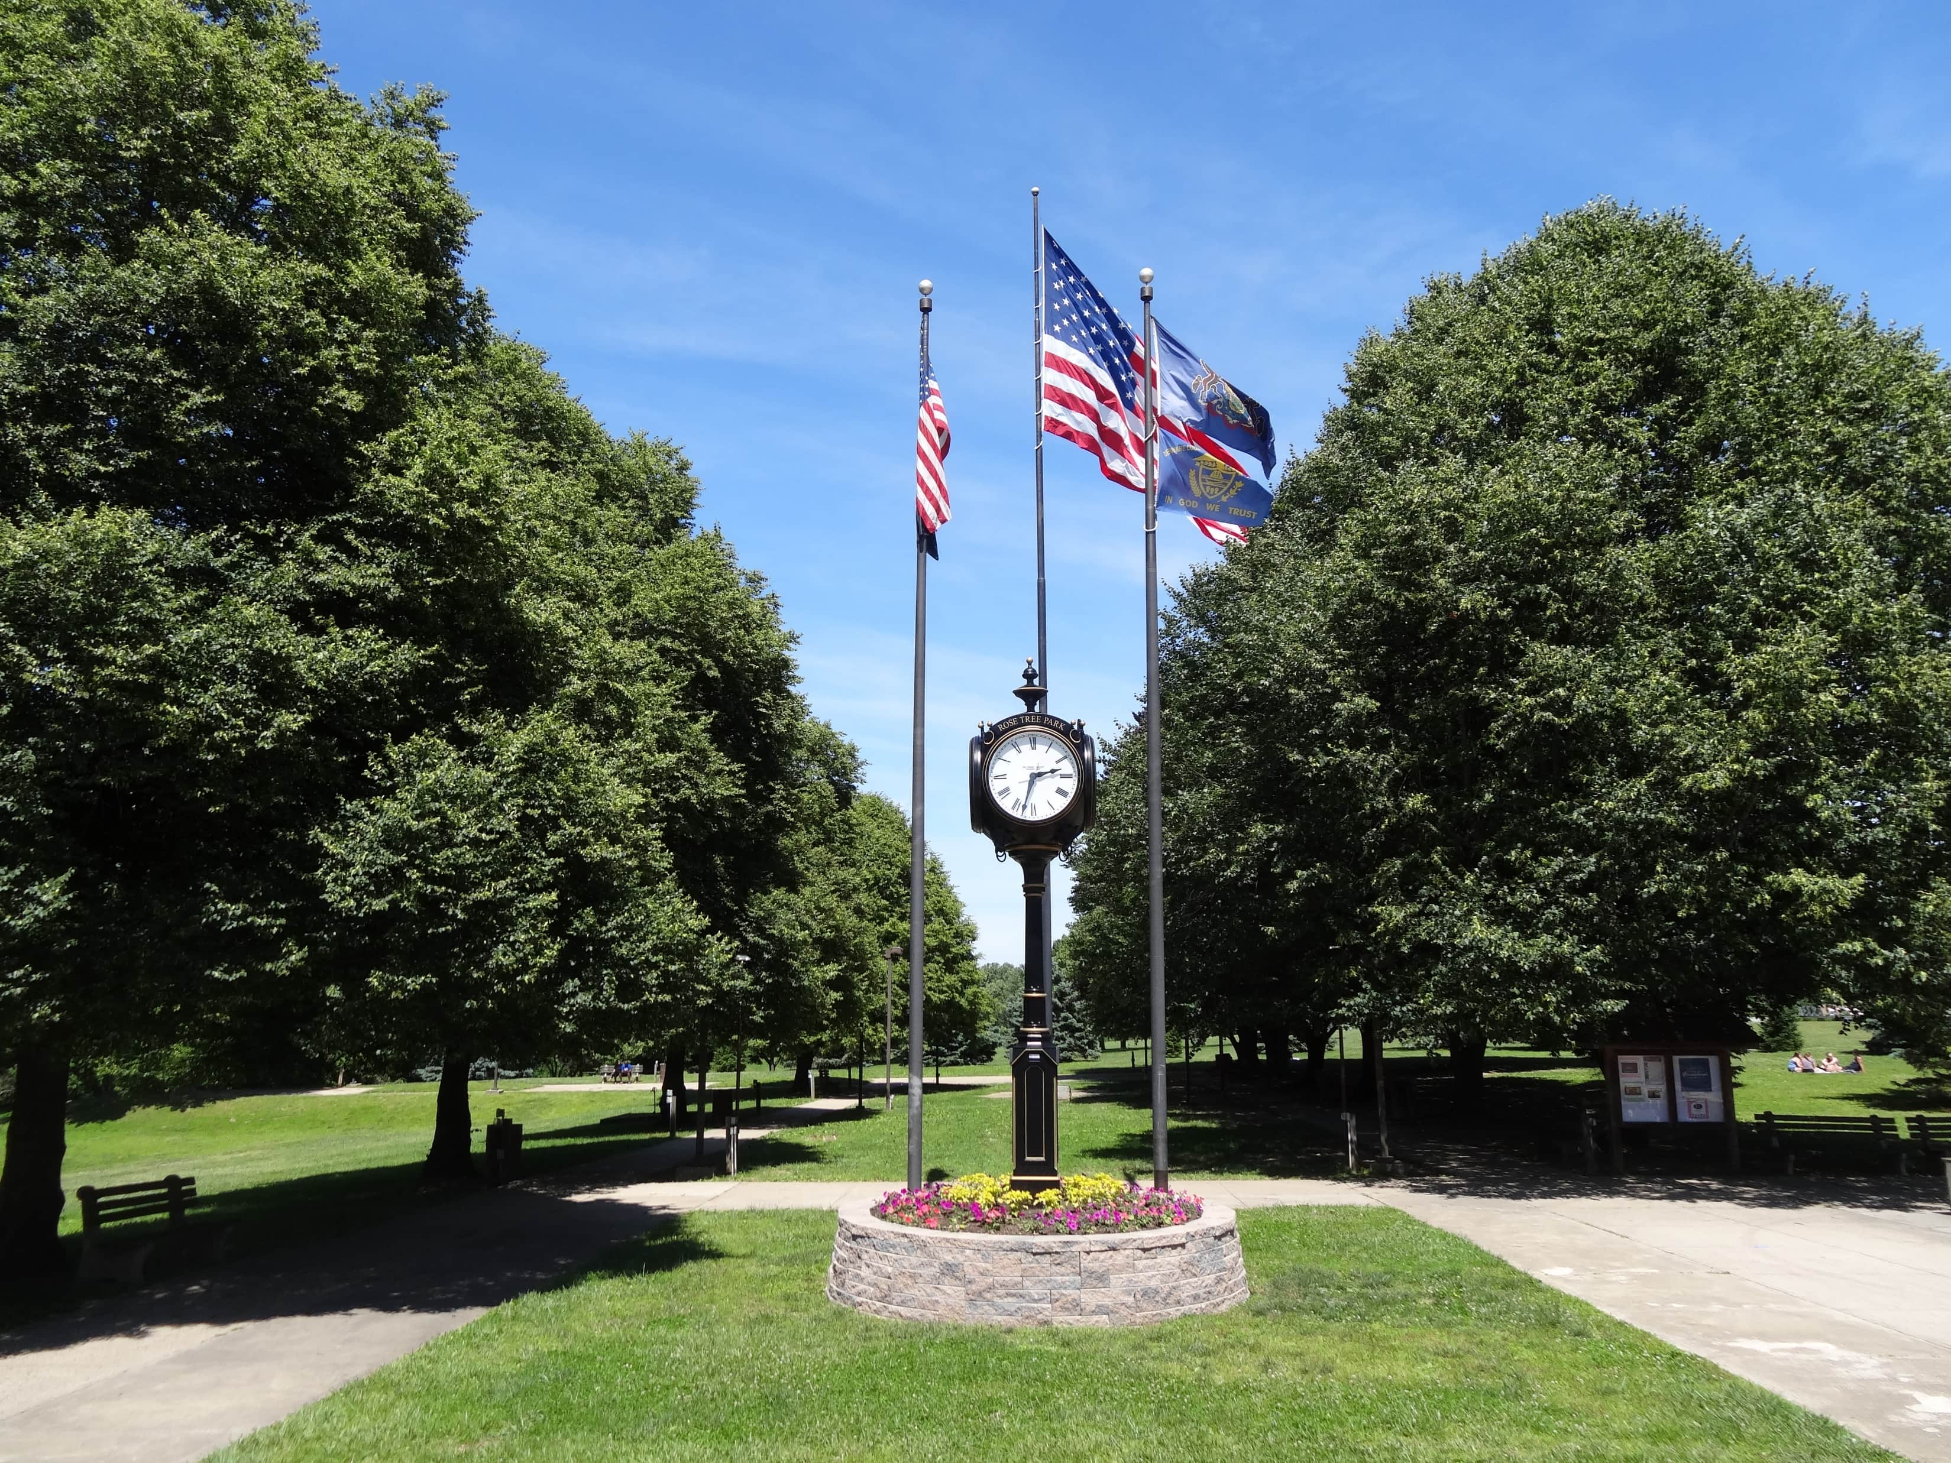
Amenities & Facilities
  2nd Largest Cross-Country Course in PA
  Destination Playground with Pavilion
  118 Community Garden Plots
  Rose Tree Summer Festival Concert Series
  Picnic Tables
  Gazebo
  18-page StoryWalk, curated by the Delco Libraries system
  2 Restroom Buildings (seasonal)
  Tree-Lined Pedestrian Mall with Benches

Slide 4
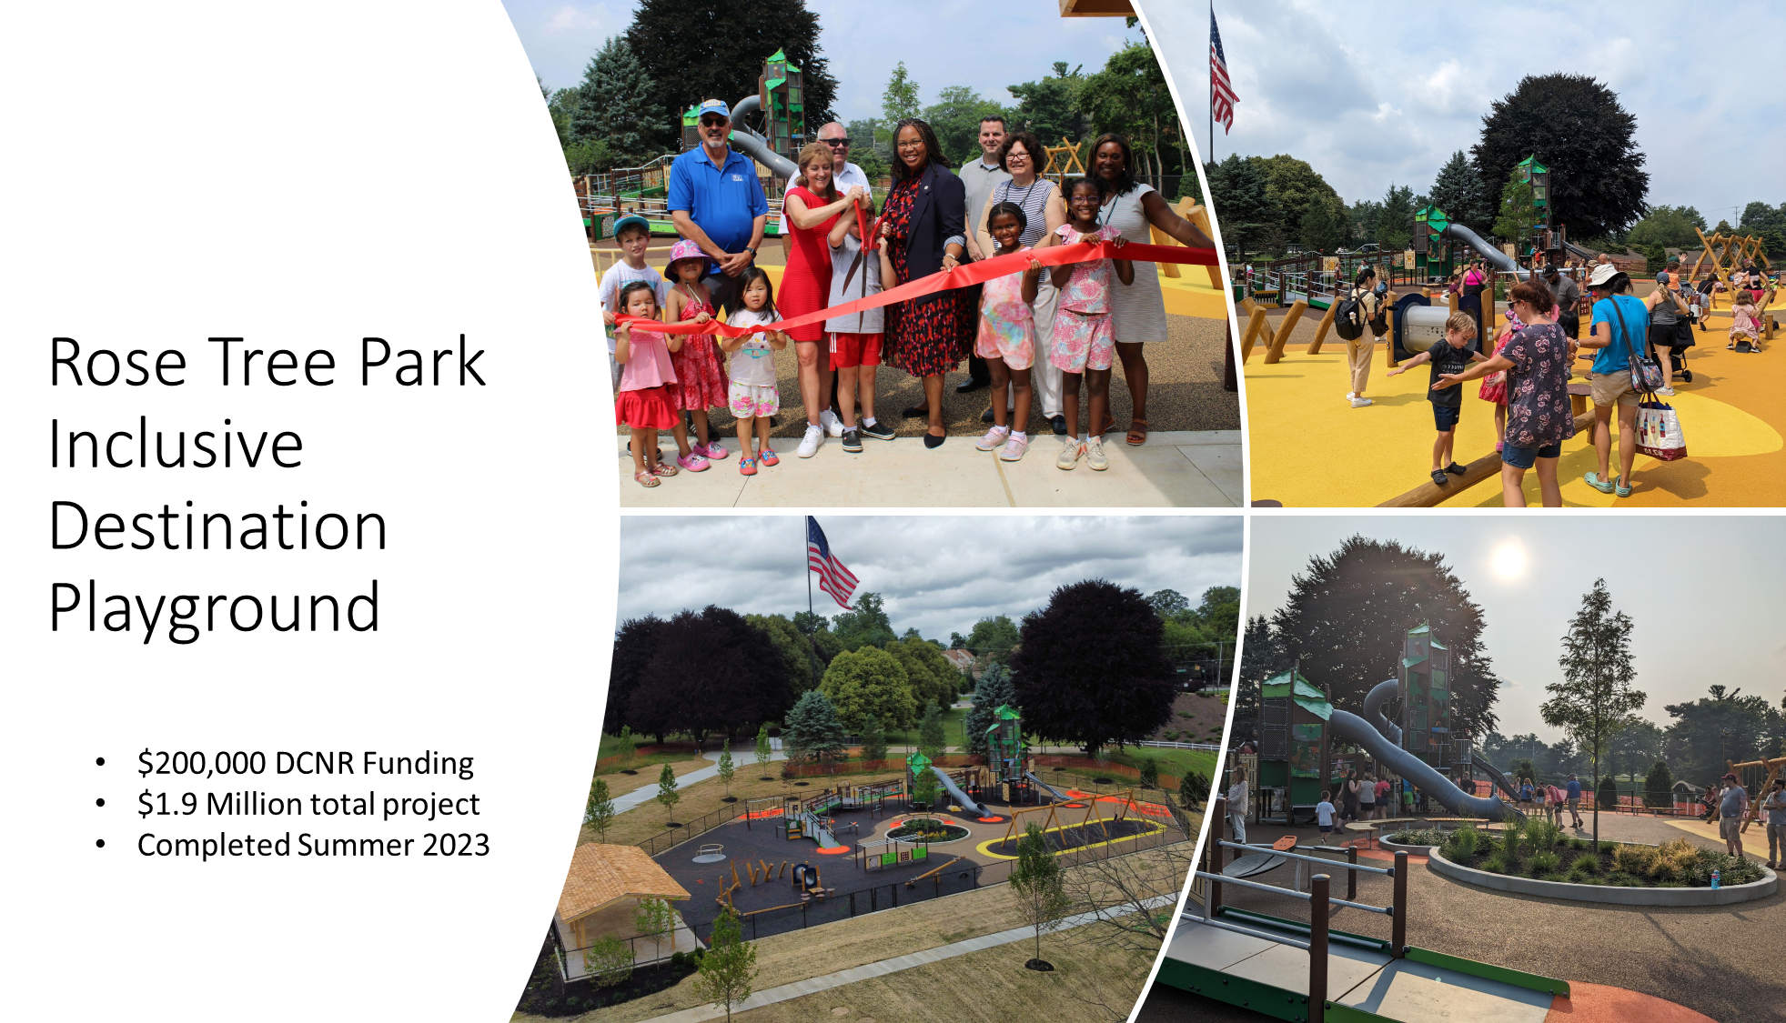


Slide 5
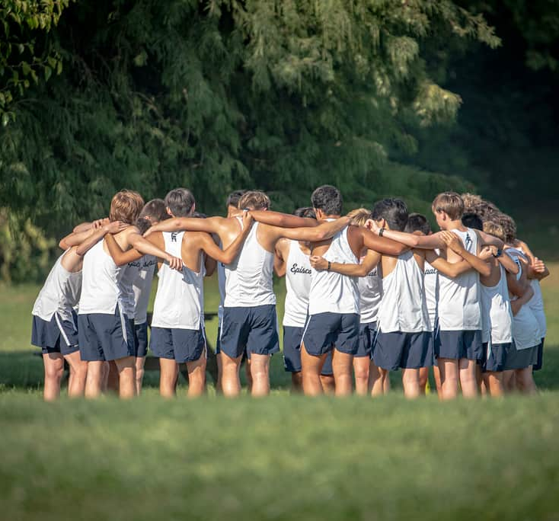
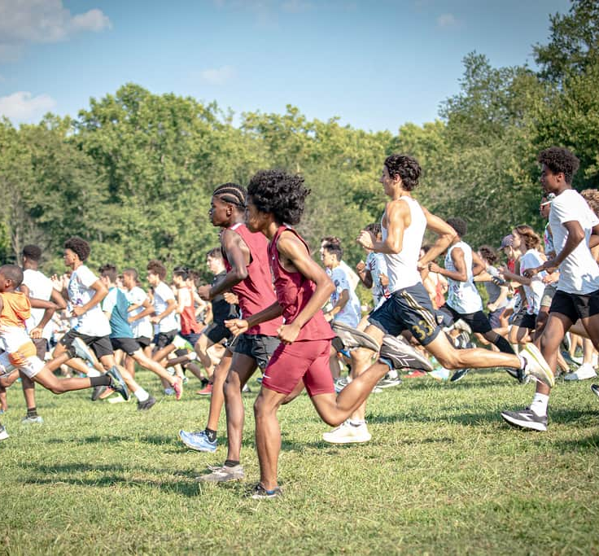
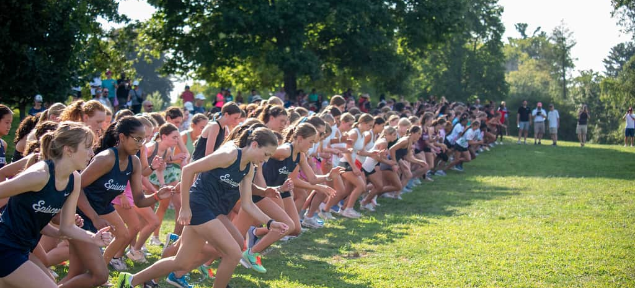
Cross Country Meets
Thousands of athletes from local middle schools, high schools, and colleges train and compete on the grounds.
Photo Credits:
Ryan Comstock Photography
Ryan Comstock
Ryan Comstock
Ryan Comstock

Slide 6
PROGRAMMING OVERVIEW
Engaging 100,000+ annually

Slide 7
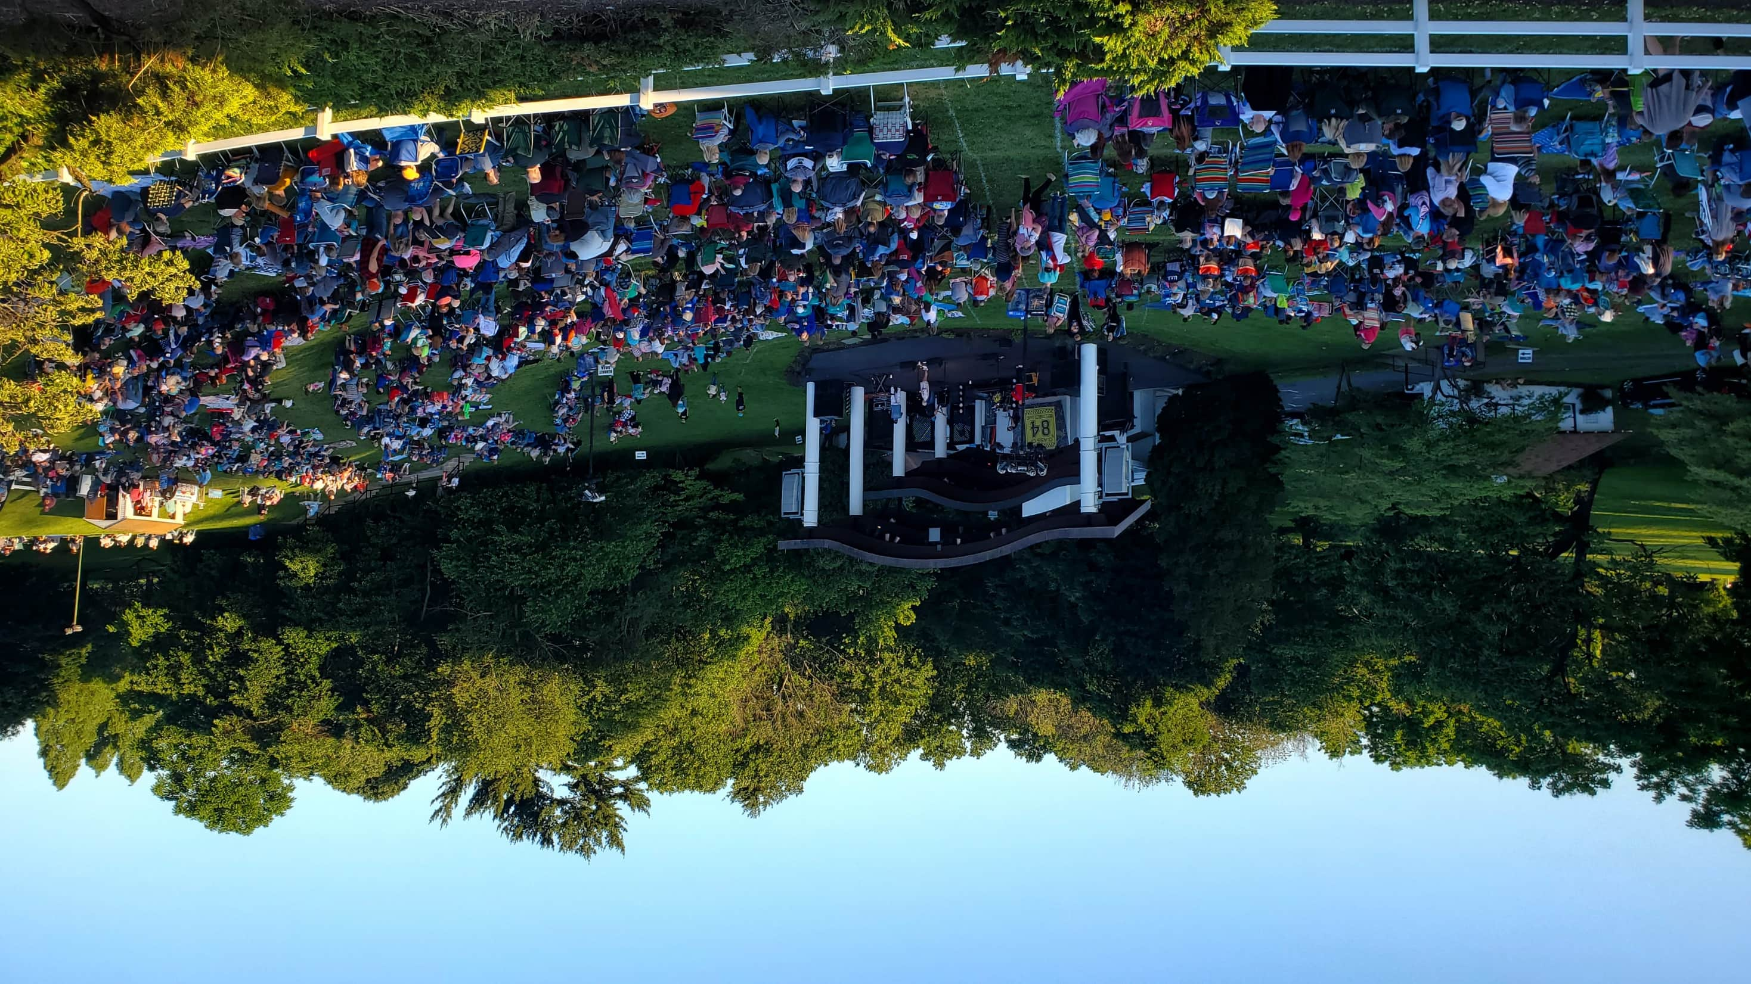
ROSE TREE
SUMMER FESTIVAL
DELCO’S ANNUAL CONCERT SERIES BELOVED TRADITION SINCE 1975
ADMISSION FREE

Slide 8
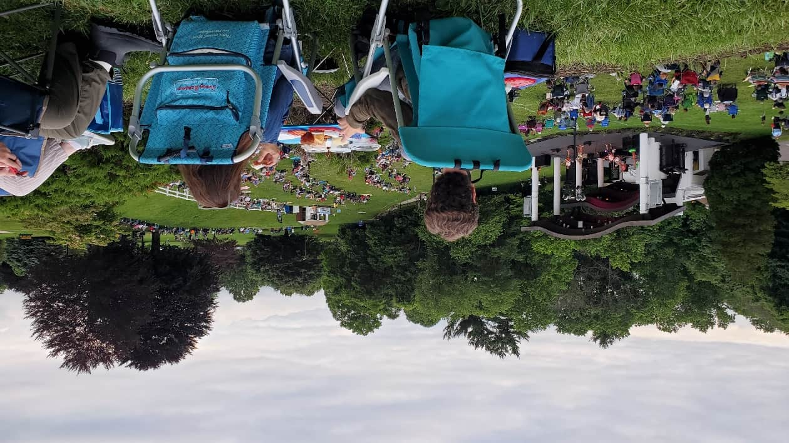
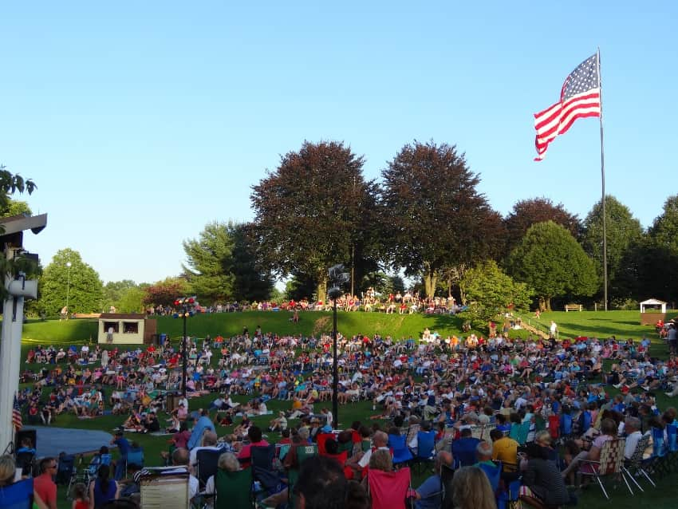
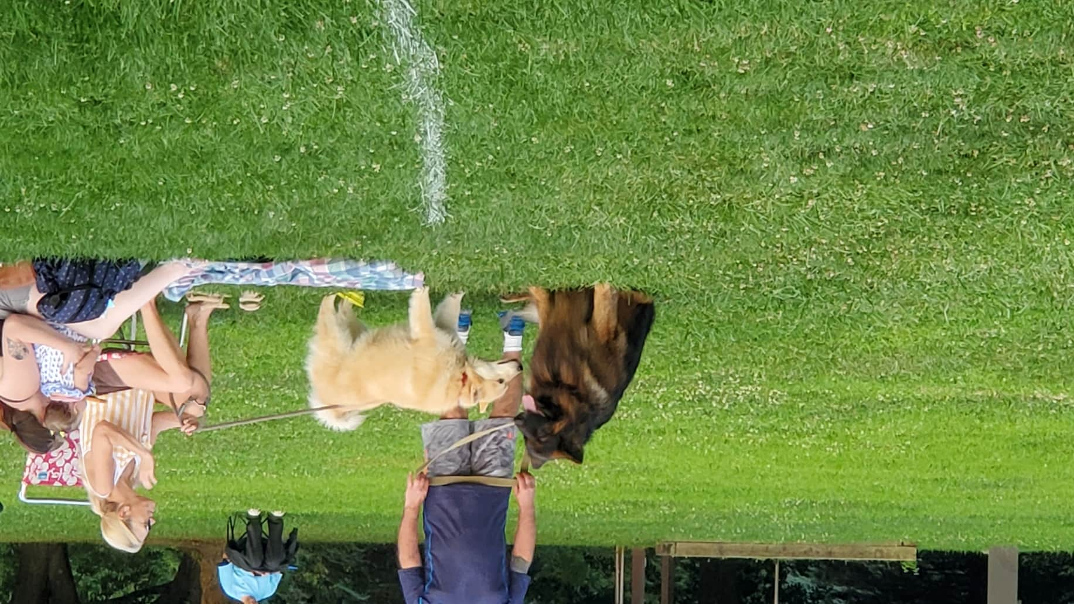
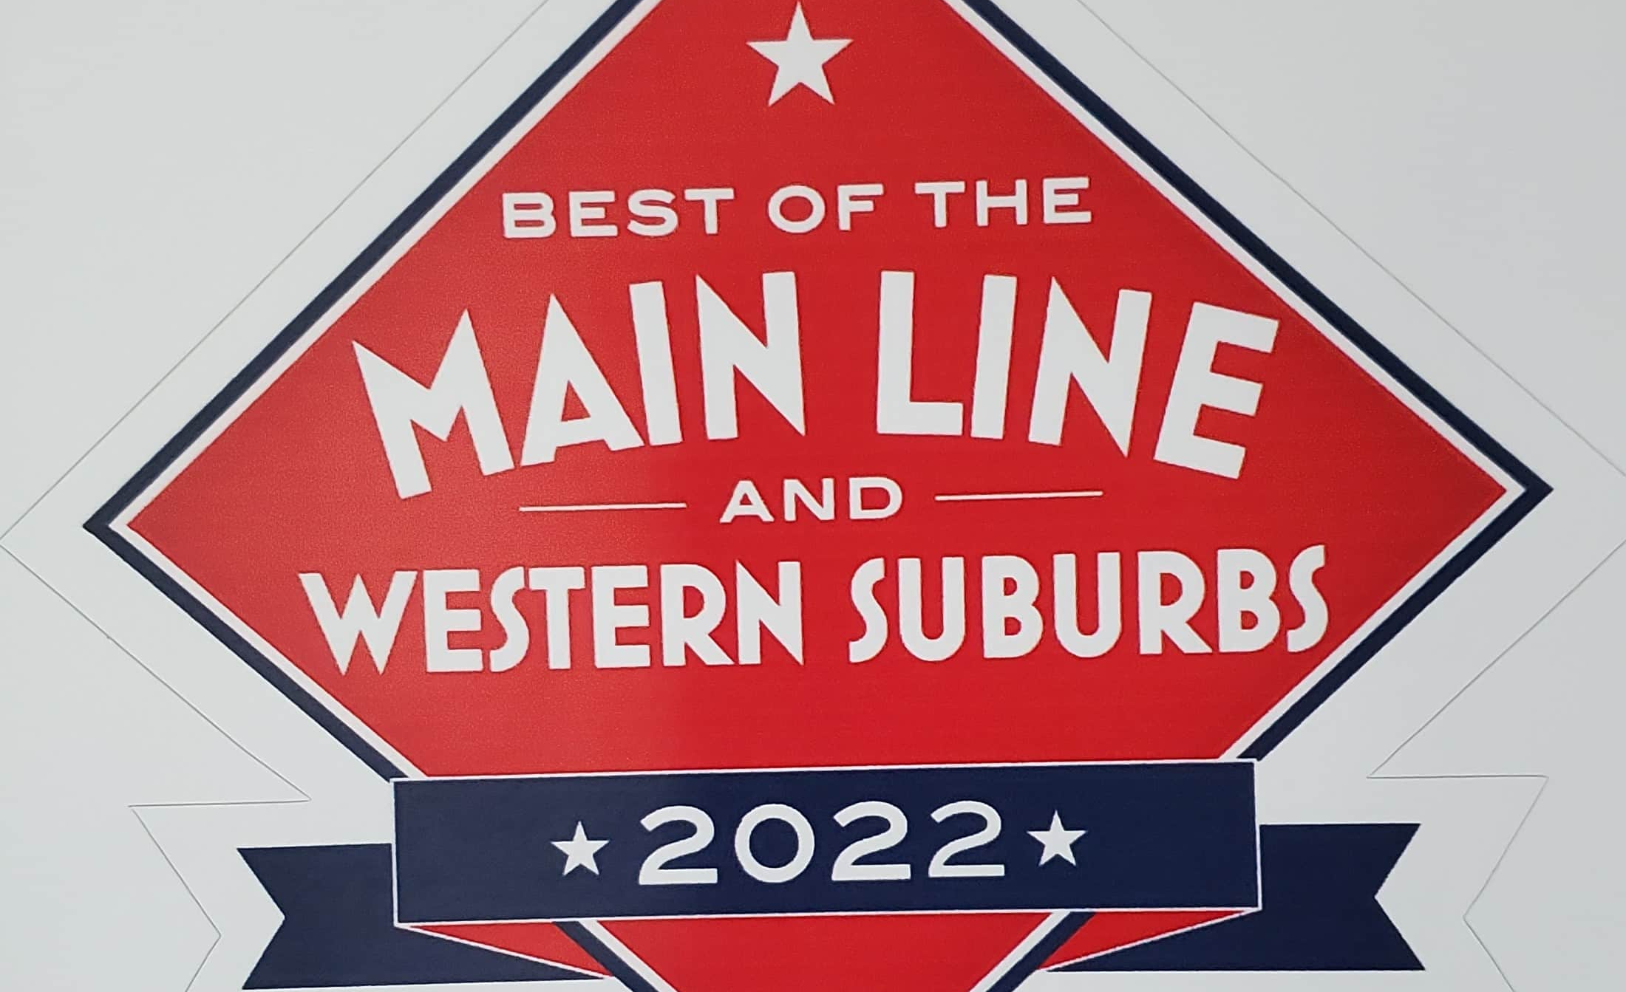
THE NUMBERS
9 WEEKS OF SHOWS
45 CONCERTS
800+ LOCAL PERFORMERS
35,000+ ATTENDANCE
THE SCENE
CHILDREN’S SHOWS
ROCK, POP, R&B
MOTOWN & DISCO
CLASSICAL MUSIC
BLUES, JAZZ & SWING
BROADWAY, OPERA
ZYDECO, MARDIS GRAS
BLUEGRASS & MORE

Slide 9
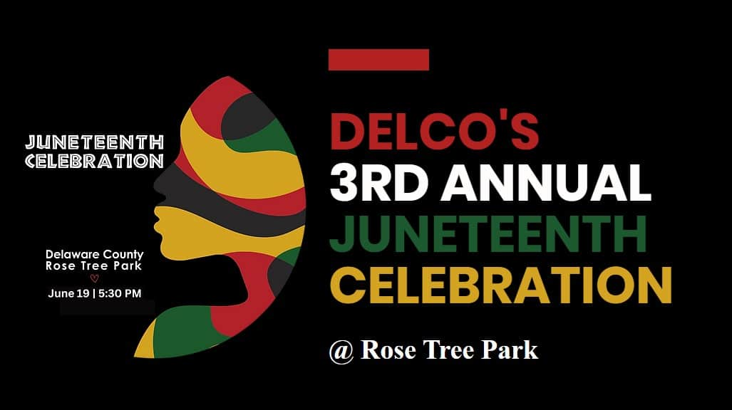
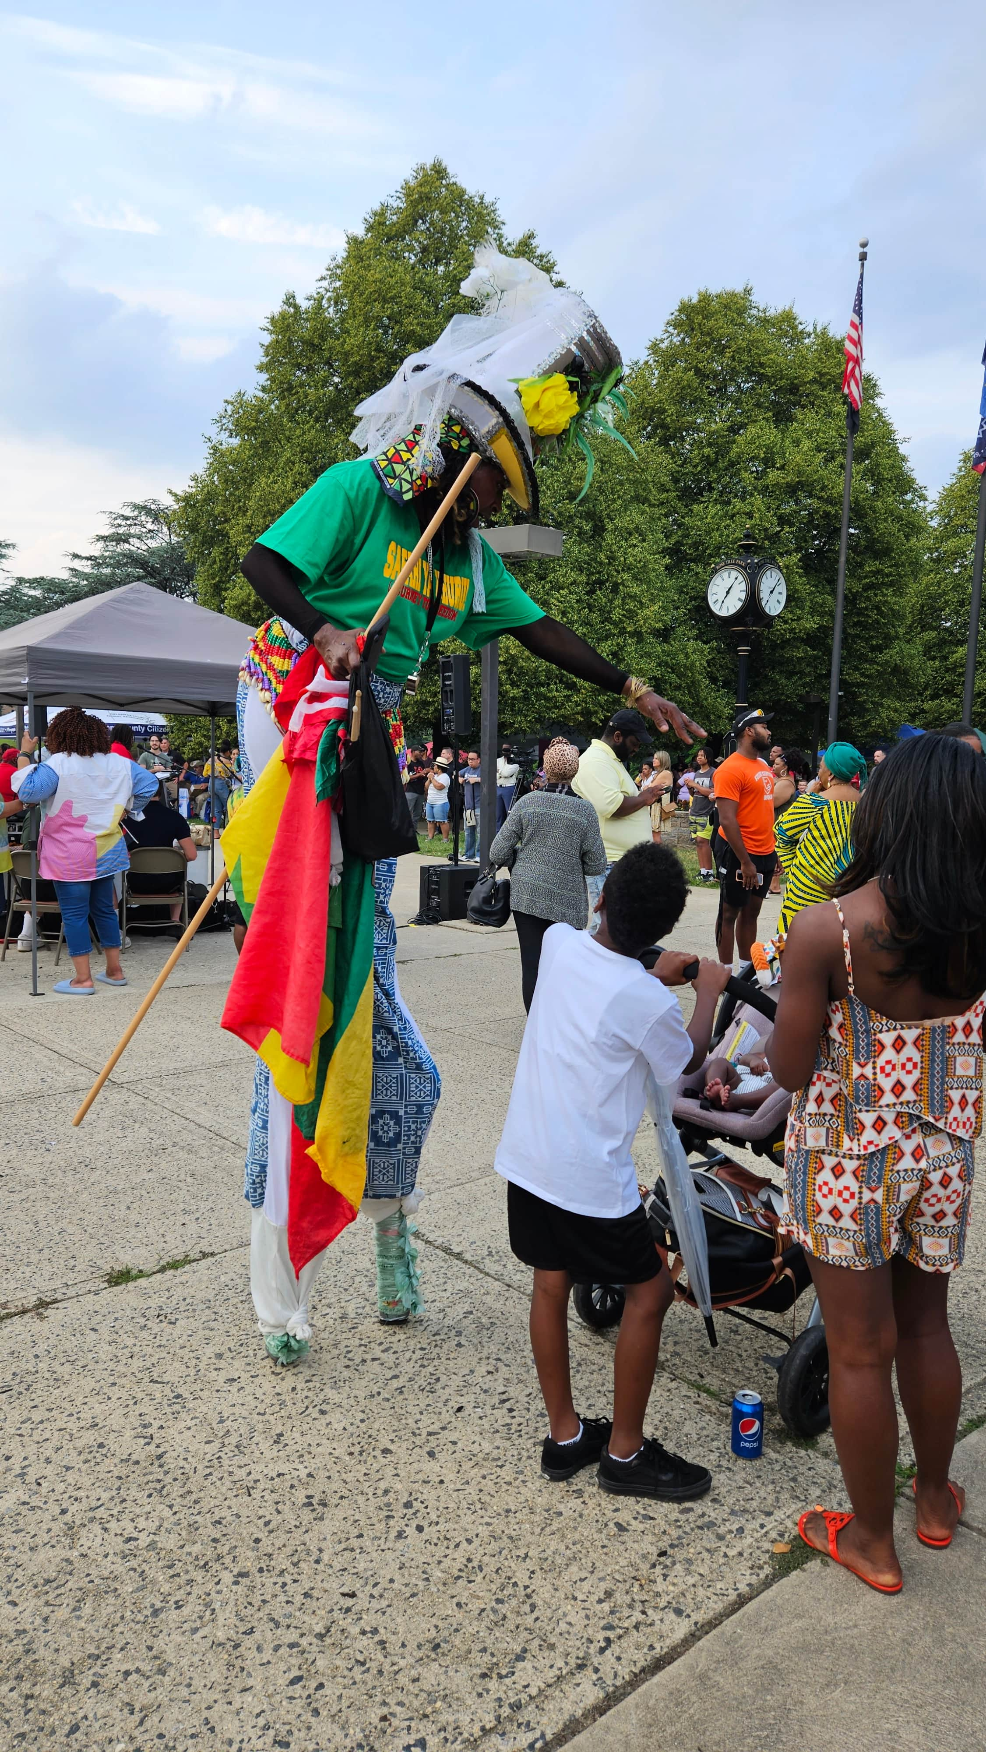
Delaware County's Juneteenth Celebration
Performances, vendors, and a concert in Rose Tree Park

Slide 10
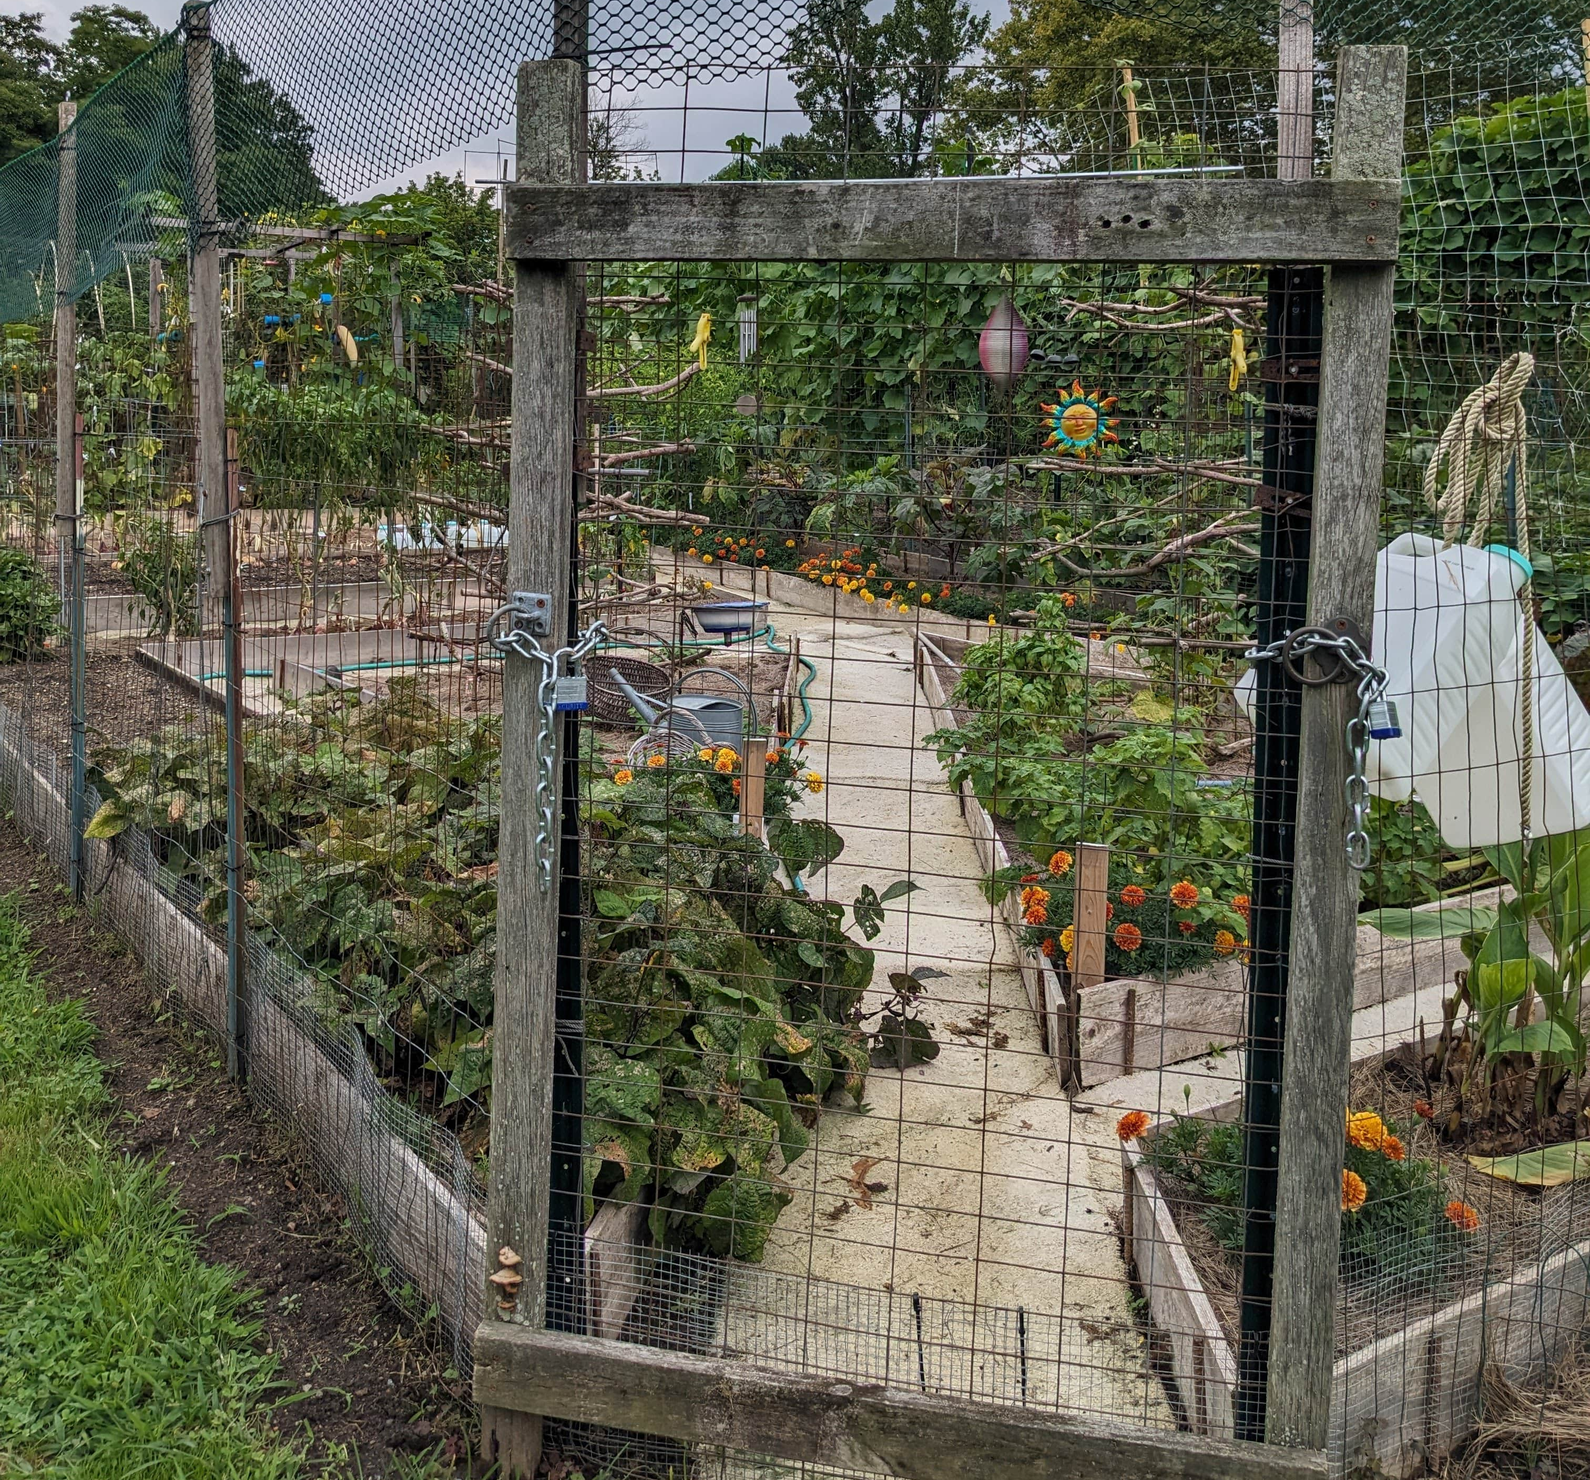
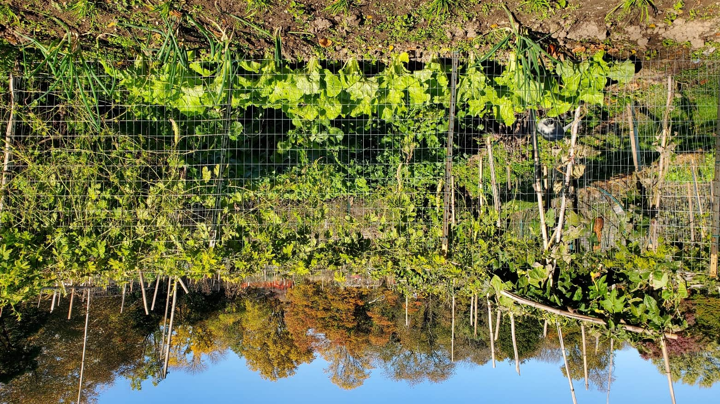
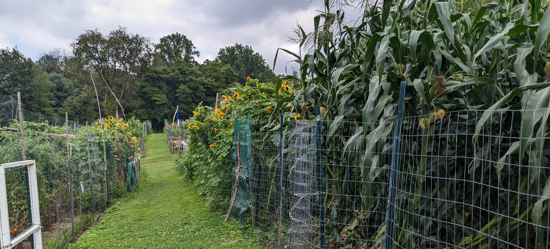
ROSE TREE COMMUNITY
GARDENS
118 Farm Plots for seasonal lease
Season runs April – November
Gardeners pay a nominal fee and provide their own fencing, supplies.
Size: 20’ x 25’
Water source available
Non-commercial use only
Organic, non-toxic practices required
Popular for over 4 decades; there’s always waiting list.

Slide 11
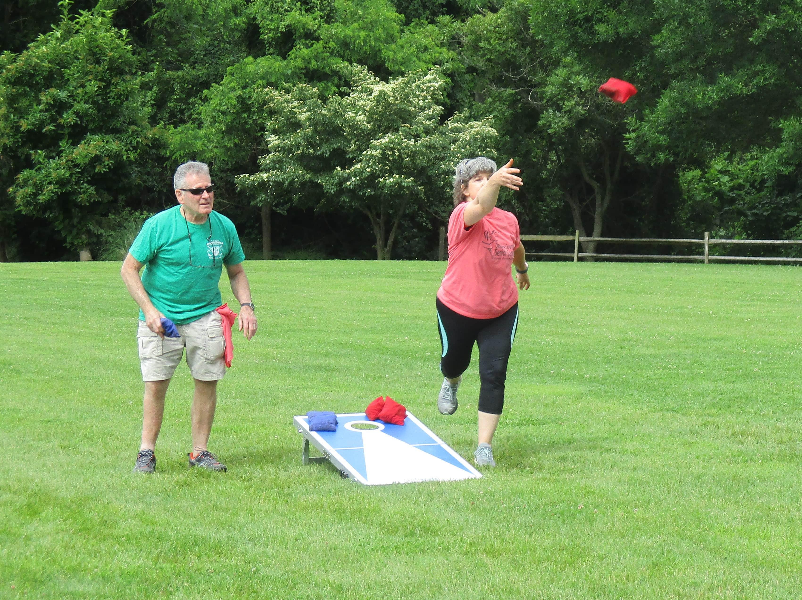
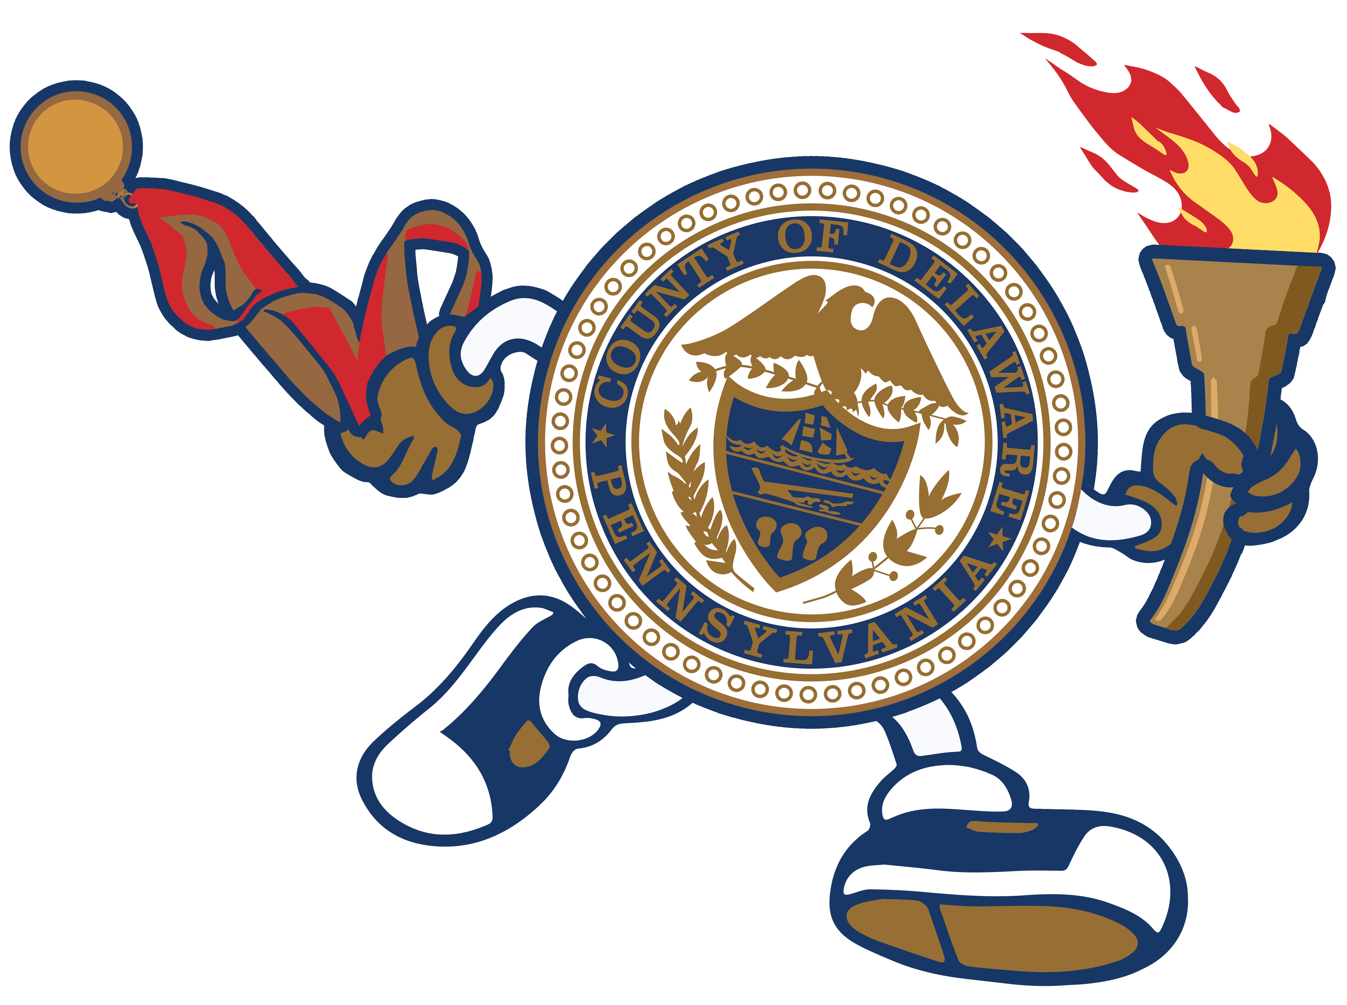
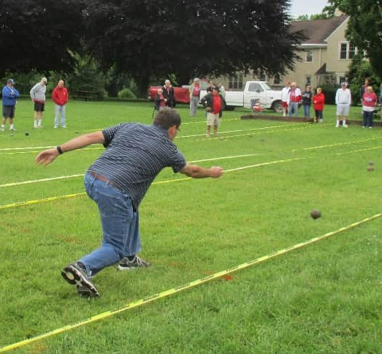
Delaware County Senior Games
Rose Tree Park Hosts Bocce & Corn Hole
DelcoSeniorGames.org
Mission: To engage residents age 50+ in two weeks of fun events that promote a healthy, social, and active lifestyle.

Slide 12
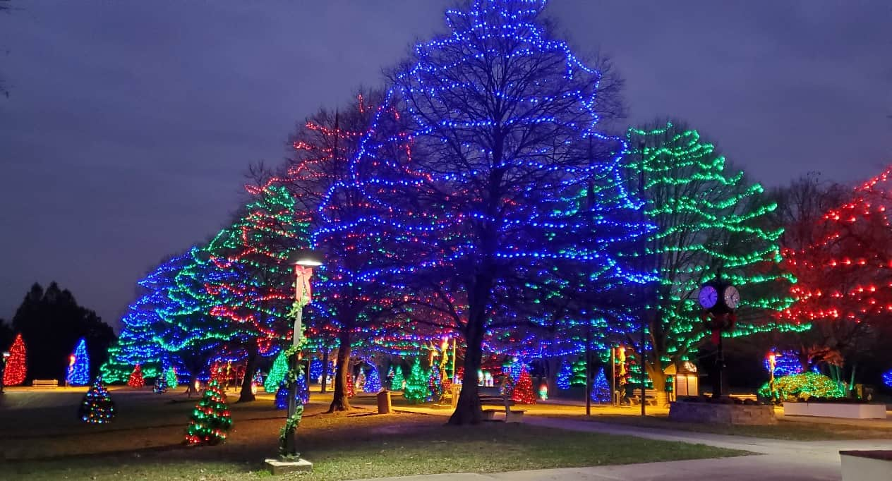
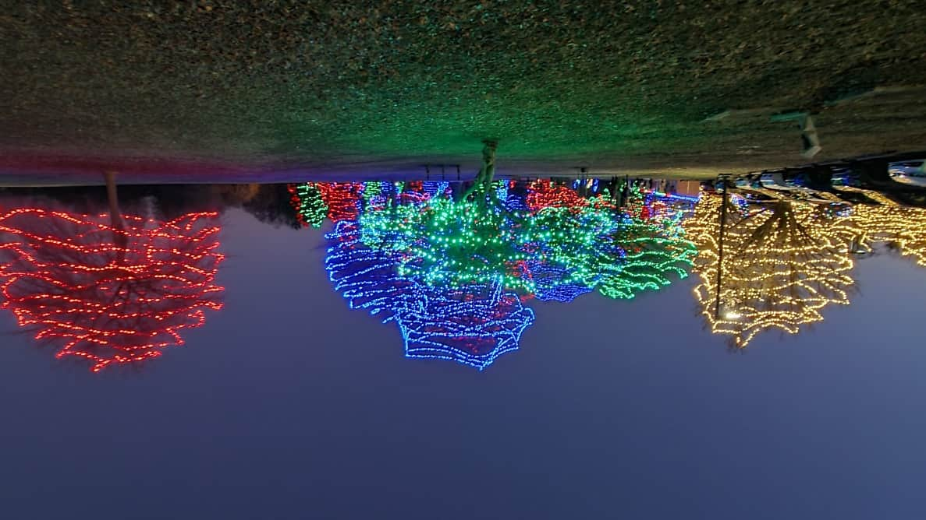
Displays are lit nightly throughout December, free for public enjoyment and enjoyed by tens of thousands of residents.
The Festival of Lights
A Delco Tradition Since 1976

Slide 13
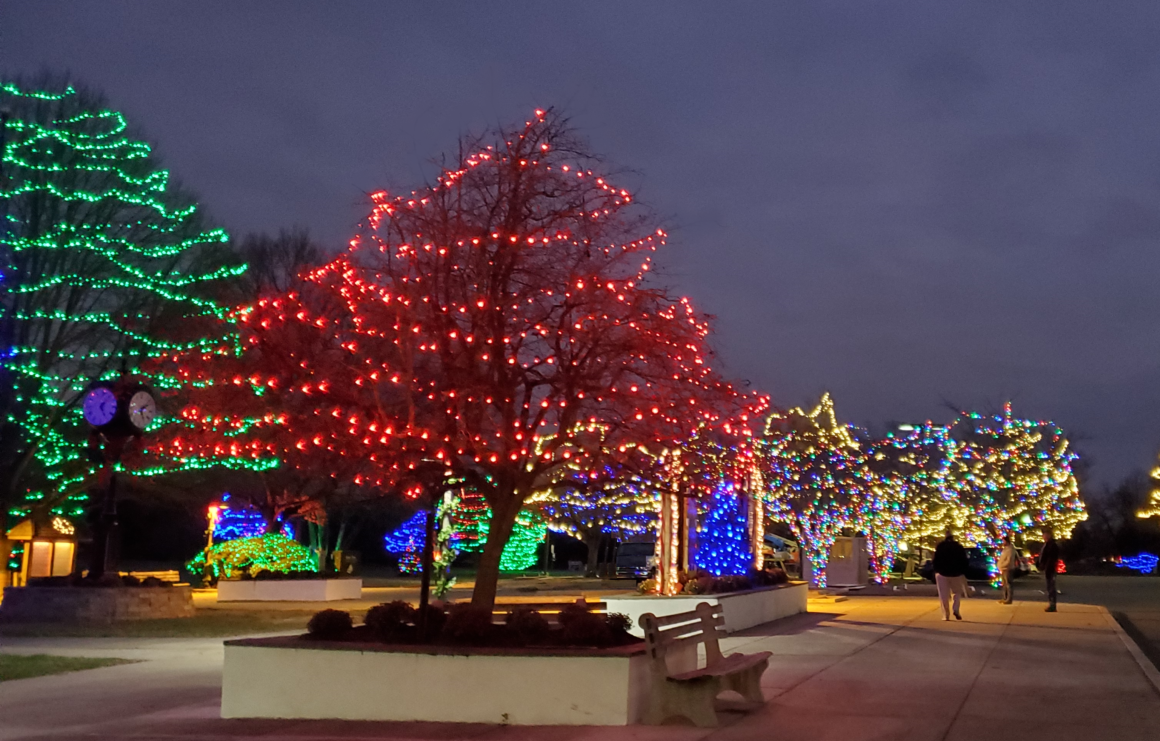
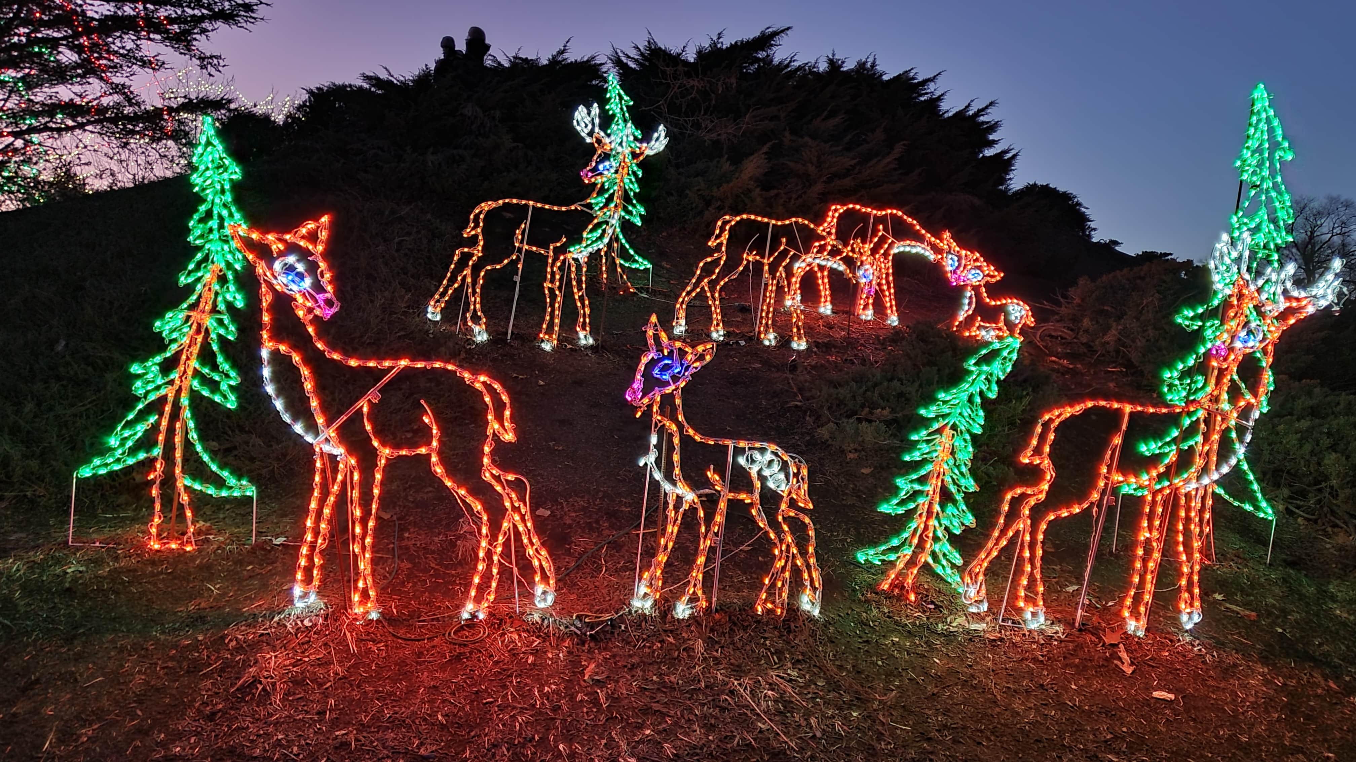
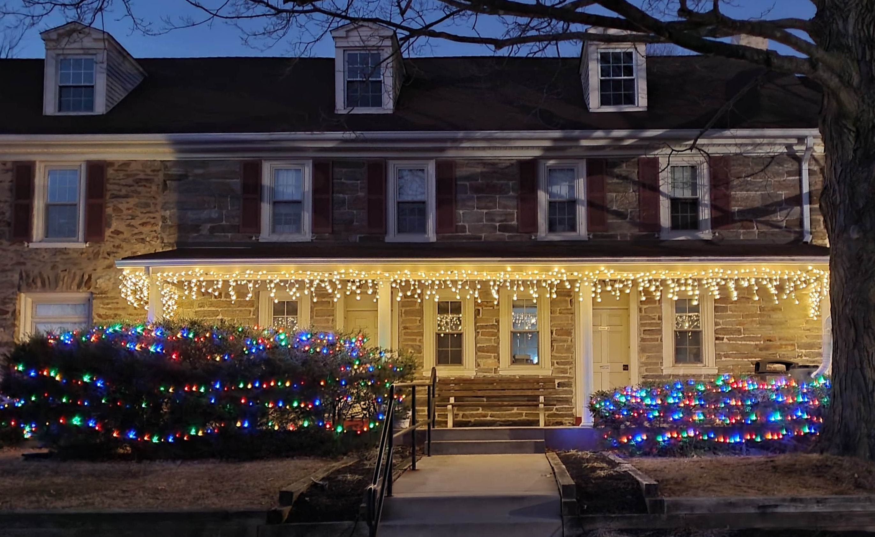
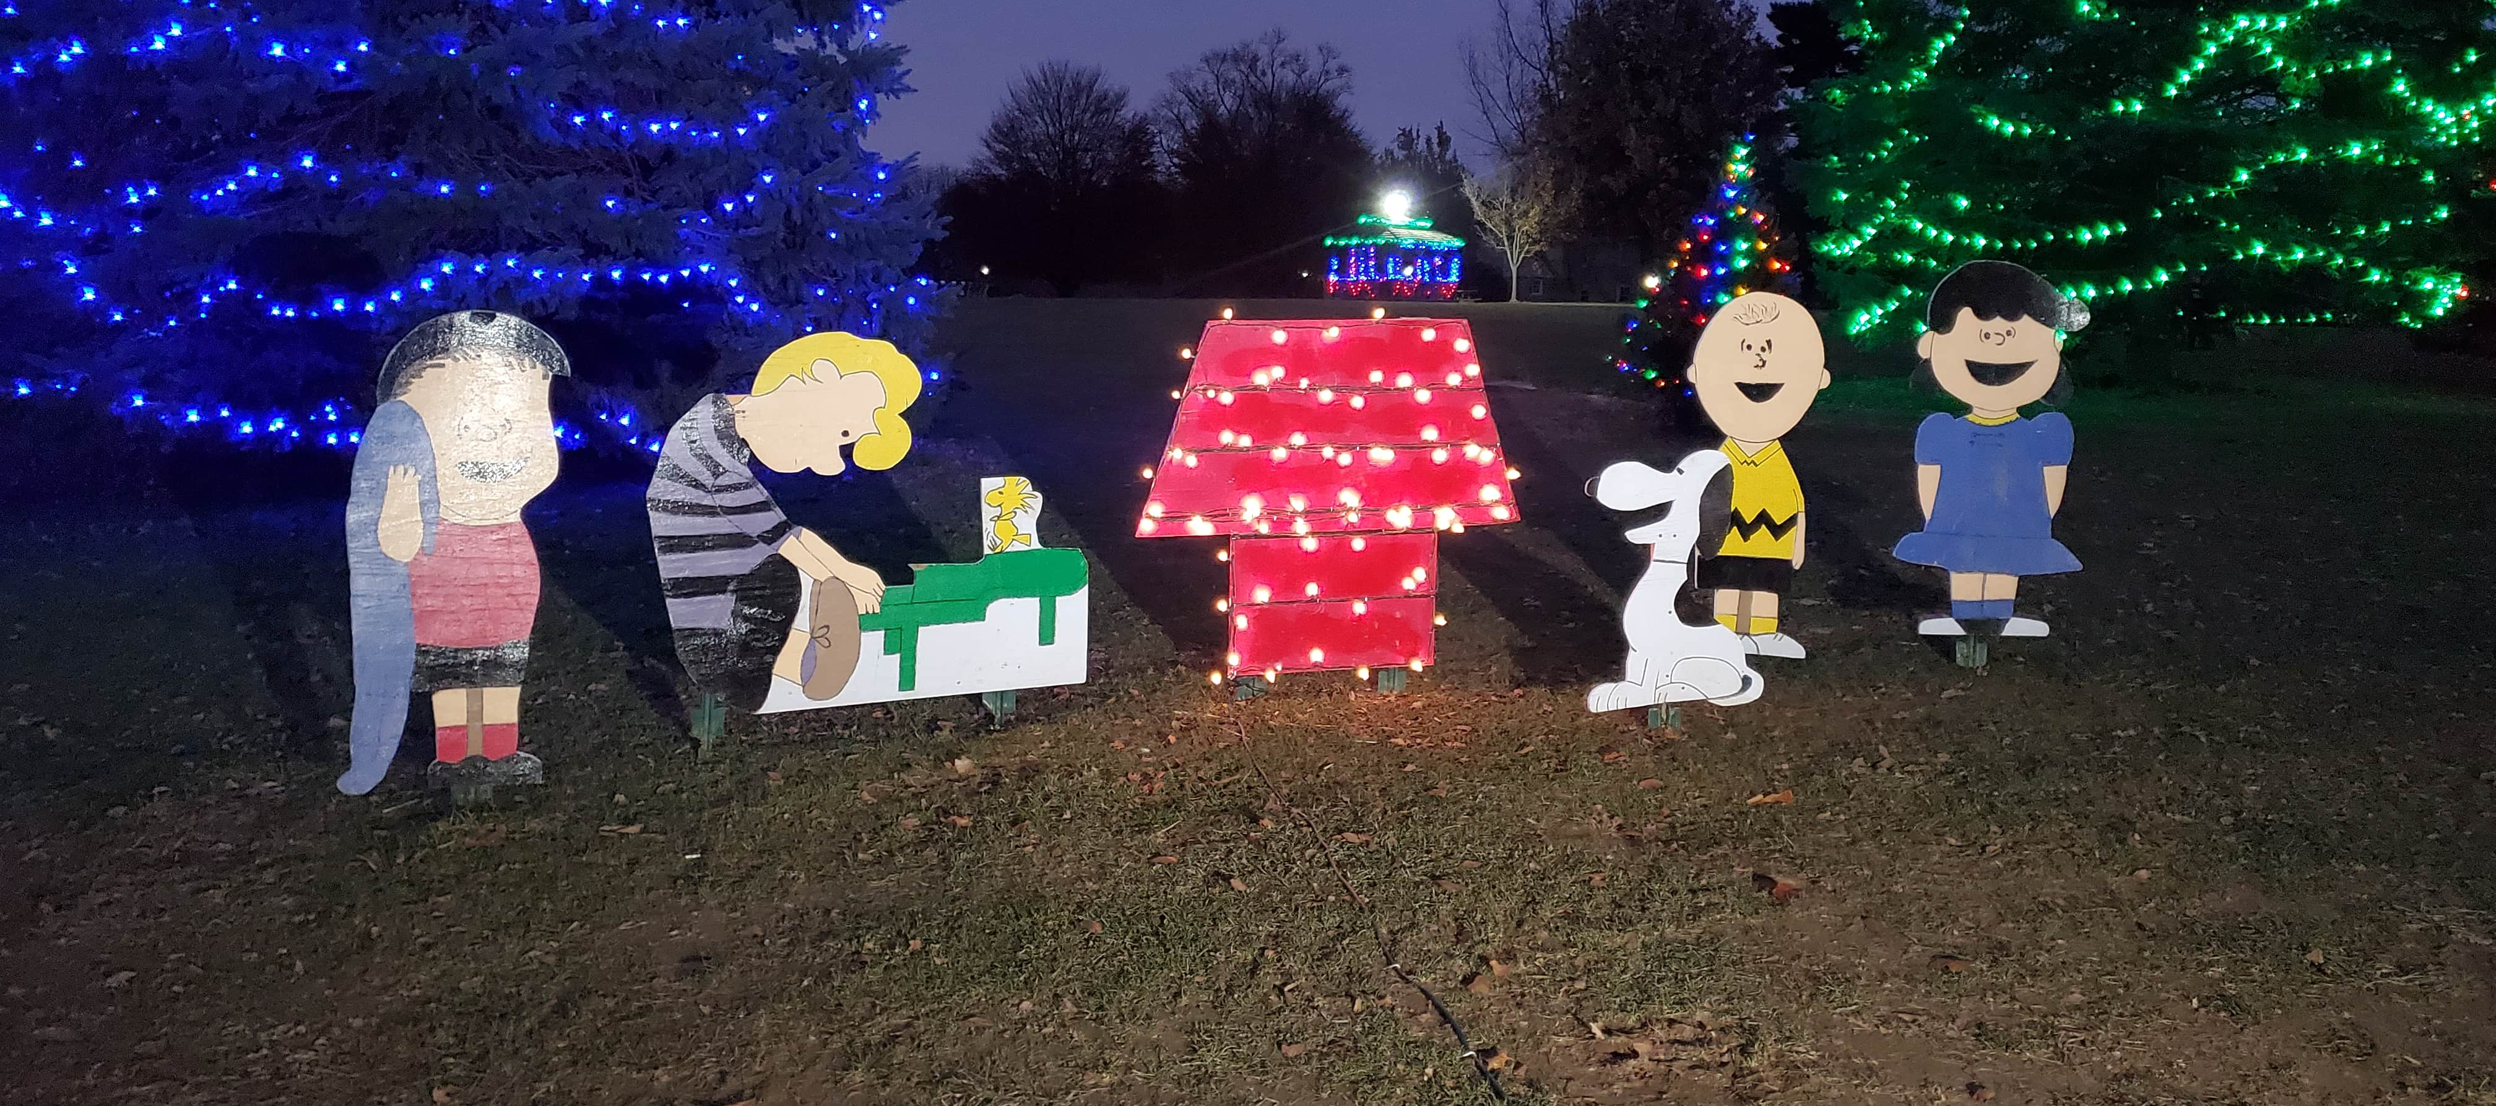
The Festival of Lights is a walk-through display.
Admission and parking are free.
Friendly, leashed dogs are permitted.
Historic Hunt Club Building

Slide 14
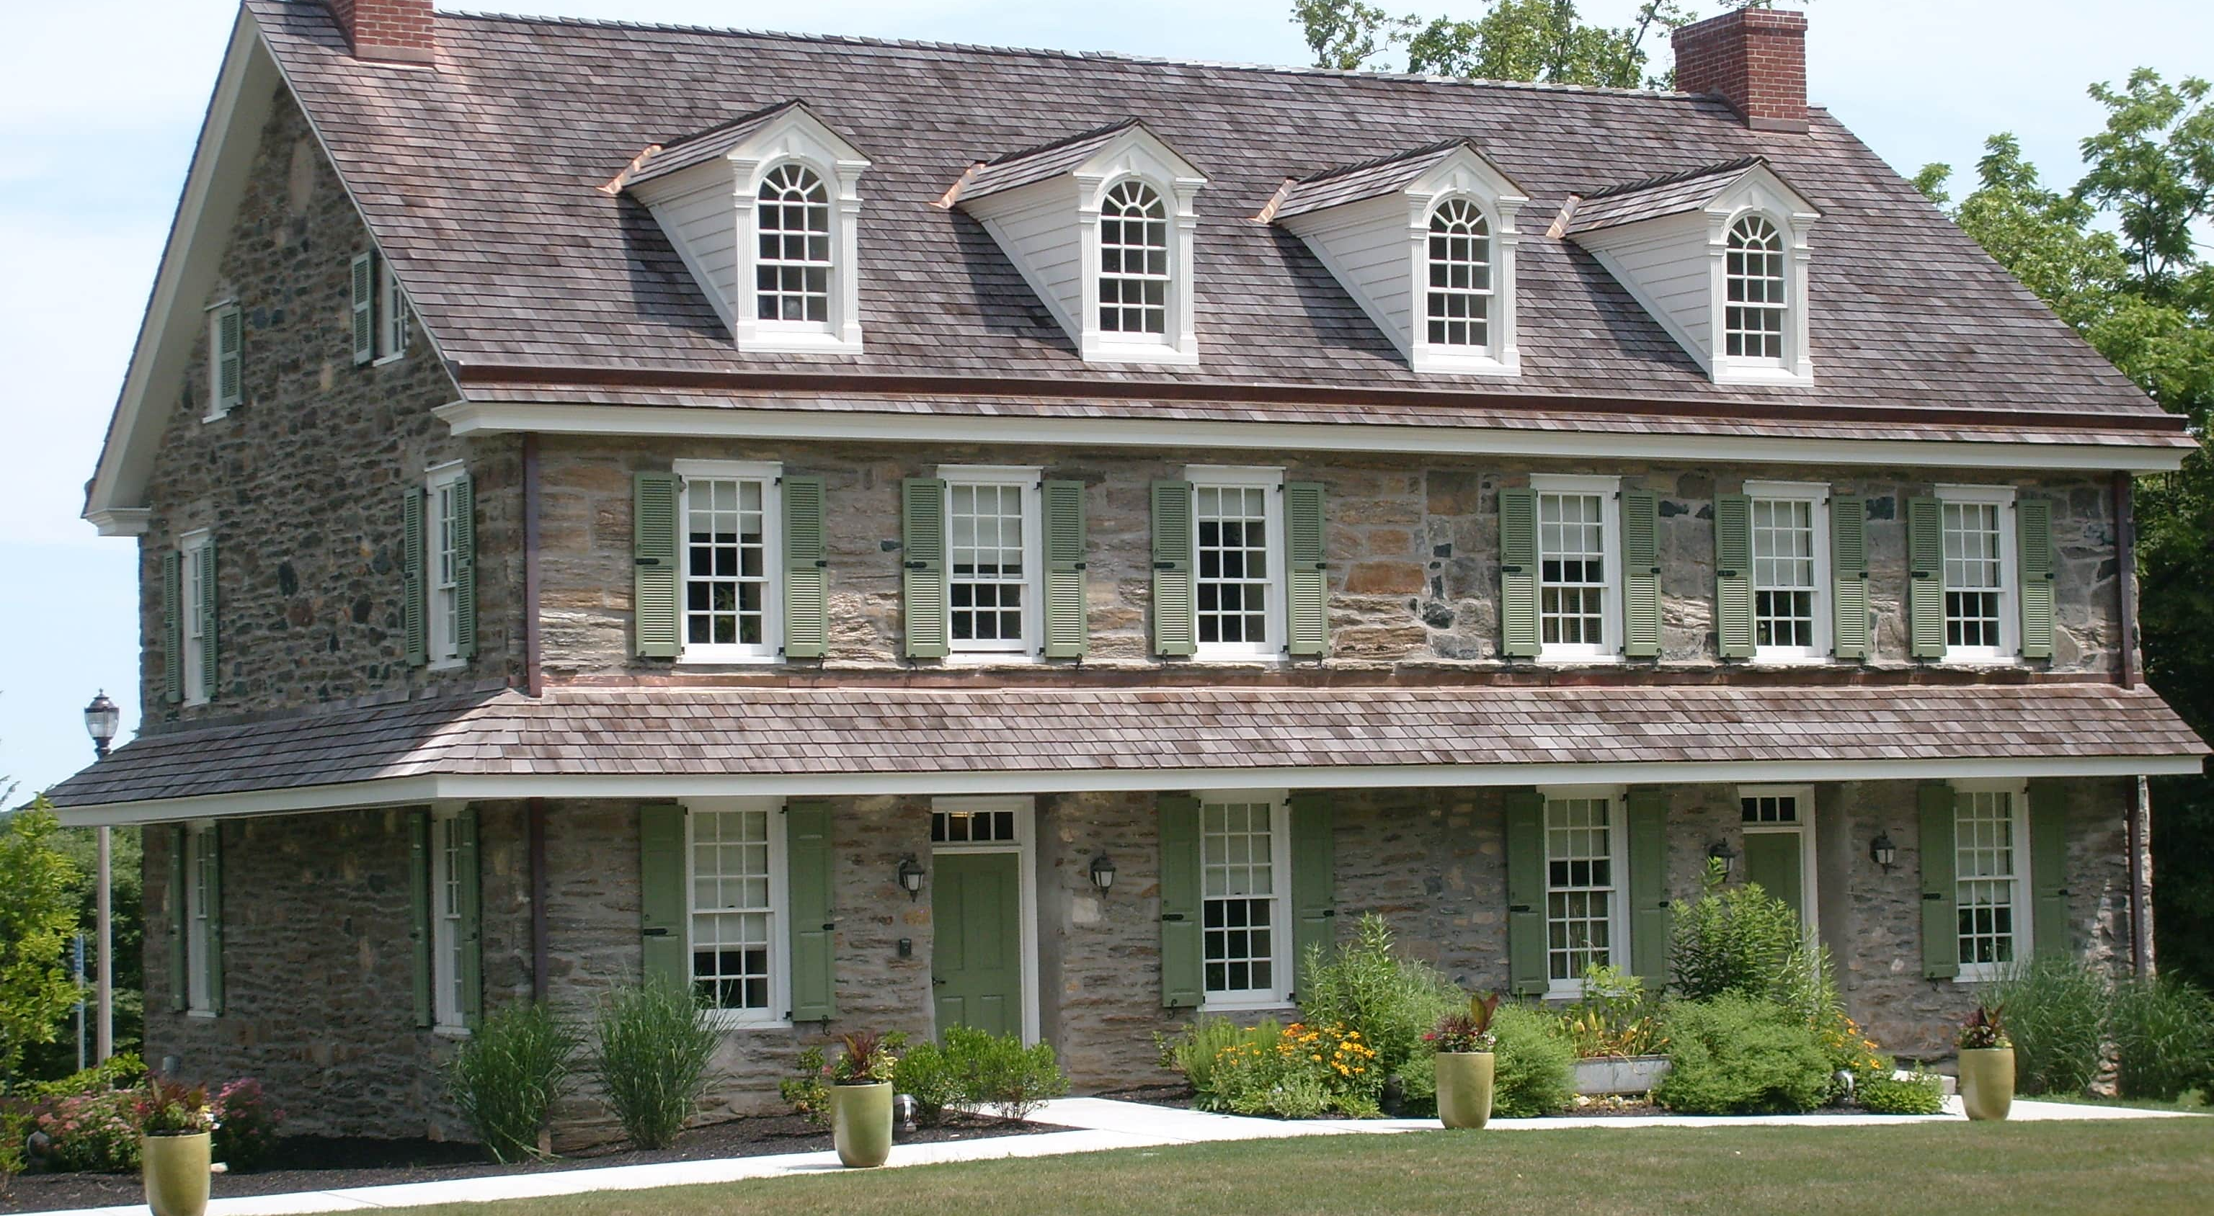
Historic Rose Tree Tavern
Produced by The Delaware County Parks & Recreation Department, 2024.
Audio Credit: Sweet Dreams by BatchBug | https://soundcloud.com/batchbug/
Music promoted by https://www.chosic.com/free-music/all/
Creative Commons Attribution 3.0 Unported License https://creativecommons.org/licenses/by/3.0/deed.en_US

