Slide 1

The 2025 Rose Tree Summer Festival: Our 50th Season
Our Milestone Year in Review

Slide 2
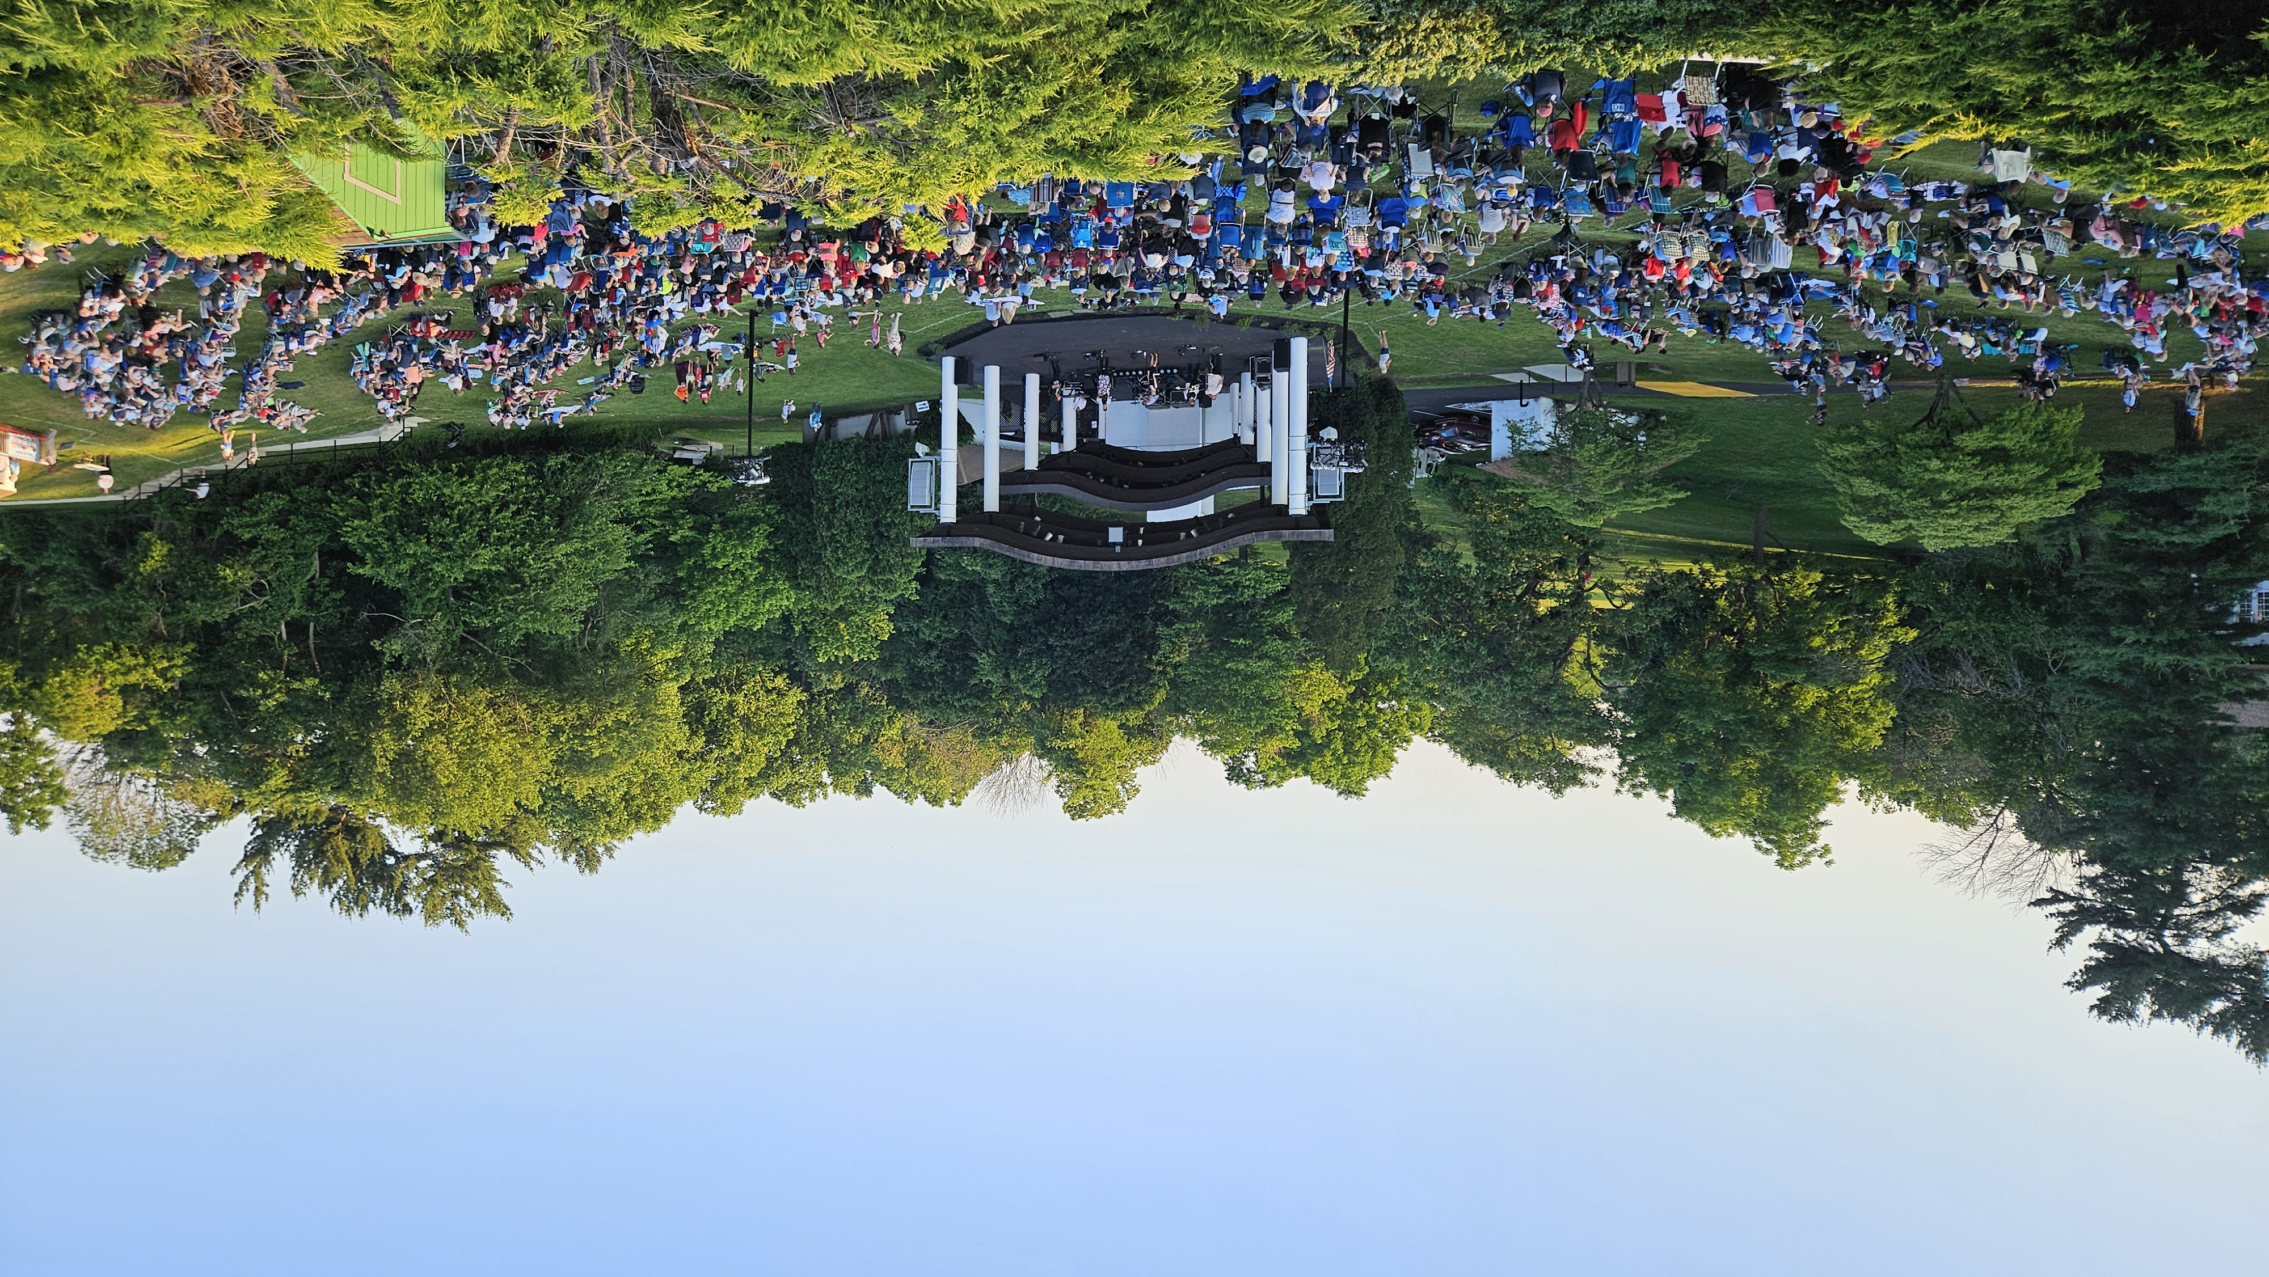
The 50th Annual Rose Tree Summer Festival June 11 – August 10, 2025 Wednesday - Sunday
Presented by Delaware County Council & Produced by Delaware County Parks & Recreation

Slide 3

WHAT’S NEW?
In our 50th season, there was much to be excited about!

Slide 4
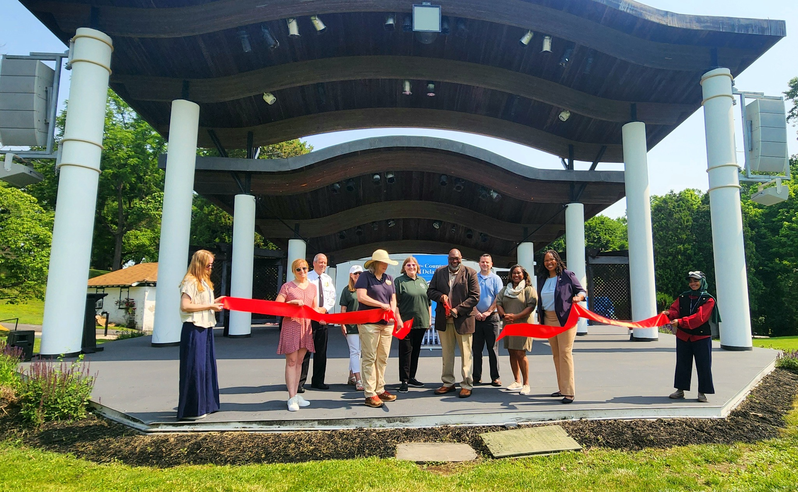
Just in time for our 50th season!
Ribbon Cutting: June 11, 2025
RENOVATIONS:
New Stage Floor and Roof
Updated ADA Public Restrooms
Handicapped Ramp to Restrooms
Re-striping of the parking lot
Tea House scraped and repainted
Delaware County Council members Richard Womack, Christine Reuther and Dr. Monica Taylor, Public Works Director Danielle Floyd, and Park Board Chair John McMullan join the Parks & Recreation team in celebrating the newly completed amphitheater renovations.

Slide 5
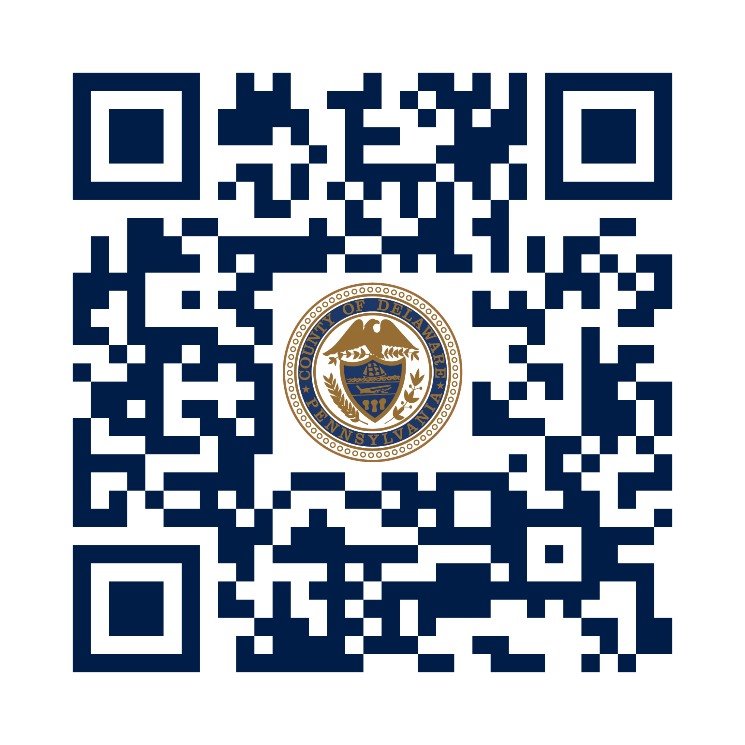
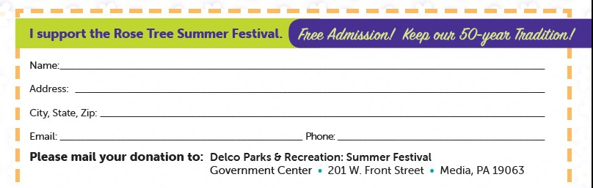
Donations
We appreciate our generous Patrons! We started accepting online donations.
Aficionados ($200+) & Friends of the Summer Festival ($100+) are listed in brochure and on the website.
Donations can now be accepted online!
Donors receive a sneak preview of the tentative schedule in early Spring.

Slide 6
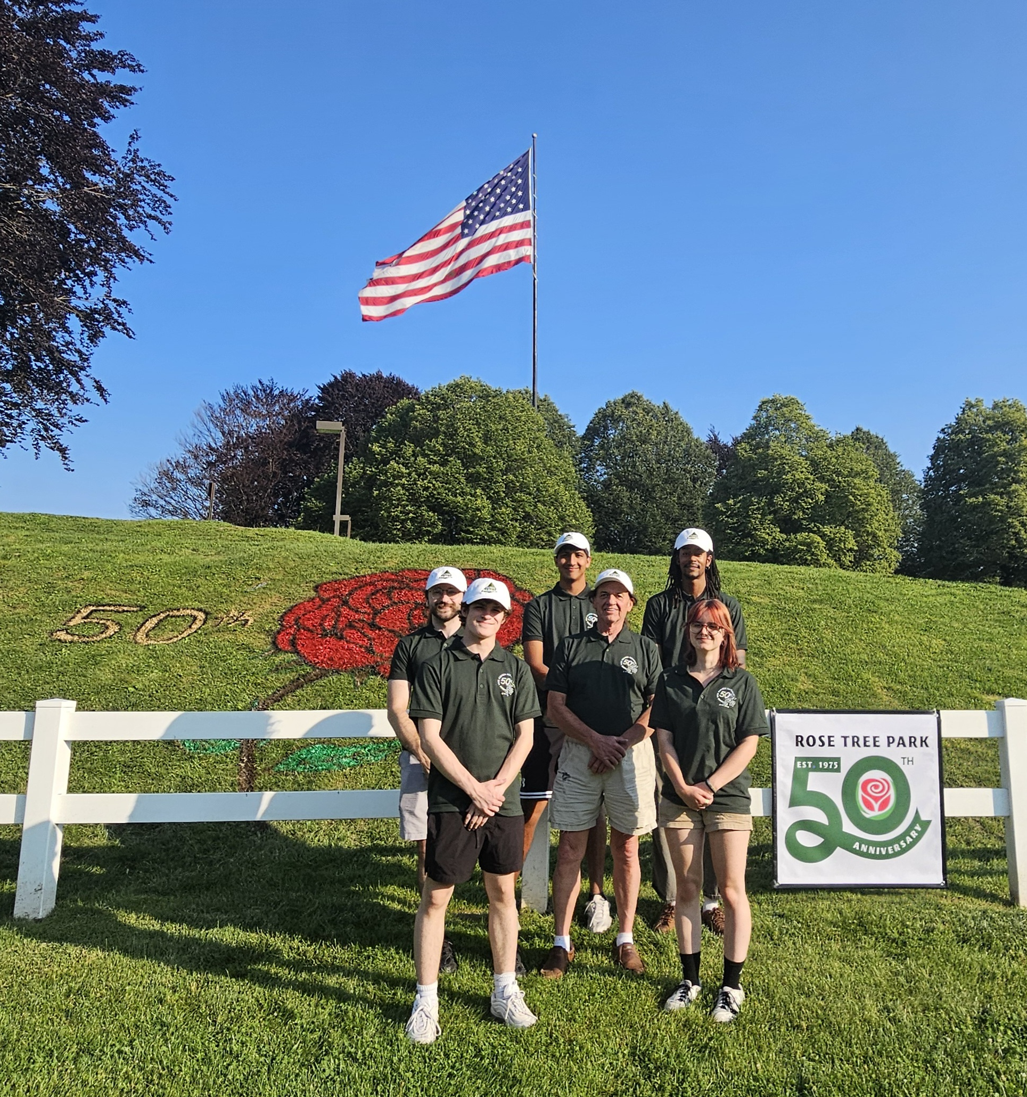

CELEBRATING 50!
Pictured: Price Stevenson, Technical Director &
2025 Crew: Matt, Brandon, Astrid, Noble, Xavier

Slide 7
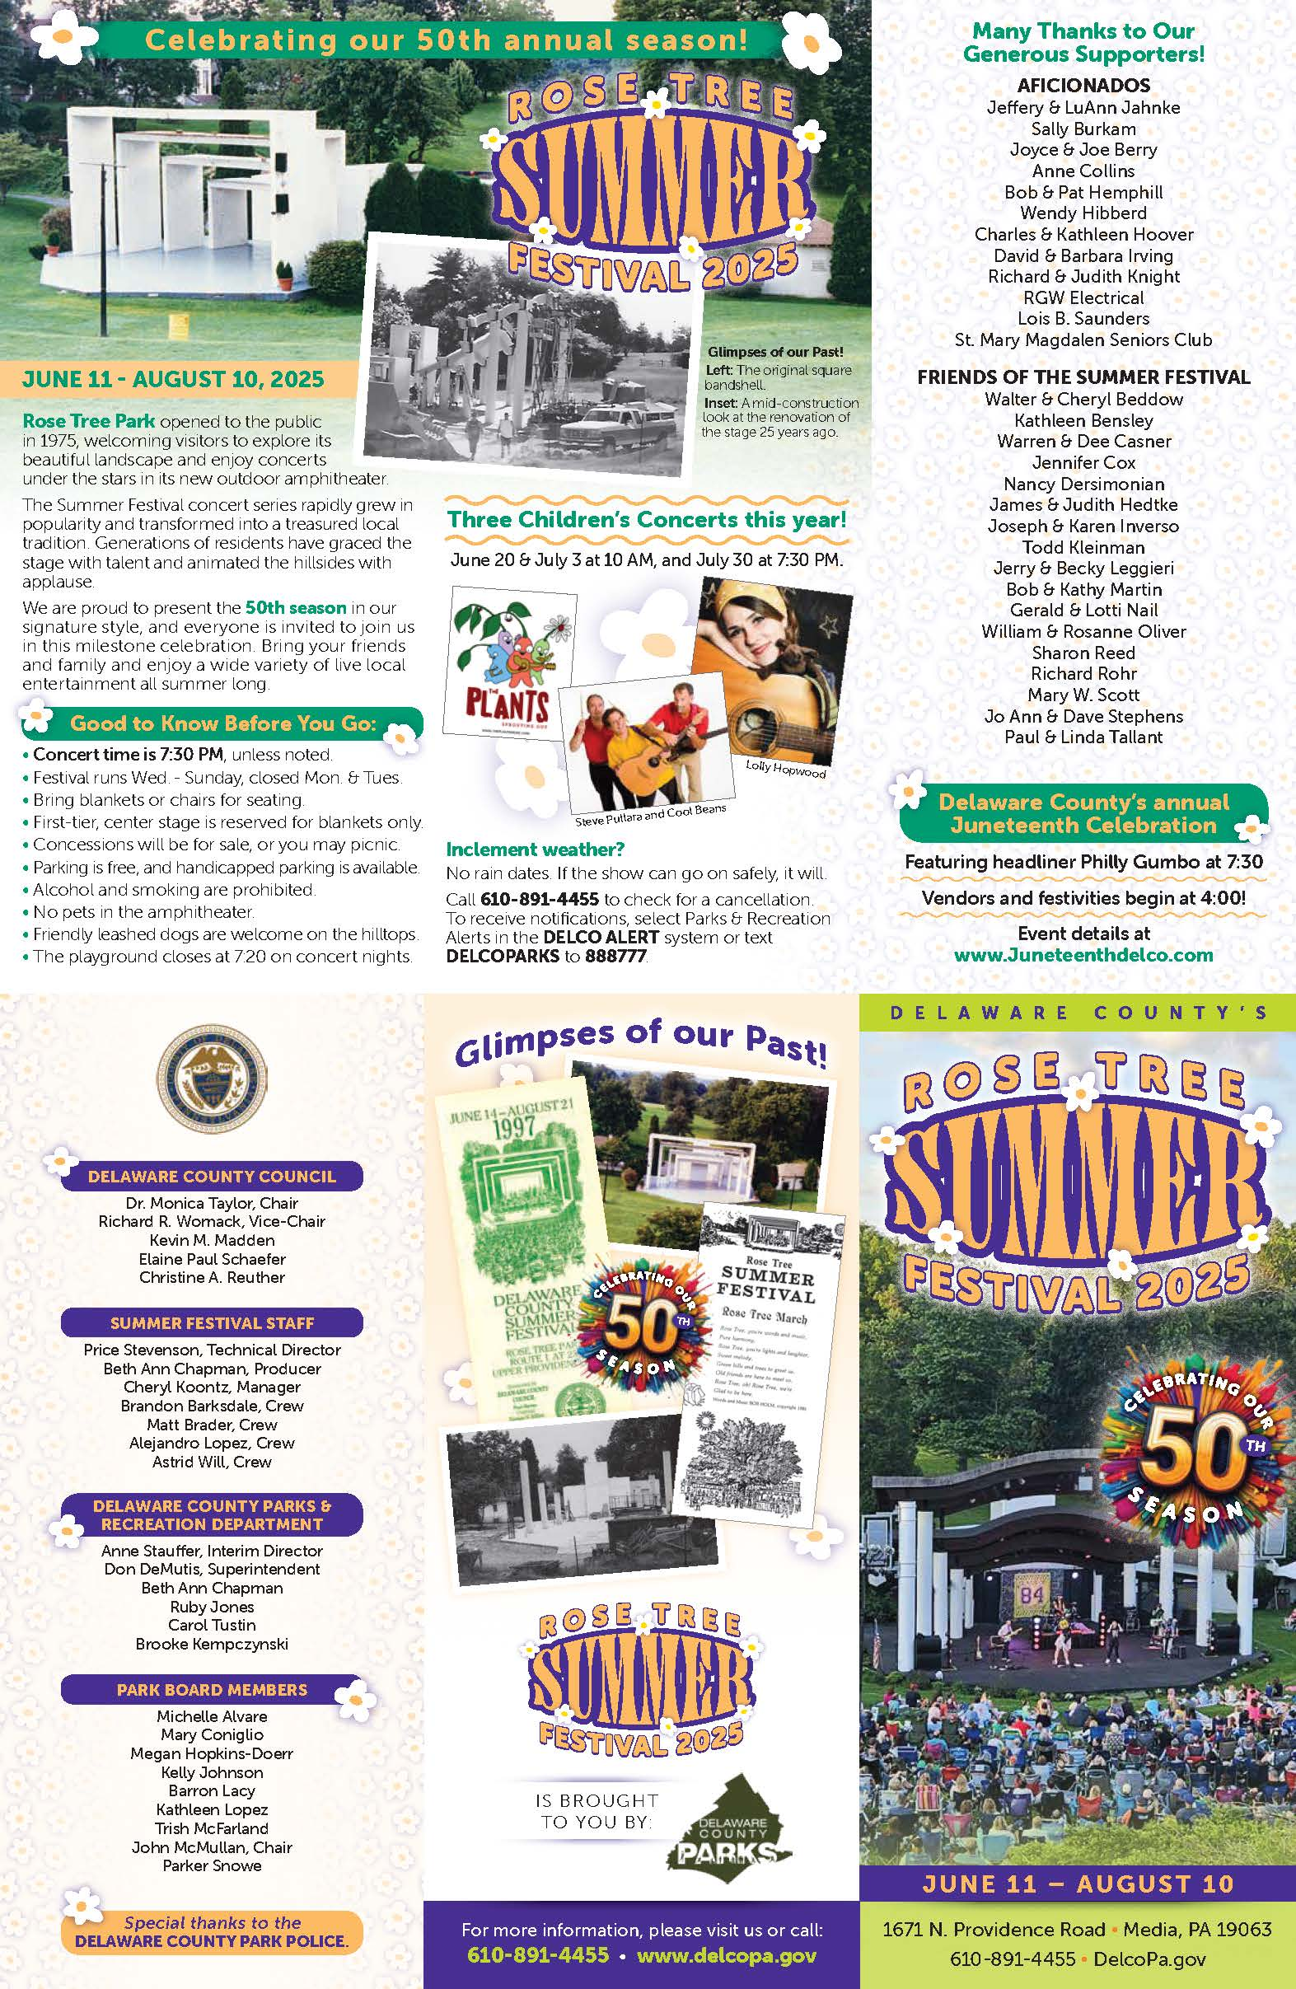
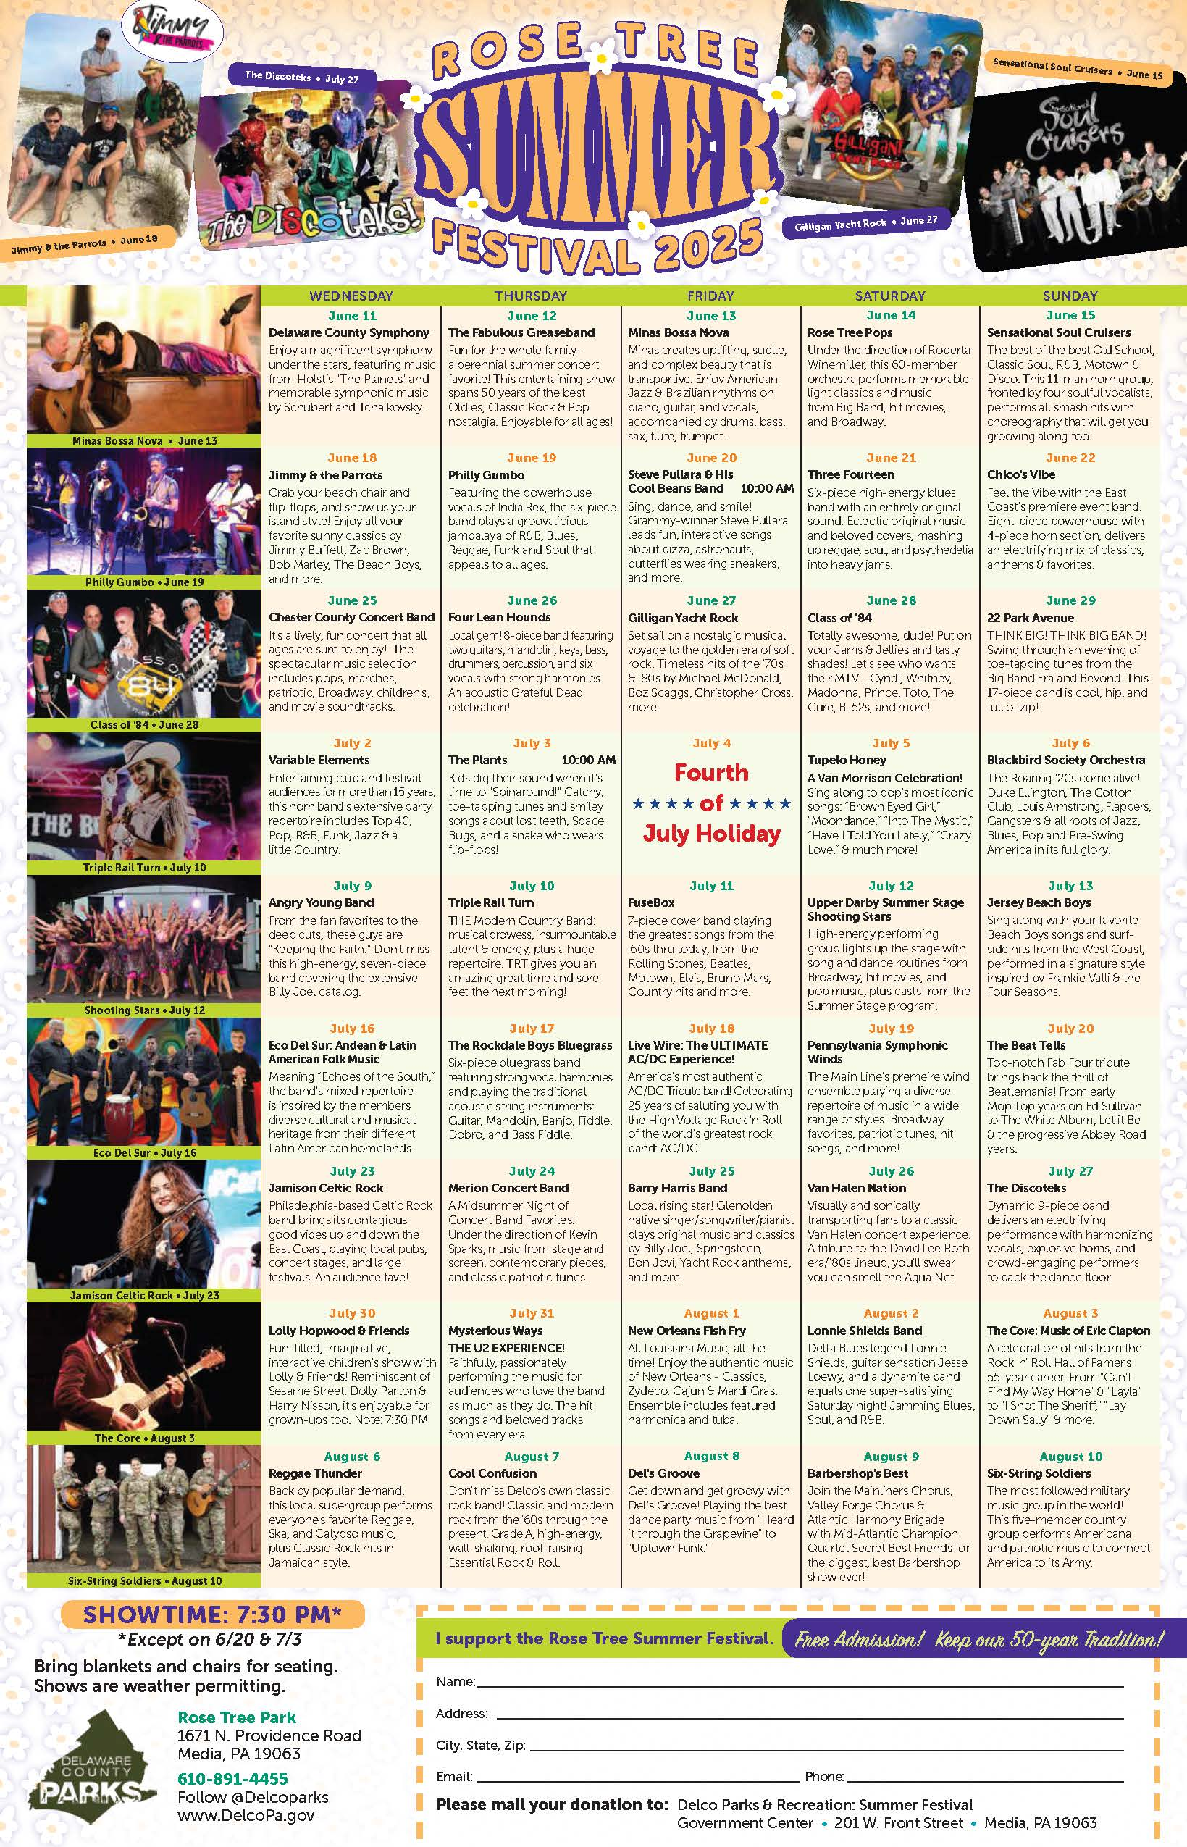
Event Brochure
15,000 Printed
Available in County Buildings & Libraries
Posted online
Sent to mailing list & SASEs
Distributed onsite

Slide 8
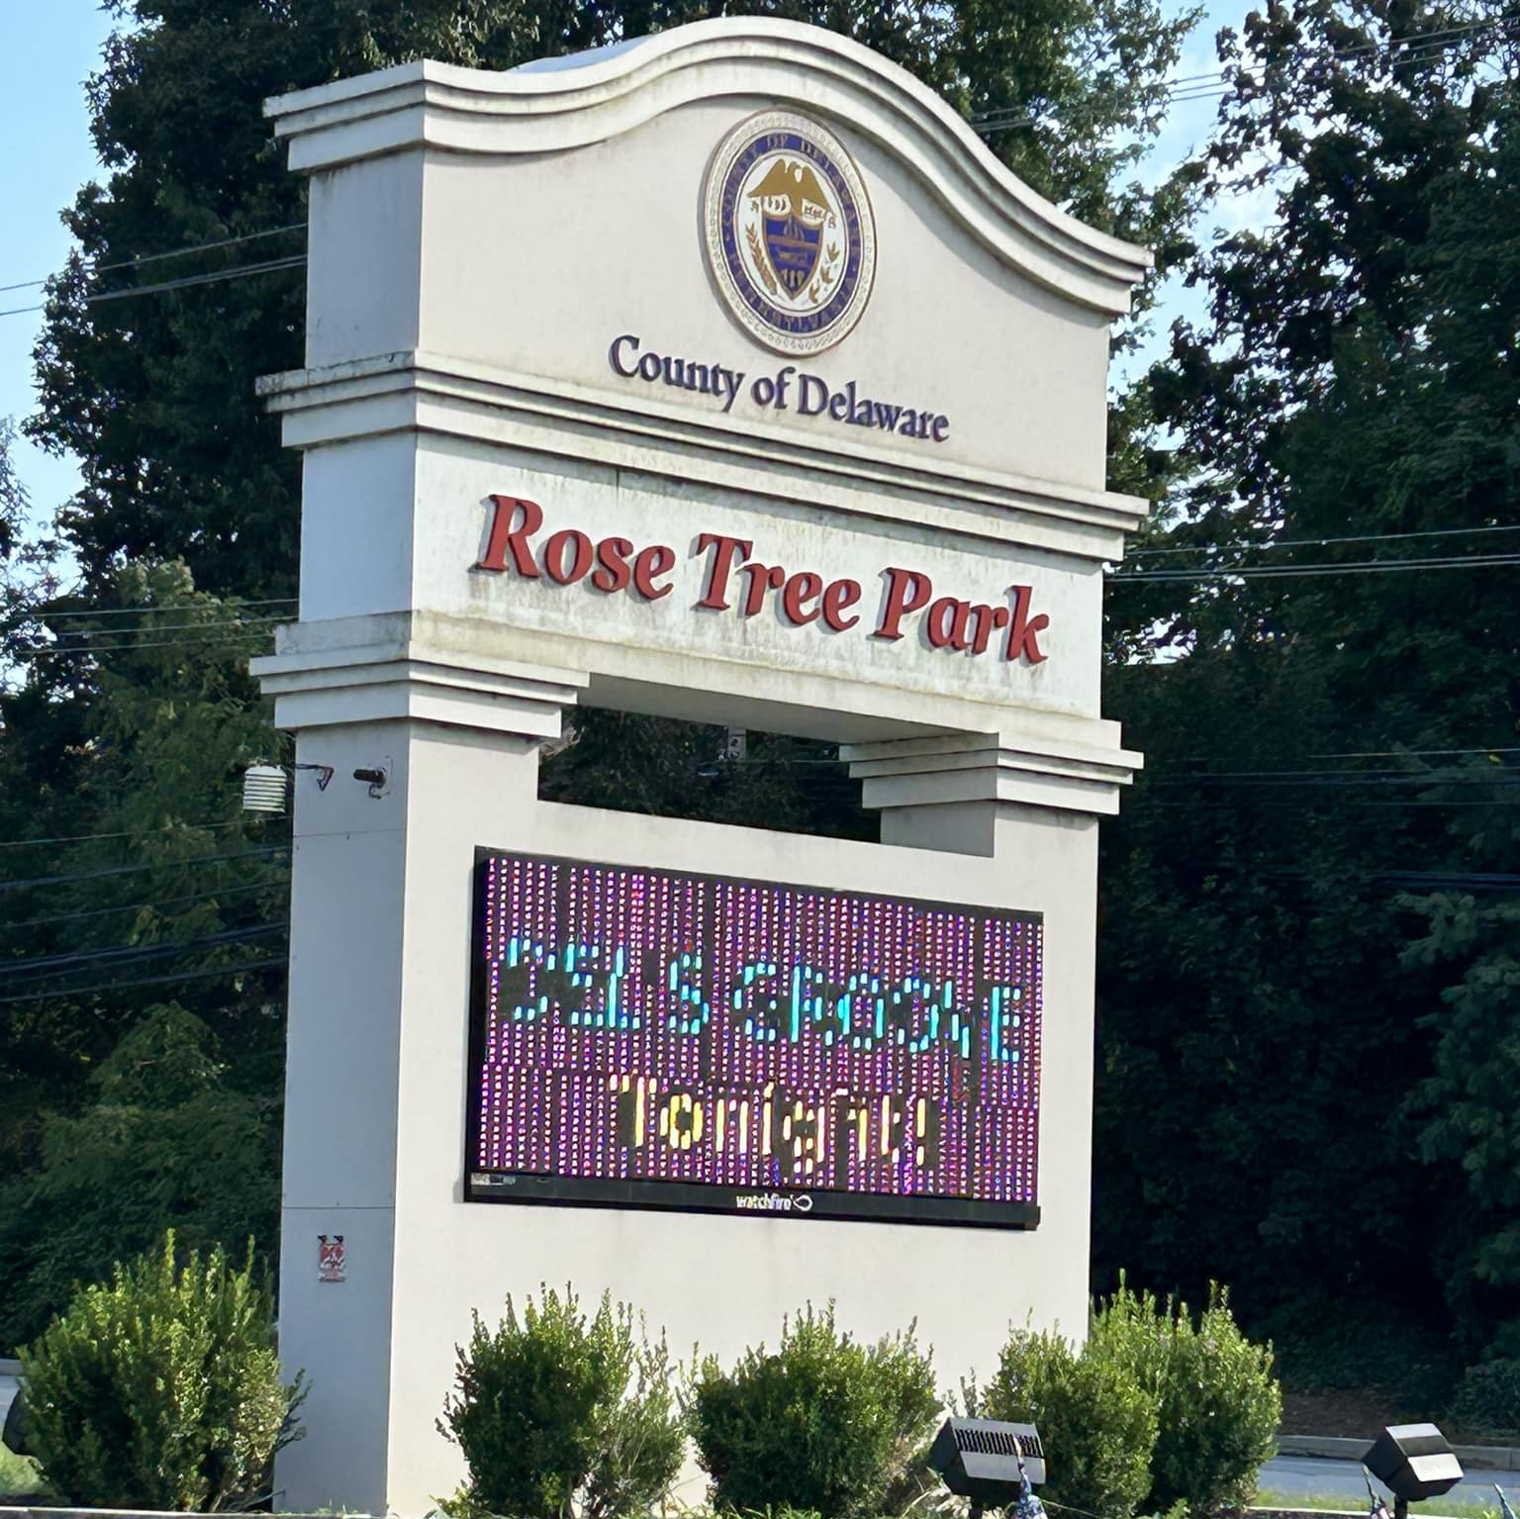
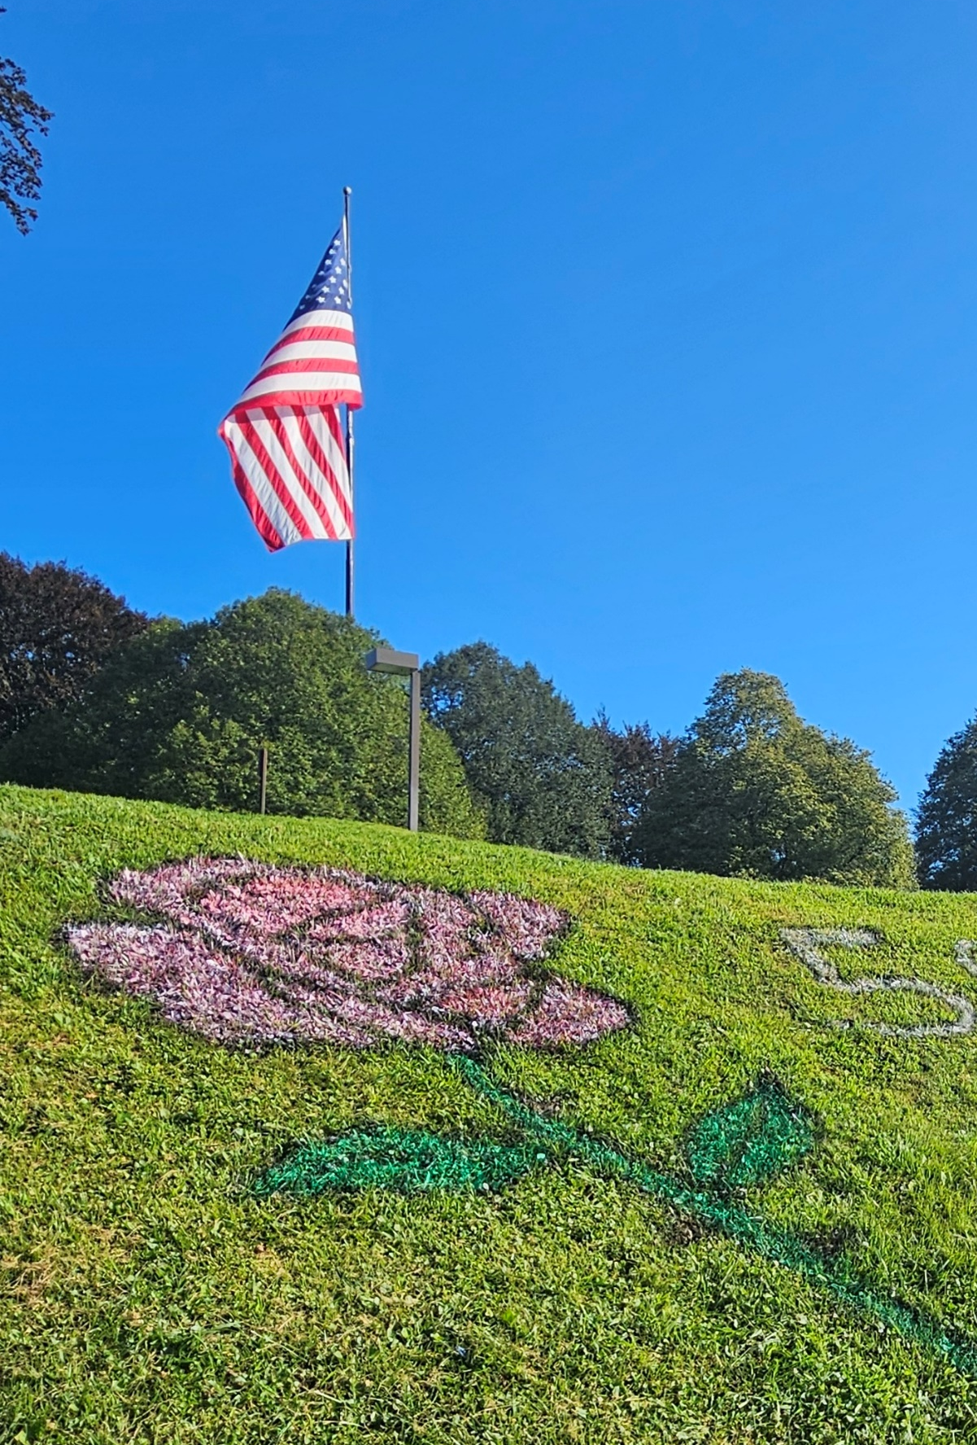



Press, Publicity & Promotion
Onsite: Rose Tree Park’s electronic sign, bulletin board in pedestrian mall Summer Festival Brochure Delaware County’s own: press releases, digest, social media VisitDelco PR: print, digital, social media Local News: Delco Times, Main Line Magazine, et al. Delco Arts Consortium Event Calendar Media Patch Event Calendar
Delco Parks Social Media: Facebook, Instagram, X (Twitter)
Delco Parks
DelcoParks
@DelcoParks

Slide 9

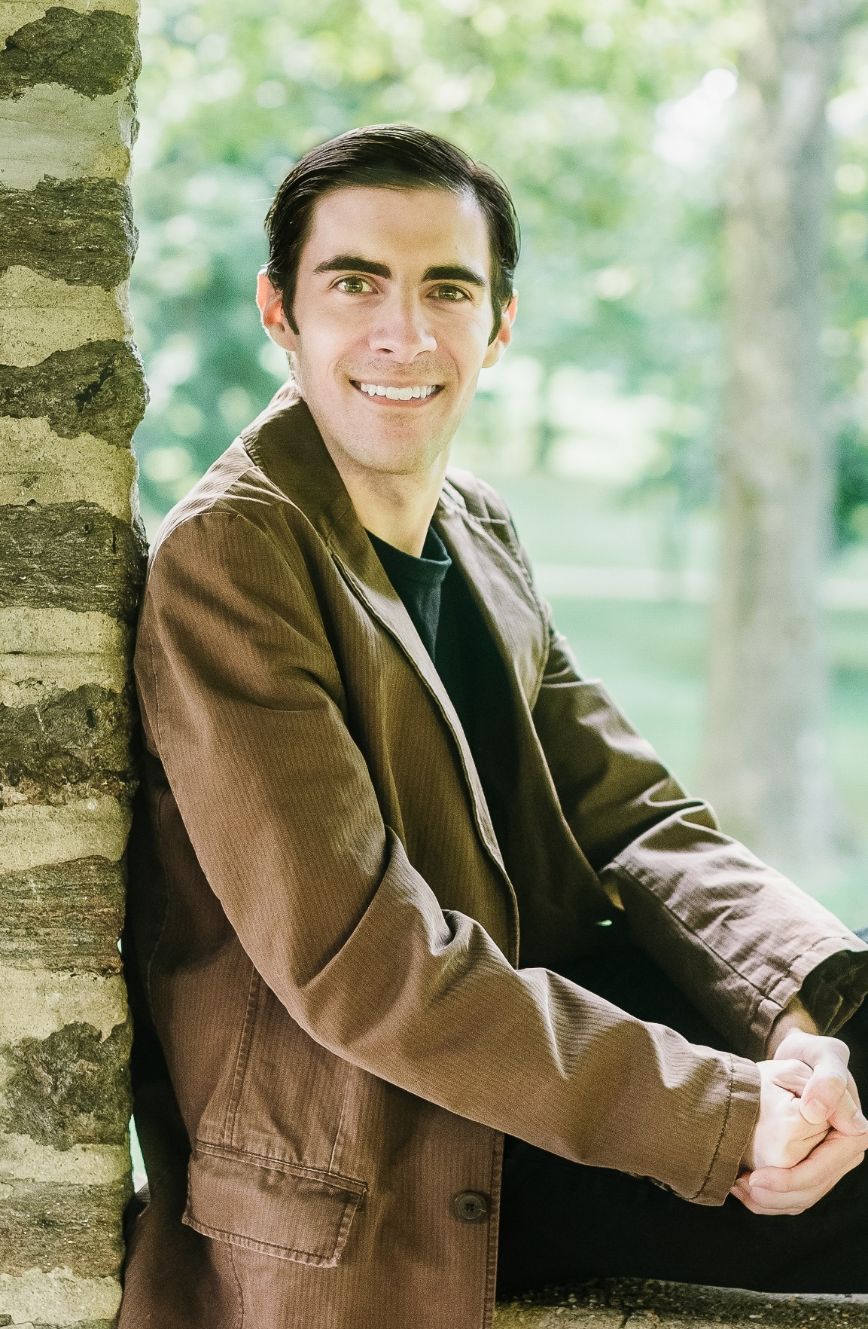
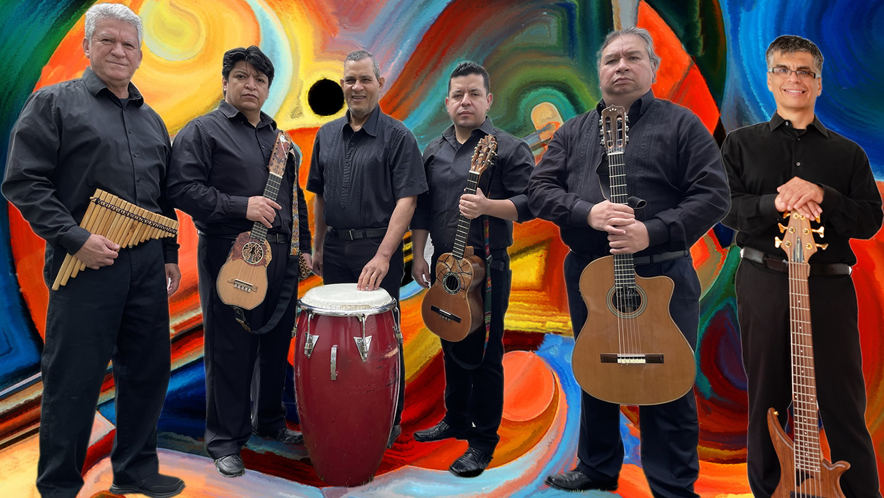
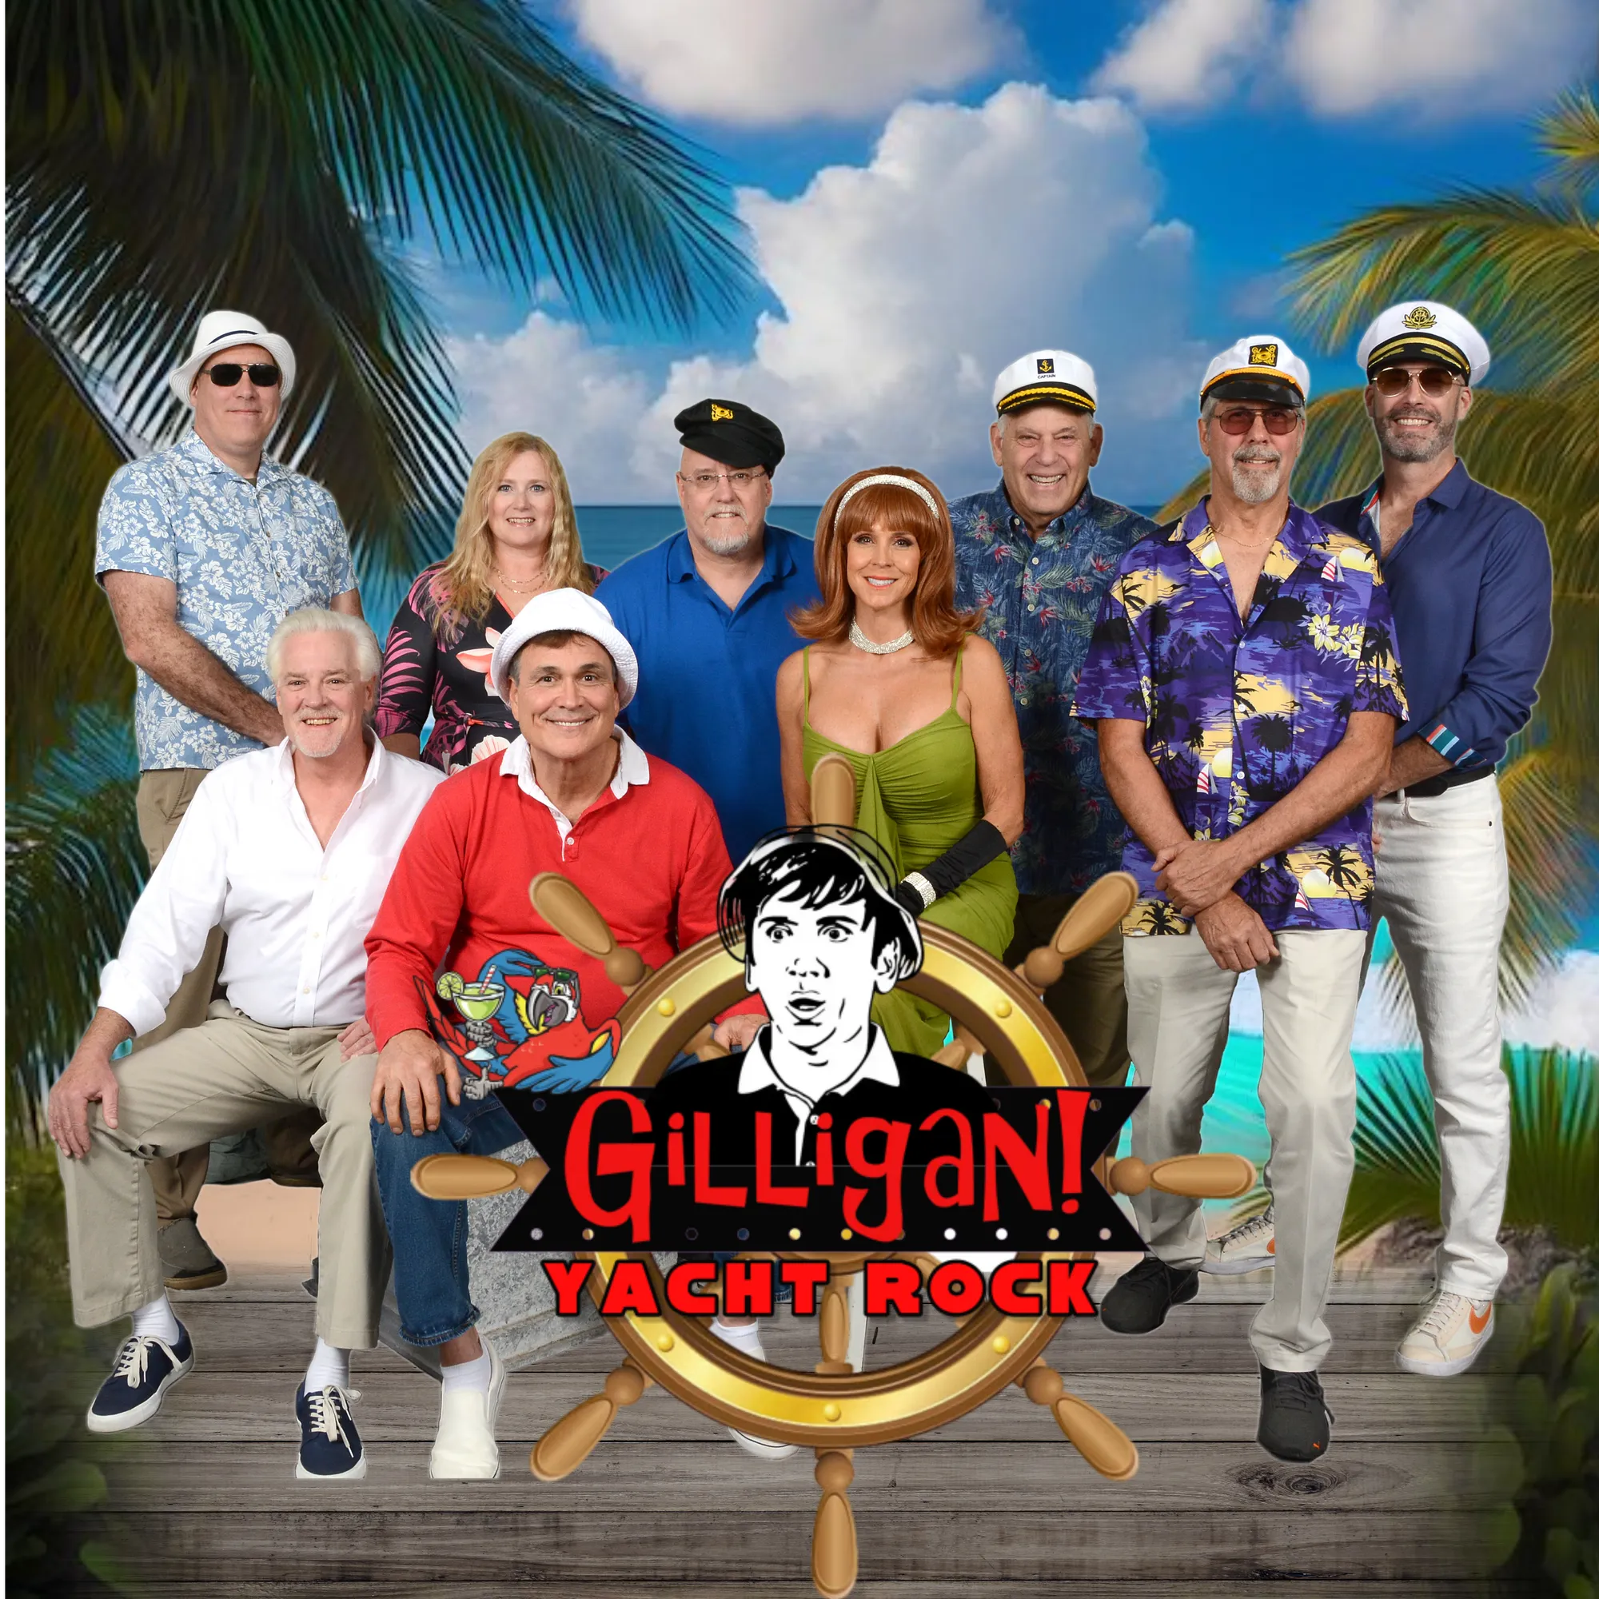
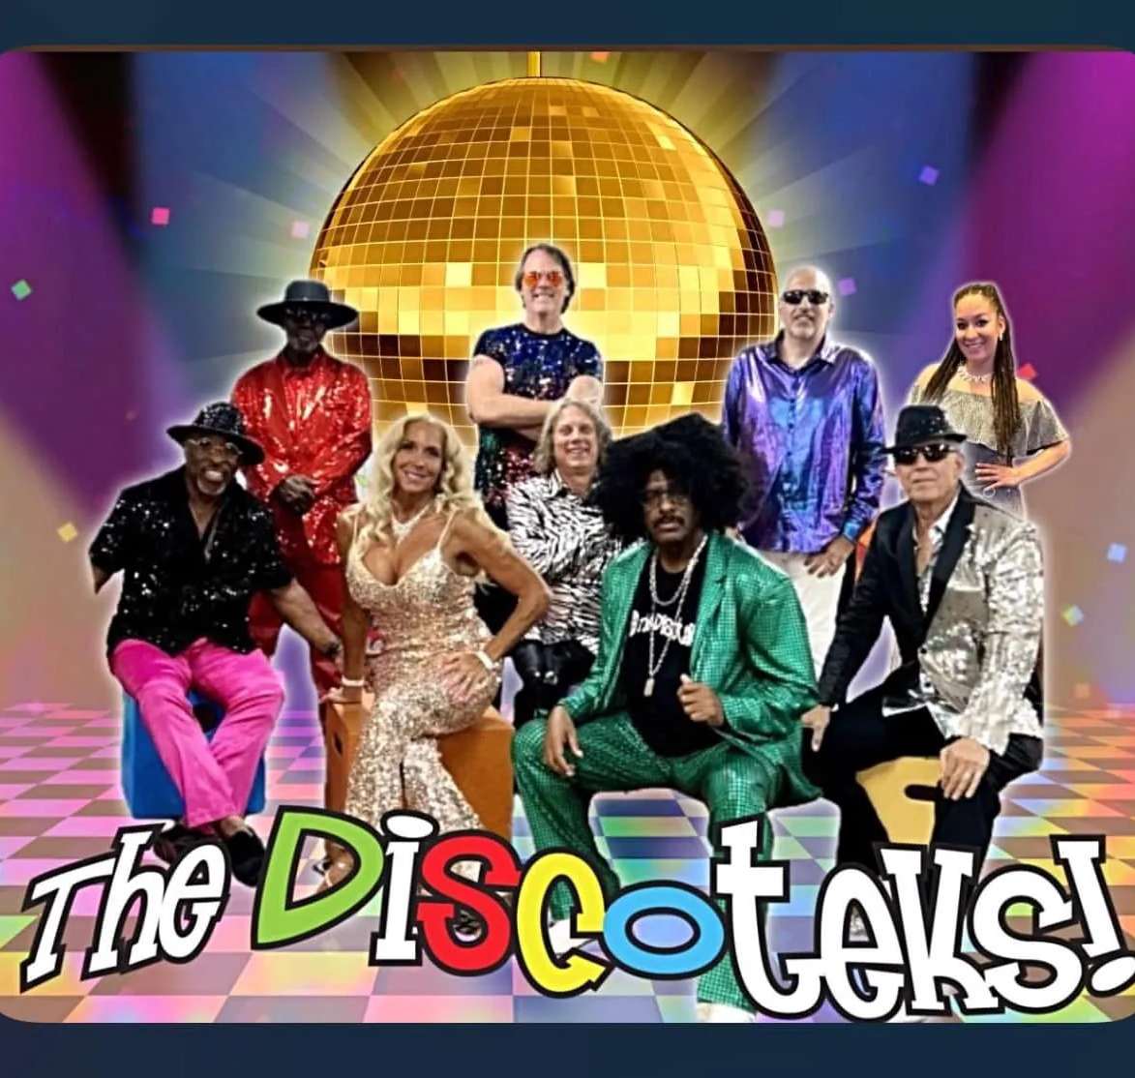
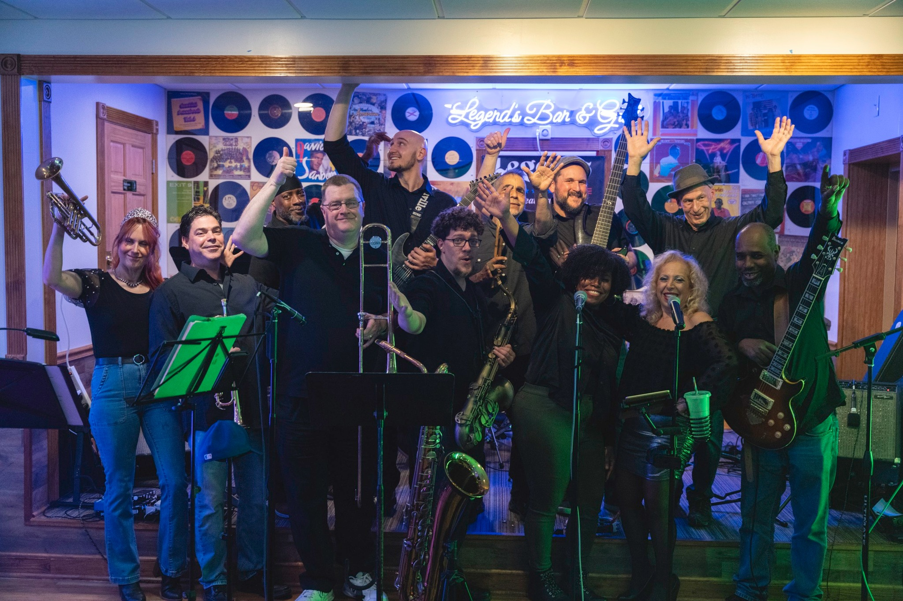

Six acts made their Rose Tree Summer Festival debuts in 2025
Barry Harris
Eco Del Sur

Slide 10

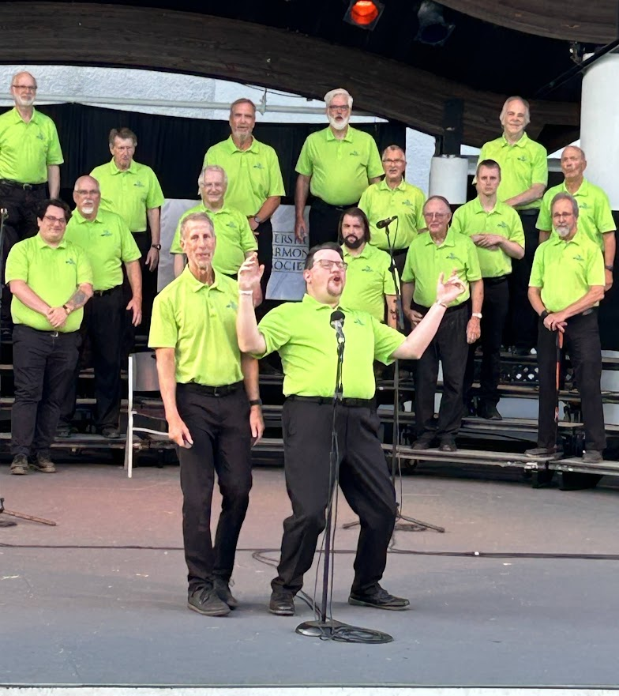
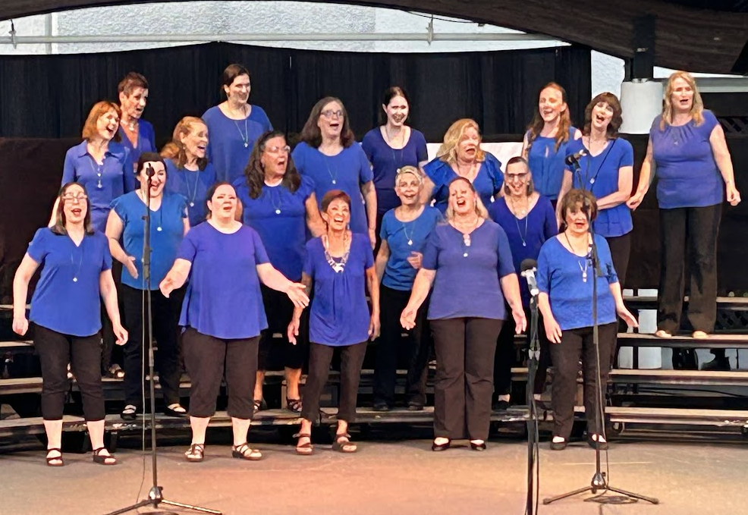
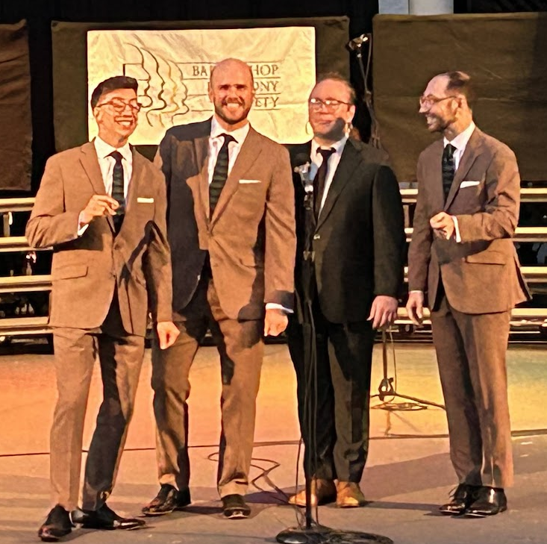
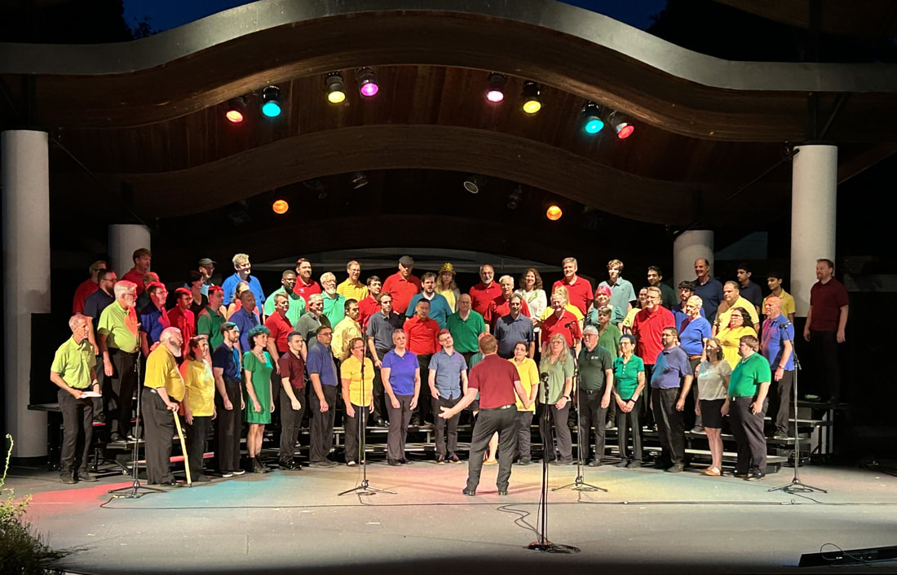
Barbershop’s Best: A Musical Community Collaboration
The Mainliners Chorus
Valley Forge Chorus
Atlantic Harmony Brigade

Slide 11
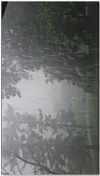


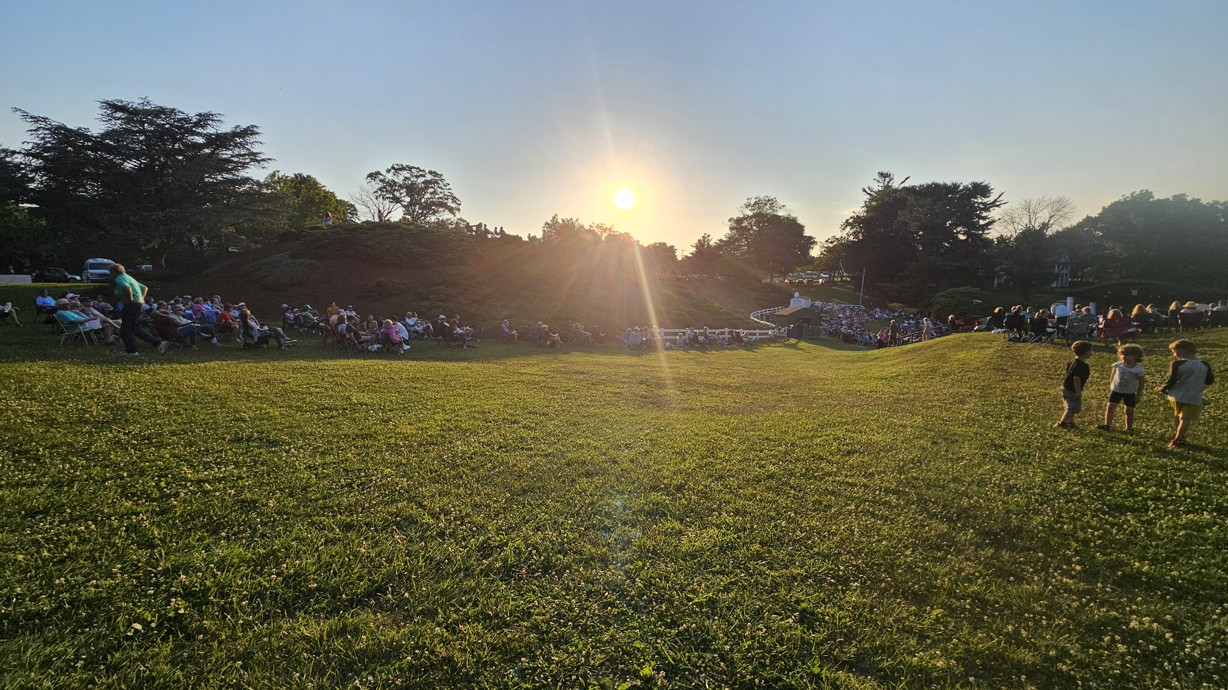
Weather: Hot & Stormy
How was the weather?
Despite a few challenges, concert attendance was strong at approximately 33,000 people for the season.
Scheduled shows: 44
Canceled shows: 6

Slide 12
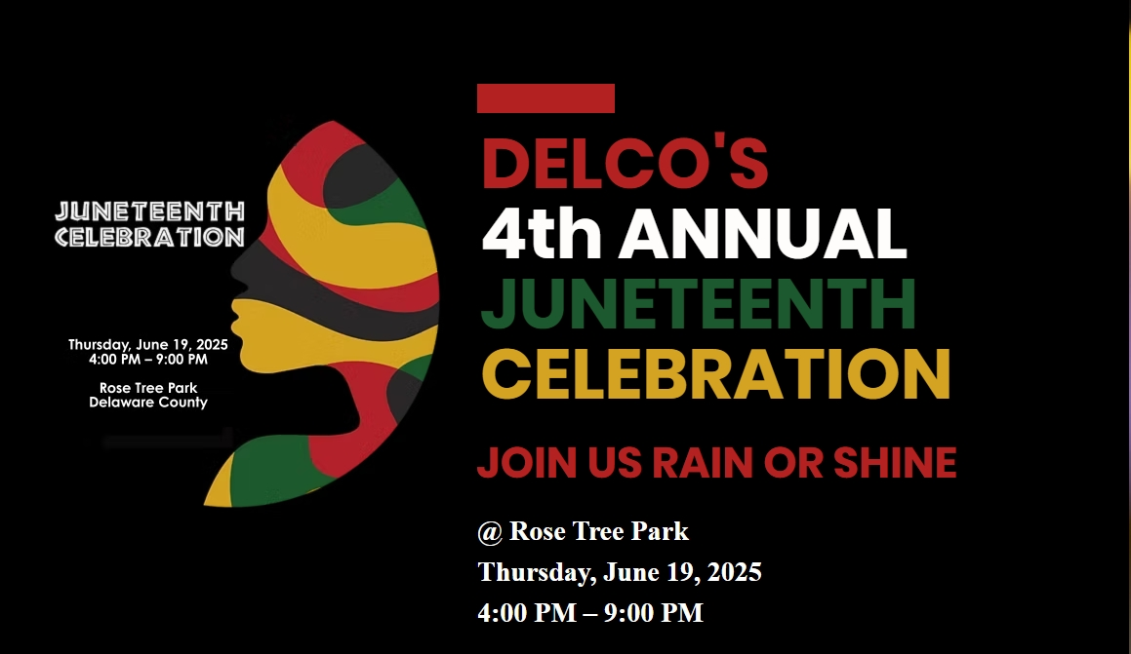
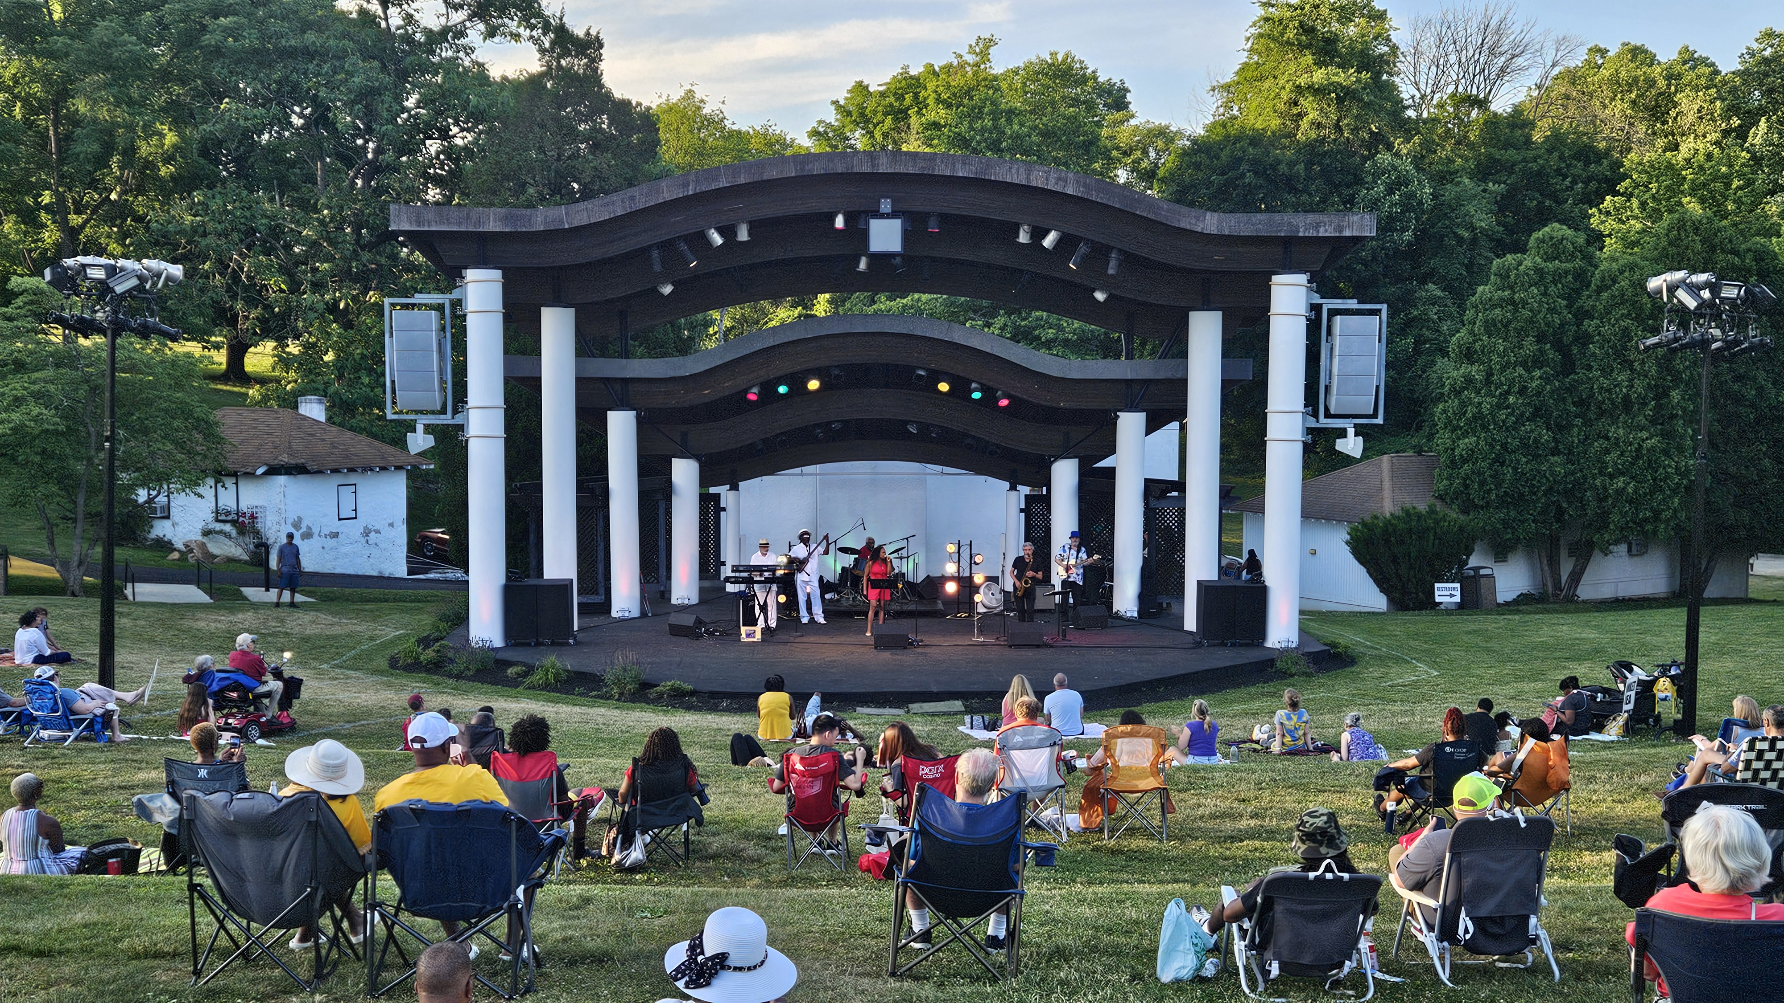
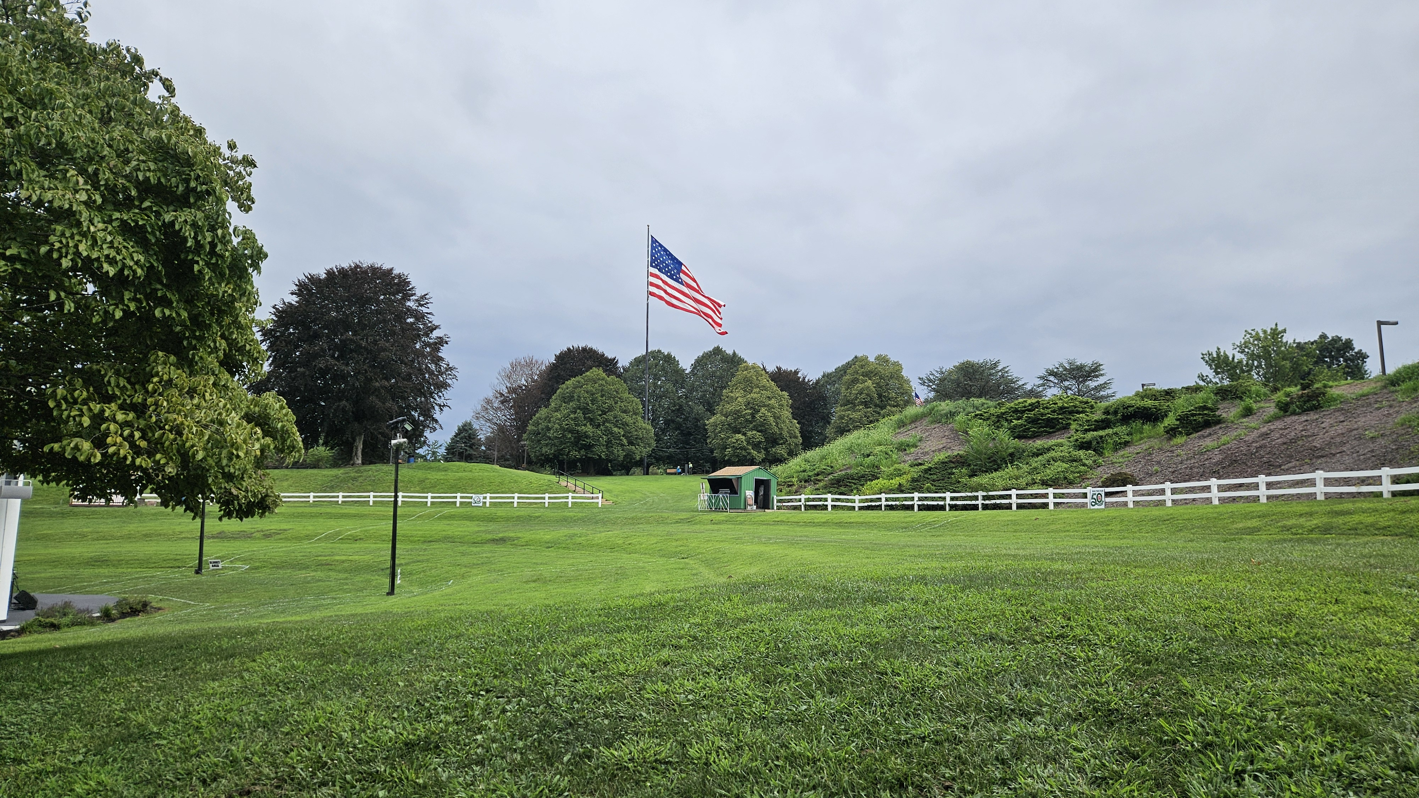
Philly Gumbo
The County’s Juneteenth celebration was cut short, and the concert had to be Canceled due to a sudden thunderstorm & possible tornado

Slide 13
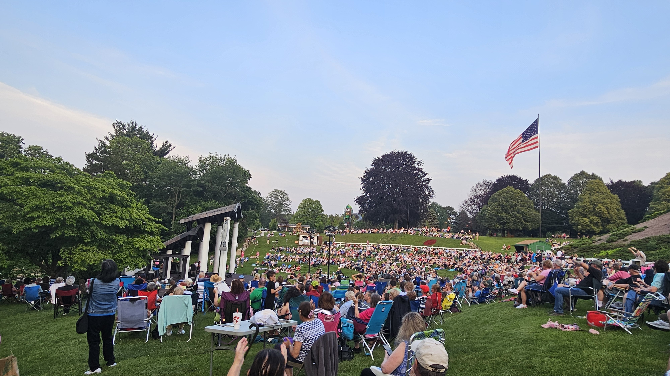
Fair skies always returned…

Slide 14
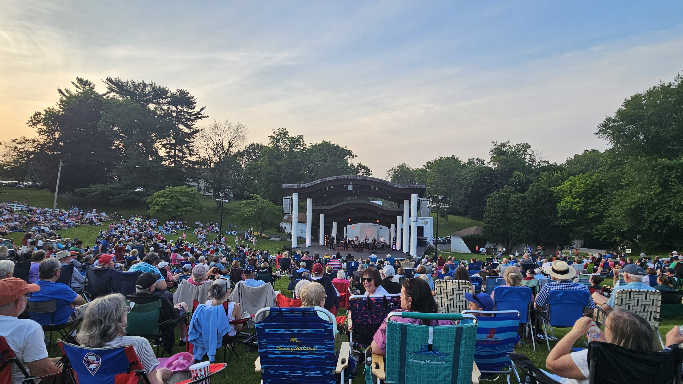
…and let the good times roll!

Slide 15
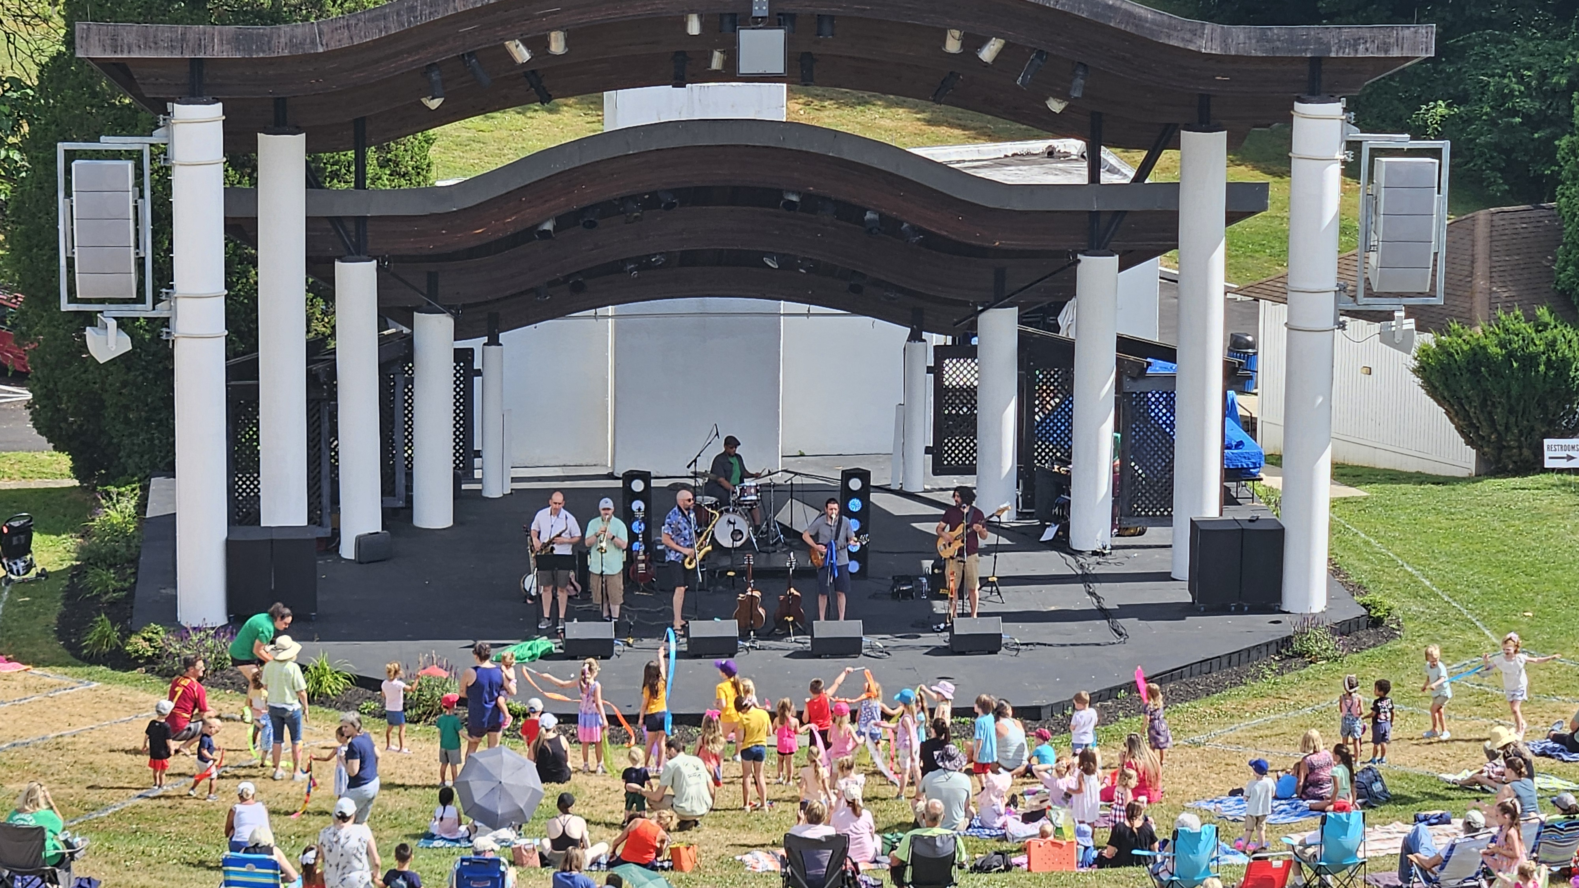
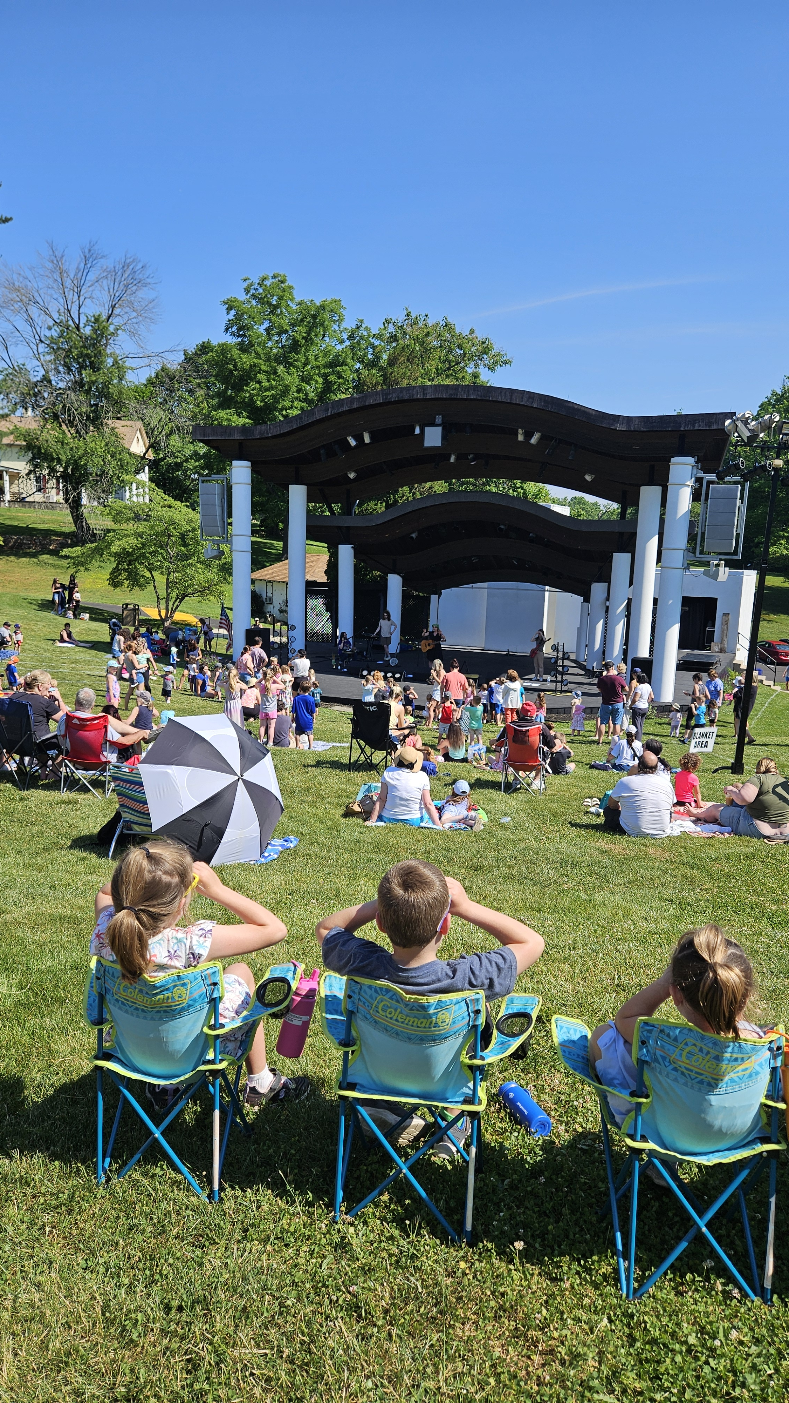
Children’s Concerts
The Plants
Summer fun in the morning sun!

Slide 16
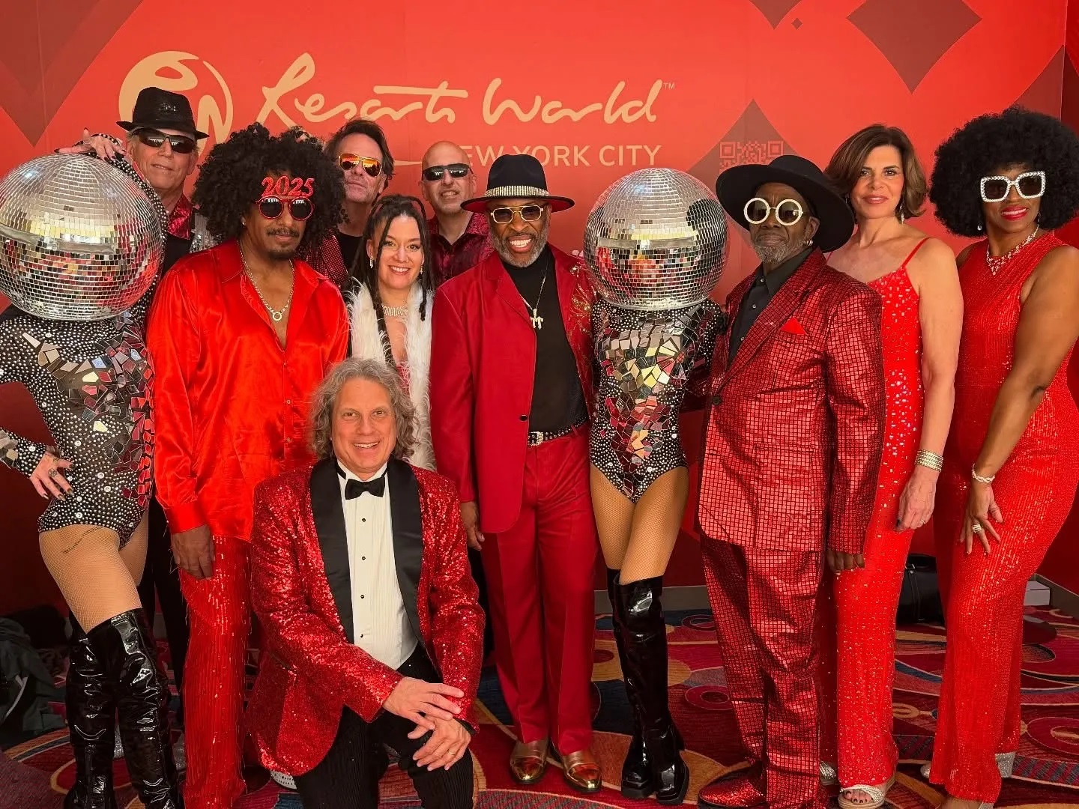
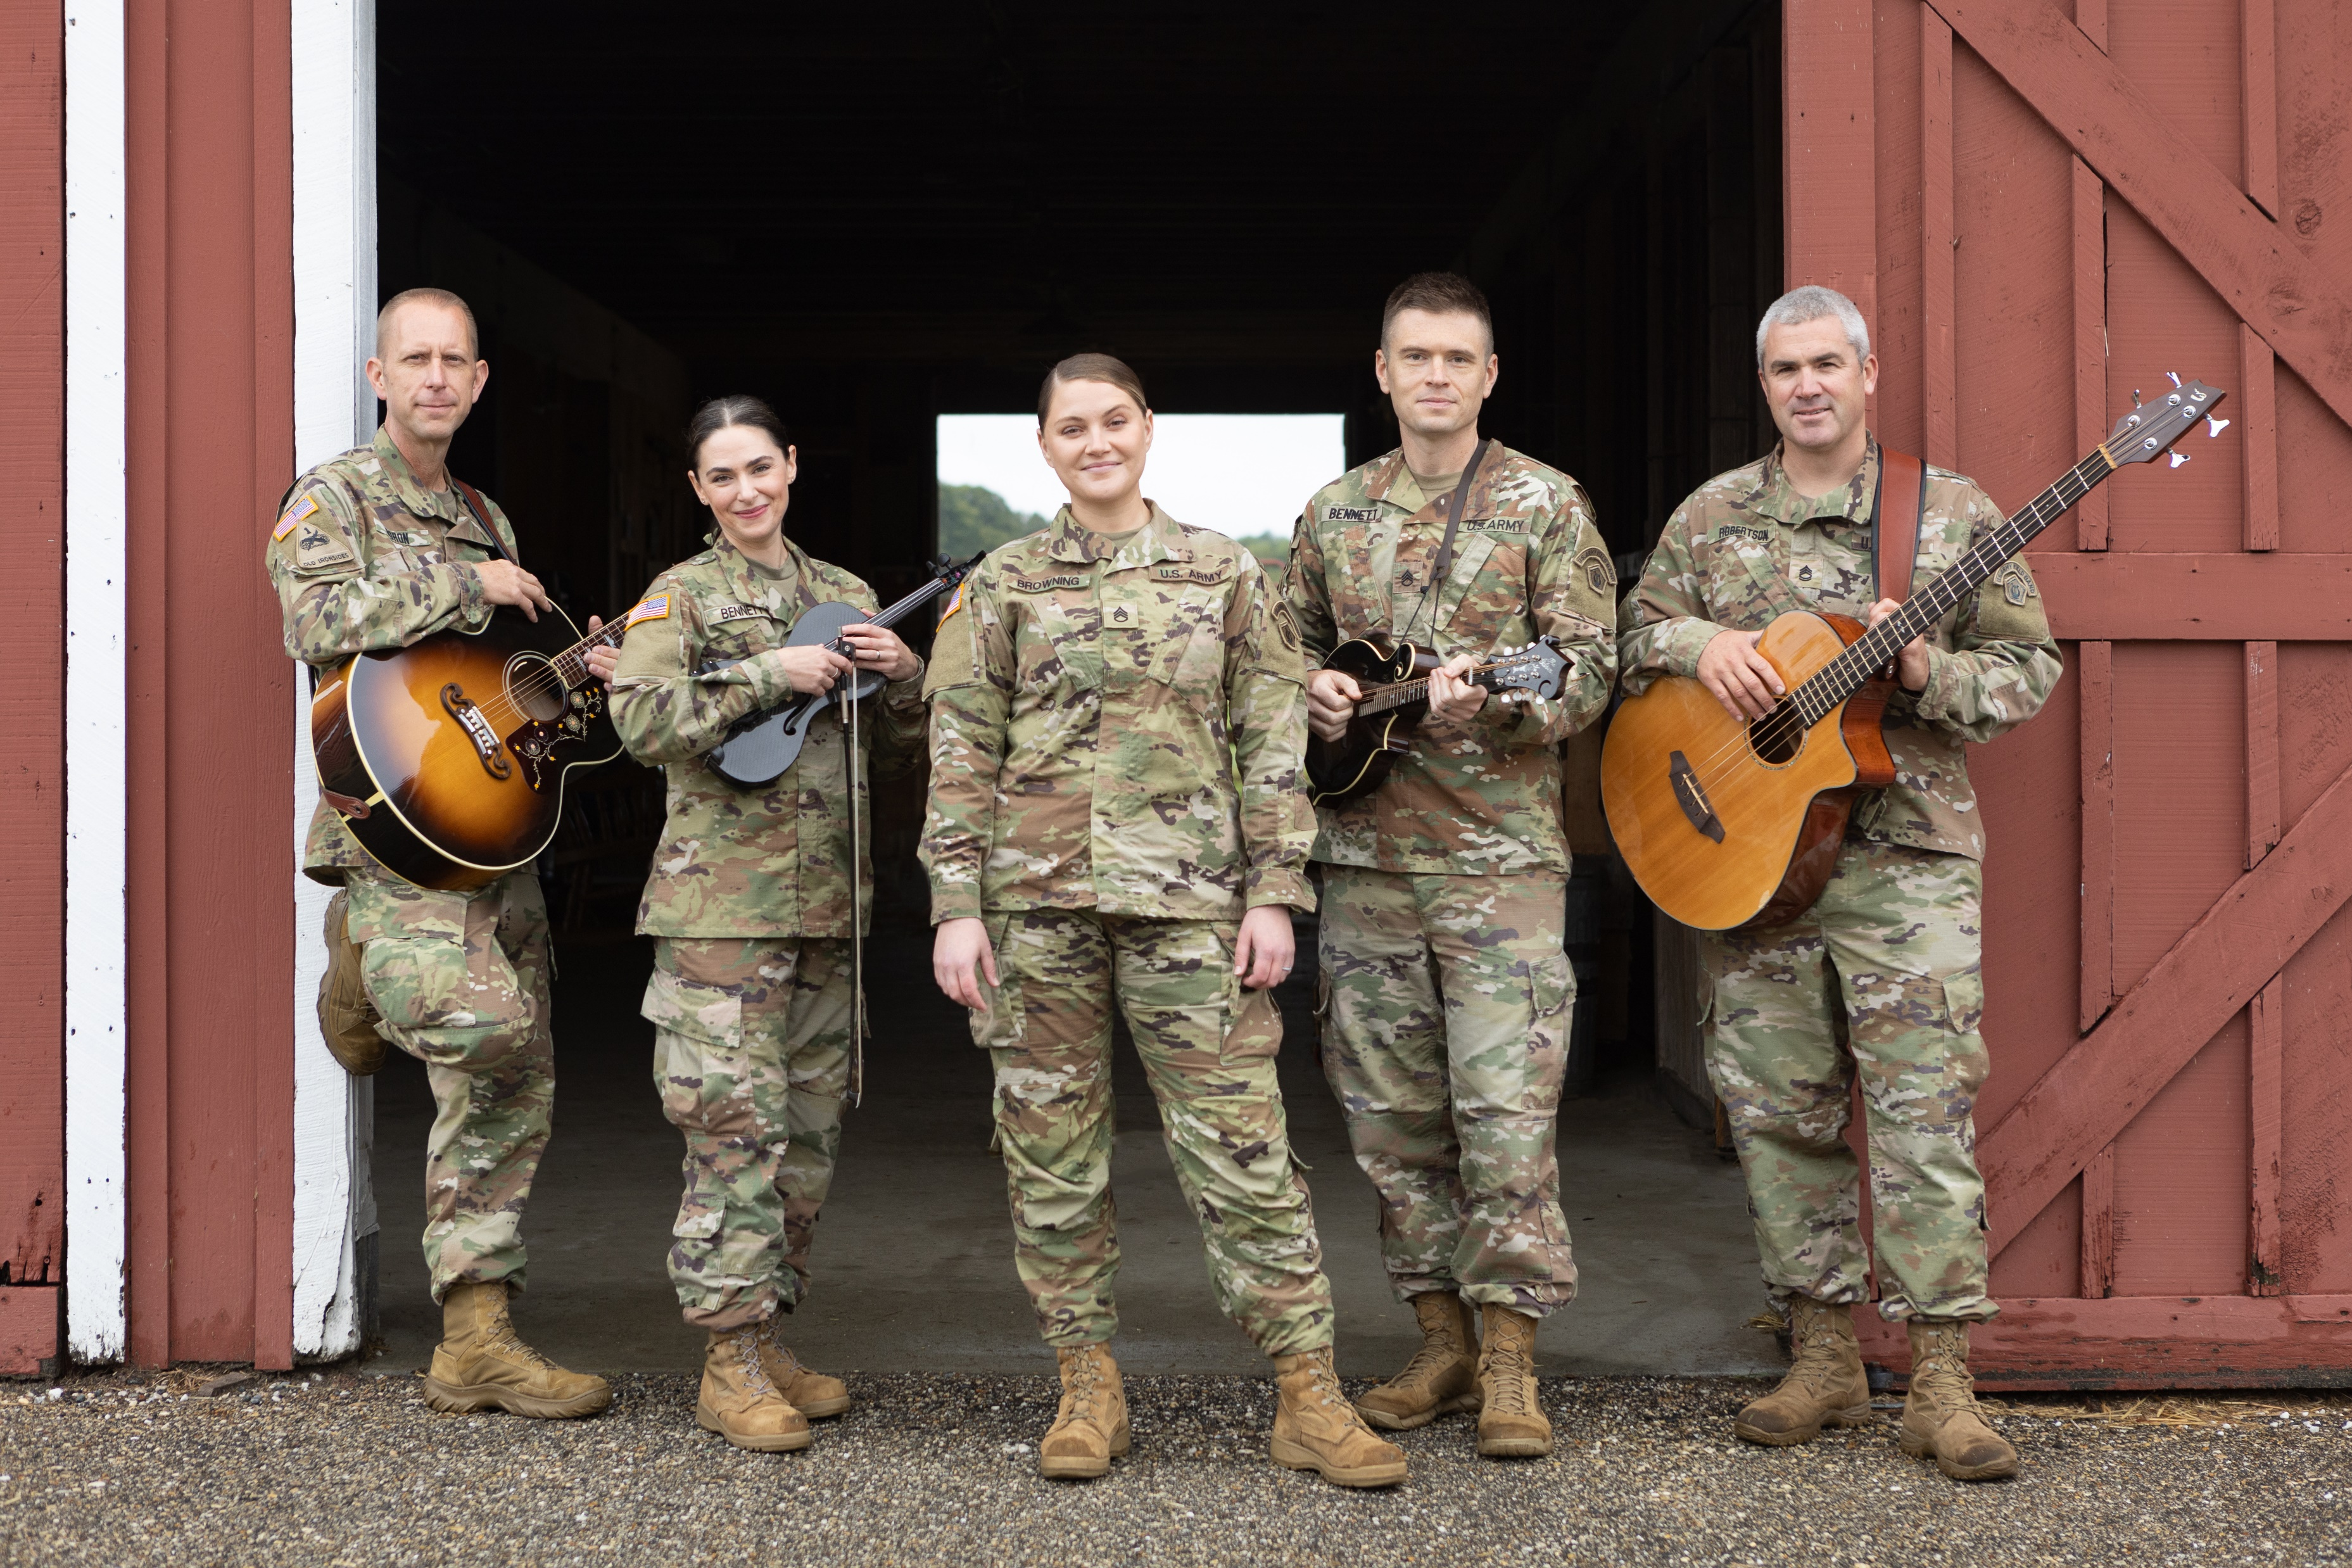
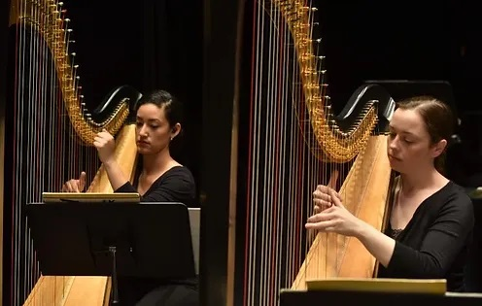
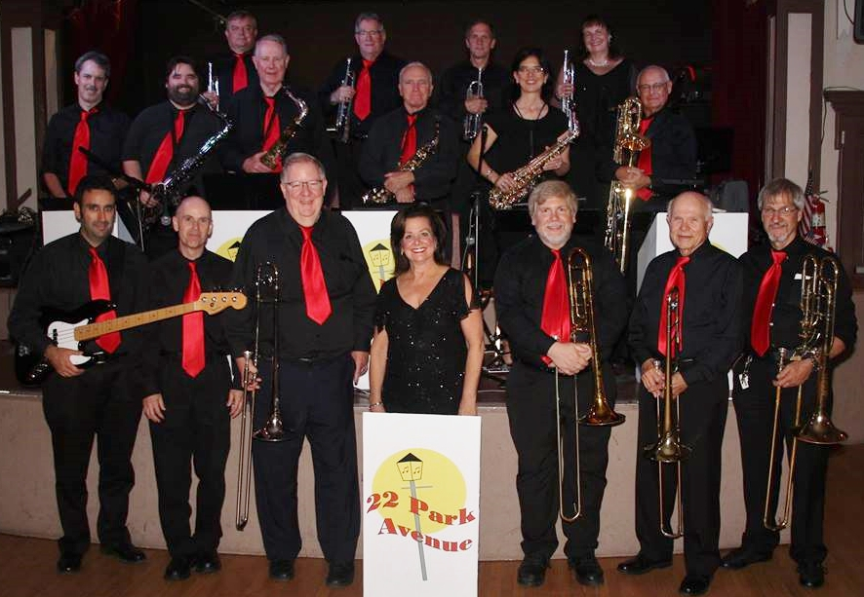
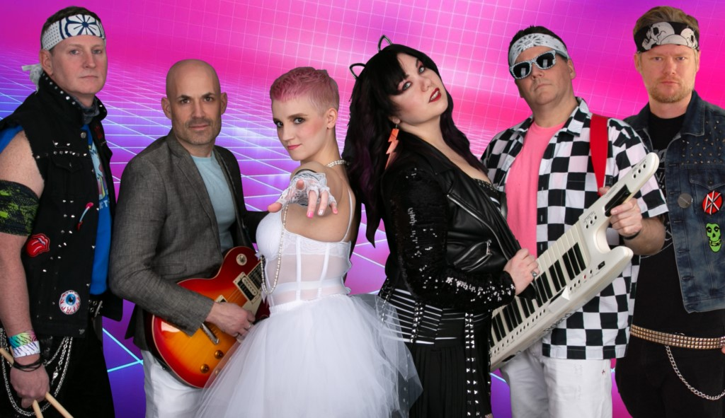
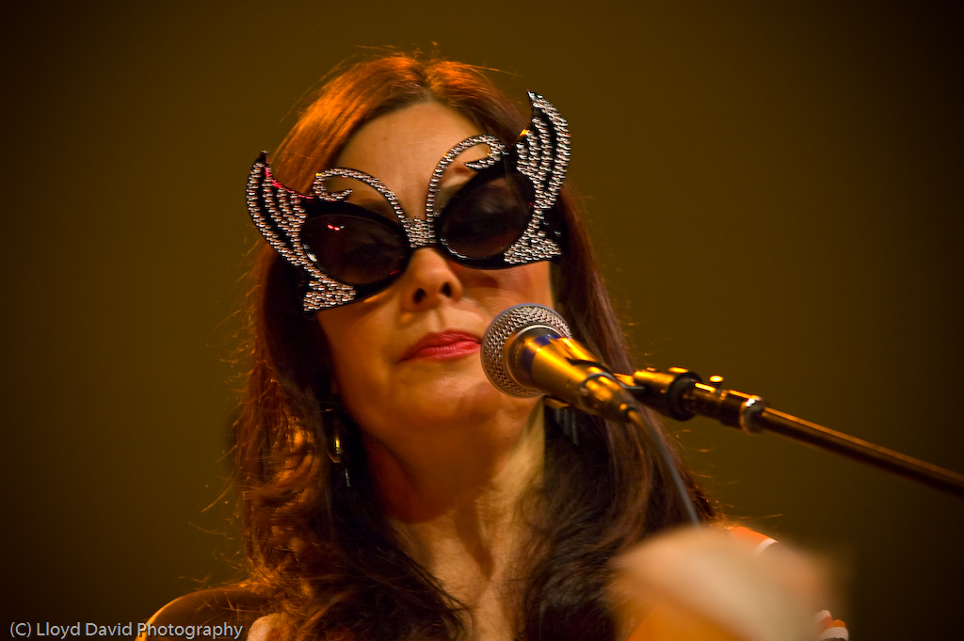
VARIETY
Classical
Americana
Disco
Bossa Nova
Big Band Swing
‘80s Pop

Slide 17

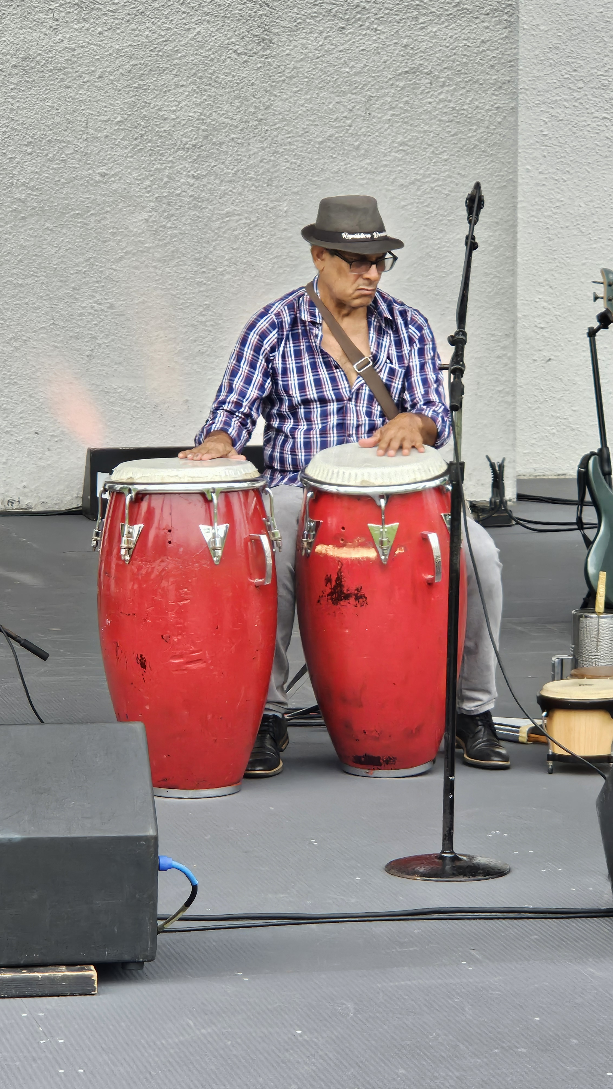

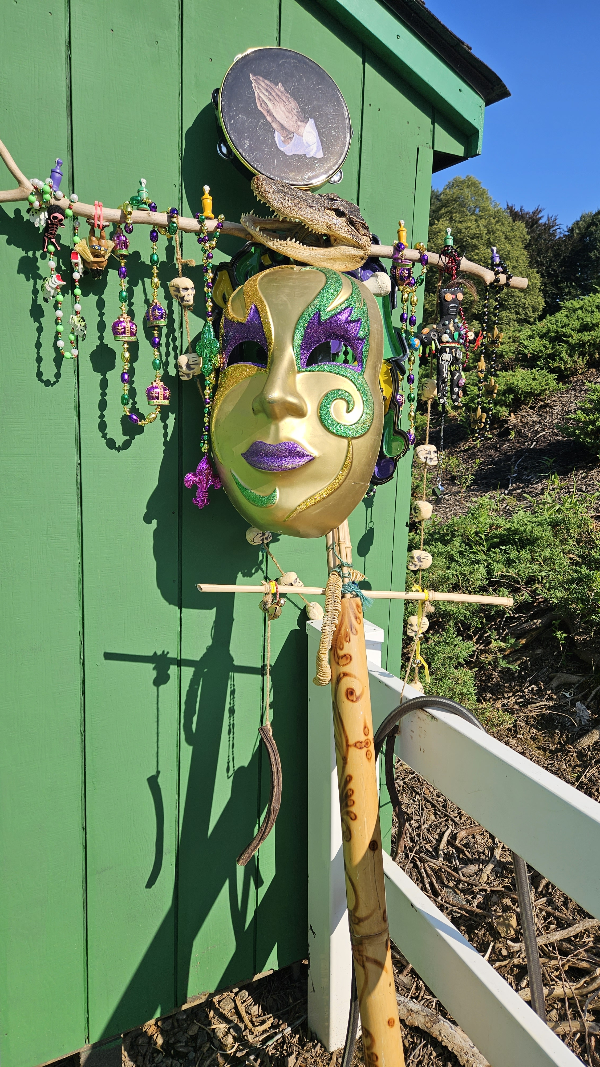
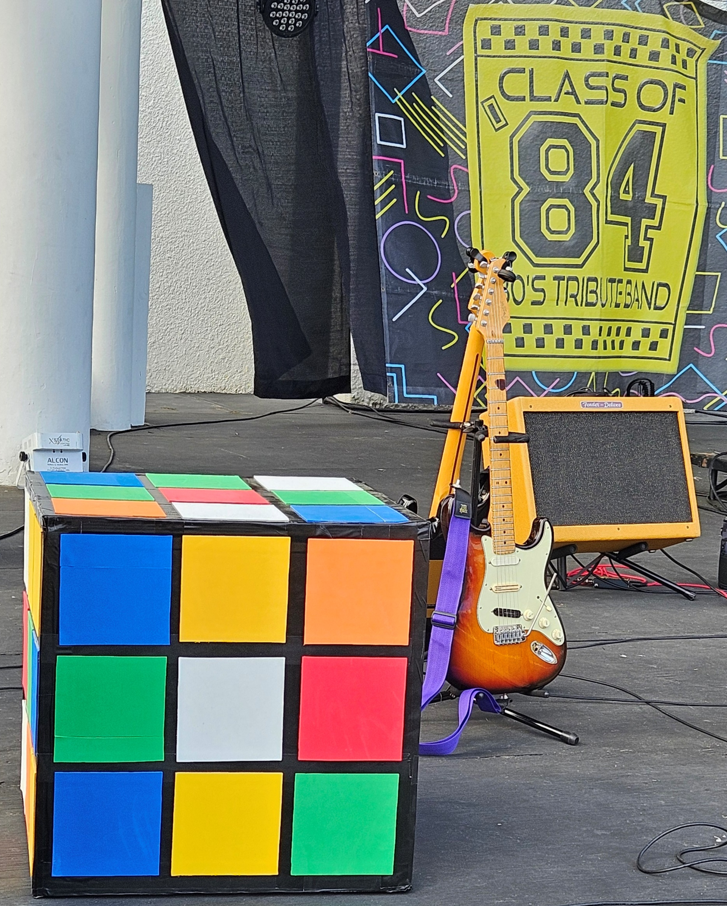


Specialty acts &
A Capella Chorus
Broadway Revue Brazilian Bossa Nova
Celtic Rock
New Orleans
Reggae & Ska
South & Latin American Folk
Tribute shows
Big Band
Blues
Classical
Country
Jazz
Motown
Rock & Pop R&B
Something for everyone

Slide 18
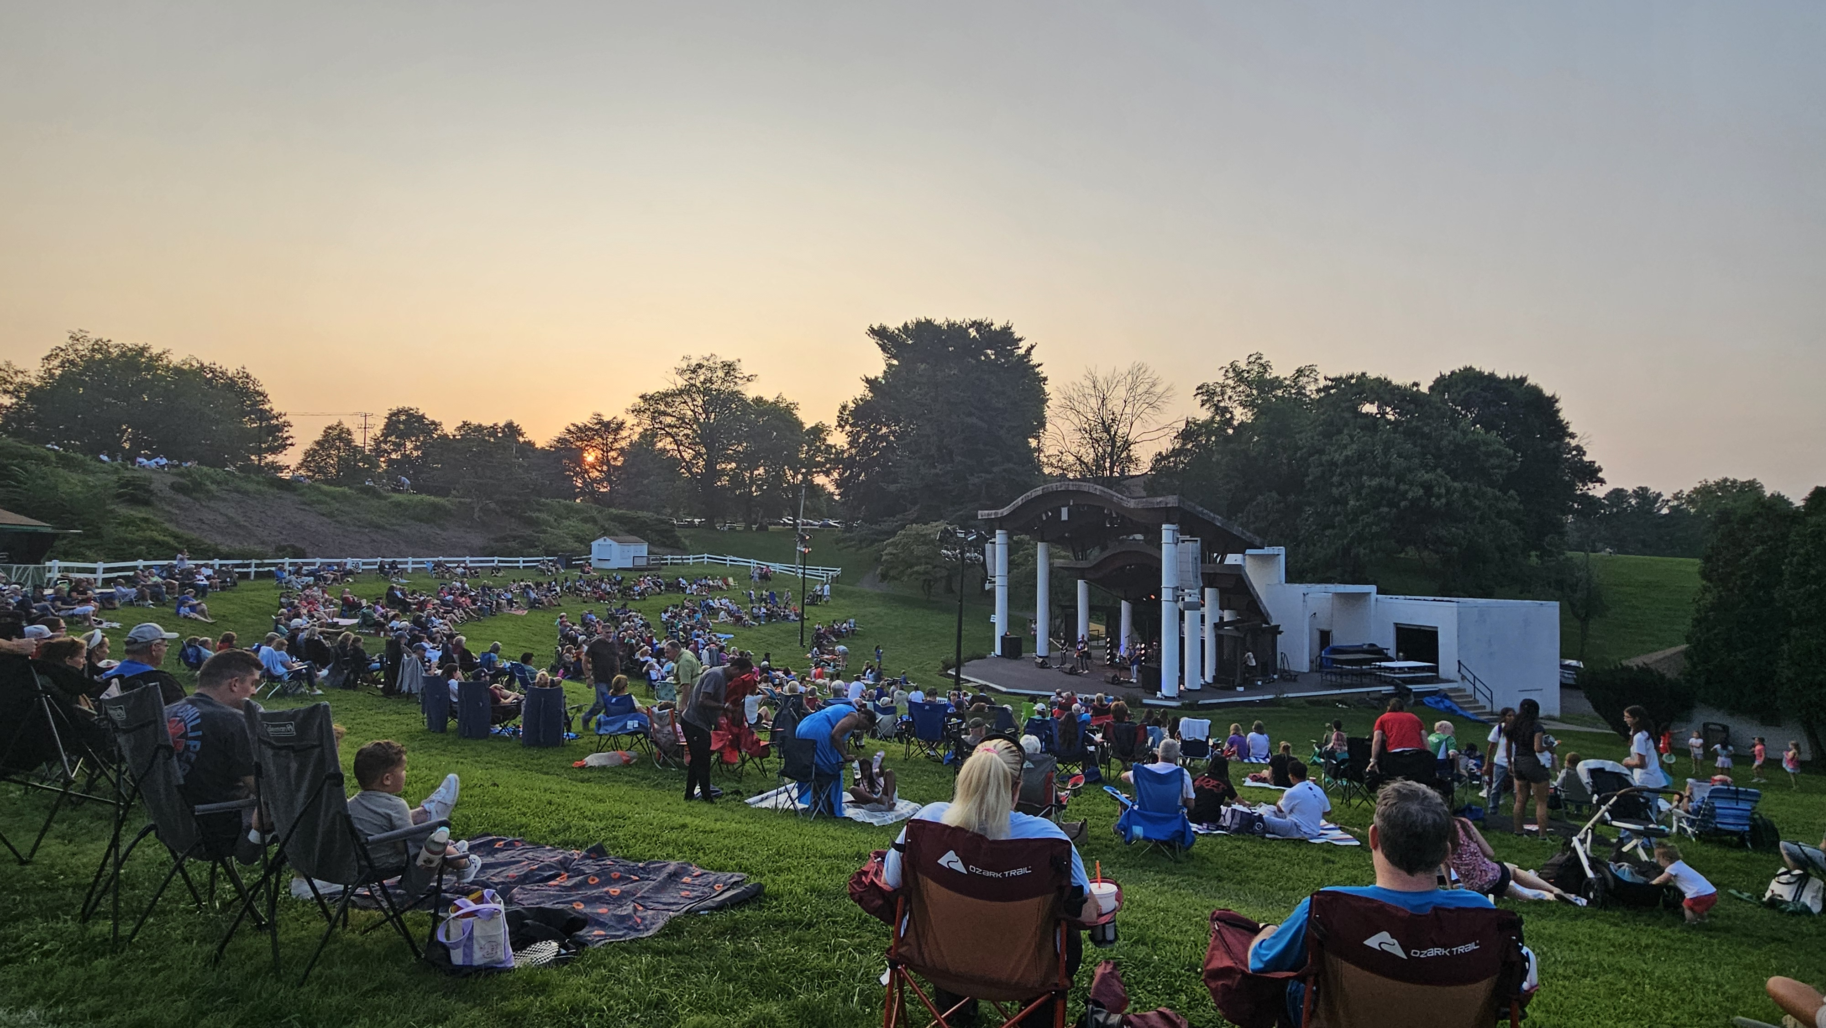
Sunset on season 50 – see you next year!

