Slide 1

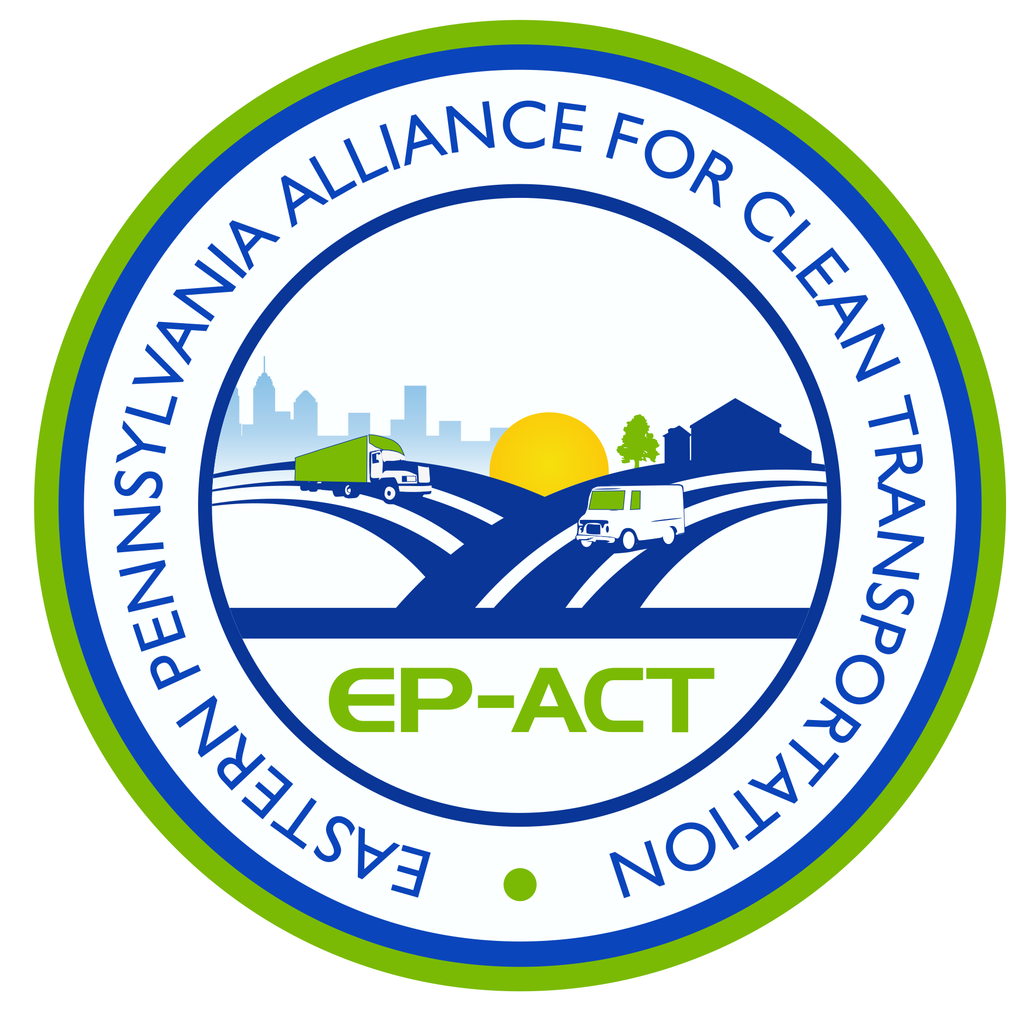

Drive Electric Pennsylvania EVs, Infrastructure & Funding

Slide 2






Mission: To reduce petroleum consumption within the transportation sector using alternatives to gasoline and diesel.
Part of the Department of Energy’s Clean Cities Program since 1993
Comprised of Public and Private companies State and
Local governments, Municipalities and Utilities
Assist with Grants/incentives/vouchers/rebates
Received over $20mm for Stakeholders projects valued over $80mm
Project Management
Education and Outreach
Stakeholder Membership
501(c) 3 Non-profit

Slide 3

The Drive Electric Pennsylvania Coalition was formed in 2016 to help plan and implement strategies for the adoption of electric vehicles throughout Pennsylvania. The coalition consists of state and local governments, industry, utility, universities, public and private companies who wish to help spur the adoption of Electric Vehicles (EV's) in The Commonwealth of Pennsylvania.

Slide 4
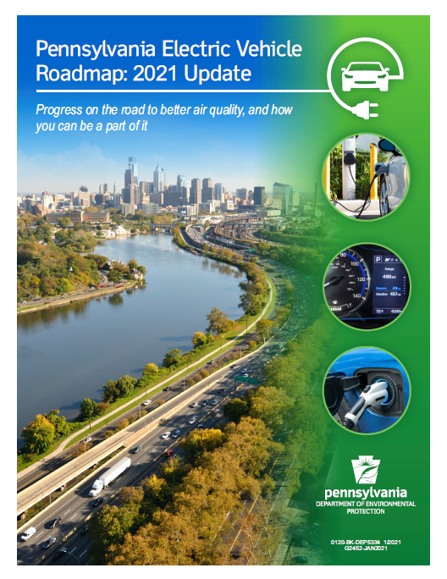
https://files.dep.state.pa.us/Energy/OfficeofPollutionPrevention/StateEnergyProgram/PAElectricVehRoadmapBookletDEP5334.pdf

Slide 5

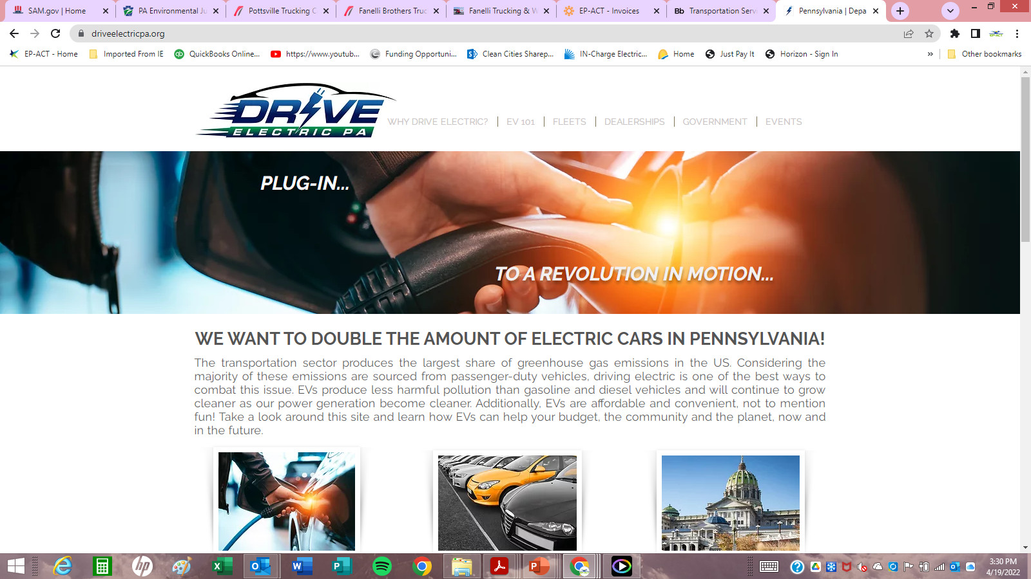
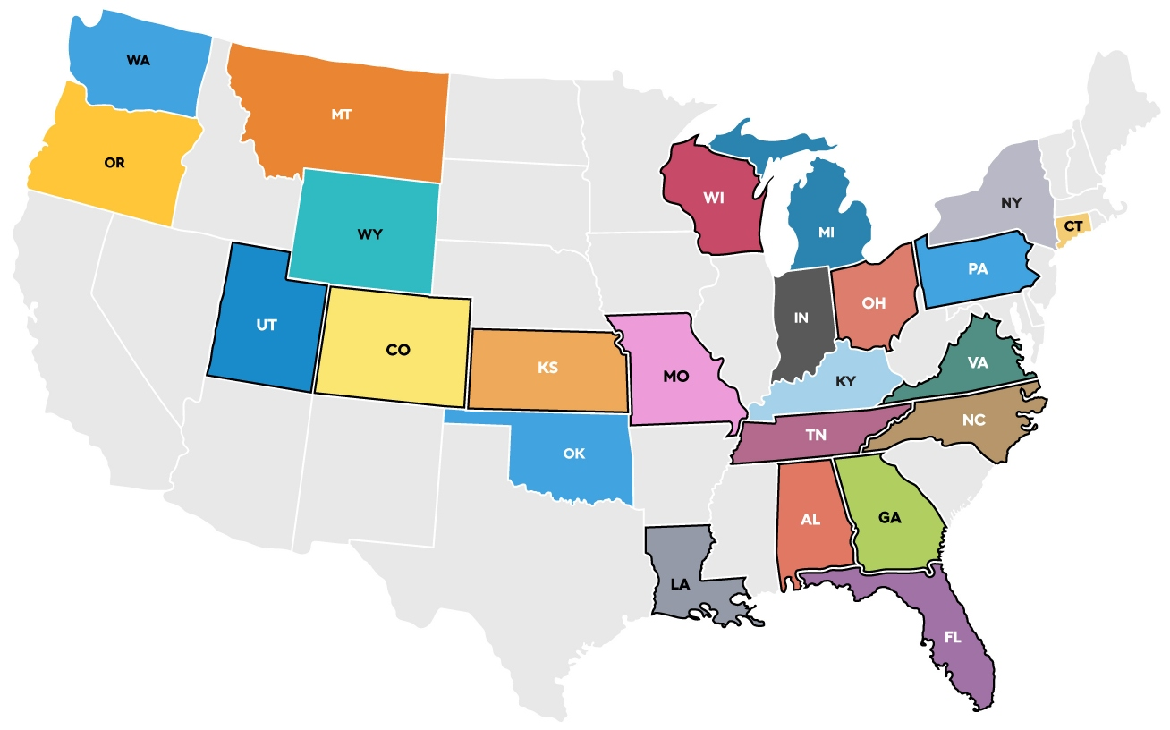
www.driveelectricpa.org
Priority Areas:
Statewide Branded
Consumer Education
Utility & Regulatory Engagement
EV Charging Infrastructure Planning
State & Local Government Education
Dealer Engagement
Fleet Engagement

Slide 6
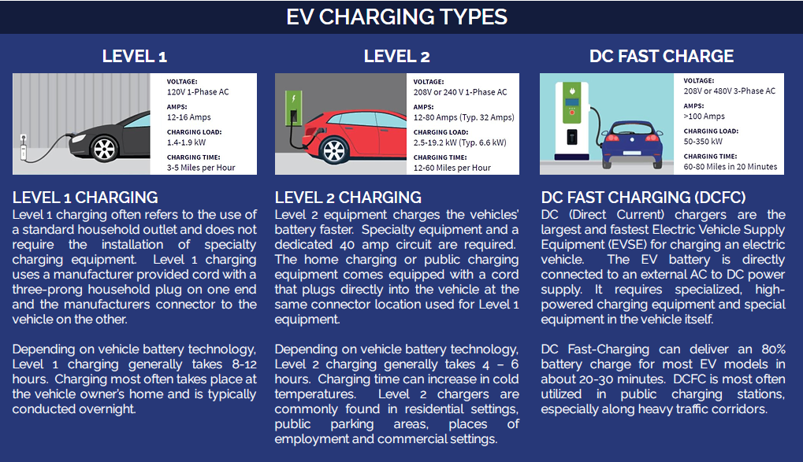

Electric Vehicle Supply Equipment (EVSE’s)
EV Charging

Slide 7
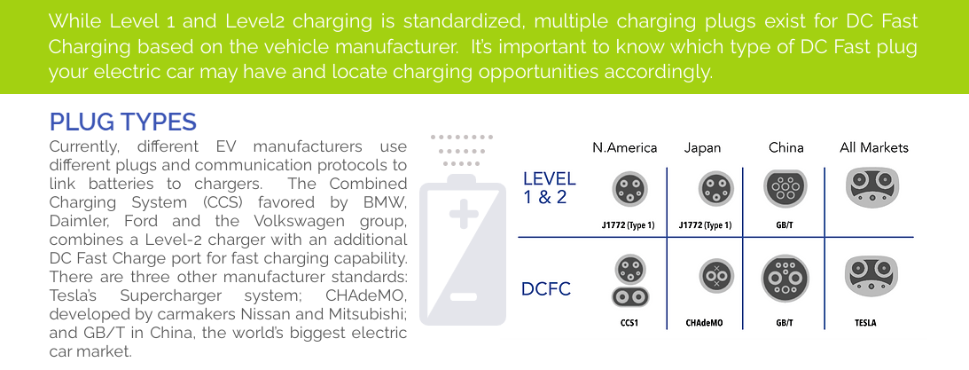
Electric Vehicle Supply Equipment (EVSE’s)
EV Charging

Slide 8
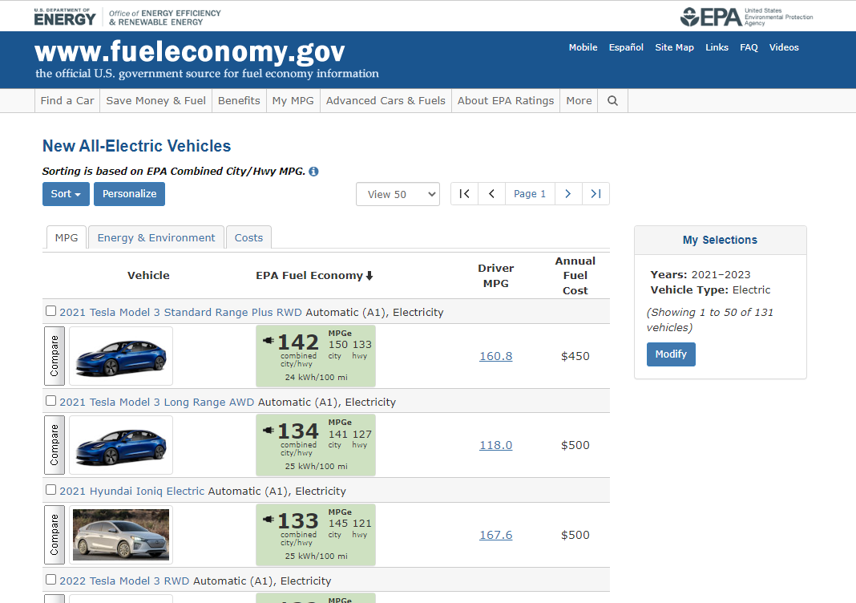
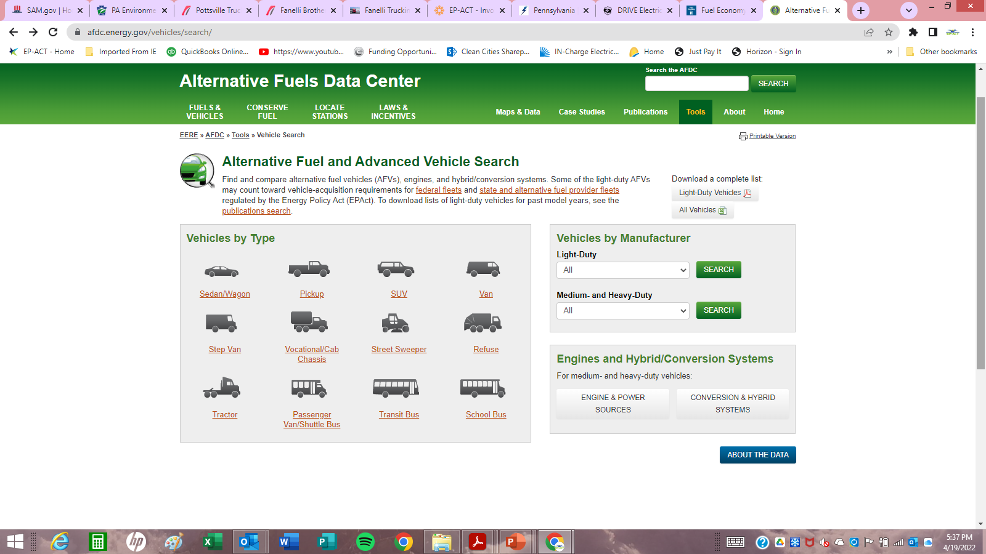
Electric Vehicle Resources
www.fueleconomy.com
https://afdc.energy.gov/vehicles/search/

Slide 9





EV Funding & Incentives
Federal
Funding Opportunities Announcements (FOA) – Clean Cities
Alternative Fuel Corridors
National Electric Vehicle Infrastructure (NEVI) Formula
$5 Billion over 5 years- PA getting $171.5 million
$2.5 Billion in Discretionary Funding (All states)
Diesel Emissions Reduction Act (DERA) ~ $5 million/year
Clean School Bus Program $5 Billion over 5 years/ $2.5 for Electric
Individual tax credit up to *$7,500 for EV
EVSE credit 30% of cost up to $30k (expired 12/2021)

Slide 10

EV Funding & Incentives
State of PA
Alternative Fuel Incentive Grant (AFIG) ~ $5-6 million/year
Vehicle Retrofit or Purchase
Alternative Fuel Refueling Infrastructure
Innovative Technology
Alternative Fuel Vehicle Rebate Program- Consumers
$750 for BEV (under $50k)
$500 for PHEV (under $50k)
Driving PA Forward
Class 4-8 Local Freight Trucks and Port Drayage Trucks
Class 4-8 School Buses, Shuttle Buses, or Transit Buses
Freight Switcher Locomotives
Ferries/Tugs
Oceangoing Vessel Shorepower
Airport Ground Support Equipment
Forklifts and Port Cargo Handling Equipment
Light Duty Zero Emission Vehicle Supply Equipment (Level 2 and/or DC Fast Chargers)
Diesel Emission Reduction Act (DERA) Option: PA State Clean Diesel Program

Slide 11
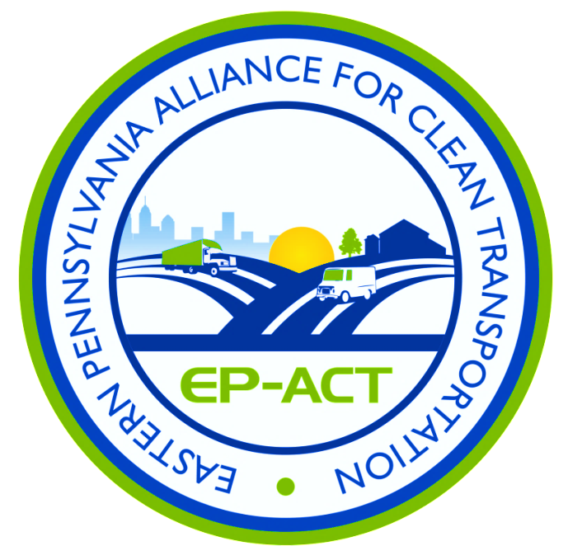
Thank you!
Tony Bandiero
Executive Director
EP-ACT
215-990-8200
tfbandiero@ep-act.org
www.ep-act-org
www.driveelectricpa.org

