Slide 1

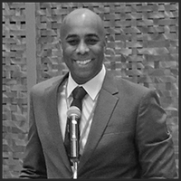
Justin J. Harris Climate Equity Collaborative

Slide 2

Climate Equity Collaborative
Justin J. Harris

Slide 3
Climate Equity Collaborative
Investing in the Future
Delaware County Sustainability Conference
June 7, 2023

Slide 4



Today’s Talk
I. A little about my journey…
“He’s a nice guy, but…”
II. Our Changing Climate…
III. The Climate Equity Problem…
IV. The Climate Equity Collaborative…
public-private-partnership as a climate solution
V. What’s next?

Slide 5
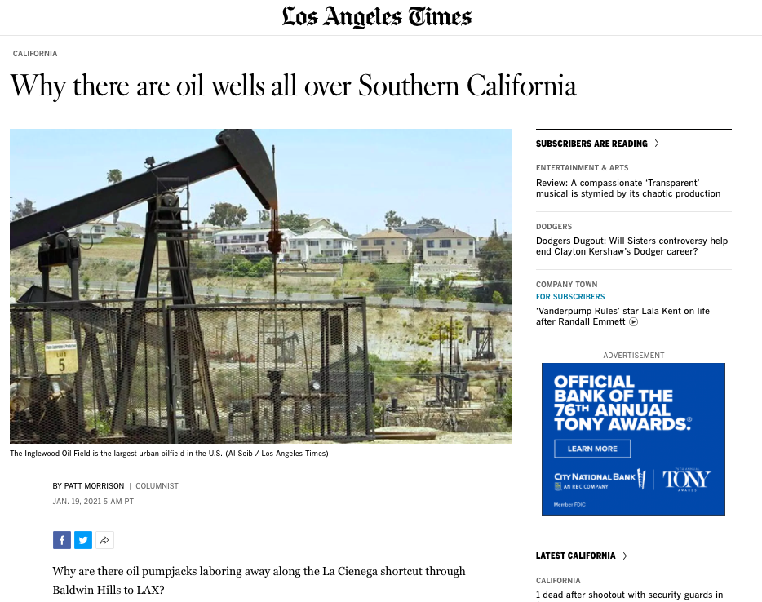
“More than 2 million California residents live within 2,500 feet of an operational oil and gas well. The state’s oil regulators recently missed a deadline to release new regulations to protect those living near drilling.”
-FracTracker Alliance estimate from 2019

Slide 6
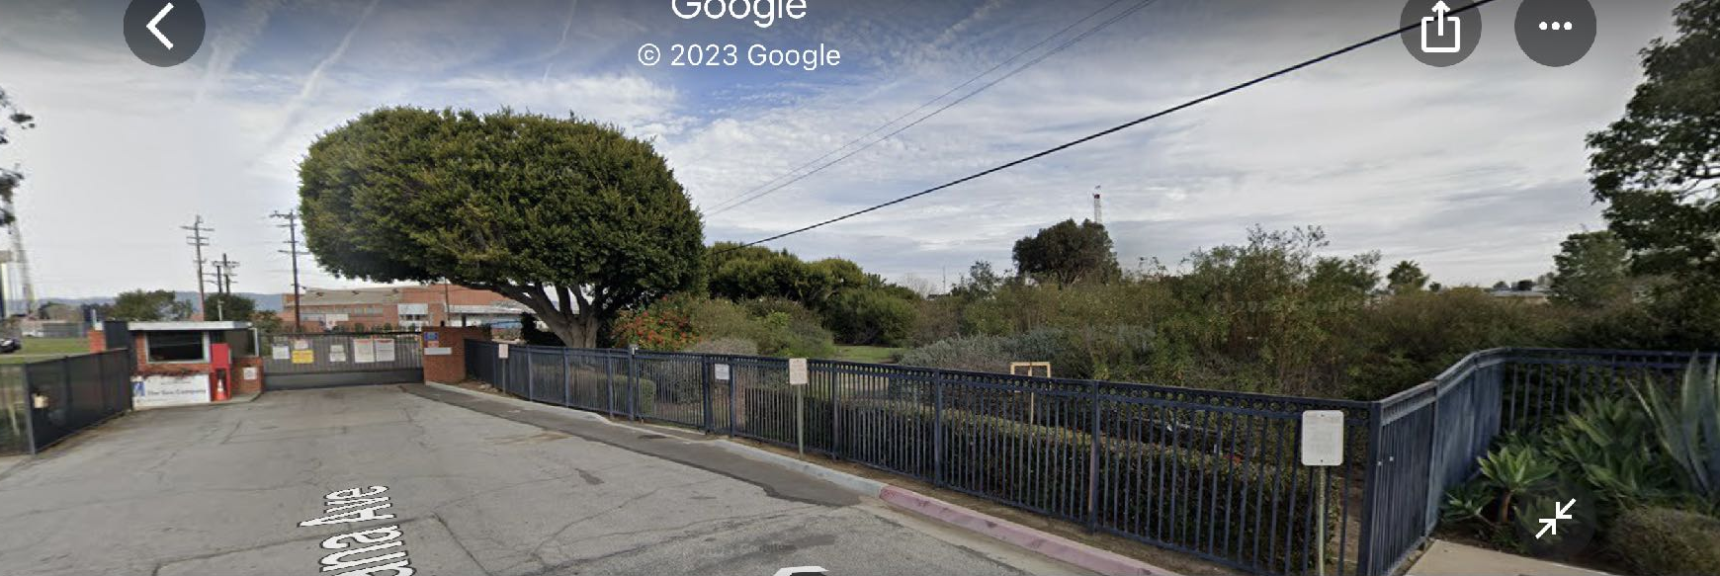
SoCal Gas
8141 Gulana Ave
Playa Del Rey, CA
90293

Slide 7
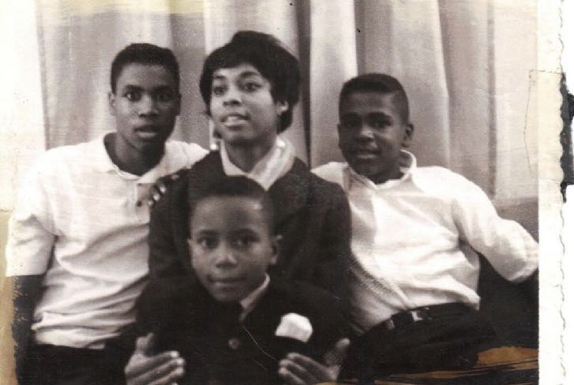
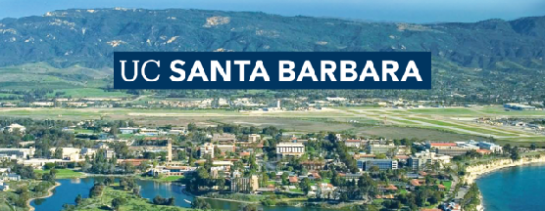
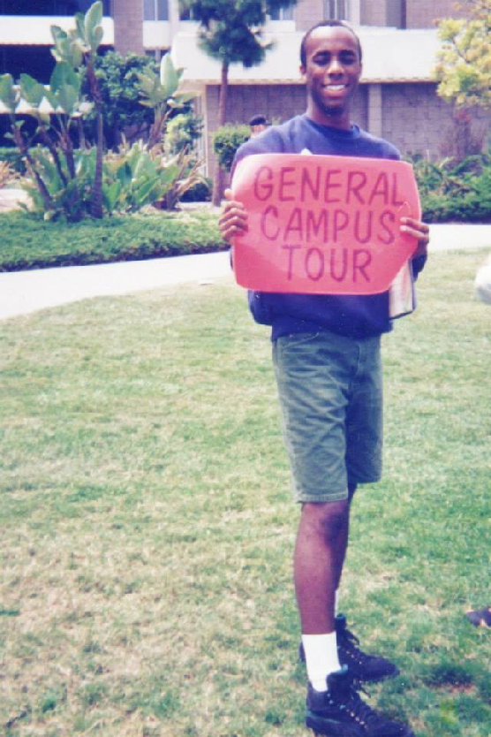


Slide 8
Beijing University
Chinese University of Hong Kong
National Taiwan Normal University
US Embassy Beijing
US Consulate Hong Kong
English teacher
Entrepreneur
Headhunter

Slide 9
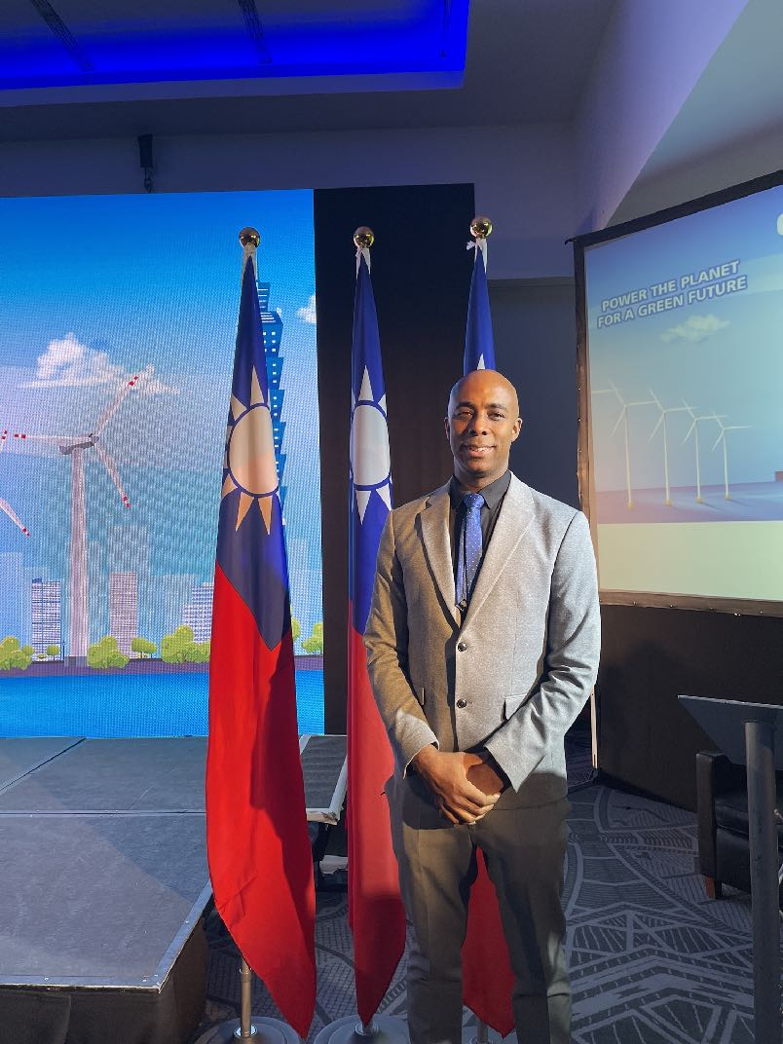

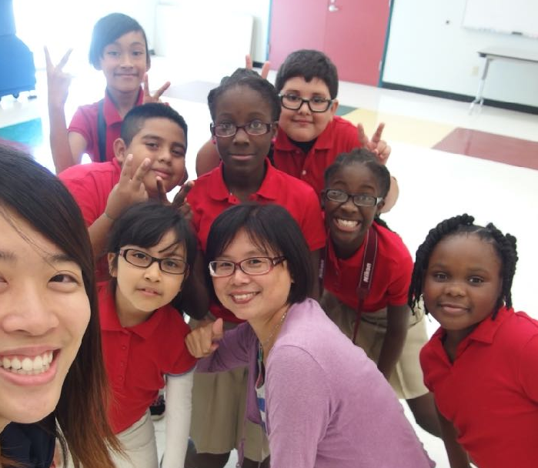

Slide 10
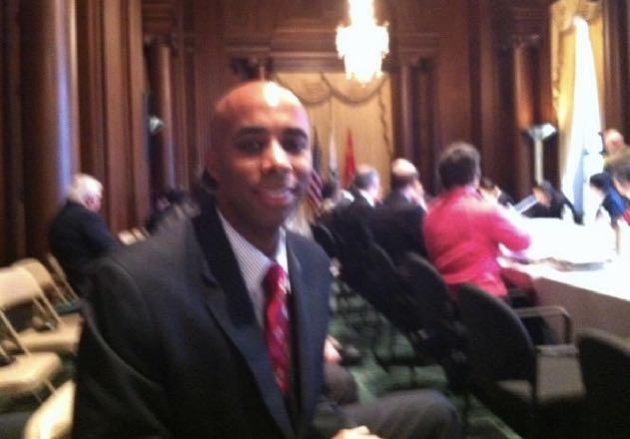
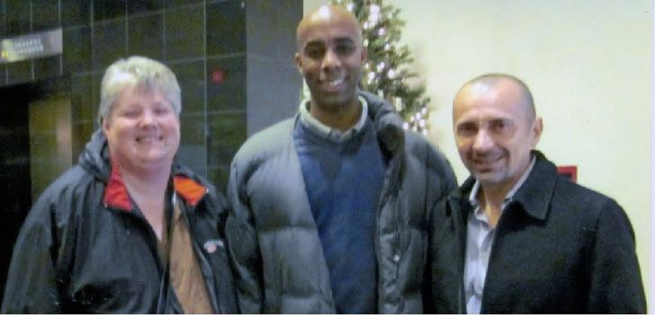
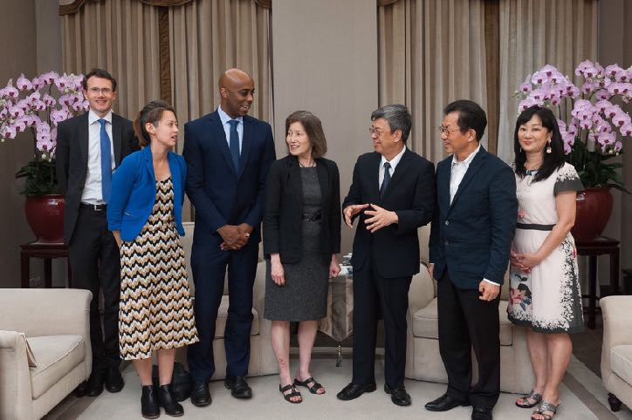
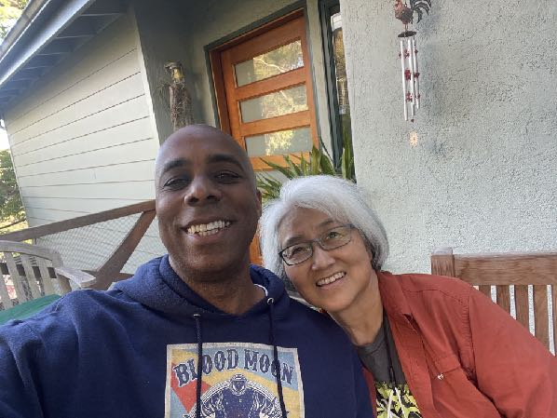

Slide 11
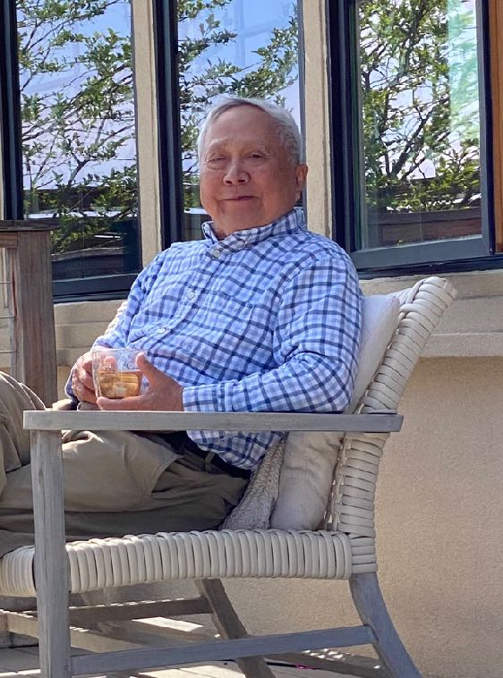
Minister Dang & Minister Lee
Notes:
Ambassador Dang — pushed on children’s environmental health. Within Taiwan
Late Minister Ying-Yuan Lee - everybody work together.

Slide 12

Smoke
Wildfire
Heat
Air pollution
Extreme weather
Flooding
Communicable disease
and the list goes on.

Slide 13
Climate change affects everyone, but underserved groups are impacted disproportionally due to inadequate opportunities and
historical inequities.

Slide 14
Our Climate Inequity Problem
It’s global. Low-income, minority groups, people with disabilities & the underserved are most vulnerable to climate risk, contributing to the cycle which 1) amplifies existing inequalities and 2) reinforces cycles of disparity.
How Did We Get Here?
Where Are We Headed?
Well-established, system-wide inequalities
Exclusion of certain socio-economic groups in solutions
Low prioritization of climate change as a global issue
Unequal access to STEM and tech jobs for overburdened groups such as minorities (US) and women
Not enough accountability for businesses and their role in contributing to climate change
Low climate literacy and inadequate attention to health impacts
Youth, particularly BIPOC youth, feel disconnected from the climate crisis. Voices are not being heard. Lack of access to educational, climate leadership and career opportunities.
Climate impacts are amplified for those in underserved communities particularly children. Our underserved communities are 25% more likely to live in areas with adverse health outcomes and the highest projected loss of jobs due to climate risks such as rising temperatures.
Climate efforts are scattershot and disconnected from what the most vulnerable are experiencing. There are insufficient
on-ramps to be part of the solution.

Slide 15
Current Gaps in Addressing Climate Change in Local Communities:
Lack of “Ecosystem” of partners united to lift up solutions from youth and frontline communities to catalyze action on intersectional public health and climate crises.
Need accessible digital platform and tools to create scalable change and learning in communities and beyond.
Limited opportunities for young climate leaders in “minority serving” colleges especially, to compete in the 21st century workforce.
Inequitable access to financial resources, and community-informed input, to implement scalable, community-based solutions.

Slide 16

Fighting for Equity: The Climate Equity Collaborative
The Climate Equity Collaborative (CEC) is a public-private-partnership that engages in system-level climate innovation, with emphasis on our youth and underserved communities.
The Focus of CEC:
While the problems stemming from climate inequity are vast, CEC is focused on youth (K-12), BIPOC-serving institutions, and underserved groups which are not sufficiently engaged and historically under-resourced in climate & public health decision-making. We aim to leverage technology and public-private-partnership to drive system-level change.

Slide 17
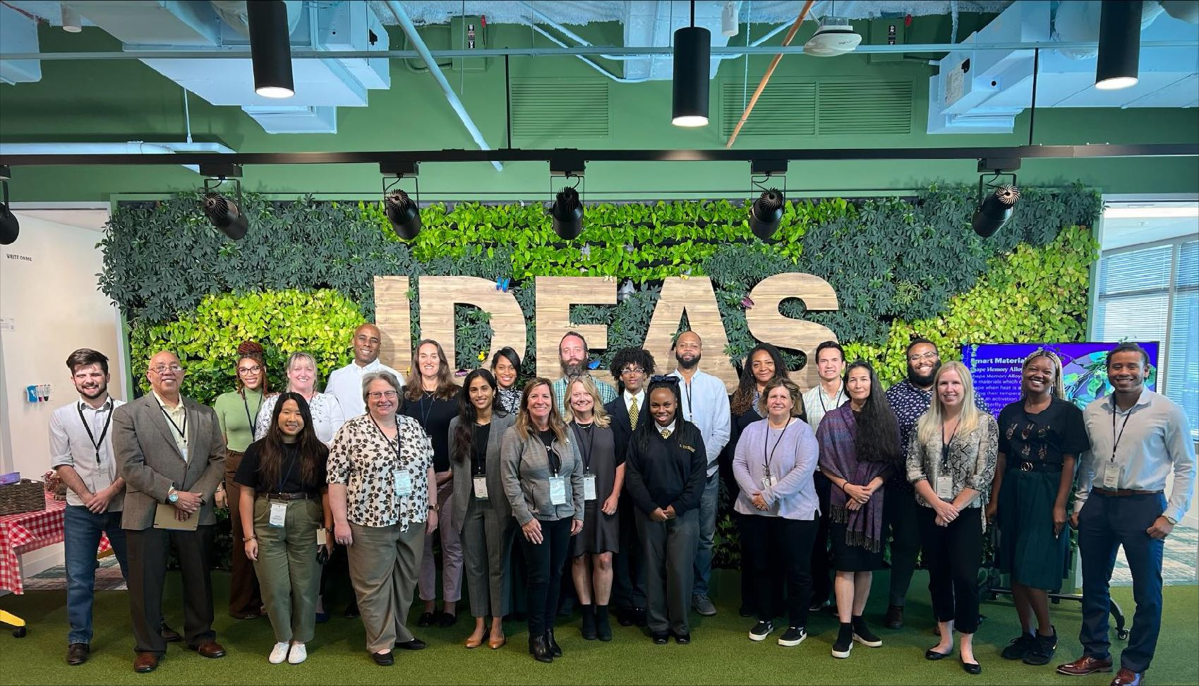

Slide 18






Official Launch: September 13, 2022
@Climate Week NYC
Anchor Partners

Slide 19




Who We Are
The Purpose
Why does climate equity matter?
The Mission
What actions will the CEC take?
The Vision
What will this coalition do and consistently deliver?
The impacts of climate change are indiscriminate, but the burden is and has been disproportionate, affecting those who have been historically unseen, unheard, and under-resourced in climate change and climate health decision-making.
The CEC is a public-private partnership that will engage underserved communities, in accelerating climate planning, bold transformative initiatives, and development efforts. We will achieve this, in part by extending this conversation to those not traditionally engaged.
With a focus on the most vulnerable communities and children, the Climate Equity Collaborative (CEC) will harness existing and new resources to develop a unique and collaborative approach to transform the way communities learn and act on climate issues— centering climate ed, kid’s health, EJ and technology.

Slide 20
What We Will Do
Build Community Trust and Facilitate Participation
Enhance Systems and
Localize Existing Resources
Drive Public-Private Collaboration and Accelerate Change
Engage Youth and
Amplify Voices

Slide 21
Our Approach: A shared ecosystem
Corporate
Nonprofit
Government

Slide 22
Our Shared Value
Your Organization
Climate Equity Collaborative
Accenture
Leader in delivering innovation in health, sustainability, and nonprofits
Collaborative of trusted partners and anchor programs with a proven track record of engagement and impact— locally and internationally.
Potential catalytic partner engaging young people in climate, equity, technology, and opportunity

Slide 23
Our community of partners and their work….

Slide 24
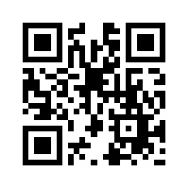

Slide 25
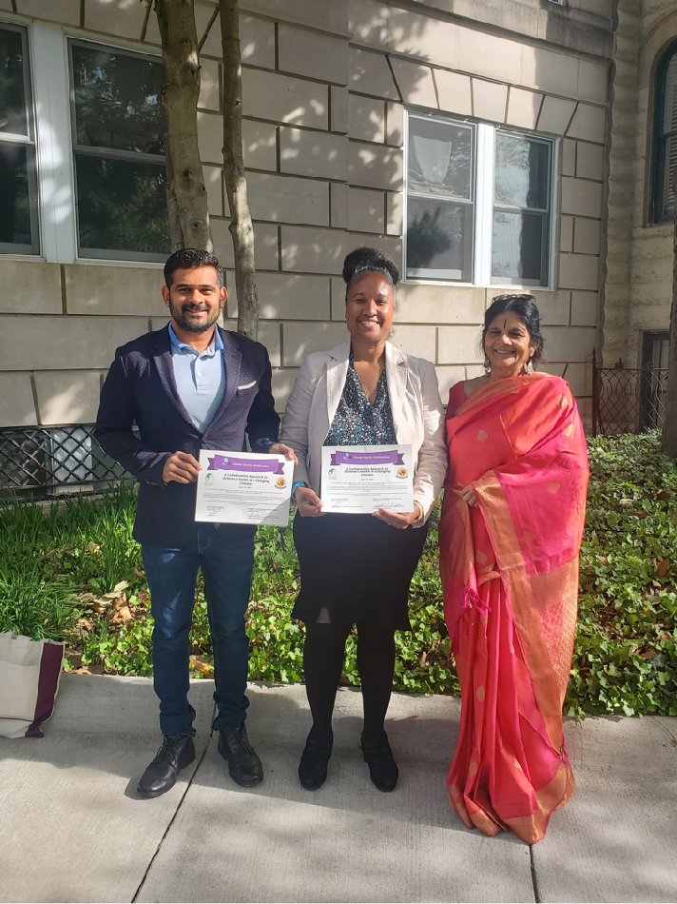


Forging Partnerships
Ongoing discussion and outreach to US EPA, CDC, HHS,
and corporate partners….

Slide 26


Global Children’s Environmental Health Network (GCEHN)
Internal Deliberative Draft for Stakeholder Discussion—
event partners and agencies being onboarded
GCEHN is a new effort to be co-founded by the Children’s Environmental Health Network (CEHN) and the Mann Deshi Foundation to build upon the success of the CEHN, which has led the children’s environmental health movement in the U.S. for over 30 years with an emphasis on science innovation and translation into effective public health standards and child-protective policy, education and training opportunities.
The GCEHN responds to the growing need to address unique environmental health threats children face in our changing climate by leveraging a network of public-private partners to advance climate equity, and improve children’s environmental health globally through collaboration, technology and innovation.
Children are more vulnerable than adults to pollutants in their air, food, and water, and the health impacts of these exposures may last a lifetime – impacting their ability to grow, learn, and thrive in our changing climate.

Slide 27

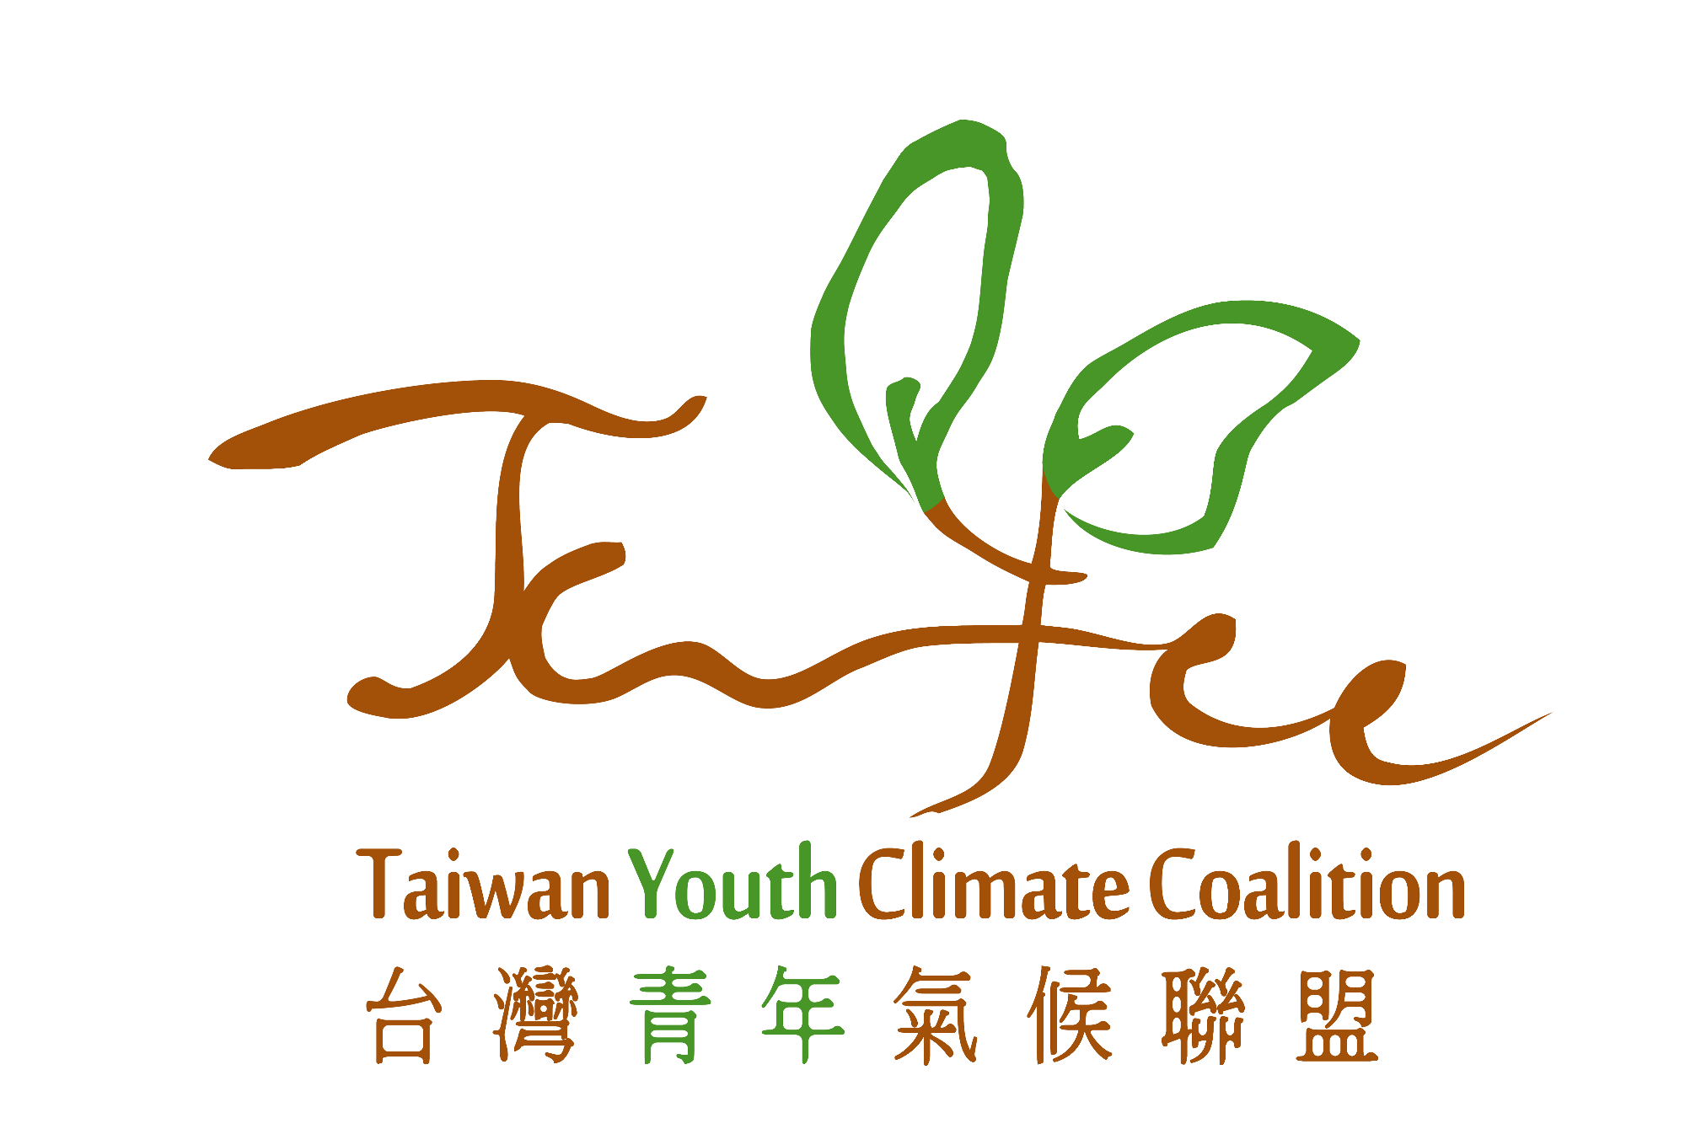
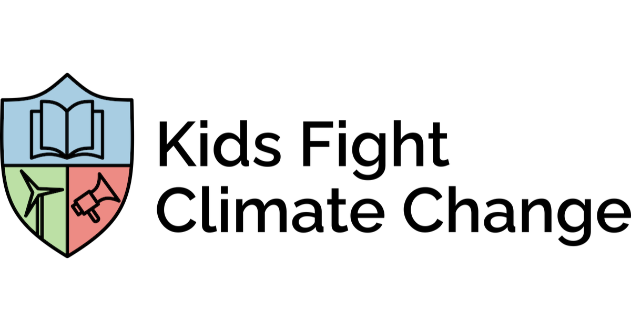




General Motors
IBM
SEMI
Microsoft & Linkedin
US Department of Transportation
National Wildlife Federation
COP28 Egypt
COP27
CEHN, NWF, WE ACT, IBM, Microsoft, General Motors, US Department of Transportation, SEMI

Slide 28
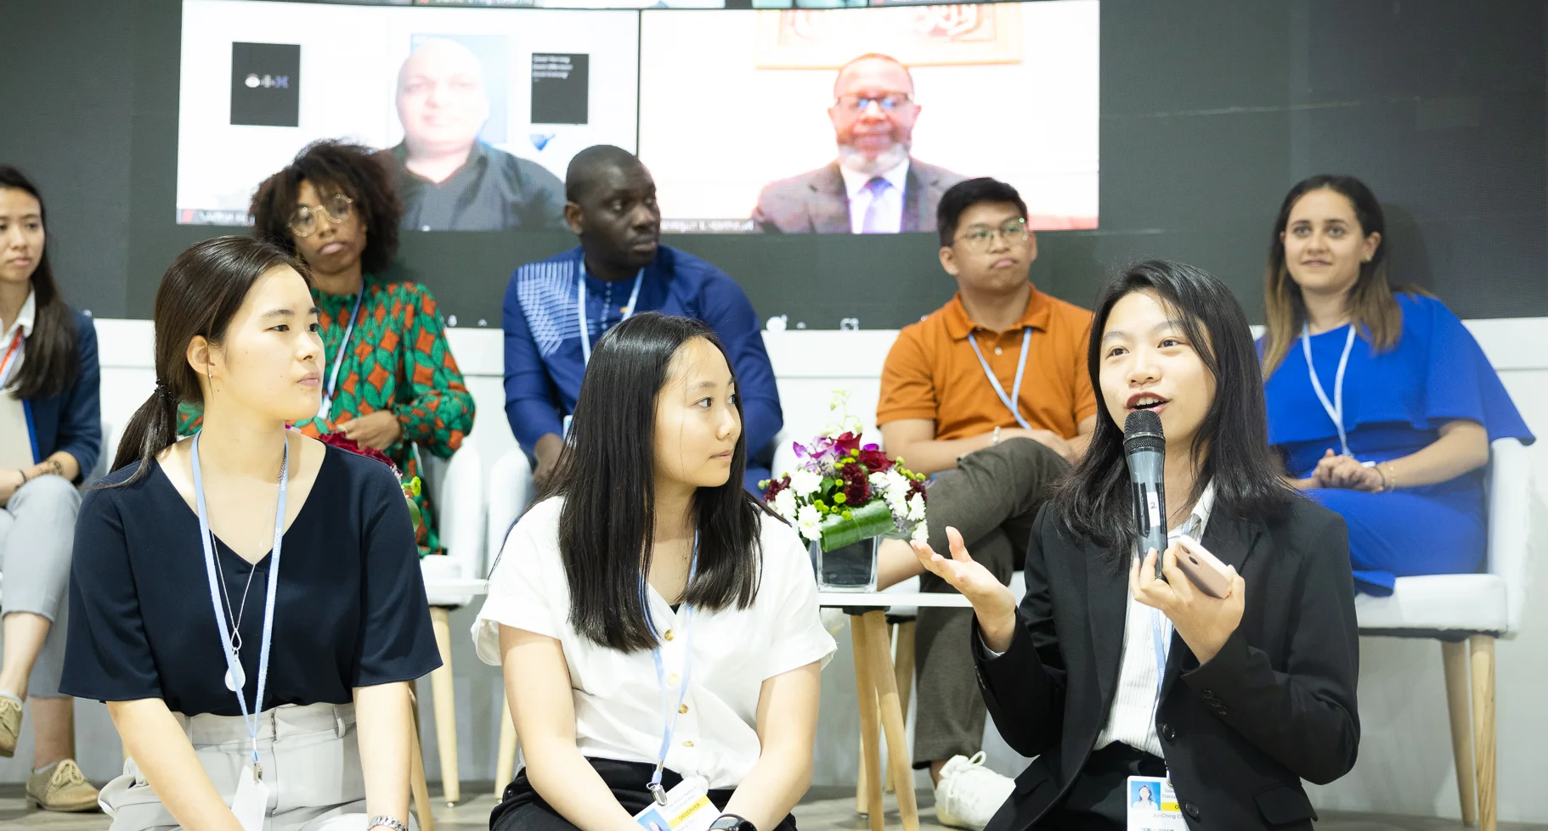
COP27 Egypt

Slide 29
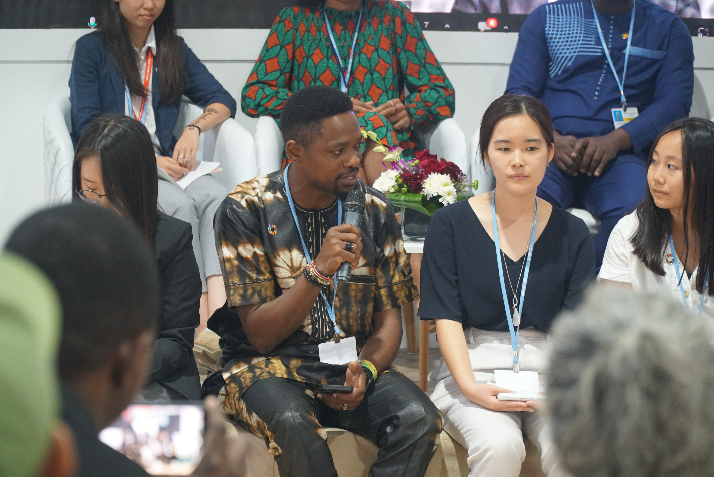
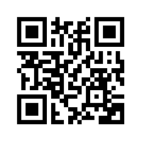
CEC’s Youth Advisory Council is a global, diverse network of individuals that help shape and further CEC’s vision, values, and mission by serving as conduits to the needs of peer organizations and community members and contributing their perspective and expertise; while the network itself will also serve as a platform for cross-organizational and cross-industry collaboration and resource and information exchange.
CEC’s Youth Advisory Council
Point of contact: Marley Hauser
4/6/23
Notes:
Bit of a mouthful at the moment, but will likely refine as we move through the consultation process – but overall encapsulates the general needs we hope this council will address, which include having a diverse, global network of individuals that:
Help to shape and further CEC’s vision values and mission by serving as conduits to the needs of peer organizations and community member AND Contribute their perspective and expertise
While the network itself will serve as a platform for cross organizational and industry collaboration, and resource and information exchange

Slide 30
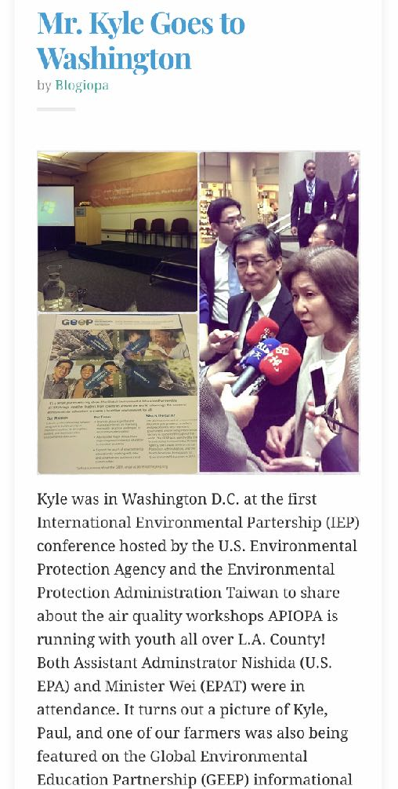
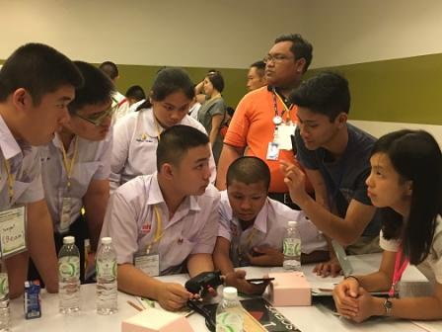
International Collaboration & Frontline Communities
Notes:
If you had a chance to see the video. This is another example.
We invited that community group to a conference of the International Environmental Partnership here in DC hosted Jane and Gina McCarthy. This was a very very big deal for that community group.
These Community level partnerships add texture to the agency’s international programs.
It gives us an extraordinary story to tell about how our international work impacts our own communities in the US and helps our international partners learn from our experience. While we also learn from theirs.
If there’s anyone curious about why the community group in the video would be really excited about this opportunity, we need only look at the EJSCREEN Report for Alhambra, CA. They are in the above the 90th percentile in terms of air toxics cancer risk, respiratory hazard, PM2.5 and other risks.
So just like in the case of the Florida school, the kids’ level of engagement shot through the roof as a result of their international experience. (Although most of them didn’t actually travel anywhere)

Slide 31
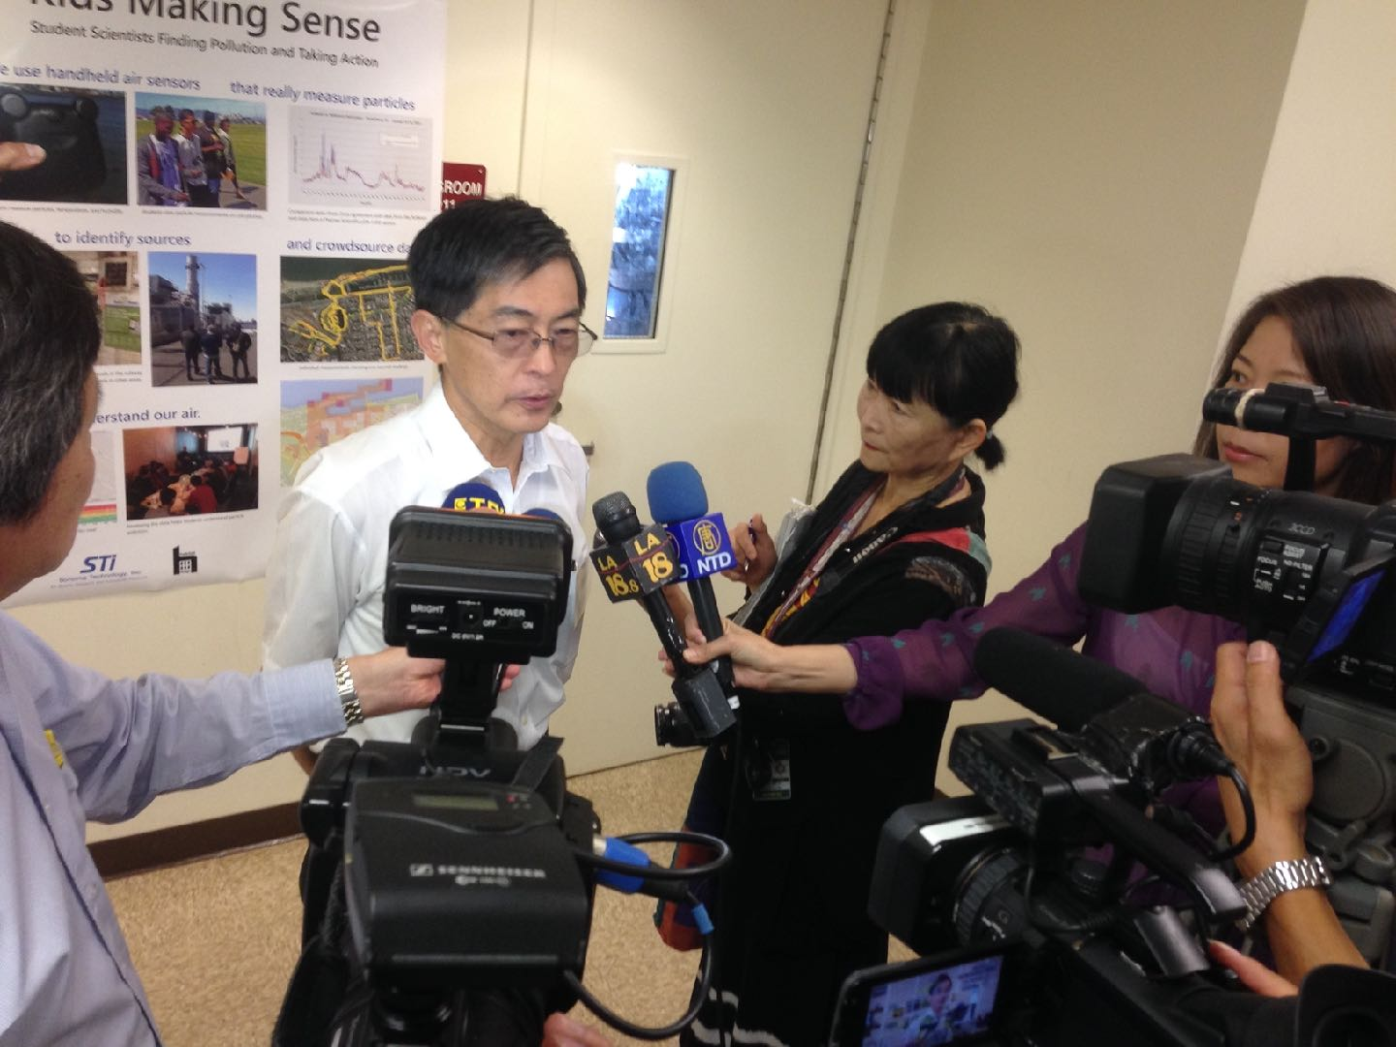
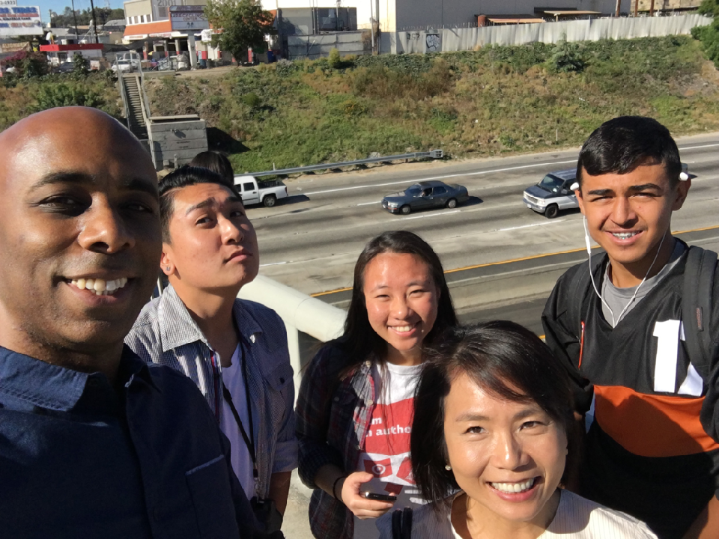
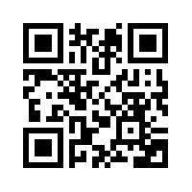
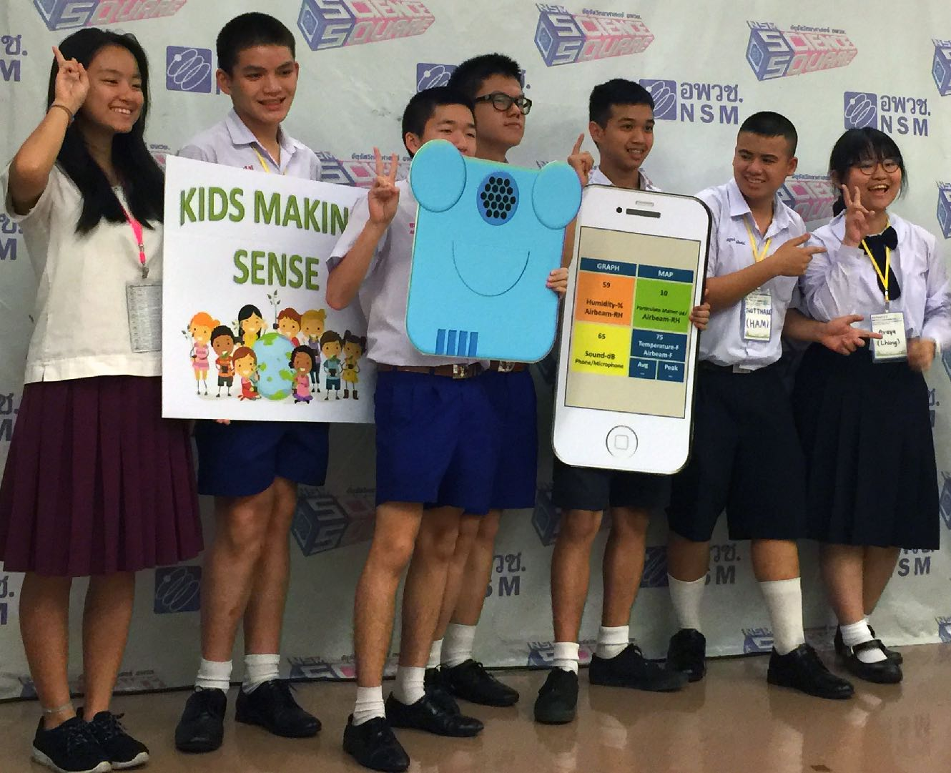
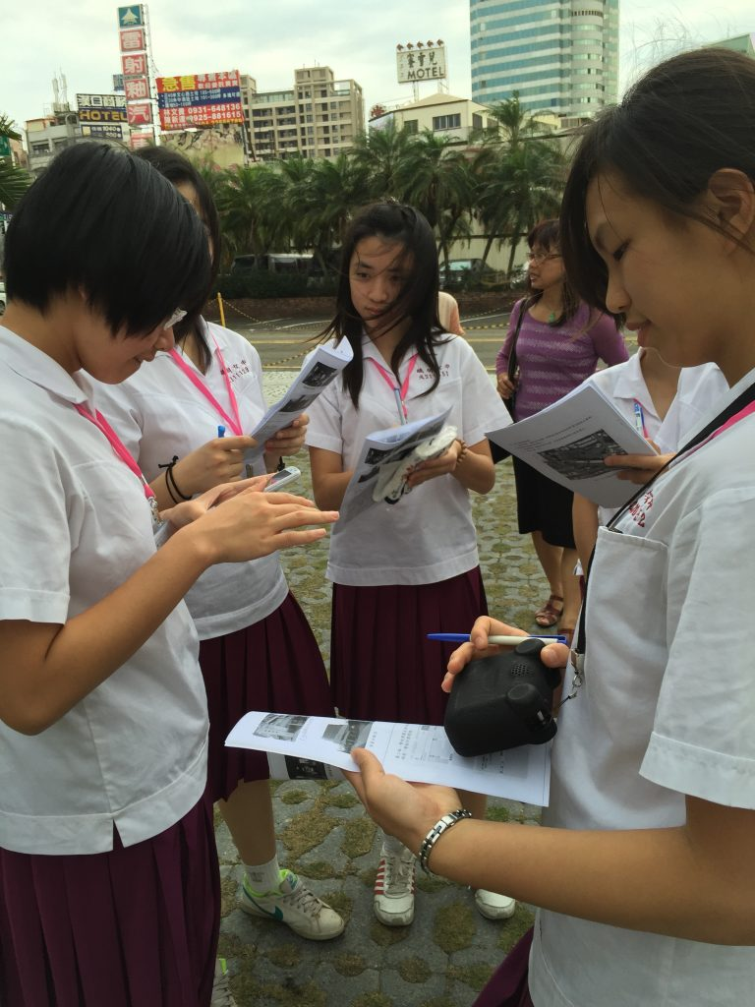

Slide 32
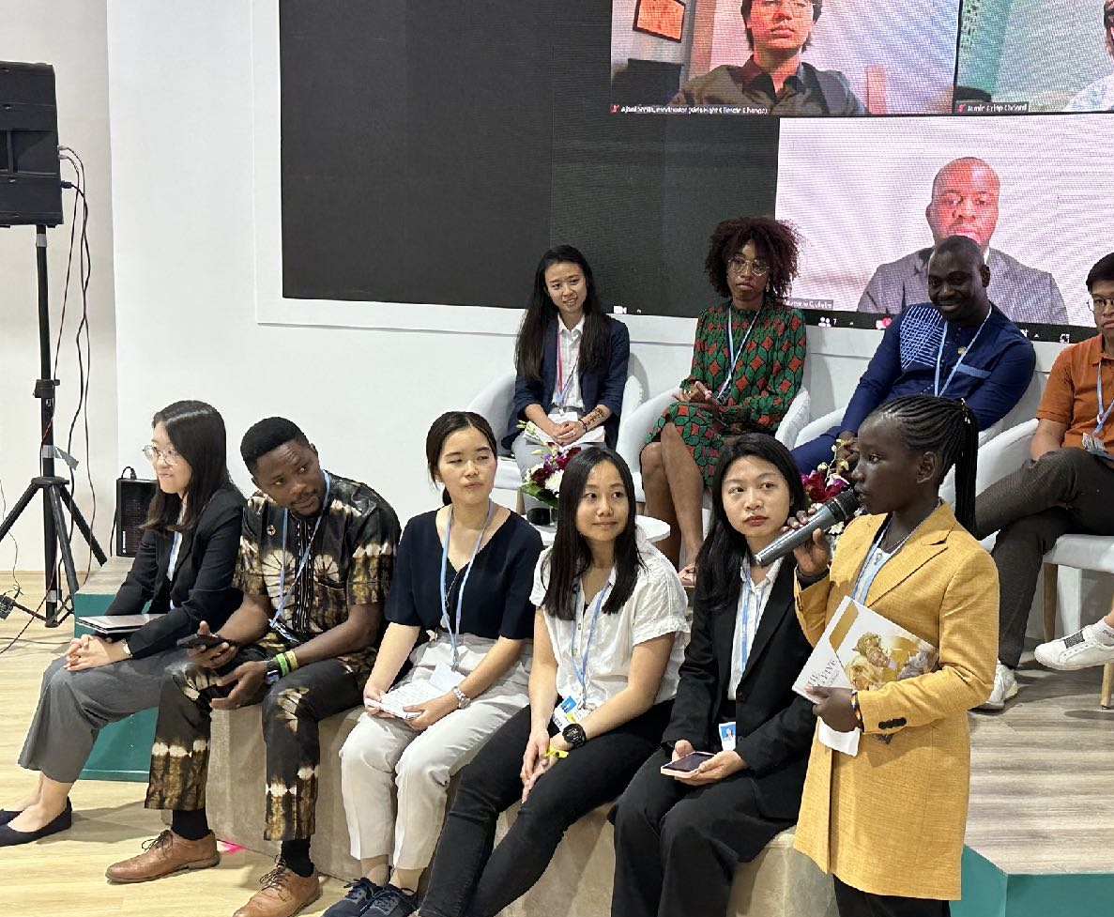
How to join the movement…
Upcoming Opportunities:
Climate Week
COP28
There are engagement opportunities
for individuals: schools & universities,
young people, companies, nonprofits and government agencies at every level…
Reach out to CEC…
justin.harris@nwf.org

Slide 33
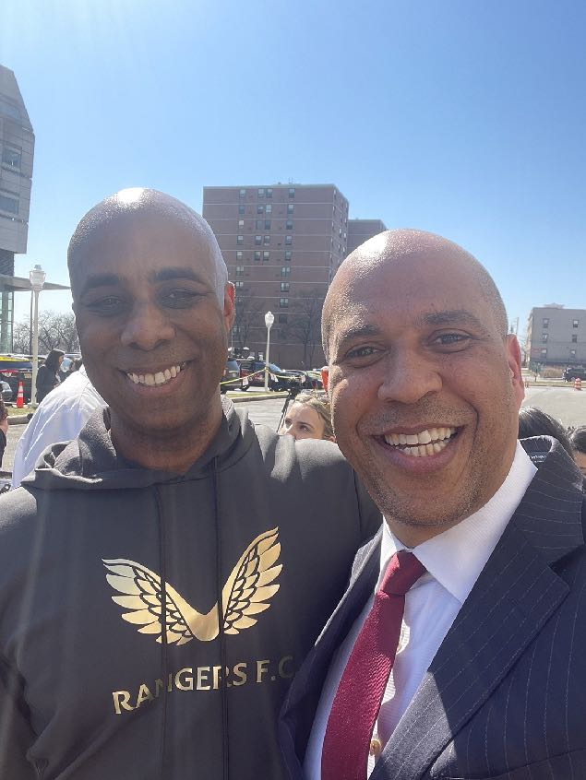
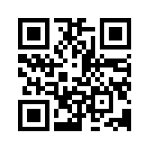

Slide 34
Thank you

