Slide 1


Dr. Peter DeCarlo Johns Hopkins University, Professor

Slide 2
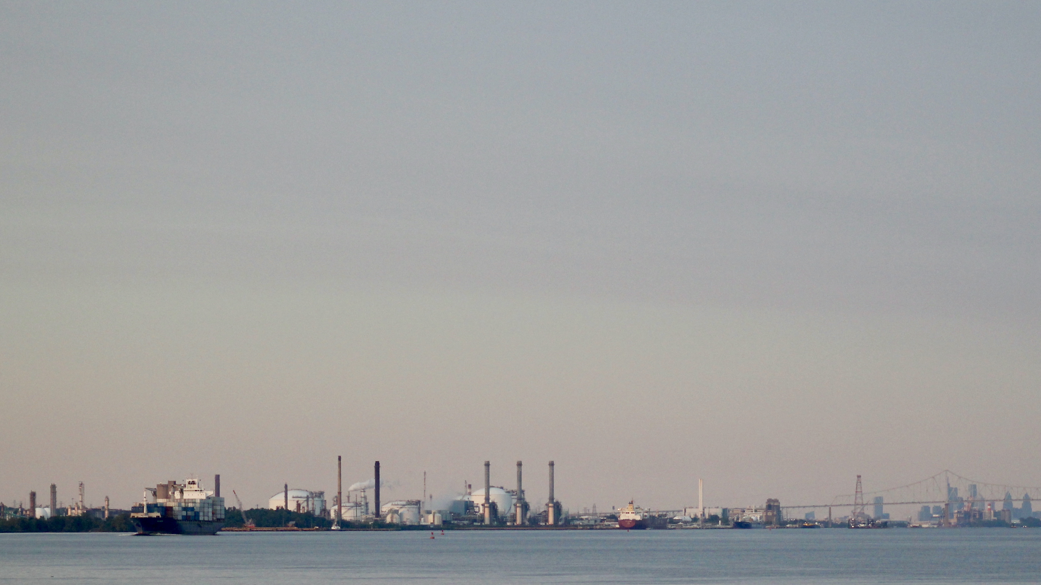

Air Monitoring Research: Science to Inform Policy – Improving Air Quality assessments for fenceline communities
The JHU Team: Peter DeCarlo, Tom Burke, Keeve Nachman, Kirsten Koehler, Ana Rule, Ellis Robinson, Mina Tehrani, Sara Lupolt, Andrea Chiger, Carolyn Gigot, Roger Shue, Amira Yassine, Shivang Agarwal
Widener University: Scott Van Bremer
Aerodyne Mobile Lab Team: Megan Claflin, Edward Fortner, Manjula R Canagaratna, Conner Daube, Benjamin Werden, Joseph R Roscioli, Jordan Krechmer, Harald Stark, Scott C. Herndon, Tara Irene Yacovitch
Notes:
Thank you for the invitation to share our team’s work on a collaborative project including a great team of JHU folks, Aerodyne Research, collaborators at Widener University and community groups in Chester, Marcus Hook, and Trainer Pennsylvania

Slide 3
Where are we falling short with communities?
Air Quality improved significantly across the US since Clean Air Act, but disparities remain.
Monitoring Locations
designed to cover a large area not a specific neighborhood
Measurement frequency
Continuous and high time resolution measurements are needed.
Air Toxics and HAPs
Less infrastructure and support for measuring specific chemicals of health concern
Regulations are set at the federal level and major changes have not been seen since 1996!

Slide 4
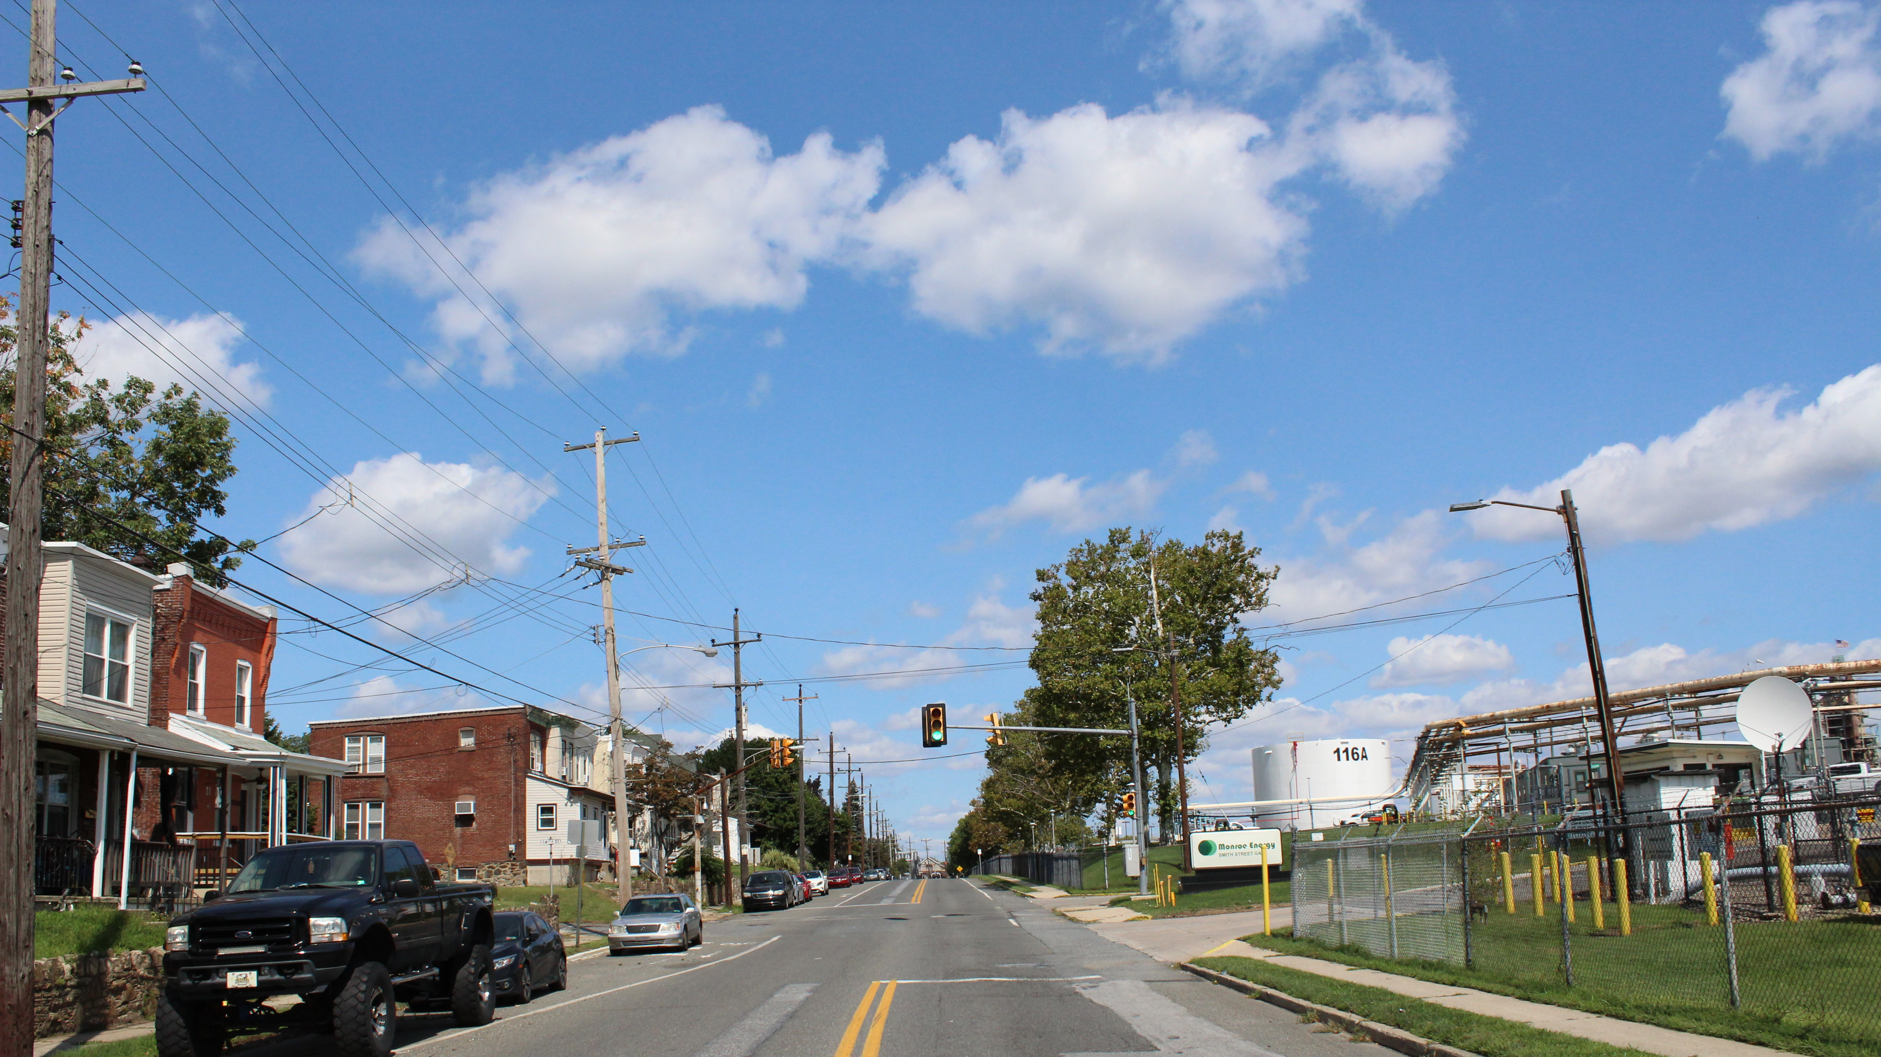
Goals of the HAP-MAP project
Improve our assessment of air pollution exposure and cumulative risk for fenceline communities
Use state-of-the-art measurement tools to characterize the spatial/chemical/temporal nature of toxic air emissions to
Regulatory measurements and models are inadequate to properly assess human health risk for fenceline communities
Monroe Refinery
Notes:
Fundamentally this research is focused on detailed characterization of exposure and risk from harmful air pollutants to communities on the fenceline of industrial facilities.
Pictorially shown here with How we measure the mixture of chemicals from this facility and how those chemicals impact the people living in the community across the street.

Slide 5
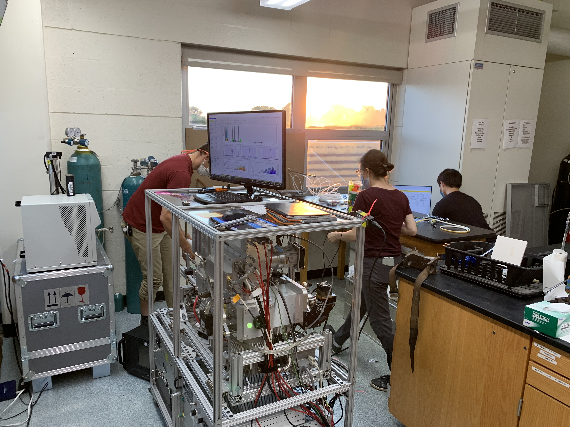
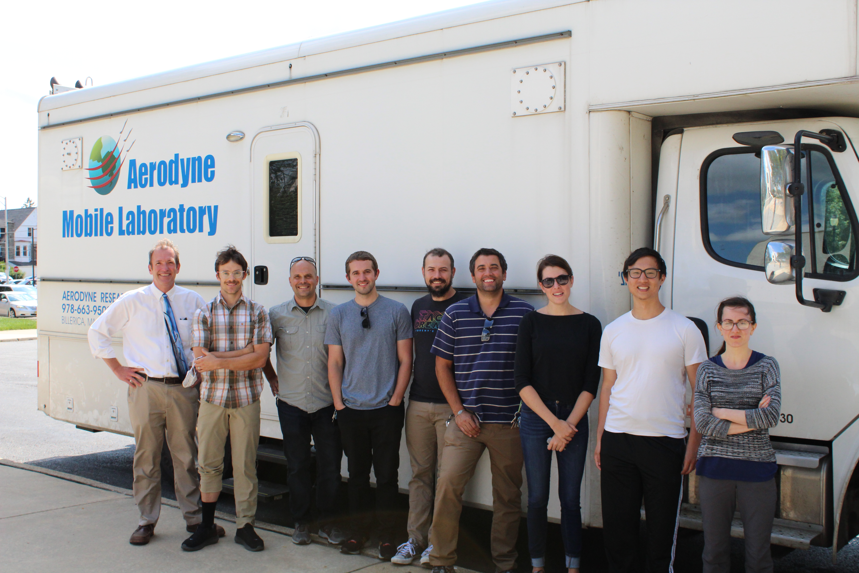
Framework of HAP-MAP project
Fixed Site – @ Widener Univ.
high time resolution: VOCs, HAPs, PM composition, Metals
Aerodyne Mobile Laboratory – spatial VOCs, HAPs, PM composition
Integrate measurements into Cumulative Risk Assessment Framework to assess neighborhood level risk
Low-cost Sensors
PM₁, PM_{2.5}, PM₁₀
Collaboration with: Widener University, Several community-based organizations, and PA-DEP
Notes:
Regulatory measurements are lacking in their ability to address neighborhood level differences in air pollution concentrations. They lack the temporal resolution, measurement frequency, and full chemical characterization of air pollutants. This project utilizes multiple measurement platforms to assess high time, multi-pollutant, and spatial concentrations of hazardous air pollutants, including benzene, toluene, xylene, formaldehyde, ethylene oxide, 1,3, butadiene, particulate matter composition including metals during September 2021.
These measurements are then integrated into a cumulative risk assessment framework to look at spatial differences in air pollution across the study area. And incorporate other community characteristics and stressors.

Slide 6
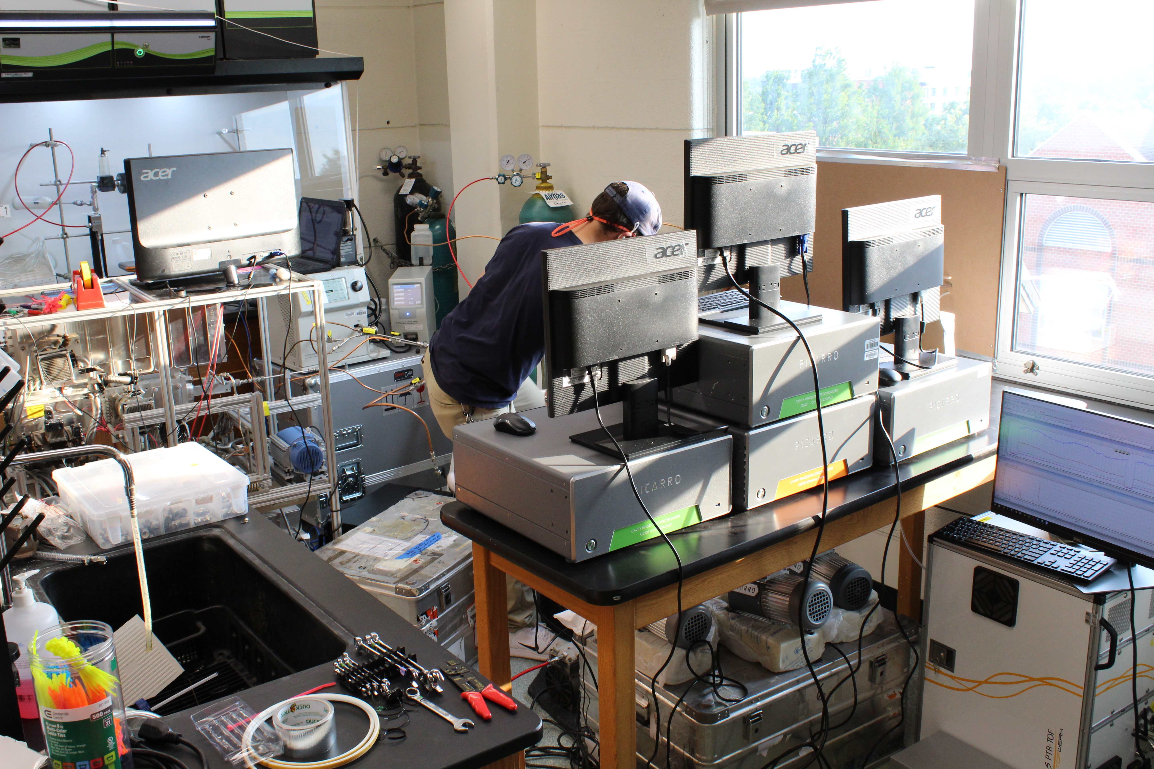
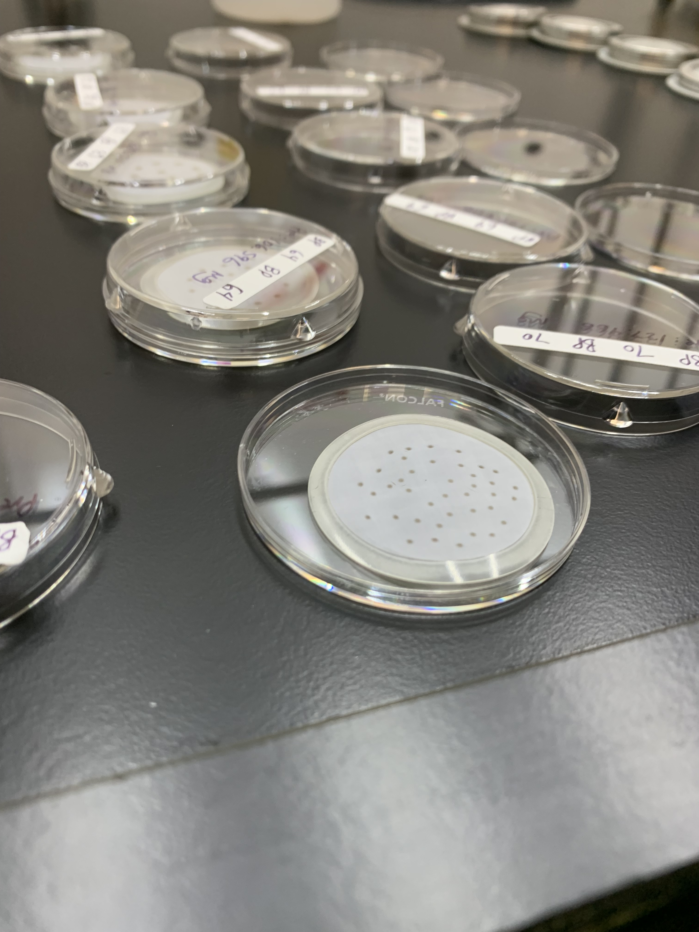
Fixed Site at Widener University
Instruments to Measure PM composition, toxic VOCs, and many other compounds.
Particles on Filters for lab analysis

Slide 7
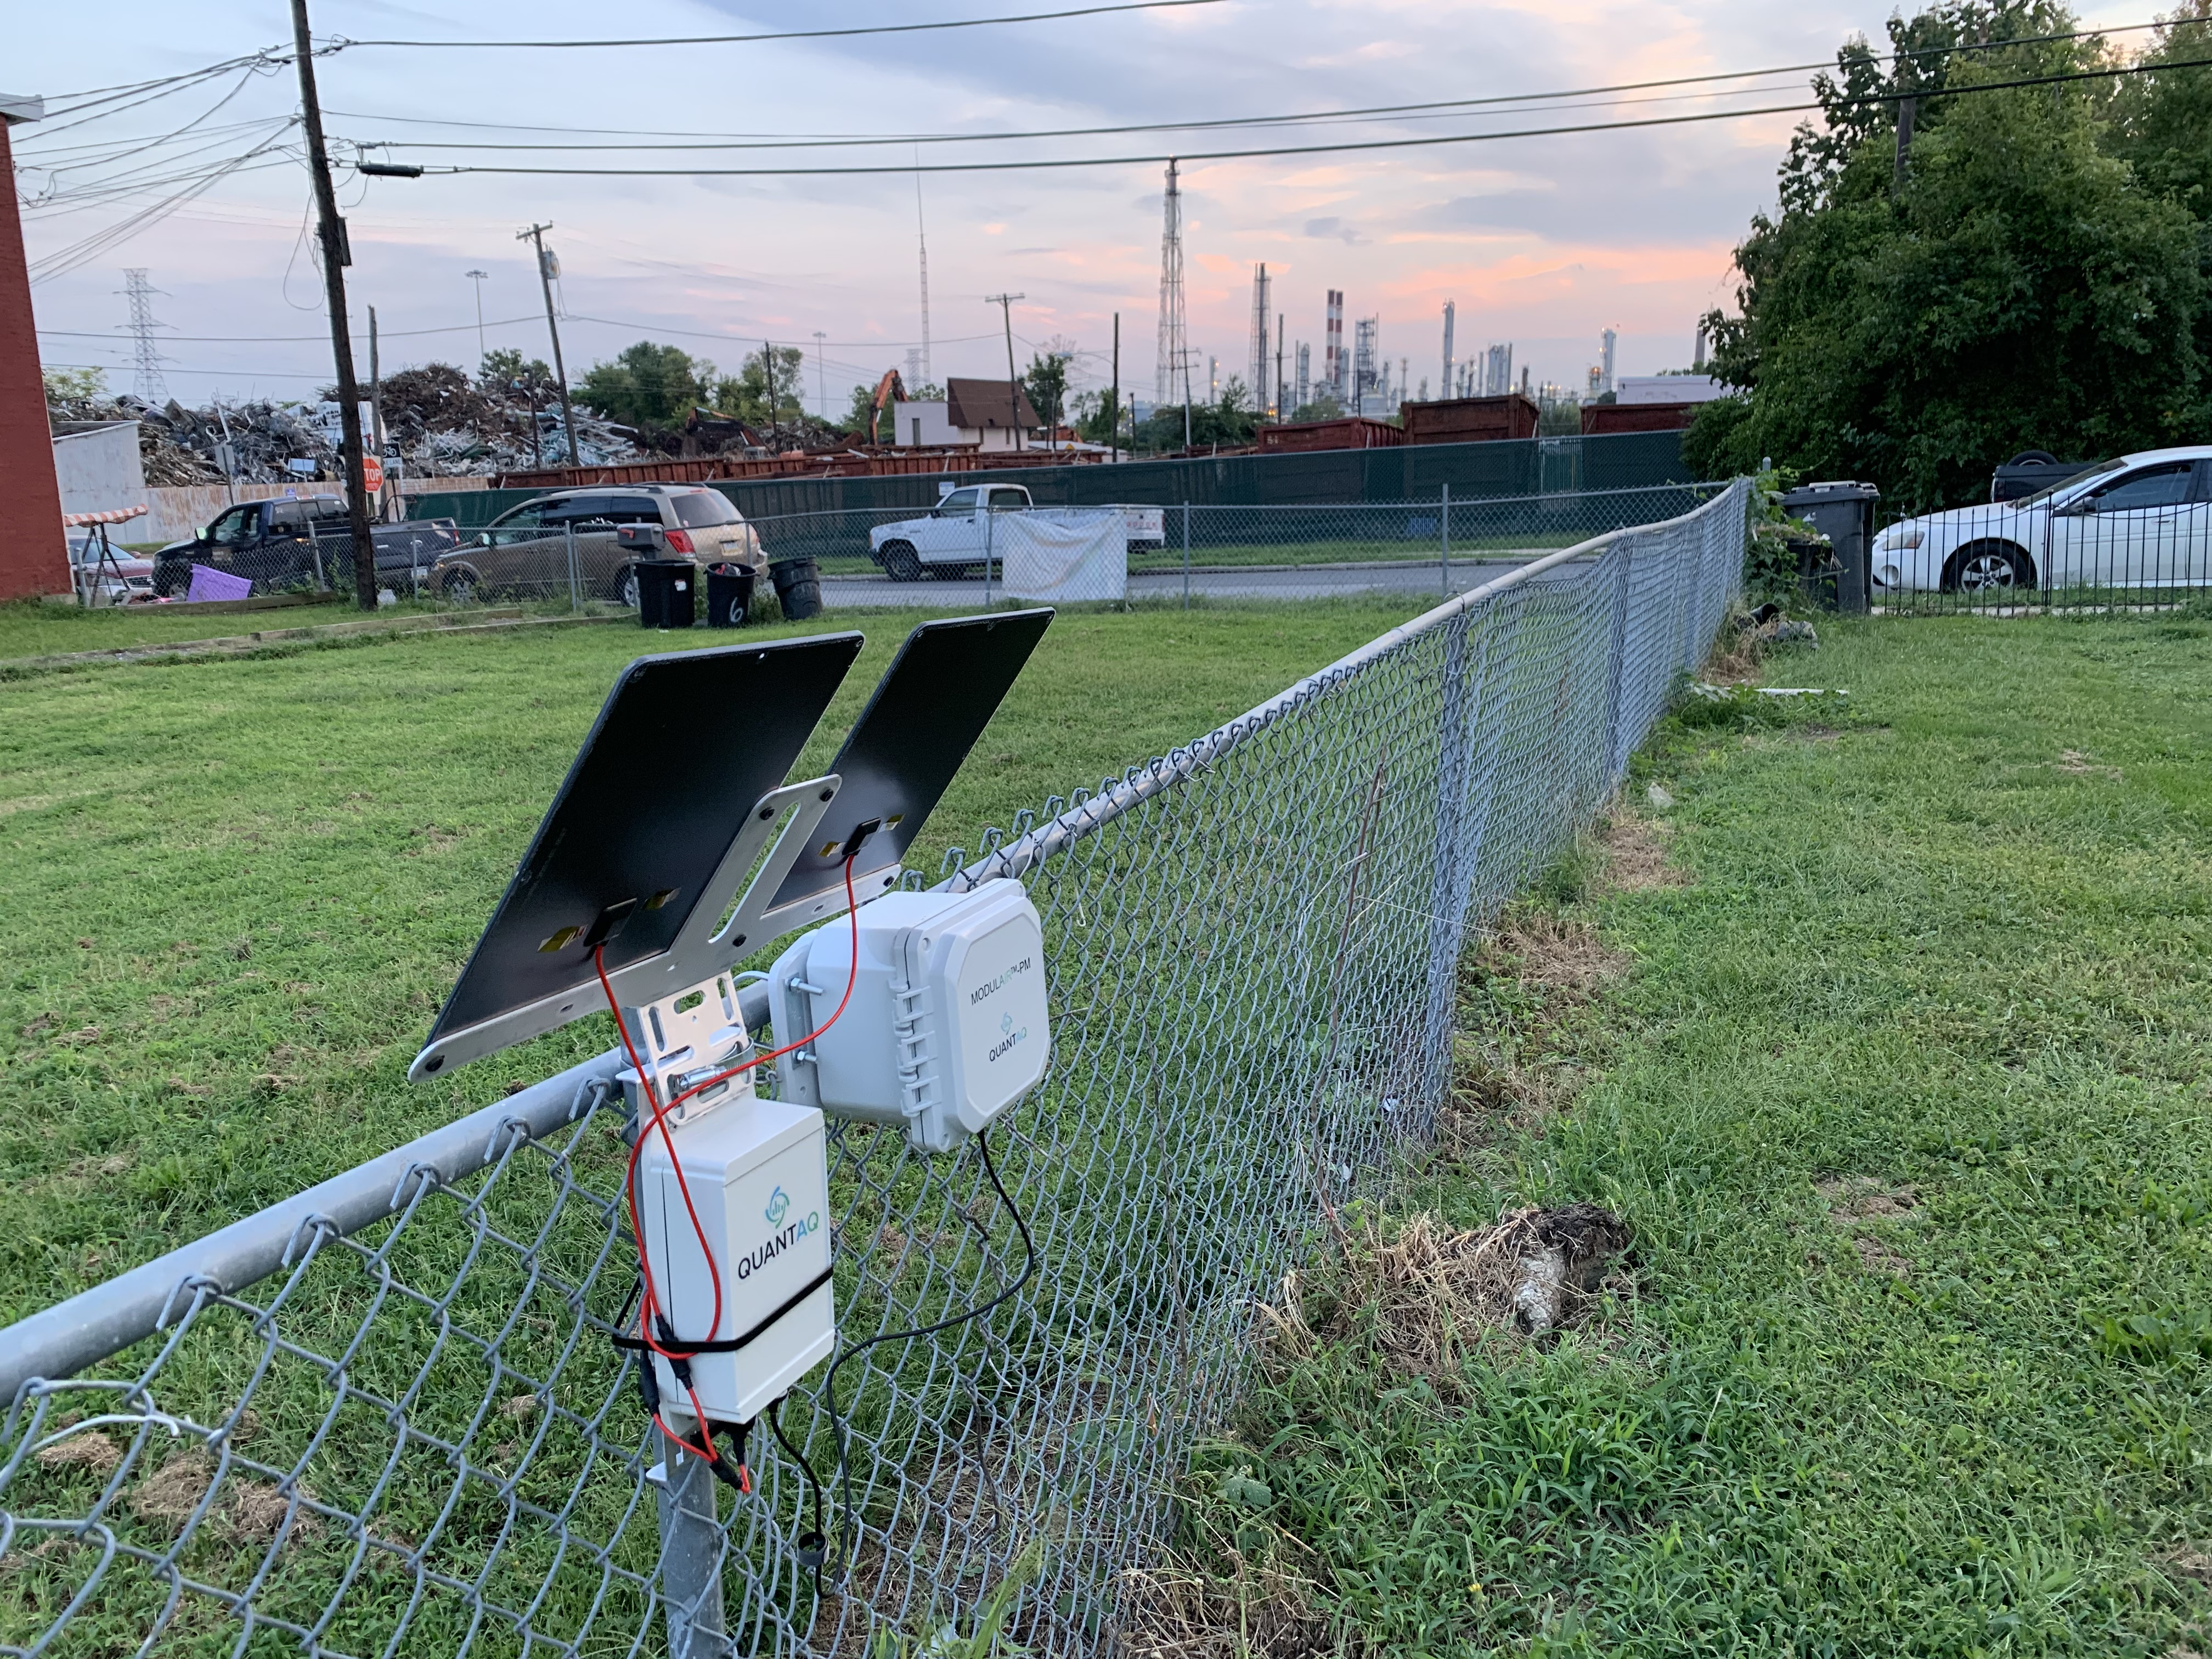
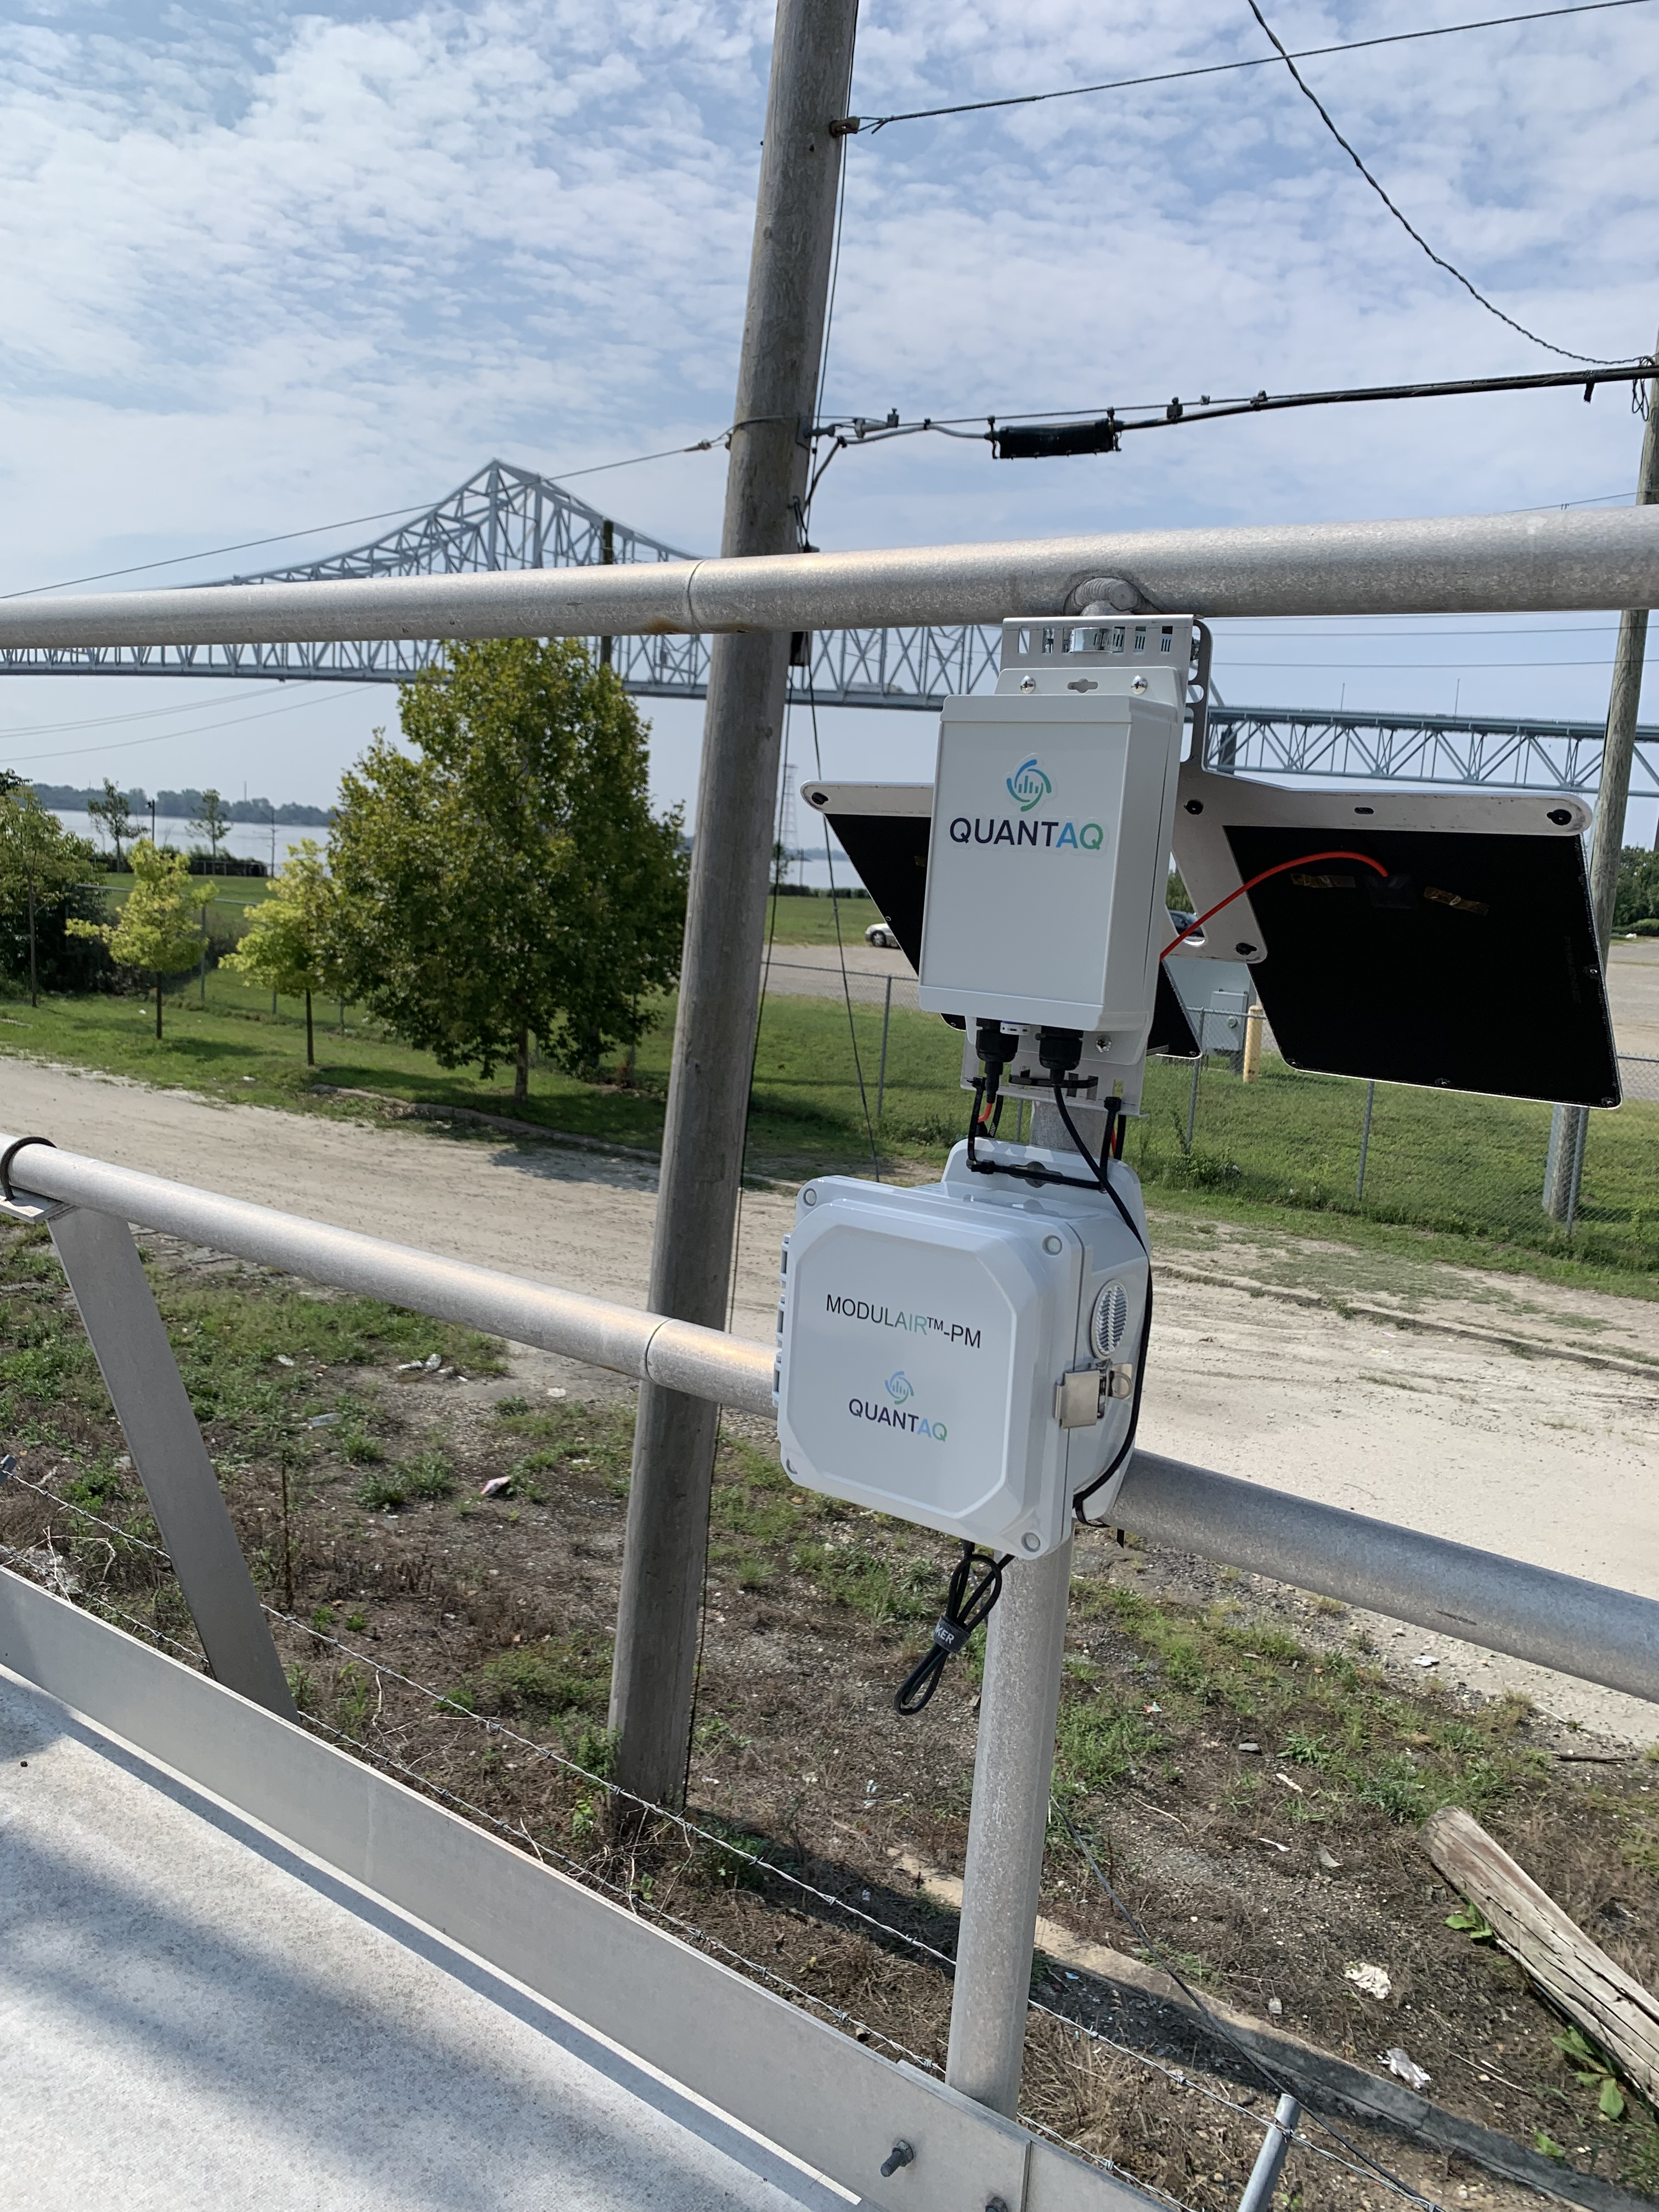
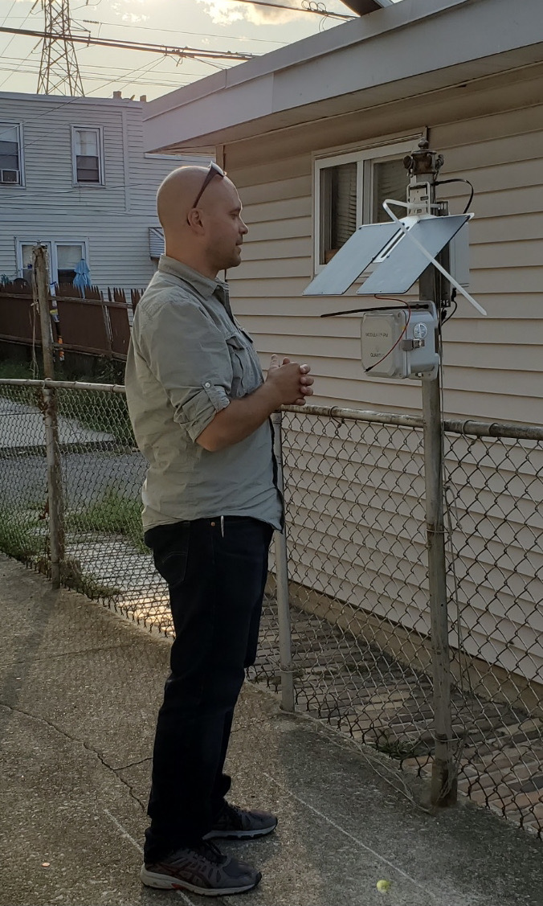
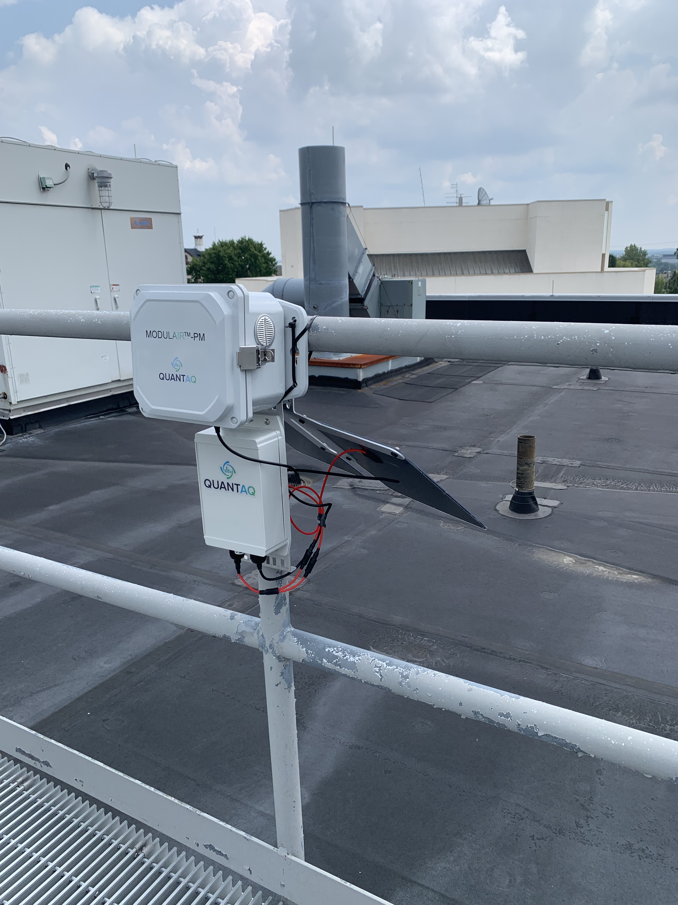
PM_{1,2.5,10} monitoring with Quant-AQ monitors
Have 1+ years of data for a detailed look at PM in the area and more to come with new studies!

Slide 8
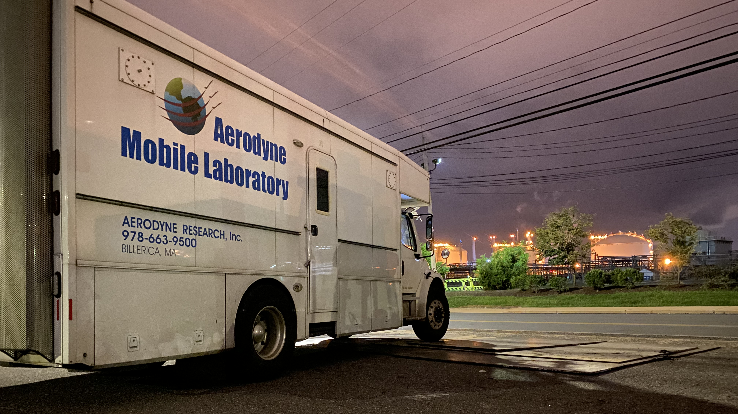
Mobile Measurements
Plume finding
Neighborhood Mapping
Can respond to community complaints quickly
Will find highest concentrations
Aerodyne Research Mobile Laboratory: Tara Yacovitch (AML PI)
Notes:
I’ll limit this lightning talk to the mobile dataset which provides a key spatial understanding of varying exposures and risks for different hazardous air pollutants across the spatial area. Inside of this vehicle are research grade instruments providing sensitive concentration measurments for the air pollutants of interest at 1 second time resolution translating to a spatial resolution of approximately 10 m at 30 mph.
We are building a similar in-house capability in EHE … stay tuned!

Slide 9
Major Facilities and area covered in initial study
Widener U.
Next a quick look at 2 of the many measured air pollutants in the study to demonstrate how we can improve our understanding of air pollution exposure and risk.
Created as an interactive google map (link).
Notes:
In preparation for the study, we looked in detail at the Risk Screening Environmental Indicators and toxic release inventory to get an idea of what the reported emissions for this area. Shown here is Chester, Trainer, and Marcus Hook Pennsylvania areas located in between Philadelphia and Wilmington. As for sources in the study area, there is the largest municipal solid waste incinerator in the country, an operational refinery and associated petrochemical industrial sites on both sides of the river, a regional wastewater treatment plant, and a major interstate…
You can see from the map the location of several of these facilities where we located low-cost PM sensors and the fixed site location at Widener University somewhat removed from the industrial fenceline.

Slide 10
Formaldehyde measurements
Contrasting the urban background (Widener U) with spatial measurements around facilities
Notes:
Formaldehyde, a key cancer risk pollutant was also measured at the fixed site and the mobile laboratory with high time resolution. 1 second. The black line is the formaldehyde concentration at the fixed site and green shows the higher concentrations observed when the mobile lab was out driving around the study area.
Again, the modelled 2014 NATA values were lower than the fixed site values measured at the fixed site, indicating the overall risk may be underestimated in the NATA.

Slide 11
Formaldehyde Map
EPA Modeled (max and min)
Background (fixed site)
neighborhoods
Pixel color is average (50m x 50m) concentration from the study, at least 10 different measurements.
Chester had the highest overall concentrations observed.
Notes:
Jumping into the data, we can see a map of the study area and the driving route driven up to 30 times during our intensive measurement period. Pictured here is the average concentration in 50x50 meter grid boxes highlighting gradients in formaldehyde concentration and there for exposure and risk.
Not only were we able to see higher concentrations in areas next to the heavy industries along the waterfront, we also see that in both the "urban background" and the fenceline neighborhoods were 1.5 to 3 times higher than the EPA Air Toxics Screening assessment models which feeds into tools such as EJ Screen. This is a clear underestimate of risk for formaldehyde.

Slide 12
Spatial map of benzene
Overall average concentration from the study, at least 10 different measurements.
Marcus Hook had the highest overall concentrations observed.
The area with the highest levels is residential and an elementary school.
Notes:
Here is another map of benzene, a known carcinogen. Average concentrations from the mobile measurement differ from what we saw with formaldehyde, but clear "hotspots" associated with refining operations, tank farms, and an unknown but persistent source. I show this to highlight the spatial differences observed for different pollutants, and to highlight that exposure and risk will necessarily differ across the communities in this study region.

Slide 13
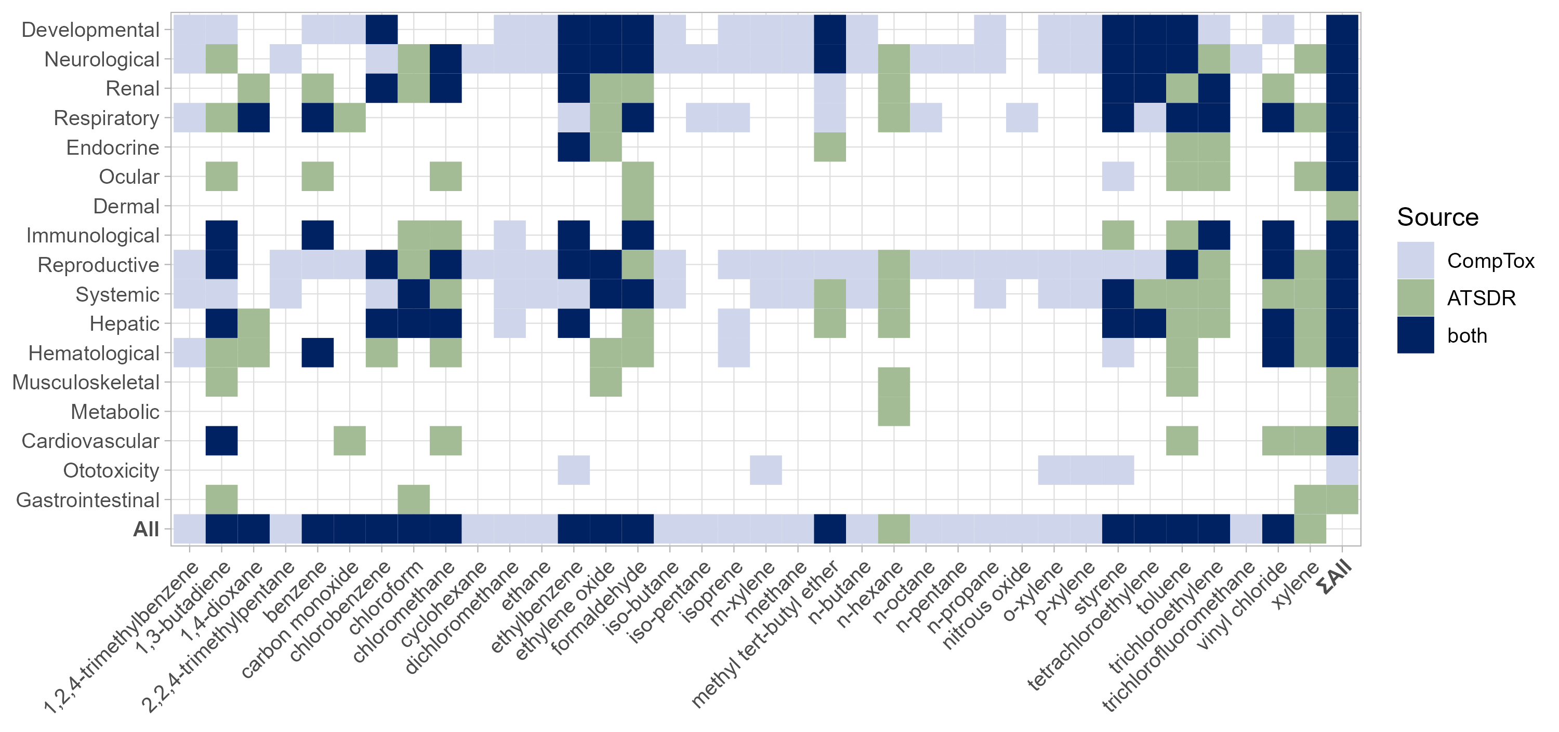
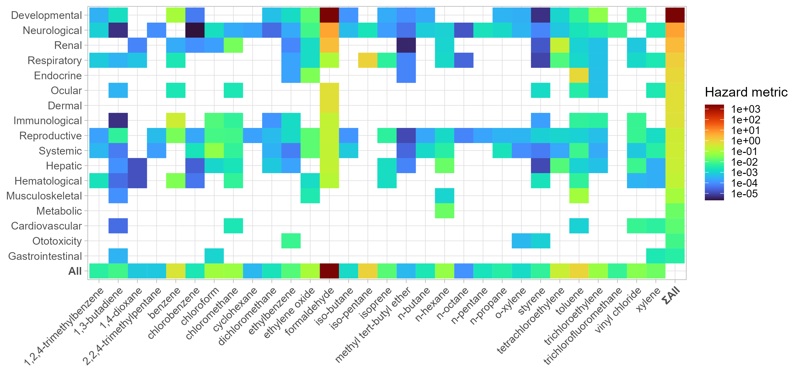
Cumulative Risk – preliminary results
Health Endpoints
Chemicals measured
Notes:
So how do we think about the risk? This chart is the compilation of a remarkable amount of effort from the risk team on this project. Mining various data bases they built this matrix of known systemic non-cancer risks vs chemical measured by the mobile lab by data source
They then took the average concentrations of the pollutants measured and assigned a hazard metric for each of the concentrations. Summing across rows provides a cumulative risk metric for a health endpoint.

Slide 14
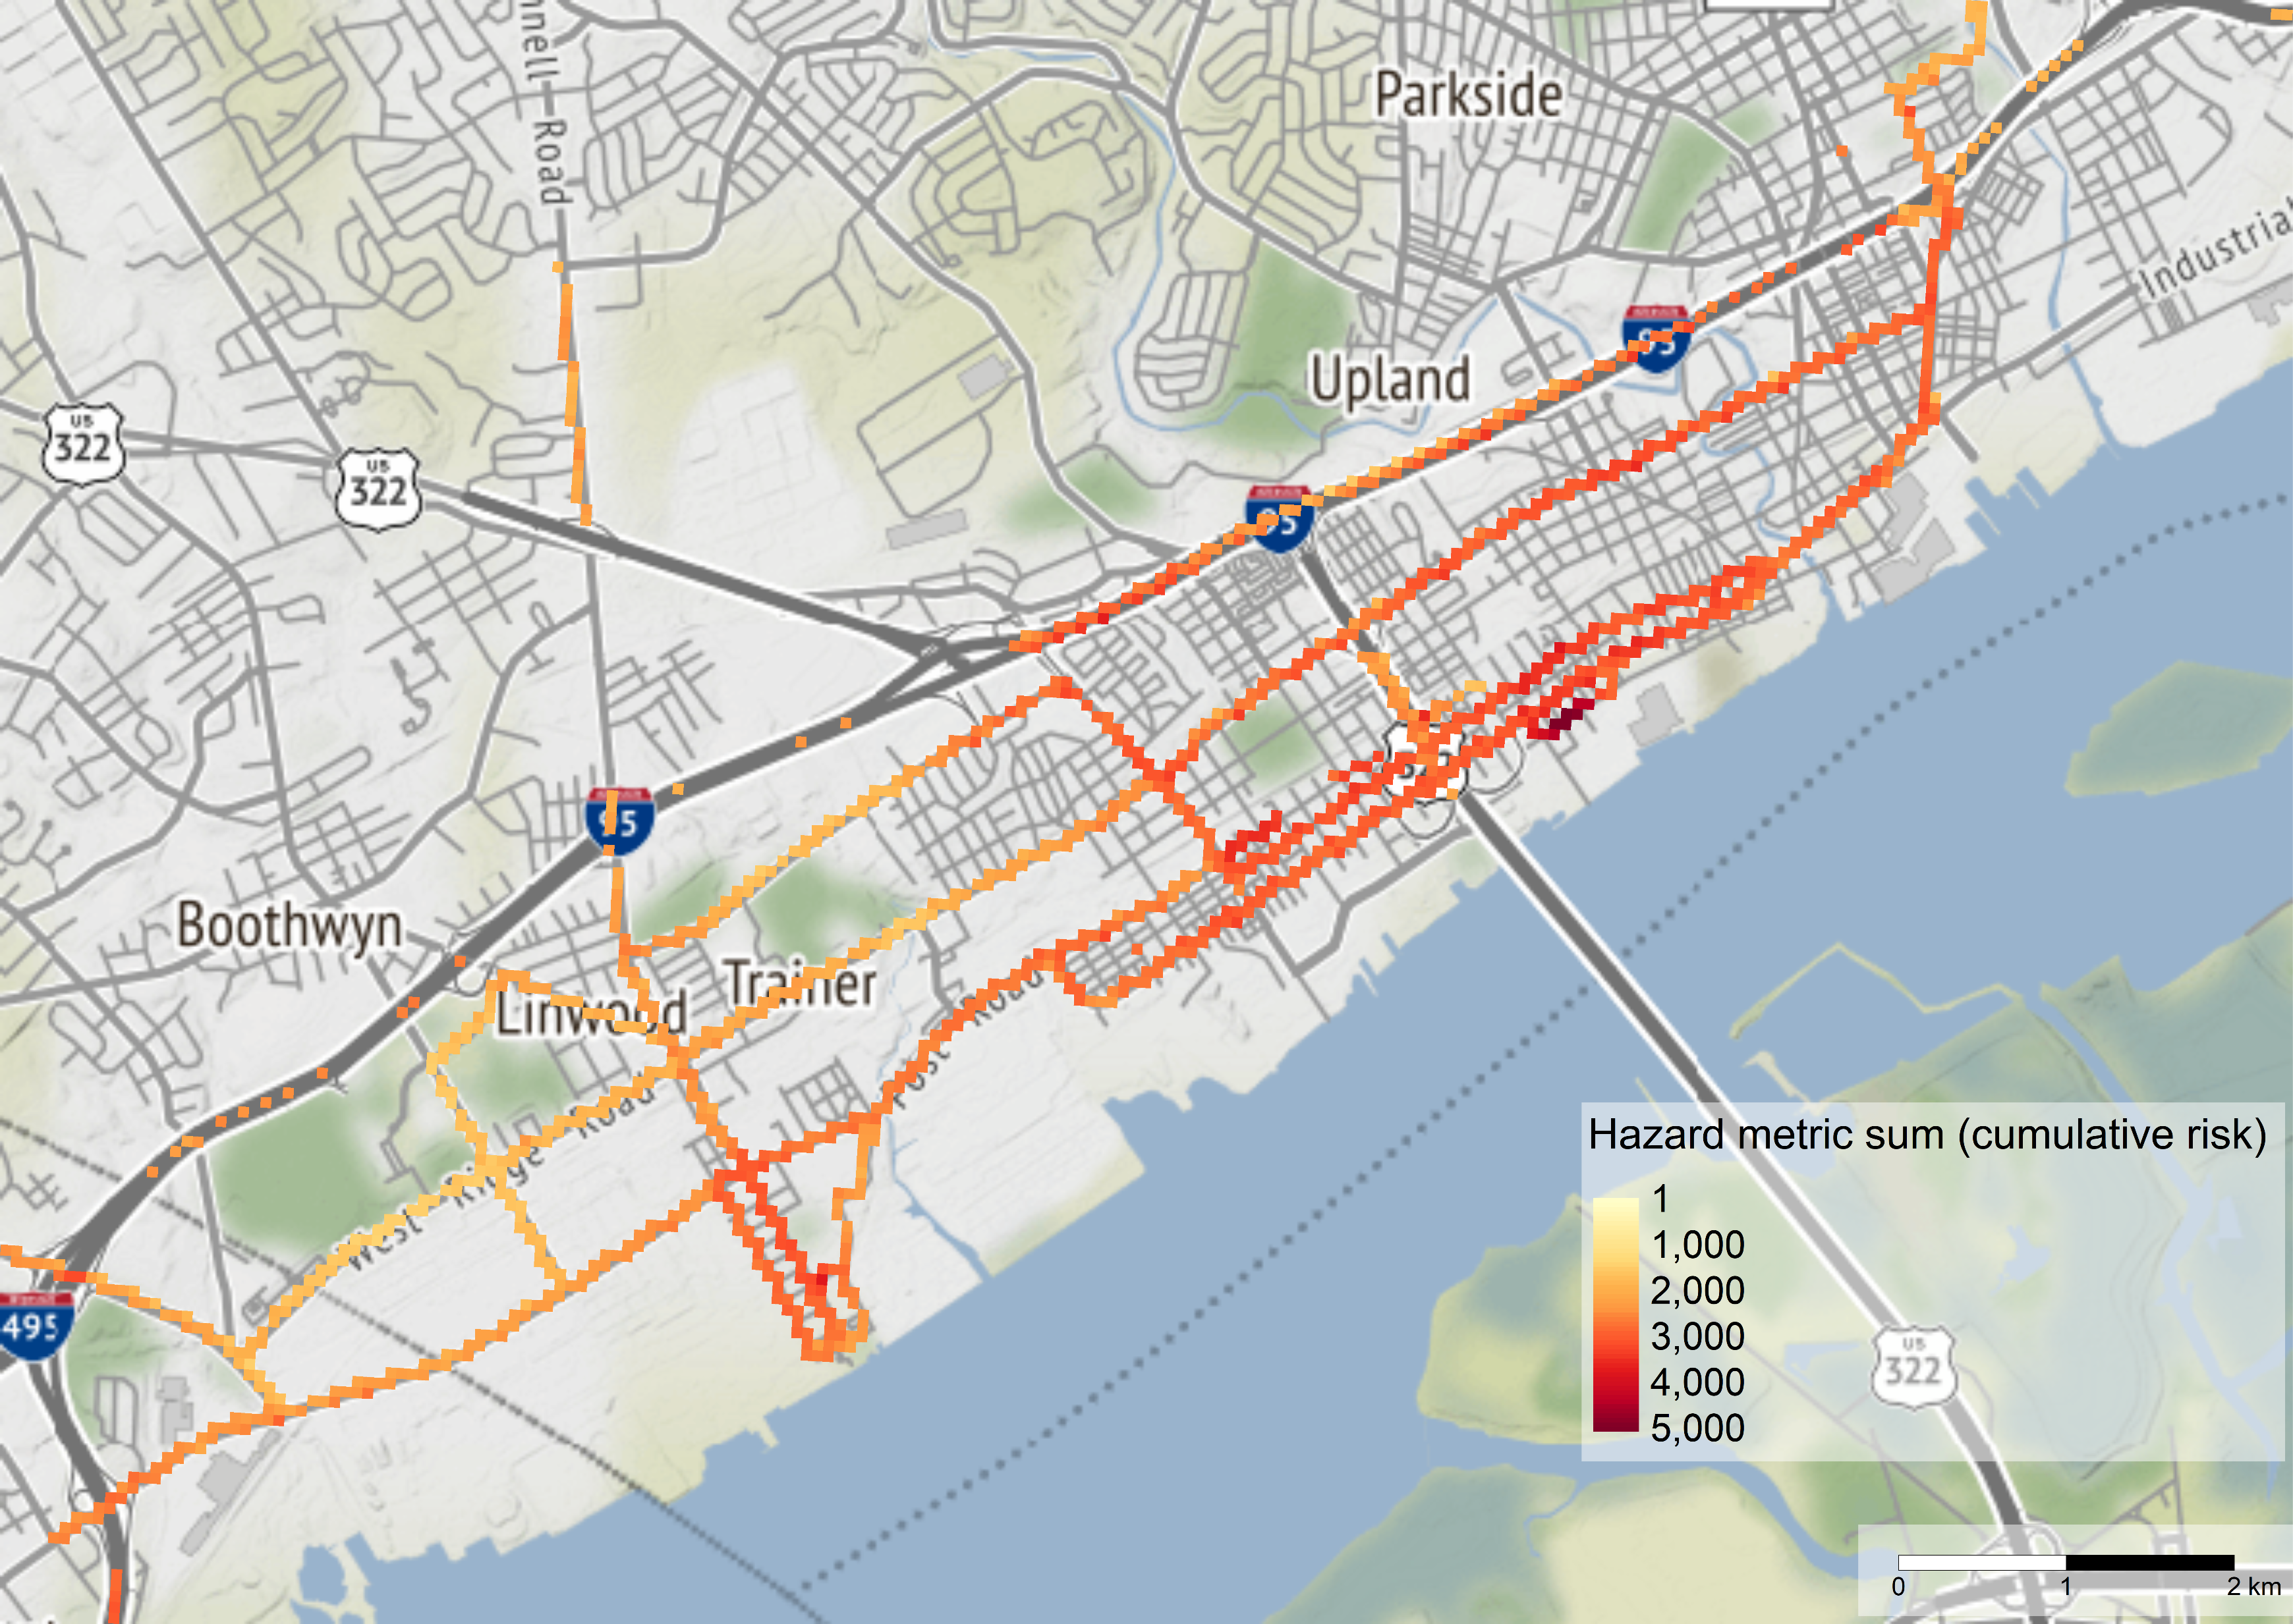
Developmental health risk – cumulative risk
Map can be made for each of the non-cancer risks identified
Each 50m x 50m has a unique combination
Extrapolatation possible between streets
Notes:
That hazard metric sum can also be mapped and illustrate gradients of risk across the study area.
We're really just scratching the surface of these incredibly rich datasets, so much more to come and many more opportunities to think about how to improve this type of assessment.

Slide 15
Overall conclusions from Initial study
Many, but not all pollutants have street-by-street differences in concentration.
Estimated pollution concentrations from EPA models Air Toxics Screening Assessment (AirTox), are typically lower than what we measured.
AirTox results are used in other EPA tools like EJ Screen
Several high concentration “plumes” of multiple pollutants including benzene were measured by the mobile laboratory during the September measurement period.
A source of formaldehyde emissions was found in Chester exhibits repeated high concentrations. DEP emission inventory suggests an underestimate of the emissions.
Continuing work to interpret community risk due to air pollutant exposures from industrial facility fenceline communities

Slide 16
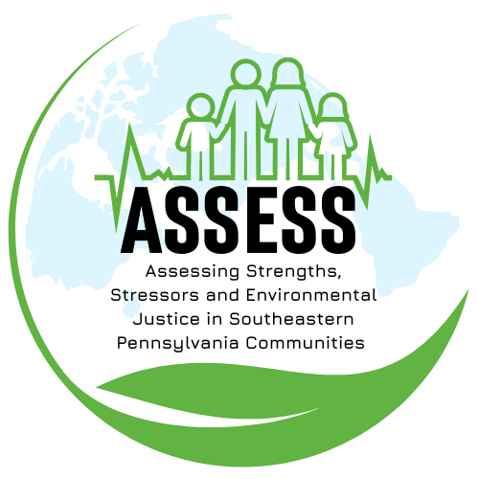


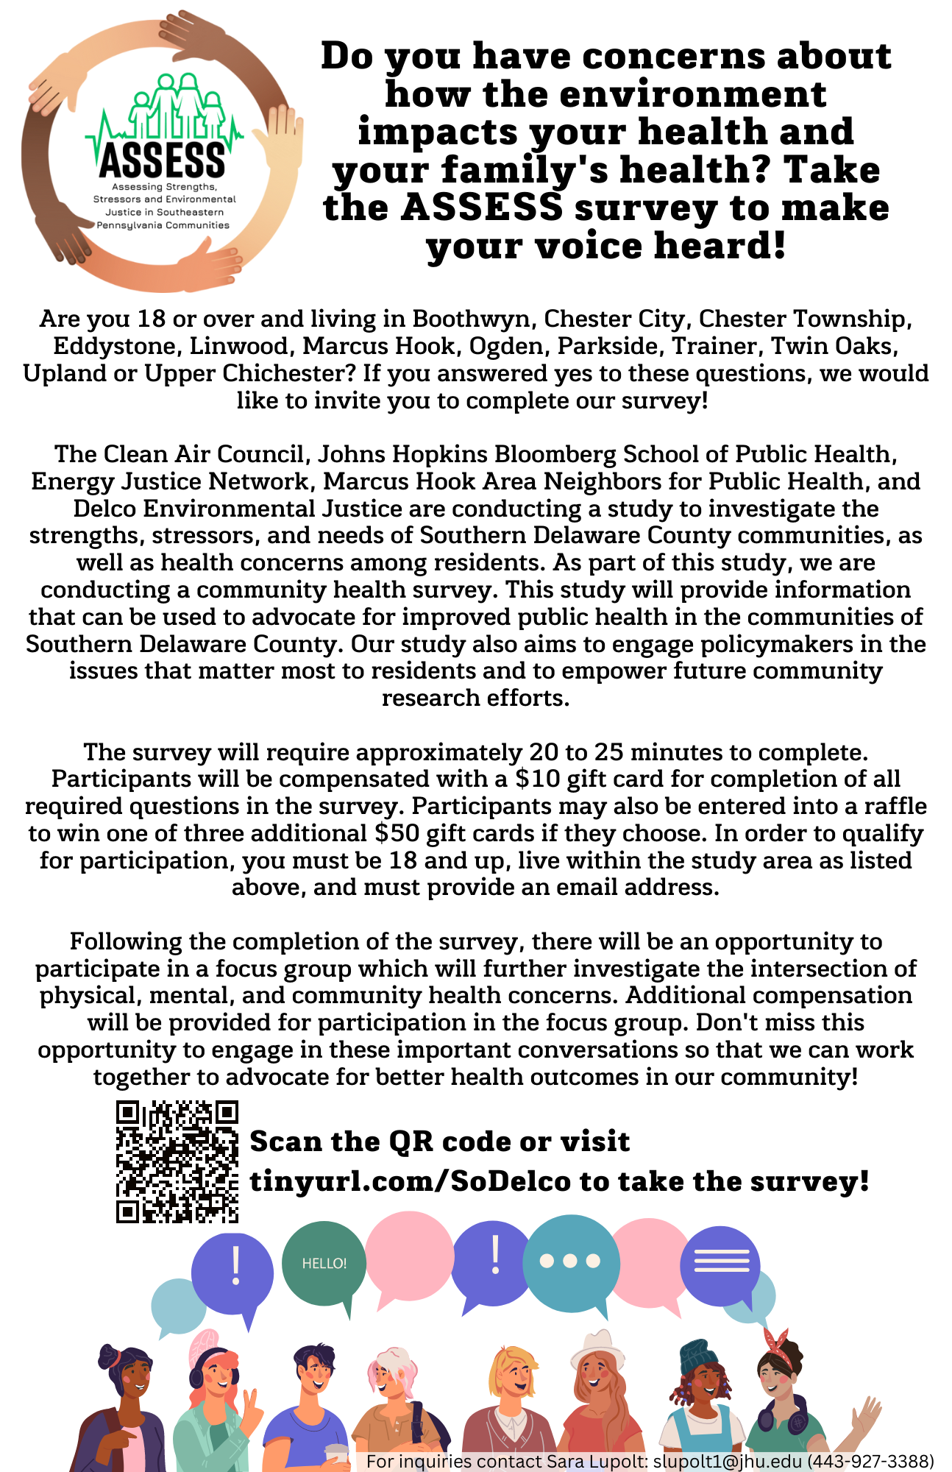



ASSESS Community Health Survey
Goal is to investigate health concerns, strengths, stressors, and needs in Southern Delaware County communities
Participants must be aged 18 and up and live in eligible borough
Survey takes 20-25 minutes to complete
$10 gift card compensation + optional $50 raffle
Partner Organizations:

