Slide 1


Watershed Friendly Behaviors and Properties
Meagan Hopkins-Doerr
Penn State Extension Master Watershed Steward Program

Slide 2
We believe that all people should have access to science-based education.

Slide 3
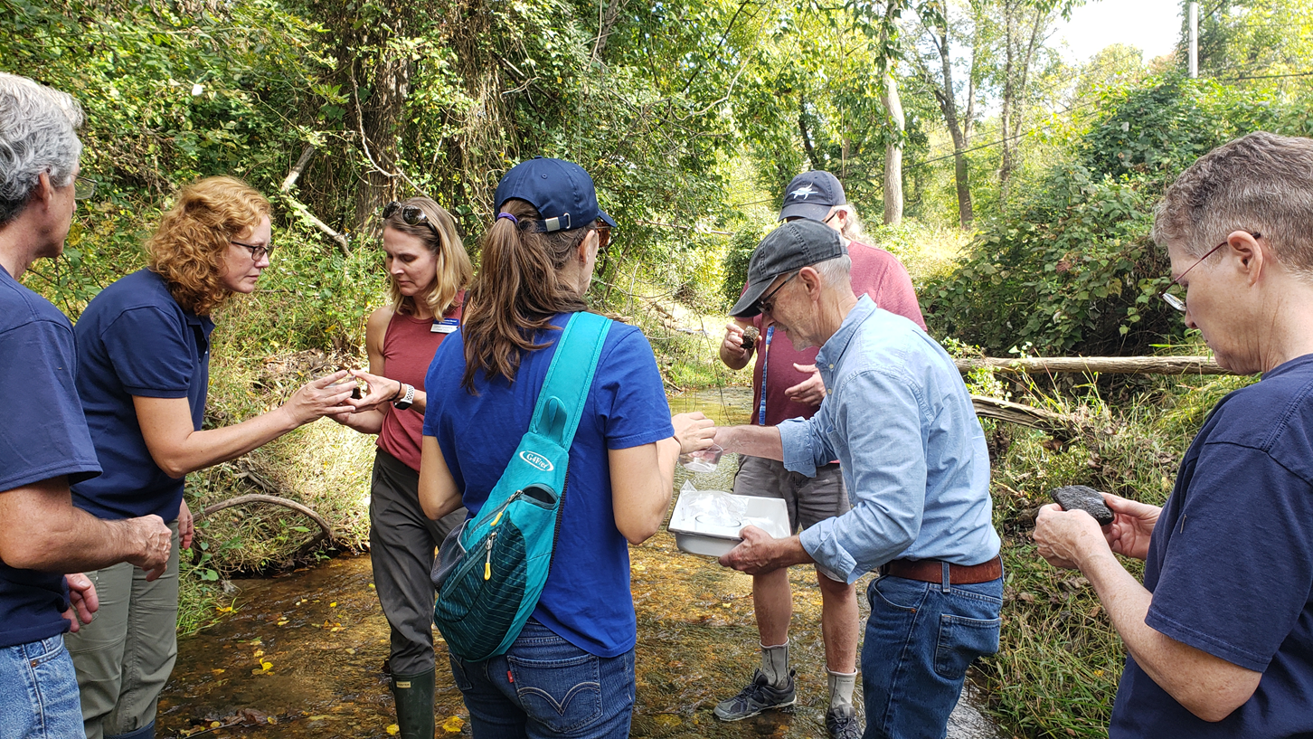
What and who are Penn State Extension Master Watershed Stewards?
Educate and empower volunteers to protect environmental resources
Create partnerships and leverage resources to increase watershed restoration and awareness efforts
Educate the community about water and natural resources.
Advance on-the-ground restoration projects.
Master Watershed Stewards are volunteers for Penn State Extension.

Slide 4
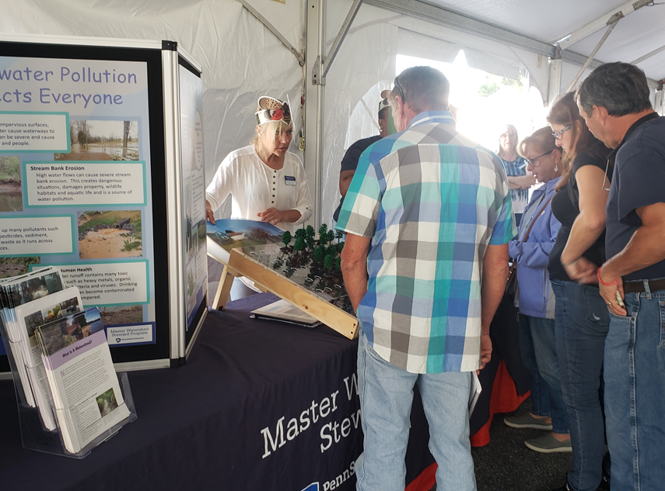
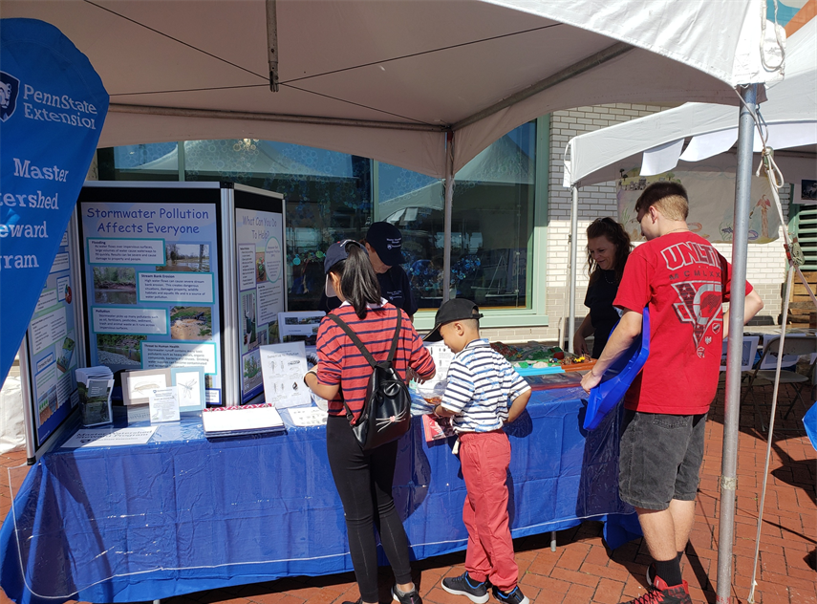
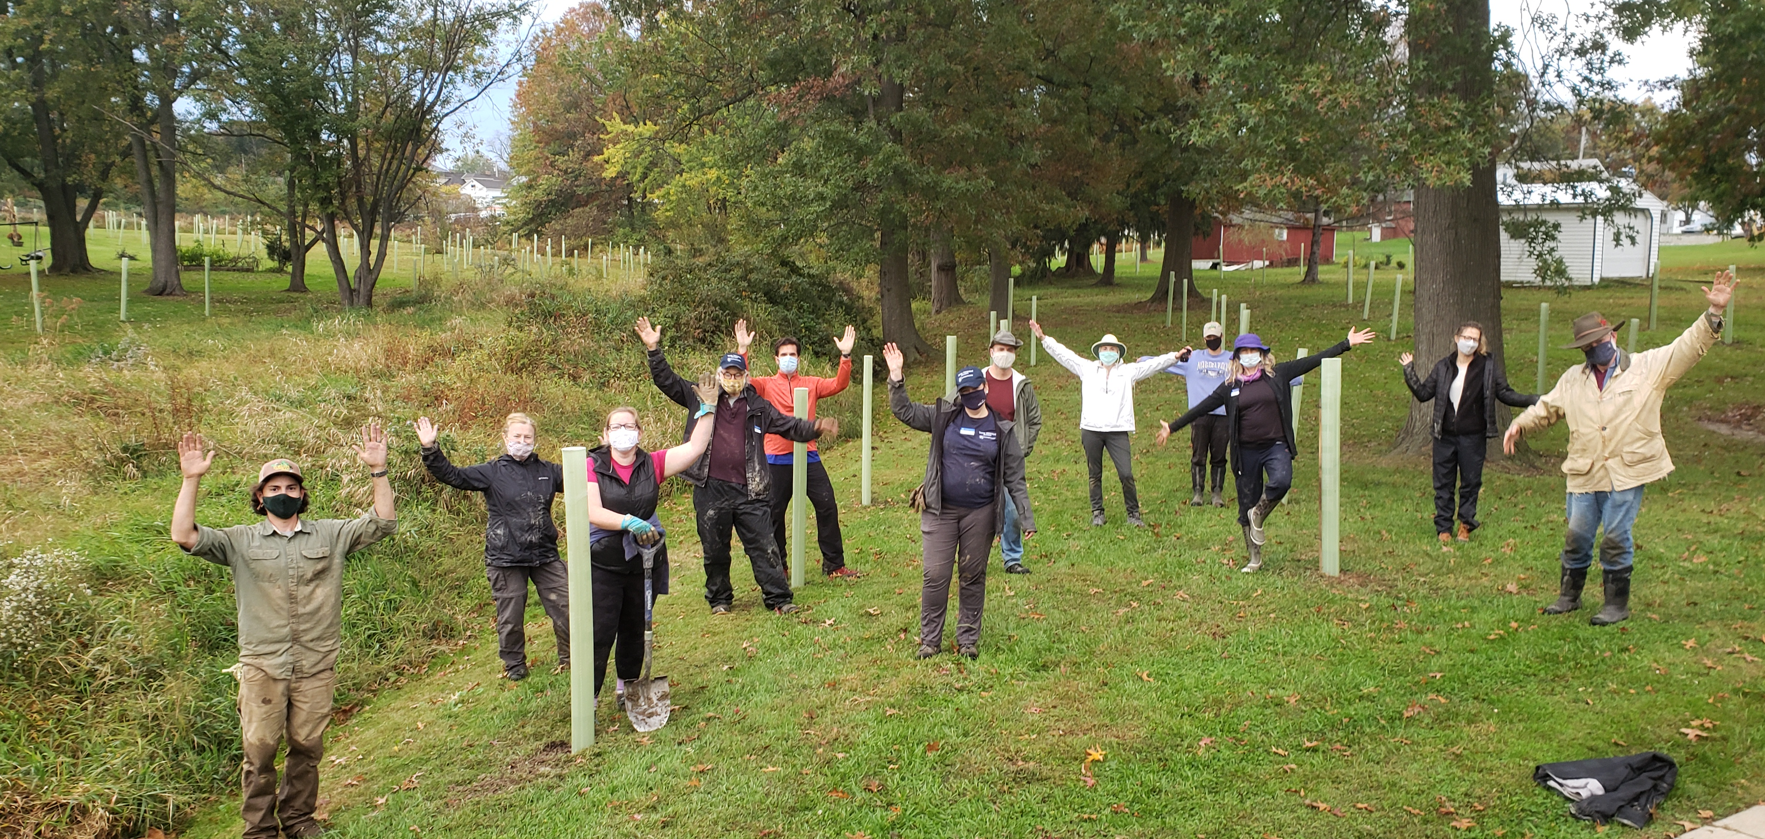
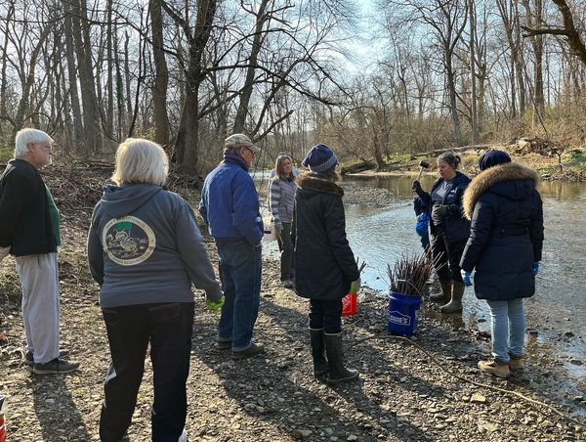
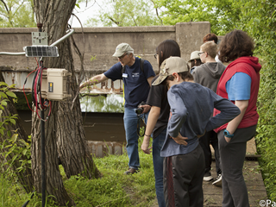
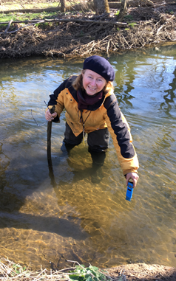
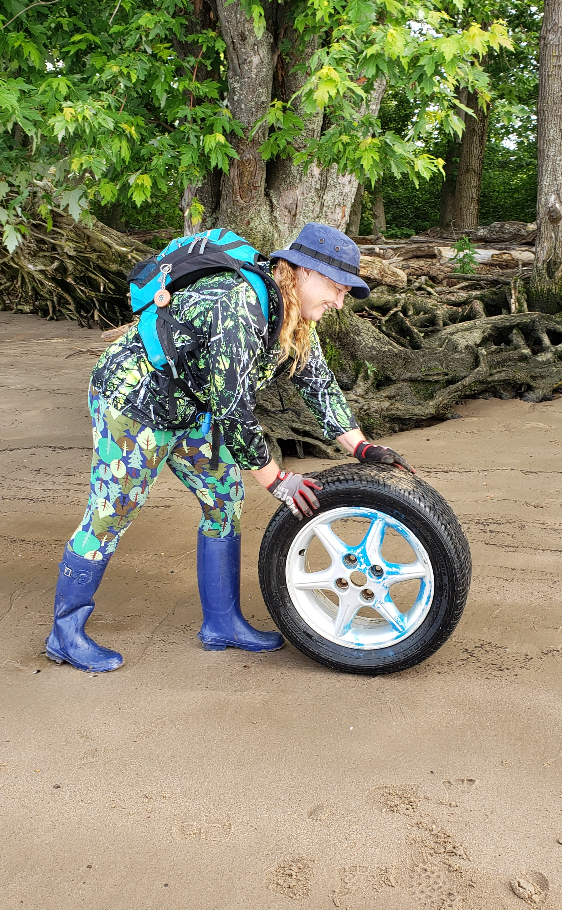
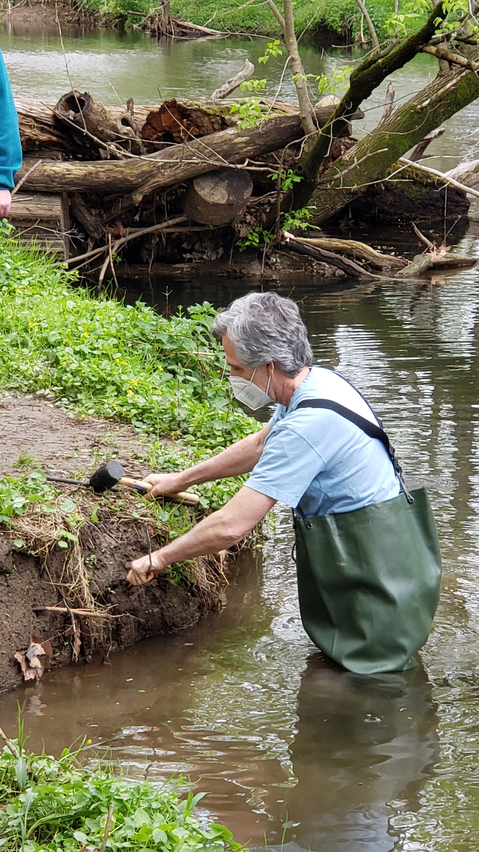
Partnerships
Public Education
“Boots on the Ground” Work

Slide 5
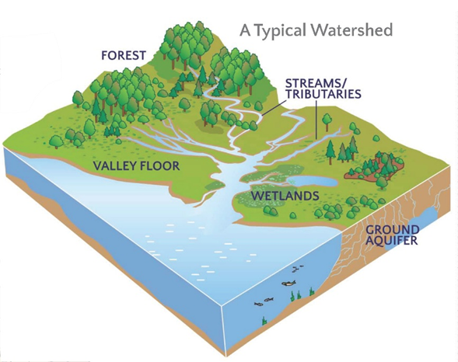
What is a Watershed?
A land area that channels rainfall and snowmelt to creeks, streams, and rivers, and eventually to outflow points such as reservoirs, bays, and the ocean. The area channels/drains to a particular body of water and the watershed is defined by that body of water.
Includes
Surface water: The obvious over-land water sources
At risk of picking up and carrying pollutants along with it
Groundwater: Water that filters into the ground
Cleaned and filtered by the ground
Seeps into streams
Fills aquifers
Source: NOAA

Slide 6
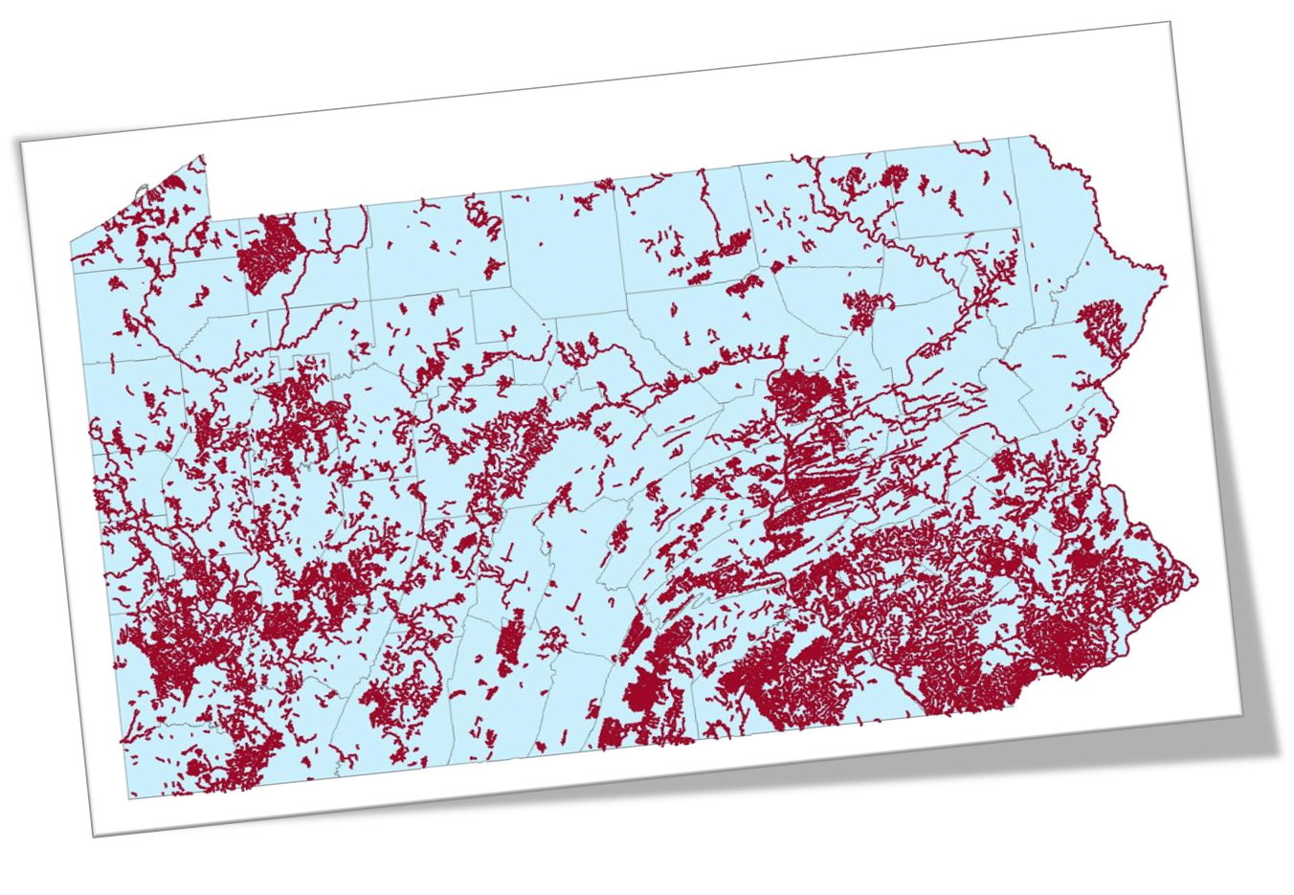
Health of Our Waterways
Over 18,000 Miles of PA Streams are Impaired
Impaired = unable to support aquatic life or be used for recreation, fish consumption, or drinking water.
Notes:
https://storymaps.arcgis.com/stories/b9746eec807f48d99decd3a583eede12
https://patch.com/pennsylvania/haverford/94-percent-delcos-streams-are-impaired-state-report-says

Slide 7
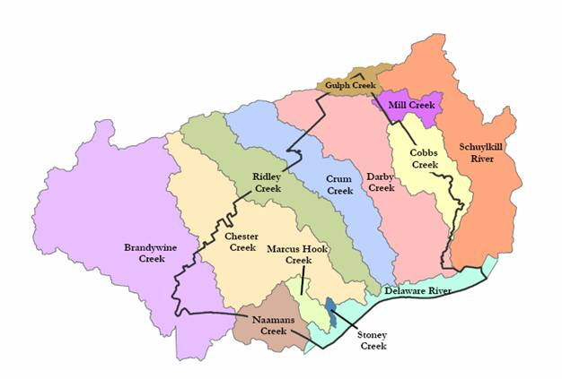
Delaware County Watersheds
385 miles of streams
365 are impaired
Source: DEP Draft 2022 Pennsylvania Integrated Water Quality Report
Source: Delaware County Conservation District

Slide 8
What can you do?

Slide 9
Reduce Stormwater Runoff from your property

Slide 10
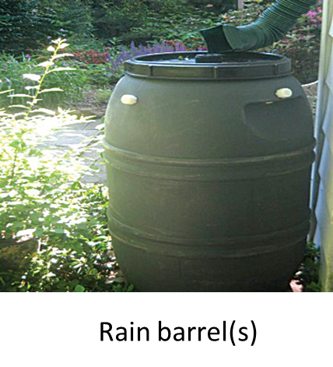
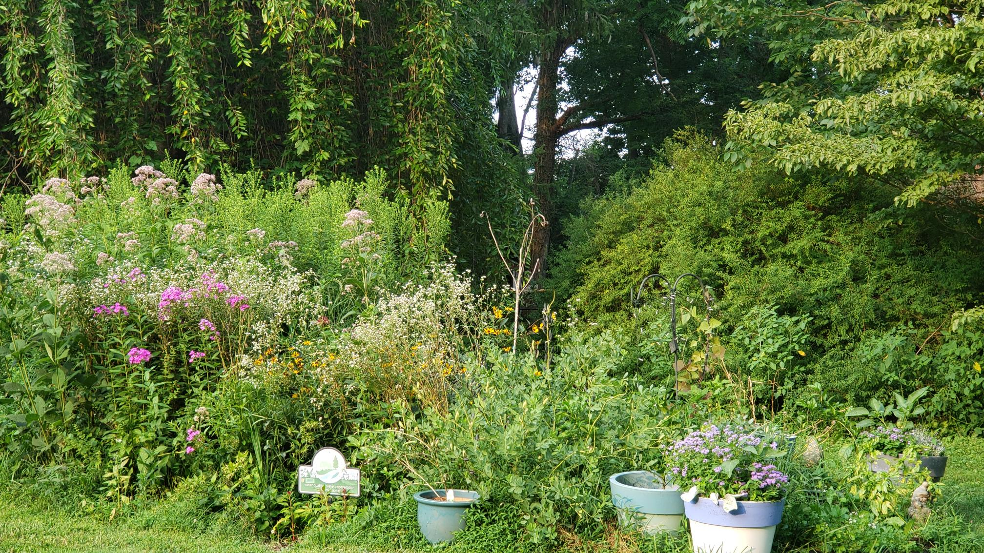
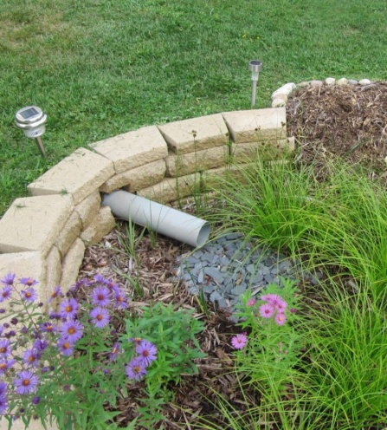
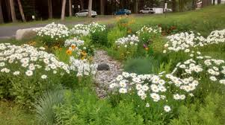
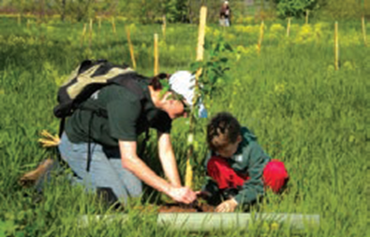
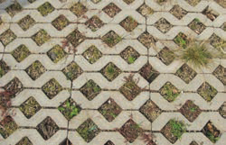
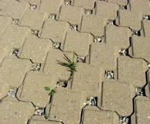
Slow down the stormwater.
Pocket meadows and container gardens
Rain garden
Plant trees
Permeable surfaces instead of solid

Slide 11
Reduce Water Pollution

Slide 12
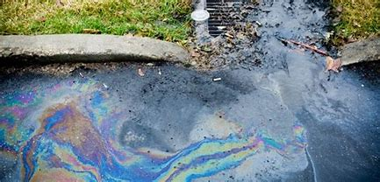
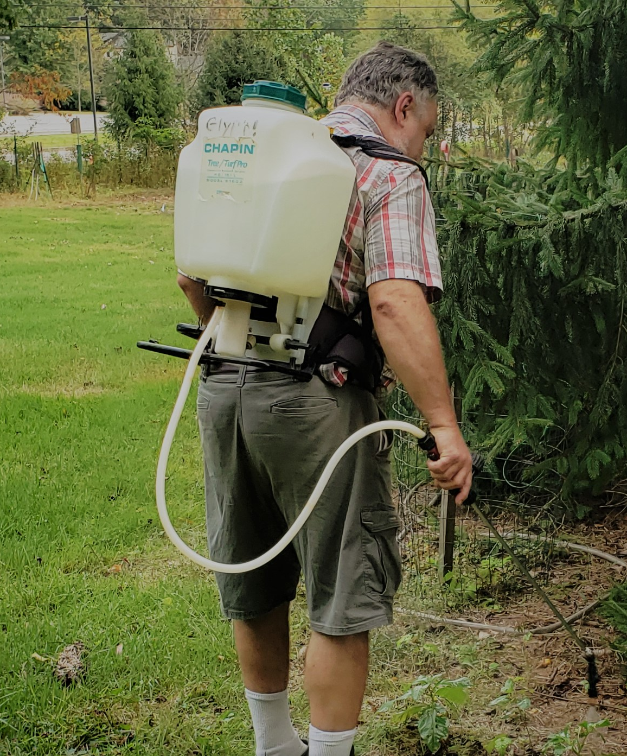
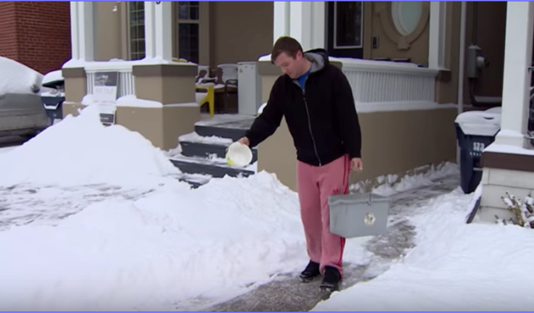
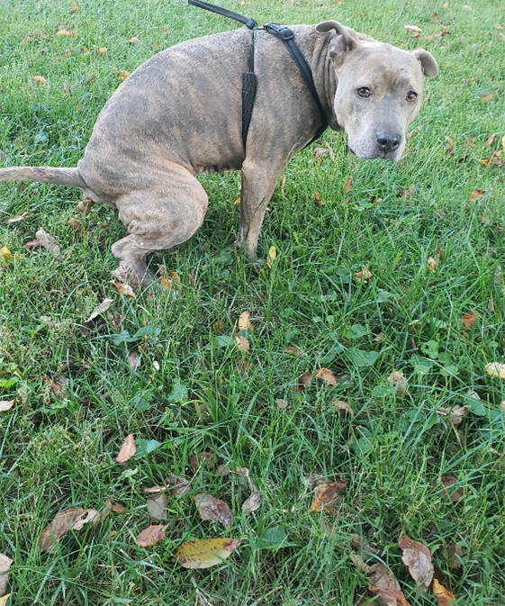
Key actions you can do to prevent runoff pollution.
Minimize the use of pesticides and herbicides
Use fertilizer and amendments sparingly
Properly dispose of animal waste
Collect or mulch grass clippings
Pick up other trash
Avoid using salt/ice melt on driveway or walkways
Avoid activities like car washing and oil changing on driveways

Slide 13
Conserve Water

Slide 14
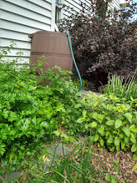
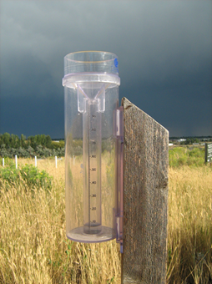
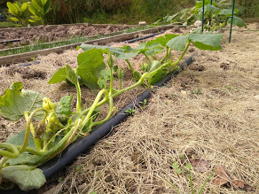
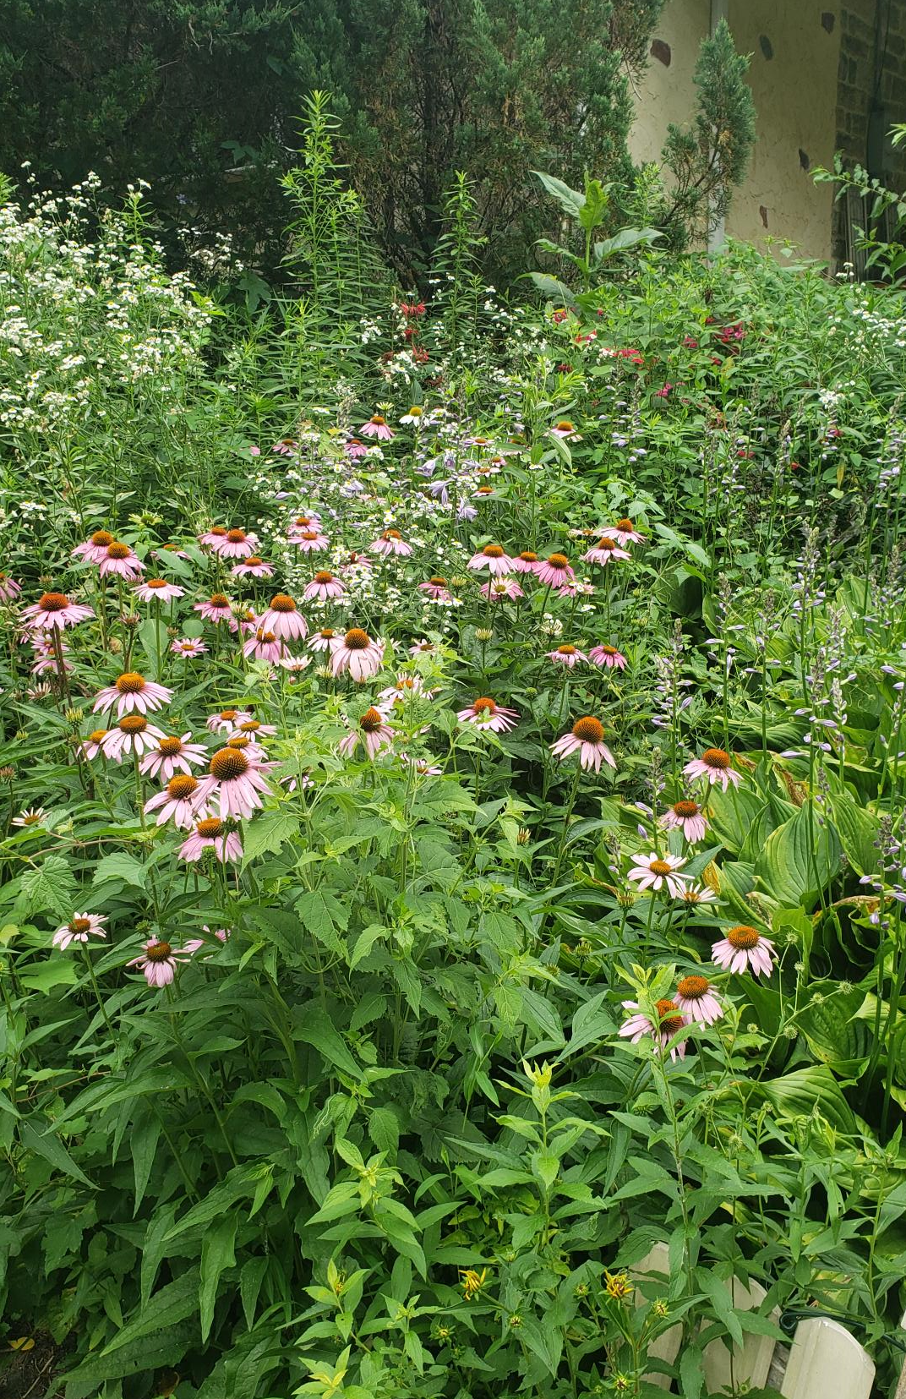
Saving Water in the Garden
Use the water in your rain barrel
Only water when needed
Use drip hoses and mulch
Plant natives that
do not
need watering

Slide 15
Support Wildlife

Slide 16
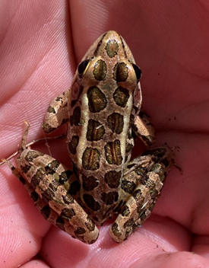
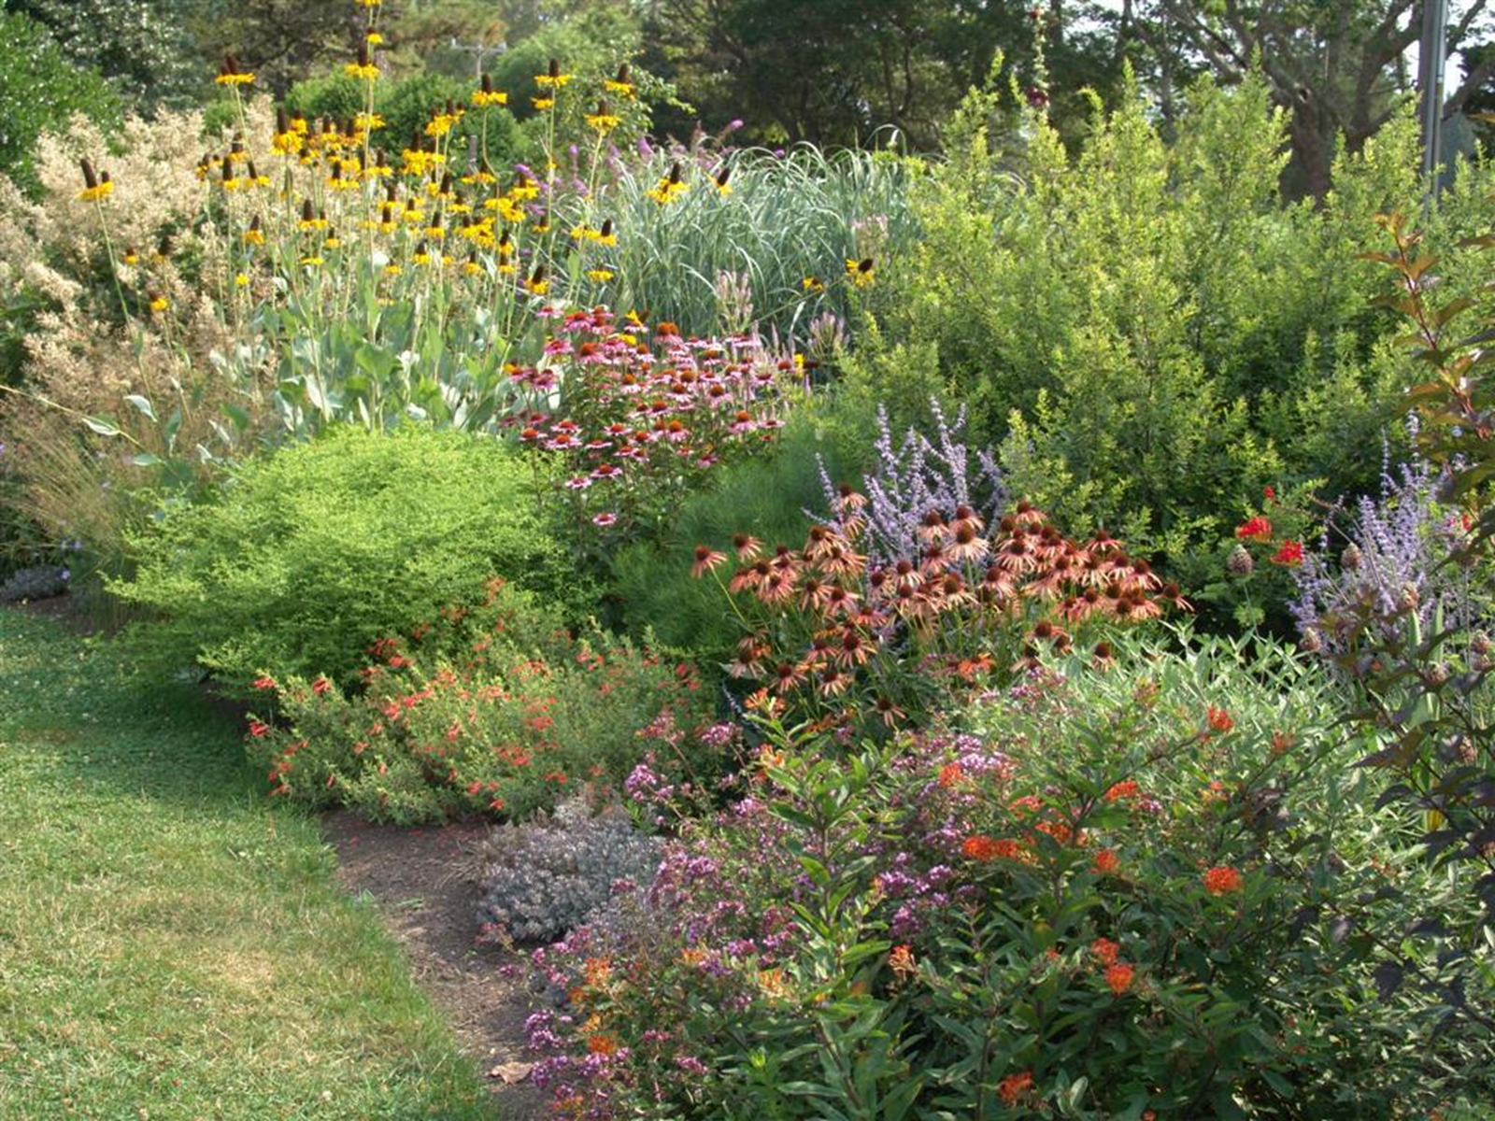
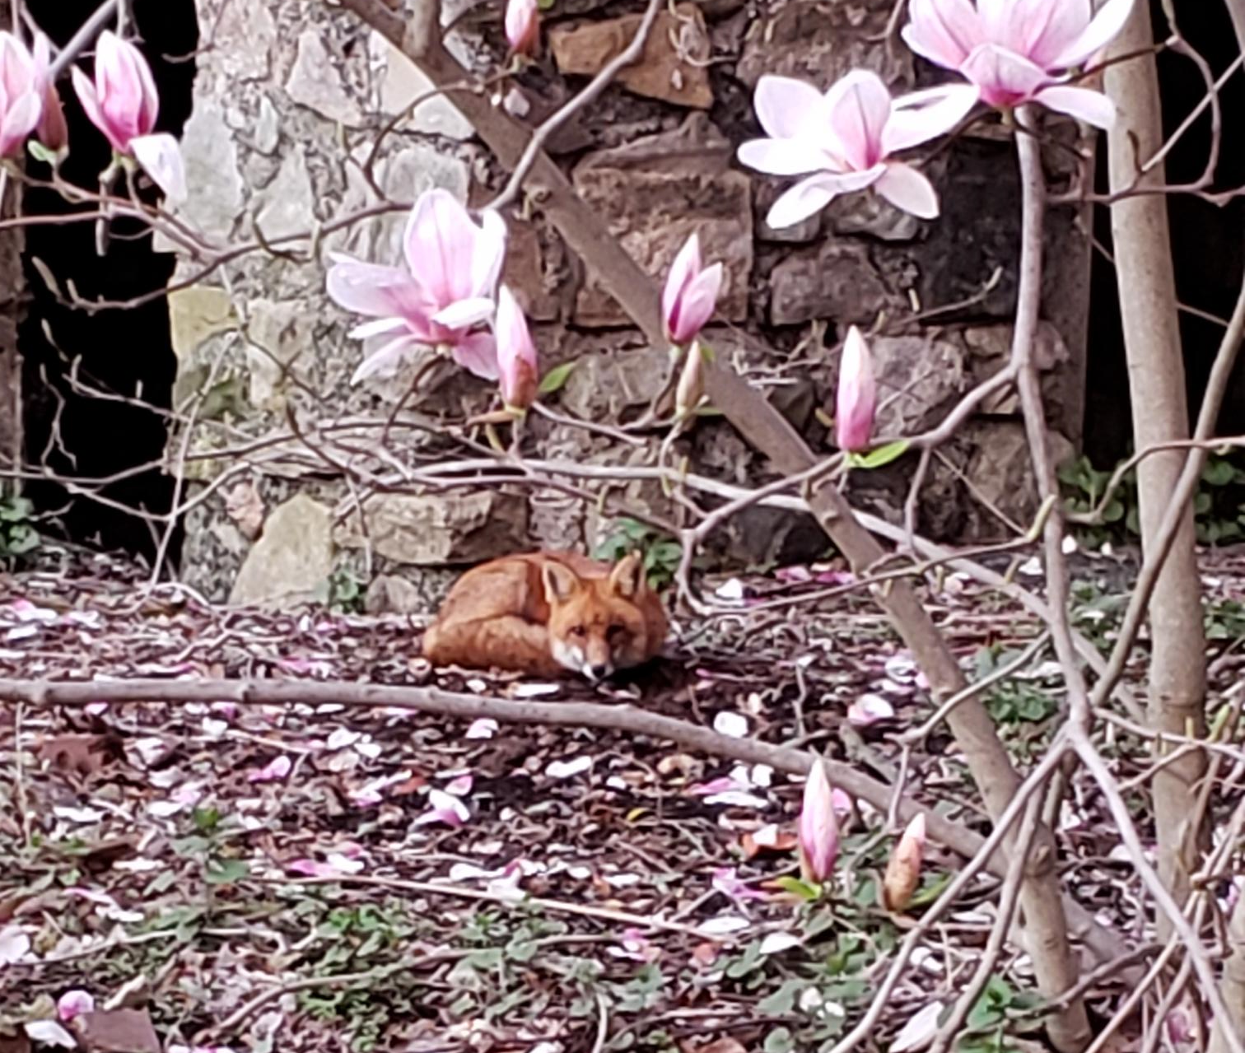
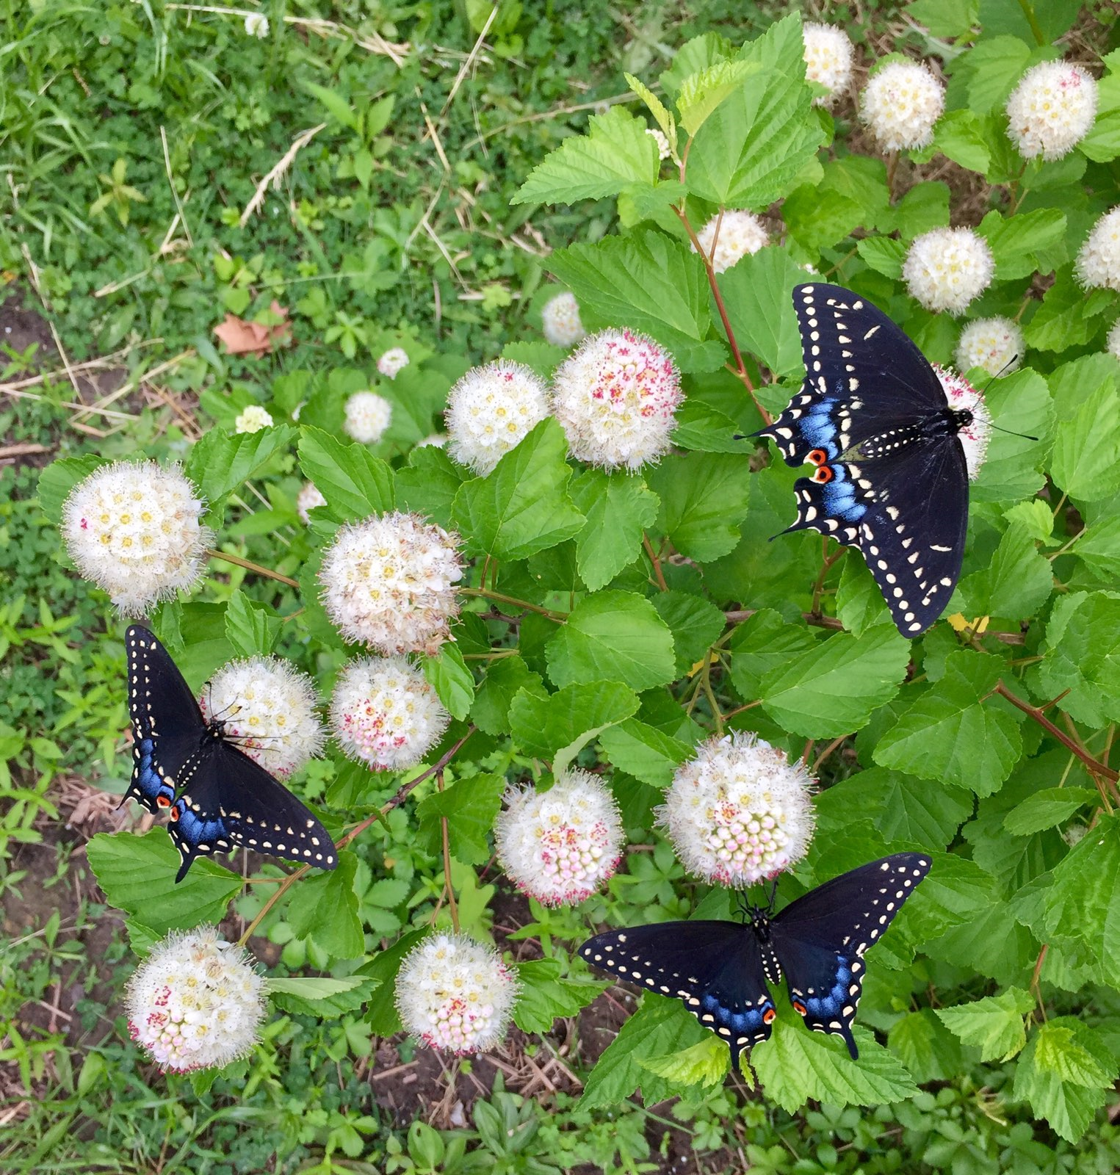
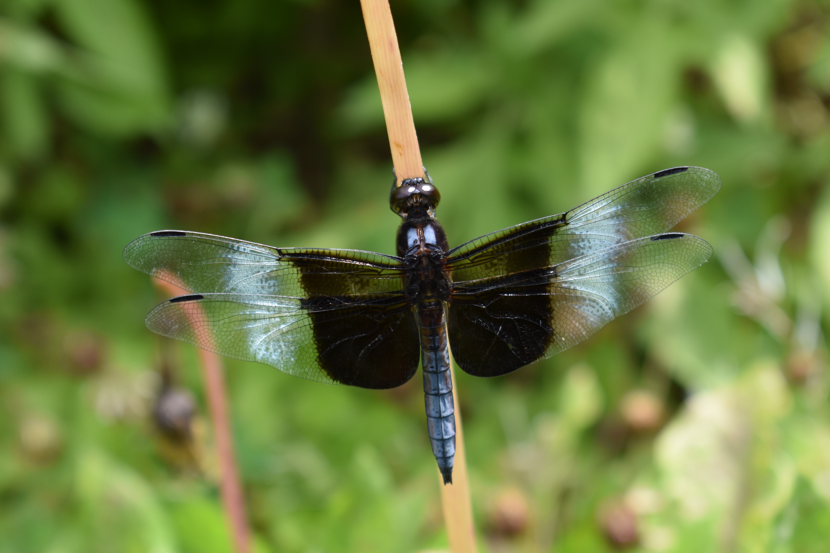
Supporting wildlife at Home
Plant native plants
Provide shade over ponds and streams
Allow and facilitate natural composting
Control/remove invasive species
Provide shelter

Slide 17
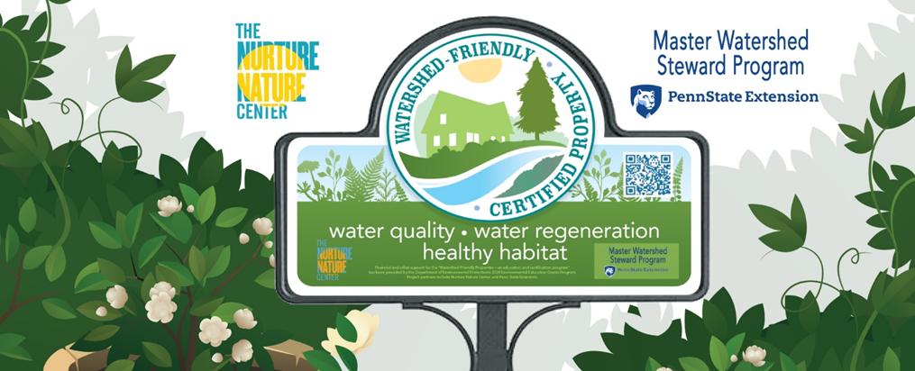
Do you already do these things?

Slide 18
Questions?
Meagan Hopkins-Doerr
mxh1135@psu.edu
610-696-3500
Master Watershed Steward Program - https://extension.psu.edu/programs/watershed-stewards
MWS of Chester and Delaware Counties - https://extension.psu.edu/programs/watershed-stewards/counties/chester-delaware
Interested in the Watershed Friendly Property Certification?
https://nurturenaturecenter.org/programs/community/wfp-cert/

