Slide 1
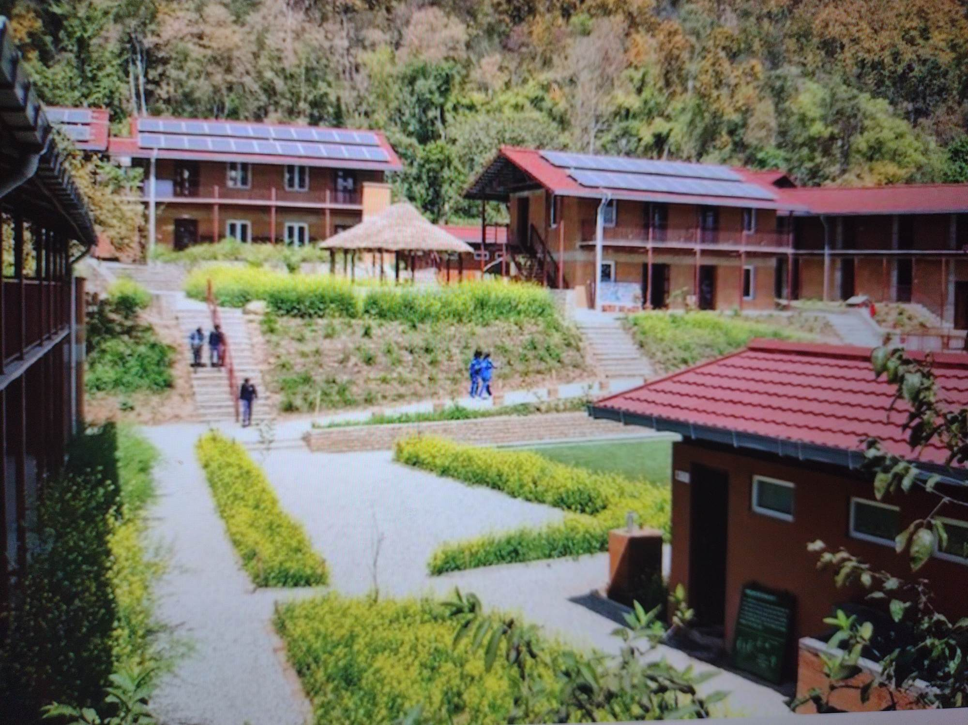
Sustainability Conference
Presentation by Melody Muhammad

Slide 2
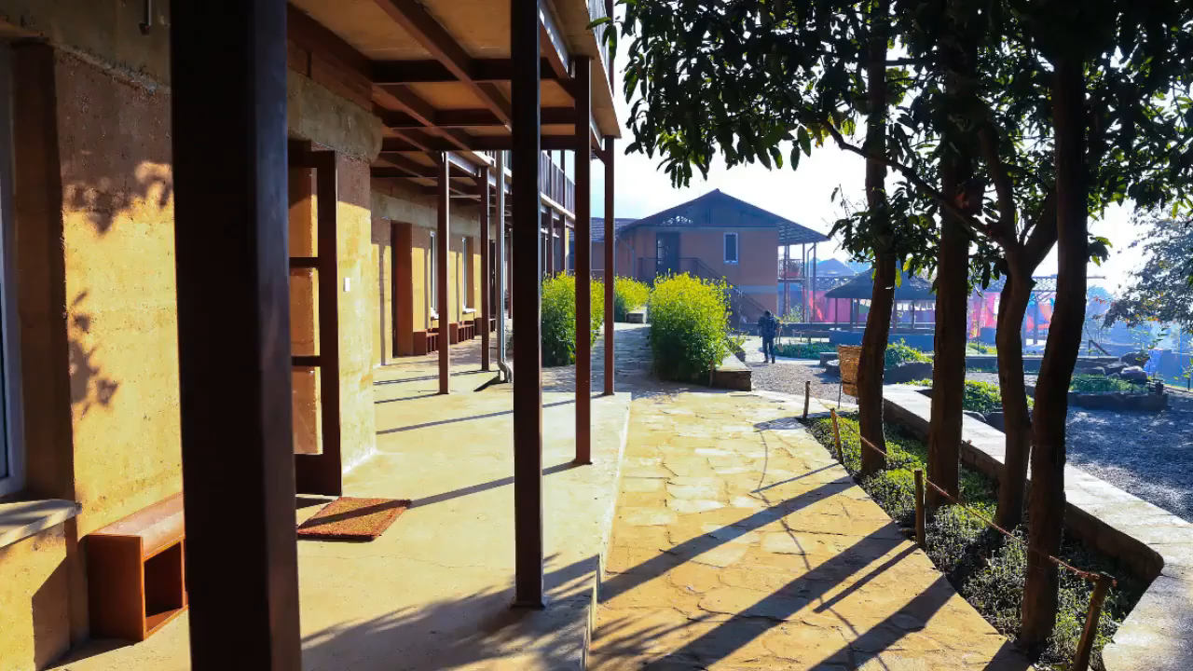

Slide 3
Sustainability: the ability to be maintained at a certain rate or level.
"The sustainability of economic growth“; avoidance of the depletion of natural resources in order to maintain an ecological balance. "The pursuit of global environmental sustainability.“
Small changes we can do to help the planet

Slide 4
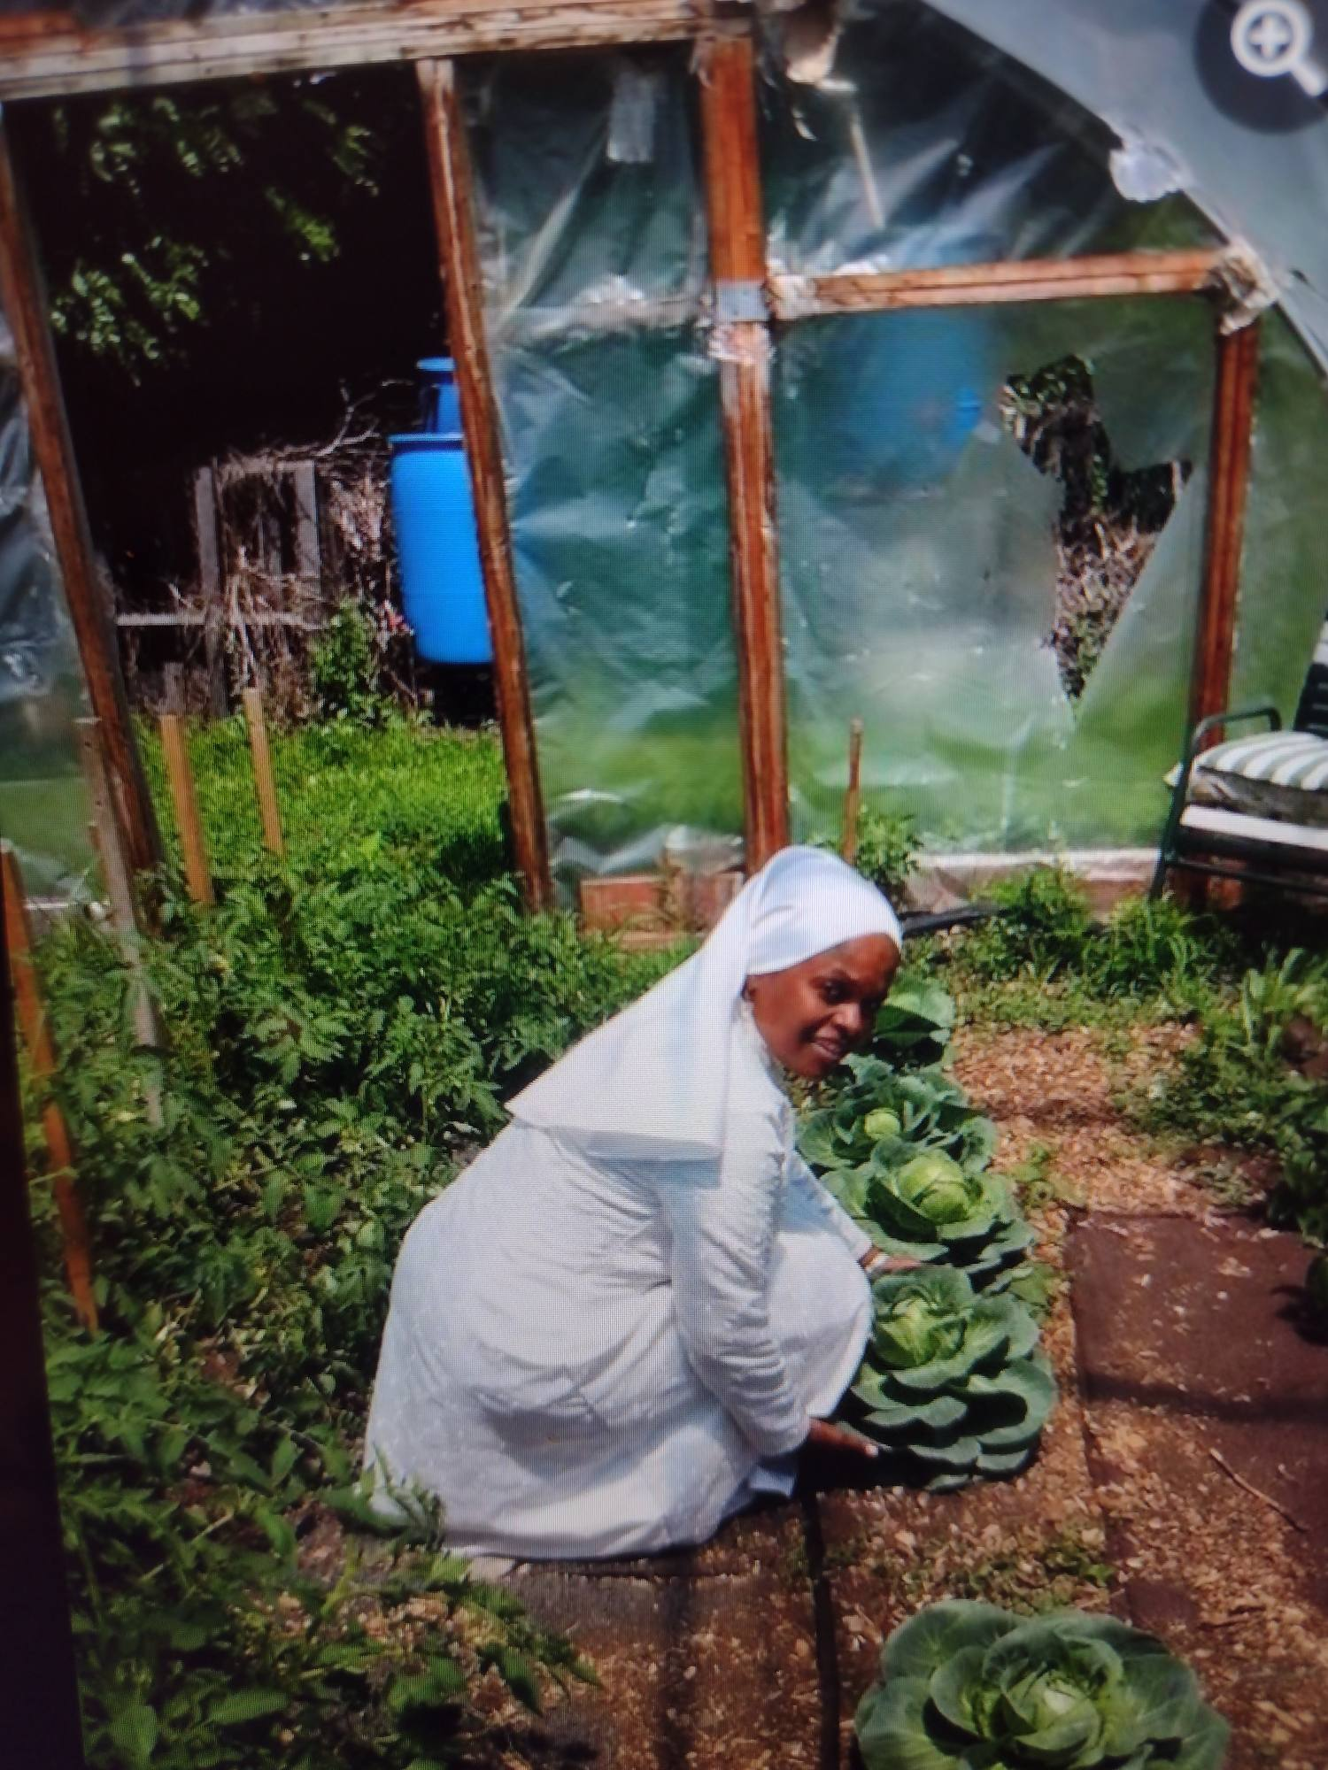
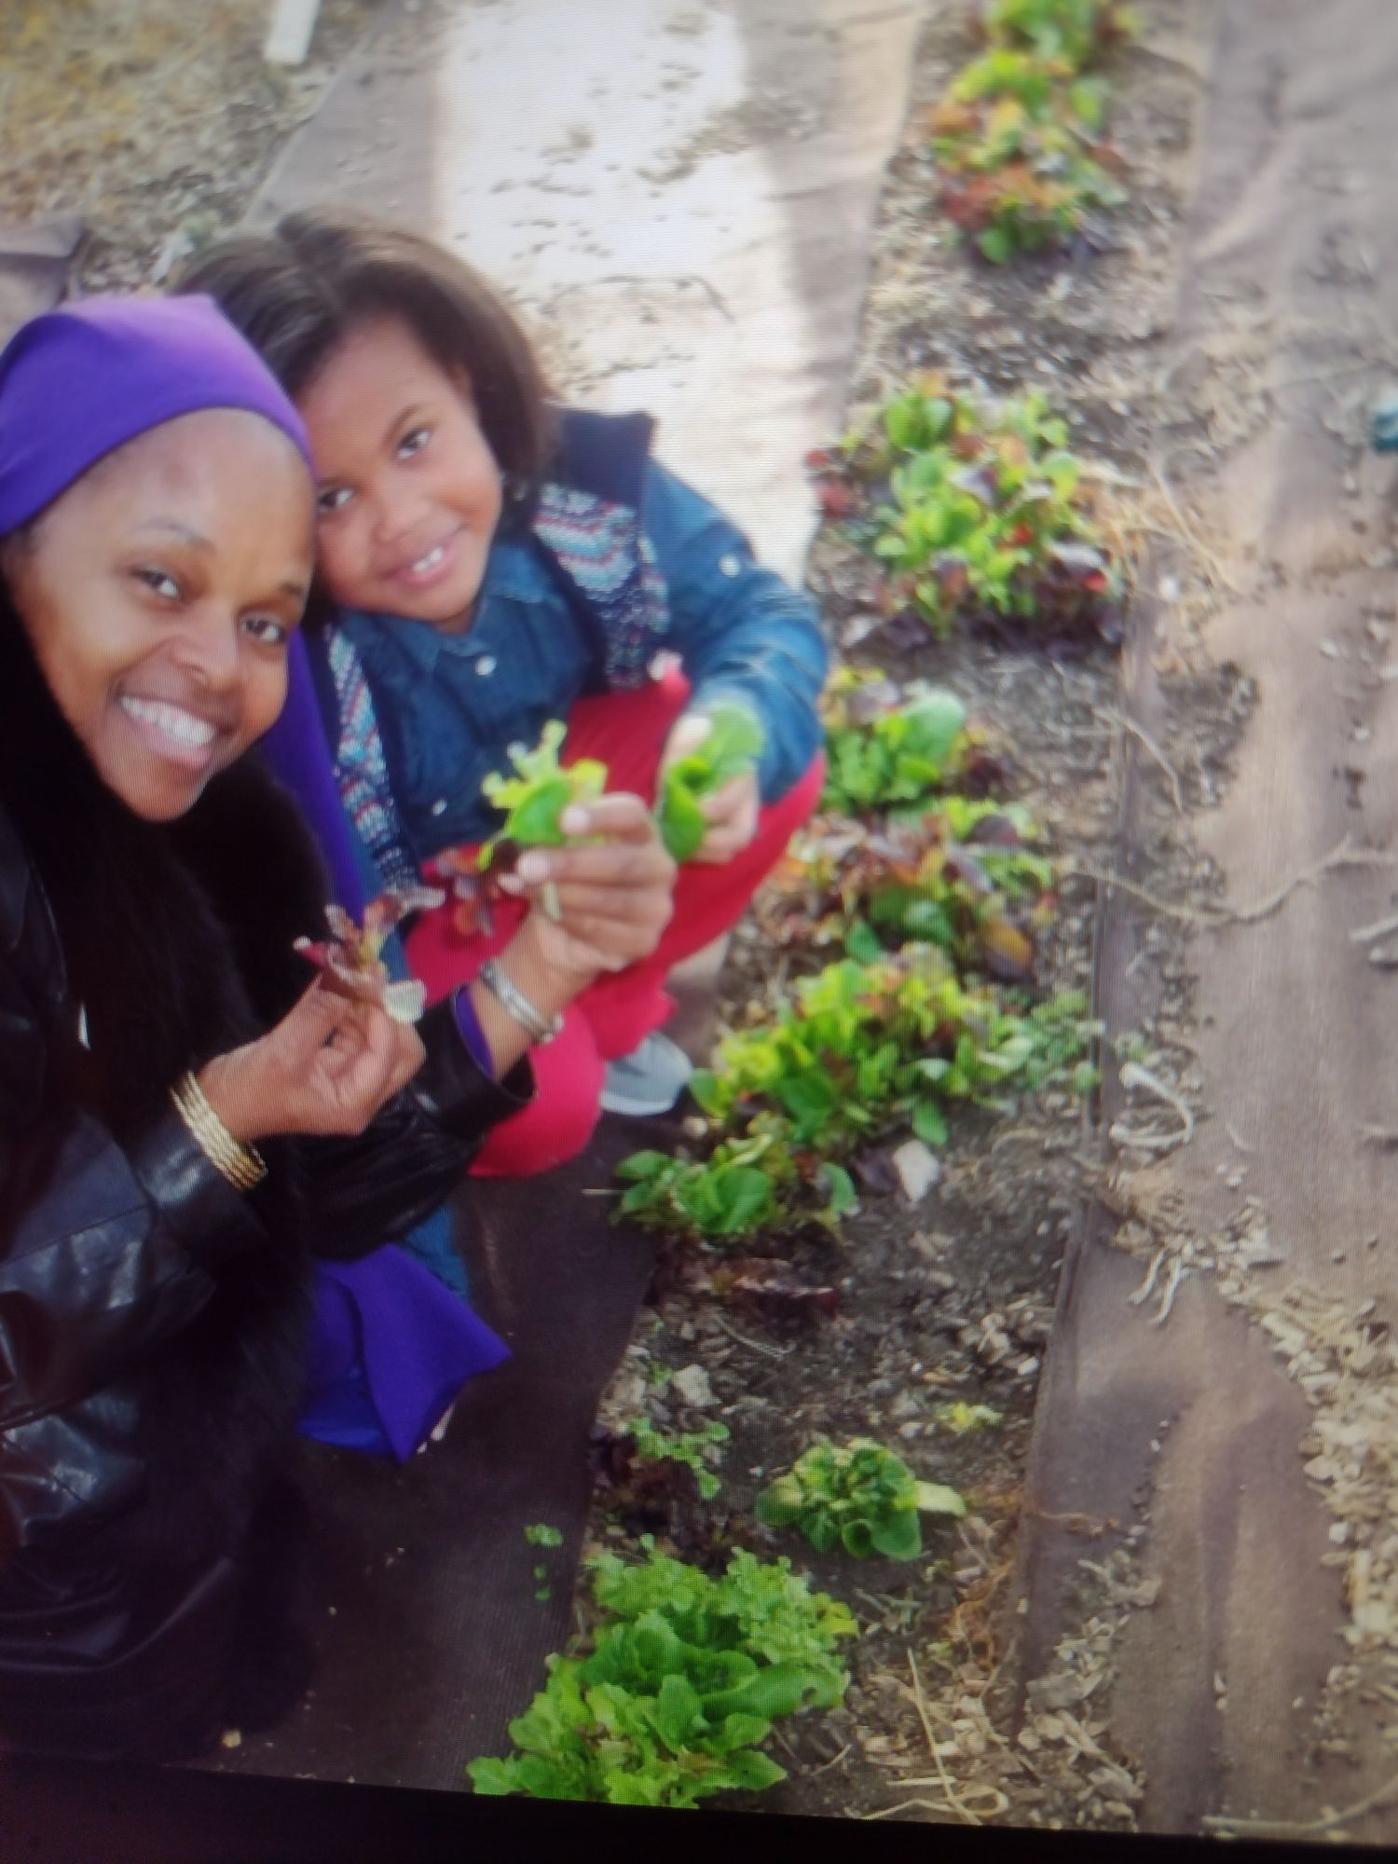
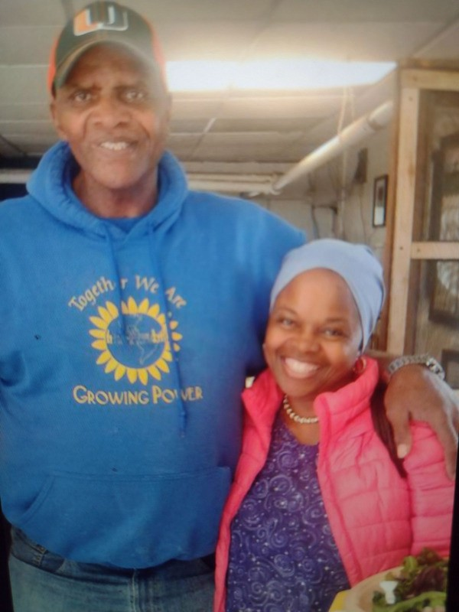
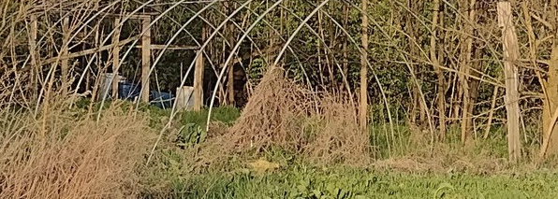
Will Allen

Slide 5
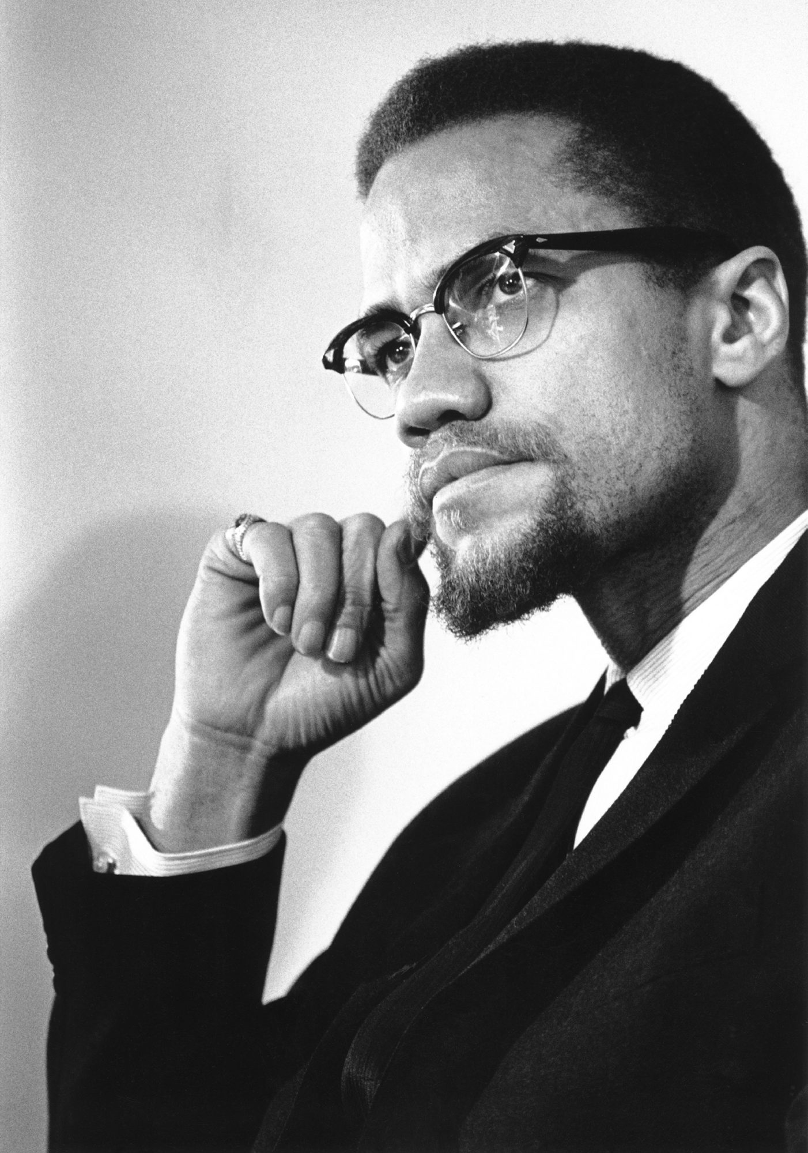
The area of the land is 57,255,000 square miles.
The area of the water is 139,685,000square miles
Total area of the land and water is 196,940,000 square miles

Slide 6
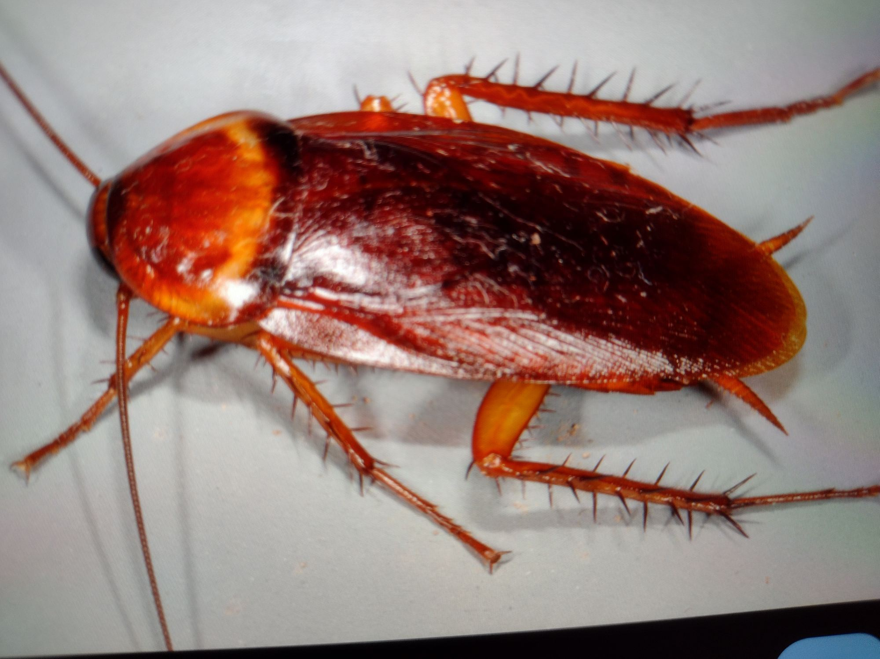

Slide 7
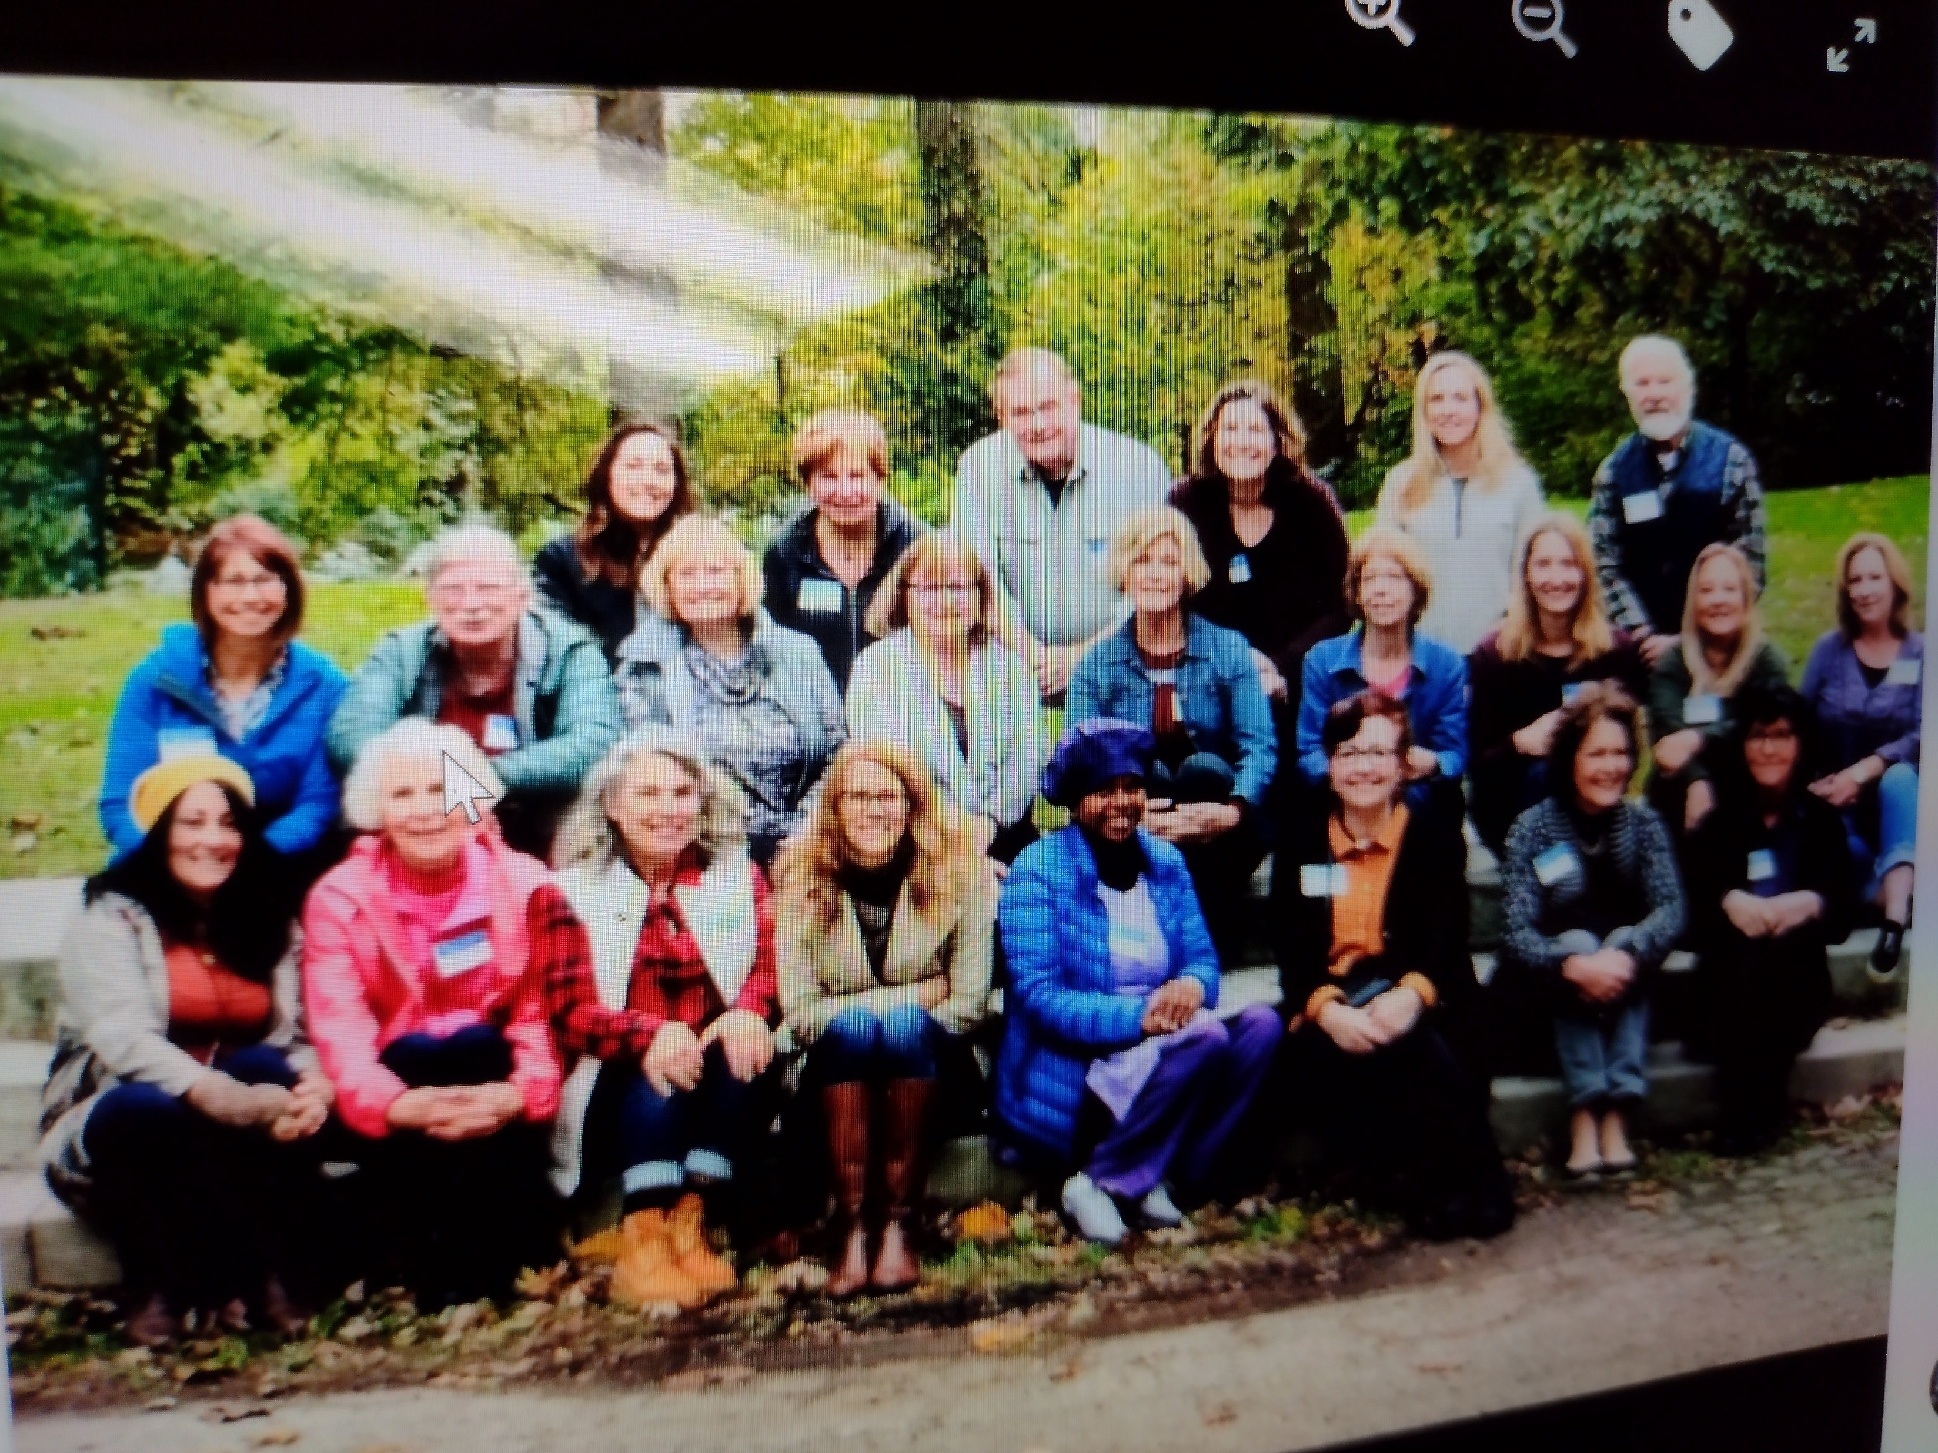
Master Gardener Class of 2019

Slide 8
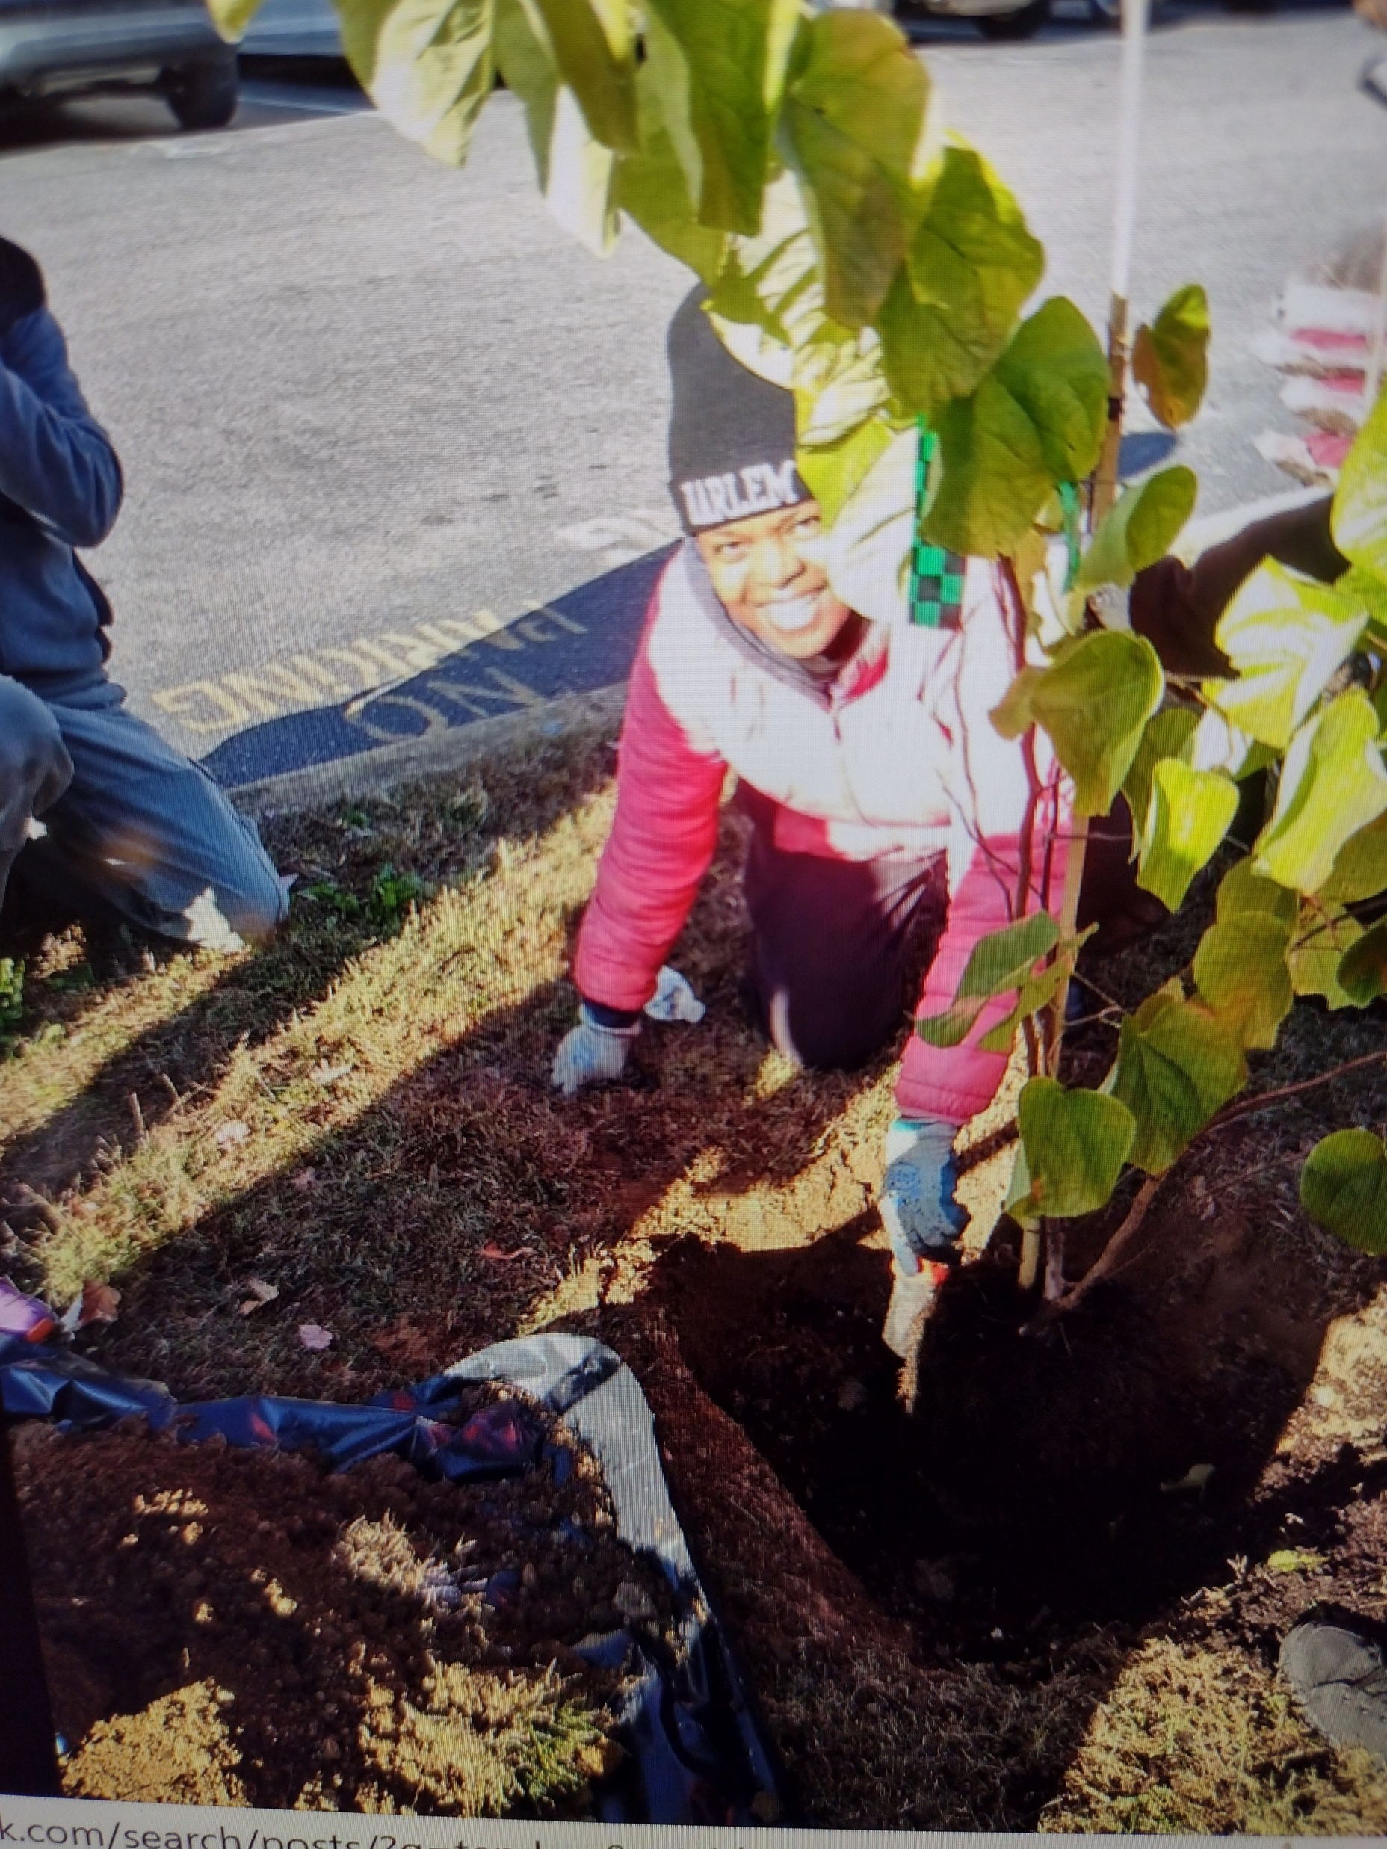
Delaware County Tree Tender

Slide 9
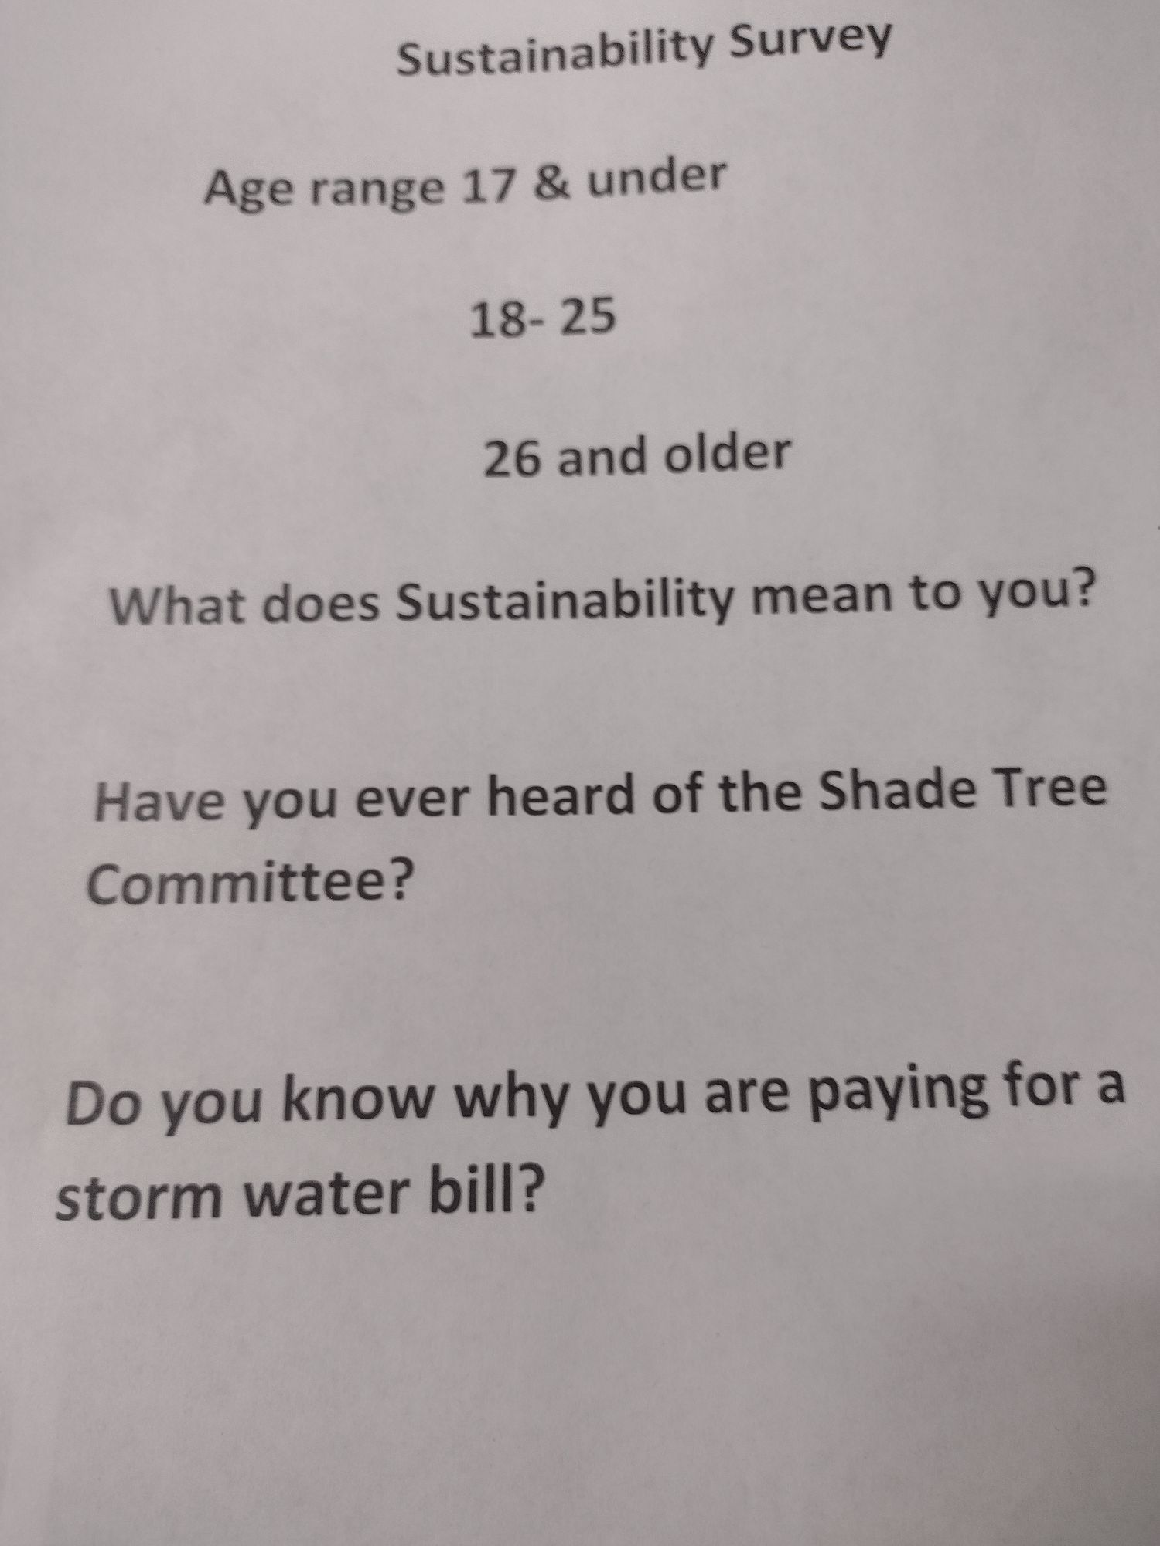

Slide 10
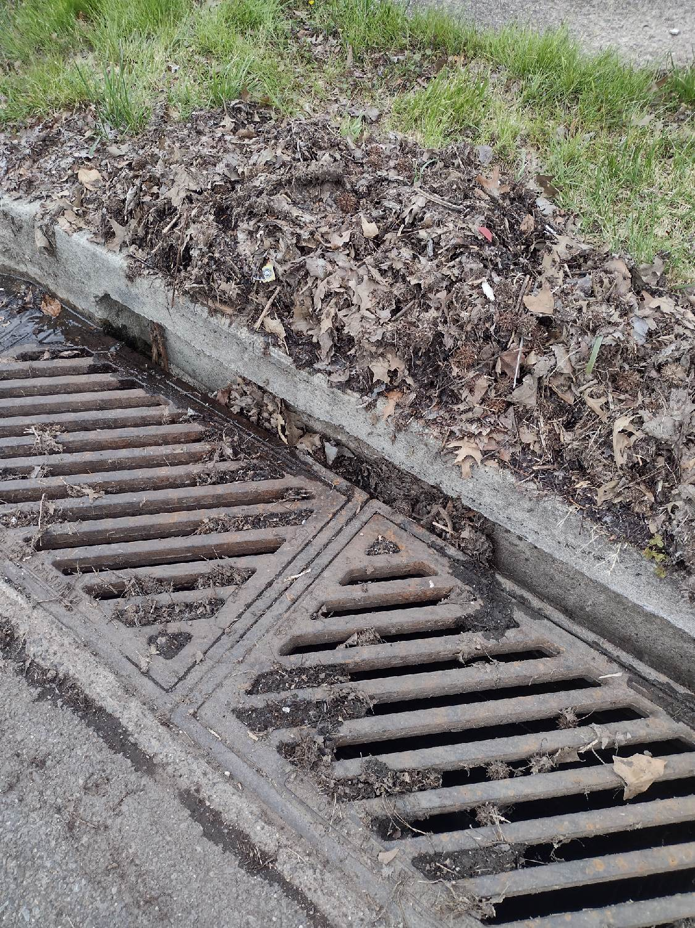

Slide 11
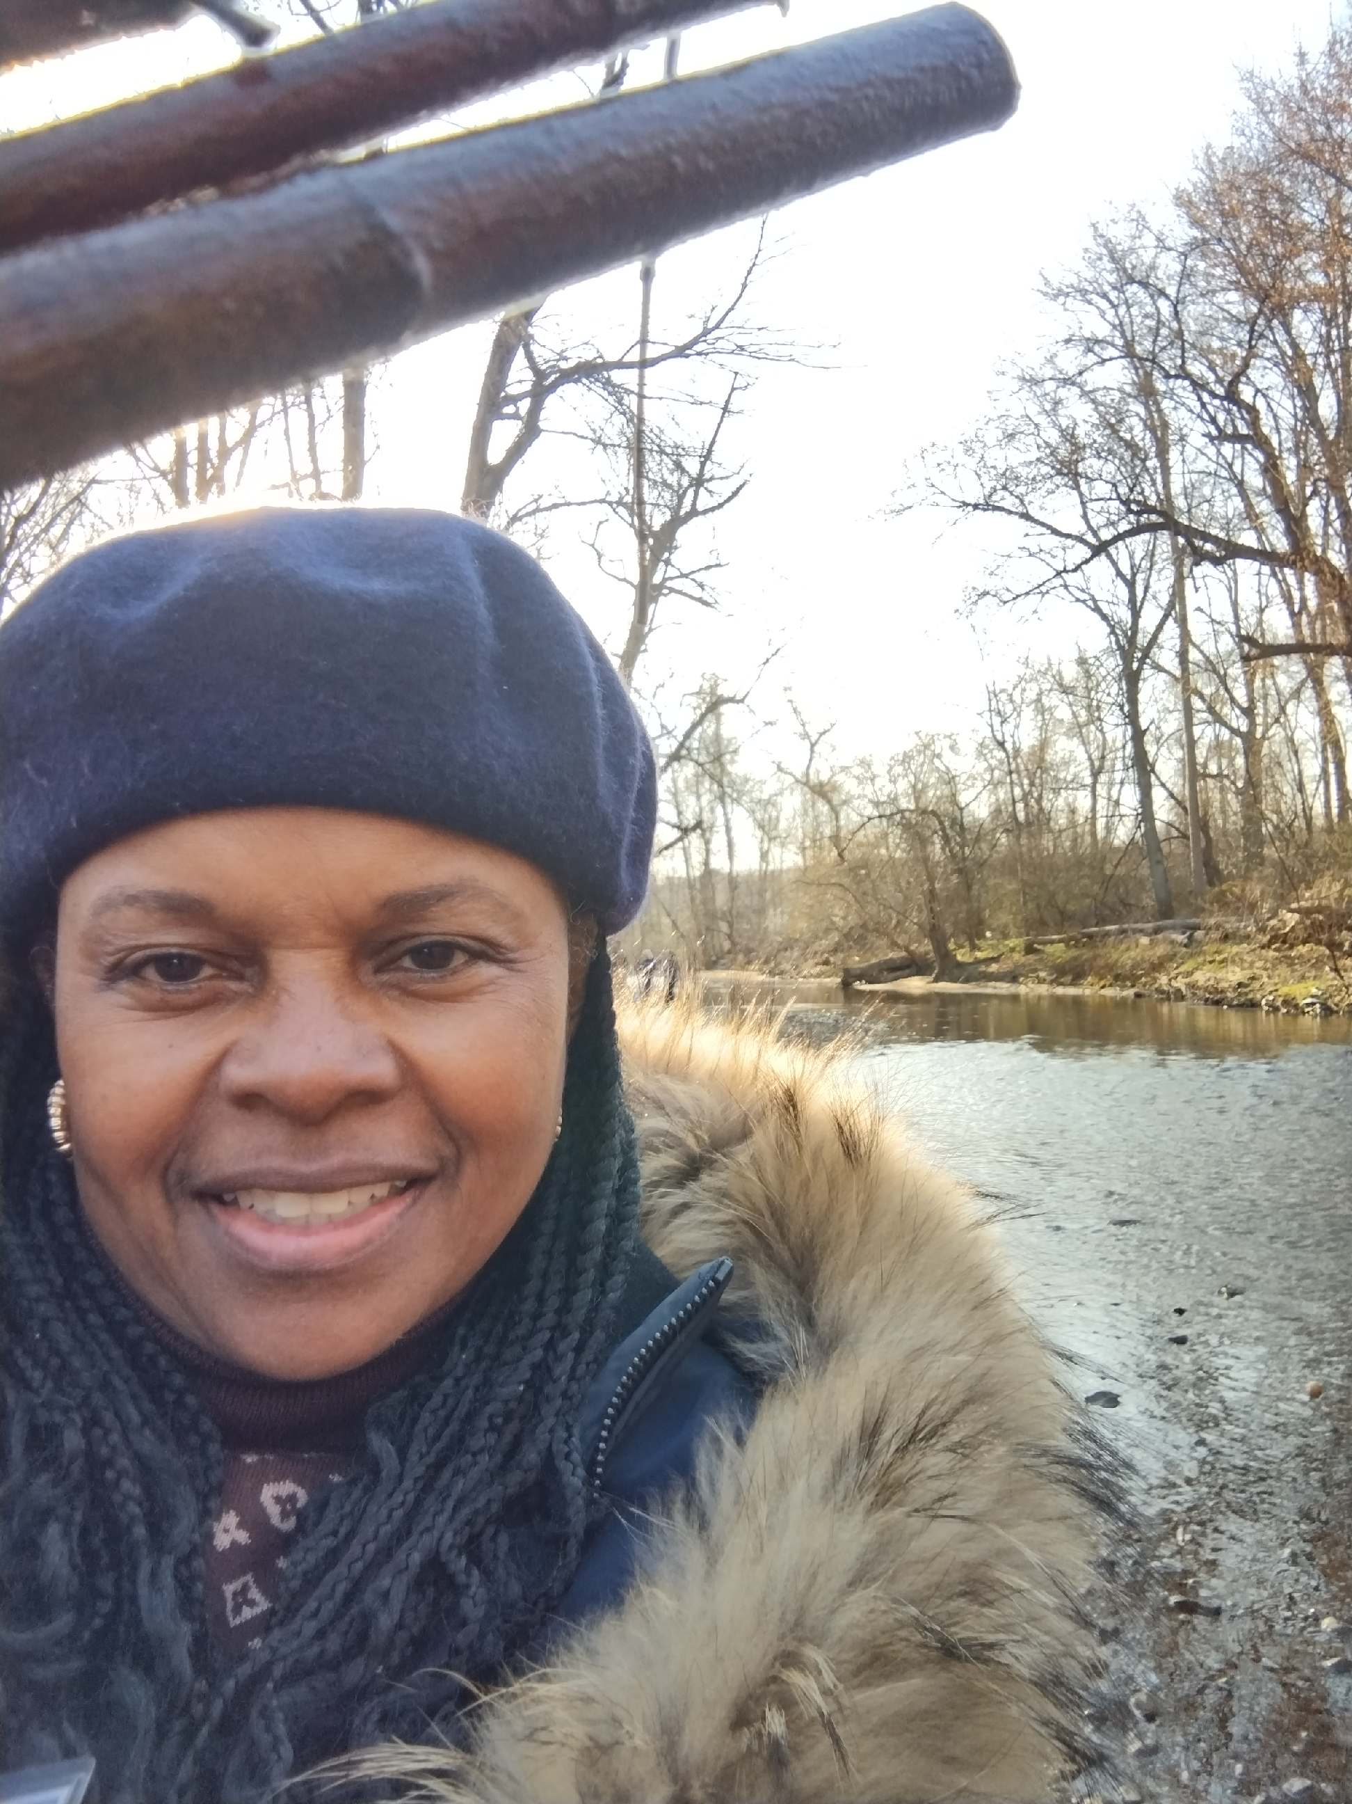
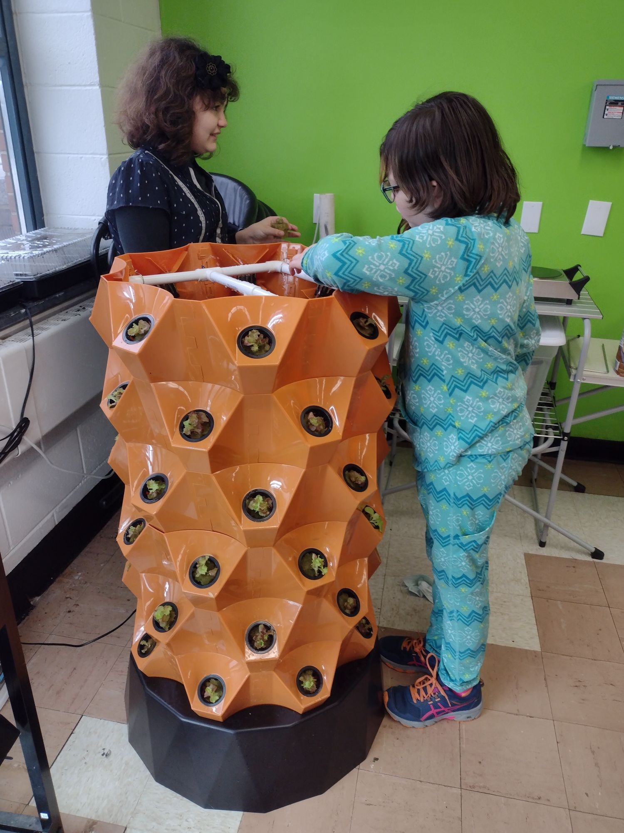
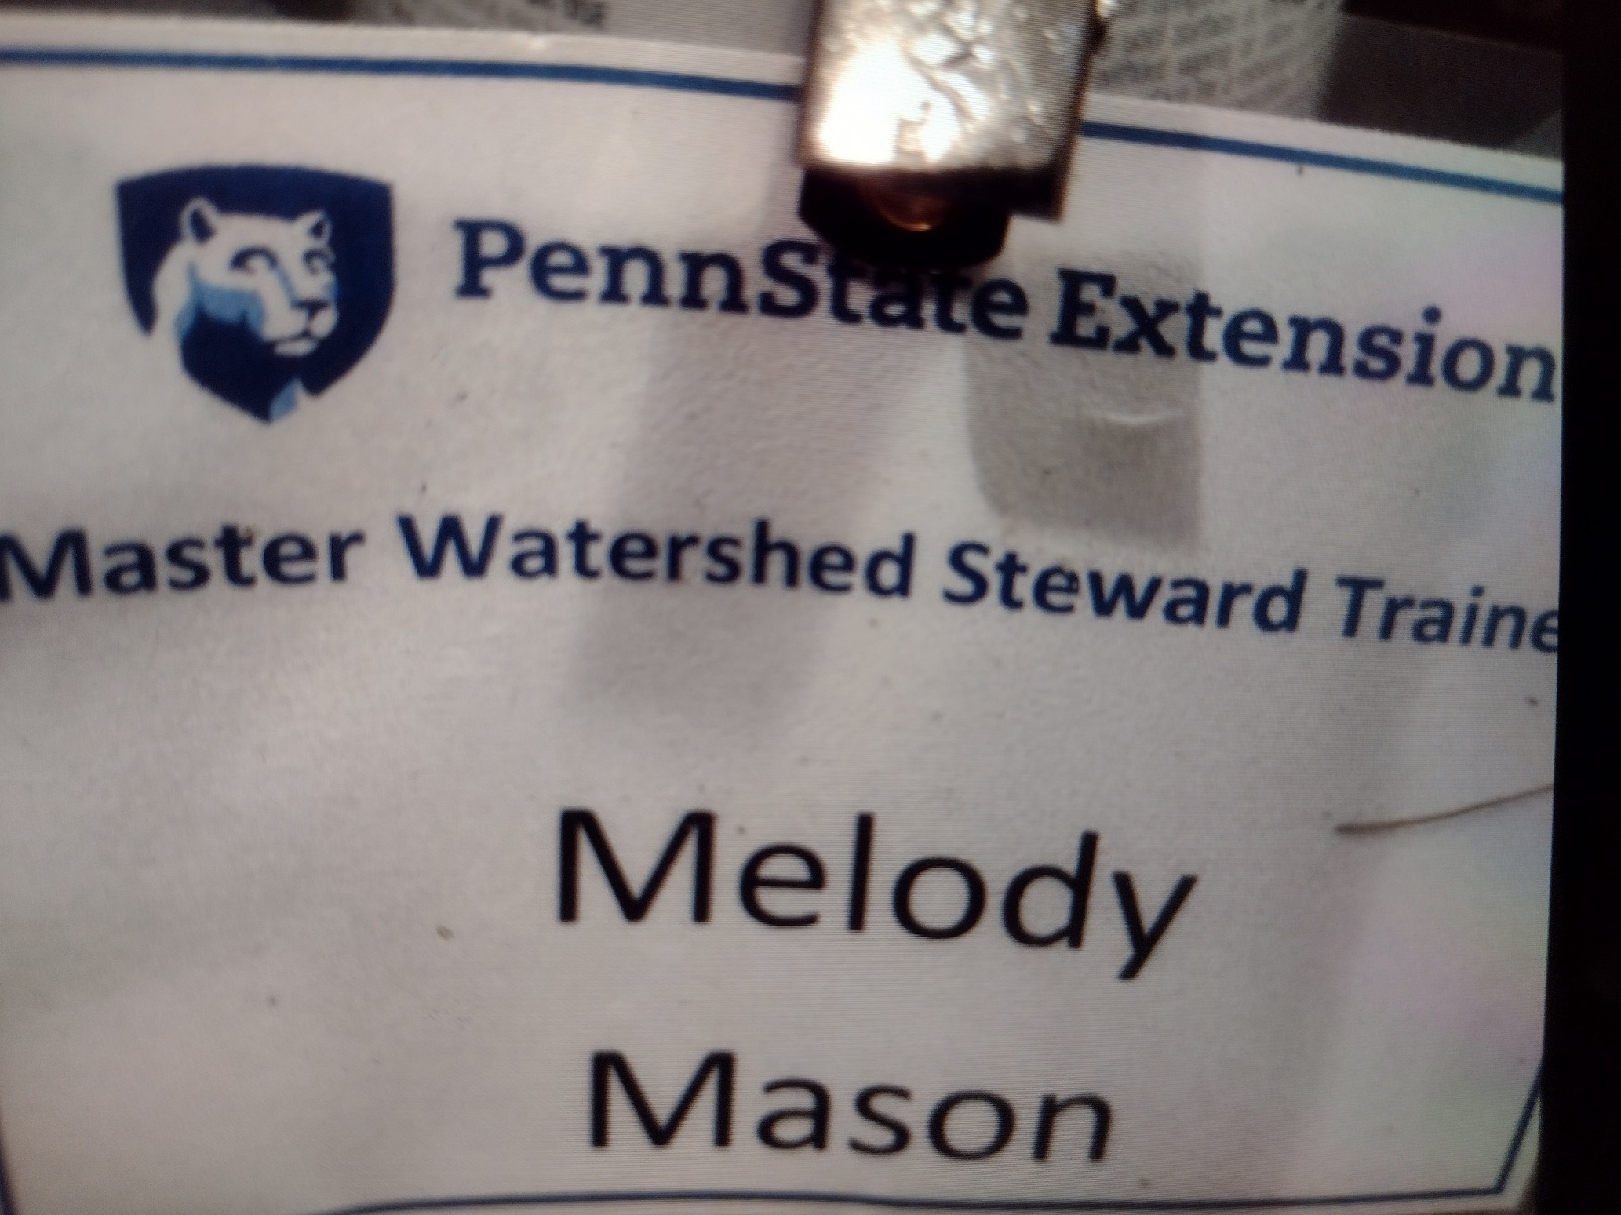
Master Watershed Steward Trainee

Slide 12
4H Leader

Slide 13
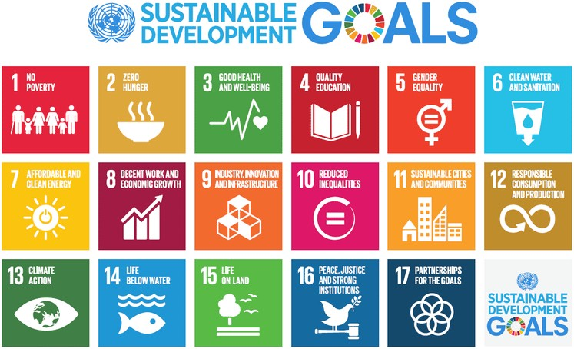

Slide 14
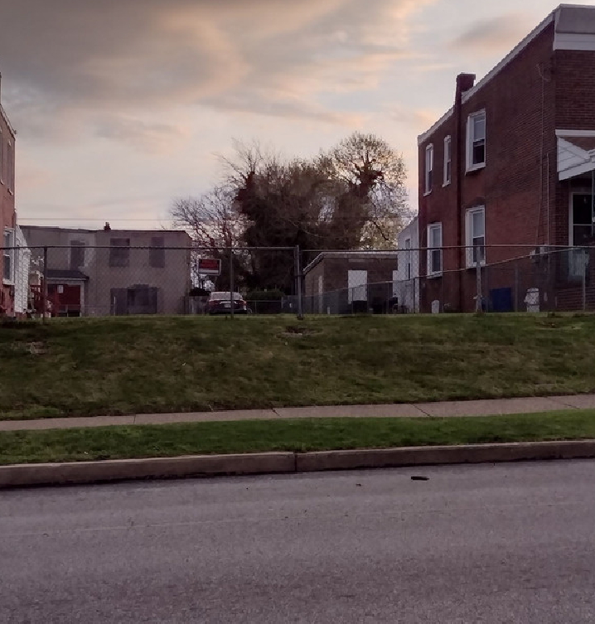

Slide 15

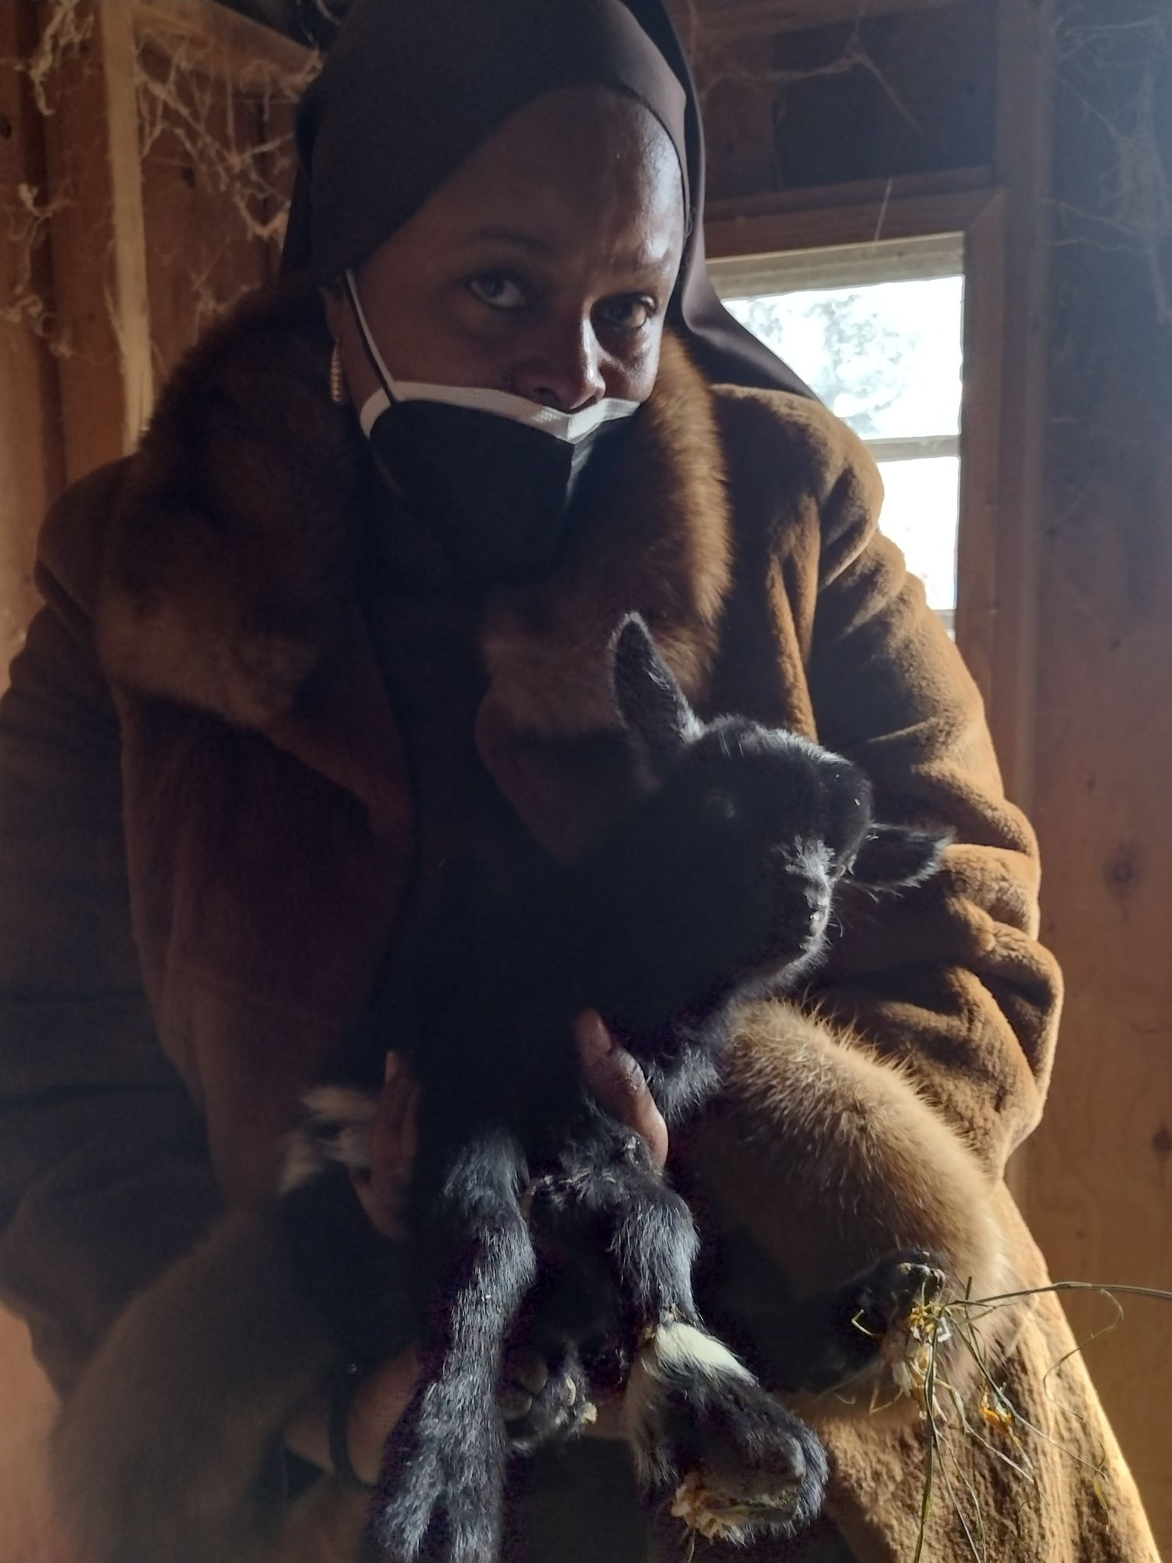



20x80 ft Lot
Community Petting Farm
Bee hive
sleeping quarters/ barn barn for goats
chicken coop tree orchard
space for workshops small Hoop House benches
compost bins rain barrels
pavilion for bad weather

Slide 16
Petting Farm Floorplan

Slide 17
EdtihFamilyFarms.com

