Slide 1
Sustainability in Higher Education: Swarthmore College’s Approach
Elizabeth Drake
Director of Sustainability
Delaware County Sustainability Conference | April 21, 2022

Slide 2
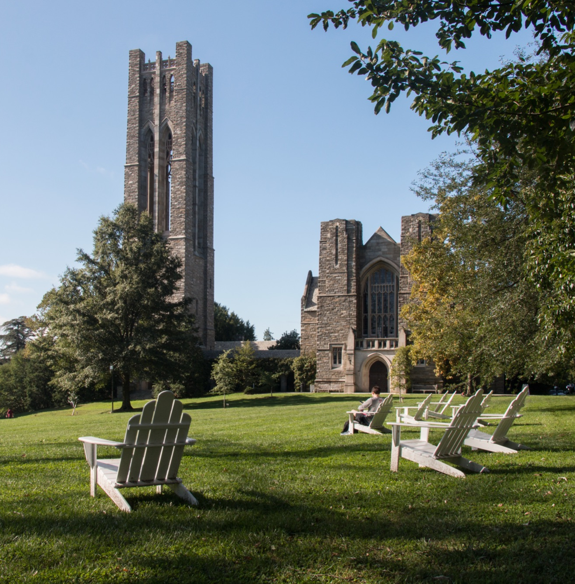
Swarthmore College
Private liberal arts college located approximately 11 miles outside of Philadelphia
Founded in 1864 as a coeducational college by members of the Religious Society of Friends (Quakers)
Approximately 1,600 undergraduate students
Campus is a designated 425-acre arboretum

Slide 3
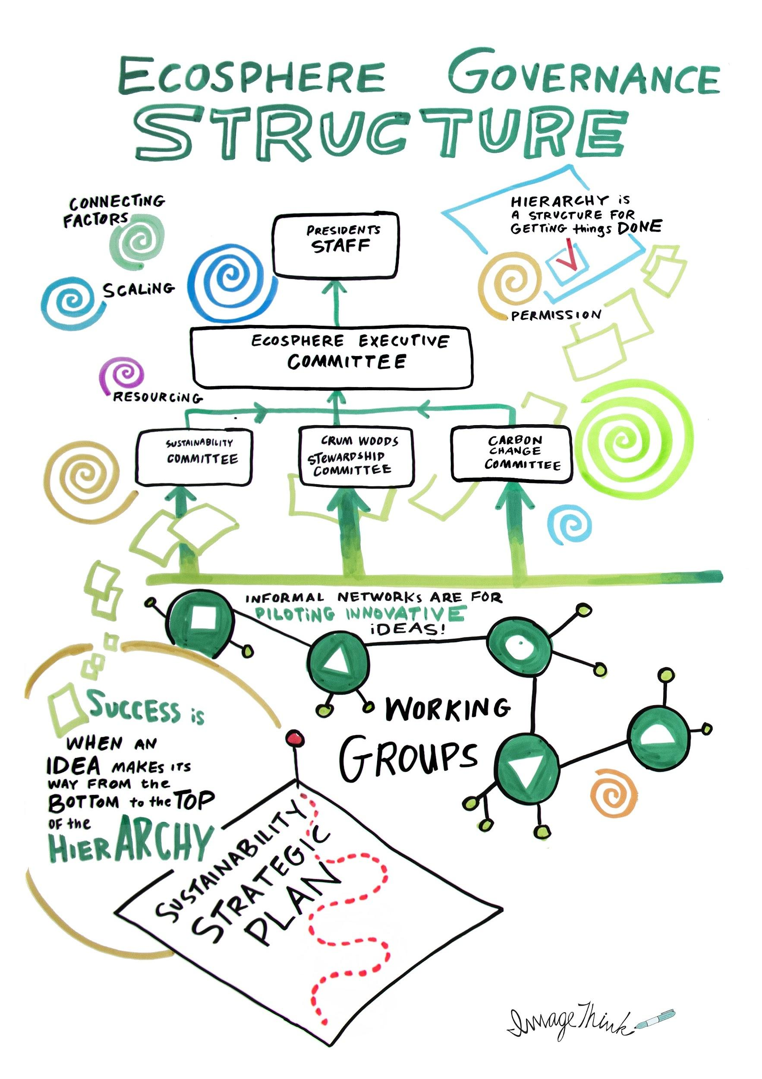
Sustainability at Swarthmore
Office of Sustainability (3 full-time staff, 2 recent graduate Fellows)
Ecosphere committees (60+ staff, faculty, students)
Executive Committee
Sustainability Committee
Crum Woods Stewardship Committee
Carbon Charge Working Group
Zero Waste Working Group
Food Systems Working Group
Environmental Studies program (15+ faculty)

Slide 4
Sustainability Progress
2011
2015
2016
2021
First sustainability coordinator hired
Climate Action Plan for carbon neutrality created
Adopted internal Carbon Charge Program
Approved Roadmap to Zero Carbon
Ongoing: Development of waste management systems, creation of student sustainability programs, development of Environmental Studies program, investments in sustainability infrastructure, and much more!

Slide 5
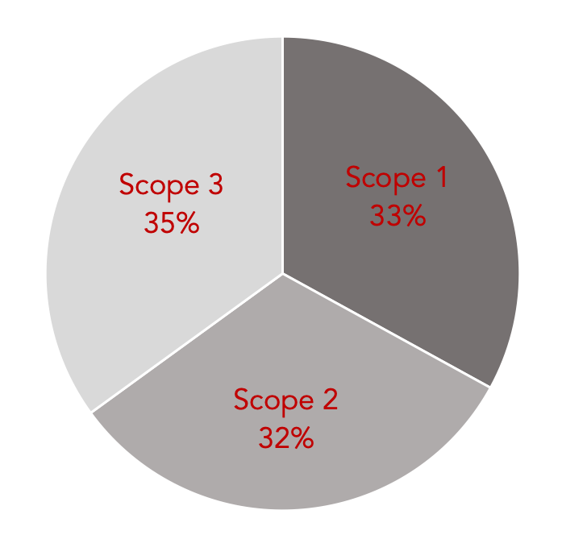
Commitment to Carbon Neutrality
In 2010, Swarthmore became a signatory to the American College and University Presidents’ Climate Commitment
Our 2012 Climate Action Plan set a target carbon neutrality date of 2035
This requires eliminating or offsetting all carbon emissions in the next 15 years!

Slide 6

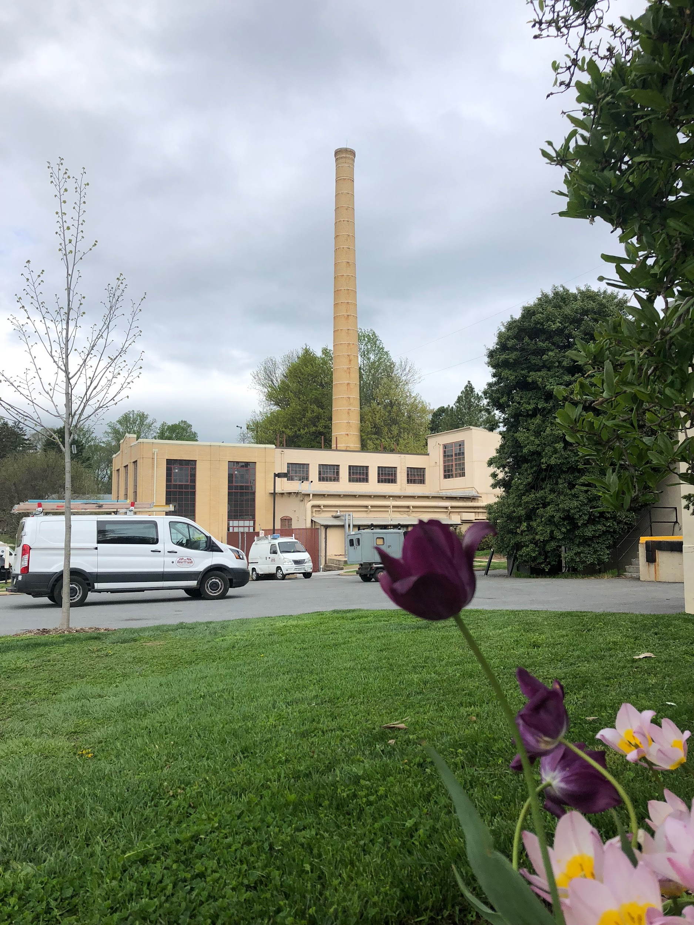
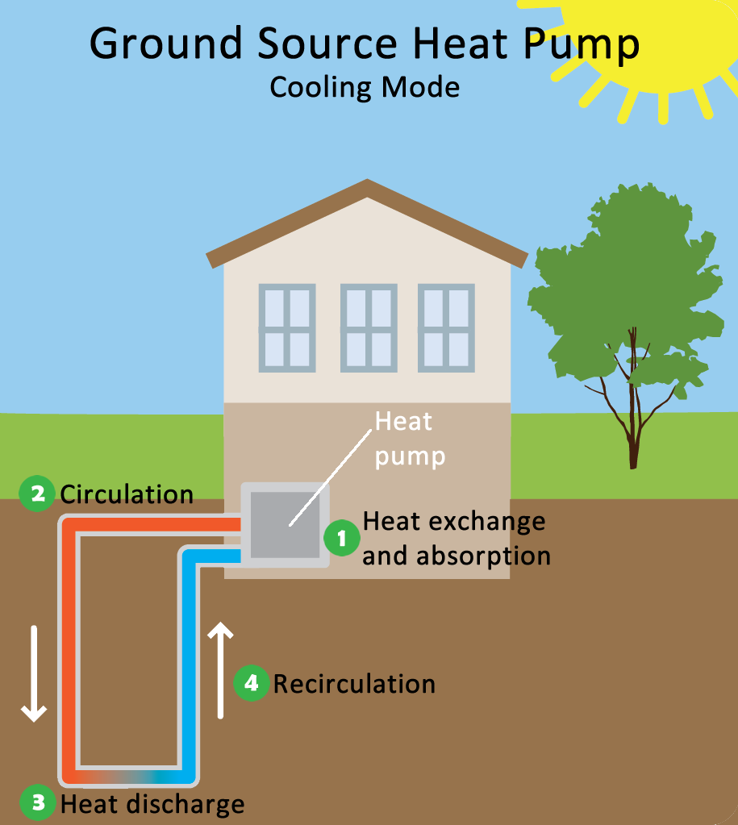

The Roadmap to Zero Carbon
Heating and cooling reliant on fossil fuel combustion
Central geoexchange plant
Renewable electricity
Backup generation

Slide 7
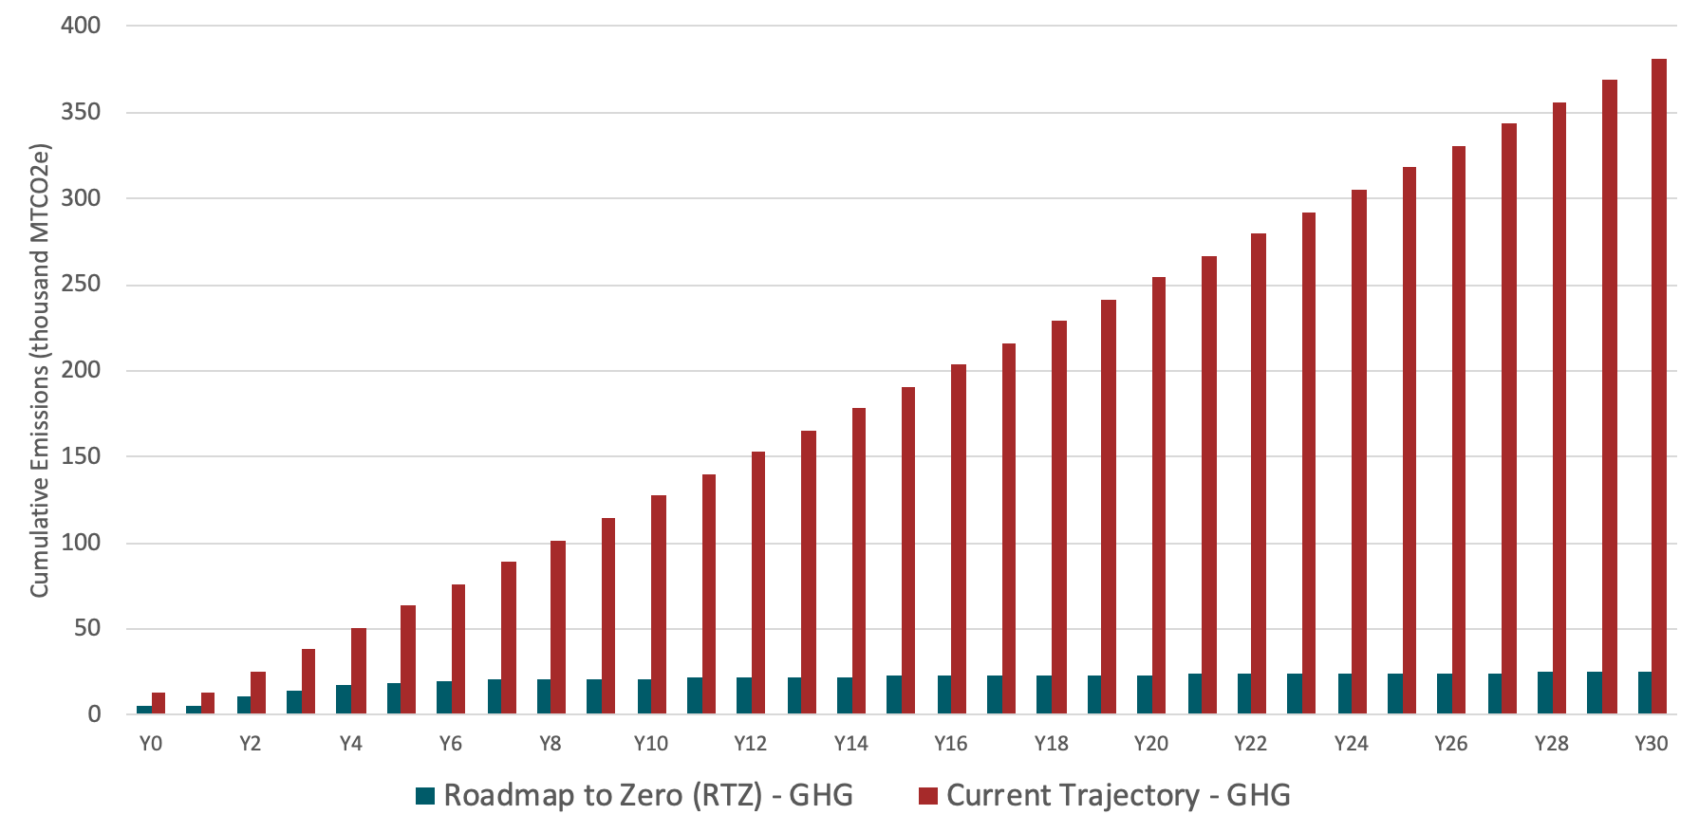
Cumulative Greenhouse Gas Emissions
More than 350,000 mtCO2e
~25,000 mtCO2e

Slide 8
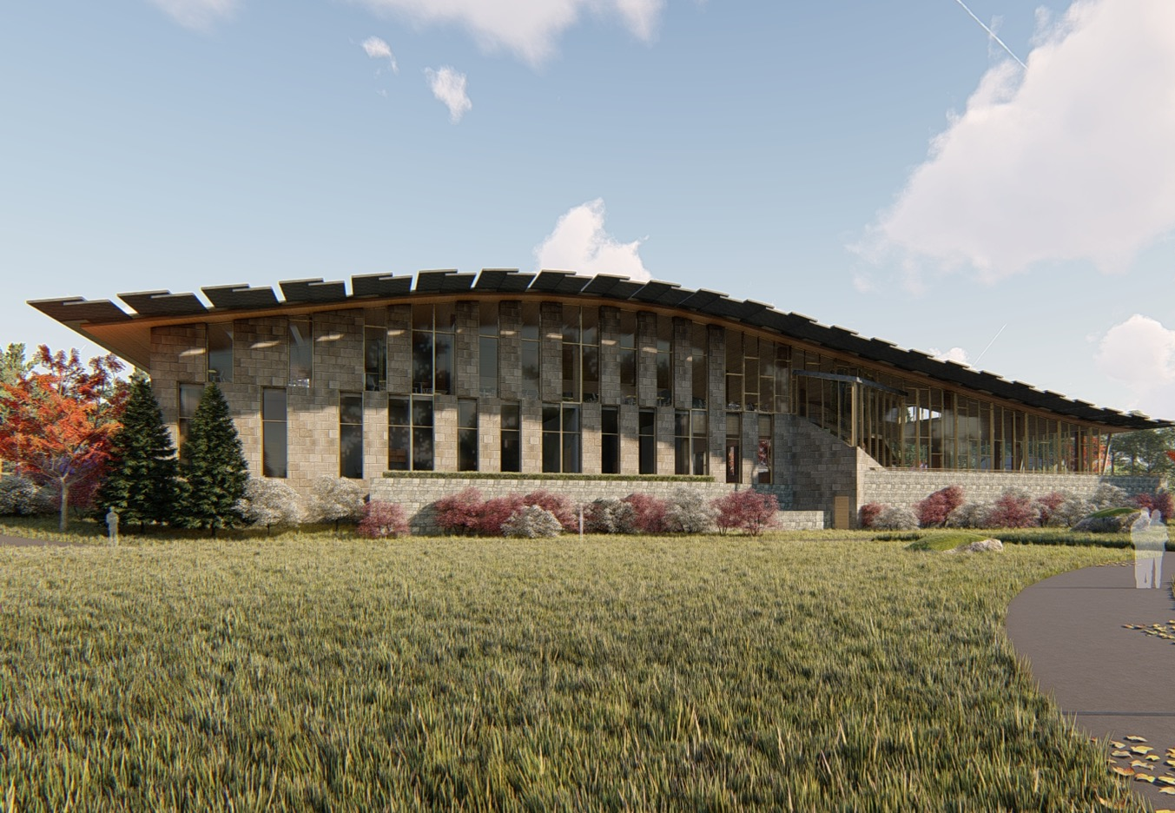
Net-Zero Dining Project
The Dining & Community Commons project, which will house the central geoexchange plant in the basement, is currently under construction.
We are pursuing Living Building Petal Certification for this project, which requires us to produce 105% of the building’s annual electricity load onsite with renewable energy.

Slide 9
Carbon Charge Program
Swarthmore’s Carbon Charge program includes three components:
Carbon fee → Levy on departments and offices creates funds for greenhouse gas reduction projects
Shadow price → proxy price on carbon used in analysis for major construction/renovation projects
Advocacy → educate & build political will for carbon pricing as climate solution

Slide 10
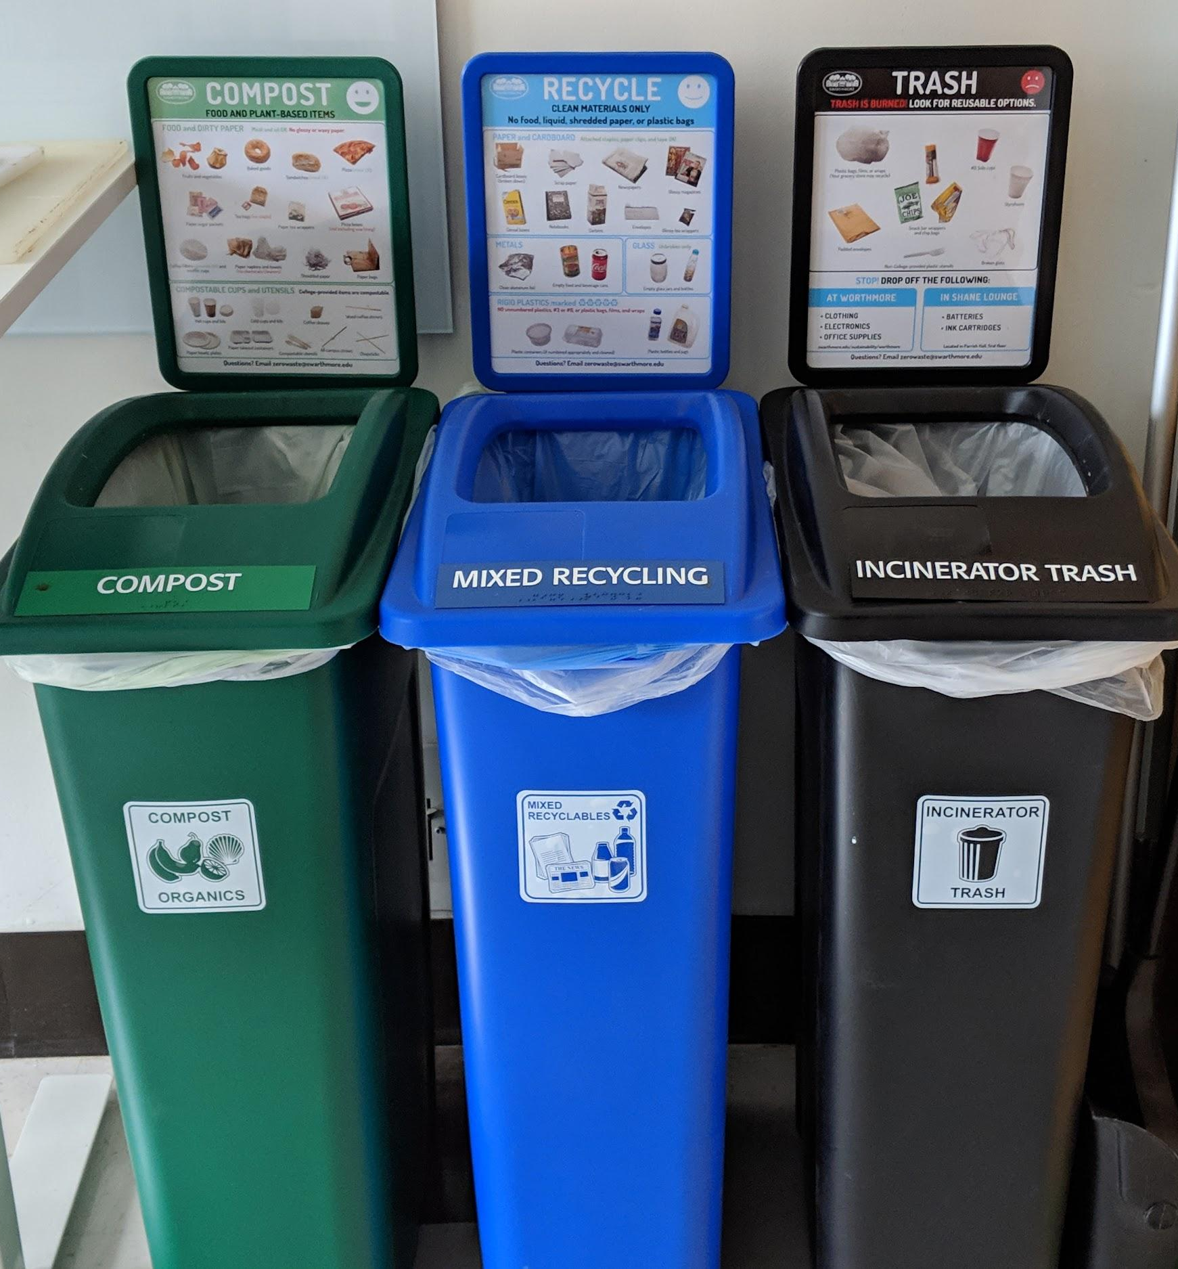
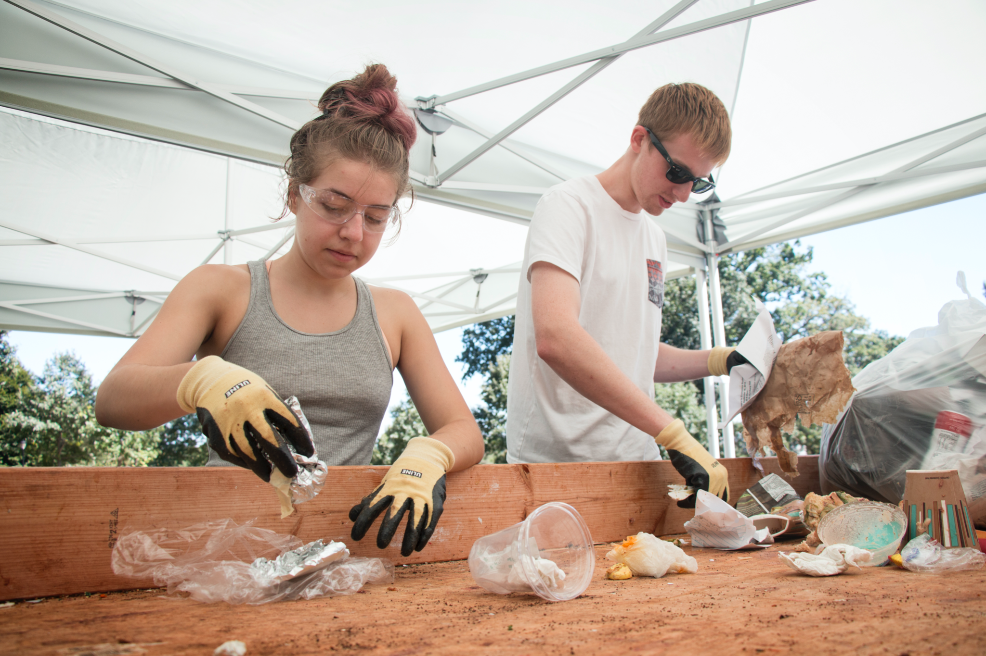
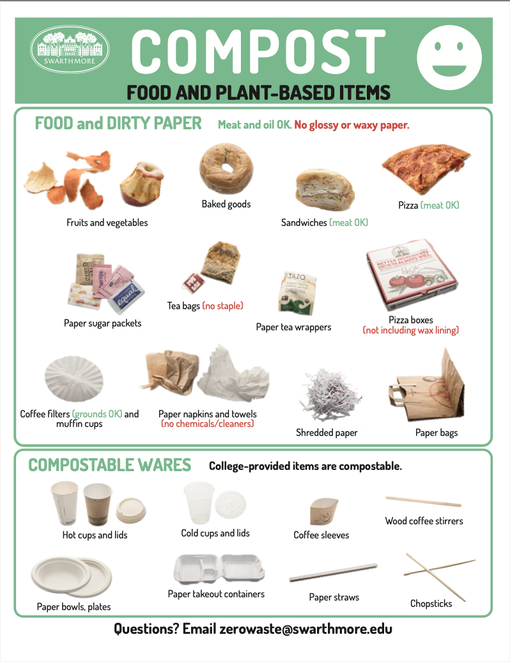
Pursuing Equitable Zero Waste
Comprehensive zero waste program include pre- and post-consumer composting, reusable container programs, move-out donation collections, education and behavior change initiatives and more!

Slide 11









Developing Sustainability Leaders
In the President’s Sustainability Research Fellowship at Swarthmore College, students learn by leading: by taking stewardship over vital sustainability challenges on campus and in the community.

Slide 12
Thank you!
sustainability@swarthmore.edu
swarthmore.edu/sustainability

