Slide 1
2024 Communications Presence Review

Slide 2
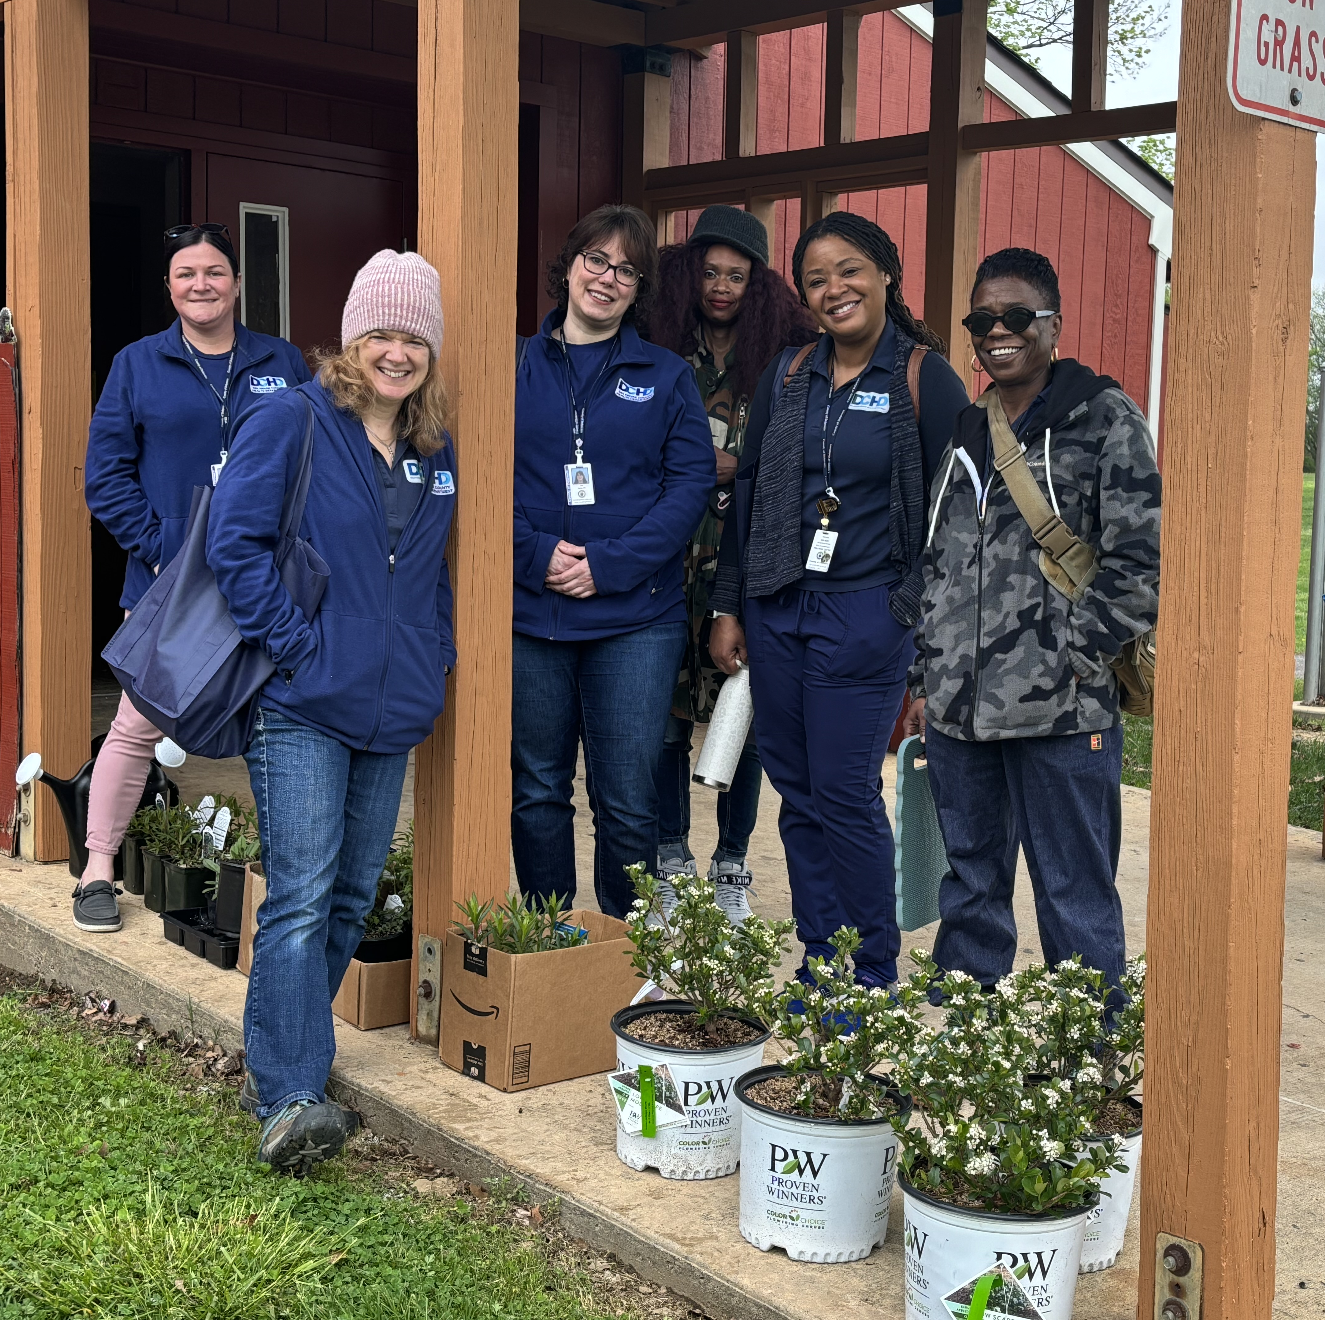
Table of Contents
Social Media
    Analytics
    Top Performing Posts
Earned Media
    News Media Stories
    Press Conferences
Paid Media
    Test and Go, Delco Revive
    Video
      CHIP Explainer, STI Myths, Narcan Tutorial.
Video Production
    Test and Go Launch
    2024 DCHD Recap

Slide 3
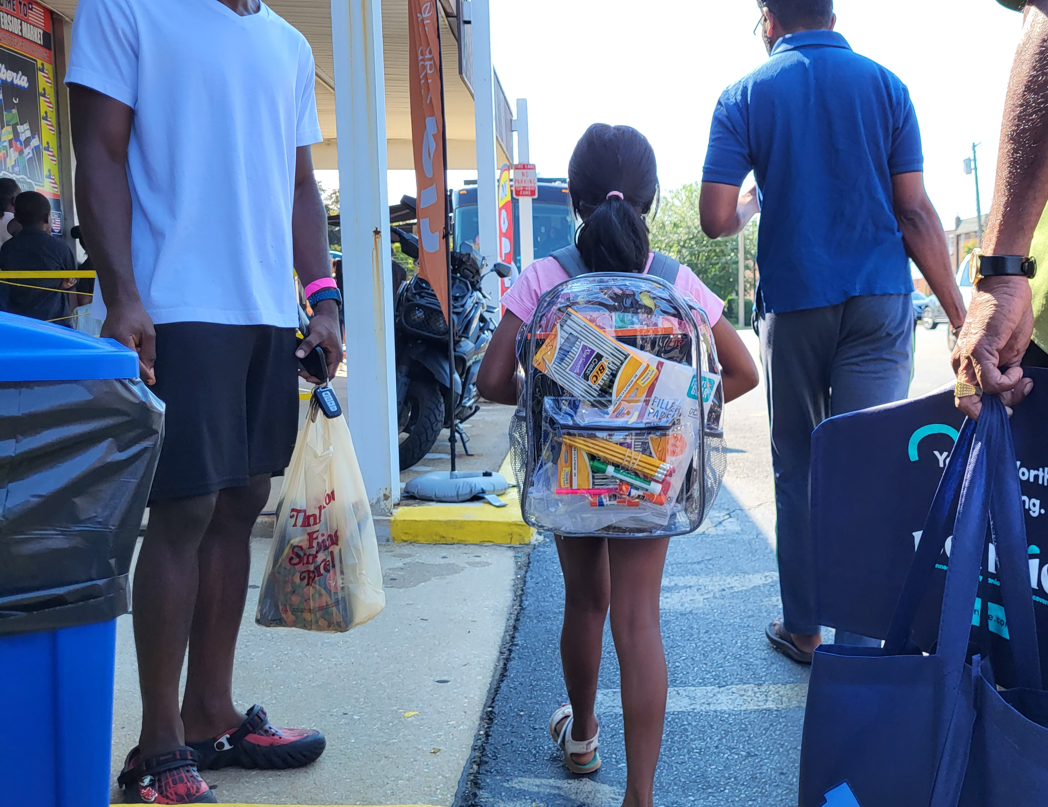



Social Media
The Delaware County Health Department Maintains 3 individual Social Media Accounts
-DCHD has access to the County YouTube and LinkedIn Channels
Facebook - @DelcoHealth
Dec. 2024 Dec. 2023
Followers 1.8k Followers 1.6k
Reached 622.7K Reach 96.2k
Instagram - @delcohealthdepartment
Followers
Dec. 2024 – 765 Dec. 2023 - 600
Impressions
Dec. 2024 – 22.7k Dec. 2023 - 19.6k
X X
X(Twitter) - @DelcoHD
Dec. 2024 180 Followers

Slide 4
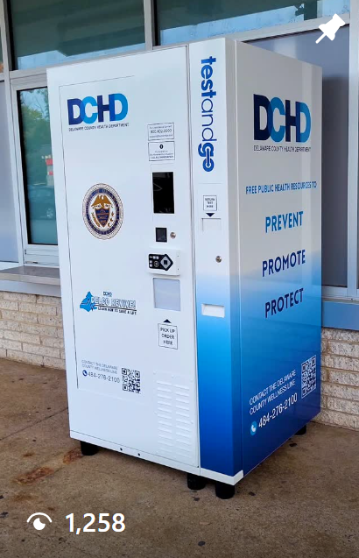

Top Performing Social Media Posts
DCHD Test and Go Reel
Black History Month Public Health Pioneer
Instagram
1258 Views
733 Reached
50 interactions
Facebook
3k Reached
3.3k Impressions
150 Interactions
Instagram
458 impressions
389 Reached
458 interactions

Slide 5


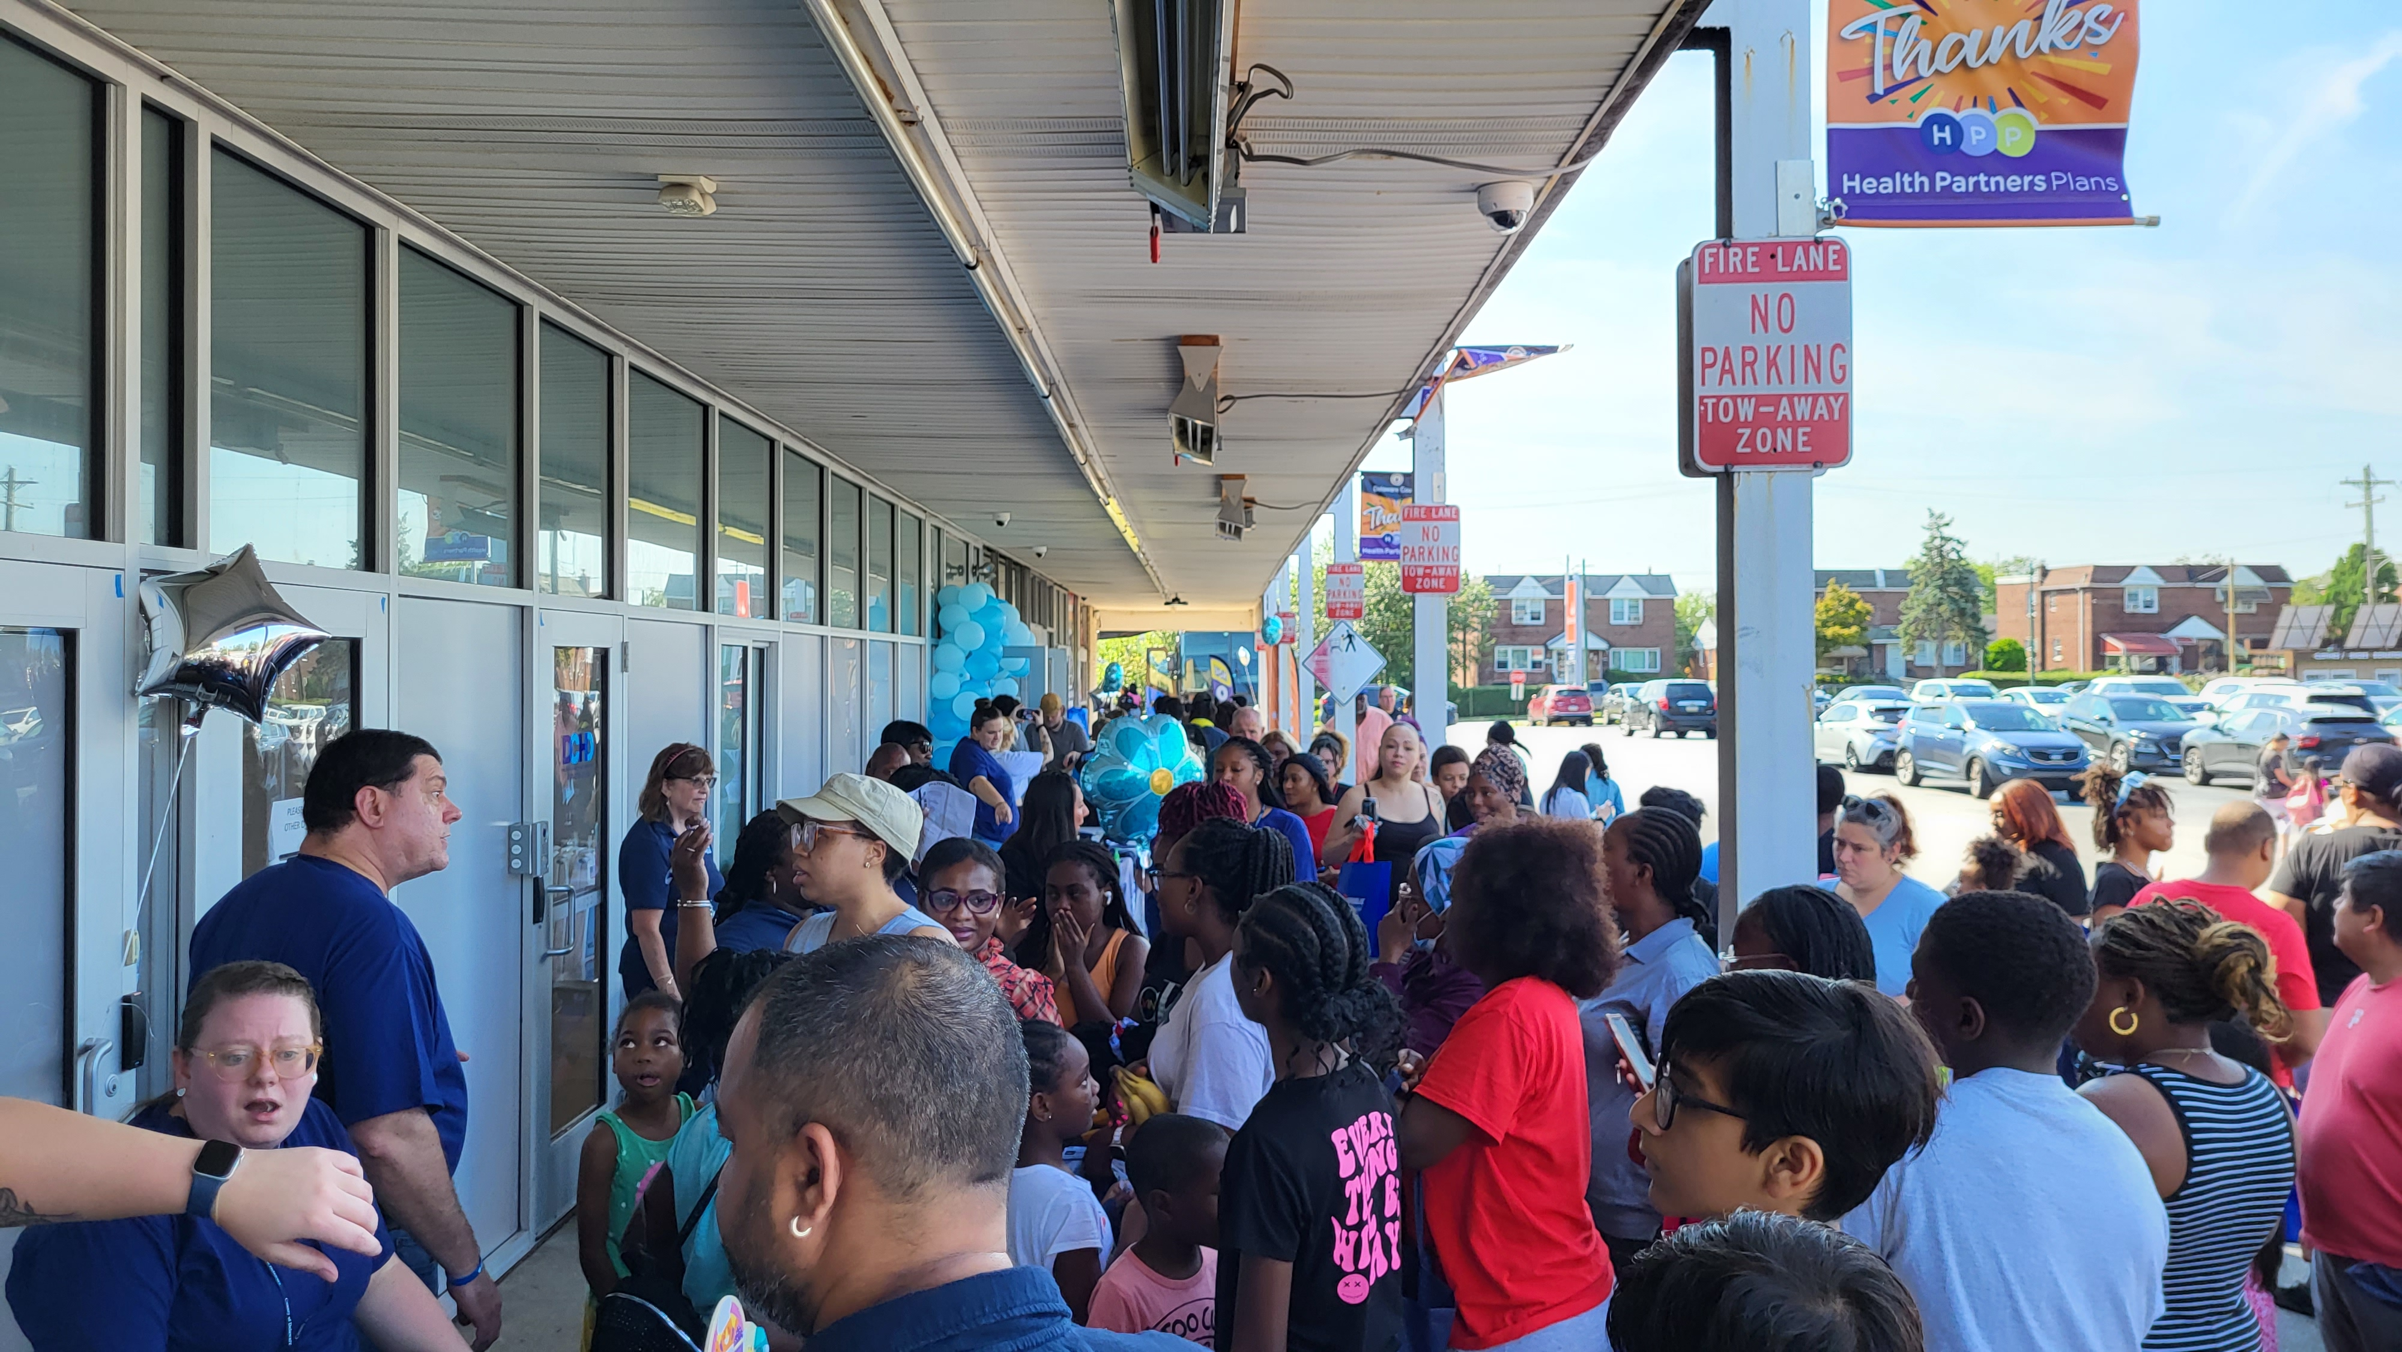
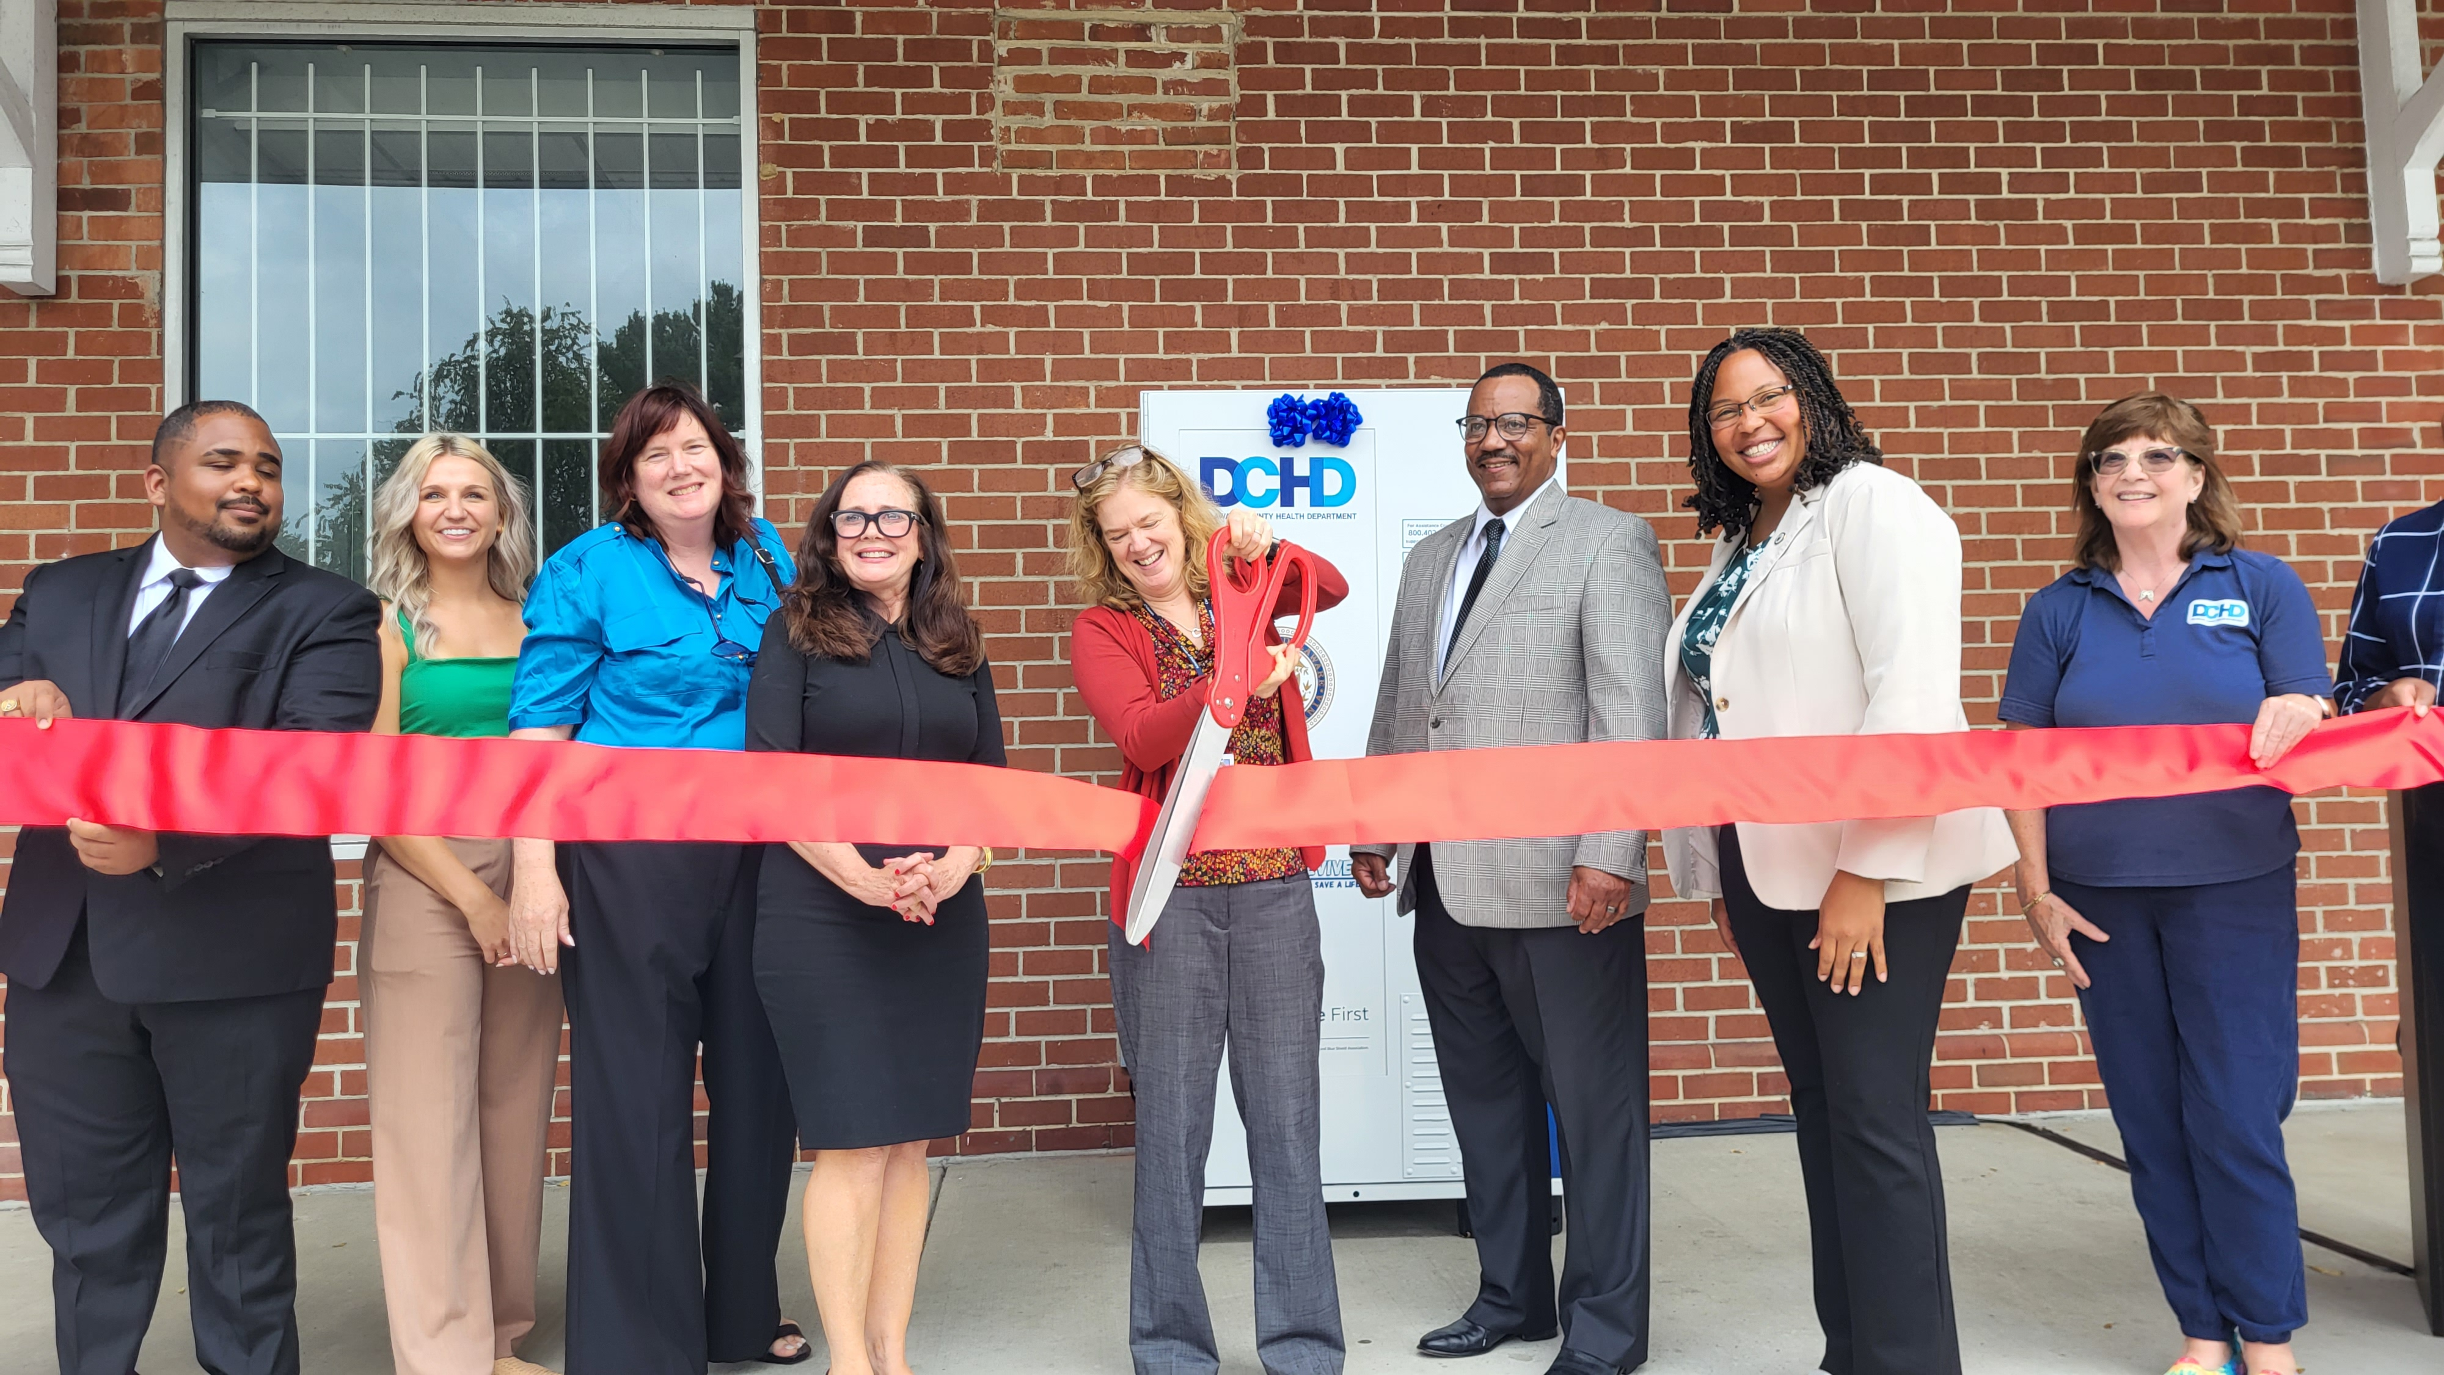
Earned Media
-Earned Media is referred to as no cost local or national news coverage.
Top Stories
Test and Go Kiosks Installed
Back To School Backpack Giveaway
Delco Revive – Learn to Save a Life
Clean the Green DCHD Delivers
Jefferson Mammogram Screening Events
Strollin’ Colon Cancer Awareness
Whooping Cough

Slide 6

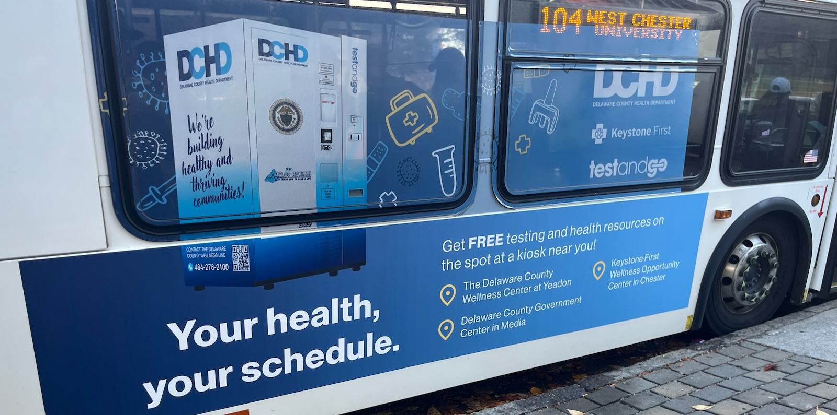
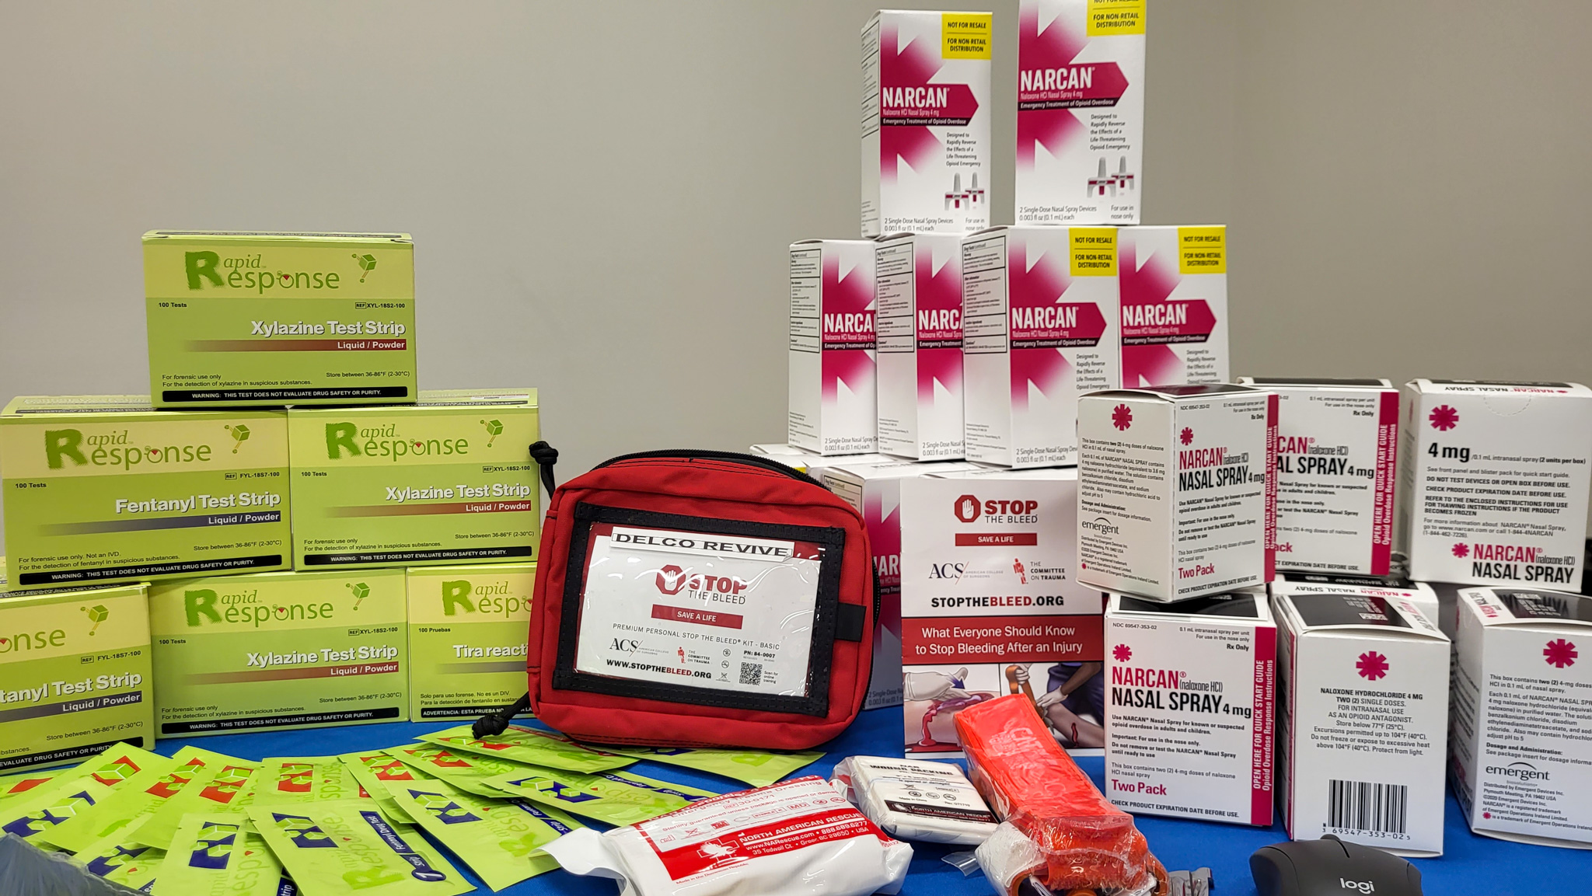
Paid Media
Elemeno Productions:
STI Facts Verse Myths
Delco Revive Narcan
CHIP Explainer ((https://www.youtube.com/watch?v=1YWAyAZStbI&feature=youtu.be)
  Delco Revive
  KYW News Radio
  Paid Social
  Promotional Material
  Test And Go
  Septa Bus Exteriors/Interior/Digital Platforms
  Clear Channel Bus Shelters
  Paid Social

Slide 7
Test and Go
https://youtube.com/shorts/Iu3k0ISIHiU

Slide 8
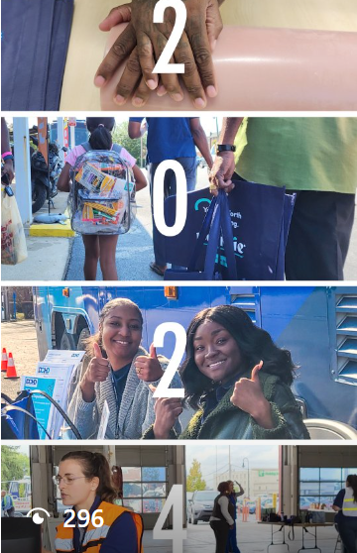
2024 Recap
https://youtube.com/shorts/DEn8HXZdLSk

