Slide 1
The Pennsylvania
Lead-Free Promise Project
Supported by Children First
Presented by
Rosemarie Halt RPh. MPH.
Children First
LFPP Consultant
rosemarieh@childrenfirstpa.org

Slide 2
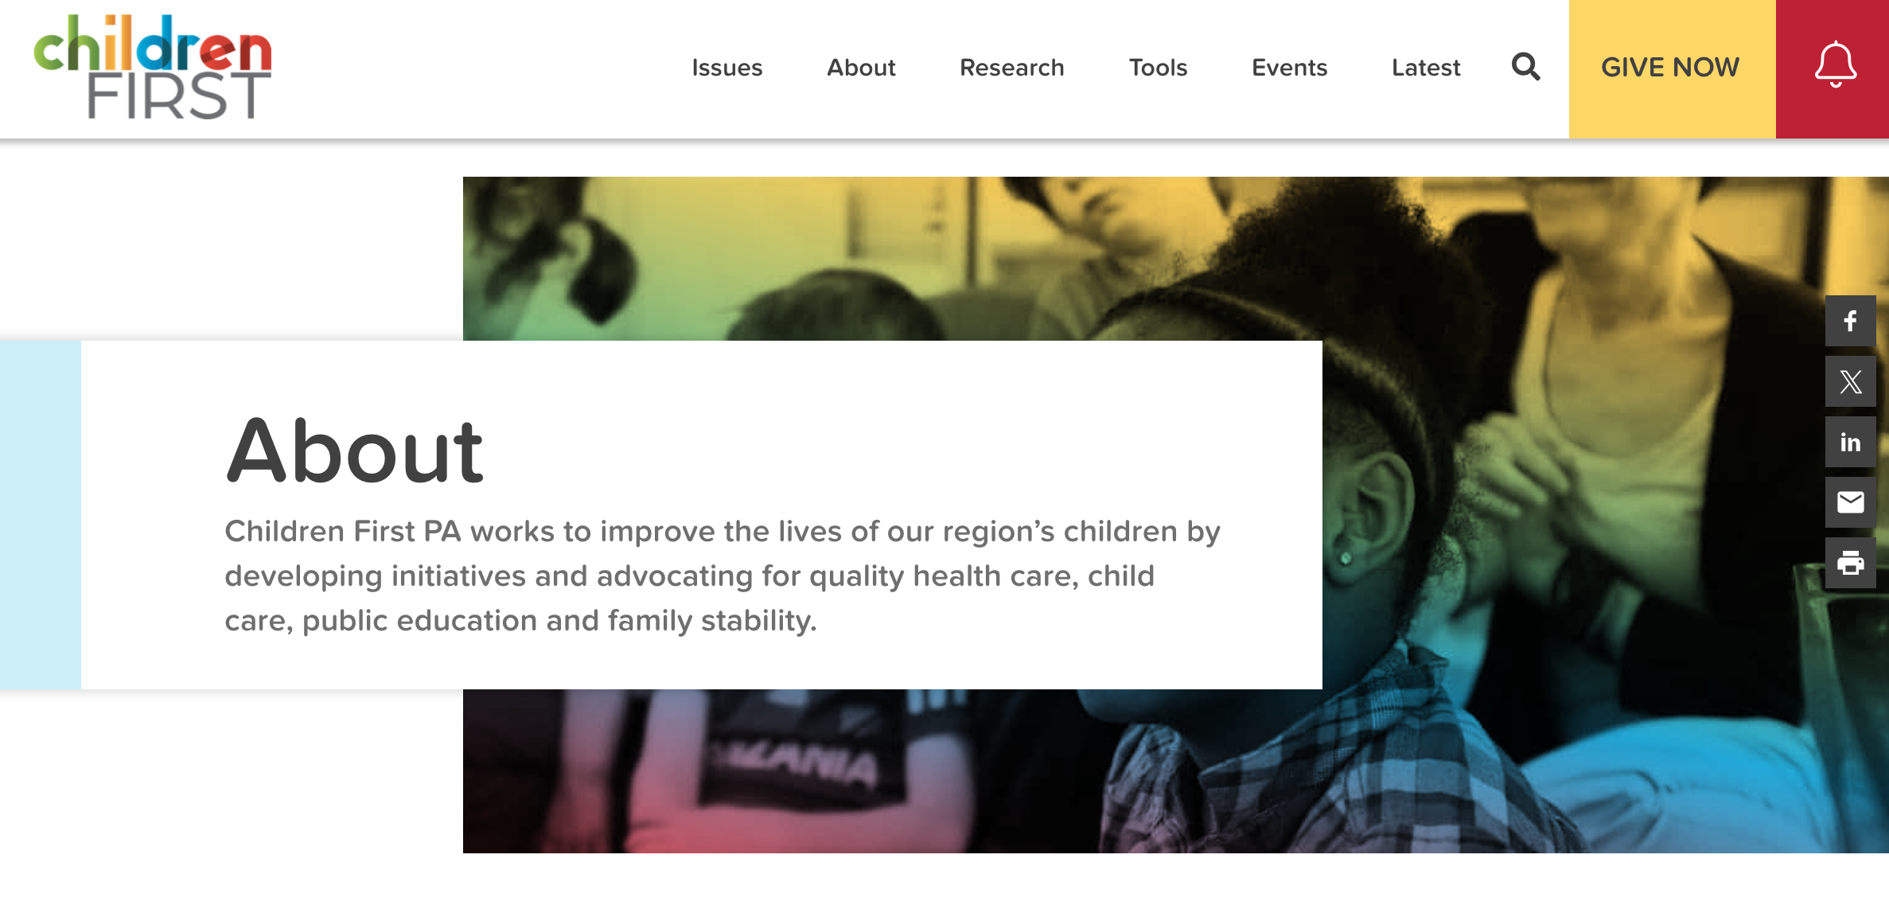
Notes:
Children First received a Pritzker State Planning Grant in collaboration with Pa Partnership for Children & PADOH on a 5 point strategy to improve children’s health in zero to three age groups. Lead was a a one of the 5 key area of impact.

Slide 3
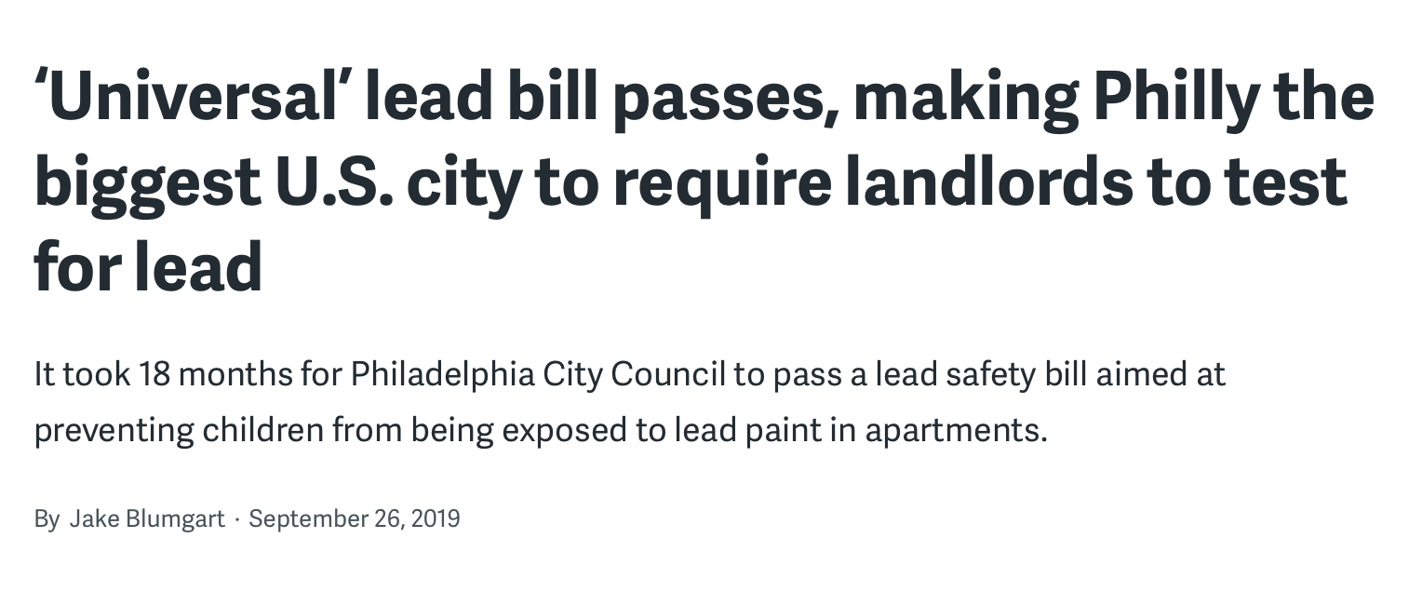
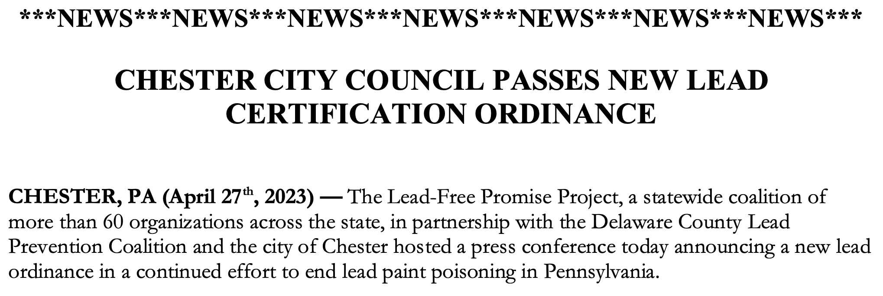
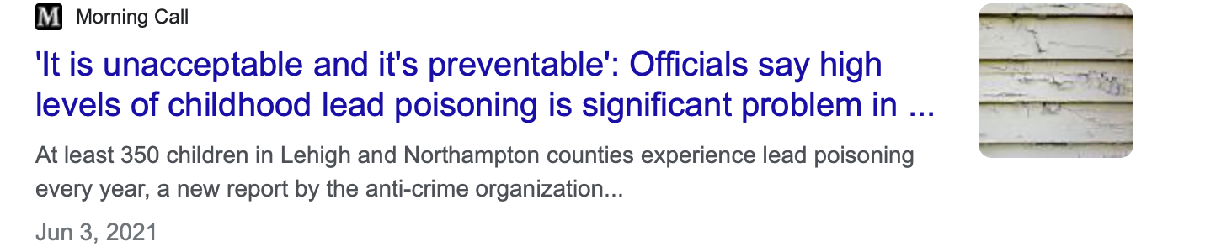
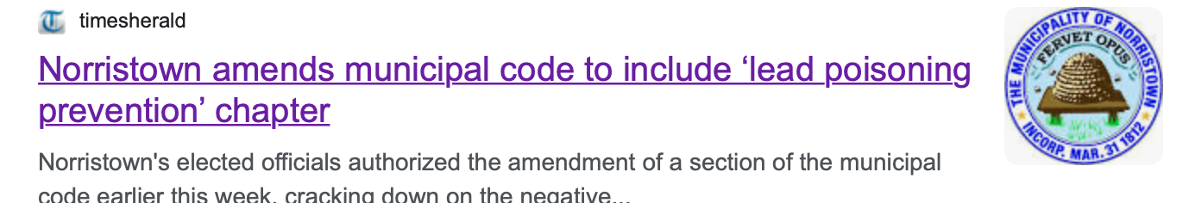
Children First
A Long Time Advocate of Lead Poisoning Prevention
Notes:
Children First was instrumental in passing local lead laws and ordiances the first being in Philadelphia & Norristown aimed at reducing lead paint poisioning by requiring rental properties and newly sold homes to be lead safe.

Slide 4

Lead Poisoning in Pennsylvania & Delaware County
70% of Houses in PA built before 1978 when lead paint was banned
81% of Houses in Delco built before 1978
*Over 7,000 children tested positive for lead poisioning in 2022
60% of the Children in Delaware County are not tested for Lead !
DELAWARE COUNTY RANKS 5TH IN PA FOR LEAD POSIONED CHILDREN
*PADOH 2022 Childhood Lead surveillance Annual Report
Notes:
CDC recommends testing blood for lead exposure. There are often no apparent symptoms when a child is exposed to lead. Because of this, a blood test is the best way to determine if a child has been exposed to lead. If your child may have been exposed to lead, talk to your healthcare provider about getting a blood lead test. Based on your child’s blood lead test results, healthcare providers can recommend follow-up actions and care.

Slide 5
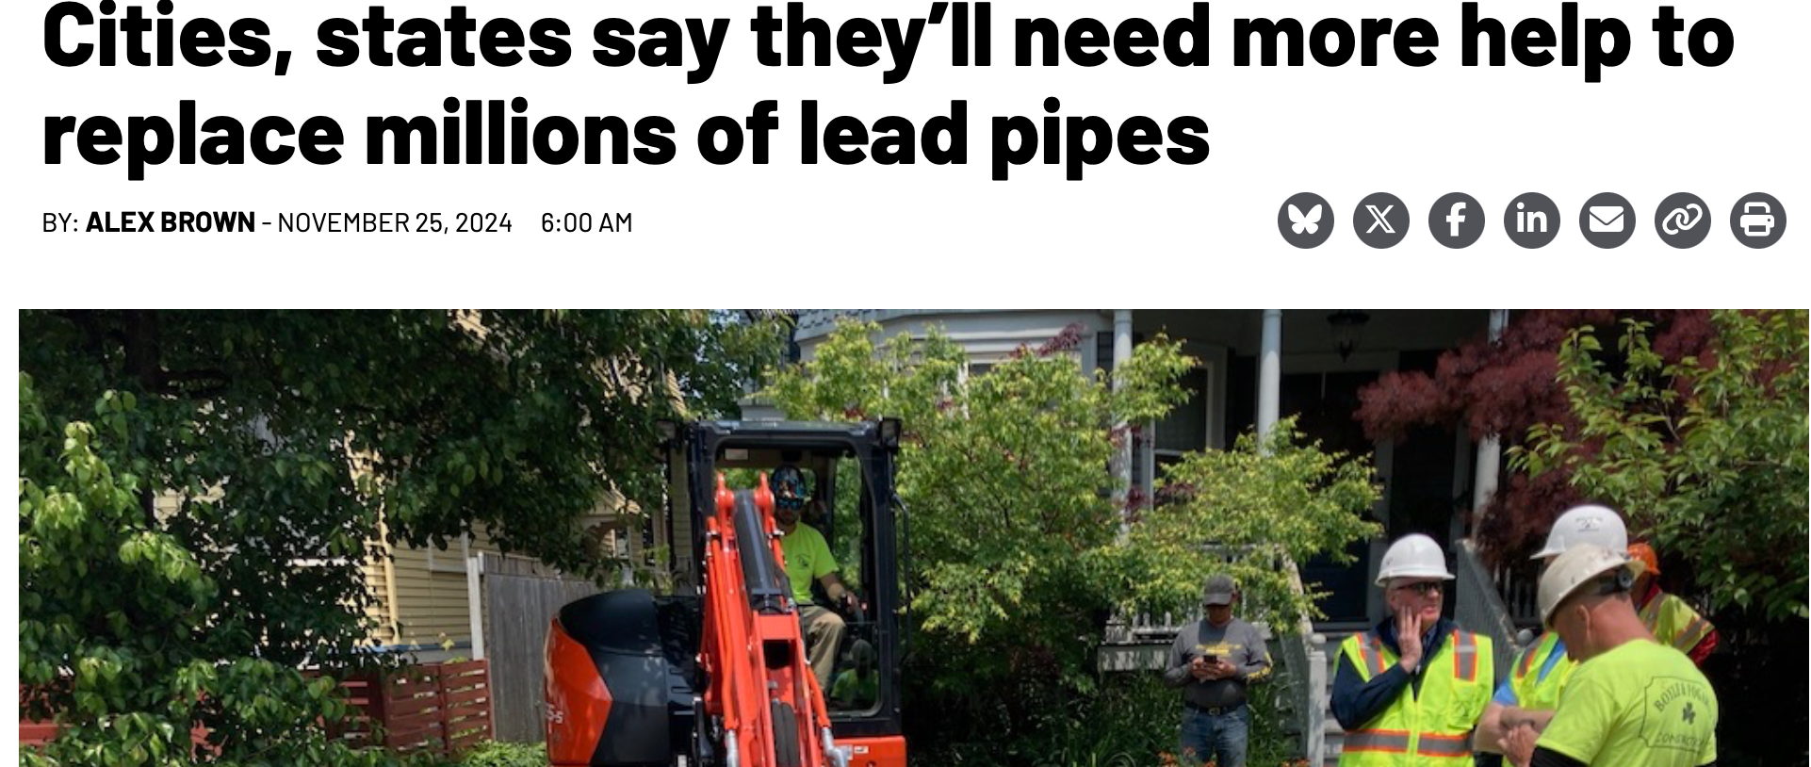


OTHER SOURCES OF LEAD POISIONING

Slide 6

Health & Environmental Justice Issue!
Children of color are disproportionately impacted because they are
more likely to live in older properties with deteriorated lead-based paint.
Black children are harmed 4 times more and Hispanic children
2 times more than White children

Slide 7
Children First Driving Lead Poisoning Advocacy
Children First
Philly Lead Law
Collaboration with PADOH
Working on Screening, education and Lead Remediation
Lead Free Promise Project
70 Coalition Members
PA & County advocacy & education
Other local lead safe ordiances including City of Chester
TA for counties
Notes:
Children First has had a focus on Lead Prevention Advocacy for over 20 years . Philly Lead Laws, Norristown & other wins have helped to spearhead statewide advocacy for all PA Children. Good examplr of how local coalition work can build momentum into larger statewide policy changes and colaitions.

Slide 8
Worth the Investment !
For every dollar spent on removing lead paint-based hazards
in children’s homes and apartments,
$17–$221 would be returned in:
Health benefits
Increased IQ,
Higher lifetime earnings
Tax revenue
Reduced spending on special education
Reduced criminal activity
i.Centers for Disease Control, (2020). https://www.cdc.gov/nceh/lead/prevention/health-ef- fects.htm
ii Wright JP, Dietrich KN, Ris MD, Hornung RW, Wessel SD, Lanphear BP, et al. (2008) Association of Prenatal and Childhood Blood Lead Concentrations with Criminal Arrests in Early
Adulthood. PLoS Med 5(5): e101. doi:10.1371/journal.pmed.0050101. https://jour- nals.plos.org/plosmedicine/article/file?id=10.1371/journal.pmed.0050101&type=printable
iii Gould, E. (2009). Childhood Lead Poisoning: Conservative Estimates of the Social and Economic Benefits of Lead Hazard Control. Environ. Health Perspect. 117(7): 1162-1167. https://

Slide 9
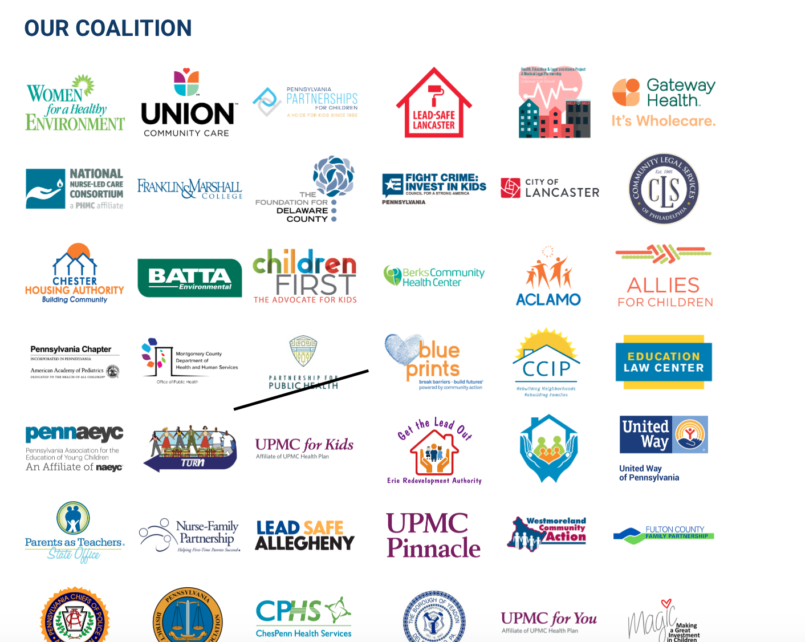

Over 70 Lead Free Promise Project Coalition Members
https://paleadfree.org
Notes:
Coalition Members work to advance the goals and organizations such as the Philadelphia Regional Center for Children’s Environmental Health, Lead Safe Lancaster and almost 70 organizations.

Slide 10
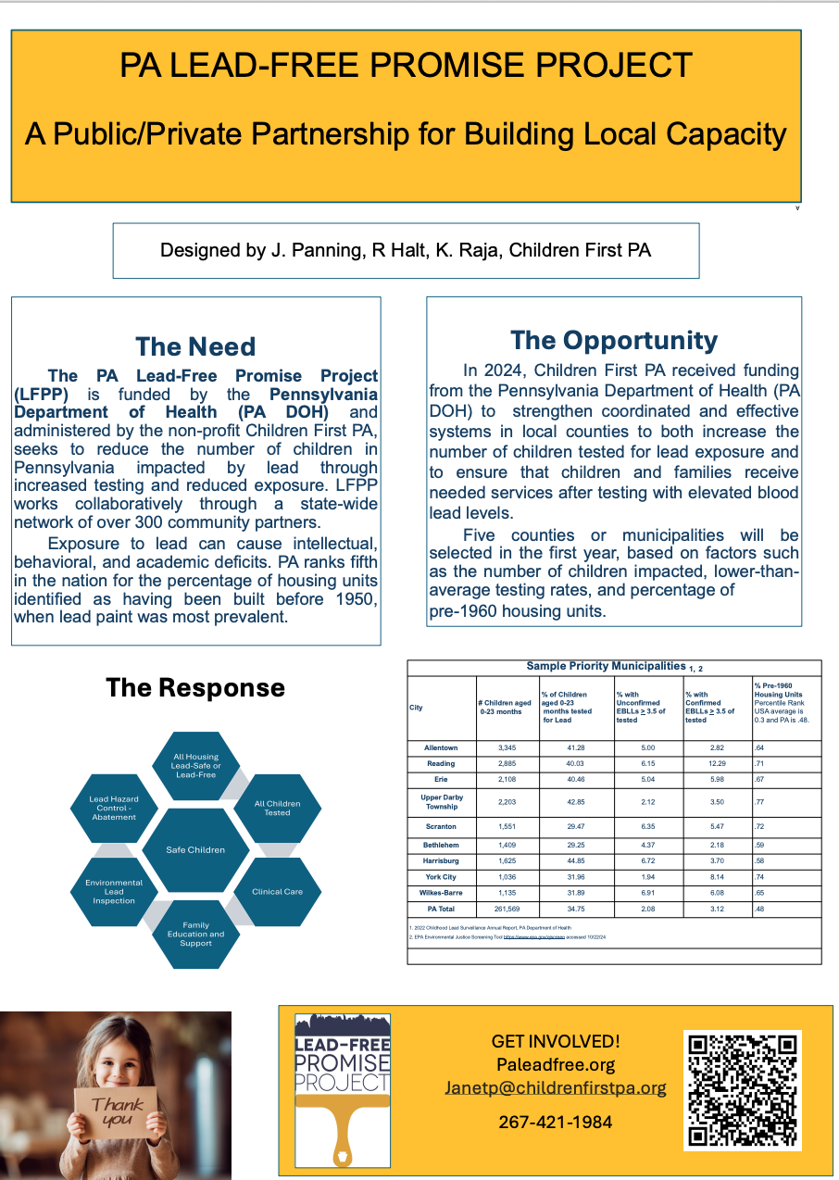

Slide 11
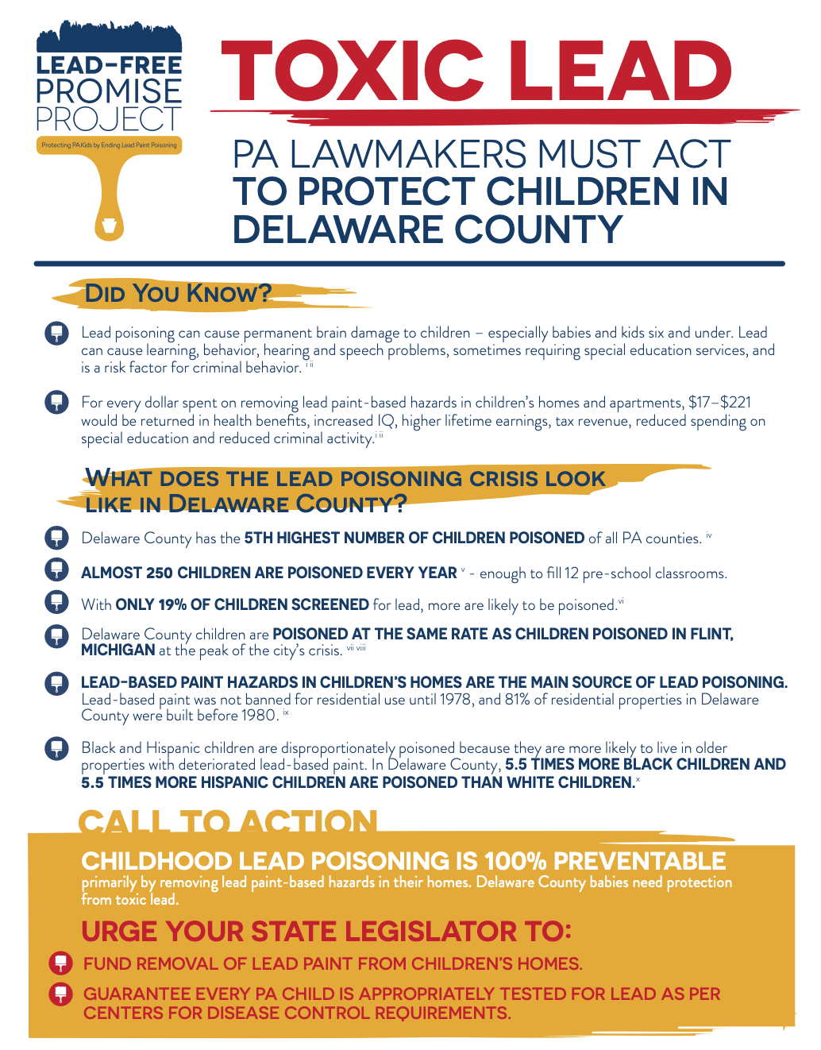
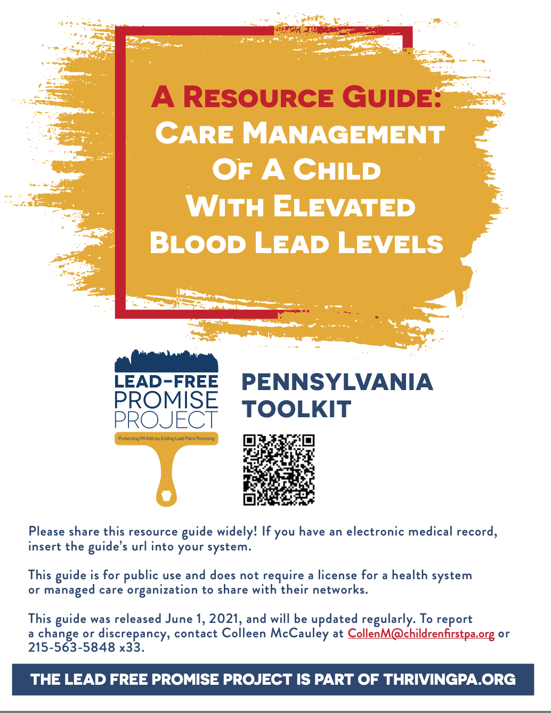
Lead Free Promise Project Toolkits
Notes:
Lead Free Promise Project toolkits are key resources for families and advocates . This toolkit is for the top 20 counties for lead paint poisoning. These fact sheets are updated yearly with PADOH Surveillance Report

Slide 12
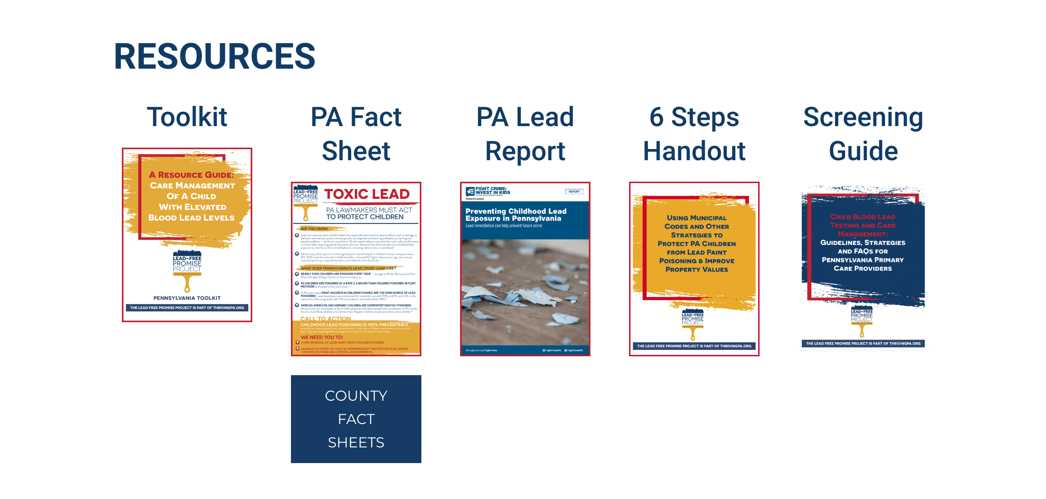
Notes:
Coalition members play a key roll in developing our resources that are on the website for organizations to download and use in their community.

Slide 13
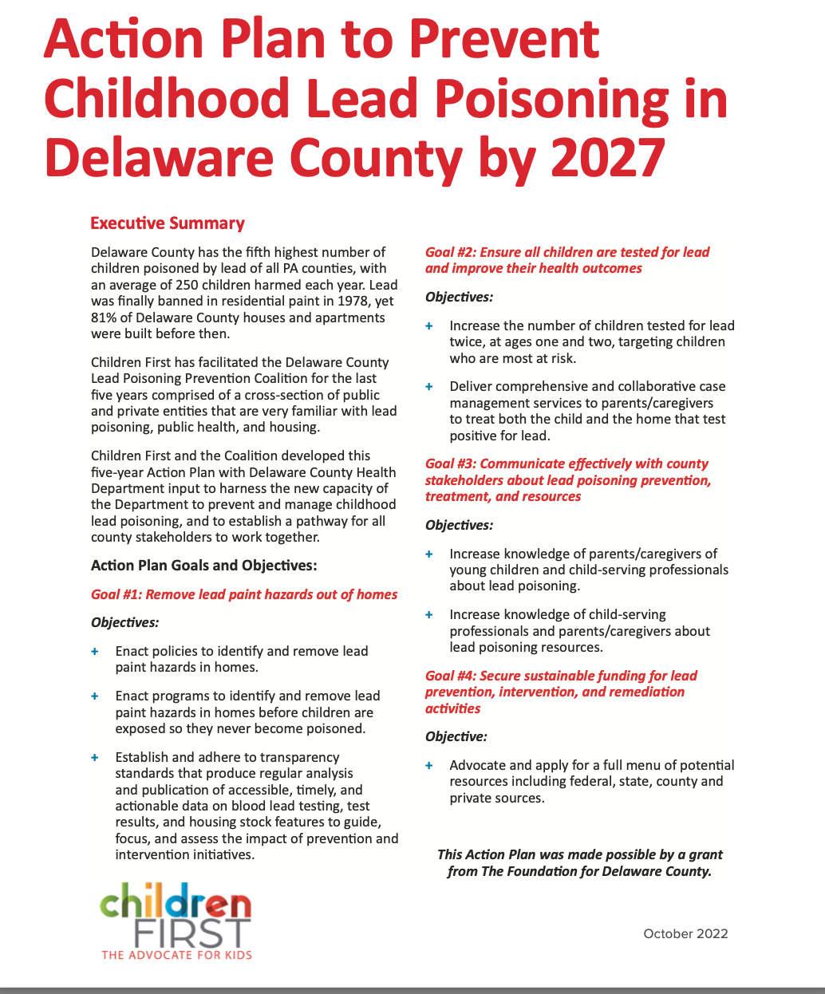
https://www.childrenfirstpa.org/report/delco-lead-action-plan/

Slide 14
The LFPP 2025 Advocacy Goals
1.5 MILLION FOR COMMUNICATION AND EDUCATION ON CHILDHOOD LEAD POSIONING
15 MILLION STATE TAX CREDIT POOL FOR HOMEOWNERS AND LANDLORDS TO INCENTIVE REMEDIATION OF DWELLING PLACES FOUND TO HAVE LEAD PAINT WHERE CHILDREN LIVE.
REINTRODUCTION OF THE CHILD LEAD TESTING BILL REQUIRING ALL CHILDREN BE TESTED FOR LEAD IN PA!
Notes:
SB 514 is part of the 2024 Advocacy Strategy for LFPP

Slide 15
JOIN US IN ADVOCATING AND
EDUCATING YOUR COMMUNITY
PA PA LEAD-FREE PROMISE COALITION PALEADFREE.ORG
DELAWARE COUNTY LEAD PREVENTION COALITION
https://www.childrenfirstpa.org/issues/child-health/lead-poisoning/lead-free-delco/
EMAIL US FOR MORE INFORMATION LEADFREEPROMISEPROJECT@CHILDRENFIRSTPA.ORG

