Slide 1

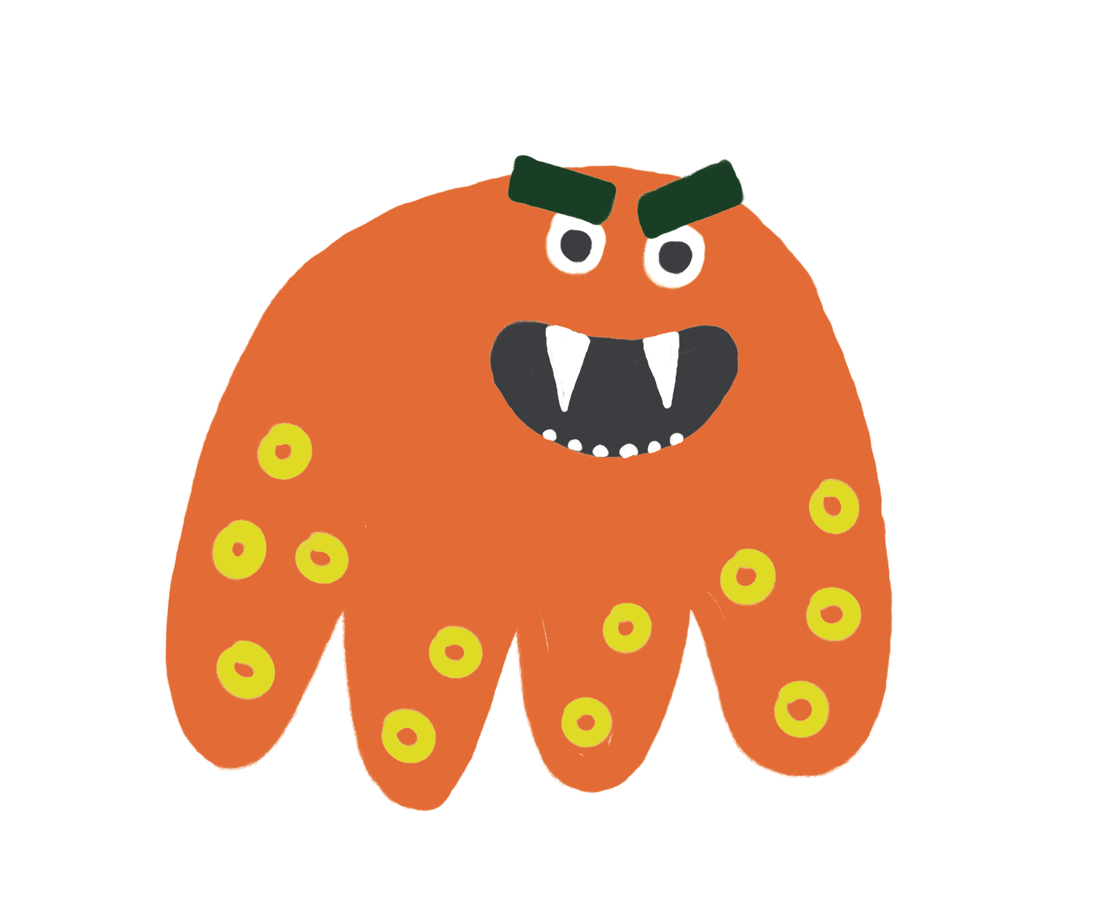
Lead Free in 1-2-3
Is Lead Lurking In Your Home?
Spring 2025

Slide 2
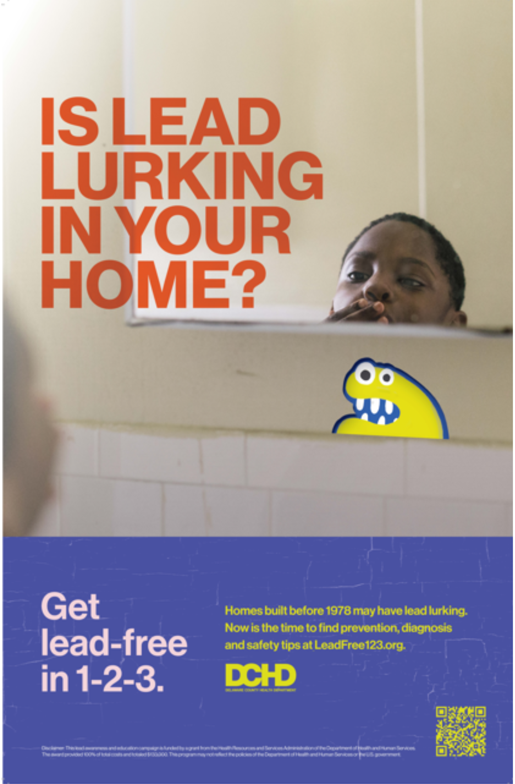
Lead Free in 1-2-3
Campaign Objective
Goal: To raise awareness, encourage testing, and reduces the prevalence of lead poisoning in Delaware County.
The campaign theme “Is Lead Lurking In Your Home” features:
Friendly Lead Monsters
Seriousness of effects from lead poisoning
Reassurance that its dangers do not have to be scary if you take proper precautions.

Slide 3
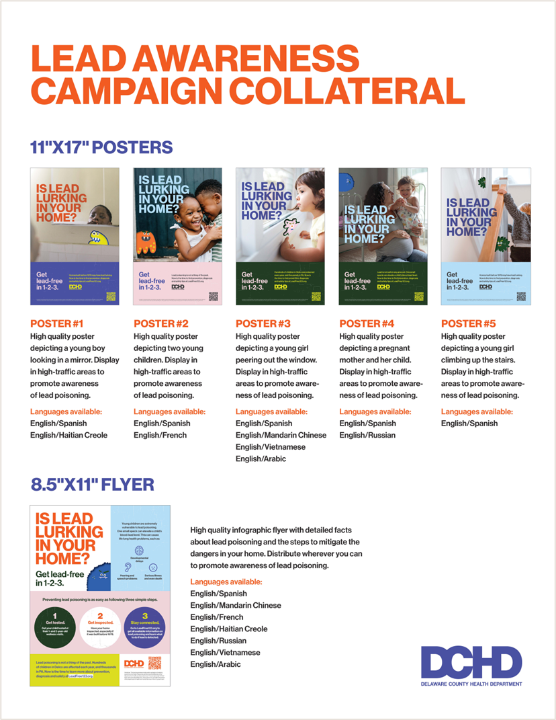

Target Audience
Specifically trying to reach:
Families with children under age 6
Pregnant women
Families living in homes built before 1978
Homes built before 1978 are likely contain lead-based paint.

Slide 4
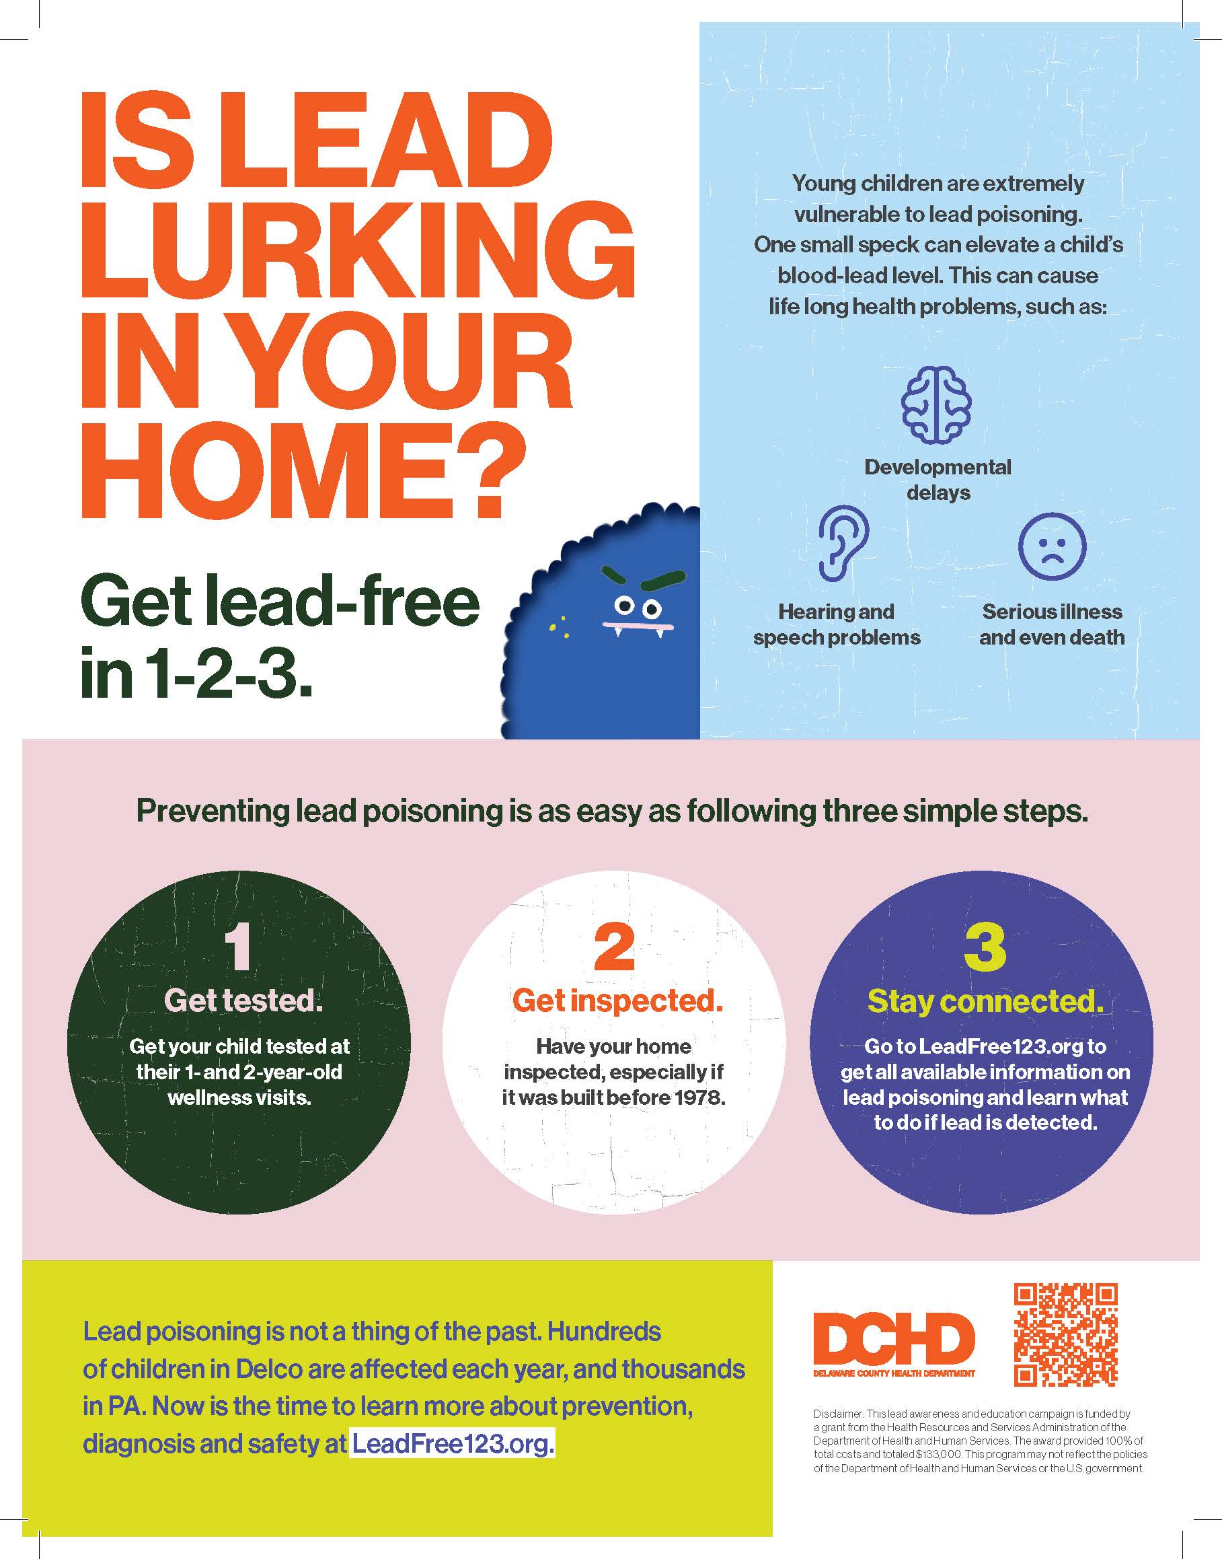
Key Messages
Lead poisoning doesn’t have to be scary
It seems like a lurking monster in your home, but if you follow our guidance, you can prevent lead from becoming a problem.
Lead Poisoning isn’t a thing of the past Hundreds of children in Delco are affected each year, and thousands in PA. Now is the time to learn more about prevention, diagnosis and safety at LeadFree123.org

Slide 5
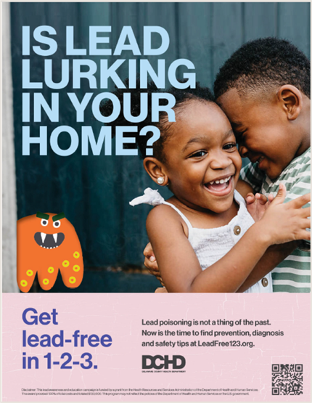

Key Messages
Young children are extremely vulnerable to lead poisoning
One small speck can elevate a child’s blood lead level.
Lead poisoning can cause lifelong
health problems including:
Developmental delays
Hearing and speech problems
Serious illness and even death

Slide 6

Lead Poisoning Impact
At risk:
Families in older housing (majority of homes in Delco are older)
Lower income, immigrant, Black and Hispanic communities
Children with lead poisoning may have:
Slowed brain development
Lower IQ
Reduced attention-span
Hearing and speech problems

Slide 7
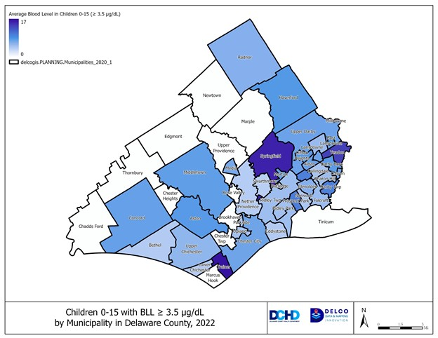

Child Lead Poisoning in Delco
County-wide: 307 out of 9,438 tested children (~3.3%)
City of Chester: 33 out of 819 tested children (~4.3%)
  *An elevated blood lead level is defined as one venous blood test ≥ 3.5 μg/dL, or two capillary tests ≥ 3.5 μg/dL within 12 weeks of each other
  ** Estimated percentages; test results for children 0-15 years of age are reportable; population estimates from the US Census are for 0-14 years of age
Source: Delaware County Child Lead Report, 2022

Slide 8
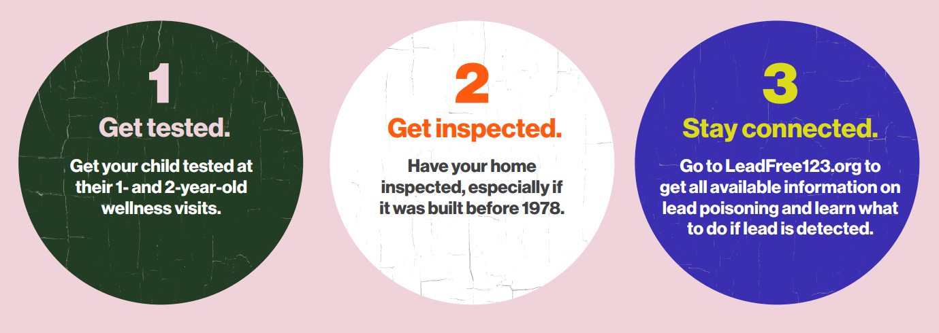
Now what? Get tested!
Talk to your child's pediatrician or primary care provider to obtain a lead test
Capillary sample: fastest way but needs a second test within 12 weeks.
Venous sample: takes blood from the child's vein and must be analyzed at a laboratory. Most accurate.
DCHD is distributing capillary testing machines to service providers

Slide 9
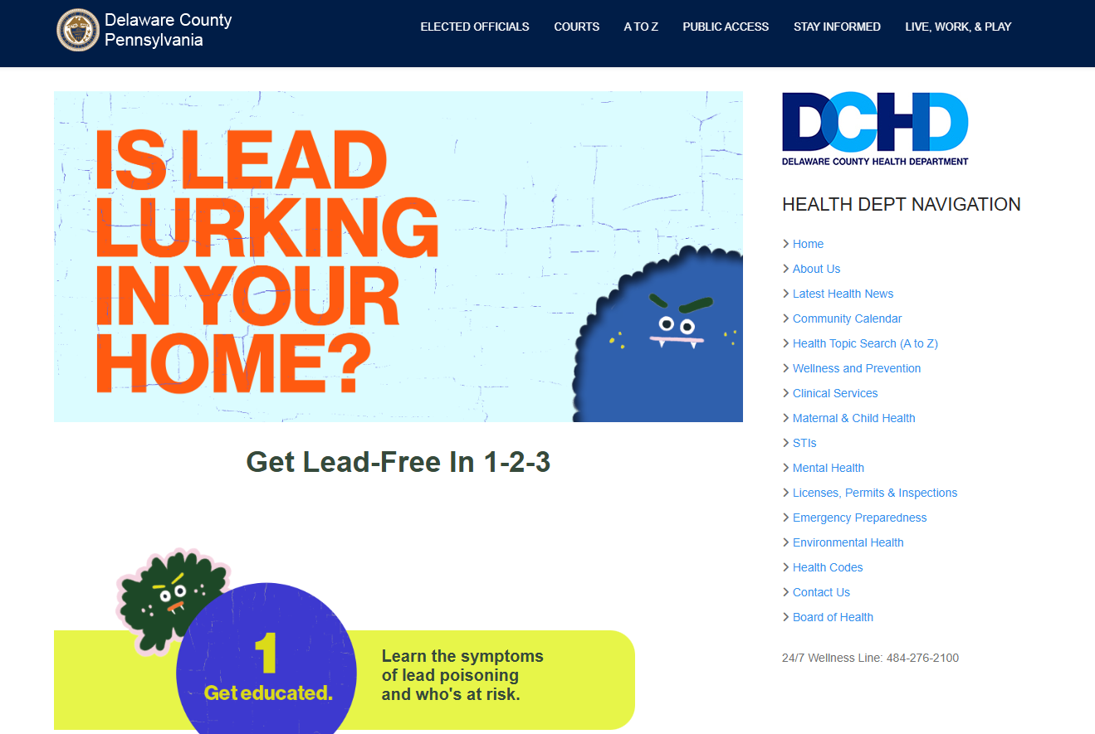
Campaign Channels
Website: Leadfree123.org
Social media:
Paid and organic promotion
Instagram
Facebook
YouTube
Clear Channel
Billboards
Bus shelters
Community partner outreach
Community event outreach

Slide 10
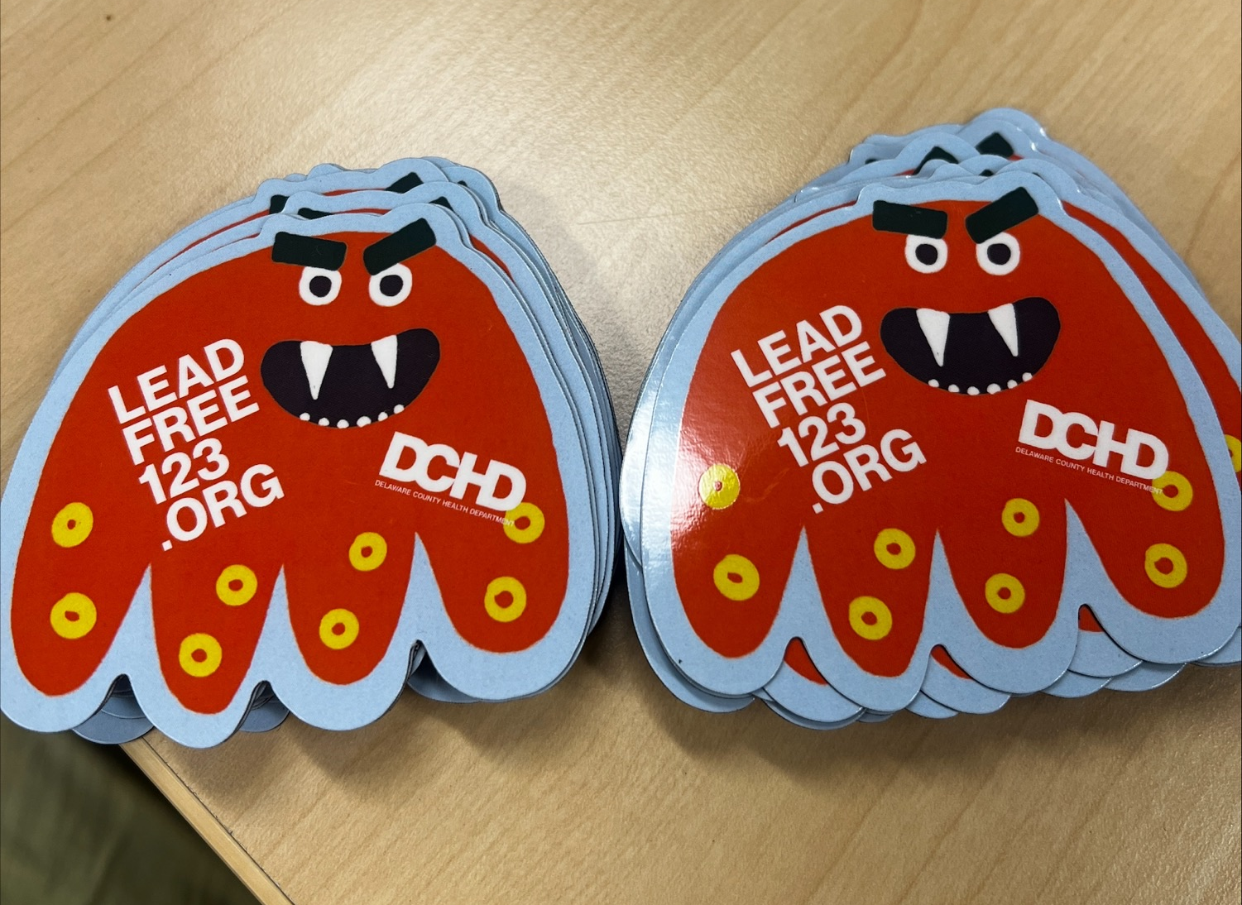
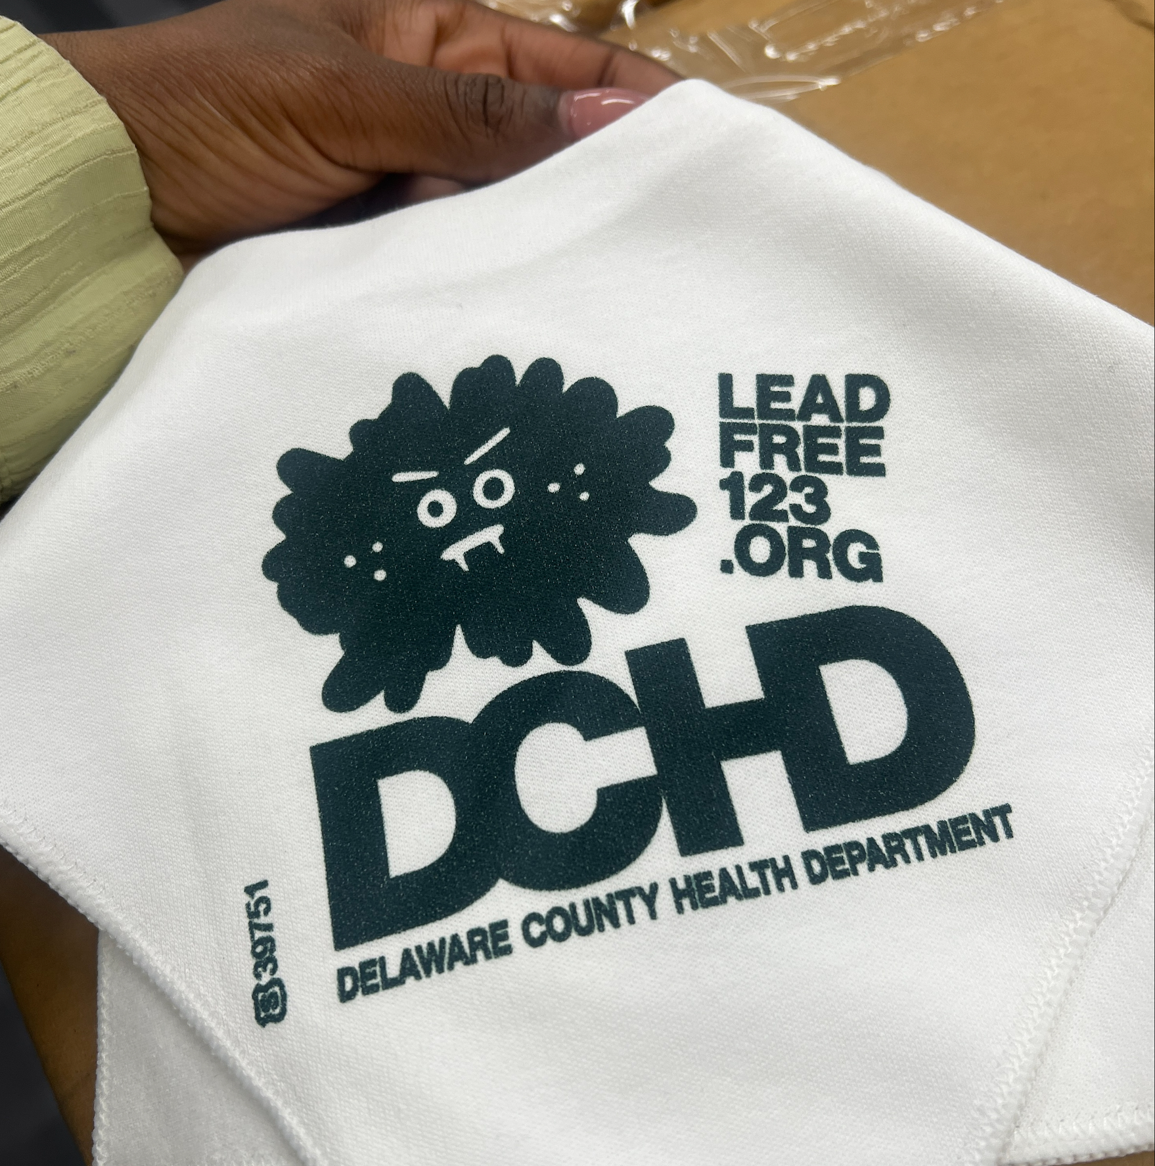

Campaign Creative Assets
Posters (Digital and Hardcopy in 8 Languages)
Video Storyboard
Video Testimonials
Billboard Bus Shelter Posters
Give-aways Merchandise:
Monster Magnets
Water bottles for adults and kids
Baby Bibs
And more!
HEPA Filter Vacuums

Slide 11

Campaign Videos
Lead Poisoning Prevention: A Mother and Daughter's Story of Awareness
Is Lead Lurking in Your Home? Get Lead Free in 1-2-3

Slide 12


Campaign Timeline
Billboards and Shelters
16 weeks starting 2/17
Paid social run
10 weeks starting 2/17
Campaign Funding
This lead awareness and education campaign is an initiative of the Delaware County Health Department and is funded by a grant from the Health Resources and Services Administration of the Department of Health and Human Services. The award provided 100% of total costs and totaled $188,819. This program may not reflect the policies of the Department of Health and Human Services or the U.S. government.

Slide 13
DCHD in Action
Addressing lead exposures in Delaware County is a collaborative effort. DCHD is working with many partners, including:
  Families
  Health Professionals
  Landlords
  Delaware County Office of Housing & Community Development
  Community Action Agency of Delaware County (CAADC)
  Local housing and code officials
  Nonprofit organizations, including the Foundation for Delaware County and Children First

Slide 14
DCHD in Action
  DCHD plays a key role in this complex system through case management, surveillance, and education.
  Maternal & child health team monitors and follows up on elevated blood lead levels (≥3.5 μg/dL) in children under the age of 16 years living in Delaware County, sharing information and referrals with families
  Population Health team shares education and outreach
  Epidemiology team evaluates surveillance data to support public health action- see reports at https://delcopa.gov/health/pages/lead.html
Notes:
The MCH nurse monitors and follows up with cases who have an elevated blood lead level (≥3.5 μg/dL) in children under the age of 16 years in Delaware county. The MCH nurse will follow up with the children’s pediatrician and parents to ensure more tests are ordered to keep an eye on the child's blood lead levels and measures are being taken at home to limit lead exposure. Cases may also be referred to the county OCD or CAADC for remediation efforts and WIC to ensure the child has proper nutrition as well.

Slide 15
Help is Available
Delaware County Health Department
  Happy to talk to families; please call our Wellness Line (484) 276-2100 or email DelcoWellness@co.delaware.pa.us
  We can help you get a blood lead test
  Partnering with the Delaware County Office of Housing and Community Development in 2025 on a new grant to assist qualified residents in addressing lead-based paint hazards in their homes
Community Action Agency of Delaware County (CAADC)
  Administers a Lead Hazard Control Program to remove lead-based paint hazards from the homes of low-income families with children under the age of 6 in Delaware County. All services are free, pending proof of eligibility

Slide 16

Thank you!

