Slide 1
BOH Epi Update
Hepatitis B, RSV, Perinatal Periods of Risk (PPOR)
DCHD Epidemiology Division
January 23, 2025

Slide 2
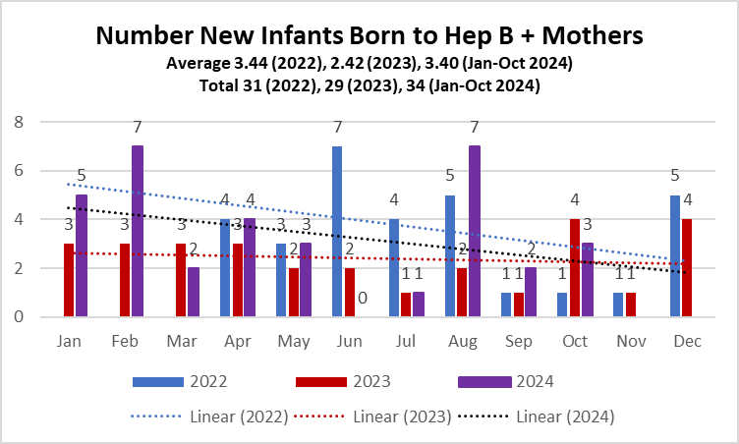
Hepatitis B Delco
* Hepatitis B vaccine-preventable liver infection caused by a virus (HBV) can cause cirrhosis, liver cancer and death
Hepatitis B spreads by sexual contact; sharing needles, syringes, or other drug-injection equipment; or from mother-to-child at birth.
Approximately 1,000 mothers transmit HBV to their infants in the U.S. each year.
Without medical care and vaccinations, 90% of HBV-infected newborns will develop chronic infection.
Up to 25% of infants infected at birth will die prematurely of HBV-related causes
Pregnant women should get tested and receive care to prevent the transmission of the virus to infants.
* DHHS https://www.hhs.gov/hepatitis/learn-about-viral-hepatitis/hepatitis-b-basics/index.html#:~:text=An%20estimated%2025%2C000%20infants%20are,remaining%20infected%20throughout%20their%20lives
Source: DCHD analysis of Pennsylvania National Electronic Disease Surveillance System NEDSS surveillance data.

Slide 3
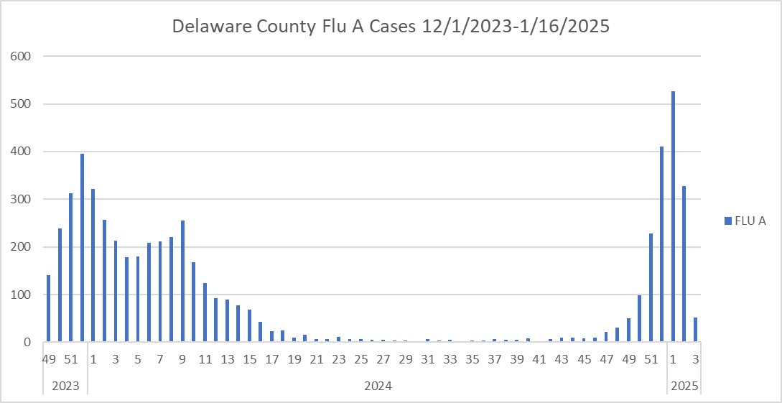
More cases of Flu A in the first week 2025 vs 2024
More cases in 2025
Flu season Fall and Winter
Flu is a contagious respiratory illness
28,000 deaths (US 2023-2024)
2019-2023 Delco Flu and Pneumonia death rate was significantly higher than Pennsylvania*
Fewer cases in 2024
Source: These data were provided by the Health Informatics Office​, Pennsylvania Department of Health. The Department specifically disclaims responsibility for any analyses, interpretations, or conclusions. https://www.phaim1.health.pa.gov/EDD/WebForms/DeathCntySt.aspx

Slide 4
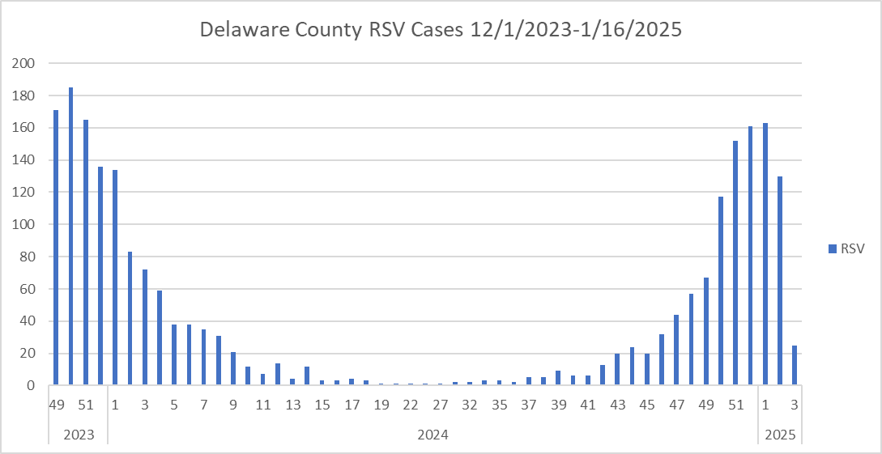
More cases of RSV in the first week 2025 vs 2024
More cases in 2025
More cases in 2025
Fewer cases in 2024
Fewer cases in 2024
Source: These data were provided by the Health Informatics Office​, Pennsylvania Department of Health. The Department specifically disclaims responsibility for any analyses, interpretations, or conclusions. https://www.phaim1.health.pa.gov/EDD/WebForms/DeathCntySt.aspx

Slide 5
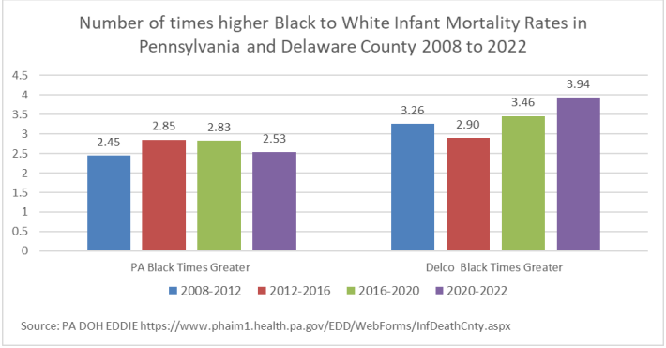
Number of times Black Infant Mortality is higher than White Delco vs. Pennsylvania
Source: These data were provided by the Health Informatics Office​, Pennsylvania Department of Health. The Department specifically disclaims responsibility for any analyses, interpretations, or conclusions. https://www.phaim1.health.pa.gov/EDD/WebForms/DeathCntySt.aspx

Slide 6
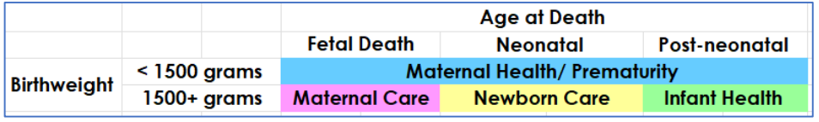
Perinatal Periods of Risk (PPOR*)
MH/P = Maternal Health & Prematurity
MC = Maternal Care
NC = Newborn Care
IH = Infant Health
Fetal Death = 16+ weeks of gestation
Neonatal Deaths = 0-27 days of life
Post neonatal Deaths = 28-364 days of life
PPOR ~ Calculates infant mortality by birthweight and age at deaths
3 PPOR studies in Delco 2008-2012 2012-2016 2016-2020
* Adapted in the US from the WHO by CityMatCH, CDC, March of Dimes
Source: DCHD PPOR Report (2016-2020). https://delcopa.gov/health/pages/epidemiology.html
Notes:
Perinatal Periods of Risk (PPOR) approach was developed during 2000-2004 by CityMatCH and its’ member health departments with support and involvement of the Centers for Disease Control and Prevention and the March of Dimes. It was adapted for U.S. cities from an approach used by the World Health Organization
- CityMatCH https://www.citymatch.org/perinatal-periods-of-risk-ppor/

Slide 7
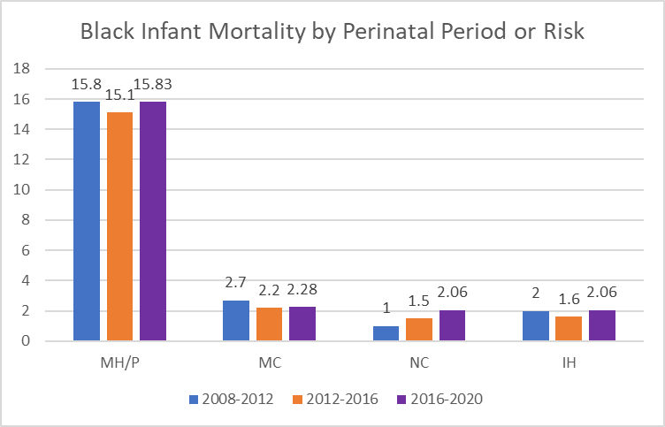
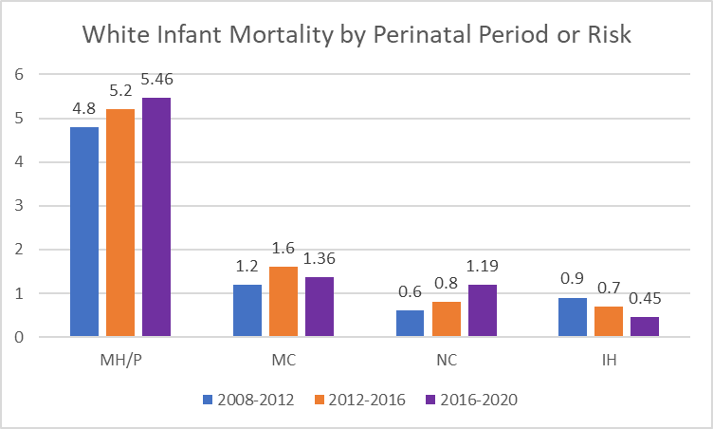
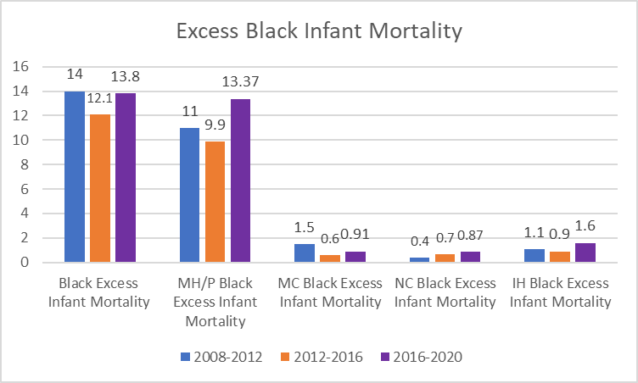
Perinatal Periods of Risk Delco
MH/P = Maternal Health & Prematurity
MC = Maternal Care
NC = Newborn Care
IH = Infant Health
Source: DCHD PPOR Report (2016-2020). https://delcopa.gov/health/pages/epidemiology.html
Notes:
Increases Infant Mortality in all perinatal periods of risk among Black mothers in the most recent PPOR (2016 to 2020)
Increases Infant Mortality in MH/P, and NC perinatal periods of risk among White mothers in the most recent PPOR (2016 to 2020)
Increases in Black excess infant mortality in all perinatal periods of risk in the most recent PPOR (2016 to 2020)

Slide 8
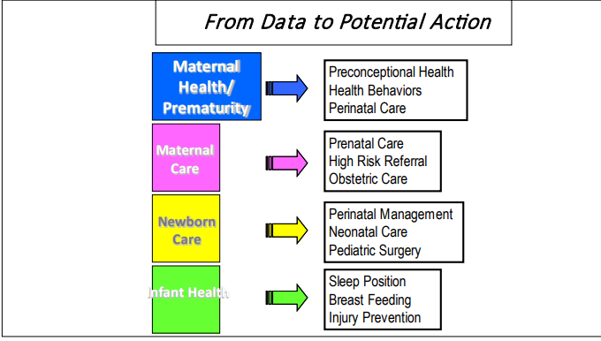
Solutions ~ Perinatal Periods of Risk Delco

Slide 9
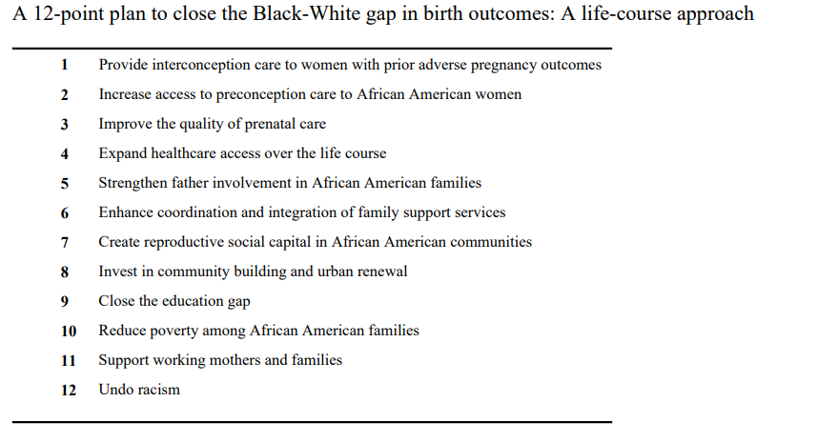
Solutions ~ Perinatal Periods of Risk Delco
Source:Lu MC, Kotelchuck M, Hogan V, Jones L, Wright K, Halfon N. Closing the Black-White gap in birth outcomes: a life-course approach. Ethn Dis. 2010 Winter;20(1 Suppl 2):S2-62-76. PMID: 20629248; PMCID: PMC4443479

