Slide 1




Solving Problems & Removing Barriers: Civil Legal Aid's
Role in the
Criminal Legal System
Laurel Anderson, Esq. & Erica Briant, Esq.
Legal Aid of Southeastern Pennsylvania

Slide 2
What is Legal Aid of Southeastern PA?
Legal Aid is a non-profit organization that provides civil legal services to low-income individuals in Bucks, Montgomery, Delaware, and Chester Counties.
We cover a variety of legal issues including: domestic violence, wills, social security, public benefits, landlord/tenant, custody, divorce, consumer and bankruptcy issues, Hurricane Ida relief, veteran's issues, name changes, and criminal record clearing!
Our criminal record clearing team consists of four attorneys who work in LASP's "Community Engagement Unit." The Community Engagement Unit provides outreach events to the communities we serve, in order to ensure that we meet the needs of those who are not geographically near or office or may not know LASP exists.

Slide 3
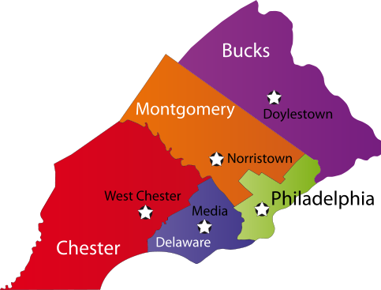
LASP Overview
LASP is a non-profit organization providing pro-bono civil legal services to low-income residents in Bucks, Chester, Delaware and Montgomery counties.
Locations:
  Bucks County:
    Bristol: 215-781-1111
    Doylestown: 215-340-1818
  Chester County:
    West Chester: 610-436-4510
  Delaware County
    Chester: 610-874-8421
    Media DV Hotline 855-879-3100
  Montgomery County
    Norristown: 610-275-5400
    Pottstown: 610-326-8280
Other Outreach locations can be found at: http://lasp.org/locations/outreach-locations

Slide 4
Qualifications
Low income = below 125% of the federal poverty line
  *Some grants have higher guidelines
Vulnerable people (regardless of income)
  Victims of Domestic Violence and related legal issues
  Seniors over the age of 60
Must be a Citizen, Permanent resident, or other limited Legal Status
  We can only assist undocumented individuals in DV cases or human trafficking
  Cannot be a conflict of interest (parents in custody cases)
Generally, we do not take fee generating cases ( i.e. Workers Compensation)

Slide 5

Areas of Practice
Family Law
  Custody
  Protection from Abuse
  Dependency (Bucks and MontCo only)
Public Benefits
  SSI/SSD
  Unemployment Compensation
  SNAP/TANF/LIHEAP/etc.
Housing Problems
  Foreclosure
  Landlord Tenant
Elder Law
Consumer & Bankruptcy Problems
Expungements, Limited Access & Pardons
Veterans Benefits & Discharge Upgrades
Name Changes

Slide 6
How to Apply for Legal Aid
The easiest way to apply for LASP's record clearing services and non-emergencies is through our online application https://www.lasp.org/apply
  Someone will follow up with the online application, but it may take several days. You can always apply by phone at the number below if you or your client prefers.
  For record clearing services for Philadelphia cases, please apply to Community Legal Services (CLS) for assistance by calling 215-981-3700
For emergency matters (Protection from Abuse Orders, evictions, etc): Call LASP's general intake line at 877-429-5994 M-F from 9:00 – Noon. It is best to call right at 9:00 a.m. and expect to be on hold.
For general questions about record clearing, you can contact the Community Engagement Unit at (847) 957-6970

Slide 7
Expungements – Record Totally Destroyed
CHARGES THAT ARE ELIGIBLE FOR EXPUNGEMENT (BY FILING A PETITION IN COURT)
Type of Charge | Explanation
Non-conviction (withdrawn, nolle prossed, dismissed, not guilty, pardoned) | Eligible for expungement immediately following final disposition. Grade does not matter.
Diversion program (e.g. ARD, Section 17) | Eligible for expungement following completion of diversion program, though may be waiting period depending on the program. Grade does not matter. Fines and costs must be paid off! For ARD, must attach ARD Completion Letter to petition.
Summary Convictions | Eligible for expungement if there is a 5-year arrest-free period following conviction. Only for convictions with summary grades. Fines and costs must be paid off!
Convictions for individuals who are over 70 years old | Eligible for expungement if individual is over 70 and has a 10-year arrest-free period since conviction. Grade does not matter (even felony convictions can be expunged!) Fines and costs must be paid off!

Slide 8



Limited Access
(or Clean Slate, or Sealing)
A judge issues a court order to seal the record from public view on UJS Portal/public case search and MOST background checks. Law enforcement and the criminal justice system can still see a sealed record, and it will show up on an FBI-level background check.

Slide 9
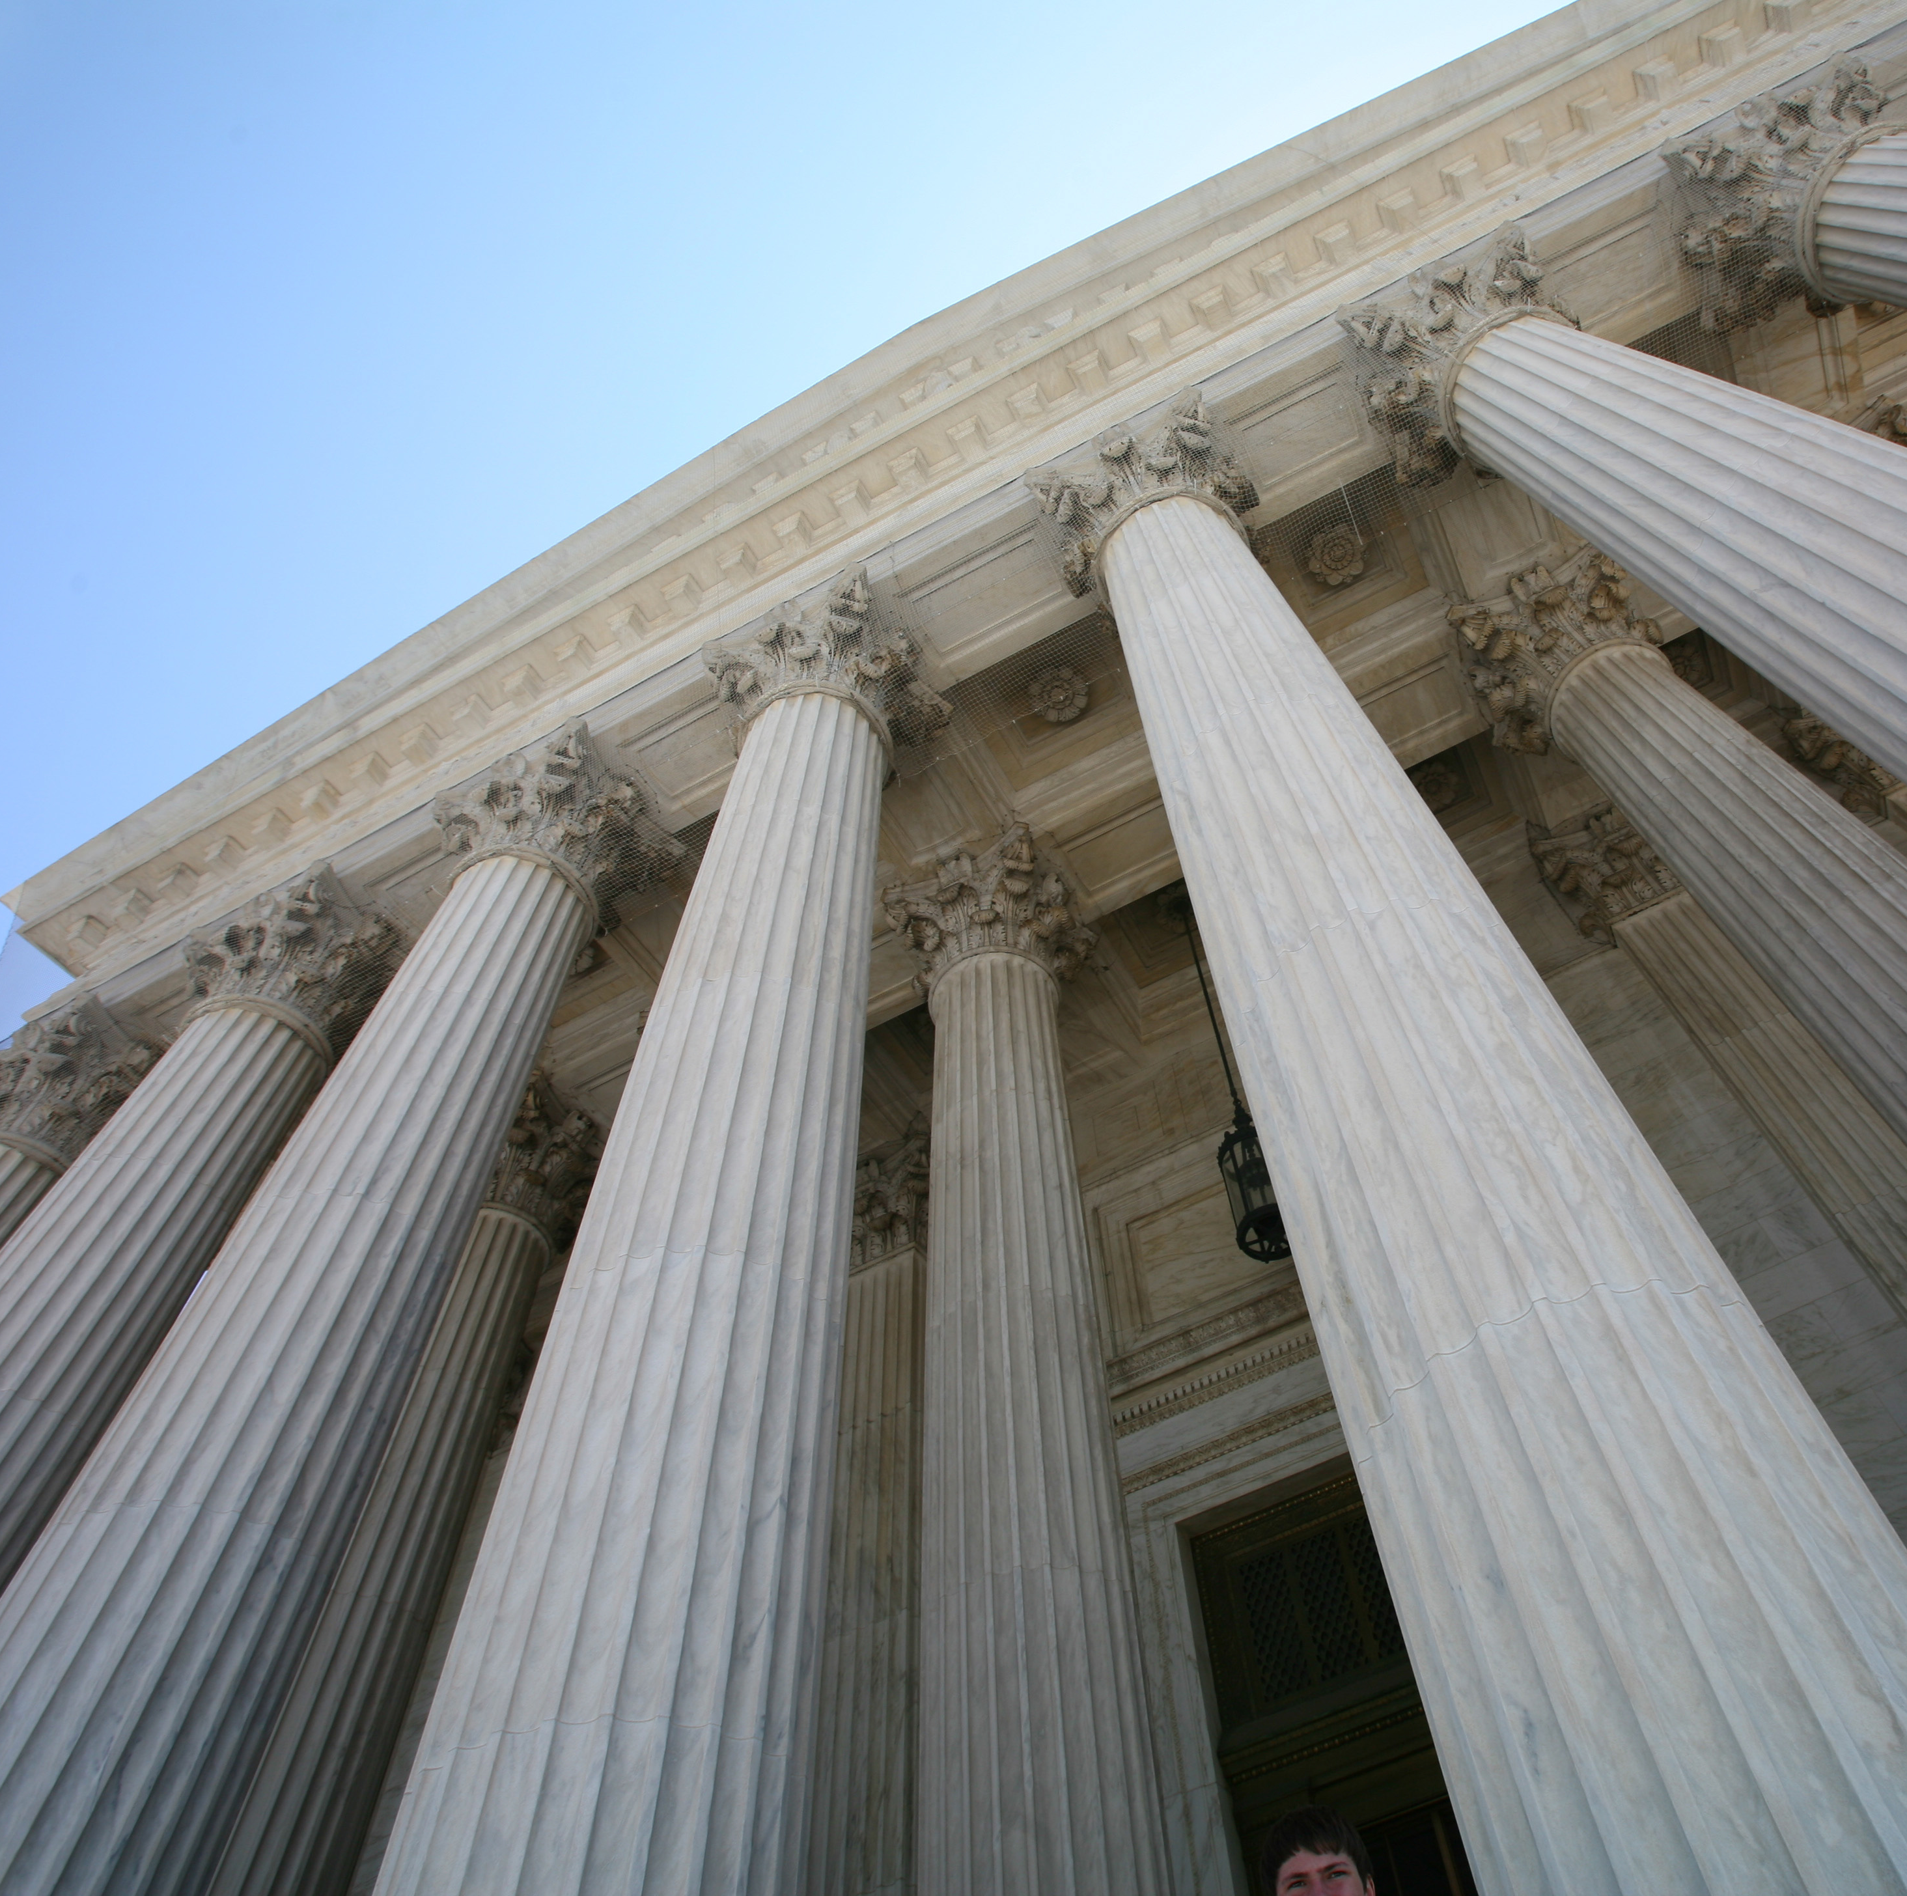
Who Can and Cannot
See a Sealed Case?
A case granted limited access can only be seen by:
  Criminal justice agencies
  Employers who are required to consider records under federal law
    Note: Not all employers who run FBI background checks are required to by federal law
  Courts, agencies, and parties to a case involving minors (e.g. CYS) or domestic violence (e.g. PFA's)
  Courts or government agencies for bar admission or candidacy for public office

Slide 10
How can I see what cases are visible to Employers and the Public?
Free court records showing public, non-sealed cases across Pennsylvania are available here:
https://ujsportal.pacourts.us/CaseSearch
Most employers pull a background check through the State Police called an "E Patch". You can pull the E Patch yourself for $22 to see which cases show up and which cases do not.
https://epatch.pa.gov/home

Slide 11
Clean Slate 3.0 – Signed into Law 12/14/2023
Amended Title 18, § 9102
Expanded the type of offenses that can be sealed in Pennsylvania including Felony drug offenses and other nonviolent, nonsexual 3rd degree Felonies, such as theft, forgery, food stamp fraud, welfare fraud, criminal trespass, etc. NOT ALL F3 Convictions can be sealed. Thus, legal advice from LASP will be necessary to get your client accurate legal advice.
Many felonies will be sealed automatically, but some clients will need to file petitions with the court
Shortened the waiting period for sealing convictions of misdemeanor to 7 years and summary convictions to five years.
M1 Terroristic Threats is newly eligible for limited access
Implementation
  Feb 12th, 2024: Petition Based Sealing
  June 11th, 2024: Automatic Sealing

Slide 12
PETITION BASED SEALING (in effect as of February 12, 2024)​
General Rule​- §9122.1(a) | All M2, M3, M, S M1, unless excluded (see below) The following F3 and F: "Qualifying offense” drug felony , Criminal mischief (3304), Trespass (3503), Theft (39xx; all Ch 39), Forgery & Fraud (41xx; all Ch 41), Welfare fraud (62 Pa.C.S. § 481), Conspiracy, attempt or solicitation of the above All restitution must be paid on the case
Time Since Conviction​-§9122.1 | Felony Conviction: 10 years without a M or F conviction Misdemeanor Conviction: 7 years without M or F conviction Summary Conviction: 5 years
Excluded Convictions - §9122.1(a.1); §9122.1(b)(1) (misdemeanors that can’t be sealed)​ ​ *See excel chart of all excluded and disqualifying convictions​ | Any F1, F2 F3 or F if not listed above M1: Art. B offense (Crimes of Violence), except terroristic threats (§ 2706) is eligible to be sealed; Art. D offense; (Crimes against the Family) firearms; sexual offense/tier system; corruption of minors
Disqualifying Convictions-§9122.1(b)(2) (review rest of record; these convictions disqualify a person from sealing of otherwise eligible misdemeanors)​ ​ *See excel chart of all excluded and disqualifying convictions​ | Within the last 10 years: 2 or more cases with M1 or felony convictions Within the last 15 years: 4 or more cases with M2 convictions or higher Felony Conviction for: Art B, Art D, firearms, or sexual offense/tier system Conviction to: indecent exposure, sexual intercourse w/ animal, failure to comply w/ registration req’ts, weapons/implements to escape, abuse of corpse, prohibiting paramilitary training Ever convicted of F1, murder, or offense punishable by more than 20 years

